Slide 1

offer healthy beverages
Notes:
Notes for trainer:
This slide set offers child care and early education providers an in-depth look at LMCC Goal 4: Offer Healthy Beverages.
You can use these slides to train providers. Hold a training on LMCC or integrate LMCC content into existing or new trainings, including in-person and online trainings.
Please feel free to adapt the slides for specific needs and audiences, including adding slides from other LMCC slide sets. For example, use the slides from the ‘Introduction to Let’s Move! Child Care’ slide set to show providers how to participate in LMCC.
We have included some interactive activities in this module to keep providers engaged and promote learning. Consider including more!
Consider adding additional slides that give information on local resources, training opportunities, and contacts for technical assistance.
For questions, please email LMCCHelp@cdc.gov.

Slide 2
Learning Objectives
Understand Let’s Move! Child Care Goals and best practices for beverages
Know the benefits of offering healthy beverages
Get strategies and ideas for offering healthy beverages
Learn about the resources and tips available on the Let’s Move! Child Care website: www.HealthyKidsHealthyFuture.org

Slide 3

Beverages Best Practices #1-4
Water: Visible and available inside and outside for self-serve
Fruit juice: Only100%; limited to no more than 4 – 6 oz. per day per child and encourage parents to support this limit
Sugary Drinks: Never
(includes fruit drinks, sports drinks, sweet tea, and soda)
Milk: Serve only 1% or non-fat (skim) milk to children 2 years and older (unless otherwise directed by the child’s health provider)
  Don’t provide water in “sippy cups” or bottles!
Notes:
Notes for trainer:
The suggestion to not give kids water in sippy cups is based on standards from Caring for Our Children: National Health and Safety Performance Standards. You can view the standards that focus on preventing childhood obesity in early care and education programs at: http://nrckids.org/spinoff/pco/preventingchildhoodobesity2nd.pdf
This resource states:
“Children should learn to drink water from a cup or drinking fountain without mouthing the fixture. They should not be allowed to have water continuously in hand in a “sippy cup” or bottle. Permitting toddlers to suck continuously on a bottle or sippy cup filled with water, in order to soothe themselves, may cause nutritional or in rare instances, electrolyte imbalances.” (p. 20)
Sucking from a bottle or sippy cup can be a soothing mechanism for children so they may suck and drink water continuously whether they’re thirsty or not. Not allowing children to drink water continuously is the key part of the suggestion. Drinking water continuously can cause a nutritional imbalance. When children drink from a cup or drinking fountain, they don’t drink continuously.

Slide 4

Benefits of Drinking Water
Keeps kids hydrated best
Reduces acid in the mouth that can cause cavities
When children drink water instead of sugary drinks, they have less calories.
  Don’t give infants less than 6 months water.
Notes:
Suggested talking points:
Sugary drinks are high in calories and low in nutrients.

Slide 5

Benefits of Skim or 1% Milk
Milk is packed with nutrients like calcium and vitamin D that help kids grow and build healthy bones.
Skim and 1% milk have the same amount of calcium and vitamin D as whole milk, but without the extra fats. Kids over 2 no longer need those extra fats.

Slide 6
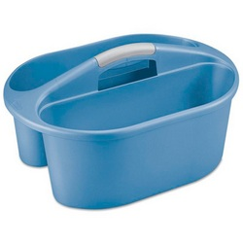
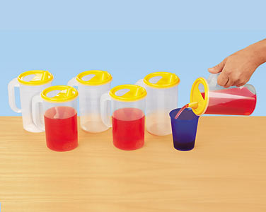
Tips to Make Water Available
Have child size water pitchers in each classroom
Use a shower caddy to carry water and cups outside

Slide 7


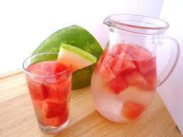
Tips to Make Drinking Water Fun
Try adding fruit slices or berries to water for an extra fun taste!
Read books about water
Notes:
Suggested talking points:
On the LMCC website, you can find a link to the Potter the Otter website where you can download the book for free. Later, I’ll show you where you can find this resource and other resources on the LMCC website.
Notes for trainer:
The direct link where you can download Potter the Otter for free: www.potterloveswater.com

Slide 8

Tips to Make Drinking Water Fun (2)
Let children serve themselves. Use small pitchers and cups!
Let kids drink from the water fountain like big kids!
Select a child to be the “water helper” for the day.

Slide 9
Tips to limit juice and say ‘so long’ to sugary drinks
Instead of juice, serve fresh fruit, which includes important dietary fiber and is a natural source of energy.
Try diluting 100% fruit juice with water to train children’s palates to enjoy mild sweetness.
If families pack drinks for their kids, ask them to pack healthy beverages. A policy helps!
  Remember to model healthy drinking by avoiding sugary drinks in front of children!

Slide 10
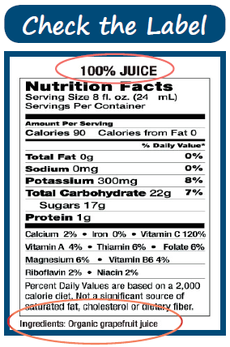
Don’t be fooled by juice labels!
Watch out for the drink labels on the front of juice packages!
100% Vitamin C ≠100% juice
Check the Nutrition Facts on the back to see if the drink is 100% fruit juice.
Notes:
Suggested talking points:
Be careful of labels! Many labels on beverages promote that the product provides ‘100% Vitamin C’. This does NOT mean that the beverage is 100% juice.

Slide 11
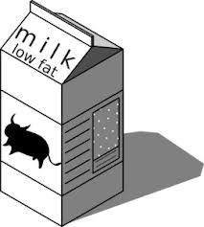




Know how to read milk labels!
Reduced Fat
Whole Milk
Skim
2%
Notes:
Suggested talking points:
It’s important to know how to read milk labels!
There are different types of milk.
There are different ways to label the same type of milk.

Slide 12
Let’s talk about different types of milk
Skim
Reduced Fat
=
2%
=
Whole Milk
=
Notes:
Notes for trainer:
Show “fat-free” milk and ask providers what another name is for “fat-free” milk. Then, click on the slide or press the right arrow and show them that “skim” is another name for “fat-free” milk. Talk about how they’re the same type of milk, just with different names/labels.
Continue with the other types of milk.

Slide 13
Which milk would you buy for children 2 years and older?
Skim
Reduced Fat
=
2%
=
Whole Milk
=
Notes:
Notes for trainer:
Ask providers the following questions: Which milk would you buy? Then, click on the slide or press the right arrow to get the red box to appear.
Remind providers that the LMCC best practices for milk is to serve only 1% or non-fat (fat-free or skim) milk to children 2 years and older
(unless otherwise directed by the child’s health provider).

Slide 14
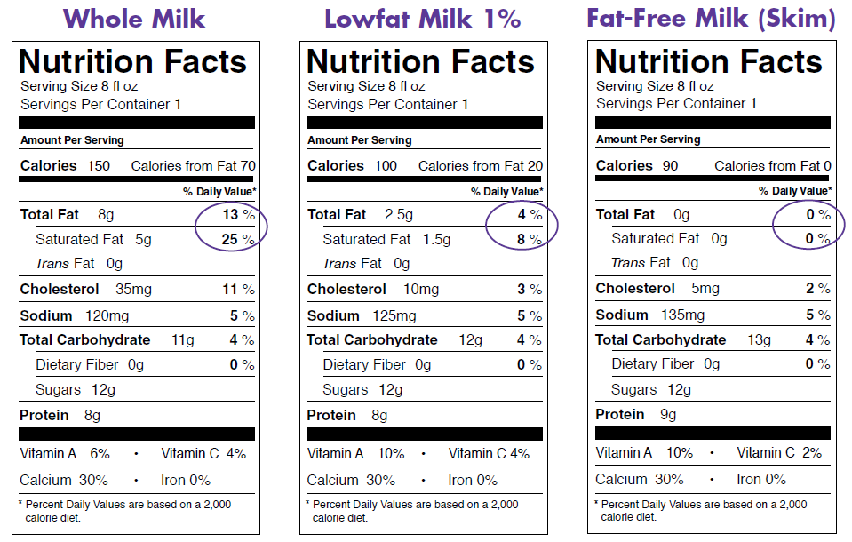
Look at the Nutrition Facts!
Notes:
Suggested talking points:
Notice that 1% and skim milk have the same amount of calcium as whole milk, but without the extra fats. Remember, kids over 2 no longer need those extra fats.
Notice that the 1% milk has less fat than whole milk and skim milk has none.

Slide 15
Knowledge Check
What is the limit for how much juice a child should drink per day?
4 – 6 oz.
6 – 8 oz.
8 – 10 oz.
10 – 12 oz.

Slide 16
Knowledge Check
What is the limit for how much juice a child should drink per day?
4 – 6 oz.
6 – 8 oz.
8 – 10 oz.
10 – 12 oz.
  Only serve 100% juice!
  Encourage parents to support this limit.

Slide 17
Knowledge Check
How often should you offer sugar drinks (like fruit drinks, sports drinks, sweet tea, and soda)?
Every day
Twice a week
Once a week
Never

Slide 18
Knowledge Check
How often should you offer sugar drinks (like fruit drinks, sports drinks, sweet tea, and soda)?
Every day
Twice a week
Once a week
Never

Slide 19
Knowledge Check
What kind of milk should children 2 years and older drink?
Whole milk
2% (reduced fat)
1% or non-fat (skim) milk
Flavored milk

Slide 20
Knowledge Check
What kind of milk should children 2 years and older drink?
Whole milk
2% (reduced fat)
1% or non-fat (skim) milk
Flavored milk
Notes:
Suggested talking points:
Some children may need higher fat, as directed by their physician.
Flavored milks should not be served because they have added sugars.

Slide 21
Beverages Best Practices in Review
Pop Quiz!
Can you recite all of the beverages best practices?
Notes:
Notes for trainer:
Ask providers to volunteer to recite beverages best practices. You can ask one or more volunteers to come to the front of the room. Try giving providers an incentive for volunteering, such as a recipe book or menu planning guide.

Slide 22
Beverages Best Practices in Review
Water: Visible and available inside and outside for self-serve
Fruit juice: Only100%; limited to no more than 4 – 6 oz. per day per child and encourage parents to support this limit
Sugary Drinks: Never
(includes fruit drinks, sports drinks, sweet tea, and soda)
Milk: Serve only 1% or non-fat (skim) milk to children 2 years and older (unless otherwise directed by the child’s health provider)
  REMINDER: Don’t provide water in “sippy cups” or bottles!

Slide 23
Finding resources and tips

Slide 24

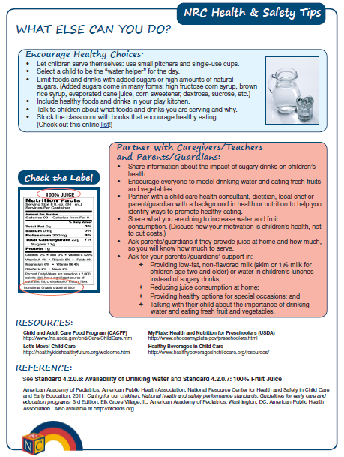
Tip Sheets & Handouts
Notes:
Suggested talking points:
You can find a number of simple tip sheets like the Water & 100% Juice Tip sheet (front and back shown here).

Slide 25


Download the Handbook at: www.teamnutrition.usda.gov
Notes:
Suggested talking points:
This resource is valuable for all providers to use when planning meals and activities for preschool-age children 2 through 5 years old, regardless of participation in CACFP. It’s full of ideas and tips that can help you make changes and meet the Let’s Move! Child Care goals to help kids grow up healthy.
The Handbook makes it easy!
In the Provider Handbook, you will find:
Ideas for meal planning, shopping, and food preparation
Tips for creative menus
Hints for meeting meal pattern requirements (if you participate in the CACFP, also known as the ‘Food Program’)
Ways to serve foods safely
Activities for hands-on learning
Suggestions for active play
Success stories from providers. Learn from others – success stories will show you new and exciting ways child care programs have met the wellness challenge.
Links to additional resources
Download the Handbook from the USDA Resource Library at:
www.teamnutrition.usda.gov

Slide 26

USDA’s Child and Adult Care Food Program (CACFP)
Save money and serve healthier meals with CACFP (commonly known as ‘the food program’)
This federal program provides aid to early education and child care centers and homes for serving nutritious meals and snacks to young children
To learn more about CACFP and contact your State agency to see if your program is eligible to participate, visit www.fns.usda.gov/cacfp/child-and-adult-care-food-program-cacfp
Notes:
Suggested talking points:
You can find information about CACFP.
You can save money and serve healthier meals with CACFP . Commonly known as ‘the food program’, CACFP provides aid to early education and child care programs for serving nutritious foods to young children. To learn more about CACFP and contact your State agency to see if your program is eligible to participate, visit www.fns.usda.gov/cacfp/child-and-adult-care-food-program-cacfp.
Notes for trainers:
CACFP provides aid to child and adult care institutions and family or group day care homes for the provision of nutritious foods that contribute to the wellness, healthy growth, and development of young children, and the health and wellness of older adults and chronically impaired disabled persons.
CACFP is a reimbursement program administered by State agencies or sponsoring organizations.
Through CACFP, more than 3.3 million children and 120,000 adults receive nutritious meals and snacks each day as part of the day care they receive.

Slide 27


Healthy Habits for Life Curriculum in English and Spanish
Notes:
Suggested talking points:
You can find the Healthy Habits for Life curriculum, a physical activity and healthy eating curriculum that uses kids' favorite Sesame Street puppet friends. Section 2 (shown above) focuses on healthy foods and beverages. The curriculum is available in English and Spanish.
Notes for trainer:
If you would like to talk more about the curriculum, please find background info on the curriculum below. Please note that this language was lifted from the curriculum.
You will find:
‹ easy-to-use, fun lessons and activities that will fit in with your existing routines;
‹ ways to establish a connection with children’s families so that children continue
to practice healthy habits at home.
What providers will learn
In order to teach the basic concepts of nutrition and physical fitness to the children in your care, this kit will:
‹ offer information about nutrition and physical activity for young children,
‹ help you to use this knowledge in your group setting, and
‹ present you with exciting options for improving nutrition and increasing physical activity during the course of your day.
What CHILDREN Will Learn
Because the greatest learning takes place in an atmosphere of fun, this kit, featuring the Sesame Street friends, is designed to provide an entertaining environment in which children will:
‹ understand the health benefits of eating
well and playing actively,
‹ be able to name some healthy foods,
‹ be more likely to try new foods, especially
fruits and vegetables,
‹ take part in a variety of physical activities, and
‹ be able to explore at home the lessons they
learned in your program.
It’s easy to use. This kit is designed to be used throughout the day and to easily fit into
your daily routine. The activities don’t require a lot of time or preparation, and they’re
versatile. You’ll find activities for large and small groups, indoor and outdoor learning, and
active and quiet play. Choose the activities that work best for your group.
‹ Section 1, Get Moving! focuses on physical activity and how it builds strong, healthy bodies.
‹ Section 2, Food and Drink to Grow On, highlights ways we can make healthy food choices.
‹ Section 3, Every Day Is a Healthy Day builds upon the first two sections to help children remember what they’ve learned – and celebrate their new knowledge.

Slide 28
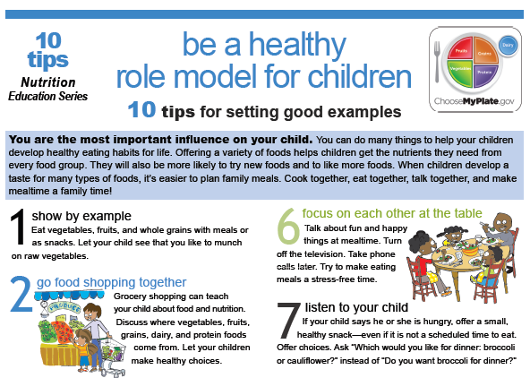
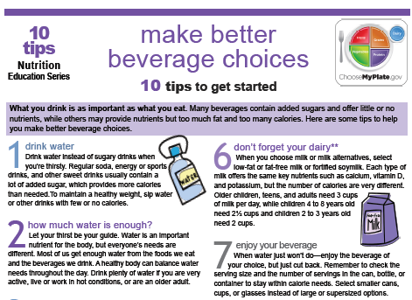
Resources for families in English and Spanish
Notes:
Suggested talking points:
Here are examples of resources from MyPlate.
You can share these tip sheets with families.
They’re available in English and Spanish.

Slide 29
What’s your next step?
Write down action steps you can
take to offer healthier beverages!
Notes:
Notes for trainer:
At the end of the session, pass out pieces of paper or note cards and pens.
Encourage providers to write down 1 to 3 action steps they will take when they go back to their programs.
Ask for volunteers to share what they wrote with the larger group.
By identifying clear action steps, providers will be ready to make changes when they return to their programs.

Slide 30
Join LMCC & Stay Connected
For more information and to sign up, visit: www.HealthyKidsHealthyFuture.org
Contact the Let’s Move! Child Care Help Desk
LMCCHelp@cdc.gov
Share your success stories!
www.healthykidshealthyfuture.org/home/resources/success.html
Notes:
Suggested talking points:
By signing up, you will get LMCC newsletters with new resources, tips, and the latest updates.
If you have any questions about LMCC, email LMCC at LMCCHelp@cdc.gov.
Notes for trainers:
We’d love to hear your success story too! To share your story, go to www.healthykidshealthyfuture.org/home/resources/success.html and fill out the online form.

