Slide 1



Staff Wellness
You matter, too!
Notes:
In this session we will be discussing the importance of staff wellness. While this collaborative focuses primarily on the health of children, supporting staff in improving or maintaining their own health has benefits for them, for your program, and for the children you serve.

Slide 2



Objectives
List key components of staff wellness
List two recommendations for each area of wellness
List three benefits of staff wellness
Identify early care and education program barriers to staff wellness
Identify one program goal to support staff wellness
Notes:
Here’s what we hope to accomplish together today. While this collaborative is focused on children, it’s a good opportunity to consider the other important people in the ECE environment—staff and families. In this presentation, we will focus on staff wellness.

Slide 3
Wellness…
What does it mean to you?
Notes:
When I say the word wellness, what comes to mind?
[You will get a variety of answers. The idea is to get people to think about how they define wellness before you give them the definition on the next slide.]
Wellness means different things to different people.

Slide 4

What is wellness?
A conscious, self-directed and evolving process of achieving full potential.
Multi-dimensional and holistic, encompassing lifestyle, mental and spiritual well-being, and the environment
Positive and affirming
Wellness is an active process. It requires awareness and directed, thoughtful attention to the choices we make.
The National Wellness Institute. http://www.nationalwellness.org/index.php?id_tier=2&id_c=26
Retrieved December 14, 2012.
Notes:
Hit key points. Wellness is holistic, focused on the positive, determined by the individual, and an active process.

Slide 5

Components of wellness
Physical activity
Breastfeeding
Stress reduction
Healthy eating
Physical activity
Healthy weight
Breastfeeding
Stress reduction
Screen Time
The National Wellness Institute. http://www.nationalwellness.org/index.php?id_tier=2&id_c=25
Retrieved December 14, 2012.
Notes:
There are a number of components to wellness. [READ components from wheel.]
All of these are important to physical health; and often to emotional, social, intellectual and spiritual health, as well. And all can be a part of occupational health, which is what we’re aiming for—to provide a healthy workplace environment and to support your program staff in making healthy choices.
And activities to address the components of wellness rarely only address one—they usually address several. For example, your staff may start a walking or Zuumba club. These activities address both physical and social wellness. Yoga or meditation practice would address physical, emotional and perhaps spiritual.
Can you think of other activities that might positively impact multiple areas? [Acknowledge responses. Ex: healthy recipe exchange could address social and physical.]
Ok, let’s move on to benefits of staff wellness. Who can give me an example of a benefit that addressing staff wellness would have either for the staff person or for the program? [Take and acknowledge responses before moving to next slide.]

Slide 6
Benefits of Staff Wellness Efforts
Helps staff identify opportunities to improve their health
Enhances productivity
Reduces absences, idleness and health care costs
Shifts focus from treatment to prevention
Increases loyalty & retention
Creates role models for children and one another
How might the ECE program environment benefit?
  How might staff feel about themselves?
  How might they interact differently with you and one another?
  How might they make better role models for children?
Notes:
Yes, here are some benefits of staff wellness efforts. [Acknowledge the answers they provided and READ others.]
The bullets are some visible benefits of staff wellness. What about some “invisible” benefits? How might feelings and interactions change? [Take responses.]

Slide 7

Areas of Focus
Healthy Eating
Physical Activity
Healthy Weight
Breastfeeding
Stress Reduction
Screen Time
Later we will think about what your program…
  Does now to support staff in these areas
  Could do to improve its efforts
Notes:
Although there are many areas of staff wellness, we will focus on the same ones we are aiming to improve in children:
Healthy eating
Physical activity
Weight
Breastfeeding
And because it is so important, we will add stress reduction.
First I’ll give you a brief overview of the key recommendations and benefits in each of these areas, and later we will think about what your program does now to support staff wellness in these areas, and what you could do.
Remember that these areas connect to not only physical health, but to all of the components of wellness. It’s all connected.

Slide 8
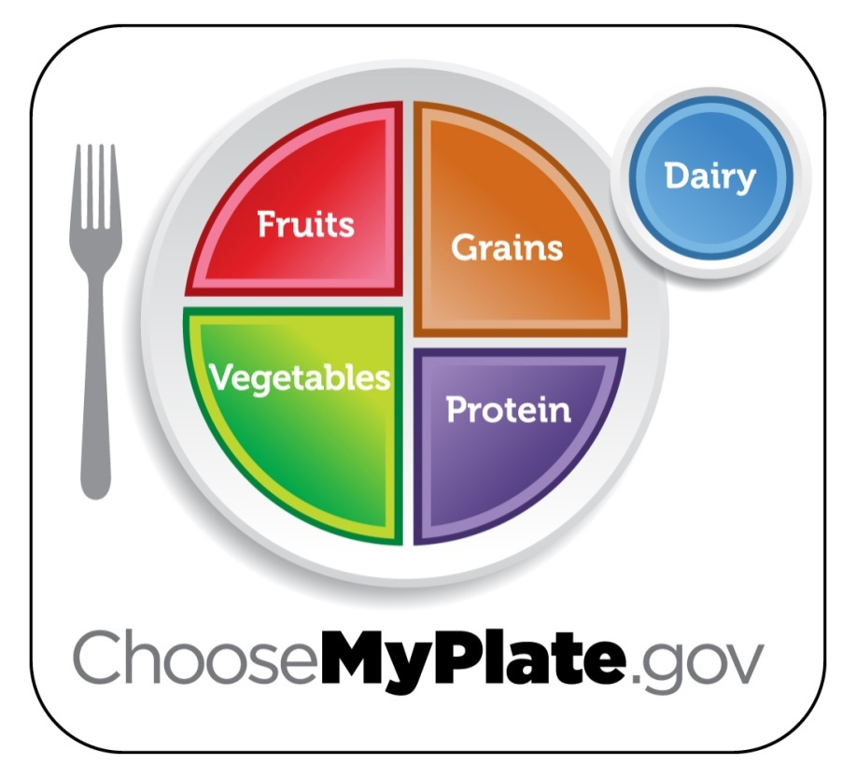
Healthy Eating
Dietary Guidelines for Americans, 2010
  Enjoy your foods, but eat less.
  Avoid oversized portions.
  Make half your plate fruits and vegetables.
  Make at least half your grains whole grains.
  Compare sodium in foods like soup, bread and frozen meals—and choose the foods with lower numbers.
  Switch to fat-free or 1% milk.
  Drink water instead of sugary drinks.
Notes:
SAY: Healthy eating. The recommendations for healthy eating come from the Dietary Guidelines for Americans, which are updated every five years. These are the major recommendations regarding diet from the most recent Dietary Guidelines.
[READ slide.]
ASK: Who sees something on this slide that you could improve in your own diet? [Wait for them to raise hands.]
SAY: Yes, almost everyone has an area they could improve. These are fairly straightforward recommendations. A few strategies you could use
For smaller portions, use a smaller plate.
For fruits and vegetables, remember to choose a variety of colors. Fresh, frozen and canned all count. Try to avoid added salt, sugar or sauces.
Whole grains can be tricky. You can look for 100% whole grain or 100% whole wheat on the front label. Or, read the ingredients. First ingredient should be a whole grain, using the word “whole” (e.g. whole wheat flour, whole oats, etc.).
Note that the milk recommendation is for skim or 1%. Two percent milk is not considered low fat.

Slide 9





Benefits of Healthy Eating
Promotes:
  feeling good!
  healthy weight
  lower blood pressure
  decreased bone loss
  decreased calorie intake
  healthy nervous system, bones, skin, cartilage, muscles and blood
Reduces risk of:
  kidney stones
  anemia
  osteoporosis, constipation
  heart disease, obesity
  type 2 diabetes, cancer
  defects during fetal development
US Dept of Agriculture. Retrieved December 20, 2012.
http://www.choosemyplate.gov/food-groups/
Notes:
READ slide highlights.
Can anyone give me an example of how you do or could support staff in healthy eating? [Take responses. Examples: healthy snacks at staff meetings; healthy celebrations; healthy recipe exchanges; making water freely available; healthy behavior contest (for eating fruits/veggies, drinking water, etc.)
Ask if any of the examples addresses multiple areas of wellness. [Take responses].

Slide 10
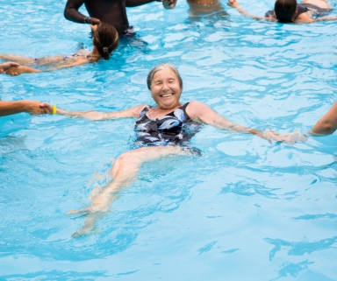


Physical Activity
What is it?
The recommendations for adults:
  2 hours and 30 minutes a week of moderate-intensity, or
  1 hour and 15 minutes (75 minutes) a week of vigorous-intensity aerobic physical activity, or
  a combination.
  episodes should last at least 10 minutes
  the more you do, the more you benefit…
  muscle strengthening exercises 2x/week
Doesn’t have to be hard, stressful or boring!
2008 Physical Activity Guidelines for Americans. Retrieved December 20, 2012
http://www.health.gov/paguidelines/pdf/fs_prof.pdf
Notes:
What is physical activity? [Accept a few answers.]
Physical activity is any movement of the body that requires more energy than resting. The recommendations for adults come from the 2008 Physical Activity Guidelines for Americans. [READ bullets.]
It’s important to remember that physical activity doesn’t mean you have to hit the gym. It doesn’t have to be hard, stressful or boring!
What are some physical activities that you like to do? [Accept examples.]

Slide 11
Benefits of Physical Activity
Lower risk of:
  Early death
  Heart disease
  Stroke
  Type 2 diabetes
  High blood pressure
  Adverse blood lipid profile
  Metabolic syndrome
  Colon and breast cancers
Promotes:
  Feeling good!
  Prevention of weight gain
  Weight loss when combined with diet
  Improved cardiorespiratory and muscular fitness
  Prevention of falls
  Reduced depression
  Better cognitive function (older adults)
2008 Physical Activity Guidelines for Americans. Retrieved December 20, 2012
http://www.health.gov/paguidelines/pdf/fs_prof.pdf
Notes:
There are many physical and mental health benefits of physical activity. [READ slide highlights]
Can anyone give me an example of how you do or could support staff in physical activity? [Take responses. Examples: staff walking club; bring exercise classes to your site; having physical activity breaks during staff meetings; healthy behavior contest (minutes of physical activity.)
Ask if any of the examples addresses multiple areas of wellness. [Take responses].

Slide 12
Healthy Weight
To maintain weight, you must have energy balance
  Energy in = energy out
Energy (calories) in
  Find your calorie goal at choosemyplate.gov
  Monitor food & beverage intake (increase awareness!)
  Increase low calorie foods (fruits & veggies)
  Prepare and consume smaller portions
  Eat a nutrient dense breakfast
Energy out
  Increase physical activity
  Limit inactivity (screen time, sitting, etc.)
Notes:
Weight is a factor of something called energy balance. You have energy balance when the energy you take in through food equals the energy you expend through everyday actions and physical activity.
Everyone has a different caloric requirement, which is based on age, sex, height, weight and activity level. You can find your own calorie goal at choosemyplate.gov. A few ways to keep your caloric intake at an appropriate level are [READ next four bullets.]
Energy out comes from your regular daily activities, plus any physical activity. It also helps to limit the amount of time you are inactive, like when you are sitting, watching TV, etc.

Slide 13

Benefits of Healthy Weight
Weight should be discussed with adults, not children
Weight is a concern because of health, not appearance
Being overweight or obese can increase the risk of:
  Heart disease
  Stroke
  Type 2 diabetes
  High blood pressure
  Breathing problems
  Arthritis
  Gallbladder disease
  Some kinds of cancer
Healthy weight ≠ health; behavior is important, too!
Small changes can make you feel great!
Notes:
Weight should not be discussed with children. They should focus on healthy behaviors like eating and physical activity. There is still a great deal of stigma related to overweight, so let’s be clear…weight is a concern because of health, not appearance.
READ next bullet.
Weight isn’t everything. A healthy weight doesn’t necessarily mean that you have a large amount of muscle and small amount of fat. So focus on improving healthy behaviors, and the weight will follow.
The activity ideas you’ve already mentioned for healthy eating and physical activity can address weight at well. Does anyone have any other examples of how you do or could support staff in achieving a healthy weight? [Take responses.)
Citation: US Dept of Health and Human Services Office on Women’s Health. Retrieved December 20, 2012.
http://www.womenshealth.gov/publications/our-publications/fact-sheet/overweight-weight-loss.html

Slide 14
Breastfeeding
Recommended as the gold standard for infant feeding ¹
  Exclusive breastfeeding for six months
  Continued breastfeeding as solid foods are introduced
  Continuation of breastfeeding for one year or longer as desired by mother and infant
Breastfeeding is more than a lifestyle choice, it’s a public health issue. ¹
If staff want to breastfeed upon return to work, do they have:
  Reasonable break time to breastfeed their child or express milk?
  A private space in which to do so?
  A place to store their pumped milk?
  Encouragement and support?
American Academy of Pediatrics. Breastfeeding and the Use of Human Milk. 2012. Retrieved on December 20, 2012. http://pediatrics.aappublications.org/content/early/2012/02/22/peds.2011-3552
Notes:
Breastfeeding is considered the gold standard for infant feeding by the American Academy of Pediatrics, World Health Organization, Centers for Disease Control & Prevention, and others. Just as many of your centers’ families breastfeed, your staff needs support in breastfeeding as well.
Recommendations are consistent:
Exclusive breastfeeding for six months (this means the infant receives no other food or liquid)
Continued breastfeeding as solid foods are introduced
Continuation of breastfeeding for one year or longer as desired by mother and infant
Breastfeeding can be a sensitive topic. Many feel that it’s a personal choice whether or not to breastfeed, and this is true. However, the health benefits of breastfeeding are clear.

Slide 15

Benefits of Breastfeeding
For baby
  Reduced risk of SIDS, asthma, ear infections, diarrhea, respiratory
  infections, obesity, childhood leukemia, and diabetes
  Easier to digest; changes as baby grows
  Improved neurodevelopment: higher intelligence scores and teacher ratings
For mom
  Reduced risk of breast and ovarian cancer, type 2 diabetes and postpartum depression
  Saves around $1,500 a year on formula
For employers
  Moms miss fewer days of work because breastfed babies are sick less often
For society
  Decreased abuse and neglect
  If 90% of mothers breastfed for 6 months, nearly 1000 infant deaths could be prevented, and the U.S. could save $13 billion in health care costs
US Dept of Health and Human Services. Office on Women’s Health. Retrieved December 20, 2012.
http://www.womenshealth.gov/breastfeeding/why-breastfeeding-is-important/index.html
American Academy of Pediatrics. Breastfeeding and the Use of Human Milk. Retrieved January 11, 2013.
http://pediatrics.aappublications.org/content/early/2012/02/22/peds.2011-3552.full.pdf+html
Notes:
Read slide
Can anyone give me an example of how you do or could support staff in breastfeeding? [Take responses. Examples: create or improve space, break time 3x/day, policies).
Ask if any of the examples addresses multiple areas of wellness. [Take responses].

Slide 16

Screen Time
Includes all time spent in front of a screen (e.g., TV, computer, video games, smart phone) for tasks not related to work or school.
Can lead to “mindless eating.”
Includes exposure to commercials advertising unhealthy foods.
Is “sedentary” time—time spent sitting. Aim for less sitting, more moving.
Takes time away from healthy activities (e.g., exercise, cooking healthy meals, spending time with family).
Notes:
Review slide points.
Note that screen time is a complex issue now, since our lives in many ways revolve around technology. Sometimes we are even using multiple types at one time, for example texting a friend while watching TV.
Note that most screen time is sedentary time. Time spent using a screen while exercising, such as using an exercise DVD, is less concerning because many of these points don’t apply (e.g., you wouldn’t be eating, exposed to commercials, or sitting.)

Slide 17


Ways to Reduce Screen Time
Keep track of screen time using a log or journal – set goals to cut down!
Take TV out of bedroom
Turn off TV during mealtimes
Focus on other activities you like to do (e.g., sports, read, cook, play with kids)
Discover different ways to unwind (e.g., listening to music)
Take up a new, active hobby (e.g., walking, yoga)
Plan screen-free activities with family and/or friends

Slide 18

Stress Reduction
What is job stress?
  The harmful physical and emotional responses that occur when the requirements of the job do not match the capabilities, resources, or needs of the worker
  Not the same as being challenged
Job stress can contribute to:
  Short term: headaches, sleep disturbances, upset stomach, short temper, job dissatisfaction, low morale
  Long term: cardiovascular disease, musculoskeletal disorders, mental health problems (depression & burnout), workplace injury
Centers for Disease Control and Prevention. Retrieved December 20, 2012.
http://www.cdc.gov/niosh/docs/99-101/
Notes:
The concept of job stress is often confused with challenge, but these concepts are not the same. Challenge energizes us psychologically and physically, and it motivates us to learn new skills and master our jobs. When a challenge is met, we feel relaxed and satisfied. Thus, challenge is an important ingredient for healthy and productive work. The importance of challenge in our work lives is probably what people are referring to when they say "a little bit of stress is good for you.

Slide 19

Stress Reduction
Higher productivity, less absenteeism and tardiness, greater employee retention, improved physical and mental health, more positive attitudes
People feel good!
Characteristics of low-stress organizations:
  An organizational culture that values the individual worker
  Recognition of employees for good work performance
  Opportunities for career development
  Management actions that are consistent with organizational
  values
Stress management techniques:
  Physical activity, meditation, yoga, tai chi, mindfulness
  Seek out community resources
    Physical activity classes
    Mental health providers
  Use workplace services like an employee assistance plan (EAP)
Organizational change + stress management = healthy workplace
Notes:
Review slide points. Emphasize that organizational change is key to stress reduction.
Mention that some workplaces have Employee Assistance Plans that cover short term counseling to help people manage stressors like family or relationship issues, major life events, financial or legal concerns, caring for aging parents or a sick child, etc.
Can anyone give me an example of how you do or could support staff in reducing stress? [Take responses.]
Ask if any of the examples addresses multiple areas of wellness. [Take responses].
Centers for Disease Control and Prevention. Retrieved December 20, 2012. http://www.cdc.gov/niosh/docs/99-101/

Slide 20
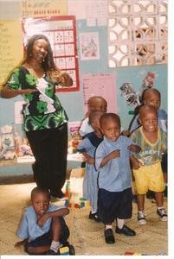
Role Modeling
“The most important role models in people's lives, it seems, aren't superstars or household names. They're 'everyday‘ people who quietly set examples for you--coaches, teachers, parents. People about whom you say to yourself, perhaps not even consciously, 'I want to be like that.' “ - Tim Foley
Notes:
Read quote. Note that this is so true—everyone in the room, and everyone back at the program is a role model.

Slide 21
Staff as Role Models
From infancy, children learn through their interactions with peers, parents and care providers
Young children naturally want to do what you do
Working with families every day gives you a unique opportunity to influence health behaviors
  Respect, trust, kindness, communication
Overweight staff members may feel physically limited from participating in activities as role models.
  Acknowledge their challenges, encourage participation as possible, encourage enthusiasm!
  Staff wellness activities will help them make personal behavior changes that will increase their ability to role model
Notes:
Discuss bullets.
One of the biggest benefits to staff wellness is the impact their personal changes will have on children and families. Generally, people are more comfortable discussing healthy behavior if they practice it themselves.
Information and advice is often better received if the person giving it is a credible source of knowledge and experience.
Some staff will have physical limitations that impact their ability to role model, for example, participating in vigorous physical activity. This is a reality, and it’s okay. Acknowledge staff limitations, encourage them to do what they can, and encourage them to be enthusiastic cheerleaders when they’re unable to physically participate. Excitement is infectious and children will feel it!

Slide 22
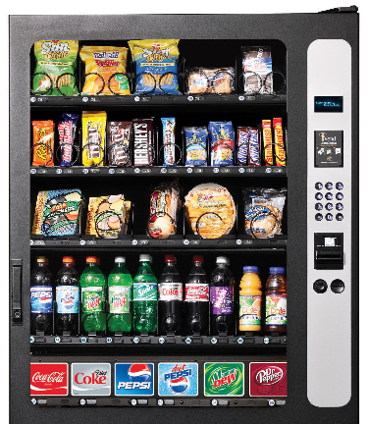
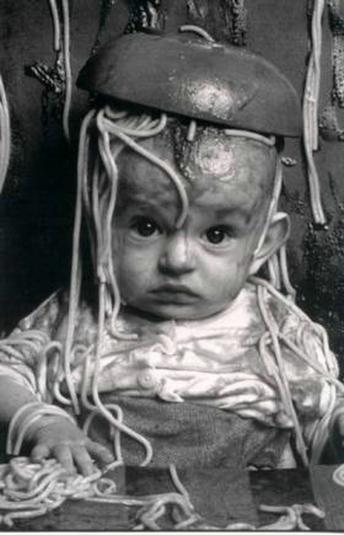
Barriers
What makes it hard for staff to make healthy choices while at work in your program?
  Healthy foods and beverages
  Physical activity
  Screen time
  Breastfeeding
  Stress
Notes:
Note that long days caring for children can be challenging for staff.
What are some things that make it hard for staff to make healthy choices while at work?
Take examples for each area.

Slide 23
Activity: Staff Wellness Assessment
Behavior | What do we do now to support staff wellness? | What are some barriers to staff wellness? | What could we do to address these barriers?
Healthy eating
Physical Activity
Healthy weight
Breastfeeding
Stress Reduction
Screen Time
Notes:
Now we are going to do an activity. Each program will do a brief assessment related to staff wellness.
Think about how your early care & education program currently supports staff wellness in each of these areas, and what makes it hard for staff to make healthy choices.
Please note a few things you could do to improve staff wellness. Choose at least two areas to address. You will have 10 minutes to discuss with your small program team. If you are by yourself today, take a few minutes to think through this on your own.
SHOW NEXT SLIDE BEFORE THEY START ACTIVITY.

Slide 24
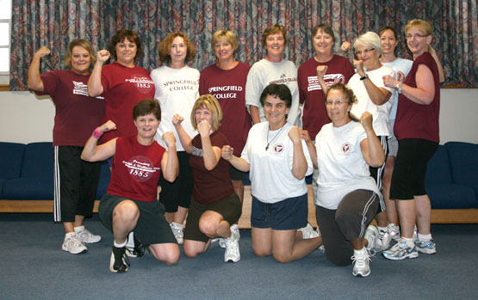

Staff Wellness Assessment
Considerations
  Policies
  Programs
  Environment
  Education
  Resources
  Social support
Barriers
What do staff want?
Notes:
Here are a few things to think about when you’re doing your assessment. The most effective interventions involve a combination of multiple supports—things like policies, programs, education, resources and social support.
We don’t want to tell staff what they’re going to do! Think about the things your staff have mentioned in the past. Do you have any ideas about what kind of wellness improvements they might want?
As participants finish the assessment, ask for attendees to share some examples with the group.

Slide 25
Next steps
Homework doesn’t include staff wellness. But…
It’s important! So, consider:
  Finding time to address it at a staff meeting
  Asking staff if a small group wants to work on staff wellness
  Using some of the handouts to facilitate conversations with staff
  Using the Program Activity for Staff Wellness
Remember to ask, encourage and support
  Frame the issue positively
  Don’t order and direct
Resource List for Staff Wellness
Notes:
Review key points.
Homework for this session is pretty full, so it doesn’t include staff wellness.
Make suggestions for next steps. Introduce Program Activity for Staff Wellness they could use back at their program. Introduce handouts that could support staff wellness.
EMPHASIZE that staff wellness can be a very sensitive issue. We don’t want to make staff feel uncomfortable, singled out or attacked because of their weight or behaviors. We don’t want to increase their stress by ordering them to adopt healthy habits or by humiliating them.
When framing staff wellness, it should be a discussion about why it’s important, how your program staff can work together to make the environment more supportive of healthy choices, and how they can encourage and support one another. Remember to be nurturing and supportive!
Introduce Resource list for Staff Wellness.

Slide 26

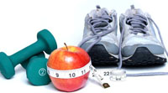
Resources for Staff Wellness
CDC’s Healthier Worksite Initiative
  Comprehensive website
  Nutrition, physical activity, breastfeeding, weight, preventive health screenings, tobacco
Tools for
  Planning
  Needs Assessment
  Implementation
  Evaluation
  Policy
http://www.cdc.gov/nccdphp/dnpao/hwi/index.htm
Notes:
Introduce them to the Resource List for Staff Wellness.
Here is one example of a great resource.

Slide 27
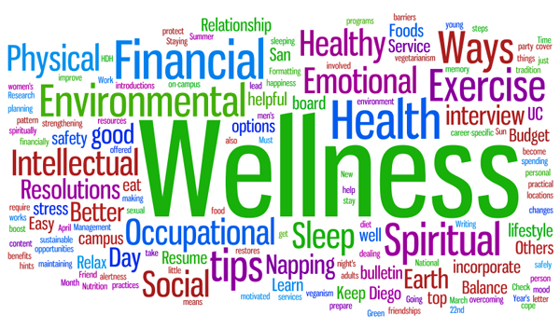
Wrap Up & Questions
“The part can never be well unless the whole is well.” - Plato
Notes:
Ask if there are any questions.
Quote from Plato. Two thoughts: if we want our staff to do good work in the program, and to be positive, nurturing role-models for children, we have to support them in being well themselves. And if we want them to be well, we have to provide an environment so that the program as a whole is supportive of wellness.

