Slide 1
Learning Session 5: Reducing Screen Time & Celebrating Success
Early Childhood Health Promotion
and Obesity Prevention
National Early Care and Education
Learning Collaboratives (ECELC) Project
Notes:
In addition to the CDC and Nemours logos you are welcome to add your own state logo(s) and unique project name to these slides.
Welcome programs and participants back to the Learning Session.
Review LS5 topic areas:
Presenting Storyboards;
Best Practices for Screen Time;
Continuing the process of change; and
Professional Development Activity.

Slide 2
Acknowledgements
A special thank you to:
Centers for Disease Control and Prevention (CDC)
For generous funding support and expertise
Nemours
For their expertise, materials, support, and time spent on the project’s implementation
Gretchen Swanson Center for Nutrition
For the evaluation component of this national effort
Notes:
Enter acknowledgements for your state partners.
The ECELC is a project funded by the Centers for Disease Control and Prevention (CDC) to support early care and education (ECE) providers to promote best practices in healthy nutrition, physical activity, breastfeeding support, and screen time.
Nemours is supporting this project monthly through their expertise, materials, and time throughout the implementation process.
Gretchen Swanson Center for Nutrition is administering the evaluation component of this project.

Slide 3
Learning Session 5 Objectives
At the end of the Learning Session, participants will be able to:
Describe best practices for reducing screen time and identify change opportunities within their program;
Use storyboard presentations to show at least one change within their program that supported healthy eating, physical activity, screen time, and breastfeeding support;
Be able to identify local organizations/agencies that support early childhood providers ; and
Be prepared to continue their Action Plan to support implementation of best practices for healthy eating, physical activity, screen time and breastfeeding support in their program.

Slide 4
Learning Session 5
The ABC’s of a Healthy Me!
Go NAP SACC*
Serving Meals Family- Style &
Supporting Breastfeeding
Continue Action Plan
& Storyboard
Reducing Screen Time & Celebrating Success
Continuing the Process of Change
LS1
Action Period
LS2
LS3
LS4
LS5
Action Period
Action Period
Action Period
Action Period
Nurturing Healthy Eaters & Providing Healthy Beverages
Action Plan
Getting Kids Moving
Continue Action Plan
& Storyboard
*Go NAP SACC is a Nutrition and Physical Activity Self Assessment for Child Care for ECE settings comparing their current practices with a set of best practices
Notes:
This session will focus on how providers can improve best practices for screen time.

Slide 5
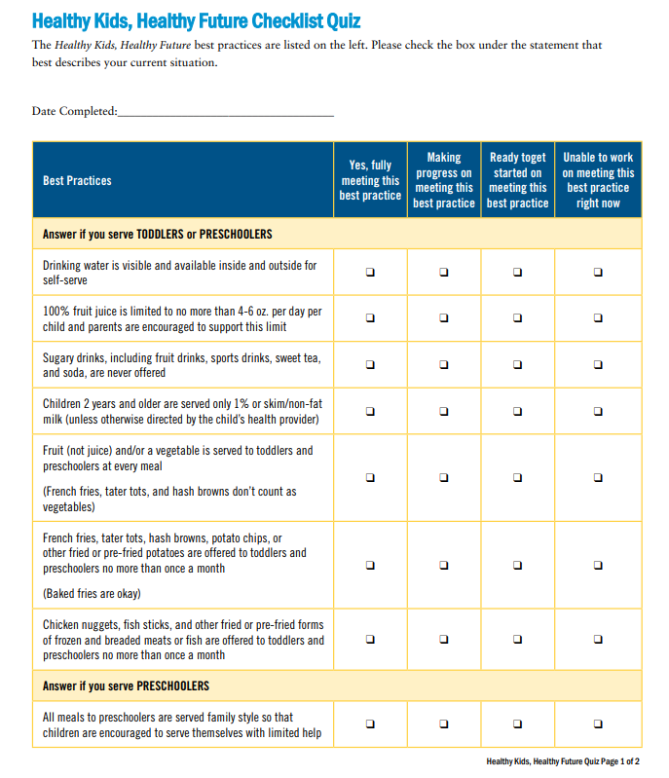
Healthy Kids, Healthy Future Quiz
Notes:
Note: Have participants complete the post Healthy Kids, Healthy Future quiz (one per program). Give participants about 10 minutes to complete the Healthy Kids, Healthy Future Quiz and discuss the improvements they have made throughout the project. This discussion can also be incorporated into the “Presenting Storyboards” segment.

Slide 6
Presenting Storyboards
Notes:
Depending on the group size, participants can present within the large group or be split up into their TA groups. Presentations can be done formally through individual presentations to the group or informally through a “gallery walk.”
Gallery Walk: Storyboards are displayed on tables and participants can take a “gallery walk” through the room to view other program’s storyboards.
This is a great opportunity for programs to share their success stories and ideas with other participants.
Note: Have index cards available and encourage participants to write down ideas they like and that they might want to incorporate into their own programs.

Slide 7
Part A: Best Practices for Screen Time

Slide 8
What is Screen Time?
What is screen time?
TV, DVDs, videos
Computer time
Smart phone, tablets
Video games
Virtual reality headsets
Notes:
Screen time is not just watching television. It also includes watching videos and DVDs, and playing on computers, tablets, video games and handheld devices.
Skyping or doing FaceTime with family members (such as a parent serving in the military oversees), or a teacher reading a story from a tablet rather than a hard copy of a book are NOT considered screen time.
Note: Remind participants that the Nemours’ Best Practices for Physical Activity includes Family Tip Sheets for reducing screen time at home. One example given suggests creating a quiet, cozy corner with picture books, puzzles, and blocks so that your child/children can play quietly rather than watch TV.

Slide 9
What are the concerns about screen time?
While watching television may be an enjoyable activity, children lack the ability to gain educational value from it
Moderation of screen time is key for healthy development and staying active
Instead of spending time watching screens, children should be engaging in physical activity and or educational activities
Notes:
Screen time is a sedentary activity that often does very little to stimulate the brain. It gets in the way of exploring, playing, and social interaction.

Slide 10
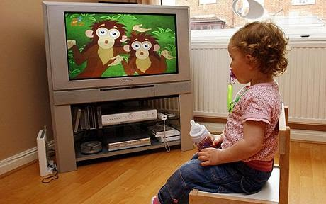
Screen Time Rationale
Gets in the way of exploring, playing, and social interaction
Children who spend more time watching TV are more likely to be overweight or obese
For children 8-16 months, every hour of viewing is associated with 6-8 fewer words learned
More hours of viewing at age 3 can lead to decreased cognitive test scores at age 6
Notes:
When children spend less time in front of a screen and more time interacting with their peers and the adults around them they learn valuable social skills.
For children 8-16 months, every hour of TV viewing is associated with 6-8 fewer words learned. More hours of viewing can lead to decreased cognitive test scores at age six.
Screen time may also lead to greater aggressive and violent behavior because young children cannot tell the difference between fantasy and reality on television and can become desensitized to violence.
TV, DVDs, and many websites include advertisements for unhealthy foods and children can learn unhealthy eating practices from this type of advertising.

Slide 11
Make the Most of Screen Time
Technology is everywhere, so if it is used for no more than 30 minutes per week in your program choose strategies that support children’s development
Make screen time interactive – talk about what you’re viewing and ask children to act out what they see
Point out new words, letters, and concepts
Discuss the issues the main characters face and how they overcome them
Help the child connect what they’re viewing to the real world
Have children take turns using a device to teach them about sharing
Notes:
Resources:
Zero to Three, Using Screen Media with Young Children Tip Sheet (http://www.zerotothree.org/parenting-resources/screen-sense/screen-sense_tips_final3.pdf).
The Campaign for Commercial- Free Childhood and the Alliance for Childhood(2012)Facing the Screen Time Dilemma: Young children, technology, and early education.(www.screenfree.org).
Choosing appropriate screen time may be difficult to do. If you choose to incorporate screen time into your classroom setting it may be helpful to follow these tips:
Be intentional- carefully choose what screen time is appropriate. Think about if the technology will support and enhance a lesson or activity that you are working on in the classroom;
Establish rules and routines - talk with children about the rules when using technology (i.e. Computer time will be no longer than 10 minutes per child. This will also allow for children to work on social skills such as sharing and waiting); and
Place technology in areas that reduce distractions - place technology in locations that allow for appropriate supervision, but easily accessible to small groups of children.
Do not include media that contains any advertising or branding. There are educational shows and DVDs today that weave developmentally appropriate academic messages or physical activity into the content. Be sure to select these types of shows and DVDs.

Slide 12
Make the Most of Screen Time
Choose strategies for including screen time that support children’s healthy development.
Screen time should be playful and support creativity, exploration, pretend play, active play and outdoor activities. Ensure that:
Screen time does not take the place of healthier activities.
Children are at a developmentally appropriate level to engage in the technology.
Children explore the use of the various technologies available to them before use.

Slide 13
Interactive Screen Time
Interactive screen time = television programs, internet, tablets, e-books, applications (apps) and other content intended to encourage active and creative use to enhance social development among children and adults
Interactive screen time strategies that support children’s healthy development:
Talk about what you’re viewing, ask children to act out what they see
Point out new words, letters, and concepts
Discuss the issues characters face and overcome
Help children connect what they view to the real world
Have children take turns using a device to teach them about sharing
Notes:
Interactive screen time strategies that support children’s healthy development:
Talk about what you’re viewing and ask children to act out what they see.
Point out new words, letters, and concepts.
Discuss the issues the main characters face and how they overcome the issues.
Help children connect what they view to the real world.
Have children take turns using a device to teach them about sharing.
Include cameras, phones, and radios in exploratory centers. Children can explore various forms of technology as they enhance both gross and fine motor skill development
Remember, children are always watching what you do and say. Be sure to participate in any activities with the children and set positive examples.

Slide 14
Intentional Screen Time
Intentional screen time = ECE providers using screen time in a purposeful, thoughtful, and appropriate way to enhance and extend curriculum, meet learning standards, and support individual children’s learning
Intentional screen time practices that support children’s healthy development
Plan ahead
Think about and set learning goals
Preview and evaluate the media selection
Select media that will help children make connections with their peers and community
Offer breaks that transition the activity on the screen to a hands-on, real world activity.
Notes:
Intentional screen time selection is important to support children’s learning and development in the classroom.
Intentional media selection consists of:
Plan ahead- intentional media selection is all about ensuring that the goals set out for the activity and the media usage are being met. Determine how the media will help you achieve your goals for the classroom and the children. Identify and follow the best practices for screen time as a guide when planning activities.
Think about and set learning goals-Technology integrated in the curriculum should not replace other activities but enhance them. Use screen time as an opportunity to enhance children’s understanding of the topic that is being covered.
Preview and evaluate the media selection- review the media prior to showing it to the children. This will allow you to determine the appropriateness of the activity, prepare you to develop activities and ways to deliver the content covered.
Select media that will help children make connections with their peers and community- allow children to explore learning. For example, if the topic of “community helpers” is being discussed, watching a video about firefighters is a good way to enhance the learning experience.
Offer breaks that transition the activity on the screen to a hands-on, real world activity.
http://www.resourcesforearlylearning.org/educators/module/20/8/26/

Slide 15
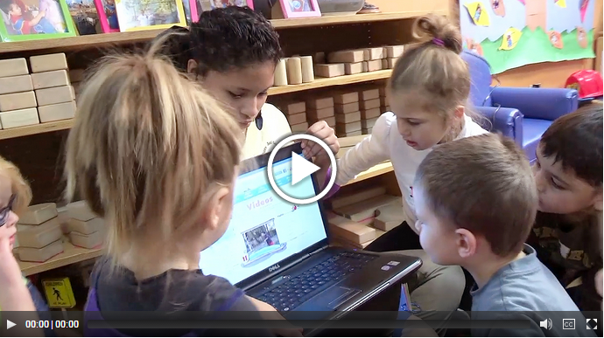
Select Media With Intention
Notes:
Click on the photo (hyperlink) to start the video. (If this does not work, load from the link below).
http://www.resourcesforearlylearning.org/educators/module/20/8/26/
Review media in advance. Make sure it is high-quality, has an educational purpose, or is intented for physical activity. It is also important to make sure the media you select is free of advertising or branding.
For more ideas, read the resource article “Integrating Media and Technology into Curriculum: Best Practices” from the Brain Buidling in Progess, Resources for Early Learning project. (link below)
Insert handout: Integrating Media and Technology into Curriculum
http://resourcesforearlylearning.org/media/content/docs/IntegratingMediaAndTechnologyIntoCurriculum_Best-Practices_1.pdf

Slide 16
Best Practices for Screen Time
Don’t allow any screen time for children less than two years.
Babies and even toddlers (up to two years old) shouldn’t get any screen time at all, according to the American Academy of Pediatrics
Activities that are active, social, and engage a child’s senses – such as touching, exploring, and playing – are much more beneficial for brain development than watching television
Notes:
Not too long ago, parents and ECE providers all over the country were buying and showing videos developed specifically for infants. But now we know that babies and even toddlers (up to two years old) shouldn’t get any screen time at all, according to the American Academy of Pediatrics.
Children under two years old are in a critical period for brain development and activities that are active, social, and engage a child’s senses – such as touching, exploring, and playing – are much more beneficial than watching television.
However, children under two, are spending about 45 minutes each day watching screen time. ECE providers should implement the best practice of eliminating all screen time for children less than two.

Slide 17
Best Practices for Screen Time
Limit total screen time in ECE for children two years and older to no more than 30 minutes per week for educational or physical activity purposes only.
The American Academy of Pediatrics recommends one hour or less of total screen time each day for children older than two
On average, preschool aged children watch about 4 hours of screen time, with the majority of it being watched at home
It’s best to minimize screen time in ECE, to no more than 30 minutes per week to reduce the total amount of time children spend in front of screens
Many programs choose not to have any screen time for any children
Notes:
Limit total screen time in ECE for children two years and older to no more than 30 minutes per week for educational or physical activity purposes only.
The American Academy of Pediatrics recommends one hour or less of total screen time each day for children older than two.
Unfortunately, young children are exceeding this recommendation. On average, preschool aged children watch about 4 hours of screen time, with the majority of it being watched at home.
In child care, preschool children still watch, on average, about 25 minutes of screen time per day. It’s best to minimize screen time in ECE, to no more than 30 minutes per week to reduce the total amount of time children spend in front of screens. Many programs choose not to have any screen time for any children.

Slide 18
Best Practices for Screen Time
Screen time should not be utilized during meal or snack time
Socializing during meals and snacks is an important part of children's healthy development and is an opportunity for positive role modeling
Time during meals should be spent modeling appropriate eating behaviors and habits, encouraging children to try new foods, talking about nutrition, and supporting the development of children’s gross and fine motor skills (e.g., self-serving of food)
Notes:
Socializing during meals and snacks, instead of using screen time, is an important part of children's healthy development and is an opportunity for positive role modeling.
Time during meals should be spent modeling appropriate eating behaviors and habits, encouraging children to try new foods, talking about nutrition, and supporting the development of children’s gross and fine motor skills (e.g., self-serving of food).

Slide 19
Best Practices for Screen Time
Ensure that any screen media used is free of advertising and brand placement
Advertising influences the food consumption of young children, and for everyone one-hour increase in TV viewing per day, children drink more sugar-sweetened beverages, eat more fast food, and consume more calories overall
Be sure to review all media prior to use to make sure it is free of all advertising and branding
Notes:
Ensure that any screen media used is free of advertising and brand placement
Children are bombarded with advertising for high-calorie and non-nutritious foods and drinks through screen media. Advertising influences the food consumption of young children, and for everyone one-hour increase in TV viewing per day, children drink more sugar-sweetened beverages, eat more fast food, and consume more calories overall.
Be sure to review all media prior to use to make sure it is free of all advertising and branding.

Slide 20
Best Practices for Screen Time
Educate parents on how to reduce screen time, or teach media literacy education* two times per year or more *Education opportunities can include special programs, newsletters, or information sheets
Many parents are not familiar with current screen time recommendations for children
It is important to educate parents about screen time, but also to partner with them to ensure children are not being exposed to too much screen time throughout the day
On average, children under two spend about 45 minutes in front of screens daily, and preschool aged children spend about 4 hours a day in front of a screen daily, most of which occurs at home.
Notes:
Educate parents on how to reduce screen time, or teach media literacy education* two times per year or more. *Education opportunities can include special programs, newsletters, or information sheets.
Many parents are not familiar with current screen time recommendations for children
Currently, infants, toddlers, and preschoolers far exceed recommended limits on screen time. The American Academy of Pediatrics (AAP) discourages use of media for children under two, but infants and toddlers spend on average about 40 minutes a day watching television or videos.
On average, children under two spend about 45 minutes in front of screens daily, and preschool aged children spend about 4 hours a day in front of a screen daily, most of which occurs at home.
Parents often view television screen time as an educational resource and are not concerned with how much their child watches. Many parents count only the time spent watching television—but screen time also includes time spent playing on or with a computer, cell phone, tablet, or video game.
Also, many parents do not understand the rating system for television programs and video games.
It is important to educate parents about screen time, but also to partner with them to ensure children are not being exposed to too much screen time throughout the day.

Slide 21
Screen Time In the Classroom
Digital technology can support dual language learners
Various forms of technology can be beneficial when working with children with special needs
Include cameras, phones and radios in exploratory centers
Children have the opportunity to explore various forms of technology and can enhance gross and fine motor skill development

Slide 22
Ways to ut Down on Screen Time
Nutrition and Wellness Tips for Young Children: Provider Handbook for the Child and Adult Care Food Program Activities to Limit Screen Time:
Play music: have children create their own dances
Organize puzzle time
Conduct a “pretend play” activity
Draw, color, create a sculpture or use playdough
Provide a sack of special activities: put together a box containing activities children do not normally engage in

Slide 23
“Go, Slow, or Whoa” Activity
If the statement is:
Recommended, participants will RUN in place
Limit, you will MARCH in place
Not recommended, you will STAND in place
Notes:
For review of best practices of physical activity and screen time for preschoolers, toddlers, and infants, conduct the “Go, Slow, or Whoa” activity.
Note: Find the “Go, Slow, or Whoa” section in the Implementation Guide. Read the statements for a particular age group without saying the answer (whether or not it is recommended, limit, or not recommended). Explain to participants that you if the statement is:
Recommended, participants will RUN in place;
Limit, participants will MARCH in place; and
Not recommended, participants will STAND in place.

Slide 24
Early Learning Standards Physical Activity Break
Notes:
Note: Use the Nutrition and Movement Activity Book to conduct the activity on page 5, Beach Ball High. Take this time to connect your states Early Learning Standards to this activity. Once you conduct the activity, facilitate a discussion around what common Early Learning Standards domains were addressed. Use your state’s Early Learning Standards as a guide to facilitate this discussion or use the domains listed in the Implementation Guide. There may be additional domains specific to your state’s Early Learning Standards, so encourage the participants to think about what else can be included.

Slide 25
Lunch

Slide 26
Part B: Overcoming Challenges to Meeting Screen Time Best Practices

Slide 27
Challenge: Screen time is needed as a distraction
Screen time helps keep children distracted while performing necessary tasks, like setting up for lunch or cleaning.
Solution #1: When cooking and cleaning, engage children by having them imitate your actions
Solution #2: Provide opportunities for self-directed play
Solution #3: Use nap time to complete tasks
Notes:
Solution #1: When cooking and cleaning, engage children by having them imitate your actions
Allow children to play with pots and pans while preparing meals or provide them with towels to help “clean up” after meals.
Offer play props to children, such as pretend food and utensils. This will stimulate a child’s imagination and help develop their motor skills.
Solution #2: Provide opportunities for self-directed play
Craft time is an excellent opportunity to keep children engaged in an activity that helps develop creativity and artistic skills. Provide crayons, markers, stickers, blank paper, construction paper, and water color paint. Offer coloring templates, especially ones that promote healthy lifestyles.
Keep children entertained with story time. Have children to select a picture book and encourage them to read on their own. You can offer group story time using audiobooks. Have children gather together to listen to the recorded narrator while one child holds the book and turns the pages.
Solution #3: Use nap time to complete tasks
Take advantage of nap time to complete cleaning, paperwork, or attend to your personal needs and responsibilities.
NOTE: All required supervision ratios must be maintained during nap time and you must be able to easily see children in the nap area while completing tasks.
RESOURCE: Pages from Sesame Street’s “Every Day Is a Healthy Day” booklet can serve as coloring pages and then be linked to fun activities. Try using the coloring pages as a fun distraction for children!
http://kidshealth.org/classroom/cc/EveryDayIsAHealthyDay.pdf

Slide 28
Challenge: Child preferences for screen-based activities
Preschoolers plead for permission to watch television and do other screen-based activities.
Solution #1: Cover or hide screens so they are out of sight
Solution #2: Enthusiastically suggest promote alternative activities that promote physical activity
Solution #3: Identify age appropriate, educational programming
Solution #4: Role model screen-free behaviors
Notes:
Solution #1: Cover or hide screens so they are out of sight
Solution #2: Enthusiastically suggest promote alternative activities that promote physical activity
Solution #3: Identify age appropriate, educational programming if screen time is allowed
Solution #4: Role model screen-free behaviors
To reduce screen time for children, try these activities:
Act out stories or skits: Hand out a variety of costume pieces and have children dress up.
Get crafty: Provide coloring sheets or make greeting cards for upcoming holidays or birthdays.
Enlist their help: Involve children in part of meal and snack preparation, as well as clean-up
Play music: Have children make up their own dances. Add ribbons and beach balls for more movement.
Puzzle time: Have easy puzzles available that children can do alone or in pairs.
Surprise them: Put together a bag or box containing activities that children don’t normally do. This will keep the children busy during times you need to do other tasks.

Slide 29
Challenge: Parents not aware of the importance of limiting screen time
Parents may not be aware of the effects of screen time on child development and may be pushing your program to offer more screen-based activities
Solution #1: Educate parents with newsletters and workshops
Solution #2: Post information about screen time on the class bulletin board or Facebook page
Solution #3: Encourage parents to practice screen-free mealtimes or participate in a ‘screen-free week’ at home
Notes:
Solution #1: Educate parents with newsletters and workshops
Provide parents with current screen time recommendations for toddlers and preschool children. Note that screen time includes computers and hand-held electronic equipment, not just television. Suggest TV programs that are educational for children and run no more than half an hour in length.
Solution #2: Post information about screen time on the class bulletin board or Facebook page
Use postings to encourage parents to reduce screen time at home and offer strategies for how to limit screen time.
Provide an overview of what television ratings mean and the influence that violence in TV programs can have on children.
Solution #3: Encourage parents to practice screen-free mealtimes or participate in a ‘screen-free week’ at home
Check out the family letter on screen time at home from the National Association of Child Care Resource & Referral Agencies, link below.
RESOURCE: Family letter – screen time at home
https://d3knp61p33sjvn.cloudfront.net/2015/02/CCAscreentime.pdf

Slide 30
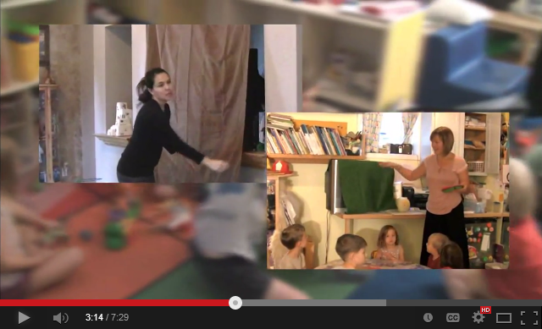
Screen Free Moments: Promoting Healthy Habits
Notes:
Click on the photo (hyperlink) to start the video.
https://www.youtube.com/watch?v=cogJkMgIjs0

Slide 31
Part C: Extending Your Learning - Staff, Families and Program Policies

Slide 32
Families and Screen Time
Best practices to keep in mind include:
Set expectations. Communicate physical activity and screen time polices when children enroll, and regularly throughout the year
Provide education to families on developmental milestones, ways to support physical activity, and how to reduce screen time
Give families regular feedback on their children’s progress related to gross motor skill development and developmental milestones
Work with families to adapt activities for children with physical or developmental disabilities
Notes:
Get to know families and share expectations
Think about how you communicate with families of children in your care, and ways to engage them related to active play.

Slide 33
Reducing Screen Time at Home
There are many ways to work with families to reduce screen time at home. Here are five examples:
Hold an annual family training at your child care center
Recommend activities that promote interaction between parents and their child and among family members.
Provide activity ideas that do not require direct participation of a parent
Provide suggestions for how families might adjust their home environment to help limit screen time
Encourage families to limit screen time to quality, educational programming
Notes:
Note: Inform participants that these tips can be found in the Best Practices for Physical Activity
Here are additional ideas:
Create a “TV allowance”, decide with your child what time of day TV will be allowed and what shows are ok to view
Move the TV’s out of bedrooms and to a central location where TV programs can be enjoyed together and monitored
Establish one time during the day that media use is acceptable
Encourage “family talk” during dinner and turn off the screen time in use
Encourage them to utilize the additional tips and resources provided in the guide as they work with their families.

Slide 34
Staff Wellness and Screen Time
There are many ways that you and your staff can cut down on your personal screen time use:
Log your personal screen time and set goals to cut down!
Turn your phone off from time to time to take mental breaks
Turn off the TV during mealtimes
Focus on other activities
Find different ways to unwind (e.g., listening to music)
Take up a new, active hobby.
Plan screen-free activities with family and/or friends
Notes:
Note: Facilitate a large group discussion of other ways to reduce screen time.

Slide 35
Screen Time Policy
Have comprehensive screen time policies
Written policies help everyone to have a clear and shared understanding of how your program supports reducing screen time
Be sure to regularly communicate policies for screen time to families along with all other program policies.

Slide 36
Screen Time Policy
To be comprehensive, policies should include these best practices:
Don’t allow any screen time for children less than two years.
Limit total screen time in ECE for children two years and older to no more than 30 minutes per week for educational or physical activity purposes only.
Screen time should not be utilized during meal or snack time.
Ensure that any screen media used is free of advertising and brand placement.
Educate families on how to reduce screen time or teach media literacy education two times per year or more.

Slide 37
Sample Screen Time Program Policy
Notes:
There are guides and resources for developing appropriate screen time policies from several state and national organizations. One example is the “Louisiana Screen Time Regulations Toolkit for Early Childhood Education Centers”
http://wellaheadla.com/Portals/0/Louisiana%20Screen%20Time%20Regulations%20Toolkit.pdf?ver=2016-10-21-110505-057

Slide 38
Part D: Continuing the Process of Change

Slide 39
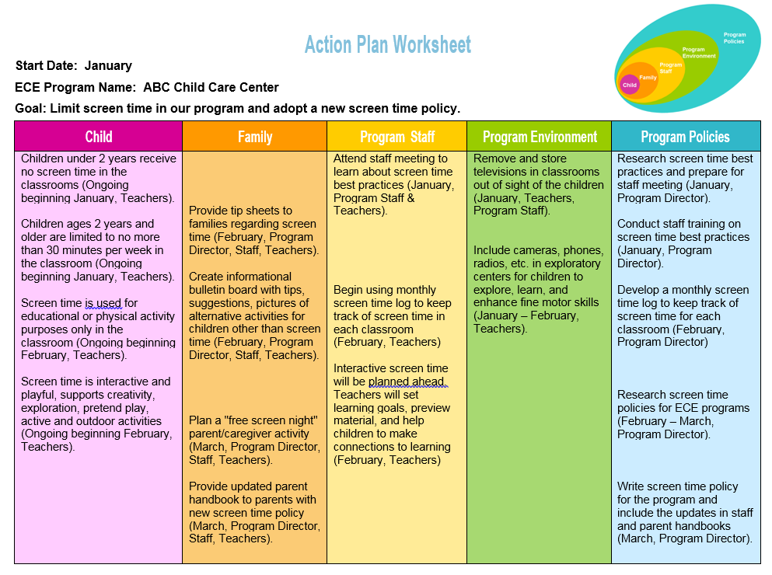
Notes:
Note: Have participants turn to the sample Action Plan in the Participant Handbook. Participants will have now fully completed their action plans, but this is an example of a Screen Time Policy Action Plan.
Remember: This is just an example policy. Goals from Action Planning could be around any of the areas introduced in LS1 including:
Healthy eating and beverages;
Physical activity;
Screen time; and/or
Breastfeeding support.

Slide 40
Notes:
Review the programs’ completed Action Plans. Have them identify what items have been completed and those that they are still working on. Explain that continuing the change process takes time. Use the following questions to facilitate the discussion:
Did the participants learn something from completing the Action Plan?
What were some of the challenges the participants faced while completing the Action Plan?
Were there any action steps that they were not able to complete? Which ones and why?
Were all individuals who were responsible for each task complete it?

Slide 41
Notes:
Note: Divide the participants up into two groups with their assigned trainer. Use this as an opportunity to provide the programs with a blank Action Plan Worksheet and have them complete the first three columns. Explain that this is an opportunity to set another goal based on the 5 improvement areas identified in Learning Session 1. If all improvement areas have been completed, use the post Go NAP SACC results to develop a long-term plan. Participants should be setting goals after the project is over. It may be a good idea to have additional blank copies of the Action Plan Worksheet available to those participants who would like to create a plan for multiple goals. This will allow those programs to continue to use this as a guide to continue to make healthy changes in their program.

Slide 42
PPT Part E: National, State, and Local Support
Notes:
If possible, invite “National, State, and Local Support” segment presenters to attend the storyboard presentations to make a direct connection with the organization or initiative and the ECE program’s role. Feel free to add slides for local agencies that are relevant to your state.
Use this segment to invite guests from various organizations to speak to participants about ways the organization can support ECE programs to meet their Action Plan goals. Some organizations/programs include the:
Cooperative Extension Service;
Supplemental Nutrition Assistance Program-Education (SNAP-Ed)
Expanded Food and Nutrition Education Program (EFNEP)
Local health department or hospital initiatives (i.e. BreastFeeding Friendly Hospitals);
Special Supplemental Nutrition Program for Women, Infants, and Children (WIC);
Child and Adult Care Food Program (CACFP);
Head Start Health Specialists (i.e. nurse and/or registered dietitian);
Child Care Health Consultants;
YMCA or other health facilities;
Farm to Preschool;
Quality Rating and Improvement System (QRIS); and
Licensing.
Note: Distribute a list of local contacts for organization or program mentioned above. Include the contact’s name, title, phone number, and email address.
If presenters are unavailable, use the following slides to introduce each organization/program. Please include contact information for the local agency or representative for each organization.

Slide 43
Supplemental Nutrition Assistance Program-Education (SNAP-Ed)
What is it?
How can it help me?
Program that supports nutrition education for eligible participants
State regulated
Educates and encourages participants to make healthy food choices
Provides information, training, and additional resources
Encourages participation in food and nutrition assistance programs
Provides parent education
Offers tools and resources to distribute to families
Encourages partnerships with community organizations
Notes:
Note: Please include your local agency or representative’s contact information.
The Cooperative Extension Service (CES) is an informal educational opportunity where “Extension Agents” go into the community to educate residents on evidence-based research surrounding several topic areas. CES houses the Supplemental Nutrition Assistance Program-Education (SNAP-Ed) as well as the Expanded Food and Nutrition Education Program (EFNEP).
The SNAP-Ed connection is an online tool that provides information, training and additional resources that supports and promotes healthy eating. Additionally, the site offers lesson plans, curriculums, and professional development trainings.

Slide 44
Expanded Food and Nutrition Education Program (EFNEP)
What is it?
How can it help me?
Program designed for individuals with limited resources in acquiring the knowledge, skills, and attitudes useful in establishing nutritious diets
Offers programs including
Adult EFNEP
Youth EFNEP
Program Delivery
Offers workshops to educate families on:
Food safety
Nutrition
Physical activity
Buying food on a budget
Provides tools and resources to help individuals and families lead healthier lives
Notes:
Note: Please include your local agency or representative’s contact information.
The Expanded Food and Nutrition Education Program offers programs targeted towards specific audiences:
Adult EFNEP: this program assists adults in learning to make nutritious food choices, buying and selecting appropriate foods, and learning skills in food production, preparation, storage, safety and sanitation.
Youth EFNEP: this program provides nutrition enrichment in various settings, with lessons on food safety, food preparation, nutrition, and physical activity.
Program Delivery: this program provides on the job training to those in the program.

Slide 45
Women, Infants, and Children (WIC)
What is it?
How can it help me?
Program that provides nutritious foods, education and counseling, screening and referrals to participants
Target population are low income, nutritionally at risk pregnant women, breastfeeding and non breastfeeding women post-partum women, infants and children
Provides funds for women and children for supplemental nutritious foods
Offers one-on-one nutrition counseling to participants
Provides referrals to other health and social services if needed
Notes:
Note: Please include your local agency or representative’s contact information.
The Special Supplemental Nutrition Program for Women, Infants, and Children (WIC) program is designed to provide services to low-income and nutritionally at risk participants. These services include providing nutritious foods, nutrition education and counseling, and screening and referrals to eligible participants.
Target Population:
Pregnant women are provided services during their pregnancy and up to six weeks after they have given birth;
Breastfeeding women are provided services up until the infants first birthday;
Non-breastfeeding, post-partum women are provided services up to six months after birth;
Infants are provided services up until their first birthday; and
Children are provided services up until their fifth birthday.
Participants eligibility is based on residential, income, and nutritional risk requirements.
Residential: indicate that the participant must live in the state in which they are applying for services;
Income: participants must have income at or below an income level standard established by the local state agency; and
Nutritional Risk: participants must be seen by a health professional who indicated that the individual is nutritionally at risk.

Slide 46
Child and Adult Care Food Program (CACFP)
What is it?
How can it help me?
Federally-funded program administered by the State
Provides partial reimbursement for meals for infants and children enrolled in ECE programs who serve children in low-income areas
Save money on food purchased for meals
Receive resources on nutrition and healthy eating
Supports healthy child development
If feeding a mother’s breast milk, CACFP participating programs can receive a reimbursement
Notes:
Note: Please include your local agency or representative’s contact information.
CACFP is a federally-funded program administered by every State. It provides nutritious meals and snacks for low-income children through ECE settings.
The federal government provides guidelines to determine income eligibility for CACFP participation based on poverty level.
All meals and snacks must meet the meal pattern requirements for children. There are also meal patterns specific to infants. Expressed breast milk is reimbursable IF fed to the infant by a child care provider.
In addition to the CACFP guidelines, some state’s have provided their own supplemental or suggested additional standards. To ensure you’re complying with state regulations, visit the CACFP State agency’s website.
Note: Explain that even if participants’ programs do not participate, it is best practice to at least align meal patterns and serving sizes with CACFP guidelines.
The “Nutrition and Wellness Tips for Young Children: Provider Handbook for the Child and Adult Care Food Program,” distributed in Learning Session 2, contains recommendations to improve program meals served in the ECE program as well as physical activities that can be incorporated.

Slide 47
Quality Rating & Improvement System (QRIS)
What is it?
How can it help me?
Standards that are designed to assess, improve, and communicate the level of quality of ECE programs and communicate ratings to the public
Standards can be county- or statewide
Uses a rating scale to assess level of quality
Increase the quality of your program
Potentially receive incentives for participation
Save costs through enrollment in financial assistance programs
Have continued support through technical assistance
Notes:
Note: Please include your local agency or representative’s contact information.
QRIS is used in all states to help increase quality early care and education (ECE) programs. The standards are used to enhance the development and provide support to ECE programs. Many states offer assistance to those programs enrolled in QRIS.

Slide 48
Child Care Aware of America
What is it?
How can it help me?
An agency that works with state and local Child Care Resource and Referral agencies (CCR&R) to ensure that all families have access to affordable child care and assistance to locate them
Increase enrollment
Provide staff training
Assist in developing a business and management plan
Serve as a marketing tool
Notes:
Note: Please include your local agency or representative’s contact information. Add in a slide about your local CCR&R.
Child Care Aware of America is the National agency of Child Care Resource and Referral. This agency provides useful tools and resources for providers, parents and families. Child Care Aware helps families learn about quality child care programs and how to locate them.
Additionally, it works to improve early learning by:
Promoting national policies;
Collecting, analyzing and reporting current child care research; and
Providing information about parenting and child care to families.
CCR&R’s are available on both state and local levels.

Slide 49
Licensing Regulations
What is it?
How can it help me?
A set of minimum guidelines regulated by the state that monitor the health and safety of licensed:
Child care programs
Family child care
Community based programs
Faith based programs
Head Start programs
Supported by the state
Maintain a child care license when in compliance
Provides technical assistance
Informs parents of requirements that must be met
Notes:
Note: Please include your local agency or representative’s contact information. Distribute copies of the state’s licensing regulations to promote discussion among the participants as to which, if any, regulations support health and nutrition, physical activity, and breastfeeding support. Encourage participants to share their regulations with their parents and program staff.

Slide 50
Early Intervention Programs
What do they do?
How can it help me?
Designed to address the educational and developmental needs of very young children with disabilities and those experiencing developmental delays
Provides free developmental evaluations of children under three
Provides support to children with developmental delays
Assists in finding special educational services for children
Works with families to provide resources and support
Provides resources and training to staff
Notes:
Note: Please include your local agency or representative’s contact information.
Early intervention services are provided for infants and toddlers with developmental delays or disabilities. These services are typically housed in the Department of Education and focus on helping eligible babies and toddlers learn basic developmental skills. Some local agencies may also provide additional services to support family members. These services assist them in understanding the special needs of their child that are being addressed.
Examples of early intervention services are:
Assistive technology;
Audiology or hearing services;
Medical services;
Speech services;
Nutrition services;
Physical therapy; and
Psychological services.

Slide 51
Part F: Professional Development Activity
Notes:
Have the guest speaker from this morning conduct an activity with the participants or have two guest speakers for this Learning Session – one for the “National, State, and Local Support” segment and the other to conduct an activity for the “Professional Development Activity” segment.
Example: Invite Master Gardeners from the Cooperative Extension Service to present on the services they offer in the community and have them conduct an activity on how to start a container garden.

Slide 52
Check-Out
Notes:
Note: Distribute the National Early Care and Education Learning Collaboratives completion certificates.
Use this time as an opportunity to reflect with the participants on today’s Learning Session and the project as a whole. Congratulate participants on their dedication to making healthy changes within their programs and encourage them to continue to set goals for themselves and the program.

Slide 53
Trainer Contact Information
Notes:
Insert your contact information.

