Slide 1
Insert trainer information here
Notes:
Welcome to the Healthy Kids Healthy Future Physical Activity Learning Session. We call this program PALS.
Thank you for sharing your time with us today to learn more about how early care settings can support young children to become more physically active.
For virtual training:
Review how to use the features of the meeting platform.
Where are chat buttons?
How to mute and unmute?

Slide 2
Notes:
A special thank you to these organizations and people who helped successfully develop this training.

Slide 3
Nemours Children’s Health is currently funded by the Centers for Disease Control and Prevention (CDC) under a 5-year Cooperative Agreement (6NU38OT000304-01-02). Through this effort, we support statewide early care and education (ECE) organizations to integrate best practices and standards for healthy eating, physical activity, breastfeeding support, and reducing screen time in ECE systems and settings.
The views expressed in written materials or publications, or by speakers and moderators do not necessarily reflect the official policies of the Department of Health and Human Services. Any mention of trade names, commercial practices, or organizations does not imply endorsement by the U.S. Government.

Slide 4
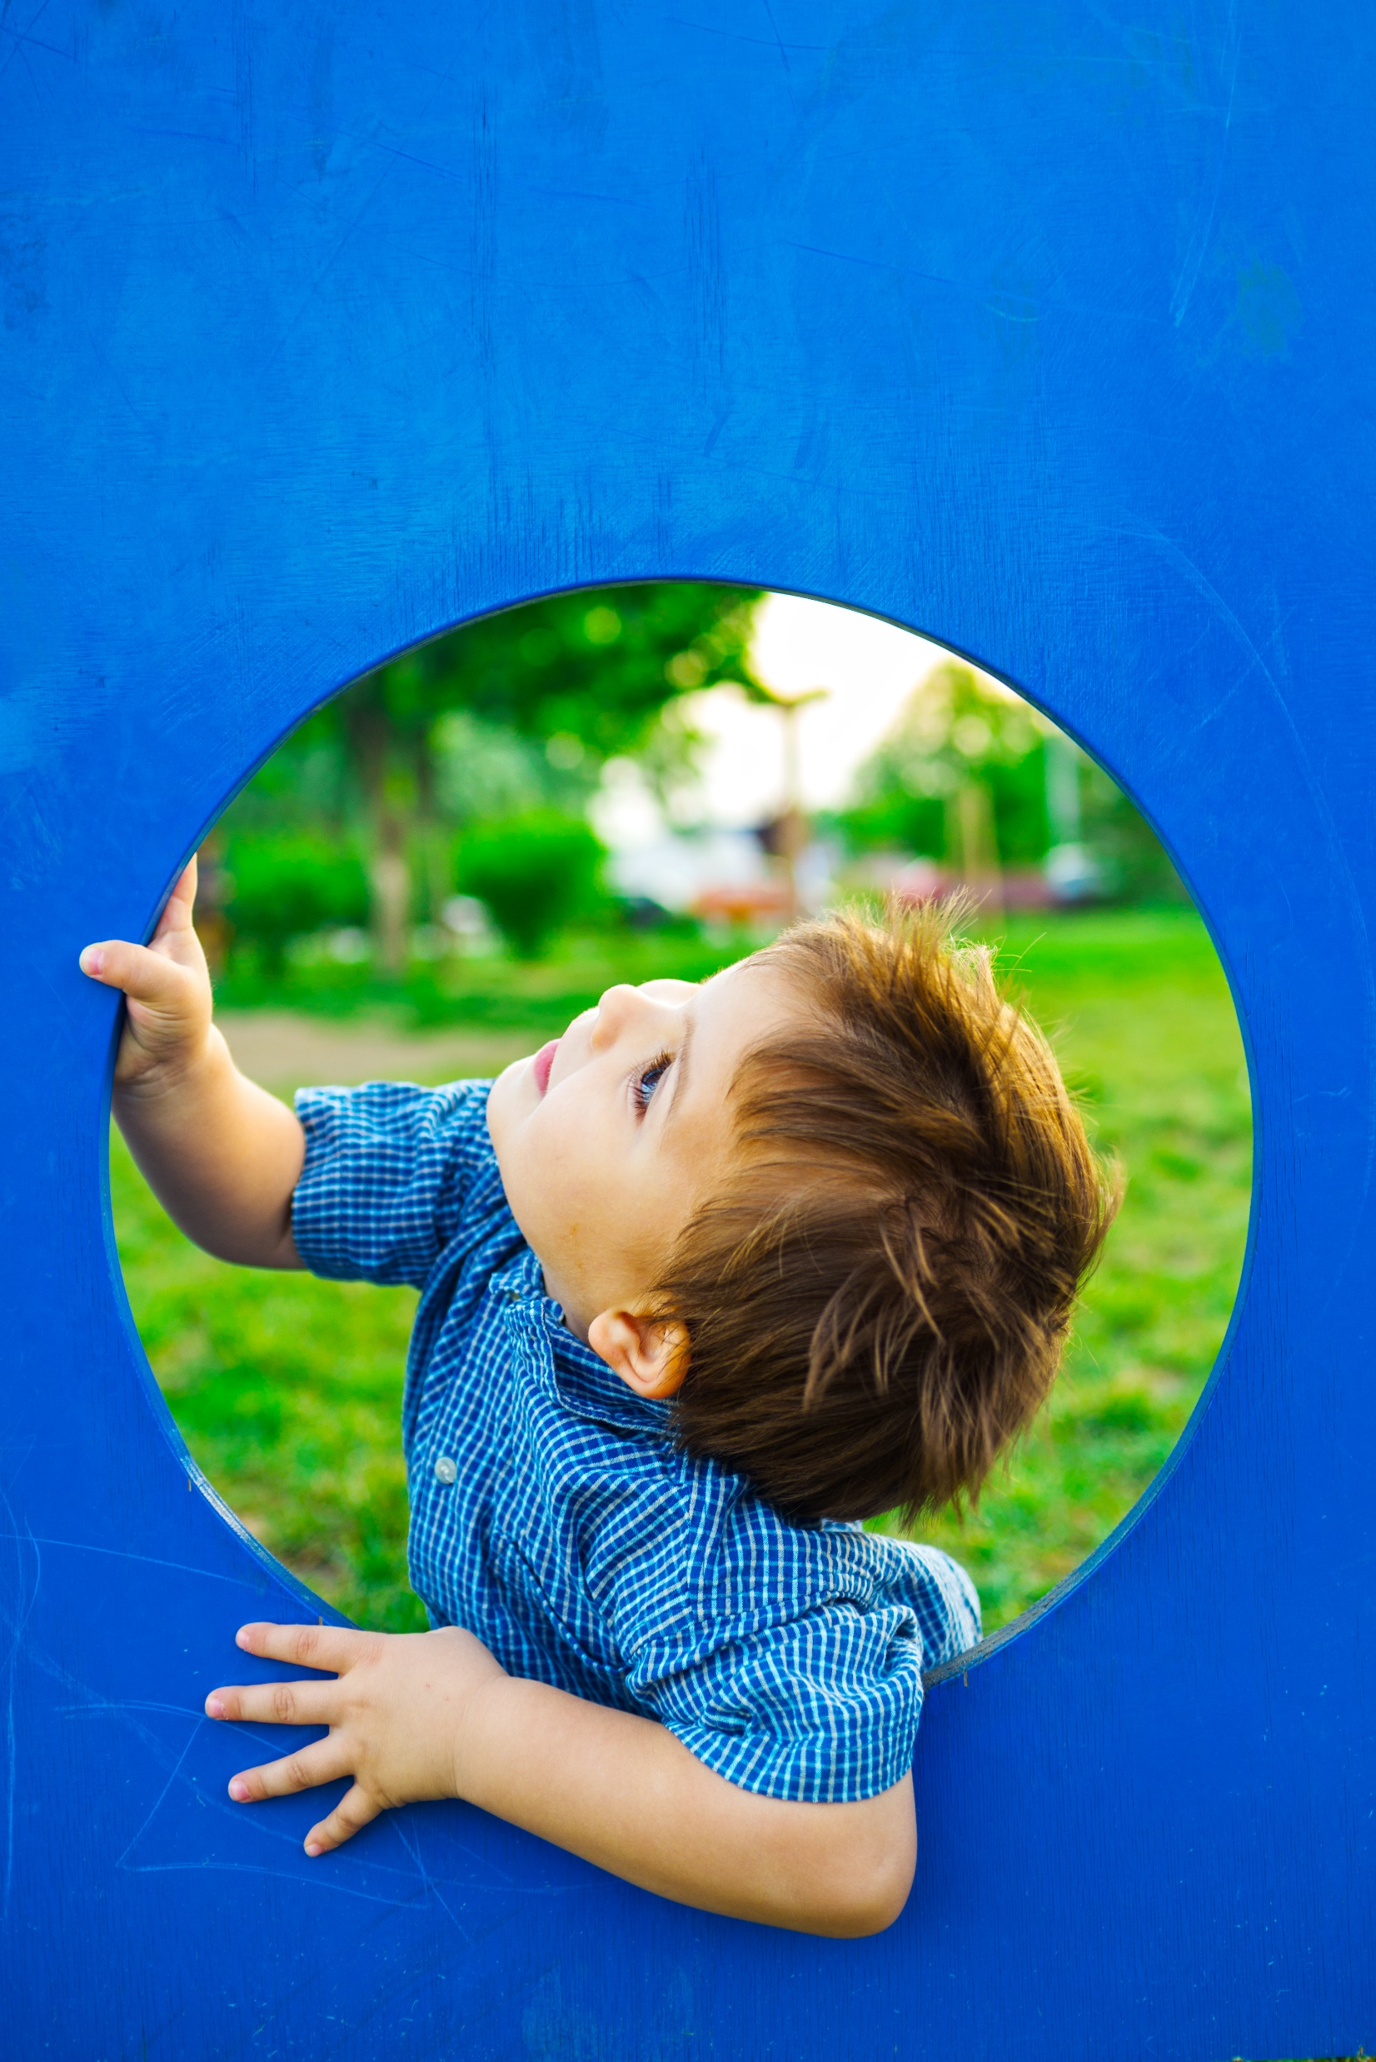
What is PALS?
A series of learning sessions focused on physical activity
Notes:
PALS is a series of 5 learning sessions focused on physical activity.
In these trainings you will learn best practices of physical activity in early care settings. The trainings will explain how ECE providers help children from birth to 5 become physically more active.The training will help you use best practices throughout your day to give children in your care the best physical activity experiences.
Trainer notes: Housekeeping
If available, share dates for future sessions.
Set ground rules or groups norms.
Have participants add suggestions to a white board or the chat

Slide 5
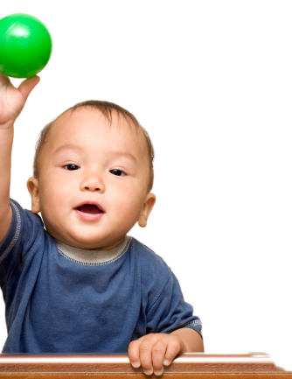
What will you learn from PALS?
After training, you will be able to:
Recognize how important physical activity is for infants, toddlers, and preschool children
Identify the role of early care and education (ECE) providers in promoting physical activity for children birth to 5
Develop skills to follow best practices of physical activity in ECE settings
Notes:
PALS focuses on the best practices for physical activity for children birth through 5 years of age.
We will cover:
How to support physical development in young children,
Your role as an ECE provider, and
How to communicate with families about the best practices for physical activity.

Slide 6
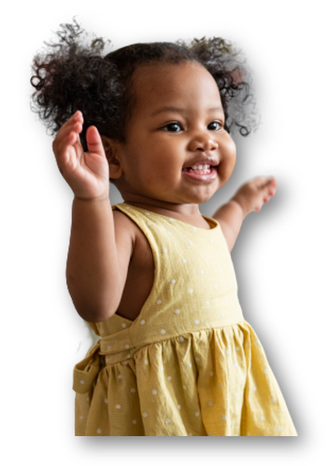
What will you learn from PALS?
After training, you will be able to:
Communicate with families about their children’s physical activity
Set policies that follow best practices for physical activity in Early Childhood Education settings
Identify opportunities for change and develop an action plan
Notes:
During our session, you will develop an action plan that focuses on physical activity.
Think about how you might want to improve your work environment so that you can better support children’s physical activity experiences.

Slide 7
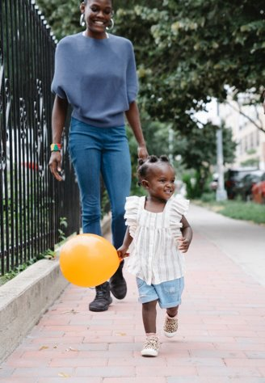
Recognize that physical activity is important for infants, toddlers and preschool children
Notes:
Today's content will focus on our first objective: Recognize the importance of physical activity for infant, toddler and preschool children.
Physical activity (PA) is important for children’s health and many other areas of child development.
We probably all have memories of physical activity from our childhood. These might have been times when we actively played with the adults in our lives, spent time outdoors in nature, chased balls, or rode bikes.

Slide 8
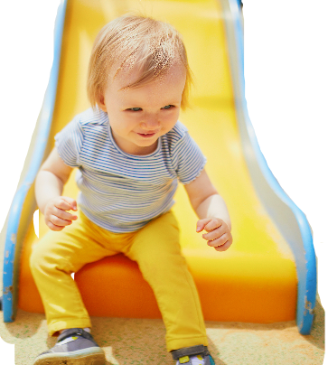
What memory do you have of physical activity from your childhood?
Notes:
Icebreaker suggestions:
Have each person introduce self and share their memory.
Break participants into groups of 4. Use breakout rooms on virtual platforms. Allow 7-10 minutes for group sharing. Debrief the activity by asking for a few volunteers to share to the large group.
Highlight 1 or 2 concepts from memories shared and link them to other areas of development and learning.
Examples: Successfully playing with large groups of neighborhood children promotes social-emotional growth. They negotiate rules, collaborate to achieve goals and develop relationships.
Pretend or imaginary play promotes thinking, conversation and problem solving.
Creative play to make forts, tunnels or castles promotes building, math and engineering skills.
Repeatedly playing games such as kickball supports the mastery of gross motor skills such as kicking.
Games such as jump rope and double-dutch require skill and timing but also promote working memory to remember chants.

Slide 9
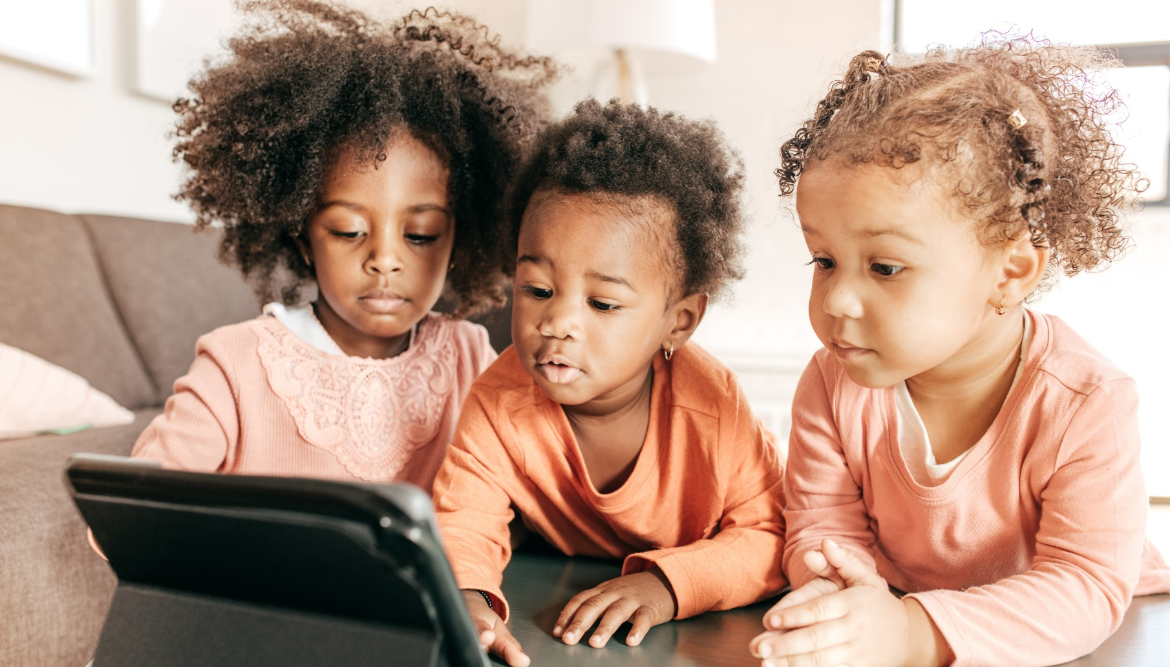
Let’s review self-assessments
Notes:
We will start with a self-assessment.
The Nemours Wellness Workbook serves to help early childhood providers, families and communities work together to raise fit, happy children. Child care providers and other early childhood professionals can use this workbook to develop their own wellness policies. This tool looks at multiple program areas including Infant Nutrition, Child Nutrition, Physical Activity, Screen Time, Family Engagement, Provider Education and Staff Wellness. We will use the physical activity portion of the tool today.

Slide 10
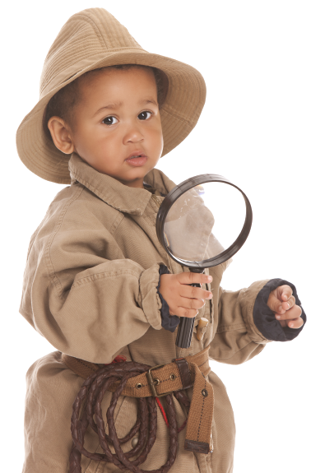
Why do one?
Self-assessments help:
Identify strengths and weaknesses of your program
Think about program practices
Compare your practices with best practice standards
Guide you as you develop policies and an action plan
Remind you to keep checking and improving
Notes:
Self-assessments can help you identify your program’s strengths and areas that need improvement.
Self-assessment results will show how your current practices relate to best practices.
They will direct you to possible changes so you can strengthen what you do.

Slide 11
The self-assessment tool for Infant & Child Physical Activity
As you fill it out:
Think about your role in your program
Answer from the viewpoint of the full program or a specific classroom
Identify at least 1 best practice that is a strength and 1 that needs improvement
In Session 2, we’ll discuss strengths and areas of improvement
Notes:
For this activity:
Have participants complete the physical activity questions from the Nemours Wellness Workbook.
Give participants about 15-20 minutes to answer the questions.
Explain that they will not submit the self-assessment but will use it to guide their action planning during training.
After completing the tool, encourage participants to consider 1 self-assessment question that is a strength for them and 1 that is an area of improvement.
Additional options for facilitating the self-assessment during PALS include:
Creating small groups by classroom or program.
Leading a large group discussion working through each of the questions.

Slide 12
Let’s talk about Your Self-Assessment
What best practices are you already doing?
What are the biggest challenges for implementing best practices in your program?
What surprised you when you filled out the self-assessment?
Notes:
Trainer notes: Have the large group discuss their findings.
The self-assessment asked you to reflect on how your practices, environment and equipment compared to the best practices for physical activity in ECE Settings.

Slide 13
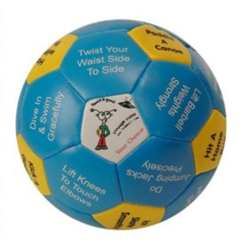
Activity break!
Notes:
Trainer notes: The thumb ball is in the trainer resource kit. If you do not have one, use a permanent marker to write activities on an inflatable beach ball. Suggested activities are:
Balance on 1 foot with hands above head
Flap your wings like an eagle
Ice skate
Swing a baseball bat; hit a home run
Row a kayak
Skip and smile
March like a soldier
Hope like a bunny
Back stroke
Swing a golf club
Directions::
Have participants stand in place, make eye contact with someone, and toss the ball to that person.
When the ball is caught, that person reads aloud and acts out the activity under their thumb. Then the entire group copies the movement.
Depending on group size, allow each person to catch the ball and conduct a movement activity.
At the end, discuss the skills used when engaging in the movement provided on the ball.
What did you notice about how you communicated when tossing the ball?
What happened to the atmosphere in the room as the game continued?
How could you use this activity with young children?
For virtual trainings ask participants to stand and do the following balance postures with you:
Stand on your toes, arms stretched straight overhead
Stand on one leg, the other leg bent at the knee, arms out sideways like wings
Stand on the other leg, arms out sideways like wings, bend forward at the waist and lift leg behind
Using heel to toe walking, walk along an imaginary line with arms out sideways
At the end, discuss the stability skills used when engaging in the movements.
How could you use this activity with young children?
How would you adapt activities for children based on geographic location or culture?

Slide 14
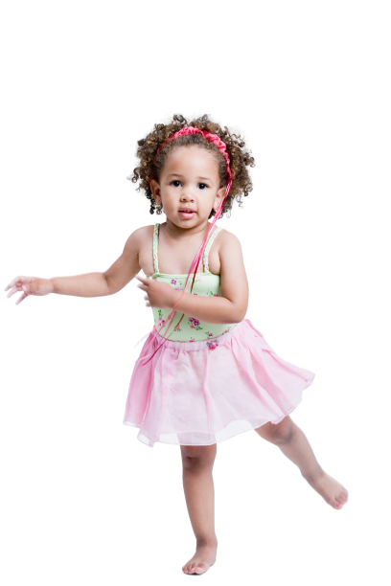
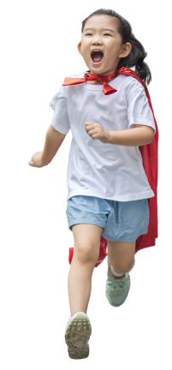
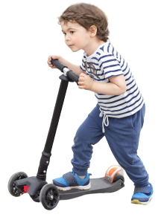
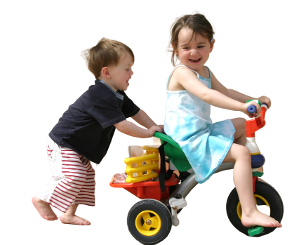
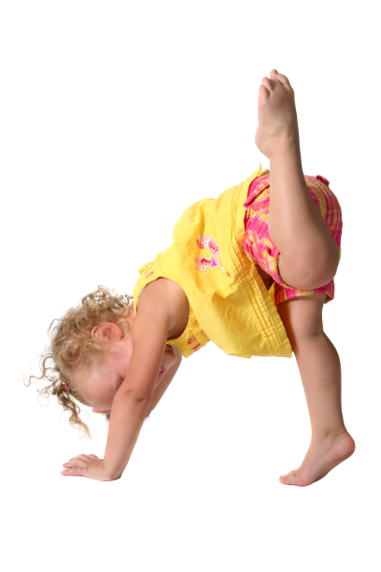
Physical activity and active play
Physical activity
Any movement of the body made by muscle effort that uses energy above the normal resting level
Active play
Large muscle (gross motor) or whole-body movement where children use energy to play in an unstructured and fun way of their choosing.
An age and developmentally appropriate way that young children are physically active
Notes:
Physical activity and active play are terms used in the early childhood field.
Active play involves large muscles. During active play, children’s heart rate increases, and they may breathe deeper.
Toddler and preschool active play involves large muscle movements that allow children to be able to run, skip, hop, and jump without limitations.
Basal level refers to the energy level the body spends in basic functions like breathing, circulating blood and digesting food.
Sources:
1. U.S. Department of Health & Human Services. (2018). Physical Activity Guidelines for Americans. https://health.gov/sites/default/files/2019-09/Physical_Activity_Guidelines_2nd_edition.pdf
2. Truelove S, Vanderloo LM, Tucker P. “Defining and measuring active play among young children: A systematic review.” Journal of Physical Activity & Health. 2017;14(2):155-166.

Slide 15
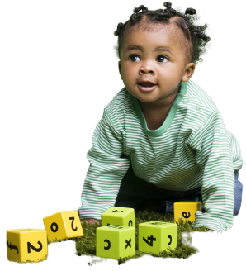
Active play looks different in infants
Active play for infants includes:
Moving and lifting the head
Kicking and reaching during tummy time
Reaching and grasping for toys
Crawling

Slide 16
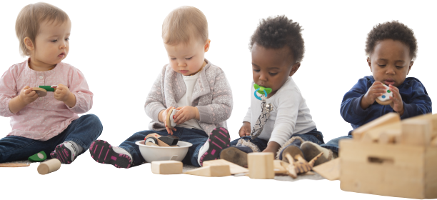
What are the benefits of physical activity?
Physical activity develops:
Cognitive skills
Gross motor skills
Social-emotional skills
Notes:
In addition to developing strong muscles and bones, physical activity helps in these ways:
Cognitive development -
Physical activity improves cognitive development, socialization, and attention in young children. It stimulates brain function and gives them a way to navigate their environment and practice skills such as working together, following instructions, and resolving conflicts.³
Gross Motor skill development –⁴
Engaging in ample physical activity gives children practice needed to achieve milestones of motor development such as crawling, creeping, standing, walking, balancing, climbing, and running. Physical activity promotes developing core muscles in the abdomen and back. Children need core muscles to sit with good posture. Good posture is essential to developing fine motor skills like moving a crayon or pencil and writing.
Social-emotional development –
Active play positively affects developing self regulation and managing behavior and emotions. During play children negotiate rules and modify behaviors to conform. During physical activities children make important decisions about how they feel about themselves, their bodies, and movement including:
Do I enjoy being physically active?
Am I good enough at physical activities?
Do I choose to be physically active when I do not have to be active?
Children must enthusiastically answer YES to these questions. Only when they enjoy and feel reasonably successful doing physical activities will they continue to be physically active. During physical activities they can practice sharing, taking turns, and helping each other. When children (and adults) exert themselves physically – especially if they are having fun – they can reduce stress and begin to relax. ⁵
Sources:
3. Khan, N.A., Hillman, C.H. “The relation of childhood physical activity and aerobic fitness to brain function and cognition: a review.” Pediatr Exerc Sci. 2014;26:138–146.
4. Yogman M, Garner A, Hutchinson J, et al; AAP Committee on Psychosocial Aspects of Child and Family Health, AAP Council on communications and media. The Power of Play: A Pediatric Role in Enhancing Development in Young Children. Pediatrics. 2018;142(3):e20182058.
5. Williams SE (2018) “Importance of active play.” J Child Obes S2-001.

Slide 17
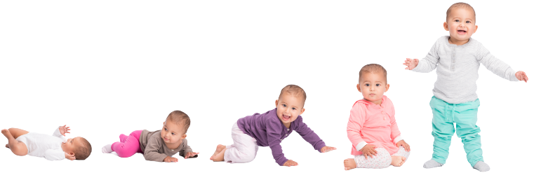
What are the stages of development?
Young Infants (0-8 months)
Focus on security and completely depend on adults
Mobile Infant (6-18 months)
Focus on movement and exploration
Toddler/Twos (16-36 months)
Focus on identity
Preschool (3-5 years)
Focus on independence
Notes:
Each stage of early childhood has distinct characteristics. You may notice how some characteristics are displayed in active play. Not all children will progress through the stages at the same pace, reflecting the natural variation in development.
Security is the focus on the young infant stage. The young infant is completely dependent on adults for its care, building trusting relationships with caregivers.
In the mobile infant stage babies focus on exploration. As motor skills continue to develop, infants focus on movement and exploring the environment. Mobile infants do not completely depend on adults and have some ability to act with more intention.
The toddler/twos stage focuses on identity. Toddlers begin to separate from the adults who have been critical for survival and development. Acquiring motor skills enables toddlers to do more on their own.
Preschoolers are increasing their independence as they see the world through their own eyes. They think in literal terms rather than through reasoning and logic. Preschoolers learn through their whole bodies as they taste, smell, watch, listen, touch, and move to explore with wonder their expanding world.

Slide 18

How does the brain develop in young children?
Brain development is how the brain grows and creates new connections
Many factors influence early brain development:
  Genetics
  Responsiveness of caregivers
  Daily experiences
  Nutrition
  Environment
  Physical activity
Notes:
Our brains begin developing prenatally and continue throughout our lives.
Infants are born with all neurons they will have for life. They spend the early years making connections between these neurons.
These connections are shaped by both genetics and experiences and are strengthened and solidified through repetition. Dependable, nurturing interactions with adults enhance developing connections.
Regular physical activity enhances brain development. Physical activity affects the brain in many ways:
It increases heart rate, pumping more oxygen to the brain.
It aids the release of hormones, improving the environment for the growth of brain cells.
It promotes brain plasticity by stimulating growth of new connections between cells in many important cortical areas of the brain.

Slide 19

Video:
The Developing Brain
Notes:
Trainer notes:
Videos can be assigned as pre-work. Before playing the video ask participants to listen for information on repetition.
https://developingchild.harvard.edu/science/key-concepts/brain-architecture/
After watching the video, lead discussion.
Sample questions:
The video talks about the importance of repetition in forming pathways in the brain. What have you noticed in your work with young children about experiences and repetition? How does repetition support developing motor skills?
The video discusses how neurons link areas of the brain controlling motor skills, language, memory, vision, emotion and behavior. In the children you care for, how do you see motor skills linked to child development?
Source:
6. Center for the Developing Child at Harvard University. (2011, September 29). Experiences Build Brain Architecture [Video]. YouTube. https://www.youtube.com/watch?v=VNNsN9IJkws&t=9s

Slide 20
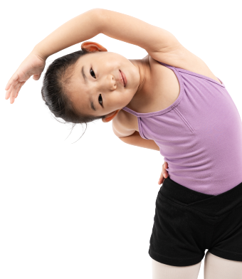
What are the cognitive benefits of physical activity?
Exercising often and vigorously and learning new motor skills benefits children’s brain function
Physical activity supports children’s learning by increasing:
  Attention
  Alertness
  Memory
Regular and sustained physical activity helps with children’s executive control including:
  Cognitive flexibility (problem solving)
  Inhibitory control
Notes:
Physical activity “improves learning on three levels:
First, it optimizes your mind-set to improve alertness, attention, and motivation;
Second, it prepares and encourages nerve cells to bind to one another, which is the cellular basis for logging in new information
third, it spurs the development of new nerve cells from stem cells in the hippocampus.”⁷
Inhibitory control involves the ability to focus on important stimuli when irrelevant stimuli are present.
Examples: The ability to listen and respond to a teacher’s instructions in a noisy classroom or to override strong but inappropriate behavioral tendencies. Inhibitory control is evident in some games such as Simon Says where children resist responding to every command and listen for specific cues.
Sources:
7. Ratey JJ. Spark: The Revolutionary New Science of Exercise and the Brain. Little, Brown Spark; 2013:45.
8. Khan, N.A., Hillman, C.H. “The relation of childhood physical activity and aerobic fitness to brain function and cognition: A review.” Pediatr Exerc Sci. 2014;26:138–146

Slide 21
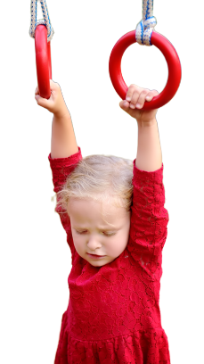
Gross motor skill development involves movement of the large muscles in the arms, legs, or the entire body
For infants and toddlers, gross motor skills include:
  Holding their head up, sitting, standing on their own, reaching, walking and running
For preschoolers, gross motor skills include:
  Jumping, throwing, catching, kicking, balancing and stretching
Notes:
The interactions children have with caregivers, family members, and peers influence motor development.

Slide 22
What are the phases of gross motor development?
Reflexive
Rudimentary
  Before birth to
  months after birth
  Reflex responses:
    Sucking
    Grasping
    Turning cheek to stimulation
  Birth to 18 months
  Voluntary control:
    Holds head up
    Extends arms
    Rolls over
    Sits up
Notes:
Reflexive Movement Phase
Before birth and for the next several months, babies are in the reflexive movement phase. During this phase, primitive reflexive responses determine movements in part. When newborns are stimulated on the cheek, they turn their heads toward the stimulation and seek to suck. If you place your finger in the palm of very young infants, infants tightly grasp it. These are both examples of reflexive movements that gradually disappear as infants mature. Note that there is overlap between the stages.
Rudimentary Movement Phase
This phase is from birth to approximately 1½ years old. Voluntary control of actions is developing in this phase. Children learn to:
hold up the head,
extend arms to grasp release an object,
roll over,
sit up,
crawl (done with the belly on the floor as in a combat crawl),
creep (done up on hands and knees)
pull to a stand.
The rudimentary phase supports moving to the next phase ⎯ the fundamental movement phase.
Source:
9. Gallahue, D.L. & Ozmun, J. (2006). Understanding motor development: Infants, children, adolescents, adults (6 ed). New York: McGraw-Hill.

Slide 23
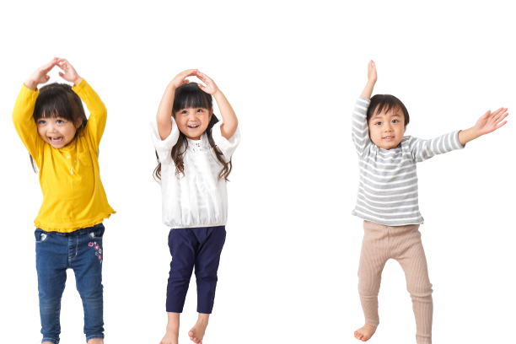
Video:
Fundamental movement skills
Notes:
Trainer notes:
This video displays activities you can do to support children and to develop their fundamental movement skills.
https://www.youtube.com/watch?v=yaF0CaNuUIc
After watching the video, lead discussion about what participants learned.
Source:
10. The University of Western Australia [KID DO]. (2020, January 7). KIDDO: Developing a Child’s Fundamental Movement Skills [Video]. YouTube. https://www.youtube.com/watch?v=yaF0CaNuUIc

Slide 24
What are fundamental movement skills?
Locomotor
Object Control
Stability
Walk
Run
Jump
Hop
Leap
Gallop
Slide
Skip
Ball Roll
Throw
Catch
Kick
Strike
Trap
Dribble
Volley
Axial
Springing
Upright Balances
Inverted Balances
Notes:
Fundamental movement skills are basic movement skills we need daily and for physical activity throughout our lives. These skills typically develop between the ages of 3 and 5 although control and fluidity develop later. They are organized into 3 categories:
We use locomotor skills to move from place to place.
We use object control skills to control an object with either our bodies or an instrument such as a bat, glove or stick.
We use stability to keep our balance when we change position and throughout all daily activities.
When children meet these skills, they can move on to more complex skills that they will use later in life. If children do not learn a movement skill well enough, they may avoid participating in that activity. For example, some adults avoid participating in physical activities because they do not have the skills - such as not participating in a social softball game that involves striking and catching a softball.
While some skills such as rolling over seem to develop naturally, all motor skill development benefits from experience, encouragement, and role modeling. With practice in play children develop increased skill, agility, coordination, and balance.
Knowledge Check: Fundamental Movement Skills Activity
Break participants into 3 groups. Referring to the 3 skill sets, have each group select 1 skill and list examples of how we use it in early childhood, middle childhood, teenage years, young and middle adulthood, and as older adults.
Ask: What activities do you use to support developing stability skills in your classroom?

Slide 25
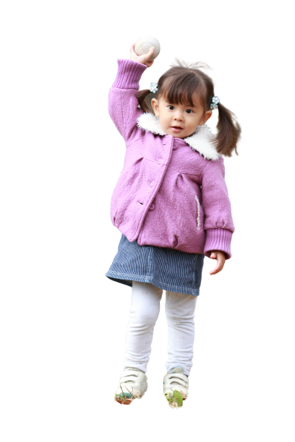
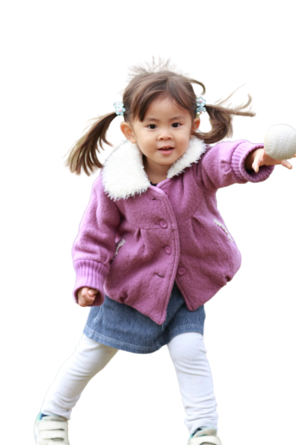
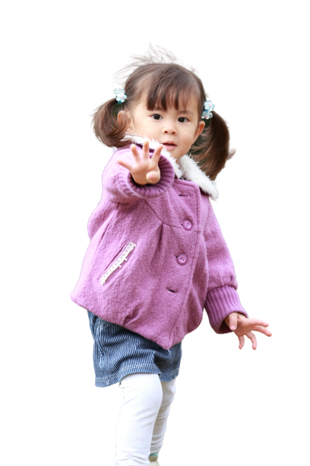
The stages of development for throwing
Initial Stage
Elementary Stage
Mature Stage
A push with one arm, no lower body movement
Face target, step, and throw
Begin with side to target, step in opposition, follow-through
Notes:
Here’s an example of 1 fundamental movement skill. Each skill listed on the previous slides progresses from initial stages to a mature stage. Children must have repeated experiences with a movement skill to develop it or reach a mastery stage.
Trainer notes: Suggested delivery options
Ask participants to stand and follow your directions as you model the initial, elementary and mature stage of 1 motor skill ⎯ the throw.
If training virtually, use the chatbox to check for understanding. Ask participants to show thumbs up or thumbs down if they understand the concept.
The Initial stage of throwing
During the initial stage, attempts to throw look more like a push. Young children isolate the movement in their arm and shoulder. Very young children usually are not yet sufficiently aware of and in control of their entire body, so they isolate movement. The throw resembles pushing the ball toward the target.
Trainer notes: To show this stage, identify and face a target. Repeat the movement of the arm pushing the ball toward the target. Do not move your lower body. Keep your feet and legs parallel.
The Elementary stage of throwing
In this stage, children face the target but step forward with their foot on the same side of the body as their throwing arm.
Trainer notes: Show this stage with a soft ball in hand, but do not throw it at the target. Show the movement several times while asking, “What is not mature about the way I’m throwing?” Draw attention to your feet. Explain that this is a same-sided movement. Throwing in this stage can be successful, but not as much as throwing at the mature stage.
The Mature stage of throwing
In this stage, children stand sideways to the target, instead of facing it. They step forward with the foot on the opposite side of the body from the throwing arm. The arm follows through continually across the body. Typically, children can reach the mature stage of throwing by age 6, 7, or 8. But throwing at the mature stage only happens if children have many chances to practice. Note that the child in the image is not executing the mature stage of the throw as she is stepping forward with the same foot rather than the opposite. Across the images the child is demonstrates throwing with both the Right and Left arms.
Trainer notes: Show this movement several times. Draw attention to the starting position ⎯ the step forward and twist of the trunk during the throw which adds force. Consider asking if anyone who played baseball or softball would be willing to demonstrate.

Slide 26
What is physical literacy?
“Physical literacy is the ability to move with competence and confidence in a wide variety of physical activities in multiple environments that benefit the healthy development of the whole person.”
Mandigo, Francis, Lodewyk, & Lopez, 2012
Notes:
How do we help children learn to move with competence and confidence? By providing children opportunities to practice skills in difference environments and master fundamental motor skills.
To describe physical literacy, we can continue with the discussion of the fundamental object control skill of the throw.
After mastering throwing, children have the muscle memory, motor patterns, and competence to transfer the skill to other situations. They can throw different types of balls such as tennis balls or footballs and likely have the confidence to participate in games involving throwing.
Helping children build all the fundamental skills gives them confidence to participate in sports and games as they get older.
Sources:
11. Mandigo, J., Francis, N., Lodewyk, K., & Lopez, R. (2012). Physical literacy for educators. Physical Education and Health Journal, 75(3), 27–30.6.
12. The Aspen Institute. (2015, June). Physical Literacy in the United States: A Model, Strategic Plan, and Call to Action. https://www.aspeninstitute.org/publications/physical-literacy-model-strategic-plan-call-action/

Slide 27
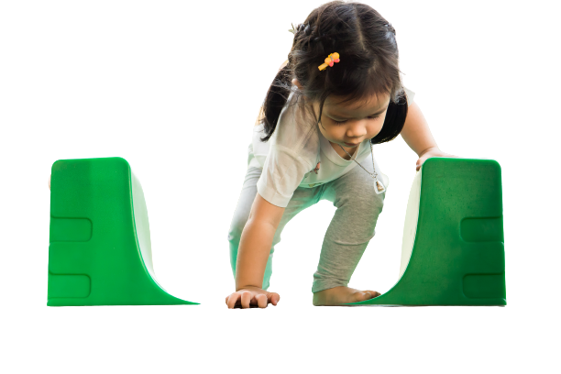
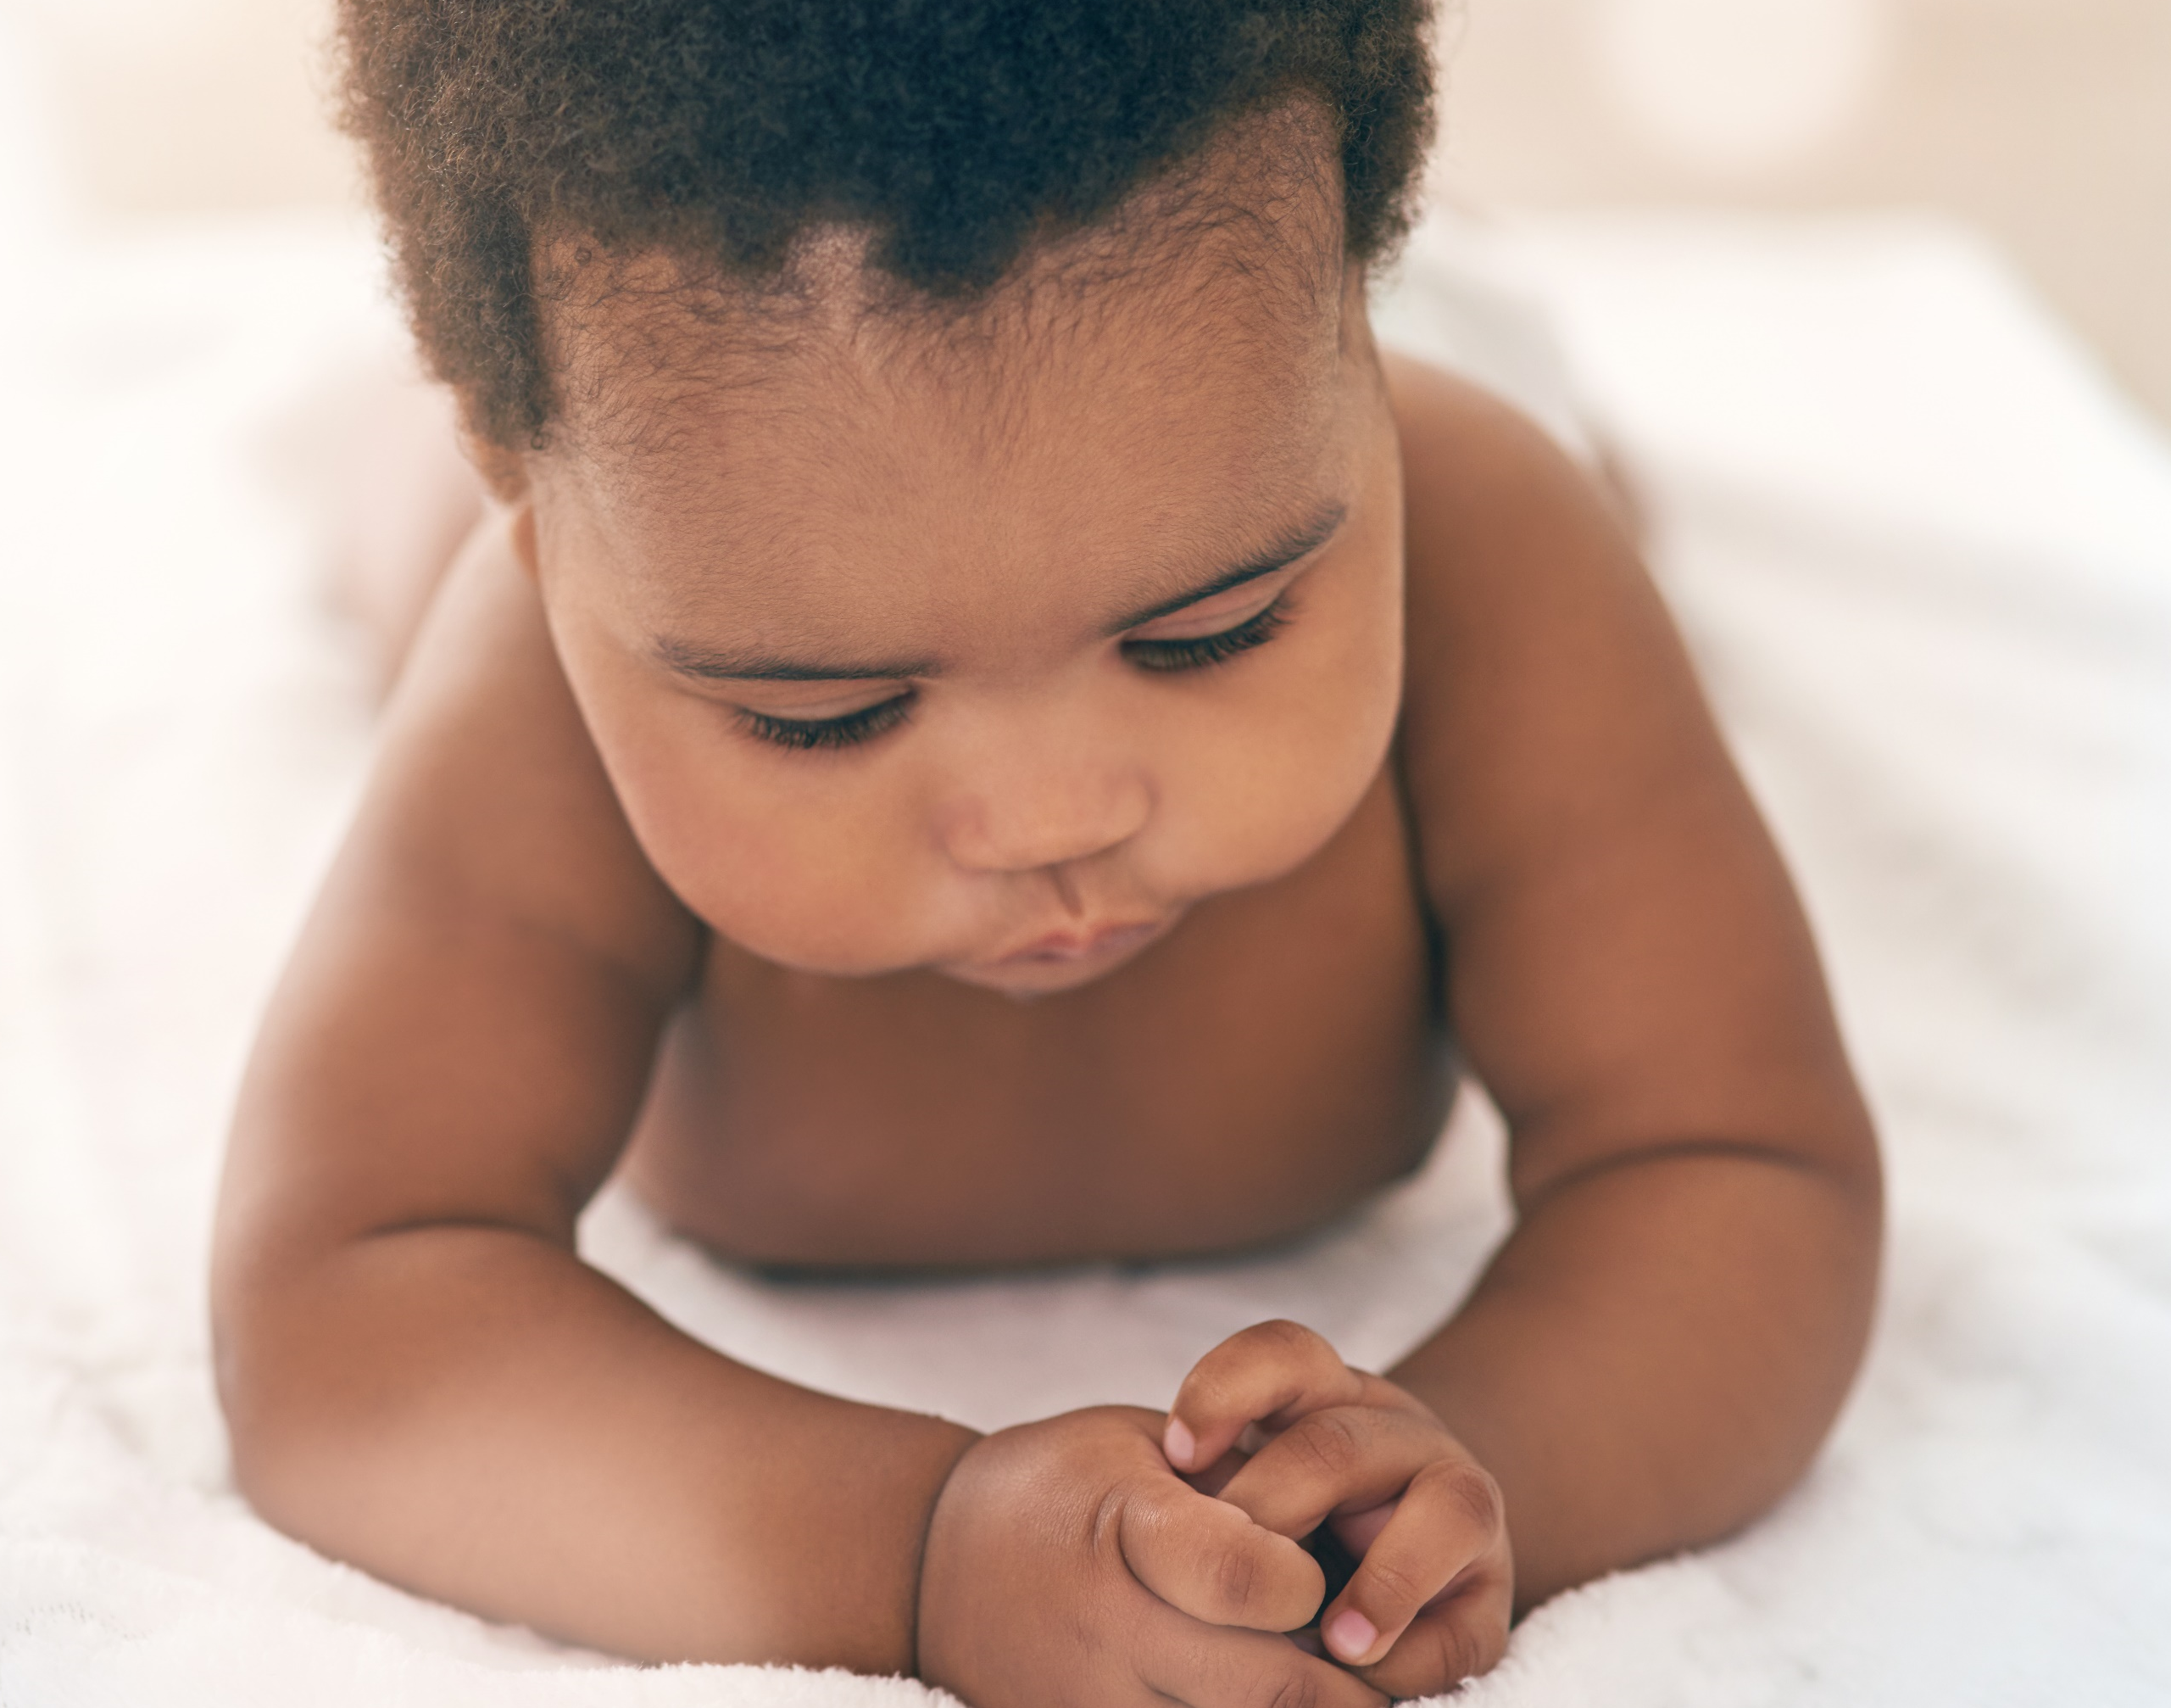
How do you promote gross motor development?
Young and Mobile Infants
Toddlers/Twos
    Encourage physical activity (“tummy time”)
    Place age-appropriate toys out of reach encourage infants to move toward the toys
    Create open spaces for infants to explore
    Provide equipment that allows for safe climbing, crawling, and push-pull activities
    Encourage physical activity at every opportunity
    Allow free play and create open spaces for walking, squatting, climbing, etc.
    Give many opportunities for children to balance, crawl under and around objects, dance, etc.
Notes:
In young infants (0-8 months), adults must give infants opportunities for physical activity and must support both gross and fine motor development. Supporting young infants to sit up allows them to see objects, reach for them, and eventually grasp them—all early fine motor skills.
Once infants are mobile (6-18 months), they are more involved in their own motor development but still need adult help to guide movement and ensure safety.
Movement and Physical Development for 6-Month Olds:
Roll over front to back and back to front
Begin to sit without support
When standing, support weight on legs; bounce
Rock back and forth, sometimes crawling backward before moving forward
Infants must spend most time in situations that offer complete freedom of movement. Get infants out of containers (carriers, car seats, jumpers, swings, etc.) and onto safe, firm surfaces, such as on a blanket on the floor or ground. They must need to repeatedly experiment with and practice simple movements. Only when infants feel joyfully secure in each movement will they be ready to explore the next movement.
To fully meet the motor development milestone to roll over in both directions (front to back, back to front), 6-month olds need the chance to learn to roll over with their head or hips or arms or legs initiating the roll, to roll slowly and quickly, and to roll partially over and stop and then resume rolling. Only when they completely master all these subtle variations will they fully meet this milestone and set a firm foundation on which to explore the next one. Lacking this totally secure ability to roll will hinder infants as they try increasingly complex motor skills.
Promoting gross motor skills in toddlers is typically not difficult, because they are always moving. Giving them chances to channel that movement safely and appropriately is important. Toddlers climb, so give appropriate materials, equipment, and space for them to do so. Physical activity also promotes fine motor development. Doing puzzles and working with other manipulatives starts as more of a gross motor movement (child uses up/down movement of the whole arm to paint on an easel) but with practice, movements become more refined (child eventually uses wrist motion to paint on an easel).

Slide 28
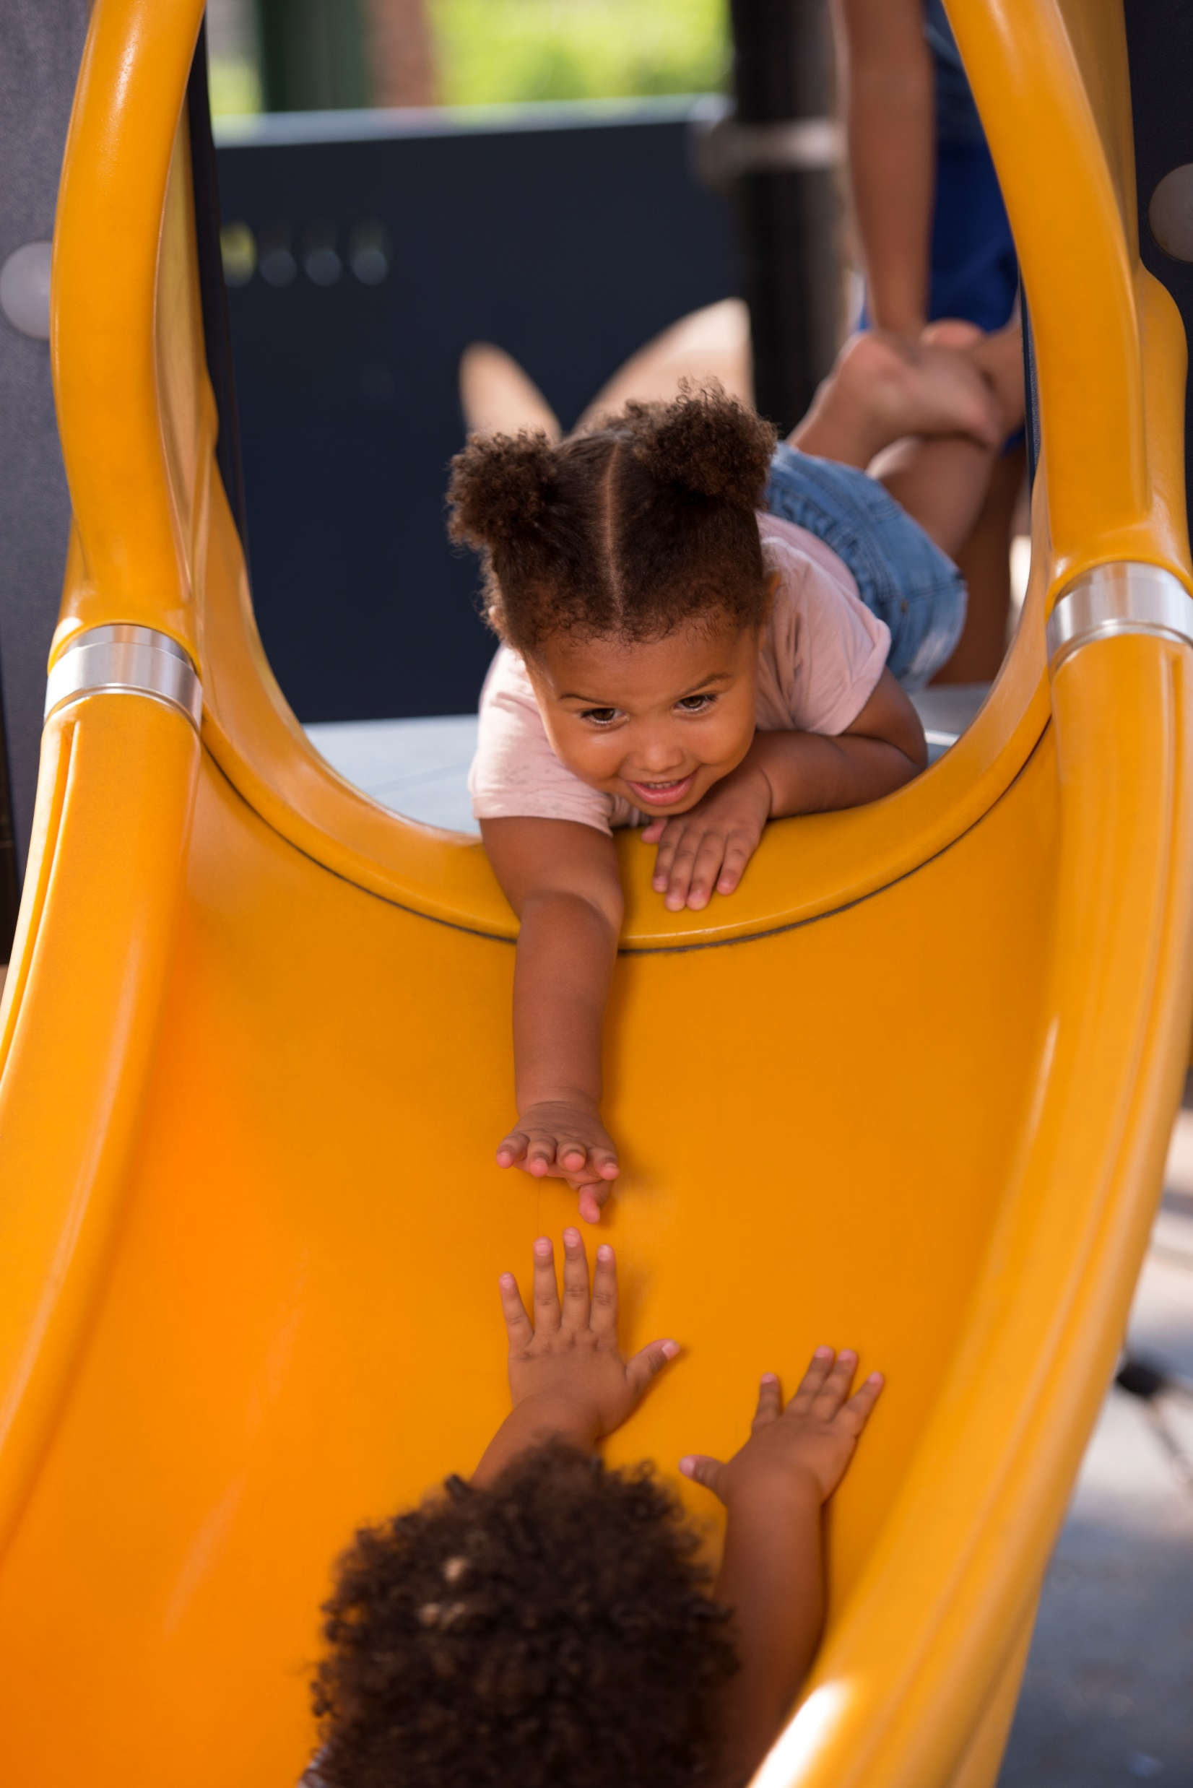
How do you promote gross motor development in preschoolers?
Encourage physical activity at every opportunity
Provide free play and open spaces for running, jumping, climbing, etc.
Give many chances to balance, swing, explore inverted positions, support the weight of their bodies, etc.
Notes:
Movement and Physical Development Milestones for 3-Year Olds:
Climb well
Run easily
Pedal a tricycle (3-wheel bike)
Walk up and down stairs, 1 foot on each step
For preschoolers to meet the motor milestone of “runs easily,” they need many opportunities to practice running. They must develop the muscular endurance and balance to repeatedly push off one foot with force and land with balance on the other. They must learn to run with their right arm swinging forward as they step with their left leg – and alternately with the left arm and right foot.
To move arms and legs in opposition requires extensive practice - first walking then running - to enable their brains to coordinate movements.
To walk up and down stairs while alternating feet requires balance that is results from many opportunities to learn to control their bodies while moving in a variety of circumstances.
Time spent as infants in containers, and as toddlers in highchairs or jumpers, and as preschoolers sitting in chairs does little to prepare young children to meet these motor development milestones.
The task for infants and young children is not just to reach each motor milestone but to totally master it. Repeated practice is vital for them to master each motor milestone. Only then will they have a solid movement foundation on which to find joy and purpose in physical activity.

Slide 29
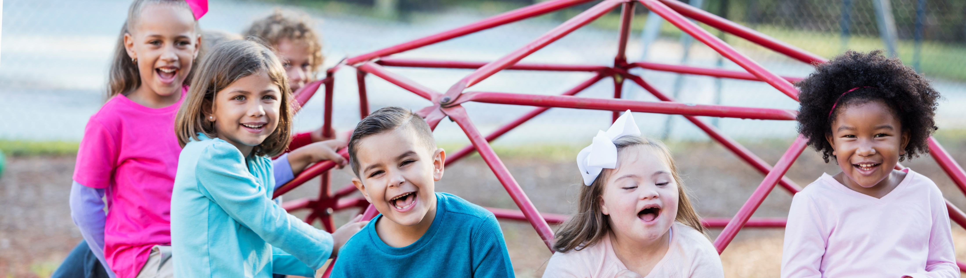
Physical activity supports children’s social-emotional development
Gives them warm and positive feedback when they engage in an activity successfully
Encourages them to listen and follow directions
Encourages them to participate in individual and group activities
Builds relationships with peers during unstructured play
Shows an interest and respect in peers
Notes:
Enjoyment and exposure to physical activity during early childhood influences physical activity levels as children grow older.
Children who have mastered skills and enjoy being physically active are more likely to continue to engage as they grow and mature.
Physical activity stimulates brain function and gives young children the opportunity to navigate their environment and practice skills such as working together, following instructions and resolving conflicts.

Slide 30

Activity break!
Notes:
Barnyard Dance is one example of a dance. There are many ways to dance and they are all fun for children. Dancing is a part of celebrations and a way we connect with our culture, families and friends.
Trainer notes:
The board book Barnyard Dance by Sandra Boynton is in the Trainer Resource Kit. If you do not have access to it, some other children’s books that promote movement can be found on the Physical Activity Resources handout. Local librarians are another resource for books that reflect the cultures in your community and support movement.
Directions:
Have participants stand and pick a partner. Groups of 3 are okay.
Once partnered, ask them to move with the actions in the story as you read aloud.
The story is short; you could repeat the activity.
Discussion Questions:
What did you notice about the group as the story progressed?
How do you anticipate children would respond?
What skills do children practice in this activity?
Moving with books supports developing vocabulary words about movement. What movement words do you use regularly in your classroom?
What other books and titles do you use to promote movement?

Slide 31

Recap:
Recognize that physical activity is important for infants, toddlers and preschool children
Notes:
In today’s session, our first objective was: Recognize the importance of physical activity for infant, toddler and preschool children.

Slide 32

Be an Influencer!
Think about the information we've discussed today and create caption and hashtag for a social media post.​
For example:​
Active play is the way! #walk the talk
Notes:
Trainer notes: ​
Divide participants into groups of four or use breakout rooms if training virtually. Ask participants to think about the content of today’s training and create a caption and hashtag for a social media post (i.e. Instagram, Twitter, Facebook). Remind participants that as ECE providers they are the original influencers for children. Give groups five minutes to think of captions and hashtags and then share back with the group. Capture responses on a flip chart, whiteboard, or virtual chat.​
​
We are all probably familiar with social media and the power of influencers to promote behaviors, personal interests, hobbies, and products. Captions are simple, concise, and attention-grabbing. They support your post and sometimes go viral. A great caption or hashtag helps your friends, family or followers to share in your experience. Think about what you’ve learned, seen, or felt during this introductory training. Create a caption and hashtag that communicates your own takeaway from today.

Slide 33

Questions?
Notes:
Trainer note:
Confirm how you will communicate with participants between session.

Slide 34
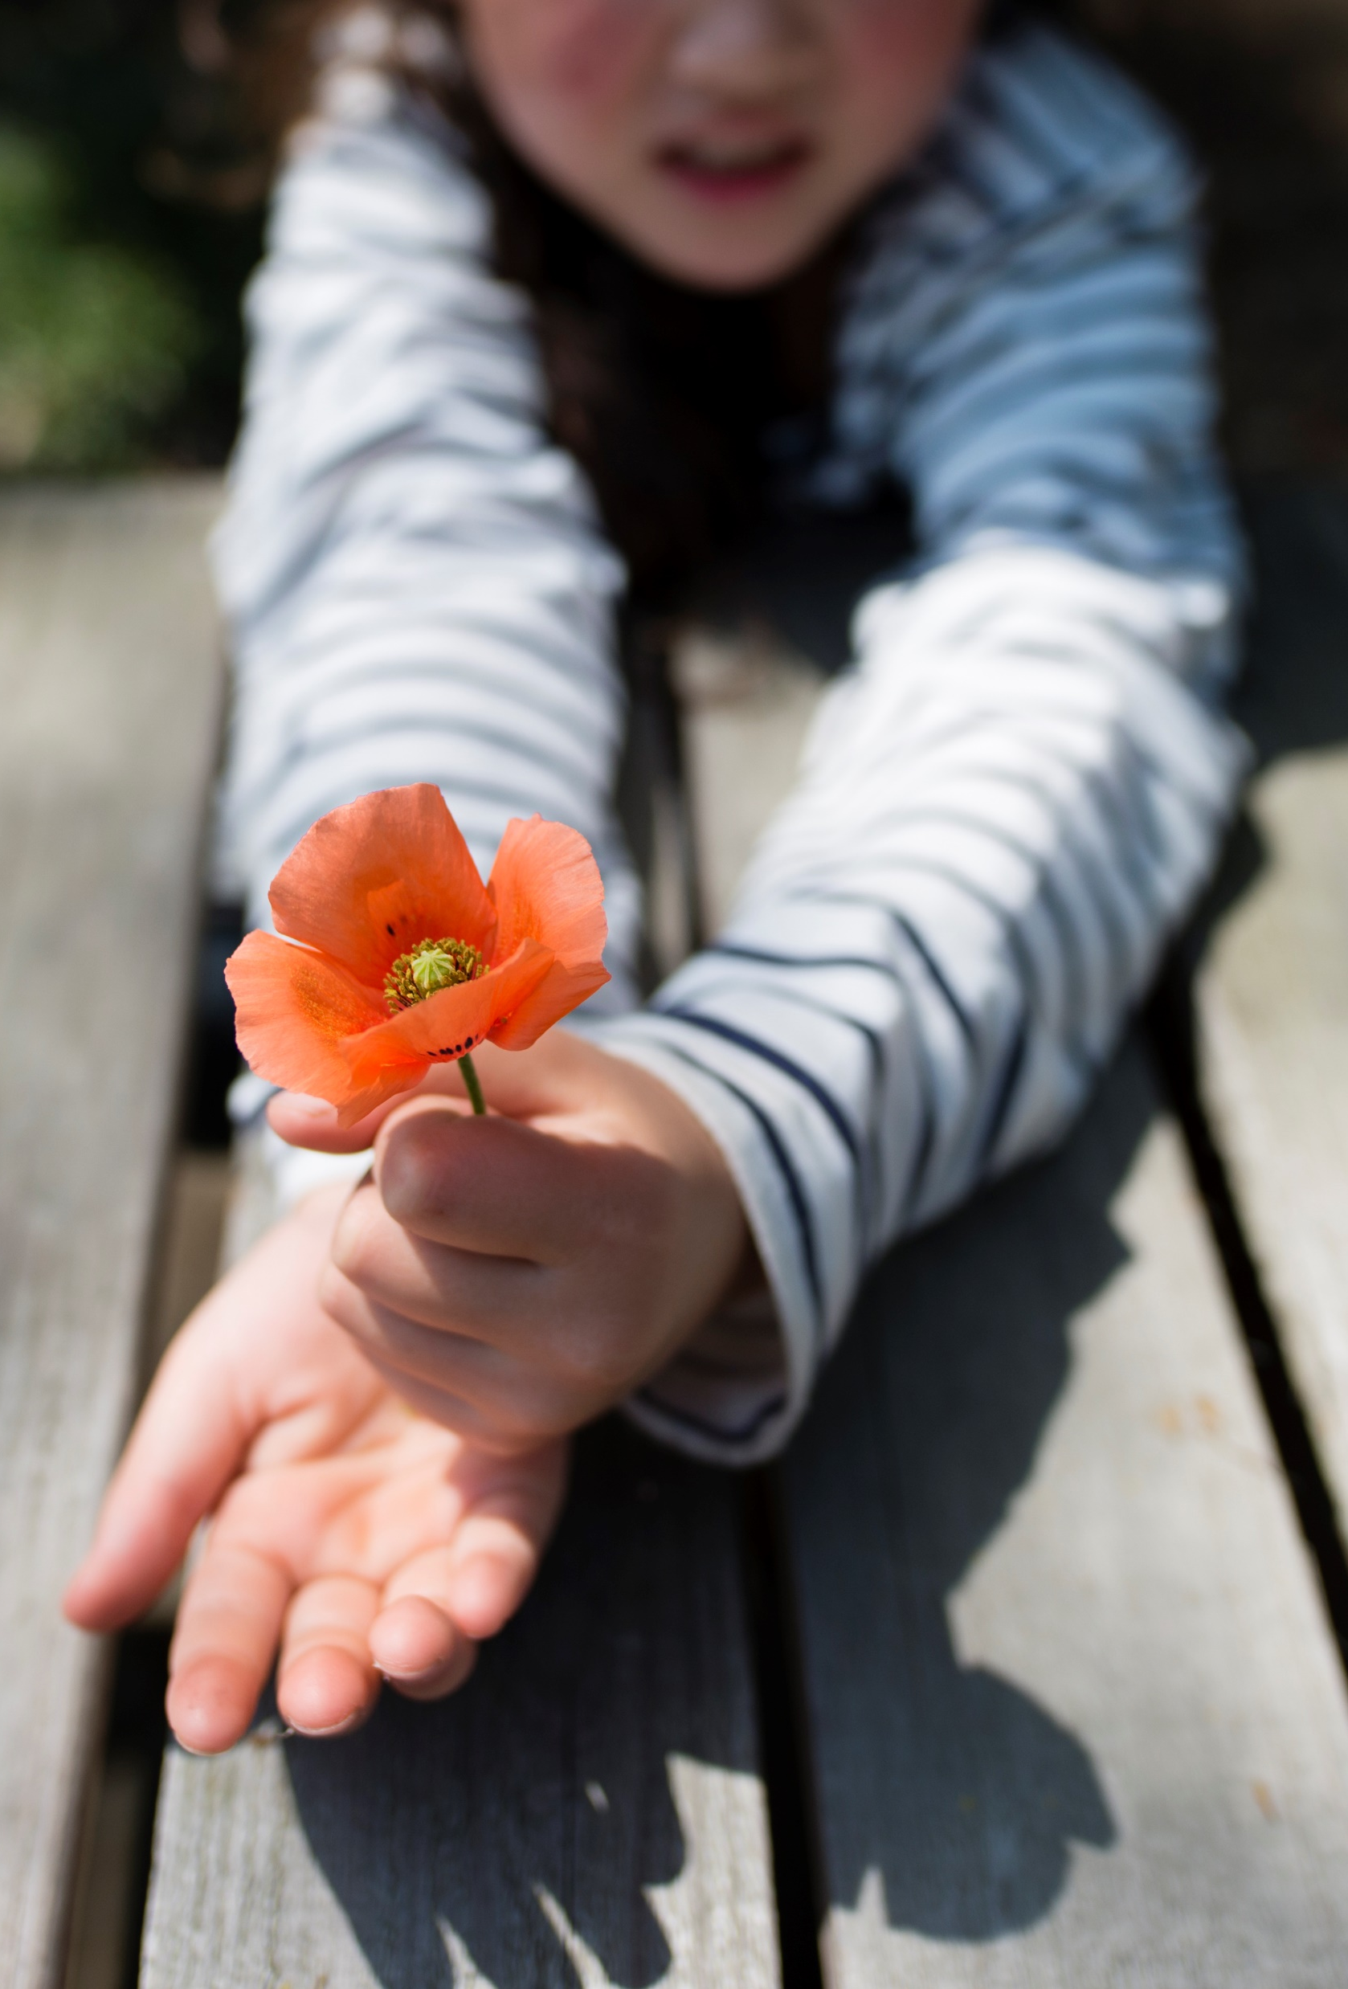
Thanks for participating in Session 1
Next session:
Insert Date
Insert Time
Insert Trainer Contact Info
PALSECE@Nemours.org

