Slide 1
Insert trainer information here
Notes:
Welcome to the Healthy Kids Healthy Future Physical Activity Learning Session.
Thank you for sharing your time with us today to learn more about how early care settings can support young children to become more physically active. In this training you will learn best practices of physical activity in Early Care & Education settings focusing on how providers can engage with families around physical activity, training and resources to support providers and program policies.

Slide 2
Notes:
A special thank you to these organizations and people who helped successfully develop this training.

Slide 3
Nemours Children’s Health is currently funded by the Centers for Disease Control and Prevention (CDC) under a 5-year Cooperative Agreement (6NU38OT000304-01-02). Through this effort, we support statewide early care and education (ECE) organizations to integrate best practices and standards for healthy eating, physical activity, breastfeeding support, and reducing screen time in ECE systems and settings.
The views expressed in written materials or publications, or by speakers and moderators do not necessarily reflect the official policies of the Department of Health and Human Services. Any mention of trade names, commercial practices, or organizations does not imply endorsement by the U.S. Government.

Slide 4
Would you rather …?
Notes:
Trainer notes:
Materials: Draw a line on the floor. This might be a line of blue painter tape, a line in the flooring material, a carpet seam, or a piece of yarn stretched out on the floor.
Directions:
Tell participants to line up on the line.
Read the series of questions. If participants prefer the first thing, they move to the right. If they prefer the second, they move to the left. If they prefer neither, they stay on the line.
Encourage them to face the center when they move so they can see what others in the group prefer. As a variation, ask them to jump to the right, slide to the right, take 3 steps to the right or make any other movement.
If training virtually have all participants turn on web cams, if able, and move to the right or left of their camera as choices are read off.
Sample questions:
Would you rather eat broccoli or sweet potatoes?
Would you rather go canoeing or hiking?
Would you rather go on a beach vacation or a mountain vacation?
Would you rather be hot or cold?
Would you rather read a romance or a mystery?
Would you rather play a board game or play putt-putt golf?
Would you rather take a cooking or a karate class?
Would you rather get a massage or a manicure?
Would you rather have lunch with Wonder Woman or Elsa?
To debrief this, ask participants to describe how they could modify this activity to do this in their classroom.

Slide 5
Best practices of physical activity: Families, Training, and Policies
Notes:
Trainer notes:
Today’s objectives include:
Develop the skills to implement the best practices of physical activity in ECE settings (Families, Training and Program Policies)
Communicate with families about children’s physical activity
Define and implement policies that reflect best practices promoting physical activity in ECE settings

Slide 6
Recap: Best practices for physical activity
Time – Recommended duration of physical activity in ECE settings
Space - Indoor and outdoor facilities
Type - Structured, unstructured, indoor and outdoor physical activity
Time
Daily Activities – Integrating best practices into lessons, transitions, and other program operations
Training
Space
Policies
Providers - The role of adults in leading, participating, role modeling, encouraging physical activity
Families
Type
Families - Supporting and communicating with families
Providers
Daily Activities
Training – Ongoing professional development to promote children’s physical activity
Policies - Written policies that help support children’s physical activity throughout the day
Notes:
The best practices for physical activity are divided into 8 areas.
During this session we will focus on families, training, and policies.
Note that policies are in the middle. A strong program policy will address each of the best practice areas.
Providers play an important role in each of the best practice areas.

Slide 7
Families influence and strongly affect children’s physical activity behaviors
Time
Training
Space
Policies
Families
Type
Providers
Daily Activities
Notes:
Families influence and have a strong impact on their children’s physical activity behaviors.
Building a relationship with families gives you an opportunity to be a resource of information and education about developmental milestones and physical activity. Open, two-way communication allows you to understand a family's developmental goals for their child. Children benefit when providers and families partner in the child’s interest.

Slide 8
Most motor skills have a very large age-range where developing the skill is considered “normal”
Some free materials can help you learn about developmental milestones
This resource from CDC includes a milestone checklist for children birth to 5
Also, free is an online training course, Watch Me! Celebrating Milestones and Sharing Concerns
Notes:
Trainer notes: Give participants Developmental Milestones (in Training Handouts section of your Facilitator Guide and on the USB). Encourage them to use the it for more comfortable viewing.
This resource from the Centers for Disease Control and Prevention details developmental milestones by age. You can print more 1-page milestone checklists for 2 months, 4 months, 6 months, 9 months, 1 year, 18 months, 2 years, 3 years, 4 years, and 5 years of age.
https://www.cdc.gov/ncbddd/actearly/milestones/index.html
Developmental milestones give you a natural opportunity to communicate with families. You support them by sharing information about what you observe during the day. You are very well positioned to help identify children who might need extra help in their development.

Slide 9
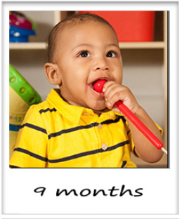
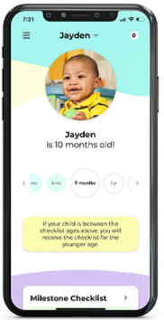
More milestone resources
Notes:
The CDC has a FREE, online training course, Watch Me! Celebrating Milestones and Sharing Concerns, with tools and best practices to help you monitor the development of children in your care and to talk about it with their parents. This 1-hour, 4-module course focuses on:
Why monitoring children’s development is important
Why you have a unique and important role in monitoring development
How to easily monitor each child’s developmental milestones
How to talk with parents about their child’s development
Where is Bear? – A Terrific Tale for 2-Year-Olds “Where is Bear?” is a terrific tale for 2-year-old children and their parents or caregivers! This interactive book encourages children to help Tiger and his forest friends in their search to find Bear.
Titles are also available for 1, 2, and 3 year old in English and Spanish. These can be downloaded for free and shared on a child’s birthday, or shared during parent nights or program tours.
Family’s can track their child’s milestones with CDC’s FREE Milestone Tracker app, now available for iOSand Android in both English and Spanish. The app provides interactive checklists with photos and video examples of developmental milestones.
The Milestones Photo and Video Library – is a library of photos and videos of each developmental milestones. This library can be useful for providers as families to view the milestones in action.

Slide 10
What can you do to engage families?
Encourage at-home goals for children
Create family challenges
Keep ongoing and open communication
Provide family newsletters, bulletin boards, notes, tip sheets, etc.
Connect families to community resources
Host family activities
Recognize and promote cultural events and practices
Notes:
Families will be more engaged if you provide a welcoming environment.
When they feel comfortable with the staff and with other families, feelings of comfort and stability will increase their support.
Families benefit if they know about activities that their children do during the child care day. They can help continue the activities at home. For example:
Share lyrics to movement songs and games with them.
Post photos and information on bulletin boards, in newsletters or in closed social media groups.

Slide 11
What can you do to engage families?
Notes:
Trainer notes:
Have a large group discussion about strategies that providers can use to engage families.
Use a sheet of chart paper to write participants’ responses. If facilitating virtually, consider using a whiteboard or Jamboard for participants to log their responses.
Some ideas are:
Share with parents the motor skills you observe and the active play their children enjoy while they are in your care. This can help you start a conversation with them about physical activity.
Share ideas for large muscle activities they can do at home using inexpensive items such as boxes, blankets or balls.
Send them photos in a closed social media group of the classroom engaged in active play.
Share information about free or low-cost community events that support active family time such as community walks, the location of community playgrounds and waterparks, and park events.
Set up quick physical activity stations for families and children to do at pick-up time such as a short obstacle course, hopscotch, hula hoops or a target to toss balls at.
Have a family night focused on physical activity. Set up games/activities that support fundamental movement skills.

Slide 12
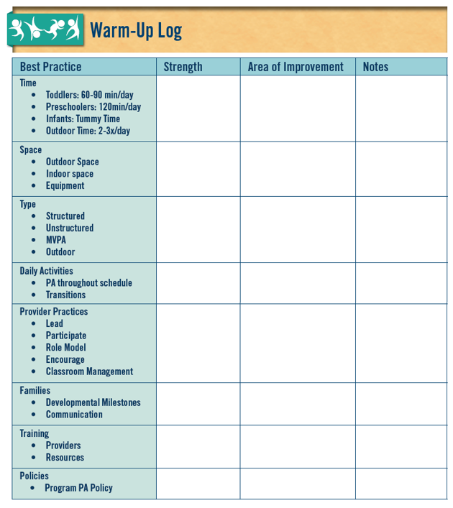
Reflect on best practices
Is engaging families a strength or area of improvement?
Notes:
Trainer notes:
Have participants refer to their PALS Warm-up Log and note if engaging families is a strength or area of improvement in their environment.
Encourage them to note ideas they have for engaging families and note key concepts from the training they want to remember.

Slide 13
Brain boost
With a resource from Jim Gill
Notes:
Jim Gill is a child development specialist, with a special emphasis on play.
This song is an example of an opportunity for playful interactions between a child and a caring adult.
https://www.youtube.com/watch?v=pjTgt96E_Co
If time allows, ask participants to share other music and musicians they use to encourage movement in their classroom.
Source: 1. Gill, Jim. (2019, September 25). My Ups and Downs [Video]. YouTube. https://www.youtube.com/watch?v=pjTgt96E_Co

Slide 14
Training can increase knowledge, skills, and activities that promote physical activity among young children
Time
Training
Space
Policies
Families
Type
Providers
Daily Activities
Notes:
In this section we will talk about provider training and classroom resources to support physical activity.
Training and other professional development opportunities can increase your knowledge, skills, and activities that promote physical activity among young children.

Slide 15
Where can you find training and resources?
Online training sessions
Children’s books
Online resources
Curricula
Notes:
Trainer notes:
Hand out and share the Physical Activity Resource handout in your Facilitator Guide or on the USB.
Review the handout and highlight those resources that participants can access.
If time permits and you have internet access, walk through and discuss a specific resource.
Highlighting any state-specific resources for physical activity. A state resources that you can share to all states and providers is Wisconsin’s Active Early https://www.dhs.wisconsin.gov/library/p-00280.htm.

Slide 16
What about Better Kid Care online training?
Multiple training sessions on physical activity are available, including:
Healthy Kids Healthy Future: Get Kids Moving
Physical Activities for Young Children: Lead with Confidence
Active Play for Preschoolers with Autism—WE PLAY
Move on: Reversing Children’s Sedentary Lifestyles Part 1
Move on: Reversing Children’s Sedentary Lifestyles Part 2
Keep on Moving!
Active Play for Rainy Days
I Am Moving I Am Learning ⎯ Active Play Every Day
Notes:
Better Kid Care's On Demand Distance Education system offers professional development that is available anytime you need it.
Over 45 states accept Better Kid Care online modules for state-specific professional development requirements. Courses are free and certificates for continuing education credits are $5. Some states reimburse or give codes to pay for the fee. Check with your state Professional Development Network.
Their website gives you a map with more information.
Note that while the trainings are free, there is a small charge for a certificate of completion.
The Better Kid Care trainings related to Physical Activity are listed on the screen. You can also find several trainings on music and movement.

Slide 17
Connecting literacy and movement can bring joy to children
Notes:
You can use many different children’s books with movement activities.
Using books this way supports children’s understanding of the concepts and vocabulary in the story.
Connecting literacy and movement can bring joy to children. Children who have a hard time sitting during stories will respond to opportunity to move in a positive way.
Trainer notes:
Ask participants to share their favorite books that support movement. Capture responses on chart paper or in the chat.

Slide 18
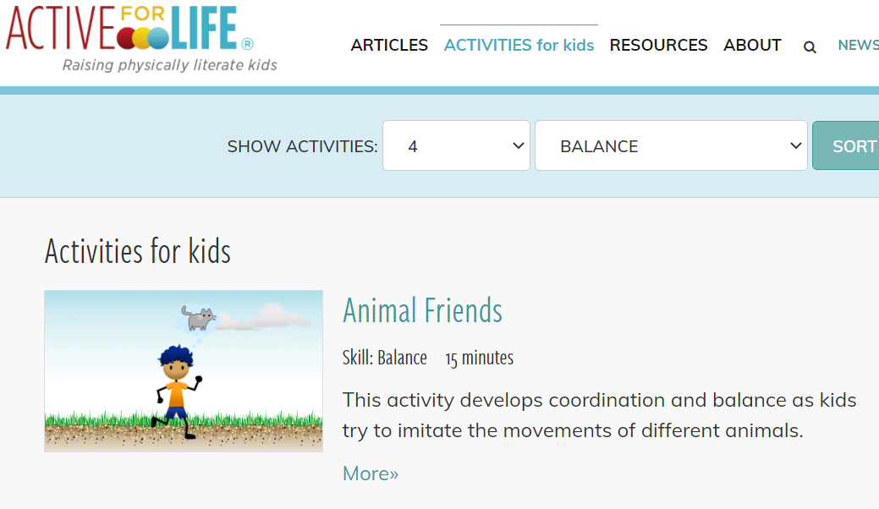
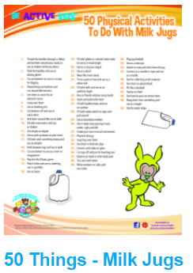
You can find helpful resources online
Be Active Kids
Active for Life
Active Play
Notes:
Each of these resources can support teachers in age-appropriate activities with low cost materials. Link are in the participant handout. If time allows, click on an image and share the website with your participants.
Be Active Kids has a wide range of 1-page ideas using inexpensive items such as milk jugs, bubbles, pool noodles, bean bags, ribbons, hoops and natural parts such as leaves.
Active for Life also has a wide range of activities that you can sort by age and skill.
Active Play, Dr. Diane Craft’s website, has several activities to download.

Slide 19
A physical activity curriculum can help you increase the amount of physical activity children experience
Notes:
A physical activity curriculum can support you as you increase the amount of physical activity children experience in developmentally appropriate ways.
Multiple curricula supporting physical activity have been developed for ECE settings.
Each listed curricula gives you a specific set of materials to help plan developmentally and age-appropriate activities.
OPEN and Sesame Street Healthy Habits for Life: We Have The Moves are free for providers to download at the links found in the handout.
Trainer note: Links are embedded in the slide for the OPEN and Sesame Street curriculum websites. If time allows visit one site during the training and spotlight some of the lessons and activities available.

Slide 20
Reflect on best practices
Is training a strength or area of improvement?
Notes:
Trainer notes:
Have participants refer to their PALS Warm-up Log and note if training is a strength or area of improvement in their environment.
Encourage them to note ideas they have about training and note key concepts they want to remember.

Slide 21
In quality child care programs, good policies support operations
Time
Training
Space
Policies
Families
Type
Providers
Daily Activities
Notes:
Quality child care programs have policies in place to support operations.
Policies define how a program is run and how children will be cared for. You can find policies in family and staff handbooks and in program manuals.
Policies can cover various areas of program operations such as:
payment procedures
late pickups
exclusion for illness
daily activities
Notice how policy is the center tile in the best practices image. A strong physical activity policy will address each best practice. In turn, the policy supports teachers in implementing physical activity in their classrooms. Incorporating a physical activity policy is one way to ensure that physical activity is a priority in a program.

Slide 22
You must communicate policies to staff and families so that they understand your program standards
Notes:
You must communicate policies to staff and families to make sure that they understand the program standards.
Written policies hold staff and families accountable.

Slide 23
How do policies help you?
If staff and families can read your written policies, they will most likely, understand and support them
Policy statements help them understand that daily physical activity is important for children’s health and well-being
Written policies help maintain practices over time despite staff turnover and other challenges
Review policies every year or when you make any changes
Notes:
Written policies make your practices known, understood and supported by staff and families.
Policy statements help staff and families understand that daily physical activity is important for children’s health and well-being.
Written policies help maintain practices over time despite staff turnover and other challenges.
Review policies every year or when you make any changes.
Include aspects of the program's physical activity policy in family handbooks. For example, include information about families’ need to provide clothing and shoes for outdoor play.
In staff handbooks, include information about:
staff expectations around structured play,
adult engagement during outdoor play and
staff clothing and shoe requirements.

Slide 24
Best practices for physical activity
Time – How long physical activity will occur
Space – Where available facilities for physical activity are and what portable equipment is available
Time
Type – What type of structured (adult-led) and unstructured (child-initiated) physical activity to expect
Training
Space
Daily Activities – What indoor and outdoor opportunities children will have to participate in physical activity throughout the day
Policies
Families
Type
Providers – What structured activities to lead, how to dress to support children's movement, how to incorporate activities throughout the day
Providers
Daily Activities
Families– What clothing to provide for outdoor play
Training – What annual training is defined for staff
Notes:
Physical activity policies should describe and outline requirements and standards that promote safe and appropriate active play opportunities.
Policies should:
Address each best practice area,
Be clearly written, and
Be easy to understand.
Parent and Staff materials should support policies. For example, parent handbooks can contain guidance on clothing parents are expected to supply that supports active outdoor play such as weather appropriate clothing, closed toed shoes and sun protecting hats.
Staff handbooks can outline expectations for adult-led activities and clothing that supports outdoor play.

Slide 25
How would a strong physical activity policy support teachers and caregivers?
Notes:
Trainer notes: Ask participants to consider how policies help them be successful supporting physical activity.
For example:
A policy statement about families providing clothing for outdoor play (Sunhats, rain jackets, gloves and hats) allows all children to play safely and comfortably outdoors.
A policy statement about the amount of time children will engage in physical activity informs teachers and caregivers of the expectations on the daily schedule and their responsibilities.

Slide 26
Reflect on best practices
Is policies a strength or area of improvement?
Notes:
Trainer notes:
Have participants refer to their PALS Warm-up Log and note if policies is a strength or area of improvement in their environment.
Encourage them to note ideas they have for creating or modifying a policy to support physical activity in their programs.

Slide 27
Questions?
Notes:
Trainer note:
Confirm how you will communicate with participants between session.

Slide 28
Thanks for participating in Session 4
Next session:
Insert Date
Insert Time
Insert Trainer Contact Info
PALSECE@Nemours.org

