Slide 1
Introductory Workshop
Insert your trainer info here, e.g. Name, credentials, contact info Date of training
Insert your logo here
Notes:
[TRAINER NOTES]
Edit this slide to add your name, credentials, and contact information. Include the date of when you deliver the training.
[SUGGESTED SCRIPT]
Welcome to Nourishing Healthy Eaters in Early Care & Education.
This series of workshops is designed to support early care and education providers deepen their understanding of how children learn to become healthy eaters. Thank you for your participation today as we explore how your daily practices as a child care professional impact children’s food journey.

Slide 2
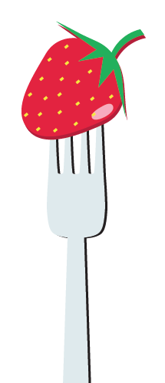
Objectives for today
Describe wellness and adult nutrition
Recognize the importance of healthy eating for infants, toddlers and preschoolers
Notes:
[SUGGESTED SCRIPT] Thank you for joining us for the Introductory Workshop of Nourishing Healthy Eaters in Early Care and Education! As you know, early childhood professionals are important role models to the children in their care. You have the influence to shape a child’s experiences, preferences, and taste for different foods.
This workshop introduces basic concepts that support children to become healthy eaters and develop a love for a variety of foods. To explore how you can nurture a healthy eater in your program or classroom, we will start off by exploring the importance of wellness and nutrition for adults. Reflecting on our own experiences and relationship with food and healthy habits will help us guide children as we promote healthy eating practices.
To get us started, join me in exploring your own food story…[NEXT SLIDE].

Slide 3
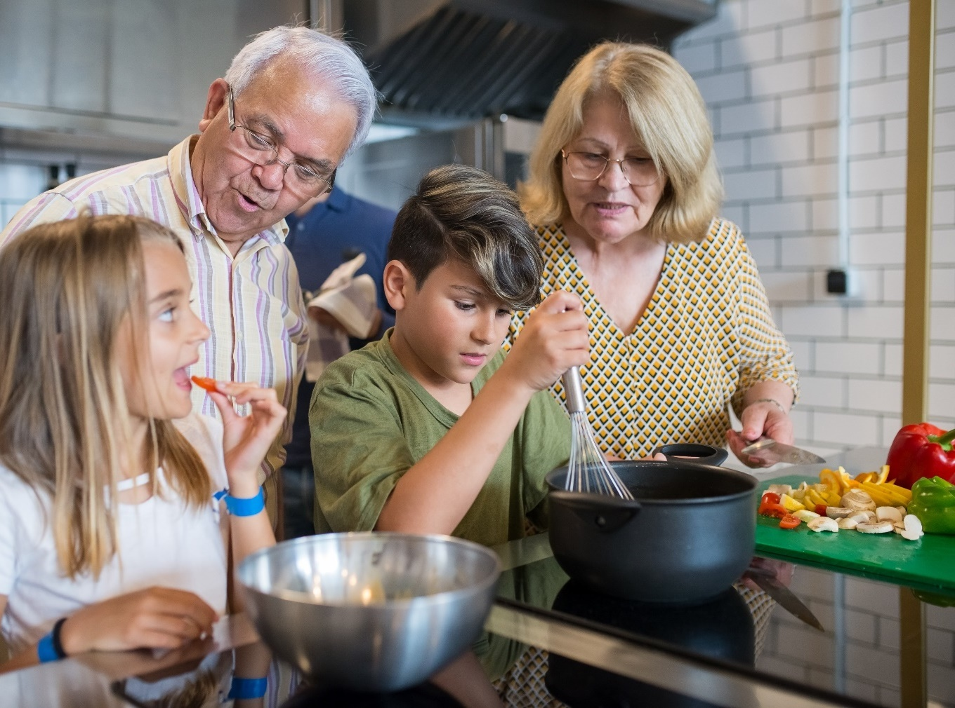
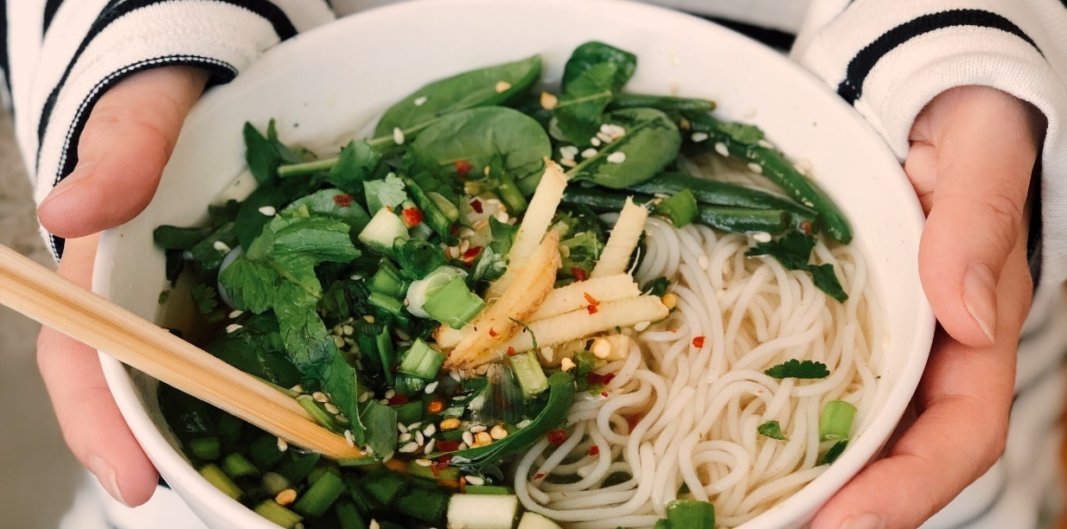
What is your food story?
Notes:
[SUGGESTED SCRIPT] Each of us has a food story. This story is based on a lifetime of experiences with eating and food. Our story includes the memories we carry, the foods we enjoy (and don’t), and our understanding of nutrition. Attitudes about food and food preferences begin to develop in early childhood. Parents, families, and adult caregivers strongly influence them. An individual’s relationship with food is influenced by how families discussed food, the climate of meals, culture, religion, tradition, and parenting styles. All families' food choices are also affected by access and availability.
[TRAINER NOTES]
Think about a brief personal story around food experiences that you are comfortable sharing or choose one of the stories below:
I grew up thinking I did not like broccoli. When I was a young child, my mother would cook broccoli on the stovetop until it was soft and mushy. I did not like the way it made our home smell. I avoided broccoli for a long time. Later in life, I discovered that steamed broccoli is a beautiful bright green color and has a great texture and taste. I began to explore broccoli recipes. Today I enjoy roasted broccoli, broccoli salads, blanched broccoli, and even grilled broccoli. I still don’t want to eat it if it is mushy!
Growing up, my Dad was picky. He liked his meat fried and only ate vegetables if they were either fried or boiled with bacon, so that’s what we ate. I remember going to a friend’s house when I was in middle school and being served roasted potatoes. I didn’t know what they were! I learned to eat foods other ways, but the smell of frying foods brings back fond memories of my childhood.
Our food situation was very unreliable when I was a teenager. I lived with my mother, who worked as a school aide and bus driver. There were times when there was nothing to eat in our home. My Mom would pull something together for dinner and try to give all or most of it to me. I remember going to bed hungry and anxious. When we did have groceries, my Mom made amazing lasagna and garlic bread-still my favorite meal. When my Mom got a better job and food was no longer scarce, I tended to overeat because of a nagging feeling that I might not have food later. Now, years later, I still struggle with that feeling.
My Dad’s parents, who were from India, lived with us when I was a child, and most of the time, either my grandma or my Mom did the cooking. My Mom grew up in Louisiana and loved to make Creole food, and of course, my grandma cooked Indian food. Most of the meals in our home were pretty spicy! I love spicy food to this day. My friends think this is funny, but I keep packets of crushed red pepper in my purse to spice up foods when I eat out.
[TRAINER NOTES] Ask participants to find the Food Story Box in the handout on page one. Allow about 10 minutes to complete the prompts.
There are several ways to debrief this activity:
Ask a volunteer or several to introduce themselves and share their responses.
Ask participants to form in groups of four and share their food stories.
Read each question aloud and ask for participants to introduce themselves and share their responses.
Summarize with some of the key concepts you hear from participants relating to culture, religion, parenting styles, food access, and the climate of meals.
Prompts in the handout include:
List out several fruits and vegetables you enjoyed as a child.
What is a dish a parent or family member prepared that you remember? Why does this dish stand out for you?
What were your family meals like as a child?
What is a food you avoid today? Why?
What is a food item you currently enjoy when you are celebrating?
How do you think your childhood experiences with food influence your food choices today?
How did culture and tradition influence your food story?
Practices around feeding children have changed over the last 50 years. These changes result from society's changes (positive and negative), information (and misinformation) around food and diets, the food industry's influence, and new science on nutrition.
Understanding the influences behind our beliefs and attitudes around food can help us be conscious of how our behaviors and actions around food impact the children in our care.

Slide 4
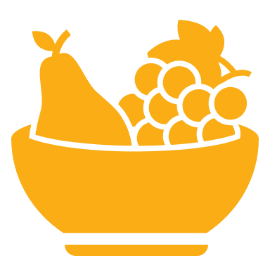
What is wellness?
Wellness means being aware of and making choices toward a healthy and fulfilling lifestyle.
Wellness is more than being free from illness, it is a dynamic process of change and growth.
Physical wellness means maintaining a healthy body and seeking care when needed. Physical health is attained through exercise, eating well, getting enough sleep and paying attention to the signs of illness and getting help when needed.
Notes:
[SUGGESTED SCRIPT]:
Now that we’ve reflected on our personal or family experiences with food, we will explore some broader terms related to health and wellness. What is wellness?
[TRAINER NOTES]
Objective 1.Describe Wellness and Adult Nutrition
Conduct a quick activity with participants capturing responses on chart paper or a whiteboard. What is your understanding of the term ‘wellness’?
A word cloud activity is an option for virtual delivery. Using a free platform such as Mentimeter or PollEV, participants can enter multiple words they think of when they hear the term wellness to generate a word cloud.
Pause here and give participants time to read the slide or ask a volunteer to read the first bullet aloud and another volunteer to read the second bullet.
Page one of the handout has a place for participants to note why wellness is important to them.
[SUGGESTED SCRIPT]
Wellness is more than being free from illness. Facets of personal wellness include physical, emotional, intellectual, environmental, spiritual, social, and vocational wellness.
The choices we make regarding wellness are shaped by what we have access to and the resources we can allocate to our wellness.

Slide 5
Benefits of Wellness for Adults
Creates role models for children, families and co-workers
Improves morale
Raises mental alertness
Enhances productivity
Reduces absences, illness and health care costs
Increases loyalty and retention
Notes:
[TRAINER NOTES] Encourage participants to reflect on what wellness means to them and record their thoughts on the bottom box on page one in the session handout.

Slide 6
Nutrition’s role in wellness and health
Good nutrition is part of a healthy lifestyle
Not all people have access to nutritious, affordable, and culturally appropriate food
Lack of access can lead to a poor diet which is associated with major health risks including heart disease, high blood pressure, type 2 diabetes, osteoporosis, and certain types of cancer
The food we eat each day affects our health — how we feel today, tomorrow, and in the future
Notes:
[SUGGESTED SCRIPT]
An important part of wellness is good nutrition. Food provides nutrients and calories that nourish and fuel the body. Our food choices are impacted by the foods we can access and afford.
Source: https://www.hhs.gov/fitness/eat-healthy/importance-of-good-nutrition/index.html

Slide 7
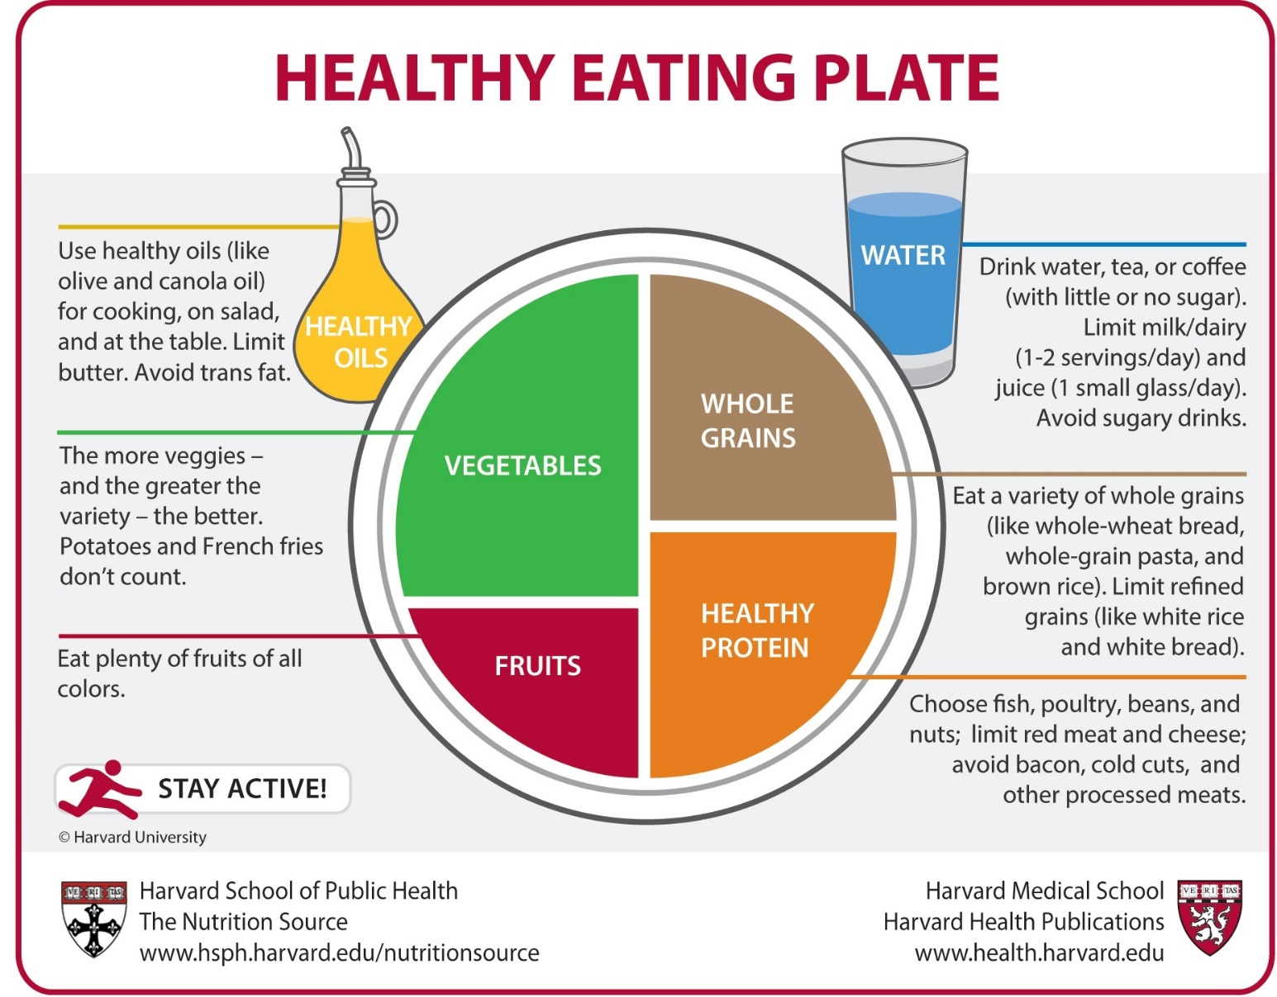
Healthy Eating Plate
Notes:
[SUGGESTED SCRIPT]
The Healthy Eating Plate, created by experts at Harvard School of Public Health and Harvard Medical School, points consumers to the healthiest choices in the major food groups.
The Healthy Eating Plate is based exclusively on the best available science and was not subjected to political or commercial pressures from food industry lobbyists.
[TRAINER NOTES] Direct participants to the Healy Eating Plate on page two of the handout.
[SUGGESTED SCRIPT]
Notice that half of the plate is fruits and vegetables.
A quarter of the plate is grains. Choose whole grains and limit refined grains, since whole grains are much better for health. In the body, refined grains like white bread and white rice act just like sugar.
A quarter of the plate is protein foods. The Healthy Eating Plate encourages consumers to choose fish, poultry, beans or nuts, protein sources that contain other healthful nutrients. It encourages them to limit red meat and avoid processed meat, since eating even small quantities of these foods on a regular basis raises the risk of heart disease, diabetes, colon cancer, and weight gain.
Water is a good choice.
Notice that the Healthy Eating Plate depicts a bottle of healthy oil. Healthy fats reduce harmful cholesterol and are good for the heart, and Americans don’t consume enough of them each day.
The figure scampering across the bottom of the Healthy Eating Plate’s placemat is a reminder that staying active is an important component of wellness.
A healthy eating pattern includes a wide variety of nutritious foods from all the food groups. Note that all foods can fit in a healthy diet.
Source: https://www.hsph.harvard.edu/nutritionsource/healthy-eating-plate-vs-usda-myplate/
[Trainer note]
Based on knowledge of the participants in your training session, consider adjusting the image on the slide.
Some options include the following:
Healthy Plates Around the World
The Institute for Family Health developed a series of “Healthy Plates” to help patients manage diabetes and other conditions. “Healthy Plates” are easy to use and are available in several designs representing different cultures. https://institute.org/health-care/services/diabetes-care/healthyplates.
Traditional Diets
Oldways is a nonproﬁt organization helping people rediscover and embrace the healthy, sustainable joys of the “old ways” of shared cultural traditions. They have developed food pyramid images that capture several cultures and traditions. https://oldwayspt.org/traditional-diets
MyPlate
MyPlate is the current nutrition guide published by the USDA's Center for Nutrition Policy and Promotion, and serves as a recommendation based on the Dietary Guidelines for Americans. https://www.myplate.gov/. The Connecticut SNAP-ED program has materials created MyPlate for All Cultures materials that may be useful for programs that participate in the CACFP. https://www.snap4ct.org/snap4ct-blog/myplate-for-all-cultures

Slide 8
Meals Relevant to other cultures
https://foodinsight.org/?s=diversifying+myplate
Notes:
[TRAINER NOTES]
The Food Insights series on Diversifying MyPlate highlights how the cuisine of different cultures and ethnicities meet the diverse meals promoted by the USDA MyPlate. You can learn more at the links provided along with the images on the slide.
Cuisines available as of July 2022 include: South Asian Muslim, Gujarati Indian, Haitian, Chinese and Latin American.

Slide 9
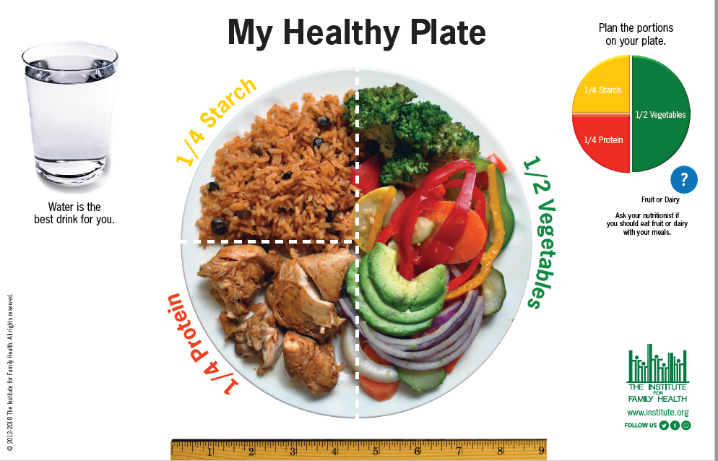
Meals Relevant to other cultures
https://institute.org/health-care/services/diabetes-care/healthyplates/
Notes:
[TRAINER NOTES]
The Institute for Family Health developed a series of “Healthy Plates” to help patients manage diabetes and other conditions. “Healthy Plates” are easy to use and are available in several designs:
American
Criollo – Puerto Rican/Dominican (English and Spanish)
Soul Food
West African
Mexican (English and Spanish)

Slide 10
Meals Relevant to other cultures
https://oldwayspt.org/
Notes:
[TRAINER NOTES]
Oldways is a nonproﬁt organization helping people rediscover and embrace the healthy, sustainable joys of the “old ways” of shared cultural traditions. They provide “food pyramids’ that depict traditional diets from several cultures. The food pyramids show examples of what to eat over time (not just at one meal!) and the relative proportion of each food group. Their site also provide ‘plates of expression’ depicting foods to compliment the heritage pyramids.
Heritage Diet Pyramids are available for the following cultures: Mediterranean, African Heritage, Latin American, Asian, and Vegetarian & Vegan
Plates of expressions are available depicting the following cultures: Western & Central Africa, South America, the Caribbean, and the American South

Slide 11
NEW Resource: Shop Simple with MyPlate
Use on any device
Budget-friendly food suggestions
Tips for purchasing and storing food
Recipes
Serving ideas
Nutrition info
Stores that accept SNAP EBT
MyPlate.gov/ShopSimple
Notes:
[SUGGESTED SCRIPT]
Shop Simple with MyPlate is a tool to help you find cost-saving opportunities in your area and discover new ways to prepare budget-friendly foods. This app is useful for those with access to a smartphone.
Enjoy the tool from any device, simply visit MyPlate.gov/ShopSimple. Browse budget-friendly food suggestions from each of the MyPlate food groups, get tips for purchasing and storing the food, serving ideas, recipes, and nutrition info. Enter your zip code to find cost-saving opportunities in your local area, including stores that accept SNAP EBT, rewards for SNAP participants, and farmers markets.
While there are many apps available that focus on healthy eating, cooking, and meal prep, we highlight this one because it is free and aligns with MyPlate and the Dietary Guidelines for Americans. There is no commercial interest related to this app but we encourage you to explore other app-based resources as well.

Slide 12
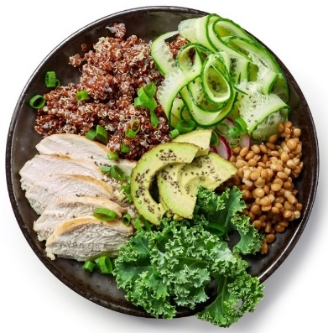
Every bite matters
The right mix can help you be healthier now and into the future
Focus on variety, amount, and nutrition
Choose foods and beverages with less saturated fat, sodium, and added sugars
Start with small changes to build healthier eating styles
Support healthy eating for everyone
Notes:
[SUGGESTED SCRIPT]
MyPlate encourages finding a healthy eating style and building it throughout the lifetime. These are the key messages from USDA MyPlate.

Slide 13
A Healthy Eating Pattern
Fruits and vegetables
Whole Grains
Low-fat or Fat-Free Dairy
Lean meats, poultry, fish, beans, eggs
Nuts and seeds
Saturated Fat & Trans Fat
Cholesterol
Salt & Added Sugars
Notes:
[SUGGESTED SCRIPT]
Many of us consume less than ideal amounts of certain nutrients needed for a healthy eating pattern. A healthy diet emphasizes fruits, vegetables, whole grains, and low-fat or fat-free milk and dairy products. It also includes lean meats, poultry, fish, beans, eggs, nuts, and seeds and is low in saturated fat, trans fat, cholesterol, salt, and added sugars.
Eating healthy reduces the risk for diseases, provides more energy, better sleep, better concentration and focus, and combats anxiety and depression while also increasing confidence.
Making healthy choices is challenging, especially with increasing food prices, food insecurity, or limited to access to quality foods or grocery stores. Even when faced with limited choices, we can rely on a few resources to better understand what we or our families are eating.

Slide 14
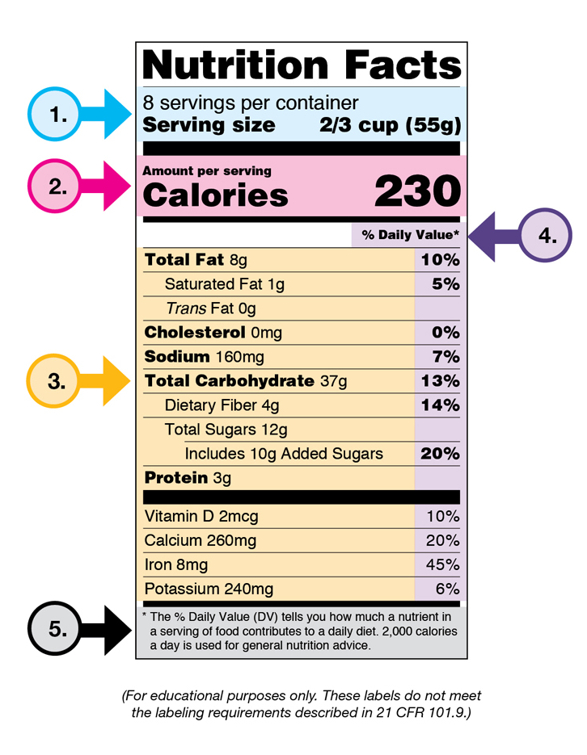
Understanding the Nutrition Facts Label
Notes:
[TRAINER NOTES] Ask participants to find the EAT SMART document on page three in the handout for easier viewing.
[SUGGESTED SCRIPT]
Learning how to understand and use the Nutrition Facts label can help you make healthier eating choices and identify nutrient-dense foods for a healthy diet.
1 - Start with the serving information at the top.
This information tells you the size of a single serving and the total number of servings per container (package).
2 - Next, check the total calories per serving and container.
Pay attention to the calories per serving and how many calories you’re consuming if you eat the whole package. If you double the servings you eat, you double the calories and nutrients.
The next section of information on a nutrition label is about the amounts of specific nutrients.
3 - Limit certain nutrients.
Check essential nutrients and understand what you’re looking for. For example, not all fats are unhealthy. Also, total sugars can include both natural and added sugars. Limit the amounts of added sugars, saturated fat, and sodium you eat and avoid trans fat. When choosing among different brands or similar products, compare labels and choose foods with less of these nutrients when possible.
3 - Get enough of the beneficial nutrients. The label is required to have information on vitamin D, calcium, iron, and potassium; vitamin A and C are not required.
Make sure you get enough of the nutrients your body needs, such as calcium, choline, dietary fiber, iron, magnesium, potassium, and vitamins A, C, D, and E.
4 & 5 - Understand % Daily Value.
The % Daily Value (DV) tells you the percentage of each nutrient in a single serving in terms of the daily recommended amount. If you want to consume less of a nutrient (such as saturated fat or sodium), choose foods with a lower % DV (5 percent or less). If you want to consume more of a nutrient (such as fiber), choose foods with a higher % DV (20 percent or more).
Remember that the information shown on the label is based on a diet of 2,000 calories a day. You may need less or more than 2,000 calories depending upon your age, gender, and activity level.

Slide 15
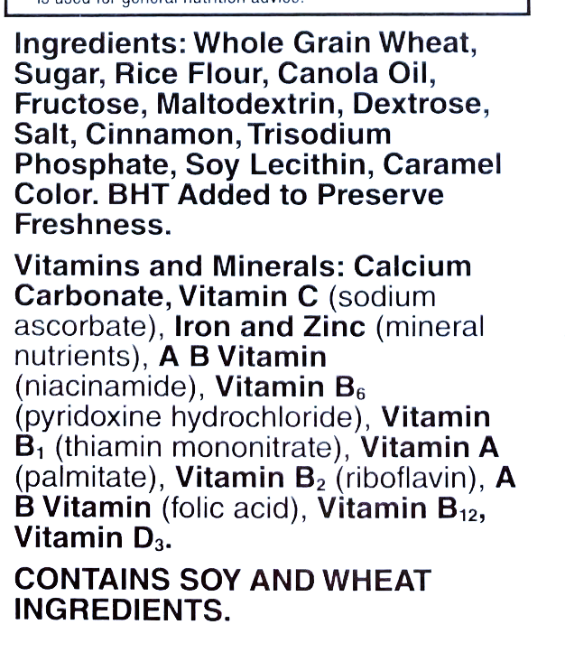
Ingredient list
Notes:
[SUGGESTED SCRIPT]
In addition to the Nutrition Facts label, the ingredient list is also a helpful tool for healthy choices. The ingredient list shows each ingredient in a food by its common or usual name. Ingredients are listed in descending order by weight, so the ingredient with the greatest contribution to the product is listed first. The ingredient contributing the least by weight is listed last.
Check the ingredient list on foods before you buy them. Use the list to determine whether a food or beverage contains ingredients that are sources of nutrients you want to get more of, such as whole-grains, or is made up of nutrients you want to get less of, such as added sugars and partially hydrogenated oils (trans fat).
Labels are helpful but can also be perplexing as some nutrients have many names. For example, sugar can be listed as high-fructose corn syrup, sucrose, agave nectar, or dehydrated cane juice, to name a few. There are over 50 names for sugar which can make it challenging to recognize.. Take a moment and find the different sugars in this product. * Sugar, Fructose, Dextrose.
Salt also has many names. It can be listed as sodium benzoate, disodium or monosodium glutamate (MSG) to name a few.
Using the ingredient list with the nutrition label can help inform your choices.

Slide 16
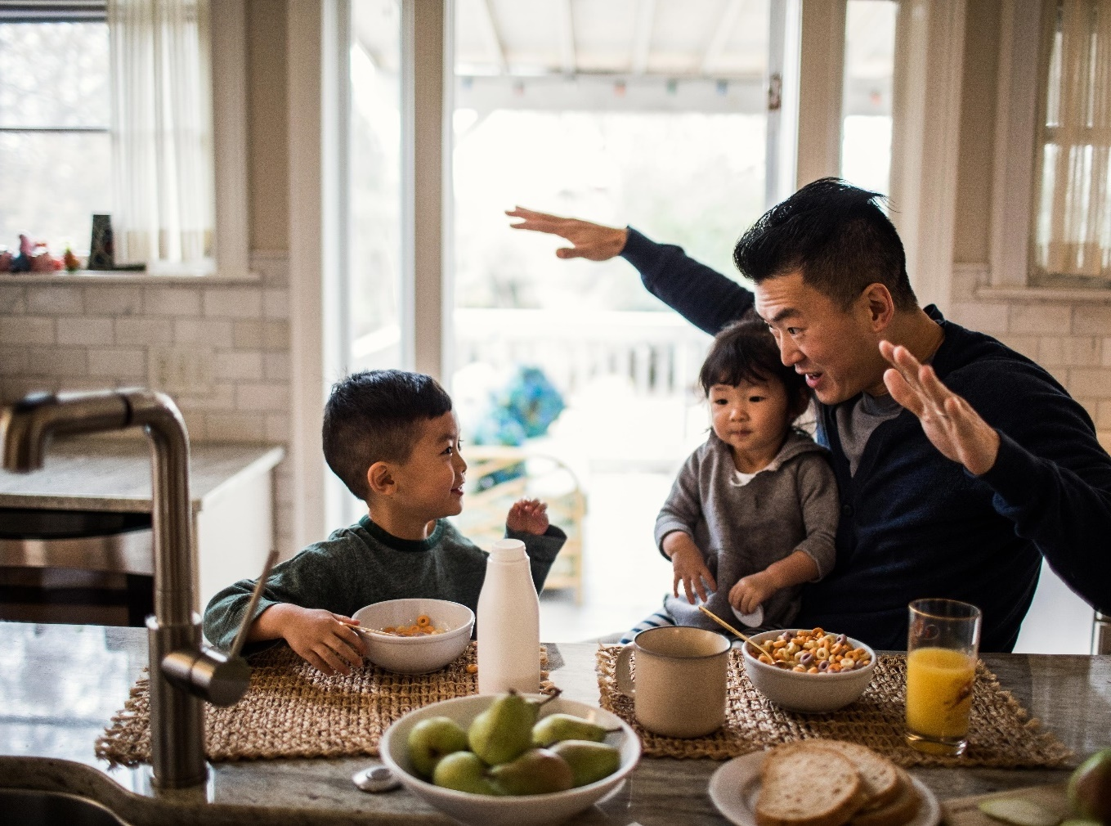
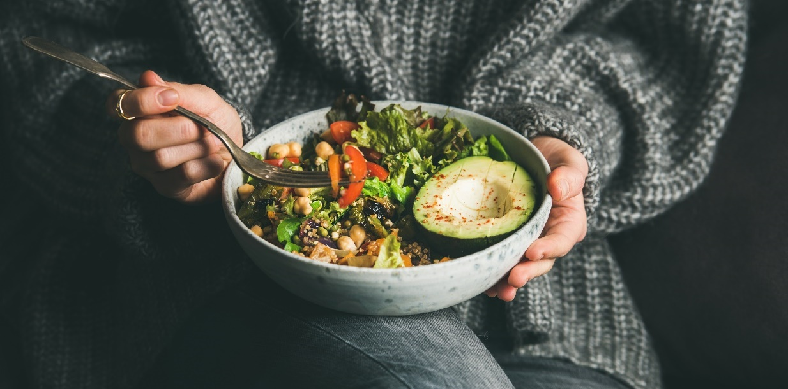
How do you choose what to eat?
Notes:
[TRAINER NOTES] Choose between one of the two activities suggested.
In groups of four, or breakout rooms if facilitating virtually, ask participants to discuss the prompt on the screen. Capture the responses on chart paper or a Jamboard.
Facilitate a large group brainstorming discussion using the question on the slide, “How do you choose what to eat?” Responses may range from nutrition and cost to proximity.
Keep in mind that a healthy lifestyle is about balance. It is not about deprivation or restriction. Part of culture and community frequently involves the sharing of foods, not all of which are healthy. But enjoying a piece of cake at a birthday party is part of finding balance.
Some possible responses include:
Nutrition
Value/Cost
Convenience
Family Decisions/preferences
Culture
Proximity/Access
Taste/Enjoyment/Pleasure
Community

Slide 17
Sugar Sweetened Beverages (SSB)
Notes:
[SUGGESTED SCRIPT]
What are sugar-sweetened beverages?
Sugar-sweetened beverages are any liquids that are sweetened with added sugars like brown sugar, corn sweetener, corn syrup, dextrose, fructose, glucose, high-fructose corn syrup, honey, lactose, malt syrup, maltose, molasses, raw sugar, and sucrose. Examples of SSBs include regular soda (not sugar-free), fruit drinks, sports drinks, energy drinks, sweetened waters, and coffee and tea beverages with added sugars.
Sugar-sweetened beverages (SSBs) or sugary drinks are leading sources of added sugars in the diet. The sugar is not hidden; in fact, the sugars are listed on the nutrition label and the ingredient list. Most adults don’t realize how much added sugar is in sugar sweetened-beverages.
Breaking the habit of drinking sugary drinks can be challenging. The rush of sugar causes the dopamine to be released to brain. This can lead to cravings for more sugar. Advertising also impacts our choices. Companies that make sugar sweetened beverages spend huge sums of money in targeted advertising aimed at communities of color. Some communities have taken steps to address those challenges through taxing, bans on super sized drinks and initiatives promoting healthier beverages.
Note that sugar is naturally occurring in foods like fruits and vegetables. These are healthy foods that contain water, fiber, and various micronutrients. Naturally occurring sugars are fine, but the same does not apply to added sugar.
Sources:
https://www.cnn.com/2020/06/23/health/soda-targets-minority-youth-wellness/index.html

Slide 18
How much sugar is in this beverage?
4 grams(g) = 1 teaspoon
65 grams = 16 ¼ teaspoons
Notes:
[SUGGESTED SCRIPT]
This label indicates that there is 65g of sugar in this beverage.
Four grams of sugar is equal to one teaspoon. To determine, the amount of sugar divide 65 by 4.
This beverage contains the equivalent of 16 1/4 teaspoons of sugar.
There are approximately four calories in one gram, so this beverage contains 240 calories, all of which are from sugar.
The American Heart Association (AHA) recommends limiting the amount of added sugars you consume to no more than half of your daily discretionary calorie allowance. Discretionary calories are excess calories to enjoy once your required nutrient needs are met. For most American women, that’s no more than 100 calories per day or about six teaspoons of sugar. For men, it’s 150 calories per day or about nine teaspoons. For children, the recommendation is 3-6 teaspoons. This is a wide range of ages, younger children would fall on the lower range of this spectrum, around 3-4 teaspoons.

Slide 19
Average intake = 22 teaspoons per day
Notes:
[SUGGESTED SCRIPT]
The average American takes in far higher amounts of added sugar per day however – an average of 22 teaspoons per day!

Slide 20
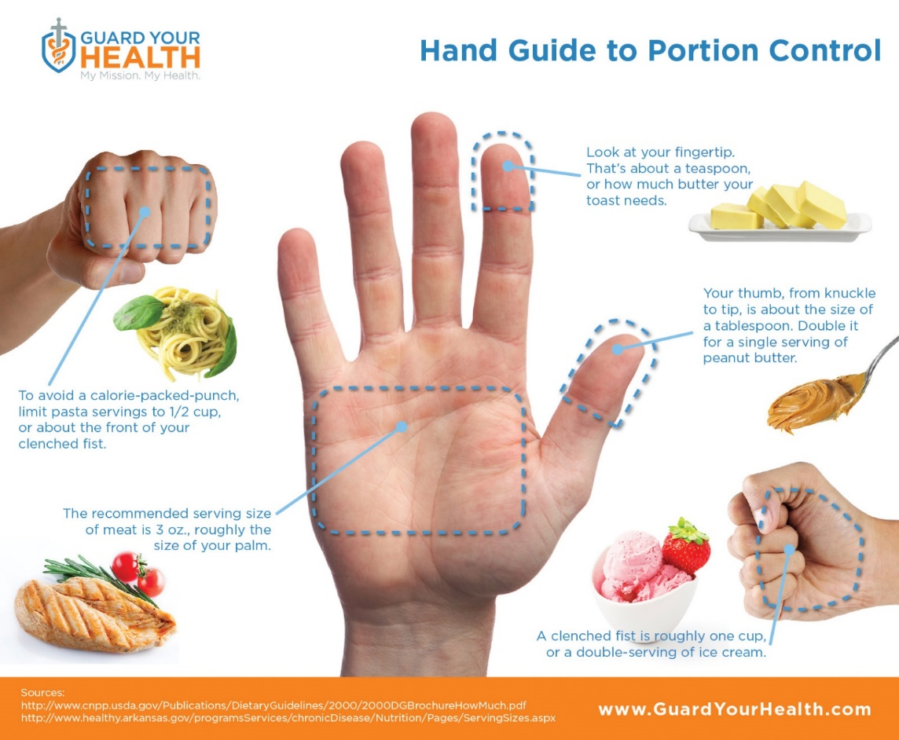
Portion Guide
Notes:
[TRAINER NOTES] Ask participants to find the Portion Guide document on page four in the handout for easier viewing.
[SUGGESTED SCRIPT]
Being conscious of portion sizes is another way to support wellness. Over time portions in restaurants have grown too large, distorted sizes. Examples include the enormous sodas or big gulps from convenience stores and the oversize plates used in many restaurants. A simple tool to help visualize portion sizes is your hand.
1. Look at your fingertip. That's about one teaspoon or one serving of butter for toast.
2. Your thumb, from knuckle to tip, is about the size of a tablespoon. Double it for a single serving of peanut butter.
3. The front part of your clenched fist is approximately ½ cup or a serving of pasta.
4. The recommended serving size of meat is 3 oz., roughly the size of your palm.
5. A clenched fist is roughly one cup or a double serving of ice cream.
6. The clenched fist (one cup) is the serving size for a serving of beans or vegetables.
7. Two open hands are about 2 cups or a serving of leafy greens.
Although hand size varies, this is a reasonable estimate for men and women. It also applies for children, smaller hands, smaller portions.

Slide 21
Challenges to Healthy Eating
Access to fresh, whole, affordable, culturally relevant food
Transportation
Time
Cooking Equipment
Cooking Skills
Space
Costs of equipment, transportation and groceries
Notes:
[SUGGESTED SCRIPT]
Healthy eating is a challenge for everyone but many families, especially in underserved communities face even greater barriers to quality food options. Even when families would like to eat healthier options, they may not be able to access healthy food options. It is important to recognize barriers to health and wellness when supporting families and children.
Access
Limited access to supermarkets, supercenters, grocery stores, or other sources of healthy and affordable quality food makes it harder for some families to eat a healthy diet. Families who live in food deserts may rely on convenience stores and fast-food restaurants, which may not sell a variety of healthy foods. About 23.5 million people live in food deserts, and nearly half of them are also low-income.*
Transportation
Food shopping typically involves multiple heavy bags to carry. Managing groceries and children while using public transportation is challenging. Transportation by car is impacted by high gas costs.
Time
Time to shop and prepare food is also a constraint for families. Time for meal preparation on top of work, school, and commuting time, can be difficult to find. Preparing fresh, whole food is more time-consuming than preparing packaged, processed foods.
Cooking equipment can be expensive. Cooking with whole foods usually requires more equipment such as knives, utensils and tools..
Cooking skills
Cooking requires skills and knowledge. Food safety, knife skills and menu planning are essential pieces of healthy eating! Most of us learn our cooking skills from our families so if you grew up in a home where people cooked regularly, you may have picked up the cooking techniques used. Some middle and high schools offer classes that teach cooking skills. Cooperative Extension Agencies in some communities offers free or low-cost cooking classes as part of family consumer science programming. Another resource for cooking skills is SNAP-Ed. SNAP-Ed is a USDA program that provides a hands-on educational approach to SNAP recipients.
Space
Many home kitchens were not built out to support a lot of cooking.
[TRAINER NOTE]
Consider sharing a map of food deserts in the community. Maps can be accessed at https://www.ers.usda.gov/data-products/food-access-research-atlas/go-to-the-atlas/

Slide 22
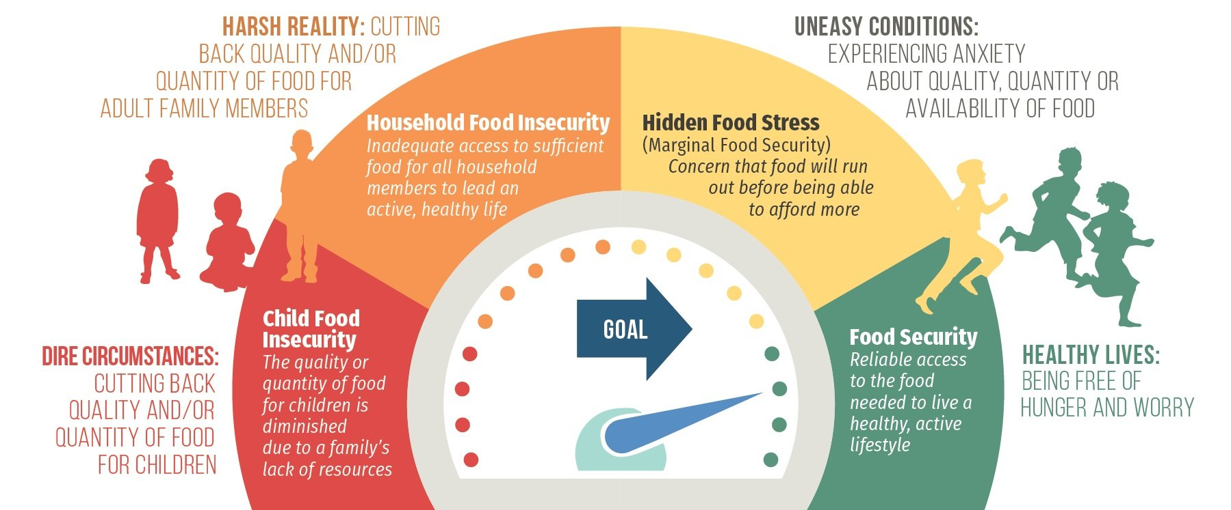
Food Insecurity
Food insecurity is defined as limited or uncertain access to sufficient, safe and nutritious food
1 in 6 children live in households that do not have a consistent and dependable supply of healthy food
Notes:
[TRAINER NOTES]
Food insecurity rates have increased sharply due to the COVID-19 pandemic. Children in food insecure households may be hungry and missing vital nutrients.
[SUGGESTED SCRIPT]
Food-insecure families may avoid hunger by choosing cheaper, more filling types of food over more costly, nutritious foods. For young children, the result can be a diet with inadequate nutrients for normal growth and development.
A family may be experiencing food insecurity if they regularly:
Are unable to afford balanced meals
Reduce the size of meals because of lack of money
Reduce the quality and variety of their regular diet due to lack of money
Food insecurity causes stress in families, which can have a negative impact on child development.
The graphic here from the Children’s HealthWatch Report Card on Food Security Among Young Children highlights the different levels of food stress that a family may experience. As you can see, families and children can experience different type of food stress and insecurity. While this graphic is from a few years ago, the pandemic has only increased these stresses for families and children.
Source: Children’s HealthWatch, HIDDEN FOOD STRESS: UNDERREPORTED IN NATIONAL DATA 2015
https://childrenshealthwatch.org/hiddenfoodstress/

Slide 23
Addressing barriers to healthy eating
Community gardens
Farm to Early Care & Education
National Farm to ECE
Farmers’ markets
Notes:
[SUGGESTED SCRIPT]
Many communities across the country are coming together to tackle these long-standing barriers to health and wellness. There are growing initiatives and organizations finding solutions to bring in healthier food options and change the power dynamics of food access and the traditional food system.
When seeking healthier food options for yourself or your ECE program, there may be additional community resources and options available to you, including:
Community gardens & Farm to Early Care & Education
Community gardens aim to increase access to fresh produce and enhance social connection around planting and growing local food. Community gardens are often supported local volunteers or may be available in your neighborhood or local school. You can even seek support for establishing a garden in your ECE program. The National Farm to School Network provides resources for ECE programs interested in getting started with gardening and other activities to bring local food to young children. https://www.farmtoschool.org/our-work/early-care-and-education.
Farmers’ Markets & Nutrition Benefits
Farmers markets can be great sources of fresh fruits, vegetables and other healthy foods. Many states provide incentives to shoppers who use SNAP to purchase local food. This incentive stretches a SNAP budget and encourages shoppers to spend more of their monthly food assistance allotment on fresh produce from the market.

Slide 24
Addressing barriers to healthy eating
Food Co-ops
Food banks & mobile food banks
Federal nutrition assistance programs
Notes:
[SUGGESTED SCRIPT]
Food co-ops are stores owned and supported by the people that shop there. Like farmers’ markets and community gardens, food co-ops emphasize community engagement and healthy, sustainable foods.
Food banks & mobile food banks can be another option for increasing food access. Many food banks are increasing their availability of healthy food options, some provide cooking skills classes or SNAP-Ed education. Mobile food banks are an option for rural communities who may not have access to food pantries or are far away from a food bank.
The two website highlighted here aim to connect communities with local food options. Local Harvest allows you to search for local farms, community supported agriculture (CSAs), Farmers Markets, and Farm Stands based on your location. www.localharvest.org
JustFood is a NYC organization focused on food justice and provides resources on food access, community food education. The website can help you find a CSA or Farmers Market. www.justfood.org
Besides these local food options, federal nutrition programs like WIC, SNAP can support families experiencing food stress and food insecurity. Many families may not realize they are eligible for these programs and the application process has changed in response to the COVID-19 pandemic. ECE programs can help connect families and staff connect to these programs. The handouts include information on Federal nutrition assistance programs and state agency contacts.

Slide 25
Break
Notes:
[TRAINER NOTES] This is a suggested point in the training to provide a 10-minute break. There is a timer in the trainer kit to help track time. Encourage participants to get up and stretch or move, get water and take care of themselves.
For virtual sessions, request that each participant return in 10 minutes with a small edible item that we will use in an exercise. This could be a raisin, a nut, a cracker, or a bite of any item available.

Slide 26
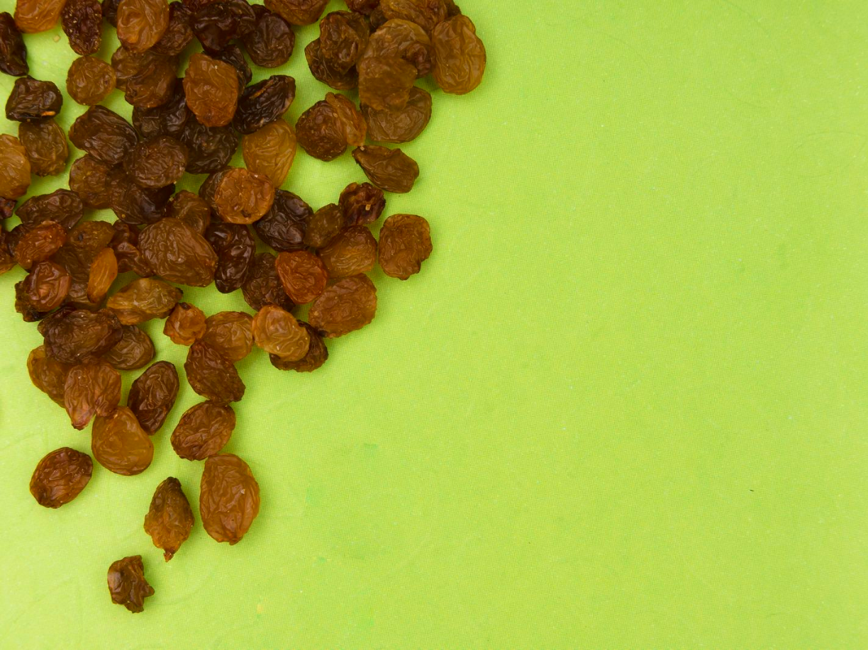
Mindful Eating Exercise
Notes:
[TRAINER NOTES]
Give each participant several raisins, or if training virtually, ask participants to hold the edible item they gathered during break.
Read the following script aloud in a slow, calm voice. Another option to facilitate this exercise is to play a video clip of a mindful eating exercise. https://www.youtube.com/watch?v=yeuDxlJgtj4
[SUGGESTED SCRIPT]
Mindfulness is being conscious or aware of something. Mindfulness in eating is being fully present and engaged in the act of eating.
1. Holding: First, take a raisin and hold it in the palm of your hand or between your finger and thumb.
2. Seeing: Take time to really focus on it; gaze at the raisin with care and full attention – imagine
that this is your first time to see an object like this.
Let your eyes explore every part of it, examining the highlights where the light shines, the darker
hollows, the folds and ridges, and any asymmetries or unique features.
3. Touching: Turn the raisin over between your fingers, exploring its texture, maybe with your eyes
closed if that enhances your sense of touch.
4. Smelling: Hold the raisin beneath your nose. With each inhalation, take in any smell, aroma, or
fragrance that may arise. As you do this, notice anything interesting that may be happening in
your mouth or stomach.
5. Placing: Now slowly bring the raisin up to your lips, noticing how your hand and arm know exactly
how and where to position it. Gently place the raisin in your mouth; without chewing, noticing how
it gets into your mouth in the first place. Spend a few moments focusing on the sensations of
having it in your mouth, exploring it with your tongue.
6. Tasting: When you are ready, prepare to chew the raisin, noticing how and where it needs to be
for chewing. Then, very consciously, take one or two bites into it and notice what happens in the
aftermath, experiencing any waves of taste that emanate from it as you continue chewing.
Without swallowing yet, notice the bare sensations of taste and texture in your mouth and how
these may change over time, moment by moment. Pay attention to any changes in the
object itself.
7. Swallowing: When you feel ready to swallow the raisin, see if you can first detect the intention to
swallow as it appears, so that even this is experienced consciously before you actually swallow
the raisin.
8. Following: Finally, see if you can feel what is left of the raisin moving down into your stomach,
and sense how your body as a whole feels after you have completed this exercise.
https://www.uaex.edu/life-skills-wellness/extension-homemakers/Mindfulness.pdf

Slide 27
Reflections on Mindful Eating
How did this experience compare to your typical eating pattern?
Did anything surprise you during the experience?
What did you notice about the raisin?
What can you take from this experience and apply to your habits?
Notes:
[TRAINER NOTES] Facilitate a large-group discussion using the questions on the slide

Slide 28
Mindful Eating Strategies
Ponder
Appraise
Slow
Savor
Stop
Notes:
[TRAINER NOTES] Encourage participants to find the mindful eating strategy handout on page five in the handout.
[SUGGESTED SCRIPT]
By applying the practices in eating mindfully, you can learn to be more present while you eat. You become more aware of your reactions to food and eating, as well as your habits around mealtime. Mindful eating doesn’t have to mean eating slowly. As you know what to pay attention to, you can eat at any speed.
You may end up enjoying food that you like even more while becoming more tolerant of food that you may not like as much. In some cases, you may learn to appreciate flavors you previously discounted. In other cases, you might identify new flavors that you enjoy. You may also find that you can decrease the emotional intensity of eating food you dislike by adding a little more space between stimulus and response. To practice Mindful Eating, keep in mind…
Ponder: Check in with yourself about your hunger before you eat – you may actually be thirsty, bored, or stressed.
Appraise: Take a moment to take it in. How does it smell? Do you really want it? Is it more than you need?
Slow: Slow down so your brain can keep up with your stomach. Put your fork down between bites and focus on the flavor.
Savor: Enjoy your food. Take a moment to savor the satisfaction of each bite – the taste, texture, everything!
Stop: Stop when you’re full – there’s no need to join the clean plate club if it means overeating.

Slide 29
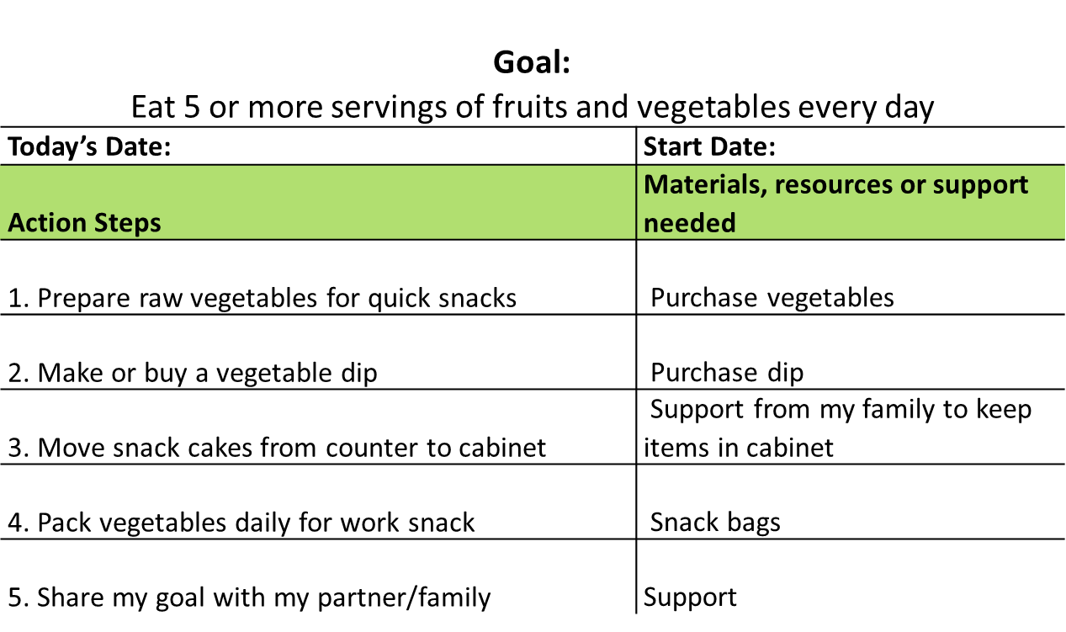
Action Plan
Notes:
[SUGGESTED SCRIPT]
Adopting new habits is difficult. We all have established behaviors around our eating habits. These behaviors are shaped by our past and present experiences, culture, and tradition. Some of these habits support health and some less so. What is a habit around healthy eating you would like to build or do more frequently?
It can be helpful to set one small goal that is realistic to achieve. The more specific, the better! The goal of this action plan is to eat five or more fruits and vegetables a day. Think about and count the servings of fruits and vegetables you consumed yesterday. Was this a typical day for you? Did you reach five servings? If you had three or four servings, then this would be a reasonable goal. If you had no fruits and vegetables yesterday, this would not be a small goal for you. Think about setting the number at two or three servings of fruit and vegetables a day.
Let's walk through the action steps. Action steps should have specific actions that move toward the goal or remove obstacles to success.
[TRAINER NOTES] Walk through the sample action plan on the slide. After reading the action steps, ask participants to share what additional action steps would help them reach this goal.

Slide 30
Create Your Goals
What are the values guiding your food choices?
What qualities are important to you when it comes to food?
What is a healthy eating habit you wish you practiced more consistently?
Notes:
[TRAINER NOTES]
The slide questions are provided as prompts for a large-group discussion to get participants thinking about goals. Goals could be a healthy eating behavior they would like to establish or an unhealthy eating behavior they would like to change. Direct participants to the action plan template in the handout on page six. Beneath the template is a list of sample goals. Encourage participants to select one of the listed goals or create a goal that fits their need.
Give participants five to ten minutes to create their own action steps. It can be helpful to encourage those with similar goals to work together. Afterward, ask a volunteer to share their plan or the group to reflect on the process of setting goals.
For virtual training, the timer may help track the remaining time.
[SUGGESTED SCRIPT] Eating is a learned behavior and based on many complex cues and emotions. The path to adopting a healthy eating behavior into your lifestyle can be an up and down journey. Relapsing into previous behaviors is common. Studies on smokers show they may take multiple times to quit before they reach a maintenance place. If your first attempt is not successful, think about what you learned in the process and attempt and adjust the course next attempt!
Understanding how challenging it is to change eating habits reinforces how important it is that we support young children in establishing healthy behaviors from the start!

Slide 31
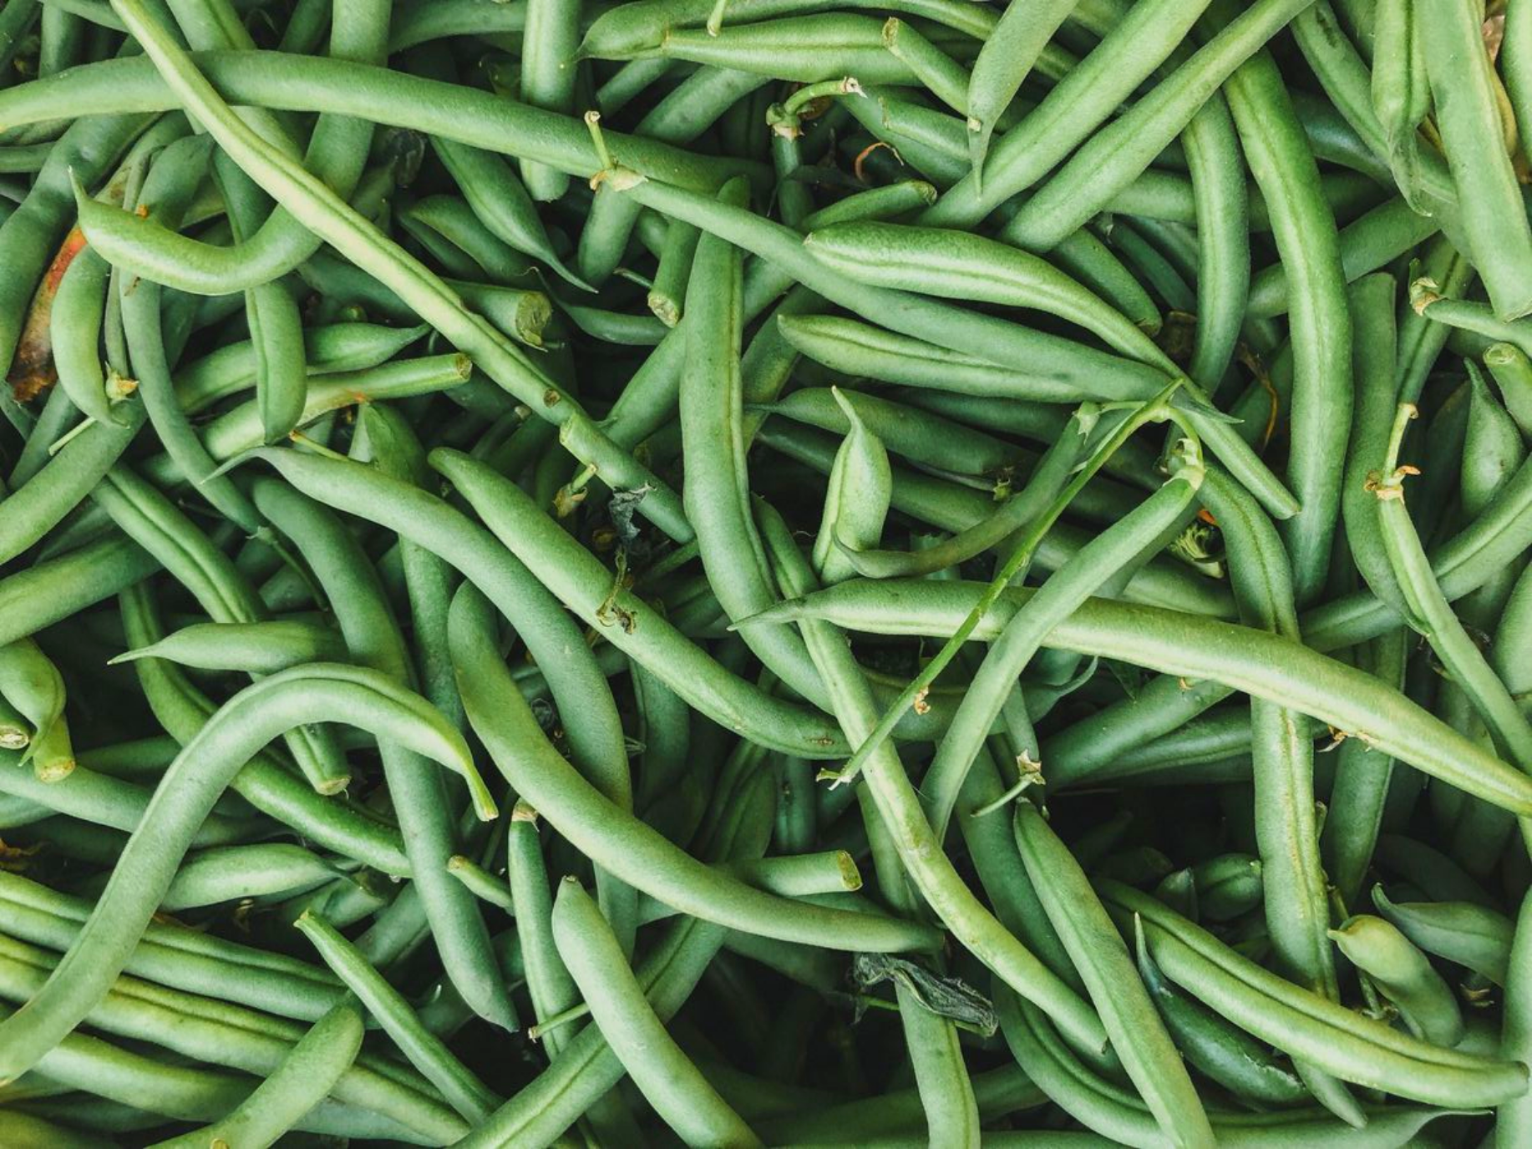
The Bean Activity
Notes:
[TRAINER NOTES] Demonstrate the movement for four or more of the various beans listed below. Ask participants to stand in place. When you call out a type of bean, they should move like the type of bean or simply follow your movement.
Another option for this activity break is to ask participants to list as many types of beans as they can in one minute. When the time has expired, see who has the longest list at the end of the allocated time and ask them to read their list aloud.
Broad Bean- Stand with your arms and legs as wide as you can
Runner Bean- Run in place
Chili Bean- Shiver and shake
String Bean- Stand on tiptoes with arms above head
Black-Eyed Peas- Stand with a hand over one eye
Kidney Beans- Bend sideways into a ‘C’ shape
Beanstalk-Crouch down in a squat and ‘grow’ slowly as you return to standing
Snap Beans- Snap fingers
Jumping Beans- Jump in place
Bean Sprout- Stand on tiptoes and make yourself as tall as possible
Jelly Bean- Wiggle and wobble like jelly

Slide 32
Why is healthy eating important for infants, toddlers and preschoolers?
Experts believe that early childhood is the best time to establish healthy eating habits
Research shows that the more opportunities children are given to sample unfamiliar foods, the more likely they are to like and accept such foods
Young children are motivated to imitate the behaviors around food modeled by caregivers and peers
Notes:
[SUGGESTED SCRIPT]
Food preferences and dietary patterns begin developing from birth. From birth to age 2 is a critical period for exposing children to a wide variety of healthy foods and setting a preference for healthy options. Child care can help influence these preferences as children may consume up to two meals and two snacks daily while in child care.
Establishing healthy eating habits early can support a lifetime of good health.
[TRAINER NOTES]
The terms early care & education (ECE) professional and caregiver are used to refer to all professionals who care for children in family child care homes, head start settings, preschools and centers. Please adjust to use the term that is acceptable for your participants. Some ECE professionals prefer the term teacher, provider, or educator.
[SUGGESTED SCRIPT]
Our habits around food and eating started developing in early childhood. As adults, we carry some of these habits and preferences today. Establishing healthy eating habits early can support a lifetime of good health.
Infants and young children are dependent on the adults in their lives to make choices on what foods will be provided and the climate and practices in the feeding environment. As early care professionals, we can help children become healthy eaters.
As children engage in meals with classmates, caregivers and their family we can see growth in multiple areas of development. We will explore nutrition's role in three areas of child development during this section: Brain Development, Physical Development, and Social-Emotional Development. We will also consider how adults can help children develop healthy eating behaviors.
Child development is a highly interactive process: Genetics, environment, social and cultural practices, and nutrition influence how a child grows.
Healthy diets for young children contribute to physical well-being and are also vital for good cognitive development. Current research shows that a varied diet rich in essential nutrients such as protein, carbohydrates, healthy fats, and vitamins and minerals supports periods of rapid growth and brain development. Also, good feeding habits and environments are crucial to a young child’s social-emotional learning.
Food preferences and dietary patterns begin developing from birth. From birth to age 2 is a critical period for exposing children to a wide variety of healthy foods and setting a preference for healthy options. Child care can help influence these preferences as children may consume up to two meals and two snacks daily while in child care.
Establishing healthy eating habits early can support a lifetime of good health.

Slide 33
Physical Growth & Development
During a child’s first six months, they grow faster than at any other time in life. Healthy food fuels this growth.
Children have specific energy needs (calories), including protein, fats, and nutrients.
As children develop their motor skills and increase their movement, they need more energy.
Notes:
[SUGGESTED SCRIPT]
From birth to 6 months, physical growth occurs more rapidly than at any other time in life and is fueled by calories and nutrients. Infants generally double their birth weight by 4-6 months of life and triple their birth weight by one year. The energy needs of infants are higher per pound than at any other time in life. Growth slows down during toddler and preschool-age years but continues at a steady rate. Fat is especially important in brain development and function.
Motor Skill Development is a part of physical growth and development. As motor skills emerge and movement increases, daily energy needs increase. Infants who are crawling need more energy than infants who have not mastered this skill.
During the subsequent training, Nourishing Infants and Toddlers & Nourishing Preschoolers, the content will explore the role of nutrition and mealtime experiences in motor skill development.

Slide 34
Brain Development
Responsive caregivers
Experiences
Protein, Fat, Iron, Zinc & Iodine
Notes:
[SUGGESTED SCRIPT]
From birth to age three, the brain grows more quickly than at any other time in life. Nutrition provides the fuel for rapid growth.
The developing brain also needs experiences in supportive environments and interactions with responsive caregivers. Feeding provides opportunities for both.
During infancy, breast milk or formula in bottles provides the nutrients needed. The physical process of breastfeeding or being held close during bottle-feeding offers experiences and interactions that nurture the brain.
As a toddler, the brain is busy forming synapses. These are the connections that allow neurons (brain cells) to communicate with one another. Many synapses are being formed in the brain's areas responsible for language development, motor skills, and cognitive skills. Mealtime components that support the developing brain include social interactions and conversations and a healthy, varied diet.
If a child suffers from poor nutrition, brain development can be compromised by the absence of key nutrients required for proper cognitive functioning and neural development. Nutrients essential for brain development include Protein, Iron, Zinc, and Iodine.
Protein restriction seen in malnutrition can result in smaller brains with fewer neurons and reduced concentrations of neurotransmitters and growth factors.*
Iron is necessary for normal anatomic development of the brain. Young children are at risk for iron deficiency because of their rapid growth and expanding volume require iron.
Zinc and Iodine play a critical role in the development of neurons.
Fats also have a crucial role as they support myelination in the growing brain. Children need a high level of fat in their diets, around 50 percent of their total calories until age 2. Babies should receive most of this fat from breast milk or formula in the first year of life.
Varied, healthy diets while in early care settings support brain development.

Slide 35
Healthy Eating Habits and Oral Health
Nutritious foods and healthy eating habits are important for growth, development, and maintaining a healthy body
The teeth, bones and soft tissues in the mouth benefit from healthy foods
Prevent tooth decay by limiting between-meal snacks
Caregivers should brush a young child’s teeth at least once a day at bedtime
Notes:
[SUGGESTED SCRIPT]
In addition to Brain Development, good nutrition is important for our teeth, gums, and mouth.
[TRAINER NOTES]
Highlight key points on slide.
Source: American Academy of Pediatric Dentists aapd.org

Slide 36
Social-Emotional Development
Feeding provides a time for social interaction and developing trust with caregivers
During mealtime, young children copy the eating patterns and behaviors of parents, caregivers, adults, siblings and peers providing a rich opportunity for Social-Emotional growth
The first three years of life can be challenging because a child’s feeding abilities and needs change with motor, cognitive and social development.
Notes:
[SUGGESTED SCRIPT]
Social-Emotional Skills are the skills that help us get connect with others and manage emotions. The skills begin developing from birth. Social-Emotional Development, like Brain Development, is highly influenced by relationships with caregivers and experiences in environments. Feeding and Eating provide multiple opportunities for social-emotional development throughout the day.
Feeding is a significant event in the daily life of an infant and young child. For a preschooler, feeding typically happens 5-6 times a day, counting meals and snacks. This might add up to 2 or more hours, comprising a substantial portion of a child’s waking hours. For very young children feeding time is an opportunity to develop trust with caregivers, to interact with others. This verbal and non-verbal communication between children and adults builds a foundation for social development.
The first three years of life are particularly challenging because a child’s feeding abilities and needs change with motor, cognitive and social development.
From birth to approximately three months, the infant develops self-regulation and organization. During this time, a child’s experiences of hunger and fullness help develop regular feeding patterns.
From three to seven months, the infant communicates with caregivers and develops self-soothing behaviors. A responsive caregiver responds to these cues helping establish trust.
From 6-36 months children the child gradually “separates” emotionally from the caregiver and discovers a sense of independence or autonomy, making use of developing motor and language skills to establish independent feeding.
With participation in group meals, the social component of feeding expands. During mealtimes we can see children engaging in activities such as social conversation, problem solving, taking turns, waiting, and self‐help skills.

Slide 37
Be an Influencer!
My food journey shapes me
#PasstheGreens
Notes:
[TRAINER NOTES] Divide participants into groups of four or use breakout rooms if training virtually. Ask participants to think about the content of today’s training and create a caption and hashtag for a social media post (i.e. Instagram, Twitter, Facebook). Remind participants that as ECE providers they are the original influencers for children. Give groups five minutes to think of captions and hashtags and then share back with the group. Capture responses on a flip chart, whiteboard, or virtual chat.
[SUGGESTED SCRIPT] We are all probably familiar with social media and the power of influencers to promote behaviors, personal interests, hobbies, and products. Captions are simple, concise, and attention-grabbing. They support your post and sometimes go viral. A great caption or hashtag helps your friends, family or followers to share in your experience. Think about what you’ve learned, seen, or felt during this introductory training. Create a caption and hashtag that communicates your own takeaway from today.
For example, My food journey shapes me. #PasstheGreens

Slide 38
Join us to learn more!
Nourishing
Infants & Toddlers
Discuss the developmental stages of becoming a healthy eater and common challenges
Identify the role of ECE professionals in nurturing healthy eaters
Recognize family engagement opportunities around nutrition and food
Identify one or more nutrition best practices to incorporate in your daily routines with children
Insert Date, Time & Location
Nourishing
Preschoolers
Insert Date, Time & Location
Notes:
[SUGGESTED SCRIPT]
Today we have discussed nutrition basics and thought about how our early feeding & eating experiences influence our eating habits.
We have considered how nutrition and wellness are interrelated and developed an action plan to improve our nutrition.
We dove into how adequate nutrition is essential to areas of child development explored the adult role in helping children become healthy eaters
Two trainings focusing on age-specific objectives are available with content relevant for providers caring for children in that age group.
Talk with your trainer for more information.

Slide 39
Acknowledgments
This training was made possible thanks to the funding, technical expertise, and guidance from the following national and state organizations.
For expertise in children’s health and wellness. This training series was developed by nutrition and early childhood experts.
For initial funding to design and develop the original Nourishing Health Eaters training series
Notes:
[SUGGESTED SCRIPT]
Finally, we’d like to acknowledge some national and state partner organizations that made this training possible.

Slide 40
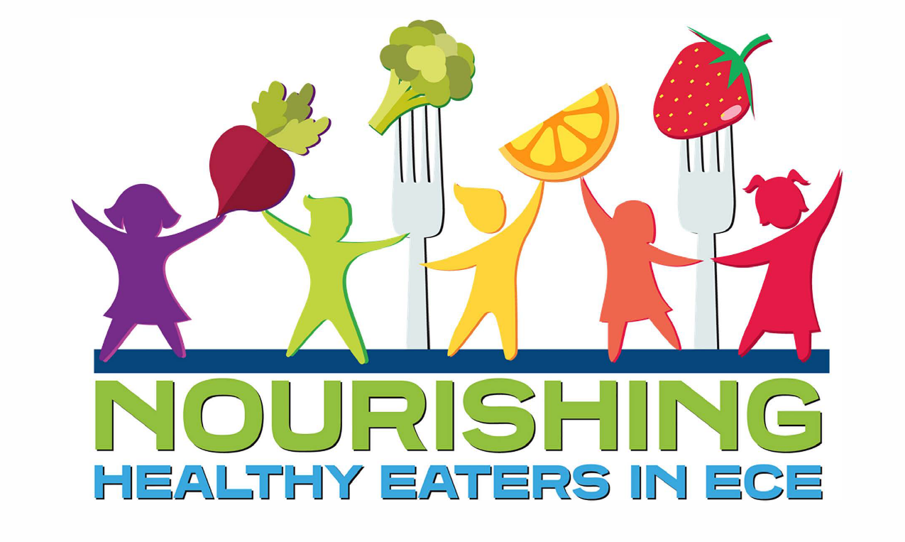
Thank you for participating in today’s training
Notes:
[SUGGESTED SCRIPT]
Thank you for participating in today’s training. As a child care professional, you can play an important role in Nourishing Healthy Eaters.

