Slide 1
Insert trainer information here
Notes:
Welcome to the Healthy Kids Healthy Future Physical Activity Learning Session. We call this program PALS.
Thank you for sharing your time with us today to learn more about how early care settings can support young children to become more physically active.
In this training you will learn best practices of physical activity in Early Care and Education settings related to time and space.
Trainer notes: Distribute and review the Warm-Up Log in the Training Handouts section of the Facilitator Guide and on the USB.

Slide 2
Notes:
A special thank you to these organizations and people who helped successfully develop this training.

Slide 3
Nemours Children’s Health is currently funded by the Centers for Disease Control and Prevention (CDC) under a 5-year Cooperative Agreement (6NU38OT000304-01-02). Through this effort, we support statewide early care and education (ECE) organizations to integrate best practices and standards for healthy eating, physical activity, breastfeeding support, and reducing screen time in ECE systems and settings.
The views expressed in written materials or publications, or by speakers and moderators do not necessarily reflect the official policies of the Department of Health and Human Services. Any mention of trade names, commercial practices, or organizations does not imply endorsement by the U.S. Government.

Slide 4
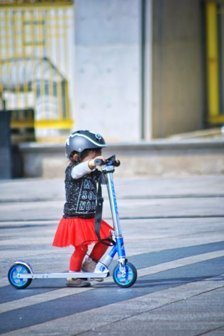
Icebreaker: Share a type of physical activity that you have never tried
Notes:
Trainer notes: Icebreaker suggestions:
Ask each participate to share their name and response to the prompt.
If time allows, ask their thoughts about why they have not tried these activities.
Are there links to past experiences and exposure to motor skills?
Are there links to access and equipment?

Slide 5
What will you learn in this session?
With this training, you will:
Learn about and practice skills for meeting time and space best practices in the ECE setting
Notes:
In this section we’ll introduce the best practices of physical activity.
These best practices come from Caring for Our Children: National Health and Safety Performance Standards for Early Care & Education Programs.
The objective for this session:
Develop the skills to implement the best practices of physical activity in ECE settings around time and space.
Source:
1. American Academy of Pediatrics, American Public Health Association, National Resource Center for Health and Safety in Child Care and Early Education. Caring for Our Children: National Health and Safety Performance Standards; Guidelines for Early Care and Education Programs, 4th ed. Itasca, IL: American Academy of Pediatrics; 2019.

Slide 6
Best practices for physical activity
Time – Recommended duration of physical activity in ECE settings
Space - Indoor and outdoor facilities
Type - Structured, unstructured, indoor and outdoor physical activity
Time
Daily Activities – Integrating best practices into lessons, transitions, and other program operations
Training
Space
Policies
Providers - The role of adults in leading, participating, role modeling, encouraging physical activity
Families
Type
Families - Supporting and communicating with families
Providers
Daily Activities
Training – Ongoing professional development to promote children’s physical activity
Policies - Written policies that help support children’s physical activity throughout the day
Notes:
The best practices for physical activity are divided into 8 areas.
Notice that policies is in the middle of the diagram. A strong program policy will support each of the best practice areas.

Slide 7
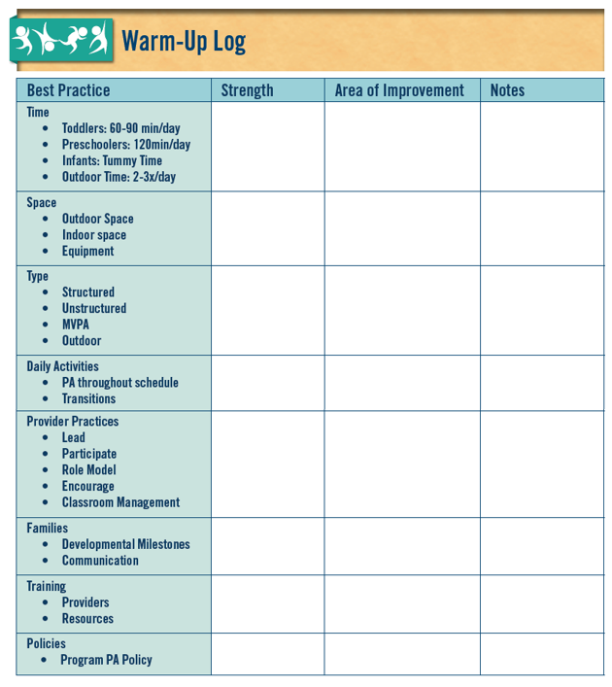
Reflect on best practices
What are your strengths? What do you already do?
What do you not do yet?
What do you want to remember later?
Notes:
Trainer notes:
At the end of each best practice section, you’ll be prompted to give participants 2 to 3 minutes to make notes on the PALS Warm-up Log (found in Training Handouts section of your Facilitator Guide and on the provided USB).
Tell participants to think about identifying strengths and areas of improvement in their own program and practices based on the content covered.
At the end of the training, the log will help in goal setting and action planning. Encourage participants to use the log for notes, ideas and thoughts as they arise during training.
As the training content addresses each best practice area, use this handout to capture notes.
In the first column note your strengths in this best practice or the things you already do.
In the second column note things you hear in the training or from your peers that you might not yet do.
The last column write any other notes or thoughts you want to remember.
We will use this log during the goal setting and action planning portion of PALS.

Slide 8
Children are not getting recommended amounts of physical activity
Time
Training
Space
Policies
Families
Type
Providers
Daily Activities
Notes:
Time is the first best practice we’ll address.
Young children depend completely on adults to create opportunities and environments for active play.
Numerous reports suggest that children do not meet daily recommendations for physical activity.
They spend much of their time being sedentary(sitting or lying down).

Slide 9
What kind of activity do children need?
Infants
Toddlers/Twos
Infants need consistent, lively, developmentally appropriate physical activities
Toddlers need indoor or outdoor Moderate-to-Vigorous Physical Activity (MVPA)
Notes:
Infants need consistent, lively, and developmentally appropriate physical activities.
Toddlers need indoor or outdoor moderate-to-vigorous physical activity (MVPA). Increased exposure to short bursts of physical activity may improve their attention and focus after participation.

Slide 10
What is tummy time for infants?
Tummy time is placing babies on their stomachs only while they are awake and supervised
Tummy time should begin at birth
It prepares infants for sliding on their bellies and crawling and helps build upper body muscles
They need many chances to have supervised tummy time every day
Notes:
Tummy time is placing babies on their stomachs only while they are awake and supervised.
Periods of time in this position can help babies develop strong neck and shoulder muscles and promote motor skills.
It can also prevent the back of infants’ heads from developing flat spots.
Include tummy time in daily routines and provide it in both indoor and outdoor settings.

Slide 11
Infants need tummy time
Tummy time should happen on a firm surface (on a blanket on the floor, across the caregiver’s lap or on the provider’s chest)
You should increase the length of time and frequency as infants gain strength and enjoy the experience
Notes:
Tummy time should happen on a firm surface (blanket on the floor, across the caregiver’s lap or on the provider’s chest).
Tummy time should always be supervised.
You should increase the length of time and frequency as infants grow.

Slide 12
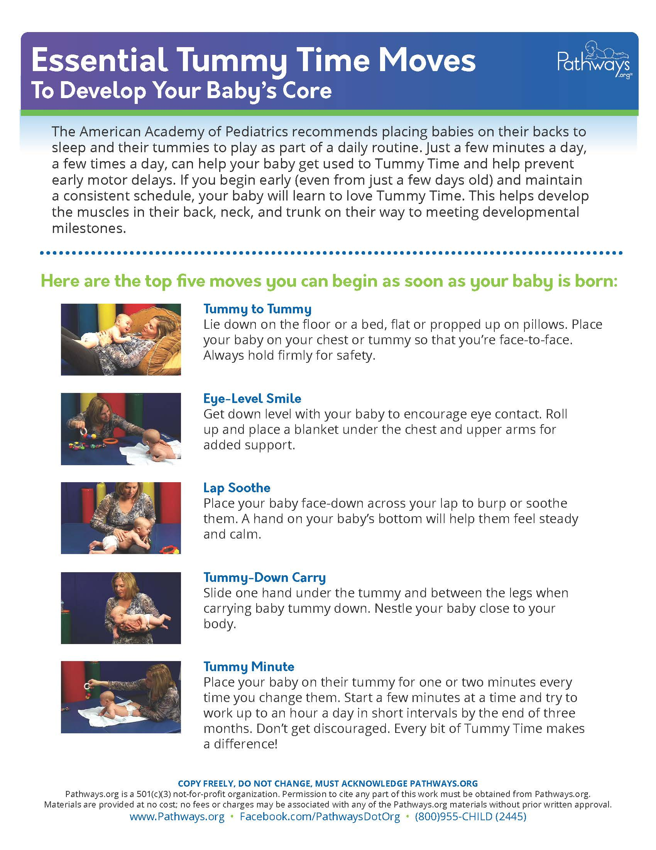
Notes:
Trainer notes: Hand out Essential Tummy Time Moves to participants (found in Training Handouts section of your Facilitator Guide and on the USB).
Tummy time can be done in many ways to support the physical development of infants.
Tummy to Tummy: Lie down on the floor or a bed, flat or propped up on pillows. Place baby on your chest or tummy so that you’re face-to-face. Always hold firmly for safety.
Eye-Level Smile: Get down level with baby to encourage eye contact. Roll up and place a blanket under the chest and upper arms for added support.
Lap Soothe: Place baby face-down across your lap to burp or soothe. A hand on your baby’s bottom will help the baby feel steady and calm.
Tummy-Down Carry: Slide one hand under the tummy and between the legs when carrying baby tummy down. Nestle your baby close to your body.
Tummy Minute: Place your baby on tummy for 1 or 2 minutes every time you change a diaper. Start a few minutes at a time and try to work up to an hour a day in short intervals by the end of 3 months.

Slide 13
How long should children be active?
Infants
Toddlers/Twos
Tummy time: 3-5 minutes in the beginning
Outdoor play: 2-3 times a day
MVPA time: 60-90 minutes every day
Outdoor play: 60-90 minutes every day
2-3 times a day
Notes:
Infants
While infants do not have a set amount of time for recommended physical activity every day, they should spend part of their day in planned and spontaneous opportunities for active play and physical activity.
Periods of tummy time can help babies develop strong neck and shoulder muscles and promote motor skills.
It can prevent the back of their head from developing flat spots.
Tummy time should be part of daily routines and should be in both indoor and outdoor settings.
Start a few minutes at a time and try to work up to an hour a day in short intervals by the end of 3 months.
Toddlers need at least 60-90 minutes of physical activity daily. The outdoor time and the MVPA time may overlap but typically toddlers do not spend all the time outdoors engaged in MVPA.
Toddlers generally accumulate moderate to vigorous physical activity throughout the day in very short bursts (15–30 seconds).
Increased exposure to short bursts of physical activity may improve their attention and focus after participation.

Slide 14
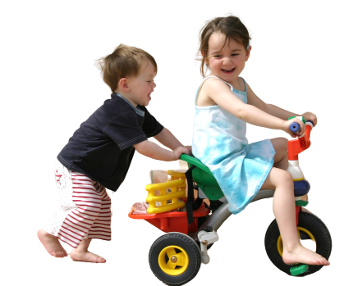
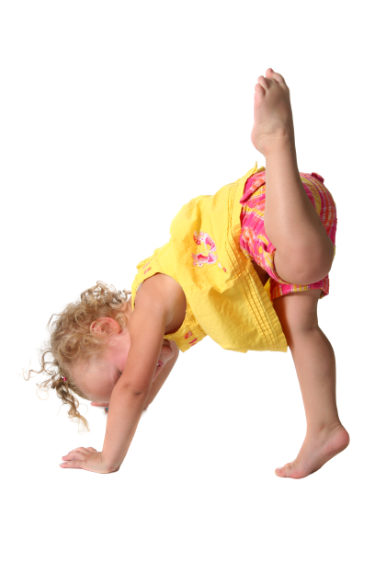
Moderate to vigorous activity combines activity types
Moderate intensity
Vigorous intensity
Causes children’s heart to beat faster and their breath to be harder, but still allows them to talk easily
Can be a brisk walk
Causes children's’ heart to beat much faster than normal and their breath to be much harder than normal leaving them “breathless”
Can be running
Notes:
Trainer notes: Make sure participants understand this definition.
Moderate to vigorous refers to the intensity of physical activity.
Moderate-intensity activity is a brisk walk that still allows normal talking and breathing.
Vigorous-intensity activity, like a jog or run or strenuous cycling, causes faster and deeper than normal breathing and interferes with the ability to talk (for example, it leaves you “breathless”). Children who are breathless because of physical activity exercise their heart and lungs along with the muscles in their arms and legs. As long as someone does not have health restrictions, becoming breathless during physical activity is healthful and safe.
Another way to think about activity level is using numbers. “On a scale of 0 to 10, where sitting is a 0 and the highest level of activity is a 10, moderate-intensity activity is a 5 or 6. When a child does moderate-intensity activity, their heart will beat faster, and they will breathe much harder than when they are at rest or sitting. Vigorous-intensity activity is a level 7 or 8. When a child does vigorous-intensity activity, their heart will beat much faster than normal, and they will breathe much harder than normal.” ²
Moderate to Vigorous physical activity combines moderate-intensity and vigorous-intensity activity.
Remember that the best practice recommendation for MVPA for toddler/twos is 60-90 minutes/8-hour day and for preschoolers is 90-120 minutes/8-hour day.
Source:
2. Centers for Disease Control and Prevention. (2021, May 8). How much physical activity do children need? | Physical Activity | CDC. https://www.cdc.gov/physicalactivity/basics/children/index.htm

Slide 15
Toddlers need indoor or outdoor moderate-to-vigorous physical activity every day
Toddlers have a distinct gait or toddle displayed with the developing movement skills
They typically walk with legs wide apart and shift their weight from side to side using the arms to balance
They are developing balance, control, coordination, and strength
Notes:
Toddlers typically walk with their legs wide apart and shift their weight from side to side using the arms to balance.
They are developing balance, control, coordination, and strength.
Toddlers are learning to climb, run, leap and balance their bodies in new ways.
Mastering movements uses many muscles and can be tiring for them.
Also, toddlers have short attention spans. They demonstrate bursts of MVPA throughout the day.

Slide 16
Preschoolers need more time for physical activity than toddlers
They typically have more stamina and have developed motor skills that support movement for increased durations of time
Best for preschoolers: 90-120 minutes every day
Physical activity can be accumulated in short 10- to 15- minute bursts across the child-care day
Notes:
Preschoolers need more time allocated for physical activity daily than toddlers.
They typically have more stamina and have developed motor skills that support movement for increased durations of time.
As with toddlers, there is likely overlap in the time preschoolers spend outdoors and the time they are engaged in MVPA. Note that these times are not distinct. Typically, not all outdoor time will be spent in MVPA.
The best practice for preschool aged children is 90-120 minutes of PA daily. Physical activity can be accumulated in short 10- to 15-minute bursts across the child-care day.
These recommendations are for full-day programs.
For example:
Full-day programs:
15 minutes x 8 hours = 120 minutes of physical activity
hour
For partial day programs, it may be useful to consider 15 minutes per hour of care.
Half-day programs:
15 minutes x 4 hours in care= 60 minutes of PA
Hour
Source:
3. Institute of Medicine of the National Academies (2011). Early Childhood Obesity Prevention Policies. National Academy of Science. Washington DC. http://www.nap.edu.

Slide 17
Reflect on best practices
Is time a strength or area of improvement?
Notes:
Trainer notes:
Have participants refer to their PALS WARM-UP LOG and note if TIME is a strength or area of improvement in their environment.
Encourage them to note ideas they have for increasing the amount of time children engage in physical activity and key concepts from the training they want to remember.
Check participants’ understanding before you move on. Suggestions include:
Use a polling feature or app such as Mentimeter.com or Poll Everywhere (pollev.com) and do a series of multiple-choice questions
How many times should infants, toddlers, and preschoolers experience outdoor play daily? Answer Choices: 0, 1, 2-3
What is the recommended amount of daily MVPA for a preschooler?
What is the minimum daily time recommended for outdoor play for toddlers and preschoolers? Answer Choices: 30 minutes, 60-90 minutes, 2 hours

Slide 18
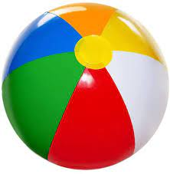
Activity break!
Beach Ball High
Notes:
Trainer notes: Conduct the Beach Ball High Activity using the materials in the resource kit.
If you do not have an activity kit, use a lightweight ball.
Directions:
Using the activity cards in the trainer resource kit, select the Beach Ball High Activity Card and the beach ball.
Have participants form a circle.
Tell participants to see how many times they can work together to hit the ball and keep it in the air without touching the ground. Count the number of hits together.
If the ball touches the ground, the game starts over.
If you have multiple balls, introduce a second ball to make the game more challenging.
If you have a large group of participants, consider dividing into 2 groups so each participant has more chances to hit the ball.
Trainer notes: Lead a large group discussion.
What developmental skills were used in this activity?
How could you modify this activity for different age groups?
What other materials can you use for this activity? (If balloons are mentioned as a replacement for balls, remind participants that balloons are a choking hazard and latex balloons can be an allergy hazard.)
If you are facilitating the session virtually, consider this activity.
Ask participants to stand and think about different types of balls used in sporting activities. Demonstrate the activity. “I’m thinking of a bowling ball that is rolled at bowling pins” Act out the motions of swinging a ball back and forward toward a target as you step toward an imaginary line. Instruct the group to act out rolling a bowling ball. Ask for several volunteers to name a type of ball and demonstrate how it is used.

Slide 19
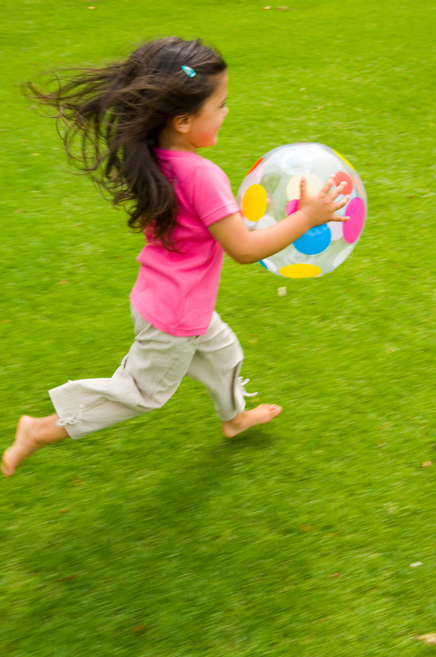
Children need space to practice gross motor skills
Time
Training
Space
Policies
Families
Type
Providers
Daily Activities
Notes:
Physical activity in young children is also influenced by the child care space and equipment.
ECE providers must identify spaces both indoors and outdoors where young children can:
be physically active,
practice gross motor skills,
engage large muscle groups, and
be active at a higher intensity (where they are breathing harder, and their heart rate is higher).
ECE providers should also offer age and developmentally appropriate equipment in these spaces to encourage young children to be physically active.

Slide 20
Children need outdoor play spaces
Outdoor play areas should:
Be next to the facility or be able to be reached by a route free from hazards
Give freedom for gross motor movement without collisions among active children
Meet playground size minimum, 75 square feet per child
Meet the American Disabilities Act (ADA) requirements
Notes:
You can supplement limited outdoor space by taking children to a nearby park or other safe open spaces.
Ideal outdoor play spaces have:
open grassy areas,
covered areas for shade and shelter,
multiple areas for different play opportunities and
portable equipment.
Follow your state and local regulations about approval for outdoor play spaces.
Source:
4. American Academy of Pediatrics, American Public Health Association, National Resource Center for Health and Safety in Child Care and Early Educ. Caring for Our Children: National Health and Safety Performance Standards; Guidelines for Early Care and Education Programs. 4th ed. 6.1.0.1 Size and Location of Outdoor Play Areas. Elk Grove Village, IL: American Academy of Pediatrics; 2019:598.

Slide 21
Think about the weather
Take children outside in weather with:
Wind chill above 15˚F
Heat index below 90˚F
Air Quality Index in a safe range
Protect children from the sun, especially 10 am - 2 pm
Use sunscreen
Have drinking water on hand
Ask families to send appropriate clothing so children can play outdoors in any weather
Children need hats, coats, gloves, rain gear, sunscreen
Keep an extra supply of clothing
Notes:
Children need several outdoor play periods every day. With appropriate clothing, children can enjoy outdoor play in almost all weather. Depending on the season, they may need boots, coats, gloves or sun hats. The length of time spent playing outdoors may be shortened during certain weather but unless weather conditions are extreme, they should still go outdoors.
Local air quality information is available on weather apps and airnow.gov. Air quality from 0-50 is considered good; 50-100 moderate and is acceptable for most people. 100-150 is considered unhealthy for sensitive groups such as people with heart and lung diseases. Above 150 is unhealthy and children and caregivers may experience side effects.
Policies for physical activity should address outdoor play. Set clear expectations for families and providers about outdoor play and clothing. Tell both providers and families to anticipate and prepare for outdoor activity when cold, hot, or wet weather prevails. As seasons change, tell families to send in items that you can keep at the program if space permits. Note that neither caregivers or children should be outside during thunderstorms and lightning.
Have extra coats or boots on hand so children can play outdoors if they don’t have proper clothing.
Consider adding rain or snow boots and other gear to the dress up area. This allows children opportunities to practice putting on and taking off these items.
During warm weather, encourage play in shady areas. Apply sunscreen and sun-protective clothing.
Always have drinking water on hand outdoors and consider offering opportunities to mist or sprinkle water in warm weather.
Trainer note: The child care weather watch can be a useful tool for helping providers consider outdoor play. https://idph.iowa.gov/Portals/1/Files/HCCI/weatherwatch.pdf
Source:
5. American Academy Of Pediatrics, American Public Health Association, National Resource Center For Health And Safety In Child Care And Early Educ. Caring For Our Children: National Health And Safety Performance Standards; Guidelines For Early Care And Education Programs. 4th ed. 3.1.3.3, Protection from Air American Academy of Pediatrics, American Public Health Pollution While Children Are Outside. Elk Grove Village, IL: American Academy of Pediatrics; 2019:598.

Slide 22
Challenge: Weather
“It’s too hot/cold/rainy/smoggy to be outside.”
Brainstorm 3 or more solutions to this statement
Notes:
Trainer notes: Assure participants that there is no single solution or right answer. You may need multiple strategies to overcome the challenge.
Suggested options for facilitating this activity include:
For face-to-face trainings:
Facilitate a large group discussion or conduct as a pair and share activity
During virtual trainings:
Use a whiteboard app such as Jamboard for participants to post solutions
Ask participants to respond in the chat
Divide participants into groups of 3-4, use breakout rooms to discuss the challenge statement
Solution 1: Plan ahead. Have options ready. Be flexible with your schedule.
Have a plan ready for where, when, and how indoor physical activity time will happen if you must cancel outdoor physical activity at the last minute.
If the grass and playground equipment are wet, take a nature walk outside. If a light sprinkle occurs, make sure children are prepared with boots and umbrellas. Nature walks also work well on hot summer days when it may be too hot for children to engage in more vigorous physical activities.
Create a stack of physical activity index cards, each describing an easy indoor physical activity.
Modify the summer schedule to have outdoor play in the morning when temperatures tend to be lower. In the winter, switch and offer outdoor play in the afternoon when it may be warmer. Similarly, if it rains in the morning, adjust the schedule and work in extra time for outdoor play in the afternoon.
Identify indoor play space for physical activity, Schedule how classes will rotate through the play space on days of inclement weather. If using a shared space or room, on the days of inclement weather, clear the indoor space for physical activity.
Use water play with hoses or sprinklers to make outdoor time cooler in hot weather.
Solution 2: Identify who will decide to cancel outdoor play time, based on weather and air quality. Set the criteria for canceling. Do not leave the decision to your personal preference or comfort.
Solution 3: Ask families to send appropriate clothing for children to play outside in any weather. You can have parents drop off children in water clothes and bring dry clothes to change into.
Solution 4: Keep an extra supply of hats, coats, gloves, rain gear, sunscreen at your program.

Slide 23
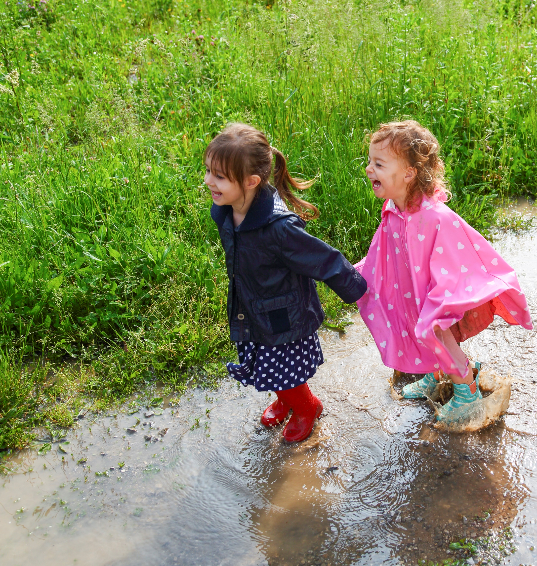
What are your state regulations for weather and outdoor play?
Notes:
Trainer notes:
Review your child care licensing regulations. Conduct a large group discussion about the requirements for weather and outdoor play.
You may choose to add a slide or edit this slide with your state’s regulations for weather and outdoor play.

Slide 24
Video: Encouraging physical activity using indoor spaces
Notes:
Trainer notes:
You need internet access to view the video.
https://www.youtube.com/watch?v=aHtD_63rjFQ&feature=youtu.be
To go to the video, click on photo. As you watch, look for examples of physical activity. After the video, lead discussion with large group.
Sample questions:
How can you incorporate physical education into your classrooms and daily routines?
What are some ideas for physically active transitions?
How can physical activities support your instruction?
What can you include in your dramatic play area to increase physical activity?
What resources can you send home to encourage physical activity outside the classroom?
Source:
6. Early Childhood Videos. Encouraging Physical Activity in Preschoolers. https://www.youtube.com/watch?v=aHtD_63rjFQ&feature=youtu.be. Published January 30, 2013. Accessed January 21, 2020.

Slide 25
Give infants time each day to move freely and explore surroundings, with adequate supervision and in a secure area
Notes:
Encourage and support physical activity with infants. Engage them on the floor and verbally encourage exploration and free movement.
Source:
7. Institute of Medicine. 2011. Early Childhood Obesity Prevention Policies. Washington, DC: The National Academies Press. https://doi.org/10.17226/13124.

Slide 26
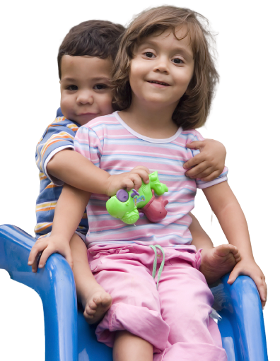
Select equipment that is safe and free of hazards
Equipment and materials must be:
Age and developmentally appropriate
Sturdy and safe
Available indoors and outdoors
Somewhat portable
You must regularly check and monitor equipment
Notes:
Select equipment that is age-appropriate and developmentally appropriate for all children.
Choose equipment that is free of hazards that might create an unsafe environment. Equipment with small parts, such as beans in bean bags, can pose a choking hazard if the bag tears open.
You must regularly check and monitor equipment.
Source:
8. Institute of Medicine. 2011. Early Childhood Obesity Prevention Policies. Washington, DC: The National Academies Press. https://doi.org/10.17226/13124.

Slide 27
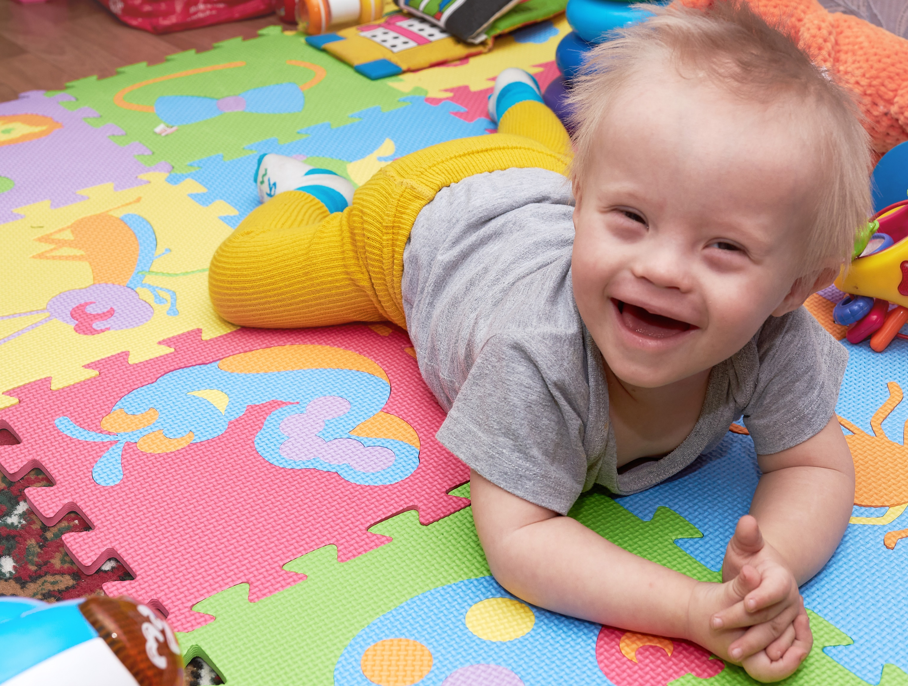
Choose equipment that is adaptive
Notes:
Select equipment that is developmentally appropriate and adaptive. Not every piece of equipment will be a good fit for all abilities. For example, the equipment needs of a child in a wheelchair will vary from than those of a child with visual impairment.
Equipment to consider includes:
Flexible balls with large hole that are marketed for infants may be useful for older children who have challenges grasping.
Various types of balls including different sizes, colors, textures, weights. Lighter balls or and larger balls can be easier to catch.
Velcro balls and mitts for children who do not have the strength to hold objects.
Chimes or bells to help children with visual impairments locate targets or objects.
Additional resources on adaptive play in ECE have been developed by the National Center on Health, Physical Activity and Disability. https://www.nchpad.org/fppics/Inclusive%20Games%20for%20Kids.pdf

Slide 28
Portable play equipment and loose play objects may promote more physical activity than fixed equipment
Consider using:
Balls
Bean bags
Hula hoops
Tricycles
Notes:
Portable play equipment and loose play objects (such as balls, bean bags, hula hoops, and tricycles) may promote more physical activity than having fixed equipment. ¹⁵
Provide appropriate supervision while children are using equipment to allow exploration and development of motor skills.
Children benefit from having given room to explore and use the equipment but need an adult close by to monitor play and ensure safety.
Source:
9. Dowda M, Brown WH, McIver KL, et al. “Policies and characteristics of the preschool environment and physical activity of young children.” Pediatrics. 2009;123(2):e261-6. doi:10.1542/peds.2008-2498.
10. National Center on Early Childhood Health and Wellness. Active Supervision. https://eclkc.ohs.acf.hhs.gov/sites/default/files/pdf/active-supervision.pdf. Accessed January 21, 2020.

Slide 29
Limit using equipment that restricts movement
Do not use restricting equipment longer than 15 minutes at a time (except when napping or eating)
Overusing equipment can limit children’s ability to build core muscles
Equipment that restricts movement includes:
Sit-in walkers and jumpers
Swings
Highchairs
Car seats in the classroom
Notes:
Use equipment such as car seats and highchairs only for their designed or intended use.
Car seats are designed for use when traveling in a vehicle.
Use highchairs during meals and snacks.
Extended use of restricting equipment can inhibit physical development.
Overusing equipment can limit children’s ability to build core muscles.
Source:
12. Institute of Medicine. 2011. Early Childhood Obesity Prevention Policies. Washington, DC: The National Academies Press. https://doi.org/10.17226/13124.

Slide 30
Challenge: Space
“We just don’t have enough space for kids to be physically active.”
Brainstorm 3 or ways to overcome the challenge of limited space
Notes:
Trainer notes:
In breakout rooms or using a whiteboard, ask participants to share how they overcome challenges with space limitations.
Brainstorm new ideas.

Slide 31
Challenge: Space
“We just don’t have enough space for kids to be physically active.”
Solution 1: Be creative in your search and use of space
Solution 2: Seek special resources and training for promoting physical activity in small spaces
Solution 3: Create a list of games and activities for small spaces
Notes:
Trainer notes:
Debrief. Compare and discuss the solutions from the charts and those presented on the slide. Tell participants that there is no single solution or right answer. They may need to use multiple strategies to overcome the challenge.
Solution 1: Be creative in your search for space. Even if your play area is a small living room, you can do active play with children.
Use long hallways. Consider movement stations in hallways.
Move tables, chairs, and toys to make an open space.
Use crowded spaces to your advantage. Set up an obstacle course. Encourage children to crawl under tables, step over chairs, and push toys back and forth across the room.
Create a learning center for physical activity to incorporate physical activity breaks into center time.
Rotate using different kinds of small, portable play equipment. Balls, yoga mats, and push-pull toys are great for promoting physical activity. Swap pieces in and out to keep things fresh.
Solution 2: Seek out special resources and training for promoting physical activity in small spaces
Take advantage of the outdoors. If your indoor play space is small, take children outside. Most indoor games can be played outside!
Consider if you really need everything in your home or center-based space that you typically have out. Could you rotate some items in and out?
Solution 3: Create a list of games and activities for small spaces.
Adult-led activities using poly dots or carpet squares can help children safely be active in small spaces.
Trainer note:
If time permits, conduct a brainstorming activity asking for ideas of games for small spaces.

Slide 32
Reflect on best practices
Is space a strength or area that needs improvement for you?
Notes:
Trainer notes:
Ask participants to refer to their PALS Warm-up Log.
Note if space best practice is a strength or area of improvement in their environment.
Encourage them to note ideas they have for improving space and use of space to support children engaging in physical activity.

Slide 33
Summary of best practices: Time & Space
Infants
Toddlers
Preschoolers
Supervised tummy time frequently
3-5 minutes increasing as tolerated
Outdoors 2-3 times daily
60-90 minutes of MVPA
60-90 minutes of outdoor play
Outdoors 2-3 daily
90-120 minutes of MVPA
60-90 minutes of outdoor play
Outdoors 2-3 daily
Notes:
Trainer notes: Ask participants to refer to their Warm-Up Log and share their notes.
Lead a group discussion:
Can they meet the best practices for time and space in their setting?
What challenges do they face?

Slide 34
Questions?
Notes:
Trainer note:
Confirm how you will communicate with participants between session.

Slide 35
Thanks for participating in Session 2
Next session:
Insert Date
Insert Time
Insert Trainer Contact Info
PALSECE@Nemours.org

