Slide 1
Nourishing Infants and Toddlers
Insert your trainer info here, e.g. Name, credentials, contact info Date of training
Insert your logo here
Notes:
[TRAINER NOTES]
Edit this slide to add your name, credentials, and contact information. Include the date of when you deliver the training.
[SUGGESTED SCRIPT]
Welcome to Nourishing Healthy Eaters in Early Care & Education.
This series of workshops is designed to support early care and education providers deepen their understanding of how children learn to become healthy eaters. Thank you for your participation today as we explore how your daily practices as a child care professional impact children’s food journey.

Slide 2
What is your favorite fruit?
Notes:
Icebreaker and Introductions
[TRAINER NOTES]
If you are delivering the training virtually, request participants to enter their response in the chat. At the end of the training, save the chat discussion to track attendance. Consider assisting participants to edit their name as it appears on the screen and chat in the platform to assist in capturing attendance at the virtual session.
[SUGGESTED SCRIPT]
Despite the health benefits of fruits and vegetables, many Americans do not eat enough in their daily diet. The 2020–2025 Dietary Guidelines for Americans recommends that adults consume 1 ½ to 2 cups of fruits and 2–3 cups of vegetables per day. However, only 1 in 10 US adults eat the recommended amount of fruits or vegetables each day. Not surprisingly, children’s consumption of fruits and vegetables mirrors adults. Approximately 85% of 1–3-year-olds don’t consume the recommended amounts of vegetables daily.
Think about your fruit and vegetable consumption yesterday? Approximately how many servings did you consume?
Today’s training will present strategies we can use to help children learn to enjoy fruits, vegetables as well as other healthy foods.

Slide 3
Objectives
Discuss the developmental stages of becoming a healthy eater and common challenges
Understand responsive feeding
Identify the role of ECE professionals in nurturing healthy eaters
Identify one or more nutrition best practices to incorporate in your daily routines with children
Notes:
[TRAINER NOTES]
Throughout this training the terms early care & education (ECE) professional and caregiver are used to refer to all professionals who care for children in family child care homes, head start settings, preschools and child care centers. Please adjust to use the term that is acceptable for your participants. Some ECE professionals prefer the term teacher, provider, or educator.
[SUGGESTED SCRIPT] During the first session of Nourishing Healthy Eaters in ECE settings, two objectives were discussed.
Describe wellness and adult nutrition
Recognize the importance of healthy eating for infants, toddlers, and preschoolers
The content in today’s workshop will build on this information.
Taste preferences and eating habits begin to be formed in early childhood and follow, to some degree, into adolescence and adulthood. Early childhood is a crucial window of development for healthy eaters. The objectives will lead us to explore the stages for learning to eat and examine how our practices as child care professionals can support children.

Slide 4
The Developmental Stages of Becoming a Healthy Eater & Common Challenges
Notes:
[SUGGESTED SCRIPT]
Like all areas of child development, the development of feeding skills follows stages with later abilities and skills building on those already mastered. Understanding the progressions of skills allows ECE professionals to set realistic expectations and create environments and activities that help children master skills.

Slide 5
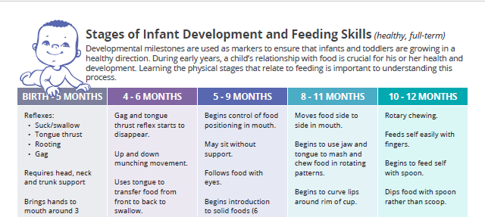
Infant Development and Feeding Skills
Reflexes
Rooting
Gag
Tongue thrust
Suck, Swallow
Coordinates suck, swallow and breathing
Requires head and neck support during feeding
Notes:
[TRAINER NOTES]
Ask participants to refer to the handout on page two titled Stages of Infant Development and Feeding Skills. Review the first two entries in each column. Seek participant input on what infant providers notice on developing oral skills.
[SUGGESTED SCRIPT]
Children develop at their own pace, so it’s impossible to tell precisely when a child will learn a given skill. However, the milestones provide a general idea of the changes to expect as a child gets older.
The handout focuses on oral motor development and physical development around feeding.

Slide 6
Motor Skills
Oral Motor Skills
Gross Motor Skills
Fine Motor Skills
Notes:
[TRAINER NOTES]
Ask participants to continue to refer to the handout on page two titled Stages of Infant Development and Feeding Skills. Note the skills that fall in each bullet on the screen. Keep in mind the timeframe for mastering skills varies for each child
Oral Motor Skills
Birth- 5 months
Coordinates suck-swallow-breathe while feeding
Up and down munching movement
Uses tongue to transfer food
5-9 months Begins control of food positions in mouth
Drinks small amounts from cup with help
8-11 months
Moves food side to side in mouth
Begins to use jaw and tongue to mash and chew food in rotating patterns
Begins to curve lips around rim of cup
10-12 months
Rotary chewing
Drinks from a straw
Bites through a variety of textured food
Gross Motor Skills
4-6 months
Good head control and can sit with support
8-11 months
Sits alone without support
Fine motor skills
5-9 months
Begins to feed self
Transfers food from one hand to another
Tries to grasp foods
8-11 months
Begins to use fingers to pick up objects (pincer grasp.)
Can put food in mouth with fands and feed self finger foods,
Drinks from cup with less spilling
10-12 months
Begins to feed self with spoon.
Begins to hold cup with two hands
Good hand-eye-mouth coordination

Slide 7
Other Developmental Domains
Social-Emotional Development
Bonding with caregiver during feeding
Building trust in the feeding relationship
Linguistic Development (language, communication, speech)
Communicating hunger and fullness
Vocabulary that is used during feedings
Back and forth interactions
Notes:
[SUGGESTED SCRIPT]
Caregiving routines such as feeding, and diapering comprise a large portion of the infant's day. These activities present opportunities to support development across all domains. Consider how social-emotional development and linguistic development are supported during feeding.
Feeding is a major event in the daily life of an infant and young child and for infants and young children feeding time is an opportunity to develop trust with caregivers, to interact with others. This verbal and non-verbal communication between children and adults builds a foundation for social development. ​
From birth to approximately three months, the infant is developing self-regulation and organization. During this time, when an infant experiences hunger, they indicate with cues, like rooting for the nipple, squirming and eventually if their needs are not met, crying.
From three to seven months, the infant and caregivers/parents form an attachment that allows them to communicate with each other and the infant develops basic trust and self-soothing behaviors. A responsive caregiver responds to an infants’ hunger cues in a consistent, responsive way helping to establish trust.​
Feeding time is also an opportunity to introduce new vocabulary, to discuss sensations such as hunger, the warmth of cereal or milk, and the textures of foods. It is a time to introduce colors discussing orange carrots or green broccoli.

Slide 8
How do we support children to become healthy eaters?
Notes:
[TRAINER NOTES]
For in-person training, provide approximately five minutes for participants to discuss the prompt on the slide in small groups. After the time elapses, use chart paper or a whiteboard to capture responses from the group.
For virtual delivery, ask participants to put one statement in the chat box. Encourage participants to capture thoughts and responses on the handout callout box on page one.
[SUGGESTED SCRIPT]
Eating healthy depends on more than just the foods we consume. What are some of the habits or characteristics of a healthy eater (adult or child)? As a child care professional, how can you support healthy habits during meals and snacks?
[TRAINER NOTES]
Some responses to the query on characteristics of healthy eaters may include:
Can respond to hunger and fullness cues and self-regulate eating
Enjoys mealtimes
Enjoys many different foods sometimes
Feels good about eating
Can try new food sometimes
Can be around new foods without getting upset
Some responses to the slide prompt may include:
Role modeling
Family style dining
Creating calm eating environments
Teaching eating skills
Having realistic expectations of children –understanding child development
Setting a predictable schedule for meals and snacks
[SUGGESTED SCRIPT]
The basic concepts of healthy eating are consistent from childhood to old age. The foods and beverages we consume impact our health. A healthy dietary pattern can help children (and adults) achieve and maintain good health. Eating is also a social act. Eating together is a way of expressing relationships, sharing life events and celebrating milestones. These social aspects of eating also play a role in being a healthy eater. The content today will consider how adults and caregivers can support children in becoming healthy eaters.

Slide 9
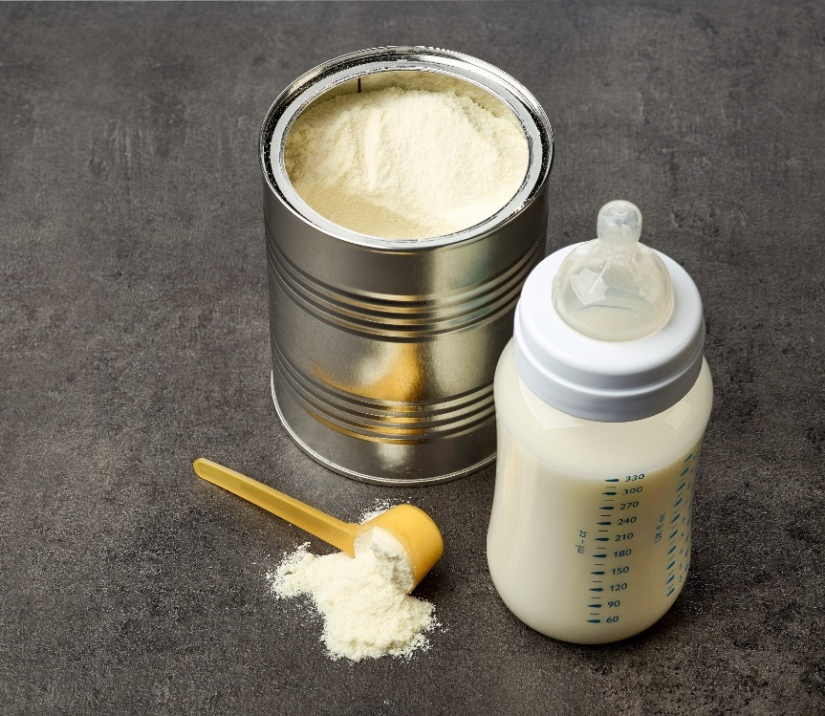
Foods for the first 6 months
Breast Milk
Iron Fortified Formula
Notes:
[SUGGESTED SCRIPT]
During infancy, babies need specific nutrients. This is a period of rapid growth and development. Breast milk is the best source of nutrition for the first year of life. It is the only food babies need for the first six months. However, if a family is unable or chooses not to breastfeed which is ok, iron-fortified formula is a healthy option. Pediatricians can help families find the formula that best meets the needs of their child.

Slide 10
Breastmilk
Provides health benefits for the breastfeeding parent and baby
Both the nutrients in breastmilk and the act of feeding contribute to brain development
Breast milk is the only food a baby needs until 6 months
Recommended through 12 months and as long as mutually desired by the breastfeeding parent and baby
The decision to breastfeed or formula feed is based on a breastfeeding parent’s comfort level, lifestyle, and individual situation.
Notes:
[SUGGESTED SCRIPT]
Choosing whether to breastfeed or formula feed their baby is one of the biggest decisions expectant and new families will make. While breast milk is the best nutritional choice for most infants, breastfeeding may not be possible for all people. Absence of structural supports such as paid parental leave and flexible work schedules are barriers to breastfeeding. Additional workplace challenges exist such as the right to take breaks to pump and access to private spaces. Child care professionals respect parent choices and support families in Later in this session we will discuss how child care can support families who choose to breastfeed.
When a family can breastfeed, it is good for babies. Breastmilk provides babies with nutrients, growth factors, and hormones. Because breastmilk changes based on the baby's needs and growth, it cannot be replicated in formula. Breastfed infants have fewer respiratory infections, ear infections, and stomach illnesses. Breastfeeding also supports the mothers’ health by lowering the risk of certain cancers, reducing the risk of diabetes, and providing benefits to blood pressure.
Developing brains benefit from both the nutrients in breastmilk and the mother-child interactions during breastfeeding. Breastfeeding is a physical act with skin-to-skin contact which supports bonding between the breastfeeding parent and child. The bonding enhances the emotional circuitry in the developing brain laying a foundation for social-emotional development.

Slide 11
Readiness signs for complementary feeding
Usually begins around 6 months, not earlier than 4 months
Can sit in a feeding chair with head control
Follows food with eyes
Can use tongue to get food off the spoon and does not push the food out of their mouth
Brings objects to mouth
Notes:
[TRAINER NOTES] It may be useful for participants to again refer to the Stages of Infant Development and Feeding Skills on page two of the handout, focusing on the column labeled 4-6 months. Readiness signs are listed on page three of the handout.
[SUGGESTED SCRIPT]
As babies grow they transition to the next feeding stage known as “complementary feeding” when parents and caregivers may begin to introduce foods along with continued breastmilk and/or formula feeding, depending on the child. Signs of readiness for complementary foods start around six months. Some babies may show these signs a bit later and some a bit earlier, but complementary foods should not be introduced before 4 months.
Complementary feeding is when foods are added to ‘complement’ breastmilk or formula. Breastmilk or formula still have an essential role in providing nutrients and calories. Complementary foods help the infant learn how to eat and support the development of facial muscles and the oral cavity. The development of facial muscles also supports emerging speech abilities.
It is important to begin feeding when infants show the developmental signs of readiness as this indicates they are ready for increased caloric intake.
Between four and seven months, infants are receptive to a wide range of flavors and textures. Infants require fewer exposures than older children to accept new foods. As complementary foods are introduced, this is an opportunity to familiarize children with a wide variety of healthy foods, especially vegetables.
Talk with families about when and what foods they are introducing. While families decide when then their child is ready for complementary foods, caregivers can be a great source of information. Develop a plan for introducing age-appropriate solid foods in consultation with child’s parent/guardian and primary care provide.

Slide 12
Positioning for Success
Sitting upright
Head, neck and truck aligned
Bolsters for support
Footrests in place
Safety straps secured
Notes:
[TRAINER NOTES]
Slide content is on page three in the handout.
[SUGGESTED SCRIPT]
Positioning is key for success.
Infants should sit upright. If they are not sitting independently, position them so that they lean back slightly. Make sure the infant is not slumping forward as this is not an ideal position for swallowing.
Ideally, the head, neck, and trunk are aligned. The infant may need bolsters such as a rolled-up dish towel or baby blanket for added stability. Make sure that bolsters don’t restrict the correct use of all safety straps.
Footrests are important. After infants grow to the point where the knees bend over the seat's edge, add a footrest. Some infant feeding chairs have an adjustable footrest. An empty tissue box or cereal box can be taped to the chair to meet the infant's feet, forming a footrest. Stability under the feet is important for adults and children during meals. Stability, when seated, supports the use of core muscles for sitting erect, reaching, and passing during meals.
Trays should fall just under the ribcage. Infant's elbows should be comfortable on the tray.
[TRAINER NOTES]
This is an optional exercise to demonstrate the impact of positioning. Ask participants to sit up straight with both feet firmly on the floor. Once positioned, ask them to pick up a nearby item such as a notebook or glass and move it from one side of their body to the other. Notice how this movement felt in terms of stability. Next, ask them to repeat the motion with feet off the ground. While the difference in adults may be subtle, to a child developing skills, stability boosts acquisition.

Slide 13
Fine and Oral Motor Skill Development
Transfer items from one hand to the other hand
Pincer grasp
Moves hand to mouth with food
Dips food with spoon
Feeds self with spoon
Curves lips around cup
Holds cup with two hands
Drinks from a straw
Notes:
[TRAINER NOTES]
Ask participants to refer to the Infant Development and Feeding Skills handout focusing midway down each column on fine and oral motor development skills. What types of activities do ECE providers do outside of meals to support these skills?

Slide 14
Foods for children 6-24 months
Human milk or infant formula should be served to at least 12 months
Offer a wide variety of healthy foods from all the food groups
Vary textures of foods such as pureed, mashed, diced
Provide repeated experiences with fruits and vegetables
Avoid foods which pose a choking hazard
Avoid foods with added sugar and high sodium
Notes:
[SUGGESTED SCRIPT]
Milk
Cows milk should not be served unless written exception is provided.
Variety
Children are born with the ability to learn to accept and enjoy all nutritious foods, but they need help from adults to develop this skill. It can take ten or more exposures for a child to accept a new food. The time from 6-24 months is an essential window for children for exposure to new foods as after age two, Neophobia, or the reluctance to try new foods emerges, and it can become more challenging to help children accept new foods. MyPLATE.GOV is a resource for more information on healthy eating for infants and toddlers.
The context or environment of exposure is equally important. A positive social environment will increase the willingness of children to try a new food. Watching adults and peers enjoy the same food can also impact children's willingness to taste and enjoy foods.
Expose children to healthy foods prepared in different ways and with varying textures such as a smooth puree, chunkier purees, mashed, and finely chopped. Varying textures helps children develop their feeding skills and move to solid table foods.
Exposure/Repetition
Infants have a natural preference for sweet and salty foods and tend to avoid bitter or sour foods, but they can learn to enjoy these foods through repeated exposure. As adults, we may tend to read babies' reactions to new foods and imply meaning. Does the response to the taste of a new food convey surprise or a dislike?
In child care, cow’s milk should not be served unless written exception from a medical professional is provided.
Repeated exposure is essential to developing acceptance of foods. Consider how an infant learns a new motor skill, such as sitting up. This skill is mastered through many attempts and more than a few failures. As adults, we encourage these attempts so the child can master this developmental milestone.
Transfer this idea repeated experiences and exposure to foods. A 6-month old infant who gets a taste of beets may open her eyes in surprise. A second and third spoonful may get pushed out of the mouth. She tastes them 6-10 times over the next 2-3 weeks and establishes a memory of this taste. She learns to accept it. During this window of 6-24 months, exposing children to a wide variety of foods, especially fruits and vegetables, supports children in becoming healthy eaters.
Choking hazards
Choking is a concern with infants and toddlers who are developing chewing and swallowing skills. Common choking hazards include grapes, hotdogs, raw carrots, popcorn, whole cherry tomatoes. Young children should always be closely observed when eating.
Added sugar and high sodium
Infants and toddlers eat small amounts of food, so it is essential that what they consume be high in nutrients, low in sodium and not contain additional calories from added sugars. Low- and no-calorie sweeteners are not recommended for children younger than age 2. Taste preferences are being formed during this period. Infants and toddlers may develop preferences for overly sweet or salty foods.

Slide 15
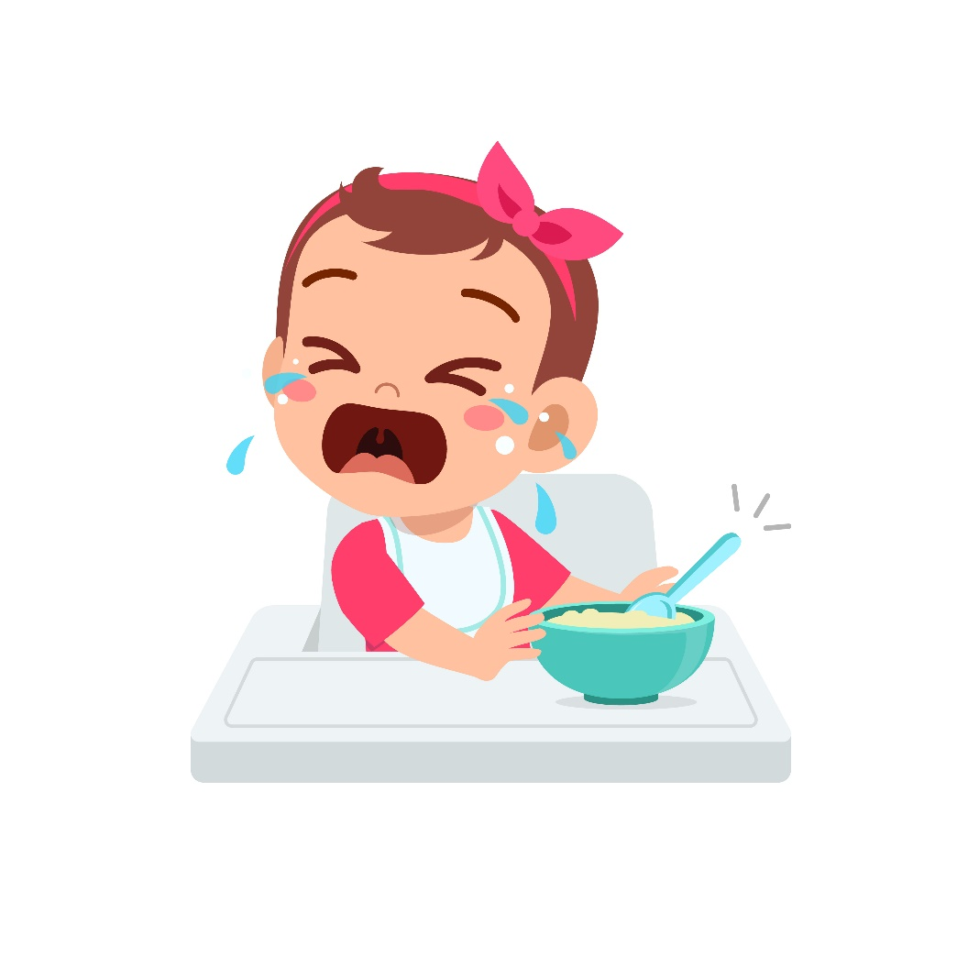
Challenges
Varied Appetites
Picky Eating
Food Jags
Sensory Processing Challenges
Notes:
[TRAINER NOTES] Slide content is on page three in the handout with space for notes.
[SUGGESTED SCRIPT]
Appetites vary
It can be challenging for adults to accept that toddlers and preschoolers go through phases. They may eat very small amounts for several meals then eat heartily for the next few meals. Remember that toddlers recognize hunger and fullness cues and know what they need. The role of adults is to provide healthy food options at regular intervals, meals, and snacks and respect the toddler's decision about if and how much they eat. While toddlers are still growing, it is less dramatic than the first year of life, and their nutrient and fuel needs reflect this.
Picky Eating
Food preferences vary. This challenge usually peaks in the toddler and preschool years. Simply described, this is when a child refuses foods often or eats the same foods over and over. Once a toddler begins feeding herself, she has control over what she eats. Another influence on this behavior is the familiarity with foods served. During the toddler and preschool years, children are ideally being introduced to new foods regularly. It is normal to have a reluctance to try new food.
Think of the last new food you tried. What do you remember from that experience? Did it smell good? Were the people you were eating with enjoying it? These sensory, environmental, and interpersonal experiences can also influence children in learning to enjoy foods.
How can ECE Professionals support picky eaters?
Allow children to help with meal prep and provide exposure to new foods through taste testing, sensory activities, gardening. Getting all the senses involved helps children build relationships with food. They get to know them and are more likely to taste them when served at meals and snacks. Some children are still learning to enjoy foods and may need many (10 or more) experiences to learn to accept them. Child care programs can support families in providing multiple experiences with new fruits and vegetables and sharing successes.
Food Jags
Likewise, toddlers may decide to limit their meals to just a few foods prepared the same way; this is known as a food jag. Food jags can occur with all children as a way to establish independence and control. Food jags are also seen in some children with sensory integration issues. To prevent or overcome food jags, continue to provide a varied, healthy menu. Offer small portions or samples. Present the same food item over several weeks in different recipes. Get toddlers and preschoolers engaged with the foods in classroom activities such as sensory activities, books, or cooking activities.
Sensory Processing Challenges
Sensory processing issues are often first recognized during the toddler years when families or caregivers notice that a child has an unusual aversion to light, sound, textures, or other senses. While sensory processing challenges are common in children who have Autism, many children with no diagnosis experience sensory challenges. Sensory processing challenges occur when the brain has trouble processing information through the senses. The smell, sight, feel, and taste of food can cause sensory overload. Sensory processing challenges in feeding can resemble picky or fussy eaters. Engaging in conversations with families around feeding behavior and observations is essential. Discuss what you are noticing and ask if families are noticing similar behaviors. Share strategies that families and caregivers find successful. If behaviors are ongoing, families should seek medical evaluation. Speech-pathologists, occupational therapists and dieticians can provide supports for children and families.

Slide 16
State Early Intervention Programs
Mission: to identify and evaluate as early as possible children whose healthy development is compromised and provide for appropriate intervention to improve child and family development.
Early help makes a difference!
Notes:
[TRAINER NOTES] Add contact information to this slide for your state early intervention program.

Slide 17
Engaging with families
Using milestone trackers to:
Help celebrate milestones and catch missed milestones early
Guide conversations and support your observations if you want to discuss concerns with families
Encouraging parents to talk with their child’s healthcare provider and to seek your states Early Intervention Program.
Notes:
[TRAINER NOTES]
Discuss information on your state early intervention program.
A variety of milestone trackers for child care providers and families are available from the CDC. https://www.cdc.gov/ncbddd/actearly/index.html

Slide 18
Responsive Feeding in Infants & Toddlers
Notes:
[SUGGESTED SCRIPT]
Responsive caregiving is the foundation of quality infant and toddler care. It involves creating an environment that is safe and predictable with sensitive, caring, and dependable interactions between child and caregiver.
Research shows that healthy brain development in young children depends on the degree of responsive caregiving that a child received during the first two years of life. Your positive interactions with infants and toddlers today help them develop the skills to build secure relationships and recognize and communicate their feelings throughout their lifetime.
One aspect of responsive caregiving is responsive feeding.

Slide 19
Responsive Feeding
A serve and return or back and forth interaction between child and caregiver
Gives children the opportunity to notice, understand, and trust their bodies' cues
Helps children to self-regulate food intake
Notes:
[SUGGESTED SCRIPT]
Responsive feeding refers to the back-and-forth interaction between caregiver and child. The caregiver who allows the infant to determine the timing, amount and pacing of a meal helps the infant develop self-regulation and secure attachment. The responsive caregiver adjusts and responds appropriately to the child’s temperament, flexibility, and reaction to change.

Slide 20
Child signals
Caregiver recognizes signals and feeds child
Caregiver recognizes signals and stops feeding
Child displays fullness cues
Child experiences a predictable response
Child experiences a predictable response
Responsive Feeding
Notes:
[Trainers notes]
Walk through the steps of responsive feeding seen on the slide. The diagram is found in the handout on page three. Ask participants to suggest cues of hunger and fullness as those tiles are discussed.
[SUGGESTED SCRIPT]
This image captures the steps of responsive feeding. While it may seem that the feeding is child-driven, caregivers set up the routines and the setting to promote the back-and-forth interactions between caregivers and child.
Positive affection and high levels of warmth are part of responsive feeding. The child establishes a sense of trust with the caregiver as his needs are met with an appropriate response.

Slide 21
What is the caregiver’s role in responsive feeding?
Recognize child’s signs
Respond to the child in a prompt, emotionally supportive and appropriate manner
Create a relaxed and pleasant feeding environment
Serve developmentally-appropriate foods that are healthy and tasty
Offer food on a predictable schedule at times when the child is likely to be hungry
for infants, timing will be more individualized
for toddlers, more structured to enable group meals
Notes:
[SUGGESTED SCRIPT]
When practicing responsive feeding, a caregiver should watch a child’s behaviors and signals. The adult should create a relaxed and joyful environment for eating.
[Trainers notes]
Highlight bullets on the slide.

Slide 22
Hunger and Fullness Cues
Cues are an opportunity to connect with families and discuss the cues they notice their child use and how they respond. Caregivers can also discuss family practices around feeding.
What do families notice as hunger and fullness cues?
How do they respond?
Are there cultural practices or beliefs around feeding infants?
Notes:
[TRAINER NOTES]
Refer to the handout Signs of infant development and feeding skills and discuss the cues listed for each age group.
Birth to 6 months
Hunger cues
Rooting
Sucking noise and motions or sucking on lips, fingers, toys or clothing
Open mouth postures
Flexion in wrists, clenched hands
Fullness cues
Sucking slows or stops
Turns head away
Falls asleep
Pushes food away
Seals lips together
Relaxes hands and wrists
Looks around and does not pay attention to caregiver
Toddlers
Hunger cues
Gets excited when sees food
Moves head toward spoons or tries to bring food to mouth
Opens mouth when offered a spoon or food
Uses hand motions, sounds, or works to indicate hunger
Fullness cues
Pushes food away
Closes his or her mouth when food is offered
Turns head away from food
Uses hand motions, sounds or words to indicate fullness
https://www.cdc.gov/nutrition/infantandtoddlernutrition/mealtime/signs-your-child-is-hungry-or-full.html

Slide 23
Paced Bottle Feeding
Hold infant in your arms, almost upright
Never prop a bottle in an infant’s mouth
Hold bottle almost sideways, not upright
Observe nipple filled with milk, not air
Allow baby to set the feeding pace
Switch arms during the feeding
Recognize fullness cues and stop feeding when cues are displayed
Notes:
[SUGGESTED SCRIPT]
Let’s consider the mechanics of bottle feeding. Paced bottle feeding is a technique that allows the infant to control the pace of the feeding.
The steps of paced bottle feeding are listed on the slide.
Hold infant in arms, almost upright. This position allows a baby to look into the caregiver’s face and for the caregiver to closely observe feeding cues.
Never prop a bottle in an infant’s mouth. Many state regulations outline that bottles can not be propped.
Hold the bottle almost sideways, not upright. With the bottle held sideways, milk flow is slower, allowing the baby to control the pace better.
Keeping the bottle nipple filled with milk reduces the amount of air babies take in with the milk.
Allow baby to set the feeding pace. Babies may want to take breaks, catch their breath, and stop to burp. Read the cues and respond. Babies will open their mouth when ready to resume the feeding.
Switch arms during feeding. This allows the baby to interact with both eyes during the feeding and experience different room views.
Recognize fullness cues and stop feeding when cues are displayed
Talk with parents about what they notice about the pace of their child’s feeding and the position they observe their baby prefers when eating. If parents do not supply bottles, programs may choose to purchase and use the same bottle and nipple used at home.
Bottle feeding an infant is a 15–20-minute interaction and a rich opportunity for social interaction.

Slide 24
Benefits of Responsive feeding
Through responsive feeding children learn to:
Listen to their body's signals of hunger and fullness
Develop self-control regarding how much food they will eat
Actively participate in meal and snack times
Effectively communicate their needs and learn that these needs will be met
To learn more about responsive feeding access a free online module at www.healthykidshealthyfuture.org
Notes:
[SUGGESTED SCRIPT]
Responsive feeding helps children to notice, understand, and trust their bodies’ cues. This awareness builds healthy eating skills that last a lifetime.
[TRAINER NOTES]
Responsive feeding may be a new term for some ECE professionals. A free 60-minute training on Responsive Feeding is available on the website listed on the screen. This module is targeted for both parents and ECE professionals.
https://healthykidshealthyfuture.org/5-healthy-goals/nurture-healthy-eaters/resources/feeding-course/

Slide 25
Nonresponsive feeding
The caregiver does not accurately read and appropriately respond to the child’s feeding cues of hunger, fullness, or food preference
There is a lack of positive back and forth interactions between the caregiver and the child
This can happen in the following ways:
a. Child is pressured to eat or overeat
b. Child controls the situation
c. Child is ignored
Notes:
[SUGGESTED SCRIPT]
a. The caregiver pressures the child to eat. (Authoritarian feeding)
This can involve the caregiver pressuring the child to eat (at defined times or a certain amount), potentially overriding the child’s internal hunger and fullness cues. An example of this might be if a provider coaxes a child to eat or drink, thinking they have not eaten enough or the right foods or amounts. This may interfere with the child’s emerging independence and learning feeding skills.
b. The child controls the situation. (Indulgence)
An example of this is a child refusing to eat a meal, throws a tantrum, and a caregiver responds by giving them something else to eat. This is known as indulgence and may be more likely to happen in the child’s home than in a childcare program with a fixed menu consisting of only healthy food.
c. The caregiver ignores the child and becomes uninvolved.
This can happen when facing the challenge of feeding multiple children at one time. The caregiver’s focus may be diverted, and he/she may not engage and support all the children in a group.
Why is it essential to avoid nonresponsive feeding?
If caregivers do not watch cues closely, it is easy to overfeed infants and toddlers. Regular overfeeding can eventually override a child’s internal controls so that they no longer have appropriate hunger and fullness cues or don’t recognize those cues.
Nonresponsive feeding can lead to overweight infants and toddlers

Slide 26
Babies don’t know when they are full
Children should empty the bottle or eat all the food on their plate
Food should be offered as a first response to crying or fussiness
Beliefs, Values and Practices
Notes:
[SUGGESTED SCRIPT]
Our beliefs, values, and practices around food and feeding children develop from many sources. Not all of these beliefs may align with responsive feeding practices.
We may remember the traditions of our parents and grandparents, and the experiences from our childhood. We may be influenced by advertisements for food products or information from current diet trends. Even noticing what how and what friends and family are feeding their children can inform our practices.
Education and information from the medical community (AAP) or USDA programs such as TEAM Nutrition, W.I.C., CACFP, and SNAP can also impact our knowledge and practices.
[TRAINER NOTES]
Divide participants into small groups for a discussion on feeding beliefs that don’t align with responsive feeding. For virtual delivery use breakout rooms for this discussion. There is a box on the handout for participants to capture discussion points. This exercise is an opportunity for self-reflection and cultural humility is key when facilitating these discussion. Many practices around food and feeding have been shaped by historical realities and injustices.

Slide 27
Summary video
Notes:
[TRAINER NOTES]
This two-minute video summarizes the session content to this point. Ask participants to listen for one key point to share after watching the video.
https://www.youtube.com/watch?v=FtQZBhHBxqY&feature=emb_logo
Https://foodinsight.org/first-year-feeding-practices-video/

Slide 28
Break
Notes:
[TRAINER NOTES] This is a suggested point in the training to provide a 10-minute break. There is a timer in the trainer kit to assist participants in tracking the remaining time. For virtual training, set up the timer from the trainer kit so participants can see it countdown. Encourage participants to get up and stretch or move, get water and take care of themselves.

Slide 29
Identify the role of ECE professionals in nurturing healthy eaters
Notes:
[SUGGESTED SCRIPT]
Young children are dependent on adults to provide healthy foods and model how to enjoy foods. As taste buds are developing, exposing toddlers to a wide variety of nutritious foods and textures builds a strong foundation for lifelong health.

Slide 30
Creating a breastfeeding friendly
child care
Notes:
[SUGGESTED SCRIPT]
Child care can be an important support for families choosing to breastfeed. The American Academy of Pediatrics recommends that babies be breastfed exclusively for the first six months. Beyond that, breastfeeding is encouraged until at least 12 months and longer if both the family and baby are willing. Data shows a drop off in breastfeeding rates when infants enter child care, and mothers return to work or school. Supporting families in their infant feeding choices can help families continue to breastfeed.
[TRAINER NOTES] For in-person delivery, divide participants into small groups. Ask them refer to the handout and review the list of breastfeeding-friendly strategies on page four in the handout. Count the number of strategies you incorporate in your child care program or home? What challenges limit other strategies from being implemented?
For virtual delivery, one option is to use breakout rooms for this activity. Another option is for the trainer to read aloud a strategy and ask participants to use a thumbs-up sign if they employ this strategy in their setting and a thumbs-down if they don’t. Ask participants to share examples of how they accomplish strategies or the challenges that limit them.
If your state has a breastfeeding friendly recognition for child care programs and homes, share the agency website and contact information with your participants.
___ Breastfeeding families have access to a private room for breastfeeding or pumping, other than a bathroom, with appropriate seating and privacy
____Enough refrigerator and/or freezer space is available to allow all breastfeeding families including staff to store expressed breast milk
____ For families who provide breastmilk we promote and support breastfeeding by talking about the benefits and recommendations
____ We promote breastfeeding and support families who breastfeed by informing families about community resources that provide breastfeeding support
____ We provide educational literature to families to promote breastfeeding and support families who provide breast milk
____ Program staff show a positive and open attitude about breastfeeding
Image source: Indiana Black Breastfeeding Coalition

Slide 31
Division of Responsibility
Adults are responsible for: | Infants are responsible:
What to feed | When to eat How much to eat Whether they eat what is offered
Adults are responsible for: | Toddlers & Preschoolers are responsible:
What to feed When to feed Where to feed | How much to eat Whether they eat what is offered
Notes:
[TRAINER NOTES] The slide image is on the bottom of page four of the handout.
[SUGGESTED SCRIPT]
The division of responsibility in feeding outlines roles in the feeding relationship. Caregivers are responsible for the appropriate structure and routine of feeding (the what, when, and where of eating), and the child is responsible for how much and whether or not to eat what the caregiver provides. In child care settings with toddler and preschool-aged children, the when is controlled by the program schedule.
Satter, E. (2000). Child of Mine: Feeding with Love and Good Sense, Revised and Updated Edition (Revised ed.). Boulder, Colorado: Bull Publishing.

Slide 32
What is the caregiver’s role in the Division of Responsibility?
Pay attention to and respond to hunger and fullness cues
Choose and prepare food
Make eating times pleasant
Role model social skills at mealtime
Be considerate of children’s lack of food experience
Trust children’s choices relating to food
Notes:
[TRAINER NOTES]
Discuss the bullets on the slide. Ask participants to consider how these align with the division of responsibility. This list is on page one of the handout. Social skills and table manners may differ by culture. For example, eating with hands is typical in some cultures and not for others. As you facilitate this content consider asking participants to reflect and share the mealtime social skills they encourage.

Slide 33
What are child’s responsibilities?
Eat the amount they need
Learn to eat the food their families and caregivers eat
Learn social skills at mealtime

Slide 34
Leading a Healthy Feeding Environment
Notes:
[TRAINER NOTES]
Click on slide title to follow link. https://mediahub.unl.edu/media/4119
Encourage participants to listen to the different comments the provider uses during meals and snack.

Slide 35
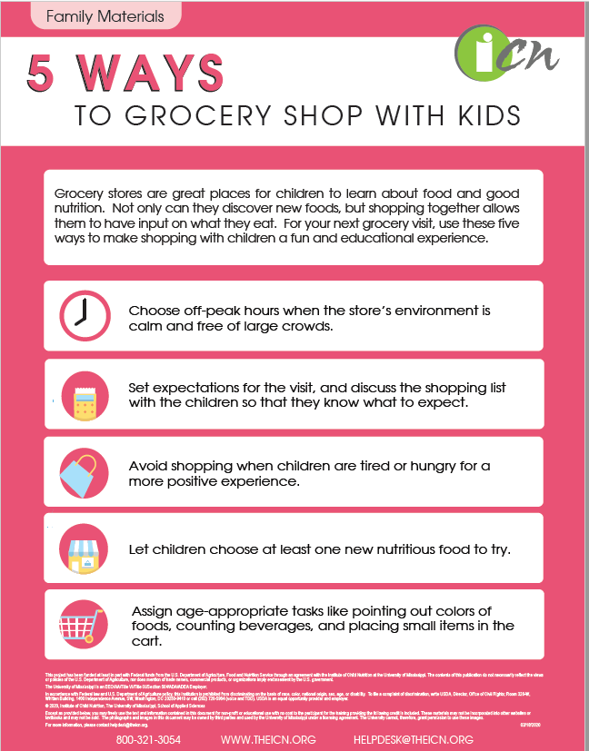
Resources to share with families
Notes:
[SUGGESTED SCRIPT]
Communicating with families around feeding supports the development of healthy eaters. This slide captures a few wonderful resources around food and feeding.
[TRAINER NOTES]
If conducting the training in-person, pass a copy of the resources around the room. Websites are in the handout. If time allows, facilitate a discussion around resources related to food and feeding participants share with families. If conducting the training virtually, consider sharing your screen and spotlighting one resource. Note that images and links are found on page five of the handout.
https://www.womenshealth.gov/patient-materials/resource/guides?from=breastfeeding
https://www.sesamestreet.org/toolkits/food/resources
https://pathways.org/wp-content/uploads/2020/03/FeedingBrochure_English_LEGAL_2020.pdf
https://theicn.org/cacfp#2c5b3c0b1a0528a11

Slide 36
Supporting Families
SNAP — the Supplemental Nutrition Assistance Program, formerly known as Food Stamps
WIC — Special Supplemental Nutrition Program for Women, Infants, and Children
CACFP — The Child and Adult Care Food Program
Emergency food resources in your community
Summer Food Program sites
Farmers to Families Food Box Program
Hours & Location of Food Pantries & Banks
Notes:
[TRAINER NOTES] Slide content is on page five of the handout.
[SUGGESTED SCRIPT]
The need for emergency food resources has increased across many communities due to the COVID-19 pandemic. Newly food insecure households may be more reluctant to seek and accept help. As an early care and education professional, sharing your knowledge of important community resources related to food and nutrition can support families and increase access to healthy foods.
The United States Department of Agriculture’s (USDA's) Food and Nutrition Service administers several programs targeted at young children and families with young children.
[TRAINER NOTES]
Consider using breakout rooms for this activity. Divide participants into three groups and assign each group one of the federal food programs (CACFP, SNAP and WIC). Instruct each group to discuss the program using the handout provided in the facilitator guide and personal knowledge. Allow ten minutes for groups to discuss and identify 1-3 points about the program to share with the large group. Invite each group to share.
SNAP
SNAP provides nutrition benefits to supplement the food budget of needy families so they can purchase healthy food and move towards self-sufficiency. To get SNAP benefits, families apply in the state in which they currently live and must meet certain requirements, including resource and income limits. Monthly allotment is based on family size. SNAP benefits can be used for a variety of healthy foods. Benefits are loaded monthly on an Electronic Benefit Transfer (EBT) card, which works like a debit card.
WIC The Special Supplemental Nutrition Program for Women, Infants, and Children - better known as the WIC Program - serves to safeguard the health of low-income pregnant, postpartum, and breastfeeding women, infants, and children up to age 5 who are at nutritional risk by providing nutritious foods to supplement diets, information on healthy eating including breastfeeding promotion and support, and referrals to health care. Most states issue WIC benefits using Electronic Benefit Transfer (EBT) cards. WIC is expanding benefits to children up to age 6
CACFP
The Child and Adult Care Food Program (CACFP) helps child care institutions and family or group day care homes provide nutritious foods to young children. Child care centers, family day care homes, afterschool care centers, and emergency shelters receive cash reimbursement for serving meals and snacks that meet Federal nutritional guidelines to eligible children. Centers and day care homes may be approved to claim reimbursement for serving up to two meals and one snack per day to each eligible child or adult participant. Meals served to children in centers are reimbursed at rates based upon a child’s eligibility for free, reduced-price, or paid meals
Additional resources for families include information about the following local programs:
These might include
Summer Meal Program Sites and serving times- This program serves children 18 and younger. The USDA has made temporary changes so that meals can be taken home and parents/guardians can pick up meals (in some states).
Food Banks
Days and hours of operations of Food Pantries and meals at Churches & Community Center

Slide 37
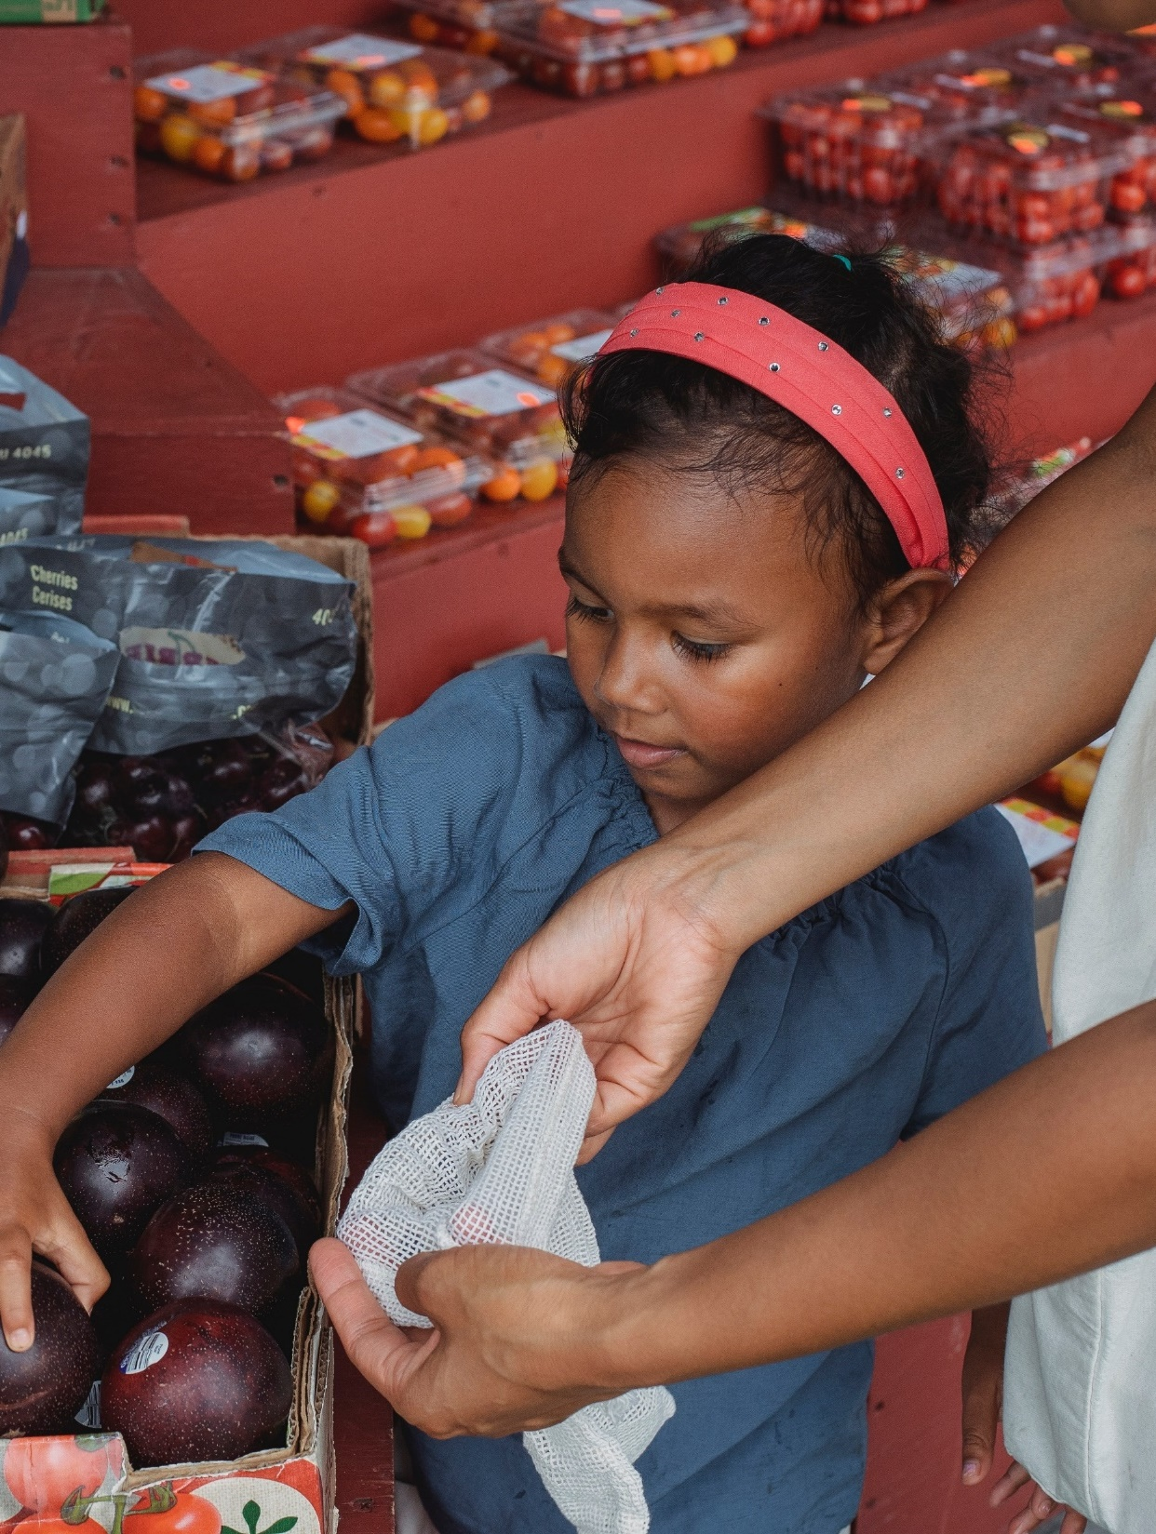
Engaging with Families
Taste Testing
Cooking events or classes
Produce basket pick up at child care
Coupon swap board
Community gardens/ECE gardens
Notes:
[SUGGESTED SCRIPT]
Some opportunities for connecting with families around food include:
Taste Testing
A taste testing is always popular events. If timed at pick-up or drop-off, a taste testing event provides a quick way to connect with parents. These could be opportunities to share new items being added to program menus or quick, affordable family meal options such as crockpot recipes. Children could help prepare some of the items and tie back to classroom activities and curricula.
Cooking Events
Cooking events or classes are a fun way to learn new cooking skills or recipes. Some cooperative extension programs offer cooking classes as part of their community programming. SNAP-Ed programs can be another resource for meal preparation education for parents.
CSA
Produce baskets, or CSAs (community support agriculture), connects families (and program staff) with local, fresh foods. To find farmers in your community who offer CSAs, check with your Cooperative Extension, local farmers market, or localharvest.org. The child care could serve as a pick-up point for families who order from the farmer.
Coupon swaps
Use a bulletin board in the lobby for coupon swapping and sharing. Save a spot on the board for information on digital coupons.
Child Care or Community gardens
Community gardens are plots of land where people work together to grow food. Share information on the gardens in your community on bulletin boards or newsletters. Child care gardens are a powerful way for children to experience and learn about foods. Families can help! CACFP can help fund certain expenses related to child care gardens.

Slide 38
Identify one or more nutrition best practices to add into your daily routines with children

Slide 39
Reflection activity
Notes:
[TRAINER NOTES]
Ask participants to find the reflection checklist in the handout on page six. This is a list of some provider practices that help children learn about food, create positive food experiences and Nourish Healthy Eaters. Allow five minutes for participants to complete the checklist. Encourage participants to identify and sharia practice they would like to add to their routines or improve. For virtual delivery, participants can add this practice to the chat box. Trainers can ask curious questions, if time allows, as to why certain practices were selected.
The practices listed on the checklist are taken from the Wellness Workbook and include only provider level practices. For most practices, All the Time is the best practice. For practices with an asterisk, Rarely or Never is the best practice.
Eating Environment
Meal time is relaxed and calm
Toddler and preschooler meals are served family style (children encouraged to serve themselves with limited help)
Early childhood providers sit with children during meals and talk informally about trying and enjoying healthy food
Early childhood providers help children learn to recognize hunger/fullness cues
Early childhood providers eat the same meals/snacks as the children and avoid unhealthy foods (e.g., soda, sweets, fast food)
Food or beverages are used as an incentive or reward*
Food or beverages are withheld as punishment*
Early childhood providers encourage children to finish their plate of food*
Infant Feeding and Nutrition
9. We feed each infant on the infant’s cues unless instructed in writing by family/guardian and child’s healthcare provider
10. We end feedings based only on infants showing signs they are full
Signs of fullness: slowing pace of eating, turning away, becoming fussy, spitting out or refusing more food.
At meal times, providers praise and provide hands-on help to guide older infants as they learn to feed themselves
We encourage infant’s families and staff to breastfeed or provide breast milk for at least 12 months (if possible or they choose to breastfeed)
Infants are fed prior to going to sleep. No infant sleeps with a bottle

Slide 40
Nourishing Healthy Eaters ABC Plan
Action I plan to take
How does my action Benefit children?
What Challenges will I face?
Date I will begin this action?
Evidence I have been successful?
Notes:
[TRAINER NOTES]
Ask participants to refer back to the reflection checklist and select one or more best practice they will add or strengthen in their daily routines. The ABC plan is found on the last page of the handout. Give participants ten minutes to complete a plan. Ask for volunteers to share. If time is limited, work through a sample plan as a large group capturing responses on a flip chart (or whiteboard if the training is virtual). Have the group suggest a best practice to address and work through each step with participants brainstorming responses.

Slide 41
Sustaining practice change
https://www.futureme.org/
Notes:
[TRAINER NOTES]
For this optional activity, encourage participants to write a letter to themselves on the website, futureme.org. On this free site users, select a future date to receive an email they write to themselves. Encourage them to select a date 4-6 weeks in the future to receive an email that is a reminder to monitor their accountability with their practice change. One or two sentences can quickly capture their goals. Practice is change is challenging and sometimes it requires relooking at goals and developing action steps that address challenges.

Slide 42
More Resources for ECE settings
Healthykidshealthyfuture.org
Notes:
[SUGGESTED SCRIPT]
The Healthy Kids Healthy Future website is full of resources to support Early Care Professionals in creating healthy environments. One resource to spotlight is Nemours Best Practices for Healthy Eating Guide. Content includes information on the CACFP meal pattern, portion sizes, family style dining, Menu Planning and Meal Preparation, Developing policies to support healthy eating and Family Tip Sheets and Daily communication forms. The booklet is available to download in English and Spanish.

Slide 43
Acknowledgments
This training was made possible thanks to the funding, technical expertise, and guidance from the following national and state organizations.
For expertise in children’s health and wellness. This training series was developed by nutrition and early childhood experts.
For initial funding to design and develop the original Nourishing Health Eaters training series
Notes:
[SUGGESTED SCRIPT]
Finally, we’d like to acknowledge some national and state partner organizations that made this training possible.

Slide 44
Thank you for participating in today’s training
Notes:
[SUGGESTED SCRIPT]
Thank you for participating in today’s training. As a child care professional, you can play an important role in Nourishing Healthy Eaters.

