Slide 1
Nourishing Preschoolers
Insert your trainer info here, e.g. Name, credentials, contact info Date of training
Insert your logo here
Notes:
[TRAINER NOTES]
Edit this slide to add your name, credentials, and contact information. Include the date of when you deliver the training.
[SUGGESTED SCRIPT]
Welcome to Nourishing Preschoolers. This series of workshops has been created to support early care and education professionals to deepen their understanding of how children learn to become healthy eaters.
Food nourishes bodies, but food also brings joy. Early childhood is a time to explore the wonder of food, discover flavors, experience textures, and notice colors. Most importantly, in early childhood, we want to help children begin a healthy relationship with food. ECE professionals play an important role in a child’s food journey

Slide 2
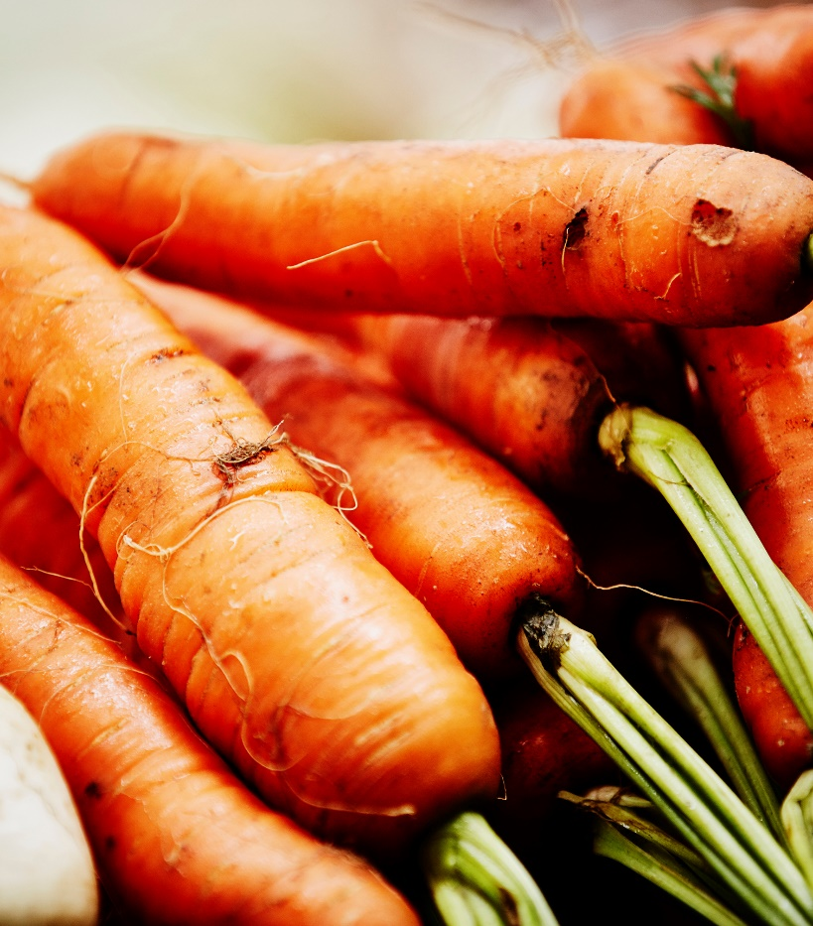
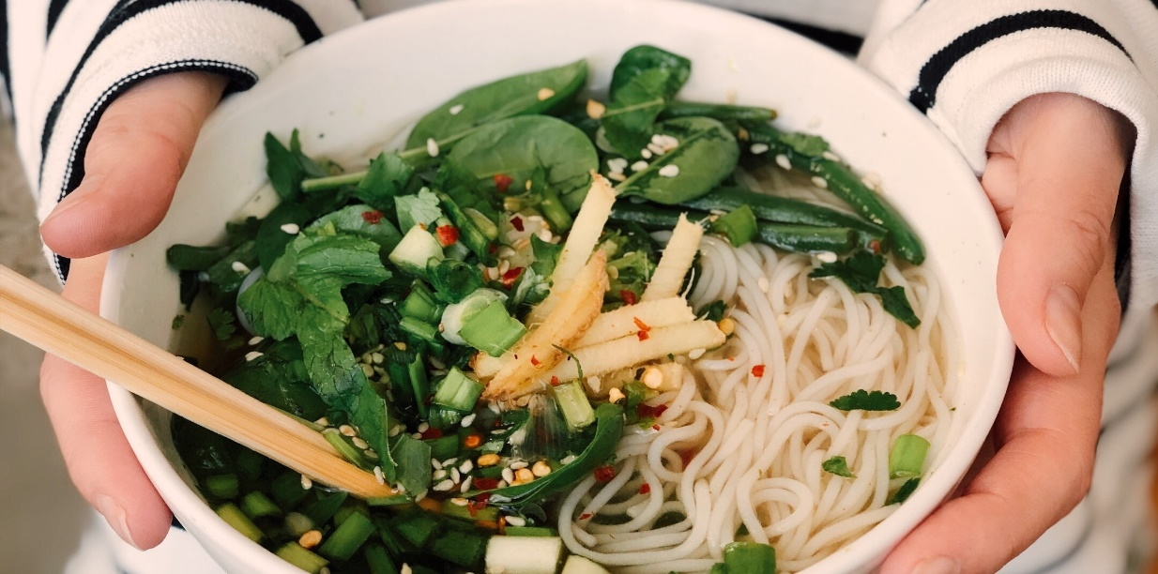
What is your favorite vegetable?
Notes:
Icebreaker Activity
[SUGGESTED SCRIPT] Despite the health benefits of fruits and vegetables, many Americans do not eat enough in their daily diet. The 2020–2025 Dietary Guidelines for Americans recommends that adults consume 1.5–2 cups of fruits and 2–3 cups of vegetables per day. Only 1 in 10 US adults eat the recommended amount of fruits or vegetables each day. Not surprisingly, children’s consumption of fruits and vegetables mirrors adults. Approximately 85% of 1–3-year-olds don’t consume the recommended amounts of vegetables daily. Today we will talk about many strategies we can use help children learn to enjoy fruits, vegetables, and other healthy foods.
[TRAINER NOTES]
Invite participants to introduce themselves and share their favorite vegetable and how they like it prepared. This activity can be facilitated asking each participant to share, by pairing or group participants together to share in small groups or by using breakout rooms if facilitating virtually.

Slide 3
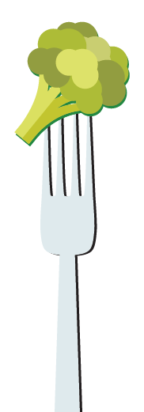
Objectives
Discuss the developmental stages of becoming a healthy eater and common challenges
Identify the role of ECE professionals in nurturing healthy eaters
Recognize family engagement opportunities around nutrition and food
Identify one or more nutrition best practices to incorporate in your daily routines with children
Notes:
[TRAINER NOTES]
Throughout this training, the terms early care & education (ECE) professional and caregiver are used to refer to all professionals who care for children in family child care homes, head start settings, preschools, and centers. Please use the term that is acceptable for your participants. Some ECE professionals prefer the term teacher, provider, or educator.
[SUGGESTED SCRIPT] During the first session of Nourishing Healthy Eaters in ECE settings, two objectives were discussed.
Describe wellness and adult nutrition
Recognize the importance of healthy eating for infants, toddlers, and preschoolers
The content in today’s workshop will build on this information.
Taste preferences and eating habits begin to be formed in early childhood and follow, to some degree, into adolescence and adulthood. Early childhood is a crucial window of development for healthy eaters. The objectives will lead us to explore the stages for learning to eat and examine how our practices as child care professionals can support children.
Multiple factors influence a child’s eating behaviors. Eating preferences and behaviors develop alongside growth in cognitive, motor, and social skills.

Slide 4
The Developmental Stages of Becoming a Healthy Eater & Common Challenges
Notes:
[SUGGESTED SCRIPT]
Like all areas of child development, the development of feeding skills follows stages with later abilities and skills building on those already mastered. Understanding the progressions of skills allows ECE professionals to set realistic expectations and create environments and activities that help children master skills.

Slide 5
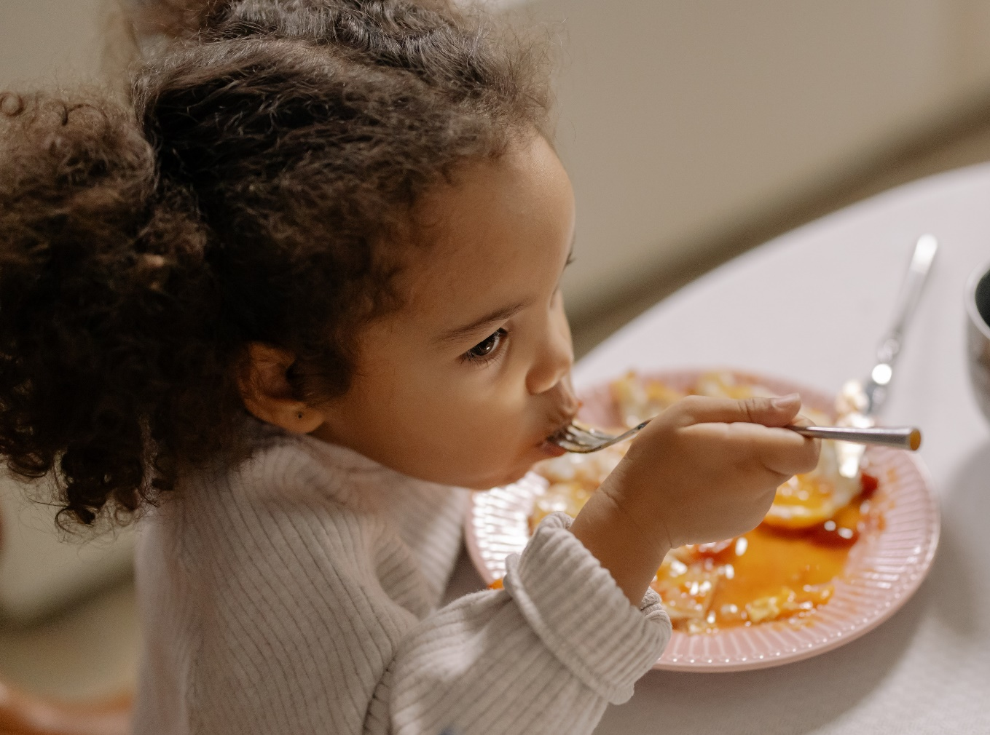
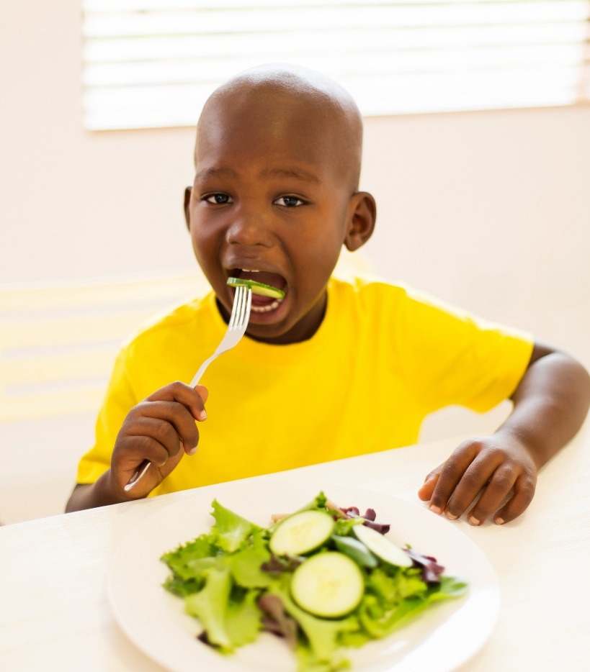
How do we support children to become healthy eaters?
Notes:
[TRAINER NOTES]
For in-person training, provide approximately five minutes for participants to discuss the prompt on the slide in small groups. After the time elapses, use chart paper or a whiteboard to capture responses from the group.
For virtual delivery, ask participants to put 1 statement in the chat box. Encourage participants to capture thoughts and responses on the handout callout box on page 1.
[SUGGESTED SCRIPT]
Eating healthy depends on more than just the foods we consume. What are some of the habits or characteristics of a healthy eater (adult or child)? As a child care professional, how can you support healthy habits during meals and snacks?
[TRAINER NOTES]
Some responses to the query on characteristics of healthy eaters may include:
Can respond to hunger and fullness cues and self-regulate eating
Enjoys mealtimes
Enjoys many different foods sometimes
Feels good about eating
Can try new food sometimes
Can be around new foods without getting upset
Some responses to the slide prompt may include:
Role modeling
Family style dining
Creating calm eating environments
Teaching eating skills
Having realistic expectations of children –understanding child development
Setting a predictable schedule for meals and snacks
[SUGGESTED SCRIPT]
The basic concepts of healthy eating are consistent from childhood to old age. The foods and beverages we consume impact our health. A healthy dietary pattern can help children (and adults) achieve and maintain good health. Eating is also a social act. Eating together is a way of expressing relationships, sharing life events and celebrating milestones. These social aspects of eating also play a role in being a healthy eater. The content today will consider how adults and caregivers can support children in becoming healthy eaters.

Slide 6
Behavior Milestones related to feeding and eating
Notes:
[TRAINER NOTES]
Orient participants to the USDA Behavioral Milestones flyer on page two of the handout. Encourage participants to spend a few minutes reviewing the bullets or review as a large group. If time supports a discussion of the milestones, prompts include:
How does this align with what you have observed in the children you care for?
How do you support children when you recognize they aren’t yet achieving a milestone?
[SUGGESTED SCRIPT]
The preschool years are an important time for developing healthy habits for life. From 2 to 5 years old children grow and develop in ways that affect behavior in all areas including eating. The timing of these milestones varies with each child. Different childrearing practices and cultural expectations can influence a child’s developmental and behavioral milestones.

Slide 7
Learning to accept new foods
Young children may need 8-15 exposures, or more, to reach acceptance and enjoyment of a new food
What is exposure?
Food item on table
Sensory experiences with food
Taste Testing
Cooking activities
Learning about food
Children’s books about food
Notes:
[TRAINER NOTES]
Orient participants to the second highlighted box on page one of the handout.
[SUGGESTED SCRIPT]
Early childhood is a window of opportunity for young children. When exposed to foods as a young child, we are more likely to learn to accept and enjoy them. Since eating preferences carry into adulthood, helping children learn to enjoy healthy foods promotes lifelong health. Children’s willingness to taste foods increases the more familiar they are with that food. Young children may need many exposures before accepting a new food.
Supporting a child with 8-15 exposures to a food requires patience.
What is exposure?
Let’s consider broccoli. Exposure can be broccoli on the table in view and a child observing peers and adults eat and enjoy that item. A child may spoon one piece of broccoli on their plate, put in their mouth and take it back out. They may lick the broccoli. While we would consider these poor table manners for adults, these sensory experiences are how they learn about food. These are all examples of exposure and support learning to accept and enjoy broccoli.
Sensory experiences are also part of familiarizing children with new foods. Appreciating the textures and smells of raw and cooked vegetables is sensory learning.
Taste-testing is a great way to expose children to new foods. Very small servings of new foods can be less intimidating when they are presented outside of meals and snacks. They can seem like an adventure
Cooking activities are also an exposure. Preschoolers can wash the broccoli, peel the stalk, and separate the head into florets.
Increasing knowledge and understanding of a certain food can also be an exposure. Learning about how broccoli grows such as seeing pictures of broccoli as it grows in a field increases awareness and may spark curiosity. For older children, sharing the nutrients broccoli provides the body can stimulate interest. In addition to vitamins and minerals, broccoli provides protein which helps build and strengthen muscles.
Reading books about foods can increase familiarity. We will talk more about children’s books in a bit.

Slide 8
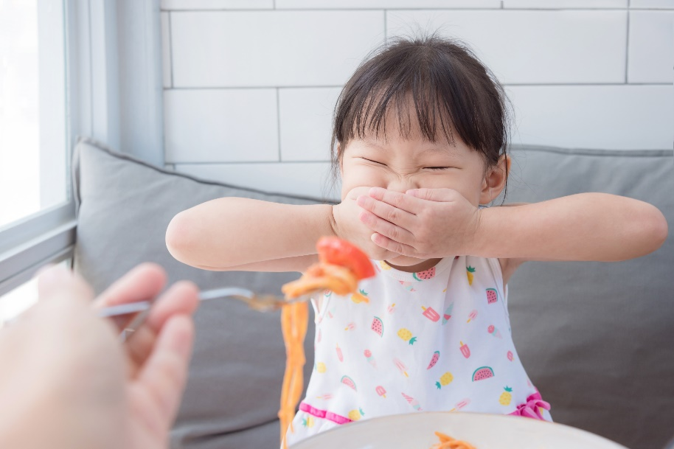
Overcoming challenges
Challenges
Strategies
Neophobia
Picky eaters
Food jags
Provide a varied menu
Offer small portions
Do not force or pressure
Provide repeated, neutral exposure to healthy foods
Serve family style meals
Notes:
[TRAINER NOTES] Slide content is on page one of the handout.
[SUGGESTED SCRIPT]
Neophobia is a fear of trying new foods. Neophobia is normal eating behavior in children 2-5 years old and usually disappears as children age. Neophobia is different from picky (or fussy) eaters who may reject both new and familiar foods. Neophobia frequently impacts fruit and vegetable consumption in young children.
Picky eating is also a normal phase of development. Picky eaters reject both new and familiar foods. Picky eating can be associated with stress and conflict at meals.
Food jags are when a child wants to eat the same foods, prepared the same way, every day and sometimes every meal. Food jags can occur with all children as a way to establish independence and control.
Strategies to overcome these challenges are similar.
Continue to provide a varied, healthy menu.
Offer small portions or samples.
Present the same food item over several weeks in different recipes.
Keep offering but not forcing healthy options.
Each strategy requires patience on the part of the adult.
We will discuss strategies more in the next section of the training.

Slide 9
Sensory Processing Challenges
Notes:
[SUGGESTED SCRIPT]
Sensory Processing Challenges
Sensory processing issues are often first recognized during the toddler years when families or caregivers notice that a child has an unusual aversion to light, sound, textures, or other senses. While sensory processing challenges are common in children who have Autism, many children with no diagnosis experience sensory challenges.
Sensory processing challenges occur when the brain has trouble processing information through the senses. The smell, sight, feel, and taste of food can cause sensory overload. Sensory processing challenges in feeding can resemble picky or fussy eaters. Engaging in conversations with families around feeding behavior and observations is essential. Discuss what you are noticing and ask if families are noticing similar behaviors. Share strategies that families and caregivers find successful. If behaviors are ongoing, families should seek medical evaluation. Occupational therapists and dietitians can provide supports for children and families.

Slide 10
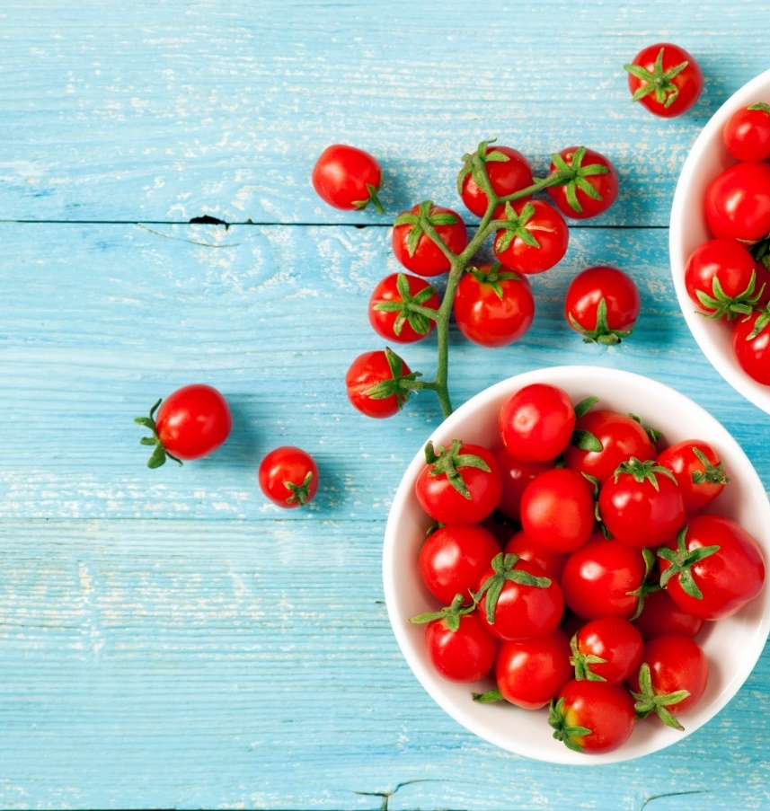
Choking Hazards
Hot dogs
Whole grapes
Cherry tomatoes
Dried fruit
Nuts and seeds
Chunks of meat or cheese
Popcorn
Chunks of raw vegetables
Notes:
[SUGGESTED SCRIPT]
Children under age 5 are at high risk of choking on foods and small items. Choking is when food becomes trapped in the airway, and the airway is blocked or severely restricted. Preschool-aged children are at higher risk of choking. They have less practice controlling food in their mouths and do not always chew food into small enough pieces to swallow safely.
Closely supervise children during all meals and snacks. As you model healthy eating, take small bites, eat slowly, and chew food well. Establishing a calm, unhurried eating environment encourages children to eat at a slow pace. Cutting items like grapes, cherry tomatoes into slivers, short strips, or small pieces reduces the choking danger.

Slide 11
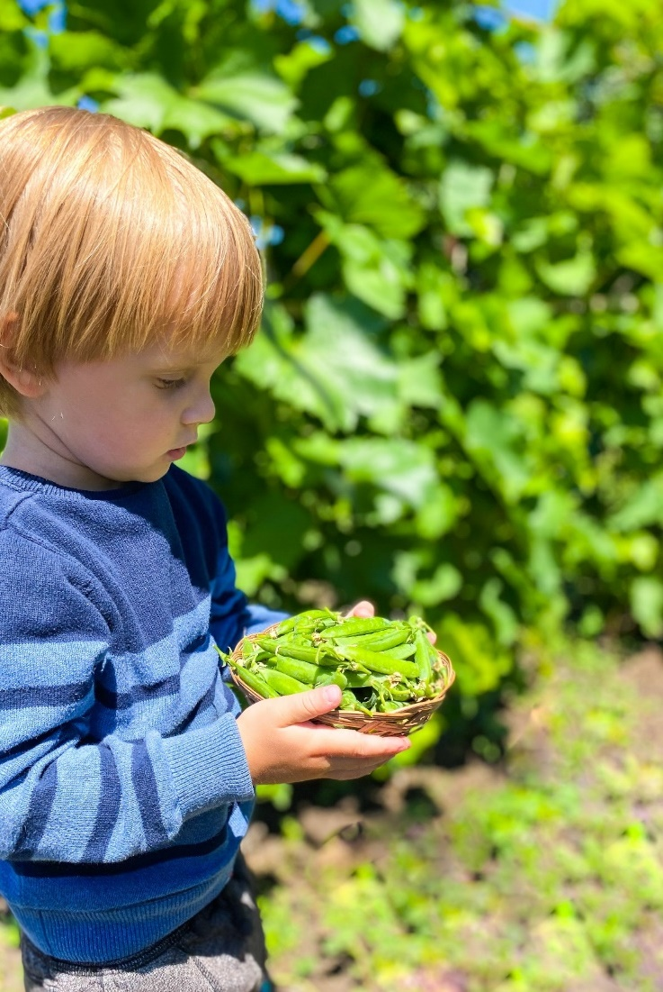
How can providers support development during mealtime?
Physical
Cognitive
Social and Emotional
Language
Notes:
[TRAINER NOTES]
Divide participants into four groups. For virtual training, use breakout groups. Assign each group one developmental domain. Ask each group to brainstorm three ways to support children in this domain during meals and snacks or classroom activities related to food. Allow five minutes in groups. Ask one person from each group to share back with the large group.
[SUGGESTED SCRIPT]
Physical development
Coaching children on using a serving utensil to include hand-over-hand support
Coaching children on passing the serving dish. This can include keeping hands and fingers on the outside of the bowl (not wrapped over the lip), making eye contact with the receiver, gently pushing the bowl across the surface,
Promoting small motor development to practice pouring (water tables or sensory tables), using tongs to move cotton balls, serving spoons to move beads etc.
Cognitive development
Supporting mealtime conversations
Increasing awareness of different foods and ways of preparing foods
Linking meal components to classroom experiences such as gardening or sensory activity
Social and emotional development
Role model table manners (Please and Thank You, using a napkin)
Creating a positive environment around food choices. Encouraging children to communicate in a polite way around food choices. For example, “No thank you, I don’t want to try that today” instead of “Yuck.” Children should always decide what and whether they will eat a food item, but verbalizing judgement can insult other children’s food choices. Don’t yuck my yum.
Promoting independence during meals through cleaning messes, clearing dishes

Slide 12
Identify the role of ECE professionals in nurturing healthy eaters
Notes:
Objective 2
[SUGGESTED SCRIPT]
Each child is born with the capacity to become a healthy eater. During the preschool years, children need supporting adults to help them master skills and overcome challenges. Next, we will discuss our role as early care and education professionals and the practices we can use to help children become healthy eaters.

Slide 13
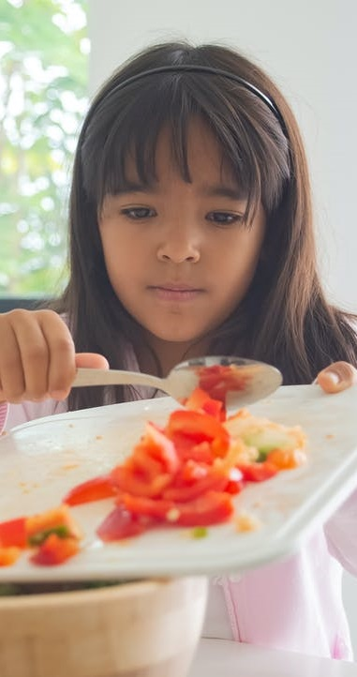
Healthy Feeding Practices
Create a consistent meal/snack routine with adequate time so children are not rushed
Provide a variety of healthy options
Maintain a relaxed, pleasant environment during meals and snacks
Minimize mealtime distractions
Eat with children
Implement Family Style Dining
Notes:
[SUGGESTED SCRIPT]
Children benefit from healthy feeding practices because they help them develop and maintain a positive attitude about eating.
Children learn to:
Listen to their body's signals of hunger and fullness
Regulate their food intake
Actively participate in meal and snack times
Effectively communicate their needs and learns that these needs will be met
Learn to accept new foods
Children depend on adults to create an environment that allows them to learn and thrive. These teacher practices or strategies listed on the slide around feeding encourage children to become healthy eaters. Positive affection and high levels of warmth are part of a healthy feeding environment.
Children will have better mealtime experiences if they are not sleepy, overly hungry, or upset. A consistent routine supports a child in developing healthy eating behaviors. Part of this routine should be sufficient time for meals and snacks. Preschoolers can be slow eaters as they are mastering the use of utensils and engaging in conversations. Rushing meals creates stress.
Serve foods that children can eat themselves with fingers or utensils.
TVs/Screens should not be on during meals and snacks.
Enthusiastically model the enjoyment of foods served. Adults support conversation, assist with serving and eating, and model desired mealtime behaviors.

Slide 14
Division of Responsibility
Adults are responsible for: | Infants are responsible:
What to feed | When to eat How much to eat Whether they eat what is offered
Adults are responsible for: | Toddlers & Preschoolers are responsible:
What to feed When to feed Where to feed | How much to eat Whether they eat what is offered
Notes:
[TRAINER NOTES]
Invite participants to view the table on page three in the handouts.
[SUGGESTED SCRIPT]
The division of responsibility in feeding outlines roles in the feeding relationship. The table can be found on page three in the handout. Caregivers are responsible for the appropriate structure and routine of feeding (the what, when, and where of eating), and the child is responsible for how much and whether or not to eat what the caregiver provides. In child care settings with toddler and preschool-aged children, the when is controlled by the program schedule.
Satter, E. (2000). Child of Mine: Feeding with Love and Good Sense, Revised and Updated Edition (Revised ed.). Boulder, Colorado: Bull Publishing.

Slide 15
Role of Adults in the Division of Responsibility
Pay attention to and respond to children’s hunger and fullness cues
Model table manners and social skills at mealtime
Be considerate of children’s lack of food experience
Choose and prepare food
Make eating times pleasant
Trust children’s choices relating to food
Notes:
[SUGGESTED SCRIPT]
Ellyn Satter is an internationally recognized authority on eating and feeding. She is a dietitian, family therapist, and author. Her division of responsibility in feeding defines caregiver and child roles in the feeding relationship from birth through adolescence. This slide captures the division of responsibilities in early childhood. In a child care setting with toddler and preschool-aged children, the when may be controlled by the program schedule.
To understand how to help children learn to be healthy eaters requires that we understand the roles in the feeding relationship. When caregivers to their job, children can do their job in eating.
Source:
Satter, E. (2000). Child of Mine: Feeding with Love and Good Sense, Revised and Updated Edition (Revised ed.). Boulder, Colorado: Bull Publishing.

Slide 16
Child Responsibilities
Eat the amount they need
Learn to eat the food adults eat
Learn table manners and social skills at mealtime
Notes:
[SUGGESTED SCRIPT]
All children are born with the ability to recognize and respond to hunger and fullness cues. Preschoolers' appetites can vary widely from day to day and meal to meal.
Children are born with the ability to accept foods. Even foods they won’t eat today, they understand that someday they will eat them. This is part of growing up.
Children are growing physically, acquiring skills, and learning to enjoy the foods provided by adults and caregivers in their lives.

Slide 17
Whose Responsibility?
Stand for adult Sit for child
1. Pay attention to and respond to hunger and fullness cues
2. Learn to eat the food adults eat
3. Model table manners and social skills at mealtime
4. Eat the amount they need
5. Trust children’s choices relating to food
6. Grow predictably in the way that is right for them
7. Be considerate of children’s lack of food experience
Notes:
[TRAINER NOTES]
This is a quick knowledge check on the division of responsibility in feeding. Ask participants to stand if role on the screen is the adult role and sit if it is a child's responsibility. The responsibilities will float on the screen, one at a time, each time you strike the enter key.
1. Adult, Stand
2. Child, Sit
3. Adult, Stand
4. Child, Sit
5. Adult, Stand
6. Child, Sit
7. Adult, Stand
Before participants sit back down, encourage them to take a quick stretch. Lift arms above the head and bend to the right and left gently.

Slide 18
Feeding Practices
Healthy Feeding Practices
Unhealthy Feeding Practices
Allow children to decide what and how much they will eat
Model healthy eating
Provide repeated exposure to new foods prepared in various ways
Gently encourage children to try new foods
Ask children about fullness when seconds are requested
Children are pressured to eat
Food is used as punishment or reward
Praise is given when children finish food
Certain foods are restricted
Notes:
[TRAINER NOTES]
Read the list of heathy feeding practices noting how each of the practices listed align with the Division of Responsibility.
[SUGGESTED SCRIPT]
Let’s look at the list of unhealthy feeding practices. These unhealthy feeding practices have been associated with negative outcomes such as increased intake of sugary beverages and unhealthy (high calorie) snack foods, and the lower acceptance of new foods. These practices can also have negative impact on children’s relationship with foods and eating.
Pressure
According to Ellyn Satter, pressure doesn’t work.
Trying to get kids to eat more, results in them eating less
Trying to get kids to eat less, results in them eating more
Trying to get kids to eat certain foods, results in them avoiding it altogether
Punishment or Reward
Using food as a reward or a punishment undermines healthy eating habits and can change a child’s relationship with food. Food is being used to control behavior which can decrease a child’s ability to notice hunger/fullness cues and regulate intake. Studies have shown that using food for reward of punishment can increase the risk of emotional eating.
Praise
Praise feels good to all of us and many children respond to praise. Healthy eating involves stopping in response to fullness cues, not a clean plate or finishing certain food items.
Restricting certain food items
Another controlling feeding practice is overly restricting certain food items, such as a high fat or sugary treat or a specific meal component. When an adult limits or restricts a particular food it sends the message that one food is better than another. For example, when an adult denies a second serving of bread, until all the broccoli is eaten, the child understands the bread to be a reward and understands it is better than vegetables.

Slide 19
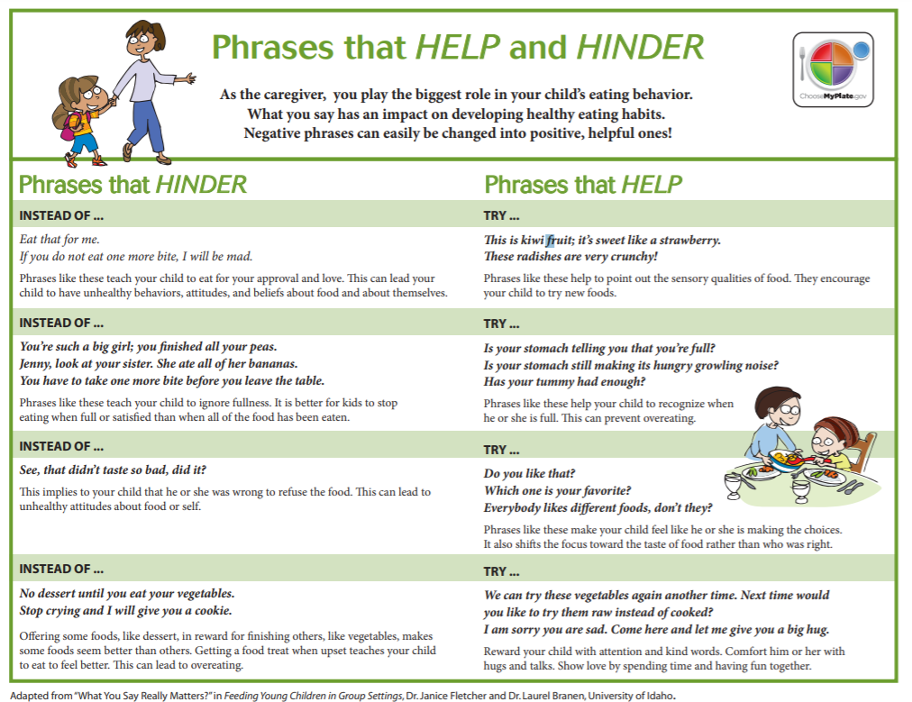
Notes:
[TRAINER NOTES]
Invite participants to find the Phrases that HELP and HINDER on page four in the handout.
[SUGGESTED SCRIPT]
As a caregiver, what you say has an impact on children’s eating habits. Many adults may have grown up as members of the clean plate club. We may have experienced this as positive pressure-being praised for cleaning our plate (or making a happy plate) or negative pressure –being coaxed, scolded, or punished for not cleaning our plate. Pressure can be positive in encouraging, reminding, cheering or telling how good and healthy a particular food is.
Pressure can also be negative in restricting, comparing children, begging, or shaming a child.
When we feel pressure, our brain focuses on responding to the pressure, which interferes with natural cues of hunger and fullness.
Neutral language around meals and feeding allows a child supports a child in eating mindfully, using senses, and responding to their individual appetite cues.
Source:
https://www.ellynsatterinstitute.org/positive-or-negative-its-still-pressure/

Slide 20
Modeling Healthy Eating: Effective Verbal Comments
Notes:
[TRAINER NOTES]
Ask participants to find the note box in the handout on page three and note the four verbal comment strategies to encourage healthy eaters during meals.
To debrief the video clip: Ask for participant reflections on what they observed and how they might incorporate these strategies in their meal and snack times with children.
The four verbal comment strategies covered in the clip are:
Make specific comments
Be enthusiastic
Ask questions about the food
Use absolute comments
https://mediahub.unl.edu/media/4119

Slide 21
Brainstorm Conversation Starters
Today we are having carrots for snack. What color are the carrots?
This morning I saw you playing in the sandbox. What were you working on?
If you could be any animal, what would you be?
Notes:
[SUGGESTED SCRIPT]
Positive mealtimes are social, relaxed, and calm with conversations between children and adults. Mealtime conversations are also a chance to continue learning from experiences and activities from the classroom. Talking about the foods served and the senses used (taste, texture, smell, sound when chewed) can spark curiosity and encourage children to try a food. Other children may find a conversation about foods they don’t enjoy (or new food) to be stressful and would benefit from discussions not focused on food. As teachers get to know children and understand their personalities, they can lead conversations that all children can enjoy to keep the mealtime pleasant and pressure-free.
[TRAINER NOTES]
Direct participants to the shaded box on page five of the handout. Divide participants into groups of 3-4 and ask them to brainstorm four conversation starters. Ask each group to share back their list. (What colors are on your plate? How did this grow? I saw you building with blocks today; what did you create? What foods do you like to eat at home? What ingredients do you think are in this? What animals do you think like to eat this food?

Slide 22
Break
Notes:
[TRAINER NOTES]
This is a suggested point in the training to provide a 10-minute break. There is a timer in the trainer kit to in tracking the time. Encourage participants to get up and stretch or move, get water and take care of themselves.

Slide 23
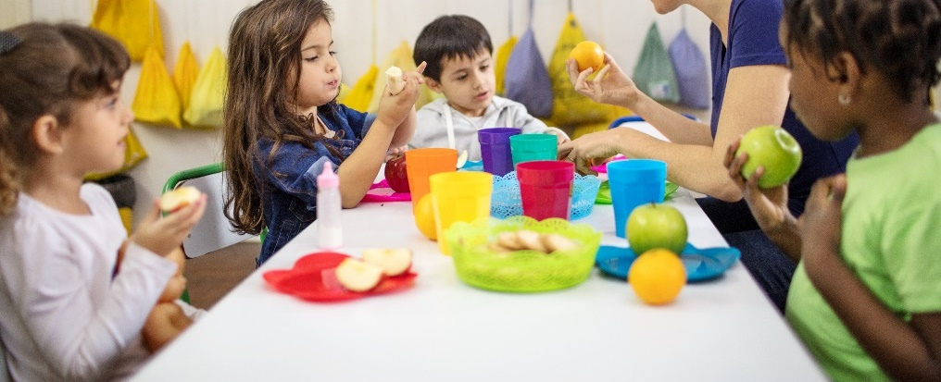
What Does Family-Style Dining Look Like?
Children help set the table
Food is placed on the table in small containers with child-sized utensils
Beverages are served in small pitchers
Children serve themselves all food and beverages
Adults sit at the table with children and role model by eating the same foods
Children engage in conversation
Notes:
[SUGGESTED SCRIPT]
Family Style Dining is a meal service that encourages healthy habits and supports the Division of Responsibility in feeding. Children have control of the choices that go on their plate. There is a feeling of safety that comes with this control, and children can consider foods within this safe space.
Family Style Dining looks different from one ECE program to the next depending on the ages of the children served and whether food is provided by the ECE program or brought from home, but the key elements stay the same. If your ECE program is new to Family Style Dining, you can introduce it slowly by incorporating a few of these elements at a time.
In its most complete form, family-style meal service involves all of the following elements:
Children help set and clear the table.
Food is placed on the table in small containers with child-size serving utensils.
Beverages are served in small pitchers.
Children choose their portion size and serve themselves independently unless adult help is required.
Adults sit at the table with children and role-model by eating the same foods and drinking the same beverages.
Adults intentionally engage with children at the table to talk about trying and enjoying new foods and to guide the conversation to create a positive mealtime environment that supports learning.
Children engage in conversation with one another and with the adults around the table.
When children are allowed to decide their own portion sizes, they generally serve themselves a smaller amount and are less likely to overeat. This decision-making process helps to reinforce children’s eating according to their internal hunger and fullness cues.

Slide 24
Getting Ready for Family Style Dining
Assist children with mealtime skills such as:
Proper handwashing
Holding utensils, glasses, plates, and bowls
Passing serving dishes
Cleaning spills and at end of mealtime
Appropriately sized serving and eating utensils help children to:
Develop and enhance fine motor skills
Improve hand-eye coordination skills
Notes:
[SUGGESTED SCRIPT]
To be successful with family style meal service, it’s important that children learn and develop certain skills.
Adults can help children develop skills to be successful with family-style dining
Children will learn mealtime skills, such as:
Proper handwashing techniques
How to hold utensils, glasses, plates, and bowls.
Children will need to be continuously reminded that serving utensils cannot go in their mouths but will master this over time. Remind children to pass bowls and plates holding the outside edges. Dishes with a small lip are ideal.
How to pass serving dishes and pitchers.
Spills will happen. When they do, remind children that it is ok to make mistakes and help with the cleanup.
An empty tub for dirty dishes placed at child level helps reduce spills during cleanup. Assisting in cleanup promotes independence and teaches responsibility.
Many of these skills require practice, and developmentally appropriate equipment can help. Child-size utensils, glasses, plates, and bowls help children develop the needed fine motor skills. Gradually, children will learn to direct their fingers, hands, and wrists to perform more complex tasks. Hand and finger skills such as using a fork, spoon, and occasionally a knife are developmental milestones that are generally achieved between 3-5 years

Slide 25
Family Style Dining
All foods are placed on the table where children and adults sit together to share the meal
Adults encourage children to serve themselves independently or with adult help as needed
Benefits
Exposure to a variety of foods without pressure
Children eat more fruits and vegetables when they observe peers and adults enjoying these foods
Children practice serving portion sizes and listen to internal hunger cues
Children gain independence and cooperation skills
Notes:
[TRAINER NOTES]
Current CACFP meal pattern guidance is that enough food should be placed on the table to allow for the full CACFP portion size required for each child. Children do not have to serve each component. Teachers can gently offer the food.
[SUGGESTED SCRIPT]
Family-style dining is considered a best practice when public health conditions permit. Children should not serve foods during an outbreak of gastrointestinal illness or other community outbreaks of disease. Follow state and local health department guidelines. Other aspects of family-style dining can continue for examples children can still decide which meal components they would like plated.
Source:
USDA Food and Nutrition Services. (2016, September 12). Offer Versus Serve and Family Style Meals in the Child and Adult Care Food Program | USDA-FNS. Https://Www.Fns.Usda.Gov/Cacfp/Offer-versus-Serve-Family-Style-Meals. Retrieved December 12, 2020, from https://www.fns.usda.gov/cacfp/offer-versus-serve-family-style-meals

Slide 26
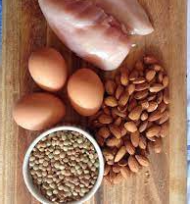
Foods to Serve
Protein
Avoid fried meats
Serve beans and lean meats
Dairy
Yogurt and cheese
Low-fat for 2 years of age and older
Notes:
[SUGGESTED SCRIPT]
Serve beans and lean meats like chicken or fish, avoiding fried meats.
Serve milk equivalent products like yogurt and cheese, using low-fat varieties for 2 years of age and older.
Work with families to understand protein and dairy options that are culturally relevant for their child and adjust the program menu as able.

Slide 27
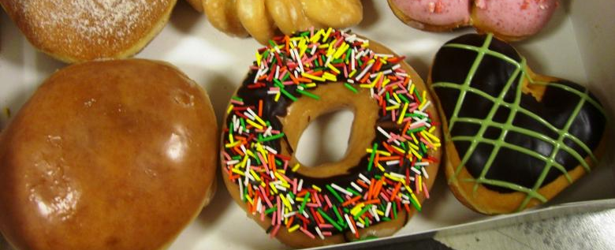
Foods to Limit
Salt
Avoid salty foods like chips and pretzels
Sugar
Avoid candy, sodas, sweetened drinks, fruit nectars, and flavored milks
Oils
Avoid trans fats, saturated fats, fried foods
Choose healthy fats like nuts, seeds, vegetable oils
Notes:
[SUGGESTED SCRIPT]
When preparing meals for young children, limit salt and sugar as much as possible. Serving whole foods instead of packaged, processed foods will make this easier. It is challenging to avoid processed food as often they are less expensive than whole foods and require less time to prepare.
Avoid salty foods such as chips and pretzels.
Avoid sugar, including concentrated sweets such as candy, sodas, sweetened drinks, fruit nectars, and flavored milk.
Limit oils by choosing monounsaturated and polyunsaturated fats such as nuts, seeds, and vegetable oils like olive oil. Avoid trans fats, saturated fats and fried foods.

Slide 28
Beverages to Serve
Milk
Whole, pasteurized milk for 12-24 months
Skim or 1% pasteurized milk to ages 2 years and older
Juice
100% juice with no added sweeteners
No more than 4-6 oz juice/day for children ages 1-6
No juice for children younger than 12 months
Notes:
[SUGGESTED SCRIPT]
What are the best beverages to serve?
Milk is nutritious, providing protein, calcium and vitamin D.
Serve whole pasteurized milk to 12- to 24-month-old children unless a doctor prescribes low or reduced fat milk.
Serve skim or 1% pasteurized milk to children two years of age and older unless a doctor prescribes low or reduced fat milk.
Work with families to understand their milk preferences.
[TRAINER NOTES]
Understand your state’s child care regulations relating to milk and other meal components. Many states provide guidance for supporting children with dietary restrictions based on a child’s medical condition, religious beliefs of the family and dietary preferences in regulations.

Slide 29
Beverages to Serve Water
Available both inside and outside
Place cups next to the faucet
Place a pitcher and cups on a counter or table
Offer during and after playground time
Offer with snack
Provide whenever requested by a child
Notes:
[SUGGESTED SCRIPT]
Water helps children stay hydrated and is a healthy alternative to sugar sweetened beverages.
The earlier children get in the habit of drinking water often, the better.
Water should be offered in a variety of ways such as placing cups next to the faucet, providing pitchers and cups on a counter or table, offering water after or during playground time, with snack, and whenever requested by a child.

Slide 30
Using books to support healthy habits
Notes:
[SUGGESTED SCRIPT]
As we have discussed experiences and exposure to food are not limited to mealtimes. Many classroom activities can help children become more familiar and curious about new foods. Dramatic play areas containing a variety of ‘healthy’ play food items encourage familiarity. Book centers or reading areas with an assortment of different reading materials stimulate imagination and thinking skills. haring books with young children supports their growing cognitive and language skills. Books can expose children to new concepts and new situations allowing children opportunities to think and develop their own opinions.
[TRAINER NOTES]
Click on the hyperlink. This 2 ½ minutes long video clip is the reading of Growing Vegetable Soup by Lois Ehlert. Another option is to read aloud the copy of the book found in the Nourishing Healthy Eaters Trainer Kit. Trainers may substitute other early childhood titles about food and eating. When selecting children’s books, providers/teachers should carefully review book contents and themes. Consider selecting books by diverse authors/illustrators that reflect the culture of the community. Children should be able to connect with the theme of healthy eating but also see themselves in the characters.
After the video or reading, facilitate a discussion of extension ideas.
Do a sensory activity with different vegetables in the book. Notice the color, texture and scent.
Practice cutting with a knife, for example, using a plastic knife on a zucchini, mushrooms, or sweet peppers
Plant seeds in eggshells or cups. Watch them grow and introduce vocabulary such as sprout, roots, leaves.
Purchase a vegetable plant to grow outside. Help children observe the plant grow by measuring its height, observing for blossoms and produce and noticing changes with the seasons.
Help the children shuck corn. Notice the texture of the husks and silks. Introduce vocabulary words to include kernel, cob, husk, silk and ear.
Share herb plants with children. Encourage them to gently rub basil, rosemary or mint to release the fragrance
Lead a brief large-group discussion on the children’s books that include food or eating. There is a short list in the handout on page five with space for participants to capture titles shared by others.

Slide 31
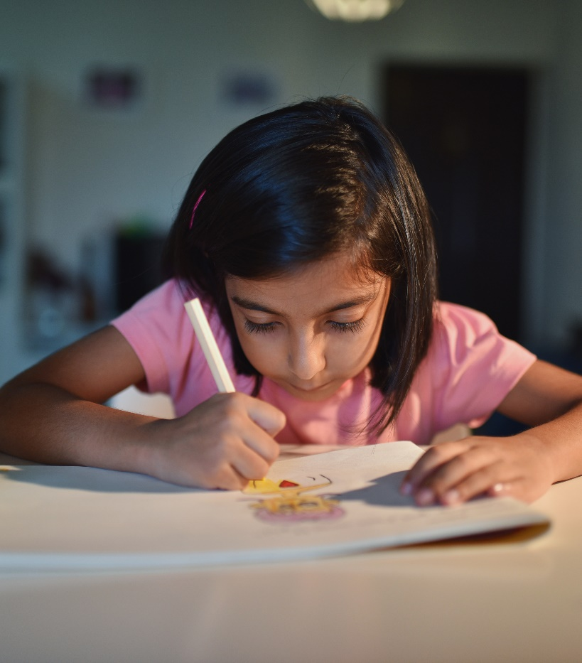
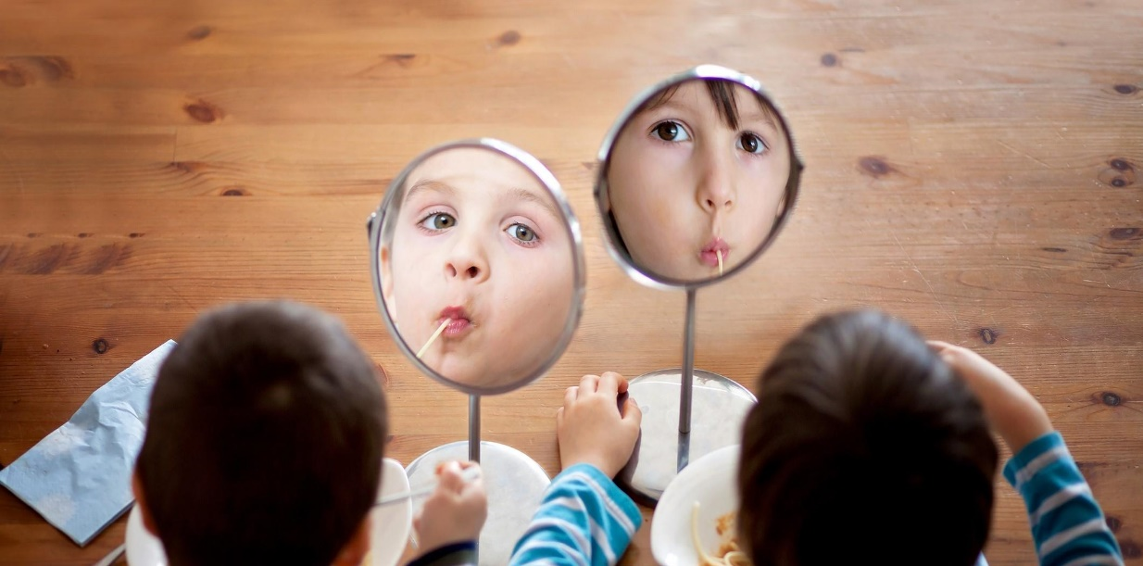
Reflection activity
Notes:
[TRAINER NOTES]
As a summary activity for this objective, ask participants to complete a Self-Reflection Activity in the handout on page six. Give participants 5-7 minutes to complete the activity. Debrief the activity by asking participants to share practices they are interested in adding to their routines. For virtual delivery, participants can add 1 practice to the chat box. Trainers can ask curious questions, if time allows, as to why certain practices were selected.
The practices listed on the checklist are taken from the Wellness Workbook and include only provider level practices. For most practices, the response All the Time is the best practice. For practices with an asterisk, Rarely or Never is the best practice.
[SUGGESTED SCRIPT]
We have discussed teacher practices to support children in their journey to become healthy eaters. As a summary activity, please reflect on your current practices. Read through each of the teacher practices and indicate how frequently you apply this in your classroom. After you have completed the list, think about which practice you could add to your routines.
Eating Environment
Meal time is relaxed and calm
Toddler and preschooler meals are served family style (children encouraged to serve themselves with limited help)
Early childhood providers sit with children during meals and talk informally about trying and enjoying healthy food
Early childhood providers help children learn to recognize hunger/fullness cues
Early childhood providers eat the same meals/snacks as the children and avoid unhealthy foods (e.g., soda, sweets, fast food)
Providers gently offer children unfamiliar foods, knowing that a child may need to sample a new food 10 or more times before learning to like it.
Food or beverages are used as an incentive or reward*
Food or beverages are withheld as punishment*
Water
9. Drinking water is available when children are outdoors
10. Drinking water is available when children are indoors
11. At snack time, drinking water is provided
Adult Beverages/Role Modeling
12. Early childhood providers drink sugar-sweetened beverages in front of children*

Slide 32
Recognize family engagement opportunities around nutrition and food
Notes:
Objective 3
[SUGGESTED SCRIPT]
Families play a primary role in the developing eating habits of preschoolers. Children's experiences in child care settings are also important in shaping habits, but what happens at home may be different. Communicating with families to understand their beliefs and experiences around meals and food can help you better support each child in his eating journey to become a healthy eater.

Slide 33
What influences families’ food choices?
Notes:
[TRAINER NOTES]
This is a suggested large group discussion activity.
[SUGGESTED SCRIPT]
Food and nutrition can be challenging topics to discuss with families as our food choices are very personal and tied to income, access, culture, and identity. It is also useful to recognize our own implicit biases as we engage in conversations with families.
Societal norms around nutrition can include preferences for certain foods, attitudes about acceptable ranges of body weight, and values placed on health. Communicating with families to appreciate their beliefs and values around food can help ECE professionals understand and support children in their food journey.
Differences exist around access and affordability to food which impact the food choices a family can make.

Slide 34
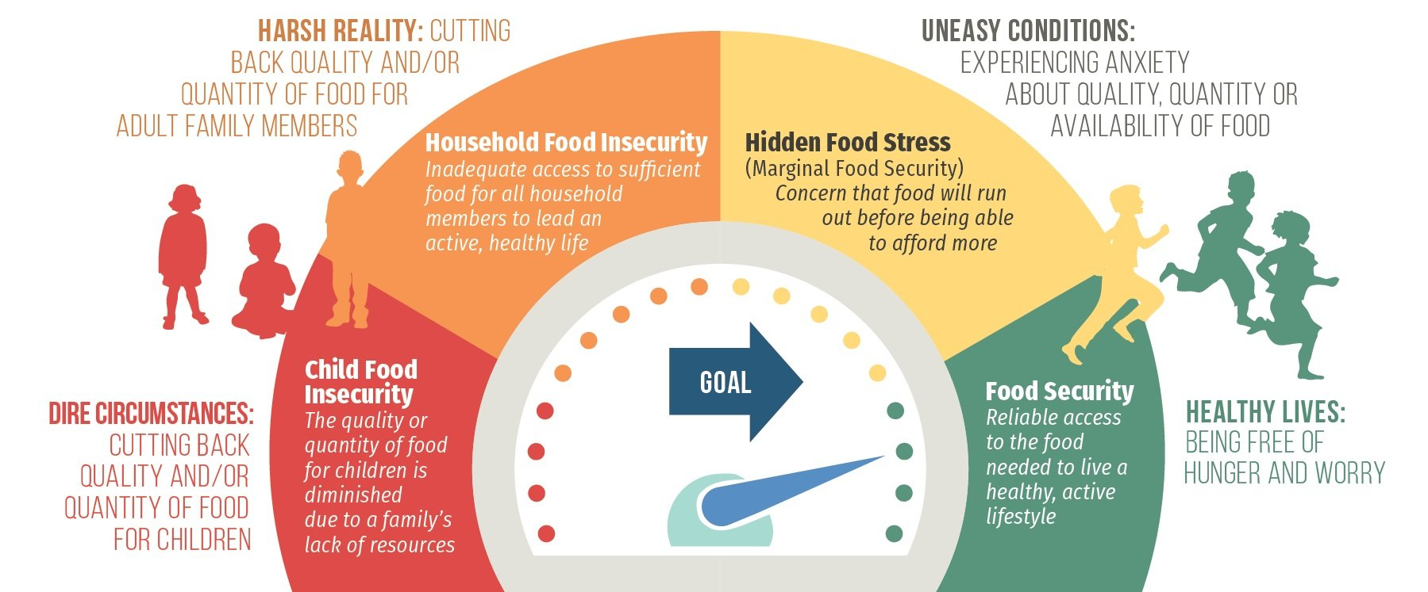
Food Insecurity
Food insecurity is defined as limited or uncertain access to sufficient, safe and nutritious food
1 in 6 children live in households that do not have a consistent and dependable supply of healthy food
Notes:
[TRAINER NOTES]
Food insecurity rates have increased sharply due to the COVID-19 pandemic. Children in food insecure households may be hungry and missing vital nutrients.
[SUGGESTED SCRIPT]
Food-insecure families may avoid hunger by choosing cheaper, more filling types of food over more costly, nutritious foods. For young children, the result can be a diet with inadequate nutrients for normal growth and development.
A family may be experiencing food insecurity if they regularly:
Are unable to afford balanced meals
Reduce the size of meals because of lack of money
Reduce the quality and variety of their regular diet due to lack of money
Food insecurity causes stress in families, which can have a negative impact on child development.
The graphic here from the Children’s HealthWatch Report Card on Food Security Among Young Children highlights the different levels of food stress that a family may experience. As you can see, families and children can experience different type of food stress and insecurity. While this graphic is from a few years ago, the pandemic has only increased these stresses for families and children.
Source: Children’s HealthWatch, HIDDEN FOOD STRESS: UNDERREPORTED IN NATIONAL DATA 2015
https://childrenshealthwatch.org/hiddenfoodstress/

Slide 35
Addressing barriers to healthy eating
Community gardens
Farm to Early Care & Education
National Farm to ECE
Farmers’ markets
Notes:
[SUGGESTED SCRIPT]
Many communities across the country are coming together to tackle these long-standing barriers to health and wellness. There are growing initiatives and organizations finding solutions to bring in healthier food options and change the power dynamics of food access and the traditional food system.
When seeking healthier food options for yourself or your ECE program, there may be additional community resources and options available to you, including:
Community gardens & Farm to Early Care & Education
Community gardens aim to increase access to fresh produce and enhance social connection around planting and growing local food. Community gardens are often supported local volunteers or may be available in your neighborhood or local school. You can even seek support for establishing a garden in your ECE program. The National Farm to School Network provides resources for ECE programs interested in getting started with gardening and other activities to bring local food to young children. https://www.farmtoschool.org/our-work/early-care-and-education.
Farmers’ Markets & Nutrition Benefits
Farmers markets can be great sources of fresh fruits, vegetables and other healthy foods. In many states, farmers markets provide incentives to shoppers who use SNAP to purchase local food.

Slide 36
Addressing barriers to healthy eating
Food Co-ops
Food banks & mobile food banks
Federal nutrition assistance programs
Notes:
[SUGGESTED SCRIPT]
Food co-ops are stores owned and supported by the people that shop there. Like farmers’ markets and community gardens, food co-ops emphasize community engagement and healthy, sustainable foods. Membership fees and/or requirements for volunteer hours can be a challenge to participation.
Food banks & mobile food banks can be another option for increasing food access. Many food banks are increasing their availability of healthy food options, some provide cooking skills classes or SNAP-Ed education. Mobile food banks are an option for rural communities who may not have access to food pantries or are far away from a food bank.
The website highlighted here aim to connect communities with local food options. Local Harvest allows you to search for local farms, community supported agriculture (CSAs), Farmers Markets, and Farm Stands based on your location. www.localharvest.org
Besides these local food options, federal nutrition programs like WIC, SNAP can support families experiencing food stress and food insecurity. Many families may not realize they are eligible for these programs and the application process has changed in response to the COVID-19 pandemic. ECE programs can help connect families and staff connect to these programs. The handouts include information on Federal nutrition assistance programs and state agency contacts.

Slide 37
Supporting Families
SNAP — the Supplemental Nutrition Assistance Program, formerly known as Food Stamps
WIC — Special Supplemental Nutrition Program for Women, Infants, and Children
CACFP — The Child and Adult Care Food Program
Summer Meal Program Sites
Emergency food resources in your community
Food Banks and Pantries
Notes:
[TRAINER NOTES]
Invite participants to view the slide information on page seven in the handout
[SUGGESTED SCRIPT]
The need for emergency food resources has increased across many communities due to the COVID-19 pandemic. Newly food insecure households may be more reluctant to seek and accept help. As an early care and education professional, sharing your knowledge of community resources related to food and nutrition can increase access to healthy foods.
The United States Department of Agriculture’s (USDA's) Food and Nutrition Service administers several programs targeted at young children and families with young children.
SNAP
SNAP provides nutrition benefits to supplement the food budget of families so they can purchase healthy food. To get SNAP benefits, families meet specific requirements, including resource and income limits. The monthly allotment is based on family size. SNAP benefits can be used for a variety of healthy foods. Benefits are loaded monthly on an Electronic Benefit Transfer (EBT) card, which works like a debit card.
WIC
The Special Supplemental Nutrition Program for Women, Infants, and Children, better known as the WIC Program, serves to safeguard the health of low-income pregnant, postpartum, and breastfeeding women, infants, and children up to age 5. WIC provides nutritious foods to supplement diets, education on healthy eating, and referrals to health care. Most states issue WIC benefits using Electronic Benefit Transfer (EBT) cards. WIC is expanding services to children up to age six soon.
CACFP
The Child and Adult Care Food Program (CACFP) helps child care settings and family child care homes provide nutritious foods to young children. Child care centers receive reimbursement for serving up to two meals and one snack per day that meet Federal nutritional guidelines to eligible children. Reimbursement rates are based upon a child’s eligibility for free, reduced-price, or paid meals
Summer Meal Program Sites and serving times- This program serves children 18 years of age and younger. The USDA has made temporary changes that support meals taken home and parents or guardians picking up meals (in some states).
Emergency food resources may include:
Days and times of operations for Food Banks and Pantries
Days and hours of operations of Food Pantries and meals at Churches & Community Center

Slide 38
Food and Families in ECE
Taste Testing
Cooking events or classes
Produce basket pick up at child care
Coupon swap board
Community gardens/ECE gardens
Notes:
[SUGGESTED SCRIPT]
Food connects us to our community, to our cultures, and each other. An event with food served is a sign of hospitality and friendliness.
Some opportunities for connecting with families around food include:
Taste Testing
Taste testing events are always popular. If timed at pick-up or drop-off, taste testing can be a quick way to connect with parents. These could be opportunities to share new items being added to program menus or quick, affordable family meal options such as crockpot recipes. Children could help prepare some of the items for taste testing and talk with their parents about the event.
Cooking Events
Cooking events or classes are a fun way to learn new cooking skills or recipes. Some cooperative extension programs offer cooking classes as part of their community programming. SNAP-Ed programs can be another resource for meal preparation education for parents.
CSA
Produce baskets, or CSAs (community support agriculture), connects families (and program staff) with local, fresh foods. To find farmers in your community who offer CSAs, check with your Cooperative Extension, local farmers market, or localharvest.org. The child care could serve as a pick-up point for families who order from the farmer.
Coupon swaps
Use a bulletin board in the lobby for coupon swapping and sharing. Save a spot on the board for information on digital coupons.
Child Care or Community gardens
Community gardens are plots of land where people work together to grow food. Share information on the y gardens in your community on bulletin boards or newsletters. Child care gardens are a powerful way for children to experience and learn about foods. Families can help! CACFP can help fund certain expenses related to child care gardens.

Slide 39
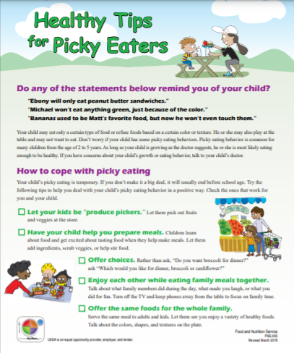
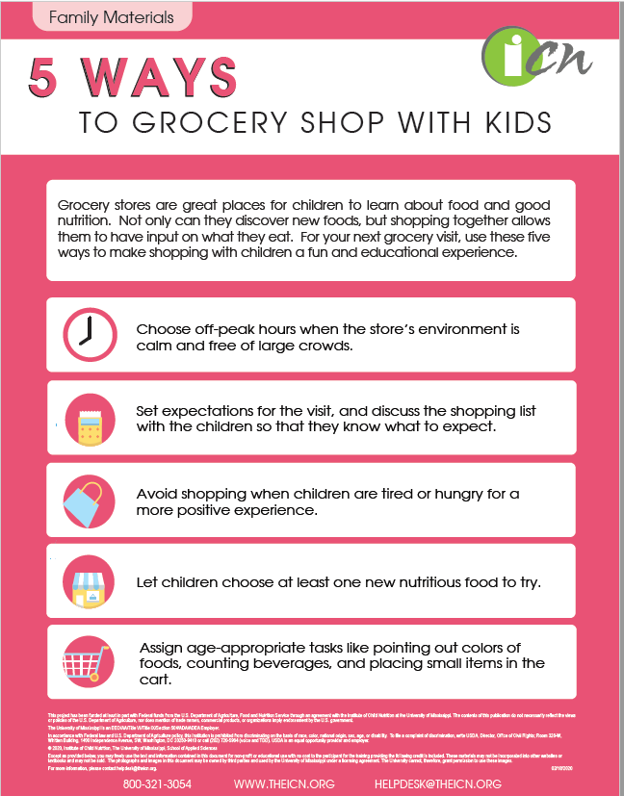
Resources to share with families
Notes:
[TRAINER NOTES]
Have samples of each of the resources available to pass around during your session. Adjust resources to your participants. Trusted sources for parent resources include the USDA Team Nutrition website, the Institute of Child Nutrition, and KidsHealth.org. Images and links are in the participant handout on page six,
[SUGGESTED SCRIPT]
Sharing tips and information with families can support a child’s food journey.
Some organizations and agencies that provide handouts and resources for families include: the Institute for Child Nutrition, Sesame Street and USDA (MyPlate.gov). Check your handout for links to the resources pictured on the slide.
https://theicn.org/resources/1481/grab-in-5/116663/5-ways-to-grocery-shop-with-kids.pdf
https://www.sesamestreet.org/toolkits/food/resources
https://myplate-prod.azureedge.net/sites/default/files/2020-12/HealthyTipsforPickyEaters_031418_508.pdf

Slide 40
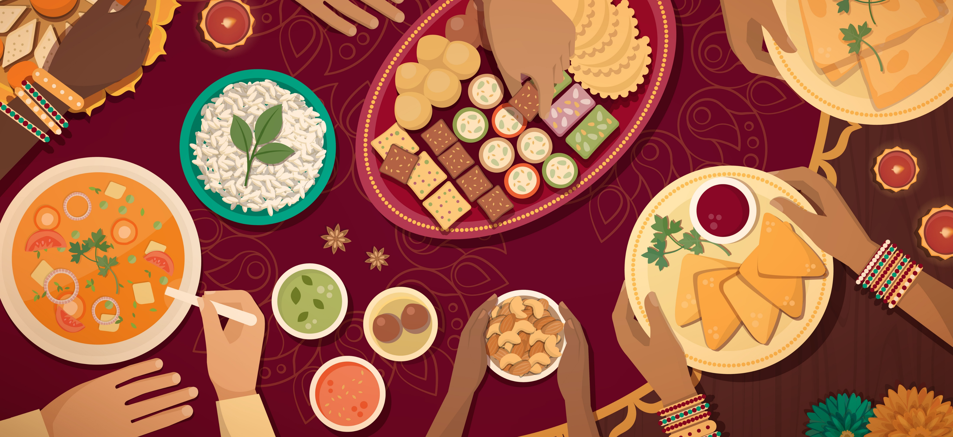
How do you engage with families around food and nutrition?
Notes:
[TRAINER NOTES]
Facilitate a large group discussion around what participants and their programs currently do to engage with families around food and nutrition. There are additional prompts below to continue the discussion.
[SUGGESTED SCRIPT]
What does family engagement look like in your program or family child care home? Do you share information on what children eat during meals?
Do families provide input to your menus?
Are there events you celebrate that tie to food such as fruit and vegetable month (June) or cultural celebrations where food is incorporated into activities or menus such as Lunar New Year, Mardi Gras or Indigenous People’s Day?
What resources around food do you share with families?
Resources & Information
Food banks & pantries (locations and hours)
Community meal sites
Educational materials

Slide 41
Identify one or more nutrition best practices to add into your daily routines with children
Notes:
[TRAINER NOTES]
Ask participants to find the reflection checklist in the and consider a practice that would like to strengthen or improve in their setting.
Eating Environment
Meal time is relaxed and calm
Toddler and preschooler meals are served family style (children encouraged to serve themselves with limited help)
Early childhood providers sit with children during meals and talk informally about trying and enjoying healthy food
Early childhood providers help children learn to recognize hunger/fullness cues
Early childhood providers eat the same meals/snacks as the children and avoid unhealthy foods (e.g., soda, sweets, fast food)
Providers gently offer children unfamiliar foods, knowing that a child may need to sample a new food 10 or more times before learning to like it.
Food or beverages are used as an incentive or reward*
Food or beverages are withheld as punishment*
Water
9. Drinking water is available when children are outdoors
10. Drinking water is available when children are indoors
11. At snack time, drinking water is provided
Adult Beverages/Role Modeling
12. Early childhood providers drink sugar-sweetened beverages in front of children*
For most practices, the response All the Time is the best practice. For practices with an asterisk, Rarely or Never is the best practice.

Slide 42
Nourishing Healthy Eaters ABC Plan
Action I plan to take
How does my action Benefit children?
What Challenges will I face?
Date I will begin this action?
Evidence I have been successful?
Notes:
[TRAINER NOTES]
Ask participants to refer back to the reflection checklist and select one or more best practice they will add or strengthen in their daily routines. The ABC plan is found on the last page of the handout. Give participants ten minutes to complete a plan. Ask for volunteers to share. If time is limited, work through a sample plan as a large group capturing responses on a flip chart (or whiteboard if the training is virtual). Have the group suggest a best practice to address and work through each step with participants brainstorming responses.

Slide 43
Sustaining practice change
https://www.futureme.org/
Notes:
[TRAINER NOTES]
For this optional activity, encourage participants to write a letter to themselves on the website, futureme.org. On this free site users, select a future date to receive an email they write to themselves. Encourage them to select a date 4-6 weeks in the future to receive an email that is a reminder to monitor their accountability with their practice change. One or two sentences can quickly capture their goals. Practice is change is challenging and sometimes it requires relooking at goals and developing action steps that address challenges.

Slide 44
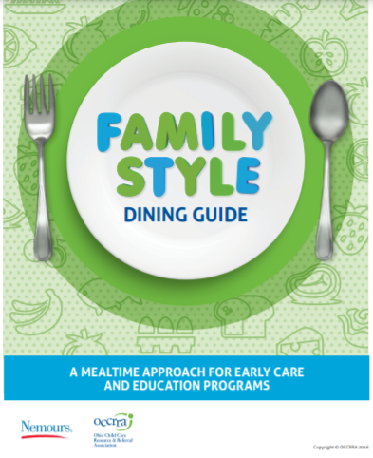
Free Resources for ECE Professionals
Notes:
[TRAINER NOTES]
Each image is linked to the resource website. If time allows, explore one resource. Images of the resources are also on the last page of the handout. Encourage participants to reach out if they would like more information on resources to help support their action plan.
[SUGGESTED SCRIPT]
Do you need any resources to support your plan? This slide has some resources that may help.
Nemours Best Practices for Healthy Eating Guide. Content includes information on the CACFP meal pattern, portion sizes, family style dining, Menu Planning and Meal Preparation, Developing policies to support healthy eating and Family Tip Sheets and Daily communication forms. The booklet is available to download in English and Spanish. https://healthykidshealthyfuture.org/wp-content/uploads/2022/03/26636_Nemours_HealthyEatingGuide_Eng.pdf https://healthykidshealthyfuture.org/wp-content/uploads/2022/03/26636_Nemours_HealthyEatingGuide_Spanish_final.pdf
Nutrition Curricula-A early childhood nutrition curricula can support teachers in introducing nutrition concepts and fun learning activities around food. Grow It, Try It, Like It: Preschool Fun with Fruits and Vegetables is free to download. Programs participating in CACFP can request a printed copy and non-participating programs can download this document free/ https://www.fns.usda.gov/tn/grow-it
Family Style Dining Guide- This 46-page booklet is a step-by-step approach in preparing children, adults, families and the program to implement FSD. https://d3knp61p33sjvn.cloudfront.net/2016/02/FamilyStyleDiningToolkit.pdf
Taste Test Guide -A taste test is an activity that introduces children to foods and beverages they may not have tried before. This 4-page guide includes food safety reminders.
https://static1.squarespace.com/static/5913265f86e6c06cfc83eb8d/t/5b327d0e70a6adc4082d84ad/1530035509839/F2PSTasteTestGuide.pdf
Recipes-The Child Nutrition Recipe Box provides program operators with recipes to prepare healthy and delicious meals that meet the CACFP meal pattern requirements.
https://theicn.org/icn-resources-a-z/usda-standardized-recipes
Sensory Activities – A short summary ideas using all 5 senses to learn about foods. http://bkc-od-media.vmhost.psu.edu/documents/Lunches1406.pdf

Slide 45
Acknowledgments
This training was made possible thanks to the funding, technical expertise, and guidance from the following national and state organizations.
For expertise in children’s health and wellness. This training series was developed by nutrition and early childhood experts.
For initial funding to design and develop the original Nourishing Health Eaters training series
Notes:
[SUGGESTED SCRIPT]
Finally, we’d like to acknowledge some national and state partner organizations that made this training possible.

Slide 46
Thank you for participating in today’s training
Notes:
[SUGGESTED SCRIPT]
Thank you for participating in today’s training. As a child care professional, you can play an important role in Nourishing Healthy Eaters.

