Slide 1
Insert trainer information here
Notes:
Welcome to the Healthy Kids Healthy Future Physical Activity Learning Session.
This is the last session of the PALS workshops.
Thank you for sharing your time with us today to learn more about how early care settings can support young children to become more physically active.
In this training you will set a goal and create an action plan that will enhance or increase the physical activity experience children have while they are in your care.
Trainer notes:
Ask participants to have the results of their Wellness Workbook Physical Activity self-assessment and the notes from their PALS Warm-Up Log ready. We will use them to develop a goal and an action plan.

Slide 2
Notes:
A special thank you to these organizations and people who helped successfully develop this training.

Slide 3
Nemours Children’s Health is currently funded by the Centers for Disease Control and Prevention (CDC) under a 5-year Cooperative Agreement (6NU38OT000304-01-02). Through this effort, we support statewide early care and education (ECE) organizations to integrate best practices and standards for healthy eating, physical activity, breastfeeding support, and reducing screen time in ECE systems and settings.
The views expressed in written materials or publications, or by speakers and moderators do not necessarily reflect the official policies of the Department of Health and Human Services. Any mention of trade names, commercial practices, or organizations does not imply endorsement by the U.S. Government.

Slide 4
Highlights, and insights
Notes:
Trainer notes:
This is the final session of the PALS session. Participants have covered the 8 areas of physical activity best practices in ECE settings.
As a recap, conduct this Pair & Share activity to get them thinking about the highlights and insights of their PALS training.
This discussion will capture changes they have already made in their environments and practices.
It may also give you an insight about the ways to improve the training and facilitation.
Instructions:
Ask participants to pull out their PALS warm up log
Divide them into groups of 3-5.
Give them 5 minutes to meet one another and discuss their highlights and insights.
When the groups come back together, ask a few volunteers to share comments from their discussion.

Slide 5
What will you learn in this session?
With this training, you will:
Identify change opportunities
Develop a goal
Identify action steps to promote physical activity with the children in your care
Notes:
Objectives for this final session:
Identify change opportunities.
Develop a goal and create an action plan.
Identify action steps to promote physical activity with the children in your care (or, for program administrators, the children in their program)

Slide 6
Recap: Best practices for physical activity
Time – Recommended duration of physical activity in ECE settings
Space - Indoor and outdoor facilities
Type - Structured, unstructured, indoor and outdoor physical activity
Time
Daily Activities – Integrating best practices into lessons, transitions, and other program operations
Training
Space
Policies
Providers - The role of adults in leading, participating, role modeling, encouraging physical activity
Families
Type
Families - Supporting and communicating with families
Providers
Daily Activities
Training – Ongoing professional development to promote children’s physical activity
Policies - Written policies that help support children’s physical activity throughout the day
Notes:
The best practices for physical activity have covered 8 areas.
Ask participants to refer to their Warm Up Logs and capture anything that stands out as you review the areas.
Note that policies are in the middle. A strong program policy will support each of the best practice areas. For example, a policy in parent and staff handbooks that outlines how long children will be outdoors daily and the types of physical activity they will experience helps everyone understand the practices that are expected. Families will understand that children will be outdoors daily, weather permitting. Staff will understand the planning they must do to develop adult-led activities.

Slide 7
Best practices for physical activity
Time:
Infants: Short periods of supervised tummy time ⎯ Toddlers: 60-90 minutes of MVPA daily
60-90 minutes outdoor play daily in 2 to 3 periods
Preschoolers: 90-120 minutes MVPA daily
60-90 minutes outdoor play daily in 2 to 3 periods
Time
Space
Type
Daily Activities
Space:
Identified spaces indoors and outdoors
Portable equipment
Limited confining equipment
Type:
Structured (Adult-led)
Unstructured (Child-initiated)
Moderate to vigorous
Daily Activities:
Indoor and outdoor activities
Transitions and learning centers
Identified on daily schedule
Notes:
The best practices for physical activity have covered 8 areas.

Slide 8
Best practices for physical activity
Time
Providers:
Lead
Participate
Role-model
Encourage
Supervise
Training
Space
Policies
Families
Type
Families:
Collaborate on child movement goals
Share developmental milestones
Provide information on community events
Offer opportunities to engage with children
Providers
Daily Activities
Training:
Better Kid Care online training
PALS
Classroom curricula:
OPEN
We’ve Got the Moves!
Physical activity policies:
Current policy reflects all best practice areas
Is supported in parent and staff handbooks
Notes:
Note that policies are in the middle. A strong program policy will address each of the best practice areas.

Slide 9
How do you develop an action plan?
Do a self-assessment
Develop goals
Identify challenges
Resources needed
Estimate costs (if needed)
Develop action steps
Identify a completion date
Share responsibility
Notes:
Action plans support the change process.
An action plan is like a mapped-out road trip.
The goal of a plan is like the destination of a road trip. Where do you want to go? What change do you want to make?
The action steps in the plan are like the directions to reach the destination.
Self-assessments help you understand where you can improve your program or practices. These areas to improve could be goals. You might select a goal that builds on current strengths.
As you work on the action plan think about challenges you may face. Consider materials, and any costs to implement the steps. Using resources that are currently available can make goals more attainable.
Action steps support children, staff, and families in reaching the goal and should also address changes to the environment that are needed. For example, you might identify needing a water station outdoors to support longer period of outdoor play.
A timeline helps keep the action plan moving toward completion. Setting completion dates supports accountability for completing each step of the plan.
Responsibilities to complete action steps should be shared among program staff in order to support buy-in and ensure implementation takes place.

Slide 10
How do you identify goals?
Review the best practices for physical activity
Think about which best practices you currently have in place and why you would like to improve your physical activity practices
Use your Wellness Workbook Self-Assessment results and Warm-Up Log to identify your strengths and areas of improvement
Identify a goal you would like to work on in your program
Notes:
Trainer notes:
Refer participants to their Nemours Wellness Workbook self-assessment and Warm-Up Log from earlier in the day.
They will use their results to develop their action plan.

Slide 11
SMART GOALS
Specific ⎯ exactly what you would like to achieve
Measurable ⎯ a way to determine if the goal has been reached
Attainable ⎯ reasonable to achieve it in a specific timeframe
Relevant ⎯ aligned with program objectives
Time-bound ⎯ with a completion date
Notes:
Setting goals is a necessary step to make changes to a program or a practice. A goal sets a broad target for what you need to accomplish.
S.M.A.R.T is an acronym used to support the development of a goal statement.
Specific: Goals should clearly state what you want to achieve. They should be specific and clearly written. Goals should define the who, what, when, and where of the desired outcome.
Measurable: Goals should contain a metric that measures the progress and completion of the goal. They might be measured by dates, the number of tasks completed or environmental changes.
Attainable: Setting goals that are attainable increases staff motivation. Reaching a goal may require developing new skills and knowledge, a shift in attitude, and possibly changes to the environment. Think about your goal based on what you currently have (for example, resources, staffing).
Relevant: Goals that align with your program’s philosophy or beliefs make sense. Goals that fit into families’ demands and interests might also be a good fit for programs. For goals to be meaningful to staff, make sure it fits into a larger picture of the program’s objectives.
Time-bound: Goals should have a target date for completion. Deadlines support recognition of progress and accountability.

Slide 12
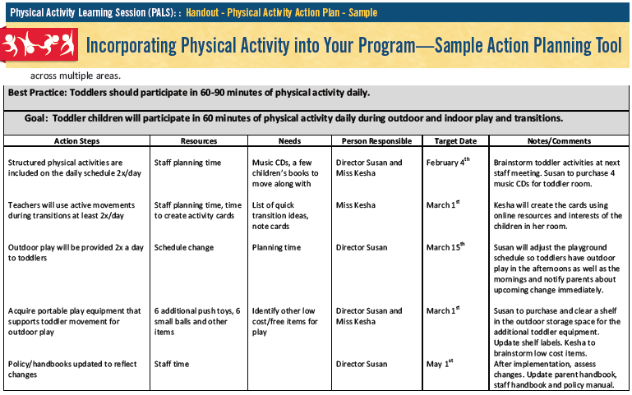
Notes:
Trainer notes:
Review the sample action plan with participants.
Highlight the best practice and goal section.
Ask them to think about how the goal listed meets the SMART goal requirements.

Slide 13
How do you create a SMART goal?
How can we make this goal stronger?
Children will be physically active in my program
Specific
Measurable
Attainable
Relevant
Time-bound
Notes:
Trainer notes:
Facilitate a discussion. Ask participants to use the goal on the slide and their knowledge of goal-setting to create a stronger goal.
The goal statement on the slide is vague and undefined. Using the SMART acronym, lead the group in a brainstorming activity to develop a stronger goal statement.
Facilitation suggestions:
Go letter by letter through the SMART acronym.
Using a whiteboard, ask participants to add wording to make a SMART goal.
If virtual, use the chat. Use breakout groups and task each group to develop a SMART goal statement. When break out ends, ask each group to share their statement.
Example:
By August 15, all lead teachers will develop a daily schedule for their classroom that includes 2 structured physical activities and 2 outdoor play periods. Activities will reflect children’s cultures, interests and abilities.
Specific - 2 structured physical activities daily and 2 outdoor play periods
Measurable - The schedules will list the specific activities to be implemented and the outdoor times
Attainable - Teachers have 4 weeks to plan for this goal. We will discuss this at our staff meeting this week with opportunities for brainstorming activities.
Relevant –Teachers create daily schedules, and this goal aligns with our program philosophy and parent expectations.
Time-bound -Completion date is August 15.

Slide 14
Create your goal
Notes:
Trainer notes:
Give participants 3-5 minutes to complete this activity.
Have them refer to their blank Action Plan.
Tell them to write their goal on the action plan template.
If you can, play music during this time.
If time permits, have participants share their goal with the group.
Add the best practice this goal aligns with from the Nemours Wellness Workbook tool to the action plan template.

Slide 15
Activity
I Spy I Spy
Notes:
Trainer notes:
Ask participants to stand up to join in this movement break.
I Spy I Spy is a call and response activity. Participants act out the movement that the facilitator ‘spies.’
The facilitator says, “I Spy, I Spy.”
Participants respond, “What do you spy?”
Facilitator responds with, “I see a band marching in place.”
All participants will march.
The activity continues with the facilitator calling out again, “I Spy, I Spy.”
Suggested callouts:
I see a gaggle of geese flying
I see skaters sliding
I see a school of fish swimming
I see musicians playing an instrument
I see a brood of hens clucking
I see a basketball team dribbling balls
I see a chef stirring a big pot of soup
I see rowers rowing
I see an artist taking a bow
To debrief the activity, ask how they could use this activity with the children they care for.

Slide 16
What are action steps?
Action steps are specific activities that you will carry out to meet your goal
Action steps should
Connect to the goal
Be clear and specific
Answer the question, How?
Notes:
Action steps are the specific activities that will be carried out to meet the goal.
They are the ‘how’ the goal will be reached.

Slide 17
What are action steps?
Think about the change process
What steps will support the changes in your program?
What resources are needed?
What challenges may arise?
Notes:
You develop your action steps based on your goal.
Developing a strong, clear goal supports understanding and developing actionable items.

Slide 18
What’s the difference?
Goals
Action Steps
A broad desired outcome
The planned implementation of the goal and objective
Toddlers will participate in at least 60 minutes of physical activity every day
Create an activity ring of physical activities that teachers can do indoors and outdoors
Notes:
Trainer notes: Use the content on the slide to help participants distinguish between goals and action steps.
Goals are like the destination of a trip.
Action steps are like the directions needed to reach that destination.
Without the directions or action steps, it can be challenging or impossible to reach the goal.

Slide 19
How do you develop action steps?
Goal:
Toddlers will participate in 60 minutes of physical activity every day during outdoor play, indoor play and transitions
Action steps:
Develop an activity ring with quick physical activities to use during transitions
Include 2 structured physical activities in daily lesson plans
Create an activity box with portable equipment to use during indoor and outdoor play
Notes:
Trainer notes:
On the slide is a sample goal and action steps.
Read through the goal and steps.
Ask participants to brainstorm more action steps that would support this goal.
Encourage them to think about their specific program and how they could reach this goal in their setting.

Slide 20
Notes:
Trainer notes:
Encourage participants to pull out this handout as you review the sample action plan.
Highlight the action steps listed.
Ask them to think about how the action steps align with the best practice and goal.
Discuss other action steps they might list to accomplish the goal.

Slide 21
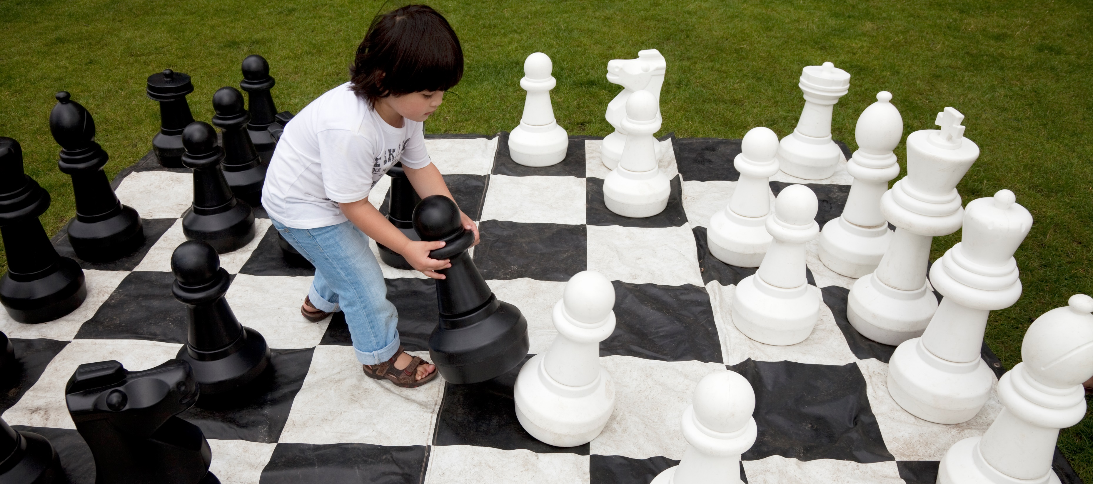
Create your action steps
Notes:
Trainer notes:
Have participants develop 2-3 action steps based on the goal they identified.
Encourage them to refer to the PALS Warm-up Log and Nemours Wellness Workbook Physical Activity Self-Assessment for ideas.
Give participants 5-10 minutes to develop 2-3 action steps
Ask volunteers to share.
Encourage participants to share possible challenges they anticipate when they implement their plan.

Slide 22
Share your goals and action steps
Notes:
Trainer notes:
Have a large group discussion about action planning.
Do the action steps that participants note align with best practice?
What challenges do participants anticipate with implementing their action plans?

Slide 23
How do you use your action plan?
Set a completion date for your action steps and goals
Share responsibility
Share your action plan with staff, co-workers, and families
Get input on action steps
Check progress on your plan and make changes if necessary
Celebrate reaching your goal
Identify your next goal!
Notes:
Action planning is a tool to support the change process.
Action plans are living documents and should be treated as such allowing for changes and revisions.
You should review action plans to identify progress, challenges, and reflections on plan implementation.
Common revisions might include:
More professional development opportunities,
Increased family engagement strategies, and
More resources needed.
Trainer notes:
Consider pairing up participants and encouraging them to follow-up with each other in 2 weeks to check on action plan progress.

Slide 24
What is the most important lesson you learned in PALS?
Notes:
Trainer notes:
Ask participants to share the most important thing they have learned during the PALS sessions. MILLY-the most important lesson learned for you, is one tool to help participants summarize the training. Encourage everyone to share. This can also be facilitated as a pair and share. Give each the group 3-5 minutes to share with a partner and then ask for volunteers to share to the large group.
All children have the right to optimal experiences with physical activity while they are in care.
Using the best practices presented in PALS, you can create environments and policies that support physical activity.
As child care professionals, you can help children experience a wide range of activities that support skill development and most importantly, learn to love being active.

Slide 25
Questions?
Notes:
Trainer note:
If you offer technical assistance, create a plan to follow up with providers about action plans. Distribute note cards and ask participants to list their names, programs and action plan goals. If virtual, use the chat to collect this information.

Slide 26
Thanks for participating in PALS
PALSECE@Nemours.org

