Slide 1

Physical Activity with Infants and Toddlers
Add trainer name and
contact information
Insert Trainer Agency
Logo Here
Notes:
Trainer notes:
This PALS Micro Training builds on content from the Physical Activity Learning Sessions (PALS). The session can be used in conjunction with PALS or as a stand-alone session.
Use this introduction slide to welcome your participants to the training and introduce yourself.
Add your contact information and agency logo to the slide.
Share housekeeping information such as the location of restrooms and silencing of cell phones.
Trainers are encouraged to add a slide with group norms if desired.
Sample group norms include:
Be considerate of differing opinions
Speak respectfully to each other
Share your knowledge and experience
Minimize side conversations
Take care of your needs
Celebrating accomplishments

Slide 2
HKHF TAP Acknowledgement
Nemours Children’s Healthy Kids, Healthy Future Technical Assistance Program is funded through a subaward agreement with the Association of State Public Health Nutritionists, the funding for which comes from the Division of Nutrition, Physical Activity and Obesity (DNPAO) in the National Center for Chronic Disease Prevention and Health Promotion (NCCDPHP) at the Centers for Disease Control and Prevention (CDC) of the U.S. Department of Health and Human Services (HHS) as part of a financial assistance award (cooperative agreement number NU38PW000047-02-00) totaling $2,275,000, which funds several ASPHN and Nemours Children’s Health programs. This program is 100 percent funded by DNPAO/NCCDPHP/CDC/HHS. The contents are those of the author(s) and do not necessarily represent the official views of, nor an endorsement, by CDC/HHS, or the U.S. government. For more information visit https://www.cdc.gov/nccdphp/divisions-offices/about-the-division-of-nutrition-physical-activity-and-obesity.html

Slide 3

Objectives
Identify and understand two benefits of physical activity for infants and toddlers.
Increase understanding of how fundamental movement skills develop.
Recognize motor milestones from birth through 30 months and how caregivers can nurture skill development.
Build awareness of quality resources on active play for infants and toddlers.
Notes:
Trainer notes:
Share objectives for the training with participants. If you do not know those attending your session, this slide could also be used as an opportunity to understand who is in your session, what their role is, and if there are additional things they would like to discuss and take away from the session related to infant and toddler physical activity.

Slide 4
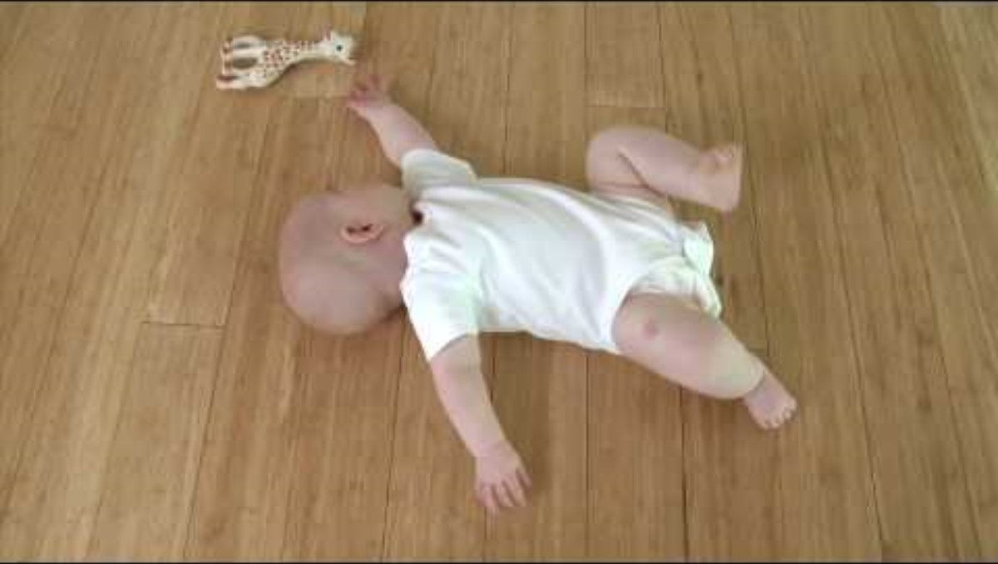
Notes:
Trainer notes:
This is a suggested opening activity for the training session. The speaker notes suggest doing this as a large group activity. Depending on the group size, this activity could also be facilitated in small groups or breakout groups if training virtually. If you choose to do small groups, ask each group to be prepared to share something from their discussion with the larger group as a debrief.
Suggested speaker notes:
For our opening activity we will be watching a brief video (3:21). After the video we will go around the room with everyone introducing themselves, sharing where they are from, and sharing one sentence about what stood out for them as they watched the infant engage in physical activity.
Video Link: Rolling - Feldenkrais with Baby Liv – YouTube https://www.youtube.com/watch?v=D9Ko7U1pLlg&t=5s

Slide 5
Objective 1
Identify and understand two benefits of physical activity for infants and toddlers.
Notes:
Suggested speaker notes:
Science continues to find more benefits to humans from being physically active. Our session content will highlight the health benefits and the link to physical literacy. Links between physical activity, social-emotional learning, and mental health are also important to both young children and their caregivers.

Slide 6
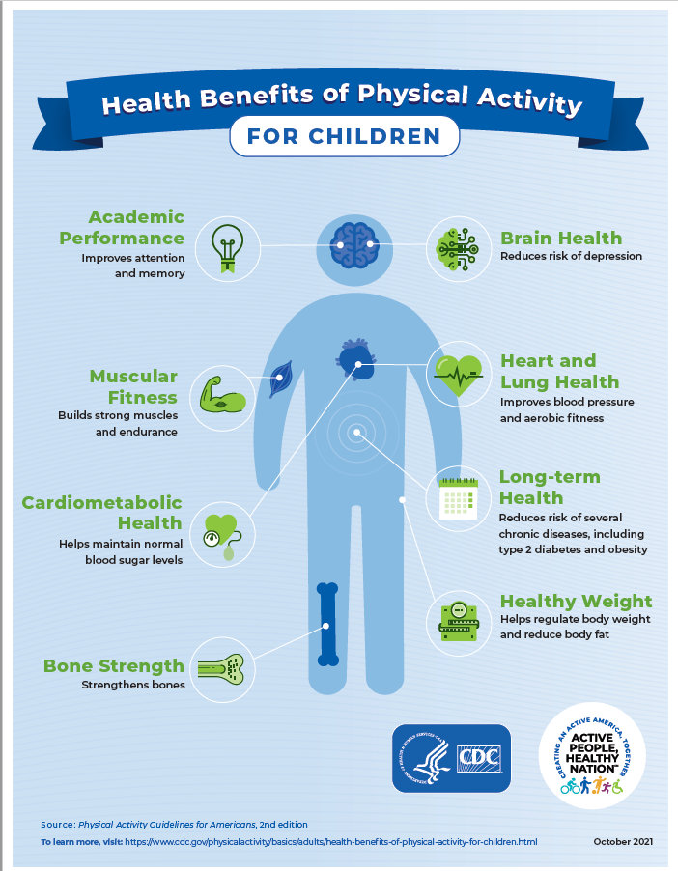
The Importance of Active Play
Early experiences with physical activity shape children’s habits and preferences influencing activity levels throughout life.
Strengthens social-emotional development.
Contributes to motor skill development.
https://www.cdc.gov/physical-activity-basics/health-benefits/children.html
Notes:
Suggested speaker notes:
The image on the slide depicts many health benefits of physical activity for children. These include improved brain health, increased bone density and strength, better blood sugar levels, and improved attention and memory. For infants and toddlers, active play is a chance to engage with caregivers and provides opportunities to build social emotional skills.
Optional large group discussion: Which benefits do you notice in the children you care for after active play?
Trainer notes:
The image on the slide can be used as a handout. It is available to download at https://www.cdc.gov/physical-activity-basics/health-benefits/children.html

Slide 7
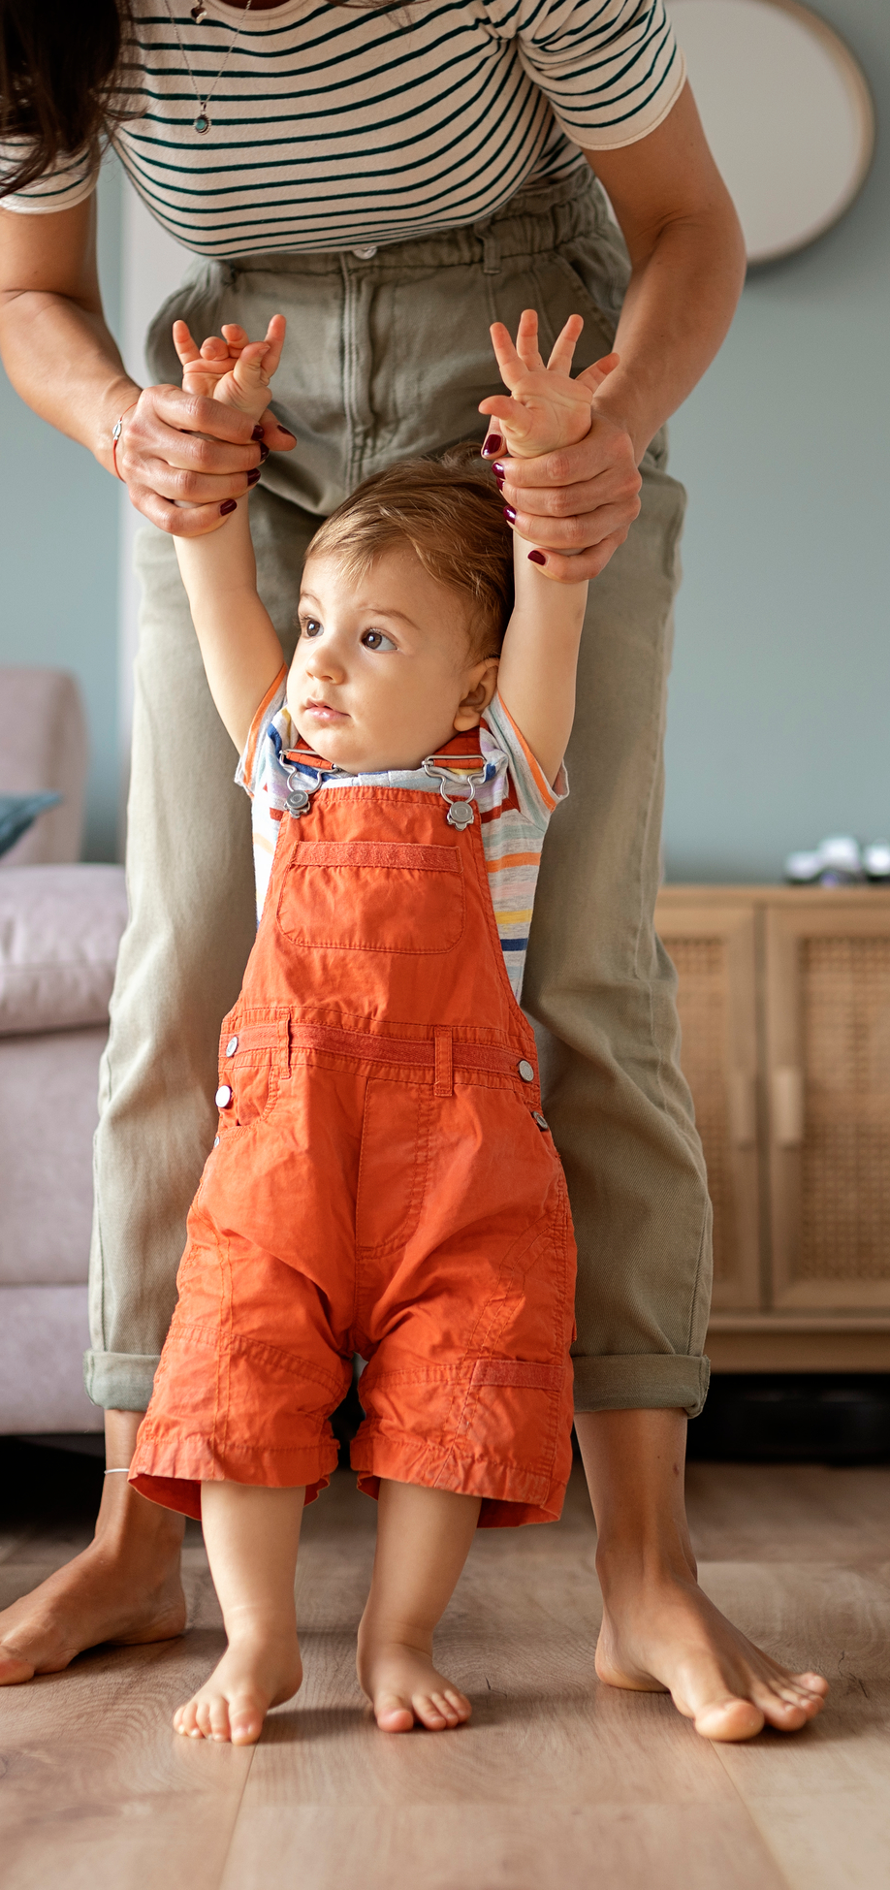
Active Play supports Physical Literacy
“Physical literacy is the ability to move with competence and confidence in a wide variety of physical activities in multiple environments that benefit the healthy development of the whole person.”
Mandigo, Francis, Lodewyk, & Lopez, 2012
Notes:
Trainer notes:
Read the slide aloud or give your participants a few moments to read the slide and consider the definition.
Suggested speaker notes:
Caregivers help children learn to move with competence and confidence by providing children with opportunities to practice skills in different environments and become proficient at skills. Studies show a strong link between skill proficiency and higher levels of active play in children. Think about your own experiences for a moment. What physical activities do you engage in? Have you tried new activities such as pickle ball or continued to do activities you enjoyed in adolescence such as dance or swimming? Do you have the confidence to try a new sport or exercise? Many of us, as adults, do not have this level of comfort or the confidence to try new physical skills. When we are comfortable in our physical abilities, we are more likely to be motivated to engage. This attitude toward physical activities and the level of comfort in our abilities is what we want for young children.
Another important aspect of physical literacy is focusing on the fun and joy of movement.
Source:
Mandigo, J., Francis, N., Lodewyk, K., & Lopez, R. (2012). Physical literacy for educators. Physical Education and Health Journal, 75(3), 27–30.6.
More information on physical literacy

Slide 8

How can Caregivers Promote Physical Literacy?
Set up environments that are safe
Provide materials and toys that encourage movement
Set up routines with many opportunities for movement across the day
Interact attentively with young children to encourage, challenge, and share joy
Actively supervise
Model movements and skills
Engage in play with children
Notes:
Trainer notes:
Share the information on the slide.
Optional group discussion- How do you support active play in your environment?
Other strategies to promote physical literacy and active play that might be discussed include:
Child proofing areas
Daily outdoor time 2-3 times each day
Limiting Screen time –The American Academy of Pediatrics (AAP) recommends no screen time for children under age 2 years except for video chats with family. The continuous running of a TV limits interactions with caregivers and can distract children from active play.
Low cost/accessible play equipment- measuring cups, pillows for crawling over, boxes to make tunnels rolled socks to throw at targets or in laundry baskets.
Carry infants to new areas throughout the day
Play games with children, such as peek-a-boo, and help children move to rhymes and songs such as ‘itsy bitsy spider’ and ‘this little piggie went to market’.

Slide 9
Objective 2
Increase understanding of how fundamental movement skills develop.
Notes:
Suggested speaker notes:
In objective two we will define fundamental movement skills and consider how they develop.

Slide 10
What are fundamental movement skills?
Locomotor
Object Control
Stability
Crawl
Walk
Run
Jump
Hop
Leap
Gallop
Slide
Skip
Ball Roll
Throw
Catch
Kick
Strike
Trap
Dribble
Volley
Axial
Springing
Upright Balances
Inverted Balances
Notes:
Suggested speaker notes:
Fundamental movement skills are basic movement skills used for daily movement and physical activity throughout our lives. Many fundamental movement skills first appear between the ages of 3 and 5 and build on the strength and skills first developed from birth to two years such as crawling, walking, grasping and throwing. Control and fluidity of fundamental movements skills continues throughout childhood as children have experience and encouragement with skills. Many skills listed on the slide don’t reach maturity until after age 6 years with adequate amounts of exposure and practice.
Fundamental movement skills are organized into 3 categories:
We use locomotor skills to move from place to place.
We use object control skills to control an object with either our bodies or an instrument such as a bat, glove or stick.
We use stability to keep our balance when we change position and throughout all daily activities.
Skills typically appear in a predictable order when a child’s body is ready and mature enough for the skill. The previous skills learned help support development of the next skill. When children is confident with a skill, they can move on to more complex skills. If children do not learn a movement skill well enough, they may avoid participating in that activity. For example, some adults avoid participating in physical activities because they do not have the skills - such as not participating in a social softball game that involves striking and catching a softball.
While some skills such as rolling over seem to develop naturally, all motor skill development benefits from experience, encouragement, and role modeling. With practice during play children develop increased skill, agility, coordination, and balance.
Let’s think about the locomotor skill of crawling and the skills the infant needs to successfully crawl. Let’s also consider how crawling provides the infant with strength and skills for the next motor skill to develop.

Slide 11


Crawling & Creeping
Crawling is movement with the infant’s belly on the ground
Infant pulls or pushes forward with elbows and knees
Creeping is movement with the infant’s belly off the ground
Infant coordinates movement moving arms and legs deliberately
Notes:
Suggested speaker notes:
Crawling is a fundamental movement skill, but it is not considered a milestone because some babies skip this skill. To crawl, infants need to have control of the muscles in their head, neck and trunk. While crawling infants are building upper body strength and building balance and stability with movement. As they crawl infants gain understanding of how to move their arms and legs purposefully.
They may reach out with one arm and push with the other, they can push with one or both elbow or knee.
If an infant is going to crawl, it usually happens by 9 months.
Creeping is the next movement skill and typically comes after crawling. However, some infants skip crawling and start creeping. When an infant is creeping, their tummy is off the floor, and they are moving and hands and knees. Infants who are creeping have developed muscle strength in the back, arms, feet and shoulders. They have coordination and are learning about how their bodies position in space (proprioception).
Some infants skip both and begin with cruising. Cruising is pulling to stand and move on their feet while holding onto furniture for support.
Supporting the development of each of these skills involves time throughout the day on the floor. Caregivers can provide objects and encouragement for the child to move toward the object. Caregivers can also limit time in confining equipment such as exersaucers and walkers. The overuse of confining equipment limits the infant's ability to develop muscle strength and explore their environment.
Additional information on Crawling:
How Do Babies Learn to Crawl? | ZERO TO THREE https://www.zerotothree.org/resource/getting-mobile/
Movement Coordination and your 8- to 12- month-old https://kidshealth.org/en/parents/move812m.html

Slide 12
Objective 3
Recognize motor milestones from birth through 30 months and how you can nurture skill development.
Notes:
Suggested Speaker Notes
Developmental milestones are skills and abilities that most children (75% or more) can do by a certain age range. Physical or motor milestones involve the development of gross and fine motor skills such as crawling, walking, and scribbling. Understanding milestone development helps caregivers support children’s growth. Milestones are a general guideline of the sequence and timeline of development. Being aware of the sequence and timeline allows caregivers to provide experiences and environments that support the next developing skills.
Some children who experience development delays have not had enough opportunities for movement. As we have discussed, children need many opportunities to practice using their bodies, building strength, and skills.

Slide 13

2 months
Holds head up when on tummy
Moves both arms and both legs
Open hands briefly
Important Milestones: Your Baby By Two Months | CDC
Notes:
Suggested speaker notes:
There are three motor milestones captured on the CDC milestone checklist seen on the slide. Infants at 2 months are developing other motor skills, such as grasping fingers or objects, that are not considered milestones. Our session today will focus on the milestones. Please raise other skills you have noticed during our discussions.
All developmental domains are intertwined, meaning that progress in one area of development often influences the progress in others. The infant in the picture could be building cognitive skills as she looks around and begins to understand her environment. She may be building trust with caregivers who interact with her on the floor.

Slide 14
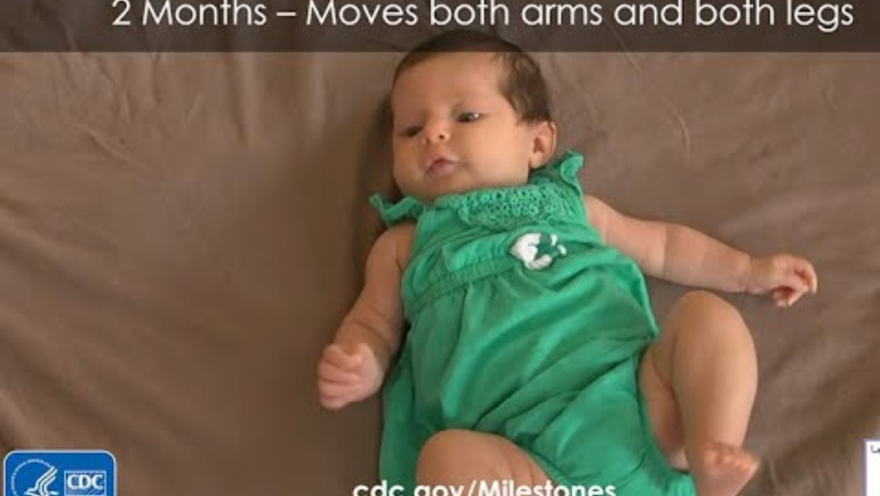
Notes:
Trainer notes:
The video clip (13 seconds ) is embedded in the PowerPoint.
Video link: https://www.cdc.gov/ncbddd/actearly/milestones/milestones-2mo.html#openMoveArm
Suggested speaker notes:
As we watch this short clip notice the arm and leg movement, what do you see?

Slide 15
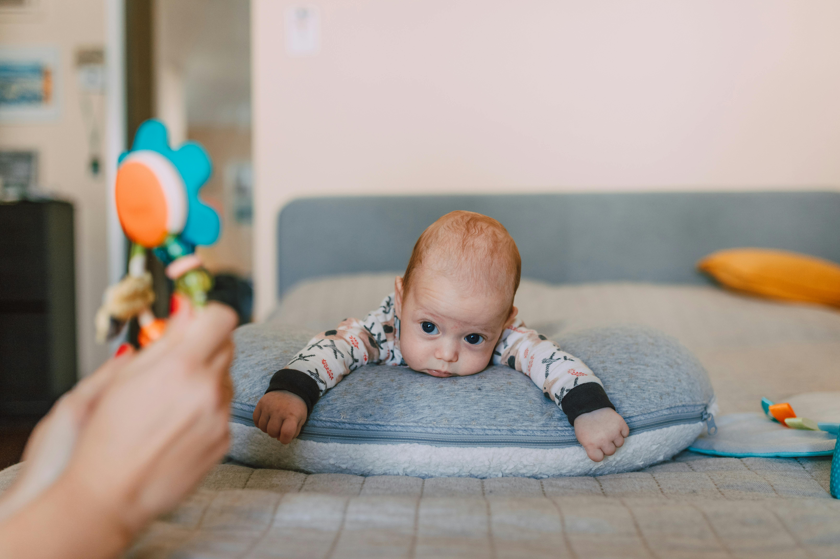
Caregiver role in nurturing motor skills for children birth to 2 months
Provide many opportunities for awake infants to be on the floor or ground outside
  Supervised
  Tummy time
  Time on the back
Provide interesting toys
Engage and interact with infant
Notes:
Trainer notes:
Share the bullets on the slide and ask participants for other examples of how they nurture motor skills with very young infants.
Photo by RDNE Stock project: https://www.pexels.com/photo/baby-looking-at-the-toy-while-lying-down-on-a-grey-pillow-6849295/

Slide 16
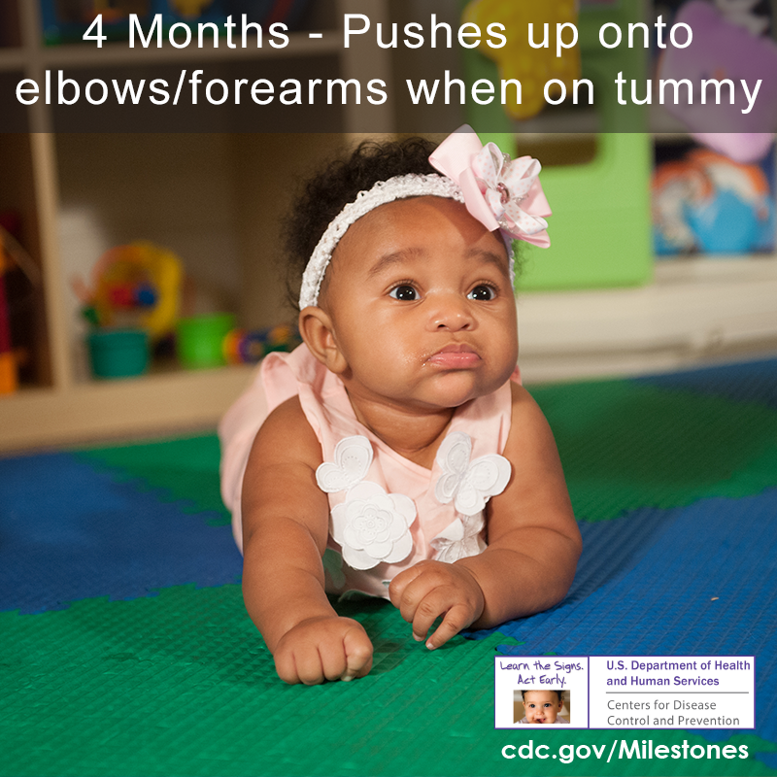
4 months
Holds head steady without support when you are holding him
Holds a toy when you put it in his hand
Uses his arm to swing at toys
Brings hands to mouth
Pushes up onto elbows/forearms when on tummy
Important Milestones: Your Baby By Two Months | CDC
Notes:
Suggested speaker notes:
This slide lists the motor that typically are seen at 4 months. An infant that has spent time since birth on hard surfaces has shoulder strength to support themselves on their elbows as seen in the image. 4 months olds are interacting with caregivers, smiling and cooing. Infants at this age will also bounce and straighten their legs when supported in a standing position.
Caregiver support looks very similar to support for 2-month-olds with many opportunities for children on floors or the ground on their tummy or back to explore and move. Interesting toys and adult engagement continue to be essential.
What other skills do you notice in 4-month-old infants?

Slide 17
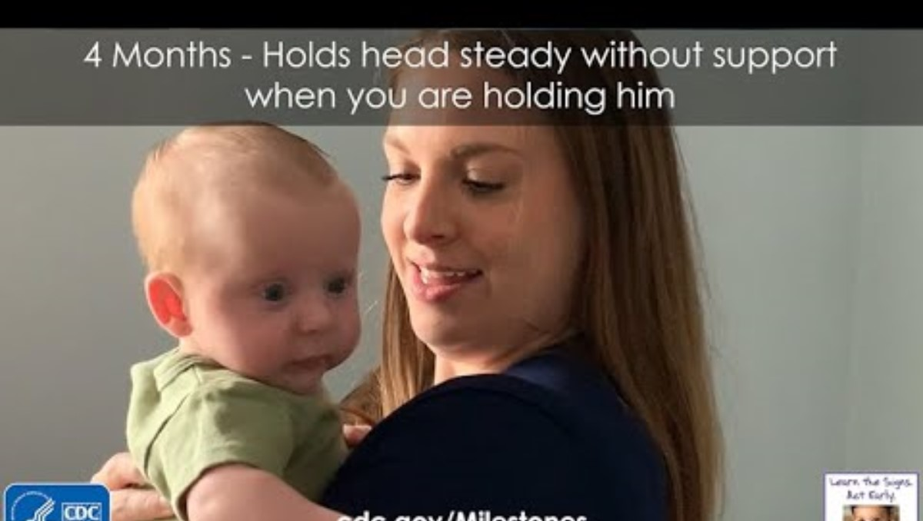
Notes:
Trainer notes:
Share this 6 second video with participants. What do they notice about the infant’s head?
Video link - https://www.cdc.gov/ncbddd/actearly/milestones/milestones-4mo.html#openHoldsHead

Slide 18
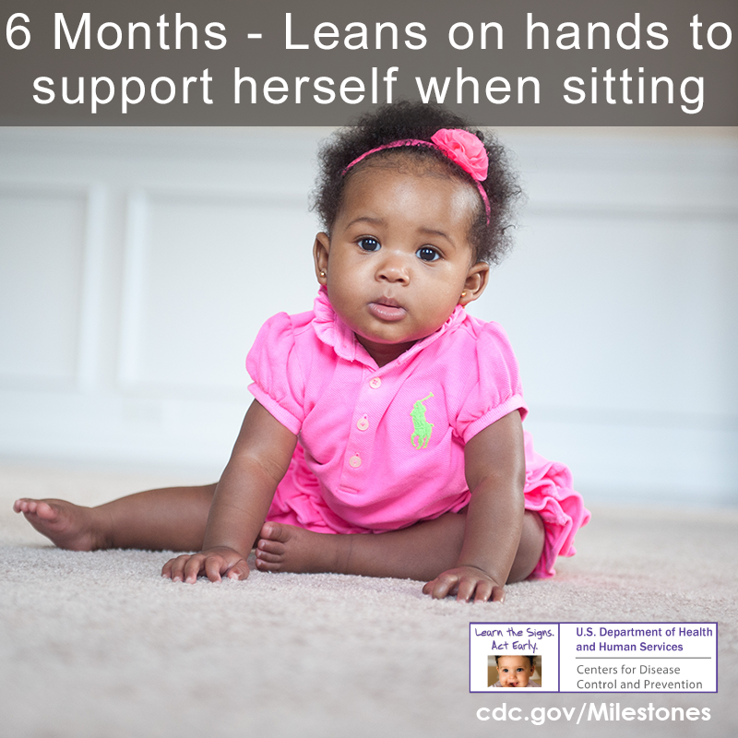
6 months
Rolls from tummy to back
Pushes up with straight arms when on tummy
Leans on hands to support herself when sitting
Important Milestones: Your Baby By Six Months | CDC
Notes:
Suggested speaker notes:
At 6 months the infant is babbling to communicate, typically rolling both ways, front to back and back to front, and recognizing familiar faces. 6-month-olds love to play with caregivers. In addition to the skills on the slide, what do motor skills have you noticed in 6-month-olds?

Slide 19

What activities can caregivers do with infants to promote 6-month motor milestones?
Rolls from tummy to back
Pushes up with straight arms when on tummy
Leans on hands to support herself when sitting
Notes:
Trainer notes
This is a brainstorming activity that can be done in small groups or as a large group. Share the prompt, give 2-3 minutes and gather responses.
Suggested speaker notes:
Thinking about the 6-month motor milestones listed, what activities could a caregiver do with the infant to encourage these skills?
In small groups, think of 1 or 2 strategies caregivers can practice.
Responses the trainer might share:
Place toys just out of reach and talk to the baby to encourage rolling.
Put the baby on their side supported by a rolled-up blanket. Talk and encourage them to reach toward and roll.
Provide gentle assistance with rolling
Allow freedom of movement
Sources:
Meeting Milestones – Helping Baby Roll https://pathways.org/videos/meeting-milestones-helping-baby-roll
Pathways.org | Roll Baby Roll https://pathways.org/activities/roll-baby-roll

Slide 20
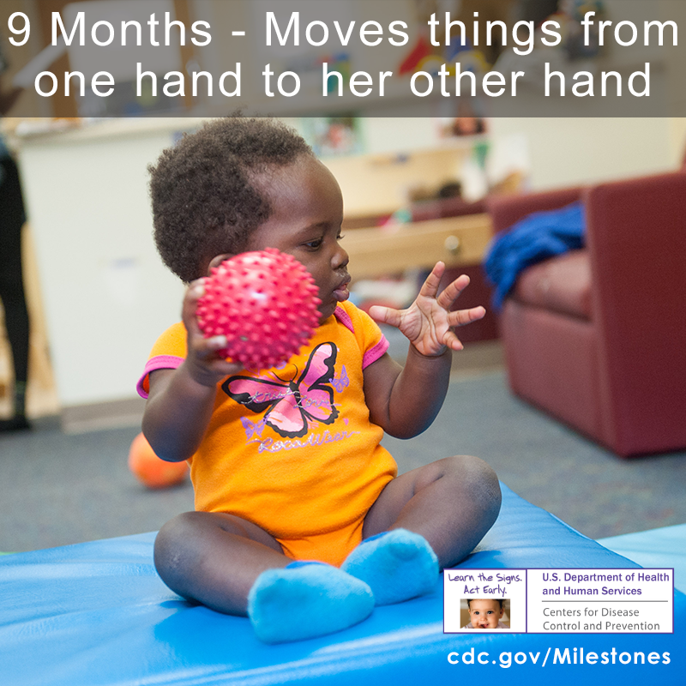
9 months
Gets to a sitting position by herself
Moves things from one hand to her other hand
Sits without support
Uses fingers to move food
https://www.cdc.gov/ncbddd/actearly/milestones/milestones-9mo.html
Notes:
Suggested speaker notes:
Here we see the motor milestones at 9 months. At 9 months some infants are crawling and pulling themselves up to a standing position on furniture or holding a caregiver's hands. 9-month-olds clap and are working on the pincer grasp-picking up small items between their thumb and forefinger.
What strategies can caregivers use to help infants develop the skills listed?
Rolling balls –sensory balls like the one depicted offer new textures
Stacking blocks
Peek-a- boo
Outdoor time in swings, strollers, and on the ground
Music and dancing with a caregiver stimulates senses
Maracas and other items the infant can shake
Pedal legs during diaper changes to raise awareness of legs and movement

Slide 21
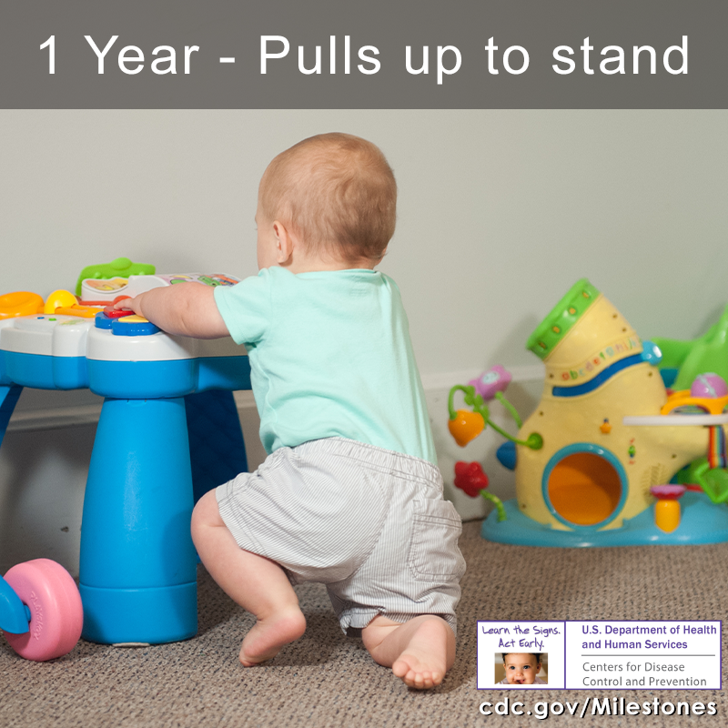
1 Year
Pulls up to stand
Walks, holding on to furniture (cruise)
Picks things up between thumb and pointer finger, like small bits of food
https://www.cdc.gov/ncbddd/actearly/milestones/milestones-1yr.html
Notes:
Suggested speaker notes:
At age 1 we begin to see communication skills soar with a few words forming, gestures, and more babbling. Cognitively they are exploring their environments to understand their world. They find objects hidden under things. They put things in containers and dump them out. 1-year olds are typically following simple directions demonstrating cognitive skill development.
A 1-year-old will pull themselves to stand and lower themselves to sitting.
As they get stronger at cruising, they may cruise with a toy in one
How can we promote motor skills with 1-year olds?
Encourage walking –hold your arms out or hold their hands for support
Provide walking toys
Blow bubbles and encourage infants to catch them
Create obstacle courses for crawling and walking
Set up room with items that allow the toddler to cruise across areas
Child proof all areas

Slide 22

Brain Break- Catching
Notes:
Trainer notes:
This is an optional brain break. Video link KIDDO: Teaching the Skill of Catching (Early Childhood) – YouTube https://www.youtube.com/watch?v=0vXVhO2gyJ8
After participant reflections, share that catching is one of many movement skills that are used across the lifespan.
As you wrap up the brain break, ask everyone to stand and pretend to do some catching. First ask them to catch a football spiraling toward them, continue with a few other items. (a beachball, a basketball, a frisbee, a set of keys, the remote, a towel falling off a hook….)
Suggested speaker notes:
We are going to watch a short video (1:10) on the skill of catching. Notice the movements of the caregivers and the children. Move along with the caregivers and mimic their motions if you like. As you watch, consider the skills such as visual tracking and grasping, that a child needs to catch a ball. After the video I will ask a few people to share what skills and activities they noticed in the video and to share the last item they caught.

Slide 23
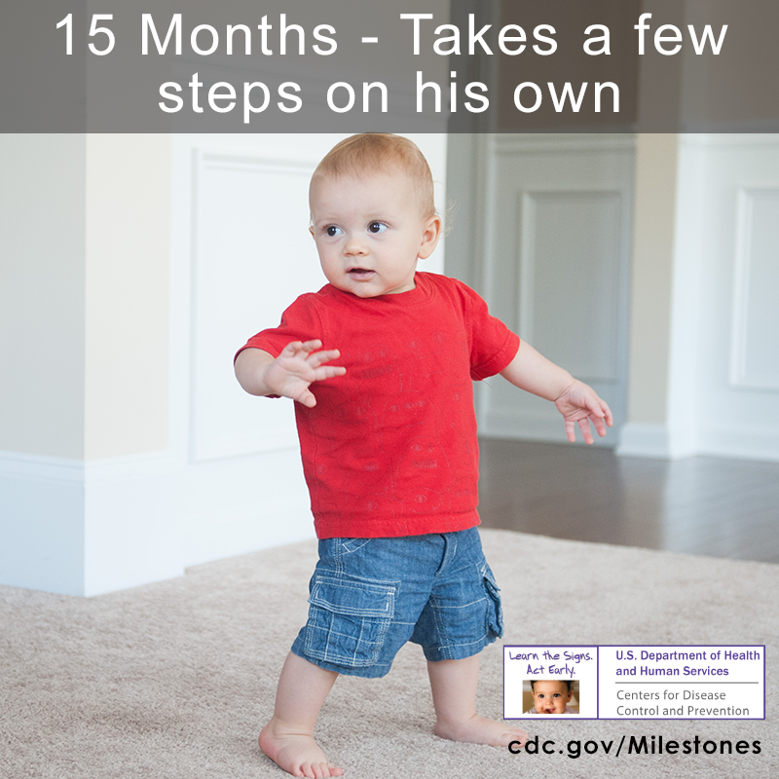
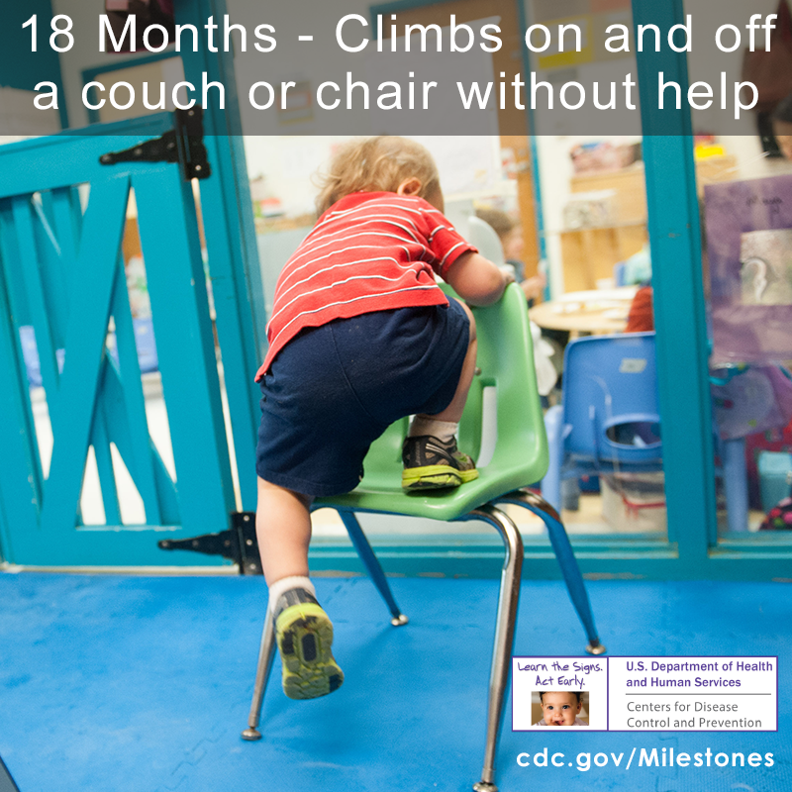
15 months
Takes a few steps on his own
18 months
Walks without holding on to anyone or anything
Climbs on and off a couch or chair without help
https://www.cdc.gov/ncbddd/actearly/milestones/milestones-15mo.html
Notes:
Suggested speaking notes:
Toddlers at 15 months are starting to walk independently. Caregivers can encourage waking skills by providing equipment such as push toys that help children practice balance and steps. Take children outside and encourage walking on different surfaces such as grass, mulched areas, and play surfaces. Walking involves standing independently and stability skills acquired as he was cruising the past few months.
How do you encourage walking?
Some children start climbing as soon as they crawl, others begin later and by 18 months are typically exploring their environment as they climb. A climber is using balance, eye-hand coordination and strength. A key caregiver role is to set up safe spaces by securing furniture to walls and using safety gates to limit access to areas. Supervision is essential
Promoting climbing can include:
Playgrounds provide equipment designed for toddlers to climb on and provide opportunities for social interactions.
Outdoor play , to include climbing on rocks or logs with supervision
Foam climbing blocks in ECE settings provide safe surfaces

Slide 24
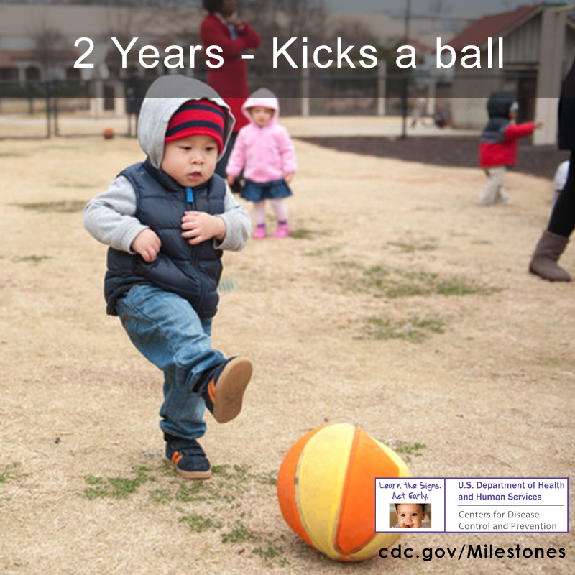
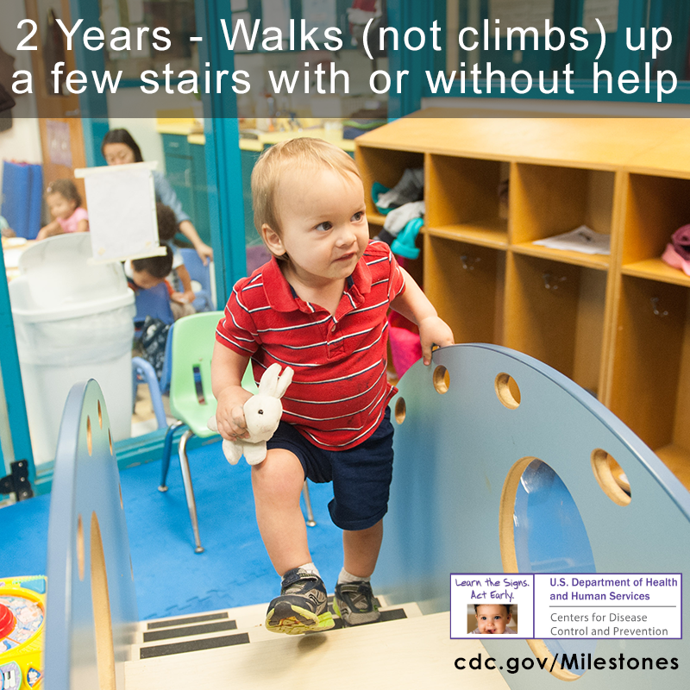
2 years
Walks steadily on their own
Kicks a ball
Runs
Walks (not climbs) up a few stairs with or without help
https://www.cdc.gov/ncbddd/actearly/milestones/milestones-2yr.html
Notes:
Suggested speaker notes:
New motor skills are emerging for 2-year-olds. They are full of energy and need lots of time to run and play, including time inside and outside. While their movement skills are improving, 2-year-olds continue to develop balance and spatial awareness. Falling or running into obstacles is common. Active play in open spaces indoors and outdoors is great for 2-year-olds.

Slide 25
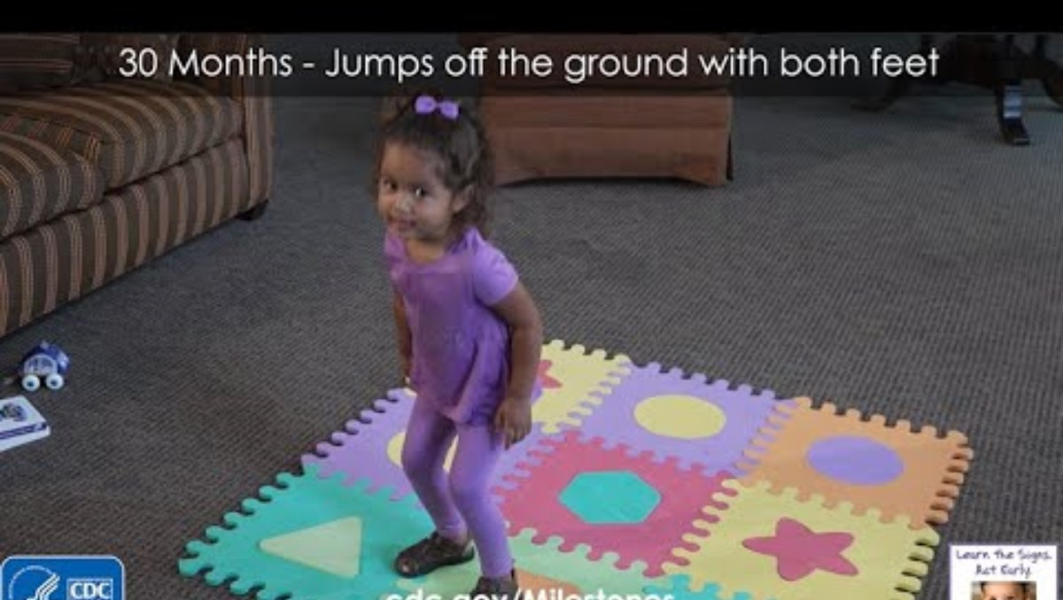
30 months
https://www.cdc.gov/ncbddd/actearly/milestones/milestones-15mo.html
Notes:
Suggested speaker notes:
A child at 30 months of age is active! They are walking up and down stairs, kicking and throwing balls, building with blocks and jumping on two feet. Cognitively children are playing pretend, demonstrating simple problem-solving skills and following two step instructions such as “put down the toy and close the door.” A child at 30 months will engage in parallel play-play next to other children and has 50 or more words. A jump requires a child to bend the knees and squat, swing the arms, and push with a burst to get off the ground. Jumping requires strength, balance, and coordination.
Let’s watch a short video of a child jumping and think about ways we can encourage children to jump.
Trainer notes:
Jumping activities include:
Jumping of surfaces of varying heights with support.
Hold the child’s hands as they Jump in place
Pretending to jump like frogs or rabbits
Jumping over shapes or lines on the floor
Jumping forward to a target
Jump on bubbles to pop them!
Important Milestones: Your Baby By Thirty Months | CDC
Video link https://www.cdc.gov/ncbddd/actearly/milestones/milestones-30mo.html#openJumps

Slide 26
Recommended Practices in ECE
Infants
Toddlers/Twos
Supervised Tummy Time:
3-5 minutes at birth increasing in frequency and duration
Outdoor Play:
2-3 Times Daily
Limited Time in Confining Equipment
MPVA
60-90 minutes every day
Outdoor Play
60-90 minutes every day over
2-3 periods
MVPA is moderate to vigorous physical activity. This is a combination of moderate-intensity (e.g., a fast walk) and vigorous-intensity activity e.g., running).
Caring for Our Children National Health and Safety Performance Standards: Guidelines for Early Care and Education Programs, 4th ed.
Notes:
Trainer notes:
This slide contains information from the PALS trainings. It is provided to underline that optimal physical activity practices support young children in developing motor skills and reaching motor milestones. Caregivers have an important role implementing practices that enhance child development. Young children need adults to support freedom of movement, safe spaces, sensory stimulation, and engagement to foster physical activity.
Suggested speaker notes:
The recommended practices for physical activity in ECE settings are listed on the slide. The practices support infants and toddlers in having active experiences that support the development of motor milestones. These practices listed are from Caring for Our Children National Health and Safety Performance Standards: Guidelines for Early Care and Education Programs, 4th edition.
Tummy time prepares infants to be able to slide on their bellies and crawl. As infants grow older and stronger they will need more time on their tummies to build strength.
Notice the time recommendations for toddlers. Toddlers experience active play in short bursts of time that should be spread over the day.
Moderate to Vigorous Physical Activity(MVPA) has been associated with more health benefits than other levels of physical activity. Benefits include musculoskeletal and cardiovascular health. Thinking about bone health children who experience recommended amounts of physical activity have been shown to higher bone mineral content which can lead to stronger bones. .

Slide 27
Recap: Caregivers roles in supporting infant & toddler skill development
Provide safe spaces-indoors and outdoors
Provide equipment the child enjoys
Engage in play with children
Provide opportunities for play across the day
Practice responsive caregiving
Notes:
Trainer notes:
This is an optional summary slide for objective 2.
Suggested speaker notes:
To recap our discussion the slide shares caregiver roles in promoting physical activity. Responsive caregiving is tuning into a child’s cues, thinking about what the child is trying to communicate, and responding to the child in a sensitive way. When we practice responsive caregiving, we recognize the individual child’s unique needs, interests, and preferences. Consistent responsive caregiving leads to children that feel safe, supported and have the confidence to try new skills.

Slide 28
Identifying & Supporting Developmental Delays
Physical developmental delays are when a child:
Is not able to do skills on the milestone checklist
Does not move their body like other children their age
Used to be able to do a skill and no longer can do that skill
Has difficulty doing a skill that other children their age can do
Acting early on developmental delays can make a big difference
Notes:
Suggested speaker notes:
We just discussed the motor milestones that children should reach between birth and 30 months. Some children may not meet these milestones for various reasons. In some cases, developmental delays are simply due to a lack of opportunity for movement. Children who are held a lot or are put in bouncer seats or walkers for long periods have less time to practice using their bodies. Once they have more “tummy time” on the floor, they catch up quickly. For children that are having difficulty doing skills that other children their age can do or if they used to be able to do a skill and can no longer do that skill, there might be a developmental delay. Acting early on developmental delays can make a big difference.
Source: https://www.healthychildren.org/English/MotorDelay/Pages/default.aspx#/

Slide 29
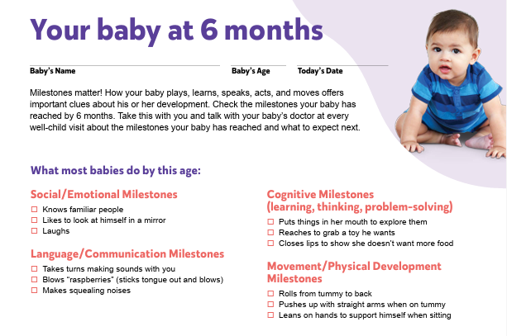
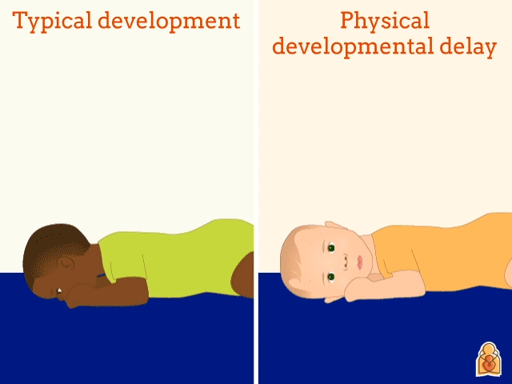
Identifying Developmental Motor Delays
Notes:
Trainer notes: Identify the notes below that are most relevant to the participants in your session (ECE providers or families).
Suggested speaker notes:
ECE Providers:
Early care and education professionals can ensure children with gross motor delays receive the help they need by:
Learning how to monitor child development
Regularly using CDC’s milestone checklists in the classroom to:
Track each child’s development progress
Guide your conversations and support your observations when raising concerns with parents
Complement developmental screenings by engaging families in monitoring milestones.
Encouraging families to use milestone checklists and resources at home to monitor their children’s development.
Helping parents to act on developmental concerns by encouraging them to talk with their child’s healthcare provider and call their state’s early intervention program.
The resource highlighted on the right is an interactive list of developmental skills from AAP. It can help caregivers to learn more about physical developmental delays and includes tips to start conversations with pediatricians. This is a great example of a resource that ECE providers can share with families to support monitoring of milestones at home.
Families:
As caregivers, you know your children best! You have what it takes to help your children learn and grow. There are a wide variety of free resources out there to help you track your child’s milestones at home. The resource on the left (your baby at 6 months) is from the CDC Milestone Checklists. In addition to checklist documents, there is a CDC Milestone tracker app available in English and Spanish.
The resource highlighted on the right is an interactive list of developmental skills from AAP. It can support you to learn more about physical developmental delays and includes tips to start conversations with your pediatrician if you are concerned about your child’s development.
Sources: https://www.cdc.gov/ncbddd/actearly/ccp/early-care-and-education.html
AAP resource: https://www.healthychildren.org/English/MotorDelay/Pages/default.aspx#/
CDC Milestone Checklist: https://www.cdc.gov/ncbddd/actearly/pdf/LTSAE-Checklist_COMPLIANT_30MCorrection_508.pdf
CDC Milestone tracker app: https://www.cdc.gov/ncbddd/actearly/milestones-app.html

Slide 30

Developmental Concerns
Encourage families to talk with their doctor about concerns.
Work with families to complete a milestone checklist, write down questions or concerns and if possible, record a video of the child to bring to the appointment.
Provide families with information on your States Early Intervention Program.
Notes:
Suggested speaker notes:
If caregivers are concerned about a delay in a skill or the child can no longer do a skill, do not wait until the child’s next check up, encourage caregivers to reach out to their pediatrician or physician ASAP.
Resource:
Concerned about development? How to get help for your child CDC Resource: https://www.cdc.gov/ncbddd/actearly/pdf/help_pdfs/How-to-Get-Help-for-Your-Child_CombinedPDF_EngSpn-2-15-20_508.pdf

Slide 31
Objective 4
Build awareness of quality resources on active play for infants and toddlers.
Notes:
Trainer notes:
If your agency or state has websites or materials supporting infant and toddler physical activity, please add slides with relevant content for ECE professionals, families, and caregivers. If you are training in-person and can print, consider sharing a copy per table for print resources.
Suggested speaker notes:
ECE professionals, caregivers and families appreciate resources that are easy to access and have information that is relevant to their work and their child’s development. The following slides will share reliable resources. Quality resources are informed by evidence and align with recommended practices. Websites such as HealthyChildren.org from the American Academy of Pediatrics. KidsHealth.org and HealthyKidsHealthyFutures.org from Nemours Children’s Health, and organizations such as the Centers for Disease Control & Prevention, Zero to Three, and Pathways provide trustworthy tools to use in your with ECE professionals, caregivers and families.
The following slides share free resources to download that support milestone development, ideas for games and activities, and low-cost materials that promote active play.

Slide 32
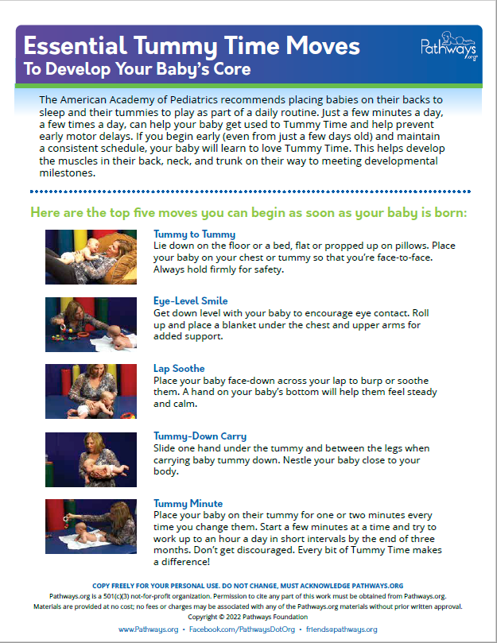

https://pathways.org/print/tummy-time-brochure
Notes:
Suggested Speaker Notes:
Pathways is an organization specializing in early childhood development and offering free resources and tools to support development. Their resources are developed with and approved by expert pediatric physical and occupational therapists and speech-language pathologists.
The brochure and 1-pager listed on the slide are available in several languages and have more information for ECE professionals, caregivers, and families on tummy time.
Pathways.org | Tummy Time Brochure https://pathways.org/print/tummy-time-brochure
Pathways.org | Five Essential Tummy Time Moves, How To Do Tummy Time https://pathways.org/videos/five-essential-tummy-time-moves-how-to-do-tummy-time

Slide 33
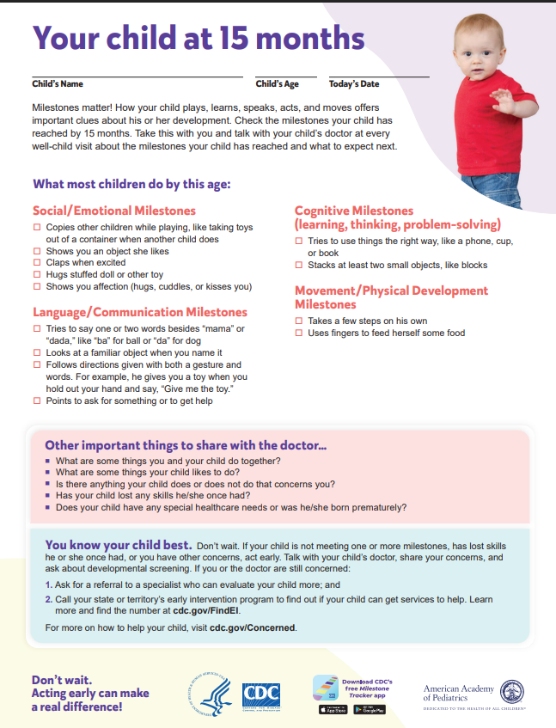
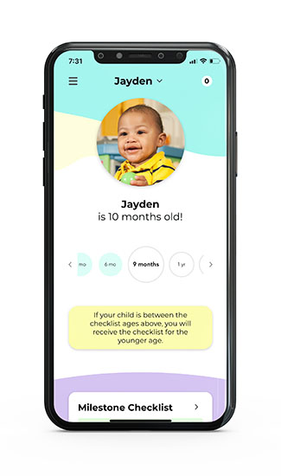
https://www.cdc.gov/ncbddd/actearly/milestones/index.html
Notes:
Suggested speaker notes:
Tracker app- Families with access to smart phones can use this free app to track their child’s milestones from age 2 months to 5 years with CDC’s easy-to-use illustrated checklists; get tips from CDC for encouraging your child’s development; and find out what to do if you are ever concerned about how your child is developing.
Checklists- The CDC checklists, 2 months through 5 years, were updated in 2022 and are available to download in 13 languages.
Also available on their website is a Photo & Video Library. Many of the photos and videos in today’s presentation are from the CDC.
Also available on the CDC milestone website are Books for families and caregivers. These short stories are designed for those caring for 1-, 2- and 3-year-olds. In the stories the characters are displaying the milestones for a specific age. Tips on each page help caregivers identify ways to help their child develop skills.
CDC’s Developmental Milestones | CDC https://www.cdc.gov/ncbddd/actearly/milestones/index.html

Slide 34
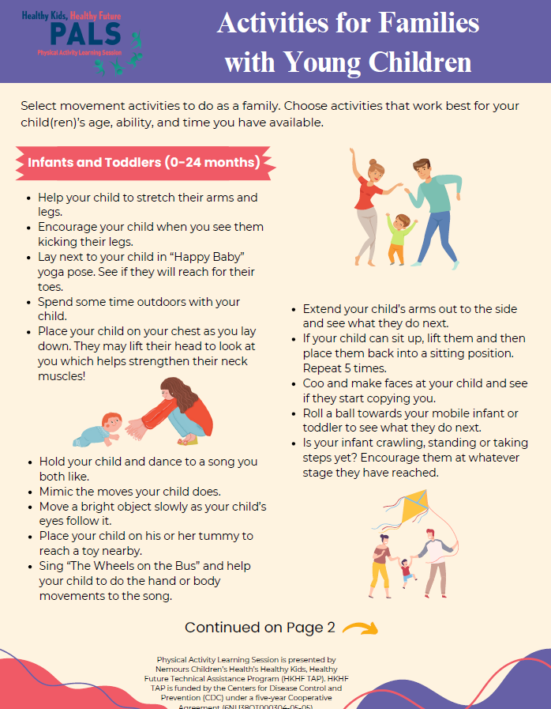
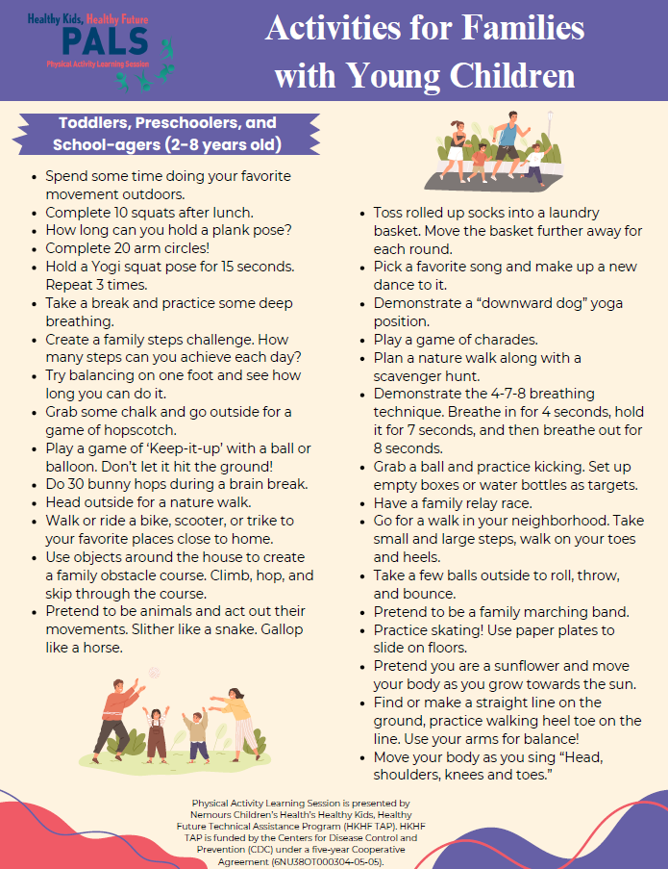
Notes:
Trainer notes:
This document can be found in the Facilitator Guide.
Suggested speaker notes:
This document developed by the Nemours PALS team has activities for children birth to 8.

Slide 35
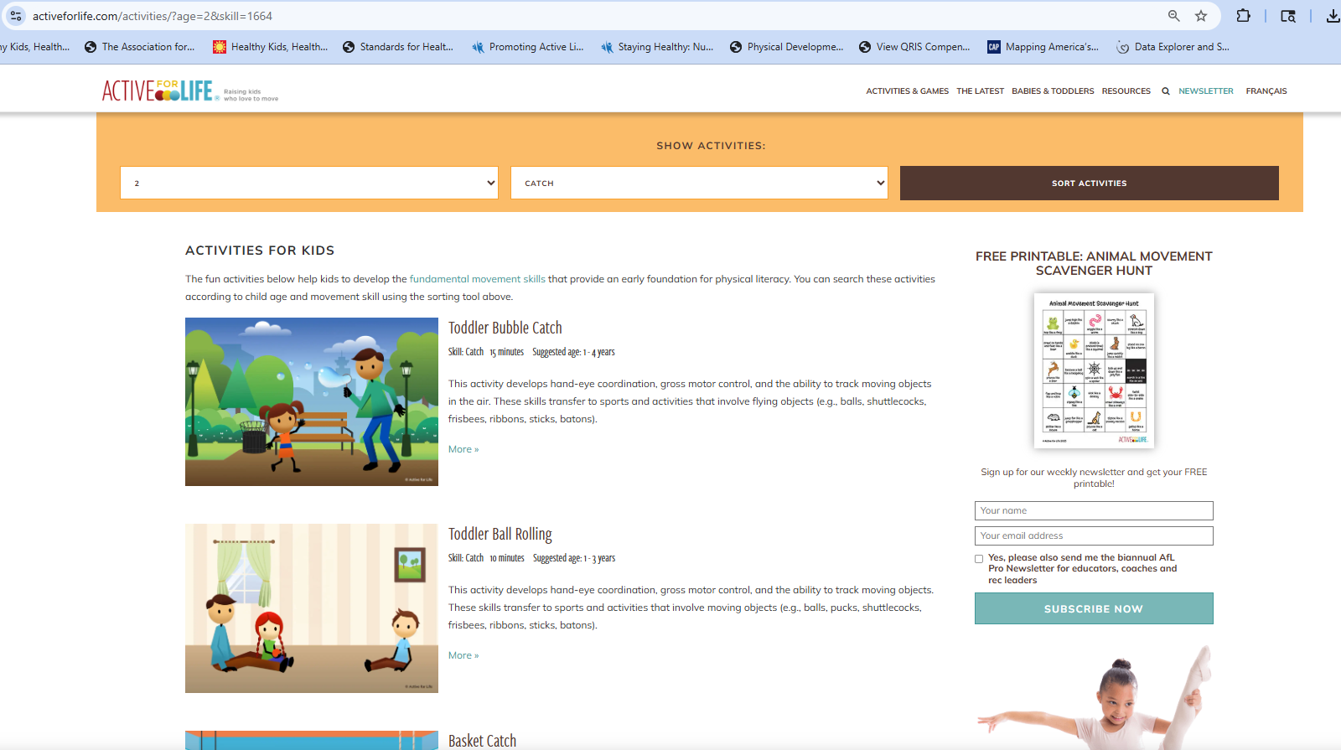
Active For Life – Where parents go for their kids' health and success.
Notes:
Suggested speaker notes:
Active for Life is a Canadian non-profit organization that promotes physical literacy. The website has blog posts, activity lists and articles that help caregivers support development. The site shown is a tool that allows caregivers to enter the age of the child and a motor skill, and a list of activities and games is generated.
Active For Life – Where parents go for their kids' health and success https://activeforlife.com/

Slide 36
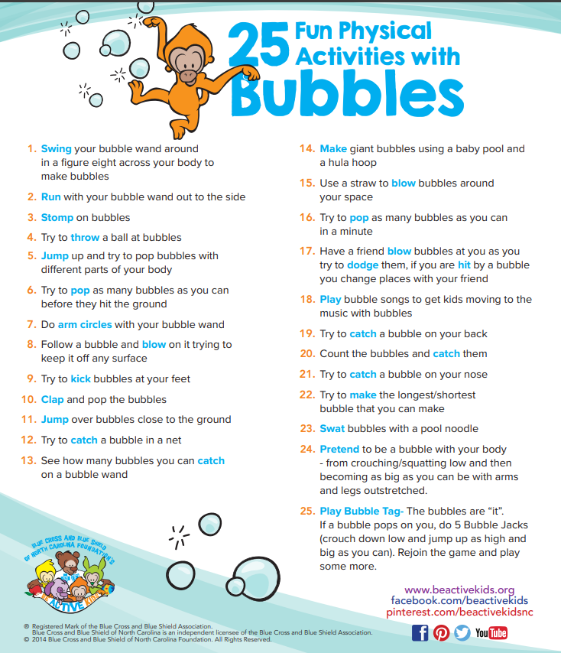
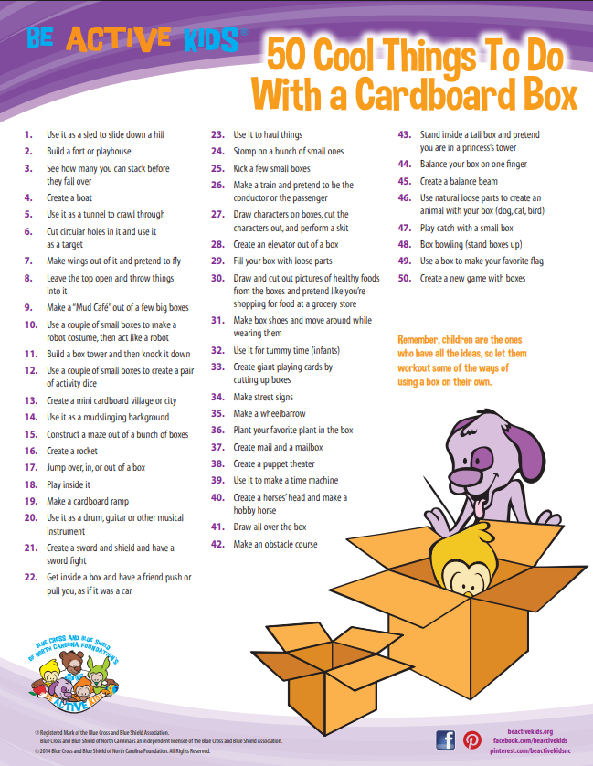
http://www.beactivekids.org/resources/handouts
Notes:
Suggested speaker notes:
Be Active Kids! Is a program of the Blue Cross and Blue Shield of North Carolina Foundation. The website has over two dozen 1-pagers with activities for young children using low-cost materials.
http://www.beactivekids.org/resources/handouts

Slide 37

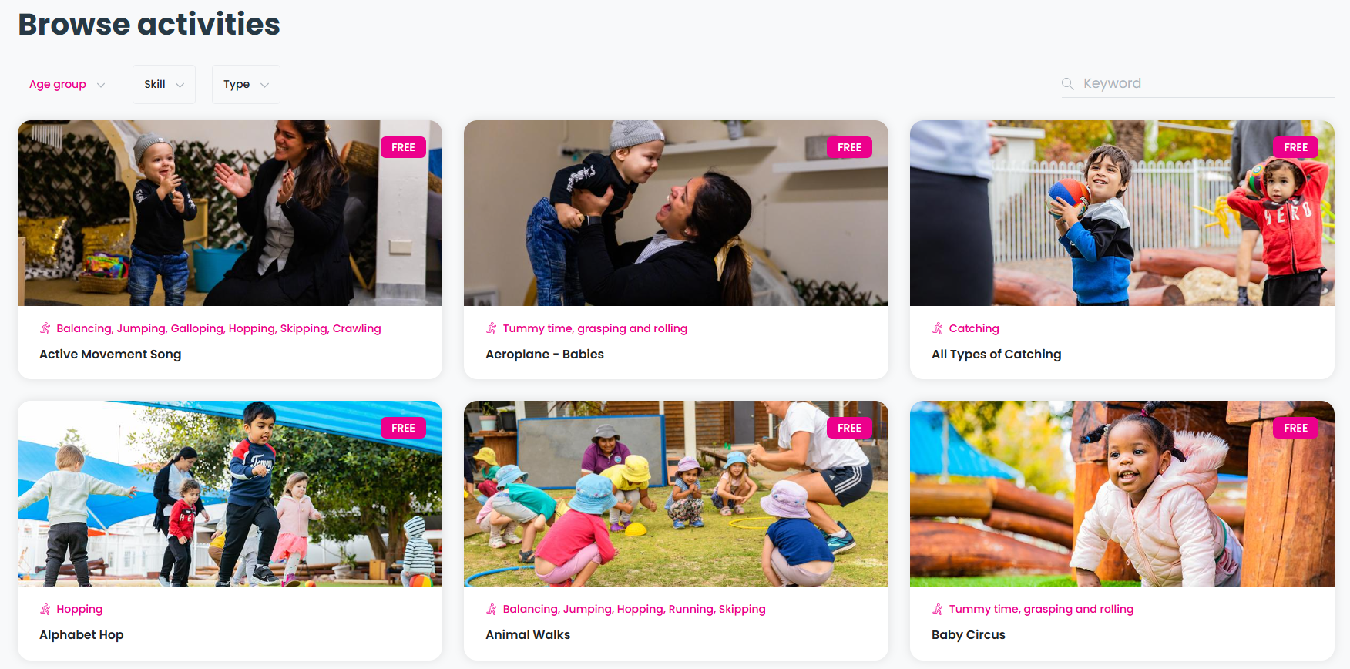
https://kiddo.edu.au/
Notes:
Suggested speaker notes:
KIDDO (pronounced kid-oh) was born from exercise and sports science research at The University of Western Australia. Kiddo shares research based online resources and tools that support families, ECE professionals, and teachers to deliver physical literacy programs to children. Activities all designed to nurture a love of physical activity that will last a lifetime. While some resources require a subscription, many KIDDO resources and videos are free.
https://kiddo.edu.au/

Slide 38

Recap
Identify and understand two benefits of physical activity for infants and toddlers.
Increase understanding of how fundamental movement skills develop.
Recognize motor milestones from birth through 30 months and how you can nurture skill development.
Build awareness of quality resources on active play for infants and toddlers.
Notes:
Suggested speaker notes:
Let’s look back at the objectives for today’s session.
We started with a focus on the benefits of active play for infants and toddlers. Our content discussed the many health benefits and physical literacy. Science continues to explore and understand how physical activity impacts both physical health, mental health, the brain, and our social health.
Objective two covered fundamental movement skills. There are three categories of skills. Skills typically appear in a predictable order when a child’s body is ready and mature enough for the skill. The previous skills learned help support development of the next skill. When children is confident with a skill, they can move on to more complex skills. Young children need lots of freedom of movement while supervised to develop skills.
Next, we covered the motor milestones from birth to 30 months and how to support families with concerns about developmental delays. What are you taking away from this piece?
Finally, we covered quality resources to share in your role working with caregivers.

Slide 39
Questions & Discussion
Notes:
Trainer notes:
To close your session, ask participants to share one resource discussed that they will explore or use with caregivers and ECE professionals.
Encourage participants to also share other resources they have found useful related to motor skills and to raise any questions.

Slide 40

THANK YOU for joining today’s training!
Add trainer name and
contact information
Insert Trainer Agency
Logo Here
Notes:
Trainer notes:
Close your session with a thank you and sharing your contact information.

Slide 41
References
American Academy of Pediatrics. (n.d.). Does My Child Have Physical Developmental Delays? HealthyChildren.org. https://www.healthychildren.org/English/MotorDelay/Pages/default.aspx#/
American Public Health Association, American Academy Of Pediatrics, Child, I., & United States. Maternal And Child Health Bureau. (2019). Caring for our children : national health and safety performance standards : guidelines for early care and education programs. Apha Press, Imprint Of American Public Health Association ; Itasca, Il.
CDC. (2024, May 8). CDC’s Developmental Milestones. Centers for Disease Control and Prevention. https://www.cdc.gov/ncbddd/actearly/milestones/index.html
Centers for Disease Control and Prevention. (2024, April 3). Health Benefits of Physical Activity for Children. Physical Activity Basics. https://www.cdc.gov/physical-activity-basics/health-benefits/children.html
Gallahue, D. L., & Ozmun, J. C. (2006). Understanding motor development: Infants, Children, Adolescents, Adults (6th ed.). McGraw-Hill.
Gehris, J. S., Simpson, A. C., Baert, H., Robinson, L. E., MacDonald, M., Clements, R., Logan, S., & Schneider, S. (2018). Resource to Share with Parents: Helping Your Child Develop Physical Literacy. Journal of Physical Education, Recreation & Dance, 89(6), 50–59. https://doi.org/10.1080/07303084.2018.1478559
Mandigo, J., Francis, N., Ken Lodewyk, & Lopez, R. (2009). Physical Literacy for Educators Gloucester . Physical & Health Education Journal, 75(3), 27–30.
Nemours Children's Health. (2022, May). Movement, Coordination, and Your 8- to 12-Month-Old (for Parents) - Nemours Kids Health. Kidshealth.org. https://kidshealth.org/en/parents/move812m.html
Parlakian, R. (2022, September 19). Getting Mobile: Movement Milestones. ZERO to THREE. https://www.zerotothree.org/resource/getting-mobile/
Pathways. (2025). Roll Baby Roll. Pathways.org. https://pathways.org/activities/roll-baby-roll
Singer, D. (2017, April 24). 6 fun household hacks for active toddlers. Active for Life. https://activeforlife.com/household-hacks-active-toddle

