Slide 1
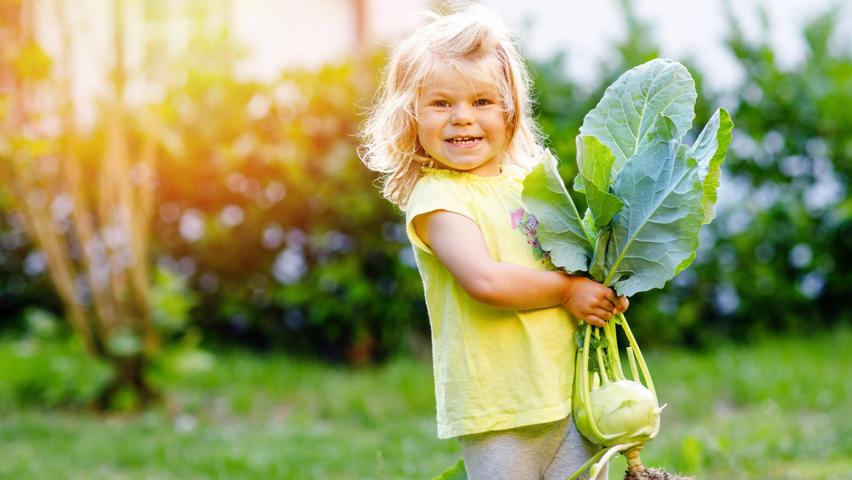
Digging In:
Active Play in ECE Gardens
Enter Trainer Name(s)
Notes:
Suggested speaker notes:
Welcome to today’s training. Research reveals that children are more active when outdoors and the features or qualities in the outdoor environments influence the levels and amounts of their activity. Studies have shown that children are more physically active in outdoor environments with varied settings, such as a fruit and vegetable garden or a sensory garden. During our session today, we will explore strategies that encourage children to be active in the garden and activities that connect to early learning about food. The program where some of you work may not currently have a garden. As we cover content today, consider how you might apply the pieces to your practices and which gardening activities might work in your setting.
Trainer notes:
Add your contact information and agency logo to the slide. The content of this session builds on PALS content on outdoor play. This PALS Micro Training is relevant for programs and providers interested in outdoor play and learning. PALS completion before this session is not required. Concepts from PALS will be reviewed. The participants in your training may include administrators, classroom teachers, and home providers. Some of your participants will not be able to add to the outdoor space or create gardens at their program. Encourage them to think creatively about how they can apply the content to their work with children. Many activities can be done without a garden setting. This session will introduce ideas and concepts they can bring back to their program to influence future quality improvements.
Consider adding a GROUP NORMS slide after slide 2. A few sample norms are listed below.
Show respect to everyone.
One person speaks at a time.
Avoid interrupting others.
Ask questions If something is unclear.
Assume good intentions. Listen with respect.
Everyone has something to share. Be sure to share while also making space for others to share.
Share your expertise, stories, and tips. Stories and experiences shared here are confidential.
Accept that each individual participating in the session will be managing different circumstances in their environment.
Assume that technological glitches will happen.
Mute yourself when not speaking
Trainer Resources
The following resources will help build content knowledge to support trainers as they facilitate discussions on the concepts presented in the training session.
Wells NM, Cosco NG, Hales D, Monsur M, Moore RC. Gardening in Childcare Centers: A Randomized Controlled Trial Examining the Effects of a Garden Intervention on Physical Activity among Children Aged 3-5 Years in North Carolina. Int J Environ Res Public Health. 2023 May 24;20(11):5939. doi: 10.3390/ijerph20115939. PMID: 37297543; PMCID: PMC10252818.
Monsur, M.; Hefner, T.; Van Allen, J.; Trina, N.A.; Andalib, S.Y.; Cosco, N. Effects of Childcare Hands-On Gardening on Preschoolers’ (3–5 Years) Physical Activity in Semi-Arid Climate Zone. Int. J. Environ. Res. Public Health 2024, 21, 548. https://doi.org/10.3390/ijerph21050548
FROST, J., & SUTTERBY, J. (2017, July). Our Proud Heritage: Outdoor Play Is Essential to Whole Child Development | NAEYC. Retrieved from www.naeyc.org website: https://www.naeyc.org/resources/pubs/yc/jul2017/outdoor-play-child-development
Kids Gardening- Kids Gardening supports educators and caregivers that bring the life-changing benefits of gardening to kids. Their resource library contains a wealth of activities and materials for ECE settings. https://kidsgardening.org/resource-library/
Farm to Early Care and Education Self-Assessment Tool https://www.farmtoschool.org/resources-main/farm-to-early-education-self-assessment. This Farm to ECE Self-Assessment from the National Farm to School Network (NFSN) and the Association of State Public Health Nutritionists (ASPHN) is designed to help ECE providers and those who work with ECE providers assess their current farm to ECE practices and develop goals and action plans to grow farm to ECE at their site. This assessment is available in both English and Spanish.
Suggested participant handouts:
Growing Healthy Families: Food, Books, and Movement
Digging into Physical Activity: Active Play in ECE Gardens

Slide 2
Funding Acknowledgement & Disclaimer
Nemours Children’s Healthy Kids, Healthy Future Technical Assistance Program is funded through a subaward agreement with the Association of State Public Health Nutritionists, the funding for which comes from the Division of Nutrition, Physical Activity and Obesity (DNPAO) in the National Center for Chronic Disease Prevention and Health Promotion (NCCDPHP) at the Centers for Disease Control and Prevention (CDC) of the U.S. Department of Health and Human Services (HHS) as part of a financial assistance award (cooperative agreement number 6NU38PW000047-02-02) totaling $2,775,000, which funds several ASPHN and Nemours Children’s Health programs. This program is 100 percent funded by DNPAO/NCCDPHP/CDC/HHS. The contents are those of the author(s) and do not necessarily represent the official views of, nor an endorsement, by CDC/HHS, or the U.S. government. For more information visit https://www.cdc.gov/nccdphp/divisions-offices/about-the-division-of-nutrition-physical-activity-and-obesity.html.
Notes:
Suggested speaker notes:
This training was developed with federal funds through the CDC. The content is those of the authors at Nemours Children’s Health and does not represent the official views or endorsement of the CDC or the US government.

Slide 3
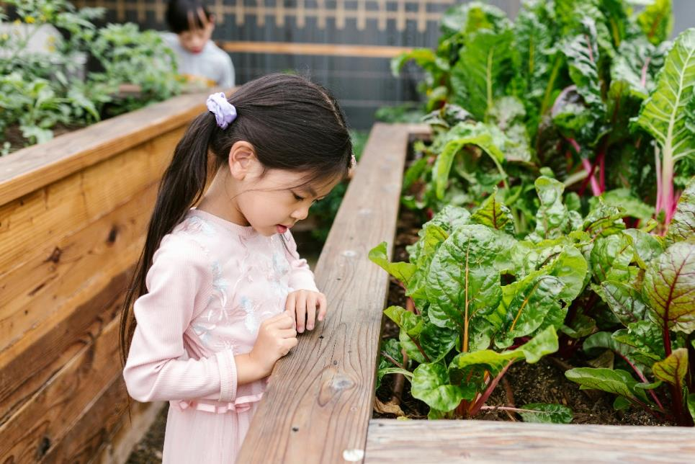
Learning Objectives
By the end of this session, participants will be able to:
Describe how recommended practices for physical activity and farm to ECE support active play in the garden.
Identify three garden activities that support fundamental movement skill development and active play.
Notes:
Trainer notes:
Read the session objectives.
Photo by RDNE Stock project: https://www.pexels.com/photo/photograph-of-a-girl-near-green-plants-8298445/

Slide 4
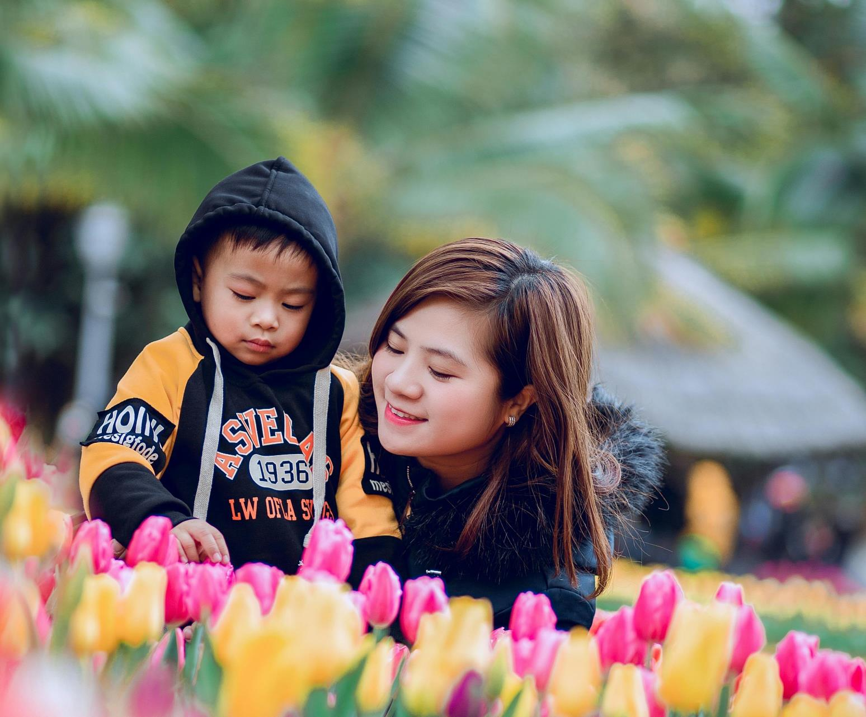
Opening Activity
Mindfulness
Activity
Notes:
Trainer notes:
The suggested connection activity for this session is a mindfulness exercise. A script to share this activity with your participants is provided below. Read slowly, in calm voice to help your participants find a mindful place.
Trainers may also choose to use a video clip for this exercise. Garden Relaxation from Bari Koral is one example of a short mindfulness exercise (3:32) https://www.youtube.com/watch?v=rx2El8Txac4
Speaker notes:
For our opening activity today, we will do a short mindfulness activity followed by introductions and a discussion on how we might use an activity like this with children. If you choose not to participate, please sit quietly as to not disturb the group.
I invite you to sit up straight in your chair with both feet flat on the ground, hands resting on your thighs. Lift your shoulders and roll them to the front three times and then to the back three times.
At your own pace, take five deep breaths. As you inhale, notice your chest rise and then fall with your exhale. Become aware of the cool air as you inhale and the warm air as you exhale. (Pause to allow time for 5 full rounds of breath) Return to your natural breathing rhythm.
In this mindfulness practice, we are going to imagine we are outdoors in a garden setting. You can imagine being in the image on the screen or in your favorite garden space. Place yourself where you are comfortable in this imaginary setting. If you don’t like to sit on the grass, picture yourself on a blanket or lawn chair. You can close your eyes, lower them and let them relax, or keep them open--whatever is comfortable for you. In our practice today we will be using our senses.
In this imaginary garden, what do you imagine you would feel on your skin? Is there warmth from sun or coolness? Is there a breeze? (Trainers pause here and after each prompt for 10-15 seconds to give participants time to reflect)
What sounds do you imagine hearing in this setting?
What do scents do you smell? Inhale imagining their scents.
What is the closest thing you can see?
Look as far as the eye can see – what is there?
What colors stand out to you?
What feelings does this setting bring to you?
Take one more deep breath.
Thank you for joining me in this short activity. This practice gave us time to slow down and become aware of our senses.
Let’s pause and allow everyone to introduce themselves and share a few words on how they felt during or after the exercise and how they might do a similar exercise with children.
After introductions
We can use activities like this with children to help them slow down, take in their surroundings, and notice the changes in the garden or outdoor setting. Mindfulness activities are most effective when conducted as a regular practice when children arrive at the garden.
Circle up and explain that everyone will be doing an observation activity. Let them know they will silently observe the surrounding environment for a designated length of time. The time frame will depend on what is appropriate for your group of children; 1-3 minutes is usually a good starting place. Tell children that while you are speaking, and they will be observing and should remain silent. Afterwards they can share what they noticed.
Allow children to choose an area in their garden as their “observation station.” If you plan to integrate this activity into your welcome routine, tell children that they will be returning to this spot over the next weeks, season, or year. Be sure to designate the parameters of the area so that they stay in your line of sight and are close enough to hear you.
Once the children are settled in, begin guiding them through their observation. Ask a few questions that are relevant to your environment such as:
What do you feel on your skin?
What sounds do you hear?
What do you smell?
What is the closest thing you can see?
Look as far as the eye can see – what is there?
What colors stand out to you?
​Discussion Prompt: Ask the participants to share their ideas for using this activity with different age groups. ​
Activity adapted from Kids Gardening- https://kidsgardening.org/resources/garden-activities-mindfulness/
Photo by Emma Bauso: https://www.pexels.com/photo/girl-touching-bush-2253890/

Slide 5
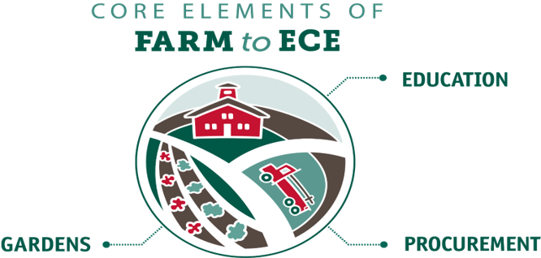
What is Farm to ECE?
Farm to Early Care and Education (Farm to ECE) is an initiative designed to enhance access to healthy, local foods in ECE settings.
Notes:
Trainer notes:
This slide is level setting for participants who are not familiar with Farm to Early Care and Education (ECE)
Suggested speaker notes:
The image on the slide is from the National Farm to School Network (NFSN), a national nonprofit network, that works to increase access to local food and nutrition education to improve children’s health and cultivate vibrant communities. ​​
It captures the three core elements of farm to ECE, Gardens, Education, and Procurement.
Food and Farming Education teaches children about where food comes from, how it is grown, and how farms and gardens work.
Procurement means local food purchasing and includes using local foods in meals, snacks, taste testing activities, and family events. Depending on the farms and farmers in your area, ECE programs may be able to source dairy, meat, fish, fruits, vegetables, herbs, eggs, honey, grains, and flours for use.
Gardens allow children opportunities to observe and become familiar with how plants grow. There are many types of gardens that could be a good fit for your program.
Our session today will focus on the gardening component of Farm to ECE and how gardening can support physical activity with young children.

Slide 6
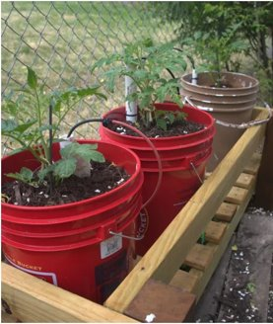
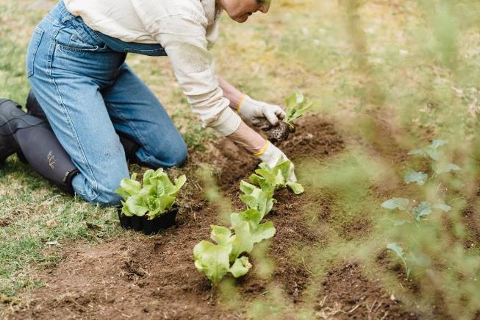
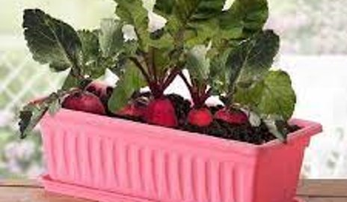
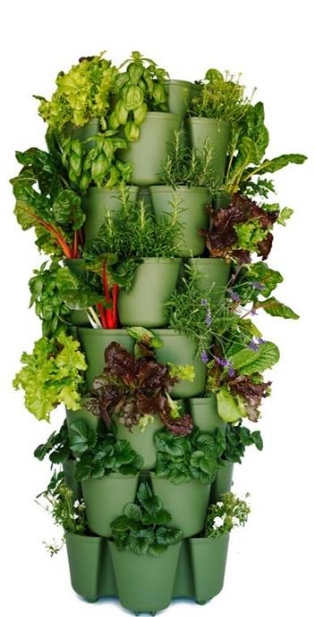
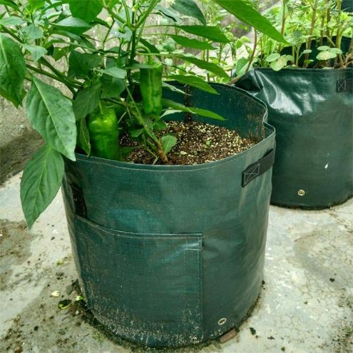
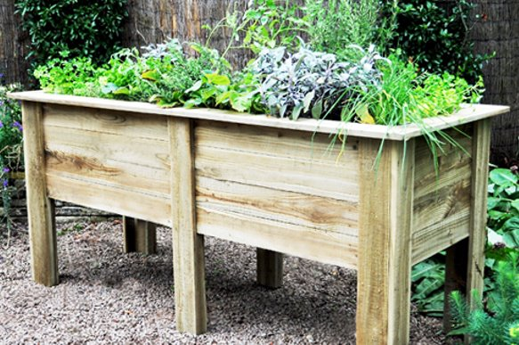
ECE Gardens
1
2
3
6
5
4
Notes:
Suggested speaker notes:
This slide depicts many types of ECE garden but is not exhaustive.
We will start in the upper left at number 1 and move clockwise.
Number 1 is an in-ground garden. This type of garden allows roots to grow deep and requires less watering. Soil organisms such as worms and fungi can improve plant health.
Number 2 is a container garden in a windowsill. This may take up minimal space and allow children frequent access to observe the plant and its growth.
Number 3 depicts an outdoor a container garden outdoors in 5-gallon buckets. As containers can leech contaminants that are absorbed by growing plants, seek out food grade containers and nontoxic options.
Number 4 is a tower garden. Garden towers are great in small spaces and need frequent watering.
Number 5 is a grow bag. Grow bags are light weight, flexible, and easy to move. Some grow bags have side openings that can be used to observe the growth of root vegetables.
Number 6 is a raised bed garden. Raised beds can be more accessible for children and adults who use wheelchairs or other mobility assistance devices.
There is not a one-size-fits all for gardens. Each program makes decisions on the types of gardens they build based on what fits their space, budget, and staff capacity. Gardens require work to keep them thriving. Our session today will also offer ideas for sites without gardens.
Optional speaker notes:
Hydroponics is a method of growing plants without soil, using nutrient-rich water to deliver everything plants need directly to their roots. This type of garden is not pictured on the slide. A hydroponic garden can be done indoors, year-round. The cost of setting up a hydroponic system can range from a few hundred to several thousand dollars, depending on the scale and complexity of the system. Providers interested in hydroponics should contact the state licensing authority to ensure they are allowable in ECE settings.

Slide 7
Terms
Moderate to Vigorous Physical Activity (MVPA)- MVPA refers to an intensity level of physical activity that provides children and adults with important health benefits. It is a combination of moderate-intensity and vigorous-intensity activity levels.
Structured Physical Activity- A planned activity led by adults to engage children. Also known as adult led physical activity.
Unstructured Physical Activity- Also known as free play and child directed play. Children start these activities and determine the outcomes of play. Adults may offer equipment, ask questions, or engage in the play on the child’s terms.
Notes:
Suggested speaker notes:
Let’s cover some of the key terms used in this session.
Moderate to vigorous physical activity (MVPA) refers to an intensity level of physical activity. While all intensity levels of physical activity are important, MVPA is linked to many health benefits. ​A Moderate-intensity activity is a brisk walk that still allows normal talking and breathing. ​A vigorous-intensity activity, like a jog, run, or strenuous cycling, causes faster and deeper breathing and interferes with the ability to talk. It may leave you “breathless". During MVPA the heart rate is elevated during MVPA building cardio endurance and stamina. Children who are breathless because of physical activity exercise their heart and lungs along with the muscles in their arms and legs. As long as someone does not have health restrictions, becoming breathless during physical activity is healthy and safe. ​
Health benefits of MVPA for children include muscular and bone strength, enhanced mood, improved sleep quality, and benefits to the brain.
While all types of physical activity are important in a child’s day we are going to discuss two types of play today.
Structured Physical Activity- Young children need lots of opportunities to develop movement skills and adults support this through structured physical activity. This includes leading games and setting up environments and experiences encourage children to move. Structured activities with young children should be noncompetitive and non-elimination so children can engage in play for longer periods of time. Adult roles include planning, role modeling, giving children movement cues, explaining games, providing equipment, and supervising.
Unstructured Physical Activity- This is also called free play or child directed play. Children may adapt games and activities experienced previously for play. During free play children may be exploring their interests and types of movement they want to practice. They negotiate the terms of play with peers building social skills. Free play can involve lots of imagination. Adult roles in free play include providing equipment and space, supervising, asking questions and possibly engaging in the play with child leading.

Slide 8
Objective 1
Describe how recommended practices for physical activity and Farm to ECE support active play in the garden.
Notes:
Suggested speaker notes:
The national recommended practices for physical activity come from Caring for Our Children: National Health and Safety Performance Standards: Guidelines for Out-of-Home Child Care Programs, Third Edition. These recommendations were developed by a professional panel of pediatricians, public health professionals, and subject matter experts.
Recommended practices for Farm to ECE were developed by the National Farm to School Network (NFSN) and the Association of state Public Health Nutritionists ASPHN).

Slide 9
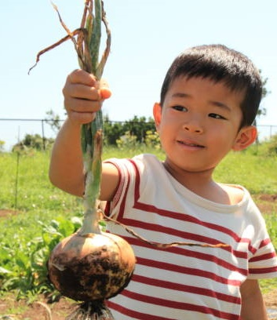
The Impact of Gardening on Physical Activity
A North Carolina intervention examined physical activity at ECE sites with gardens over two years.
The study found that children at the intervention sites experienced 6 minutes more Moderate to Vigorous Physical Activity (MVPA) and 14 minutes less sedentary time each day.
Data showed a stronger impact for boys than girls, and for younger children (3-year-olds) than older children (5-year-olds).
Well, N. et al, 2023, Gardening in Childcare Centers: A Randomized Controlled Trial Examining the Effects of a Garden Intervention on Physical Activity among Children Aged 3–5 Years in North Carolina.
Notes:
Suggested speaker notes:
Gardening is one strategy shown to increase physical activity in early childhood education settings. A study at North Carolina ECE sites with gardens found that children increased daily physical activity amounts and decreased amounts of sedentary times. This is important because many young children in the U.S. are not getting enough physical activity each day, and early childhood is a critical time to help children build a love of movement, active play, and confidence in their bodies.​
Gardens naturally invite movement- digging, carrying, reaching, and exploring, while also supporting learning across multiple domains. As children plant, observe, and care for flowers, fruits, and vegetables, they engage in hands-on experiences that build science, math, and language skills, while learning where food comes from and how it grows.
Optional notes:
While 6 minutes a day may not seem like a large amount of time, over 20 days this would add up to 120 minutes (2 hours of physical activity) and 280 minutes (4 hours and 20 minutes) less sedentary time.
Source:
Wells NM, Cosco NG, Hales D, Monsur M, Moore RC. Gardening in Childcare Centers: A Randomized Controlled Trial Examining the Effects of a Garden Intervention on Physical Activity among Children Aged 3-5 Years in North Carolina. Int J Environ Res Public Health. 2023 May 24;20(11):5939. doi: 10.3390/ijerph20115939. PMID: 37297543; PMCID: PMC10252818.

Slide 10
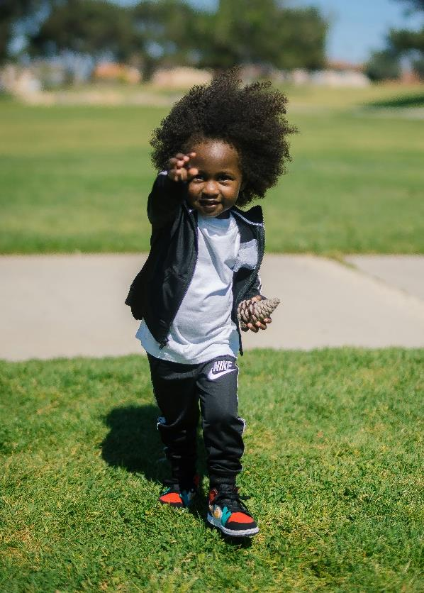
Recommended Physical Activity Practices
Space-Young children are provided adequate space to practice gross motor skills including outdoor play areas.
Type- Children experience different types of play daily including adult-led, free play, MVPA, and outdoor play.
Daily Activities-Outdoor play is woven in the daily schedule 2-3 or more times per day.
Provider Role- Adults schedule outdoor time, set up experiences, lead activities, encourage children, role-model, and supervise.
American Public Health Association, American Academy Of Pediatrics, Child, I., & United States. Maternal And Child Health Bureau. (2019). Caring for our children : national health and safety performance standards : guidelines for early care and education programs. Apha Press, Imprint Of American Public Health Association ; Itasca, Il.
Notes:
Trainer notes:
Recall that the recommended practices for physical activity come from Caring For Our Children. Recommended practices for outdoor time include outdoor spaces, types of play, daily activities, and the provider’s role.
Suggested speaker notes:
Let’s spend a few minutes recalling some of the recommended practices that support Physical Activity in the ECE Garden.
The slide lists 4 areas:
Space-Young children need adequate space to practice gross motor skills including outdoor play areas. Research has shown that children are more active outdoors as the have more space to move and use large muscles.
Type- Children should experience different types of play daily, including adult-led, free play, MVPA, and outdoor play. Moderate to Vigorous physical activity combines moderate-intensity and vigorous-intensity activity. Moderate-intensity activity is a brisk walk that still allows normal talking and breathing. Vigorous-intensity activity, like a jog or run or strenuous cycling, causes faster and deeper than normal breathing and interferes with the ability to talk (for example, it leaves you “breathless”). Children who are breathless because of physical activity exercise their heart and lungs along with the muscles in their arms and legs. As long as someone does not have health restrictions, becoming breathless during physical activity is healthful and safe.
Daily Activities- Outdoor play should be woven into the daily schedule 2-3 or more times per day for infants, toddlers, and preschoolers.
Provider Role- Providers (adults) are responsible for setting up environments and experiences that support children in active play and practicing fundamental movement skills. Some provider roles include scheduling outdoor time, setting up experiences during outdoor play, leading activities, encouraging, being a role-model, and supervising.
Source: Tandon PS, Saelens BE, Zhou C, Christakis DA. A Comparison of Preschoolers' Physical Activity Indoors versus Outdoors at Child Care. Int J Environ Res Public Health. 2018 Nov 5;15(11):2463. doi: 10.3390/ijerph15112463. PMID: 30400603; PMCID: PMC6265760.

Slide 11

Outdoor play recommended practices
Infants
How many times each day do the children at your program go outside?
Experience outdoor play 2-3 times daily
Toddlers & Preschoolers
Experience
Outdoor play 2-3 times daily
60-90 minutes of outdoor play daily
2 or more structured (adult-led) activities
Notes:
Suggested speaker notes:
The recommended practices come from Caring for Our Children: National Health and Safety Measures for Young Children in Out of Home Settings and include 2-3 periods of outdoor play daily, weather permitting, for all children. There is not an established time recommendation for infants to be outdoors.
Children who spend more time outdoors tend to engage in higher levels of physical activity when compared to those who do not. Recommended practices also include that children experience a minimum of two adult led activities outdoors daily. Children may be more active in structured activities and with planning adult led activities allow children to practice developing motor skills.
Trainer note:
This is a recap of PALS content. After discussing the practices, advance the slide for the reflective prompt to appear. Information on weather can be found in the Facilitator Guide
Optional group discussion questions:
How does outdoor time happen on hot and cold weather days?
Does the daily schedule shift with the seasons? (e.g., outside during the coolest part of the day in the summer and warmest part of the day in the winter)
What happens during outdoor play time? Are ECE providers leading activities, engaging with children and modeling enjoyment of outdoor play?
.

Slide 12
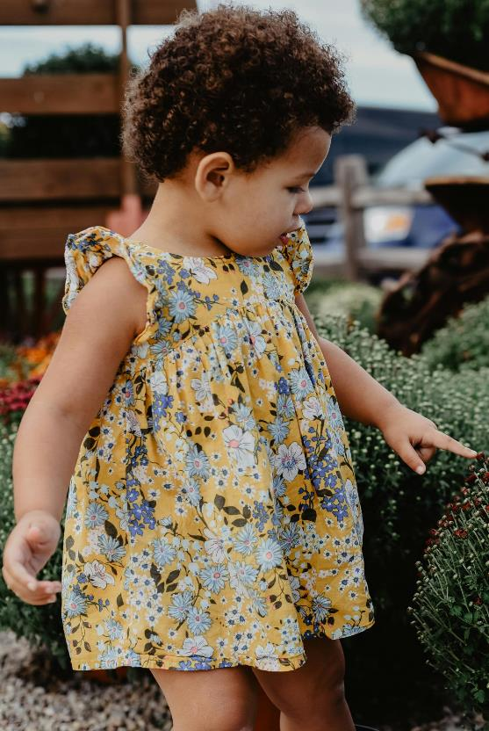
Recommended Farm to ECE Practices
The program has a garden bed, in-ground garden, or container gardens.
Children participate in indoor or outdoor gardening activities at least once a week in season.
Gardening education is aligned to Early Learning Framework, Common Core, or state adopted content standards
https://www.farmtoschool.org/resources-main/farm-to-early-education-self-assessment
Notes:
Suggested speaker notes:
As shared in the introduction, farm to early care and education (farm to ECE) is a set of activities that include purchasing (procurement) and serving local foods, gardening (indoors or outdoors), and food and agriculture education activities. The National Farm to School Network and the Association of State Public Health Nutritionists have developed a free self-assessment tool of practices that support all three areas of Farm to ECE work. The slide has 3 activities or practices from the tool that are especially relevant to our topic today.
Gardening can look different based on each program’s setting and landscape. Gardening can look like container gardens, rooftop gardens, windowsill gardens, or programs that access space in a community garden.
Incorporating garden activities in the daily schedule with intentional focus on physical activities can increase the amount of time children are outdoors and engaged in active play.
Most early learning standards and common core indicators contain physical development and motor skill criteria, as well as science, literacy, math, and social studies standards that can be embedded in gardening activities.
Source:
Farm to Early Education Self-Assessment https://www.farmtoschool.org/resources-main/farm-to-early-education-self-assessment

Slide 13
Benefits of outdoor play and outdoor time
Caregivers & Children
Children
Exposure to fresh air
Vitamin D
Boosts immunity
Improves vision
Lowers stress
Improves sleep
Strengthens mental wellbeing
Increased amounts of
active play
creative play
problem-solving play
  cooperative play
Increased awareness and appreciation of the environment
Notes:
Suggested speaker notes:
While recommended practices are important, let’s take a moment to consider how both adults and children experience positive things from outdoor time.
Adults and Children
The benefits of time spent outdoors continue to be understood. Research reveals many health benefits from outdoor time including strengthening the immune system. Short periods of exposure to sunlight promote the production of Vitamin D in the body. Vitamin D helps regulate the amount of calcium and phosphate in the body which are essential for bone, teeth, and muscle development.
Mental Health-fights depression and anxiety.
Time spent outdoors decreases the risk of Myopia (also called short-sightedness or near-sightedness) in children and ECE providers. Outdoor time allows us to focus on distant objects like trees or play equipment such as a ball flying through the air— anything that’s more than an arm’s length away. This use of long-distance vision uses different parts of the eye muscles. Think about how much time children and adults spend on devices that limit the use of peripheral and distance vision.
Children
The time spent outdoors is strongly linked with children’s physical activity levels. Outdoor open spaces allow children greater opportunities to practice and develop gross motor skills.
Studies have shown that children who spend time outdoors as young children grow up to be more engaged in the environment and conservation.
Other benefits of outdoor play for children include increased amounts of active play, creative play, problem-solving play, and cooperative play.
Children also develop an increased awareness and appreciation of the environment.

Slide 14
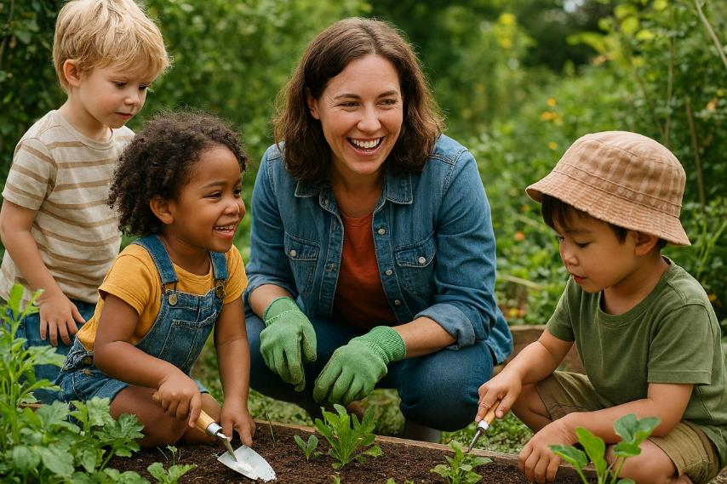
Benefits of time in the garden for children and caregivers
Builds connection to nature
Motor skill practice
Builds respect for the environment
Develops responsibility in caring for plants
Strengthens observation skills
Builds understanding the life cycle of plants and the seasons
Notes:
Suggested speaker notes:
Time in a garden can also provide positive experiences and growth for children and caregivers.
For staff, gardening offers a chance to learn new skills or strengthen existing ones that support both personal and professional development. Staff may build confidence in growing fruits and vegetables and carry these skills beyond the program into their homes, where they can share fresh foods and healthy habits with family and friends.​
For children, hands-on gardening experiences support learning about fruits, vegetables, and herbs while building understanding of plant growth cycles and the impact of weather—key STEM concepts. Gardens also allow children to observe foods served at meals and snacks as they grow, sparking curiosity and increasing willingness to try new fruits and vegetables.
Optional large group discussion:
What benefits do you experience from being outdoors or working in a garden?
Image: Microsoft Co-Pilot

Slide 15

Movement Break
Notes:
Trainer notes:​
This break uses a children’s book to encourage movement. Participants are challenged to move as able when they hear the key words Up, Down, and Around
The trainer demonstrates each movement before starting the video, and participants are encouraged to join in with the demonstration to ‘practice’ the movements.
The video is 1:18 in length and is embedded in the slide. The link is https://www.youtube.com/watch?v=ESSdklflEIE
Speaker notes:
Before we move to the next objective, we have a movement break. Children’s books can be used to encourage movement and learn about gardens and food. For this activity, I invite you to stand. This activity can be adjusted to be done seated.
Each time we hear key words in the story we will do a specific movement. I invite you to move with me as I demonstrate.
When we hear the word “UP”, we will reach up high and stand on our tiptoes, as able. Seated participants reach and stretch up high with their arms.
When we hear the word “DOWN”- We will bend at the waist and reach toward the ground. Seated participants will bend to one side and reach toward the ground
When we hear the word “AROUND”- Standing and seated participants swing the arms to the right and left turning their torso.
Optional discussion questions:
What are other movements you might lead the children to do on the cued words?
What did you notice in the illustrations of the book?
What concepts about food and gardening are children hearing in the story?
How could this activity be adapted for different ages and abilities?

Slide 16
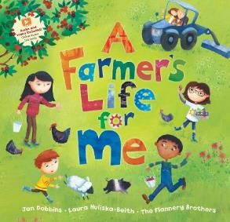
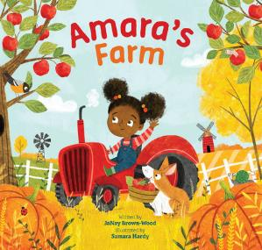
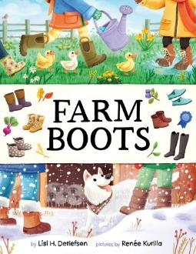
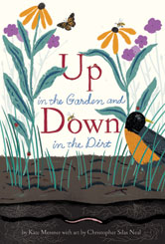


Food, Farming, Gardens, and Movement
A Farmer’s Life for Me by Jan Dobbins
Amara’s Farm
by JaNay Brown Wood
Farm Boots
by Lisl A. Detlefsen
Up in the Garden, Down in the Dirt
by Kate Messner
Big Red Barn
by Margaret Wise Brown
Right This Very Minute: a table to farm Book about food and farming
by Lisa Detlefsen
Notes:
Suggested Speaker Notes:
Children’s books on topics related to food, farming, nutrition, and gardens offer rich opportunities to expand a child’s vocabulary and understanding of how food is grown. These books can also provide opportunities for movement. Actively engaging children by encouraging movement can help maintain interest in the story. Adults can pause as they read the story, comment on the images, and suggest children move in a manner from the story. This movement might be climbing a ladder against the apple tree, stomping in boots through the snow, or the child’s interpretation of how an animal moves. Children can practice skills, such as balancing, as they reach to pick cherries or lifting as they pretend to lift a shovel of heavy soil. They can imagine using tools, harvesting food, or imitating movements of insects or farm animals.
Six titles that could be used for movement are listed on the slide. Links to a booklist with additional gardening titles are found in the participant handout.
Trainer notes:​
The participant handout has links to a 7-page list of children’s books developed by Mass Audubon, a nature-based conservation organization in New England. This list was developed in 2024 and has books grouped by 17 subjects, including composting, cultural cooking, food insecurity, dietary choices, farming, and urban gardens. https://www.communityclinicalconnections.com/wp-content/themes/cccph/assets/downloads/2024/07/Farm_to_ECE_Children's_book_list.pdf
Consider printing and passing this list around during your session to allow participants to see the resource.​
Additional book lists you may want to share include the link to the search tool developed by Growing Minds. https://growing-minds.org/childrens-literature/ ​
The Junior Master Gardener Program and the American Horticultural Society have a shorter list of titles through the “Growing Good Kids – Excellence in Children’s Literature Awards” Program. https://jmgkids.us/bookawards​

Slide 17
Objective 2
Identify three garden activities that support motor skill development.
Notes:
Suggested speaker notes:
Gardening is one strategy shown to increase physical activity in early childhood education settings. Many young children in the U.S. are not getting enough physical activity each day, and early childhood is a critical time to help children build a love of movement, active play, and confidence in their bodies.
Before we start with activities lets discuss some background information on the development of motor skills. Those of you who have attended a PALS session may recognize this content.

Slide 18
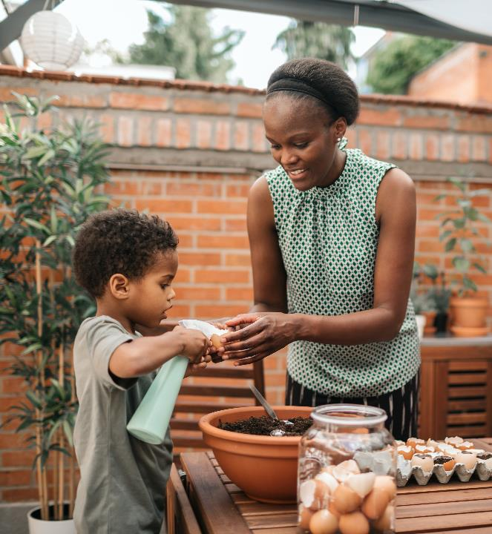
Motor Development
Motor development is the process through which we learn to move and to control movement.​
Fine Motor Skills involve the small muscles in the hands, fingers, feet, and toes.
Gross Motor Skills involve the large muscles in the arms, legs, and torso.
All developmental domains are interconnected.
Movement supports and is supported by cognitive, social-emotional, and linguistic develop.
Notes:
Suggested speaker notes:
Motor development is the process through which we learn to move and learn to control movement. Starting at birth infants begin to develop movement skills.
There are two types of motor skills- fine motor and gross motor.
Fine motor skills involve smaller muscles found in the hands, feet, fingers and toes.
Fine motor skills include grasping, picking up and dropping objects, and holding something. For example, whole hand grasping and the pincer grasp are skills used in writing. Children practice the whole-hand grasp when they use a small shovel, spray bottle, or watering can. The pincer grasp is used when picking up small objects such as a seed to plant or sort.
Gross motor skills involve larger muscles found in the arms and legs. Gross motor skills in the garden can include pushing a wheelbarrow, lifting plastic pots, or watering cans,
While our session today focuses on the connection between the garden and physical activity and motor development, it is important to note that all developmental domains are interconnected. Acquiring skills in one domain leads to growth in other domains. Consider the toddler who is just walking and now is better able explore and understand their environment (cognitive) and move to interact with peers (social).

Slide 19
Fundamental Movement Skills
Locomotor
Object Control
Stability
Walk
Run
Jump
Hop
Leap
Gallop
Slide
Skip
Ball Roll
Throw
Catch
Kick
Strike
Trap
Dribble
Volley
Axial
Springing
Upright Balances
Inverted Balances
Notes:
Suggested speaker notes:
Movement skills develop on a typical trajectory or path. Skills may develop faster for some children and slower for other children. The Milestone Moment flyers from the CDC provide a guideline for skills to be looking for in children.
Fundamental movement skills are the basic movement skills we need daily and for physical activity throughout our lives. Many of these skills typically begin to develop between the ages of 3 and 5 years while control and fluidity progress with experience and practice. Fundamental movement skills are organized into 3 categories:
We use locomotor skills to move from place to place.
We use object control skills to control an object with either our bodies or an instrument such as a bat, glove or stick.
We use stability to keep our balance when we change position and throughout all daily activities.
Fundamental movement skills are important as skills build upon each other. As children learn one skill, they can move on to more complex skills that they will use later in life. If children do not feel confident doing a movement skill, they may avoid participating in activities that use that skill. While some skills may seem to develop naturally, all motor skill development benefits from experience, encouragement, and role modeling. With practice in play, children develop increased skill, agility, coordination, and balance.

Slide 20
Gardening and Fundamental Movement Skills
Locomotor
Object Control
Stability
Walking
Pushing a wheelbarrow
Carrying tools and supplies
Garden games
Digging
Adding soil
Planting
Harvesting
Watering plants
Installing plant supports
Lifting materials
Turning
Twisting
Bending
Reaching
Notes:
Suggested speaker notes:
Now let's consider garden tasks that support the three categories of fundamental movement skills.
Optional group discussion:
Ask participants- What additional garden activities can you think of that support the fundamental movements skills?

Slide 21
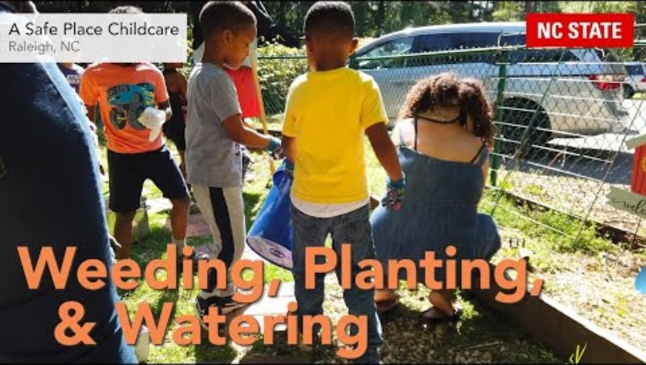
Notes:
Suggested speaker notes:
Next, we will watch a short video from the Natural Learning Initiative at NC State University of preschoolers in an ECE program garden. As you watch, notice the fundamental movement skills you see the children doing.
Trainer notes:
The embedded video is 1:58. Depending on time available, you can choose to play only the first 30 seconds. Weeding, Planting, & Watering – YouTube https://youtu.be/Q3ixAJpfblY?si=Uqu4OFr_7gz91ZU6
After the video wraps up, prompt participants- What fundamental movement skills did you see children doing in the garden?
Some responses could include:
Walking throughout the garden
Reaching for gloves or plants
Lifting plants and moving with them across the space
Digging in the dirt
Planting

Slide 22
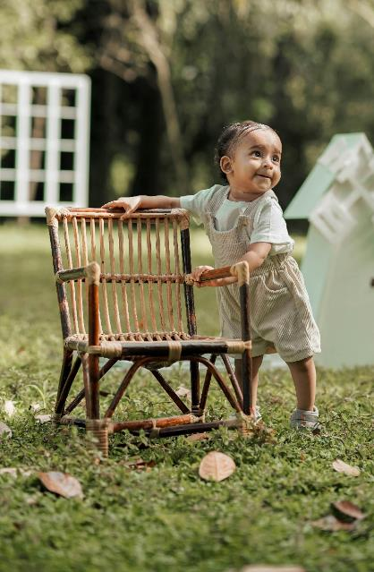
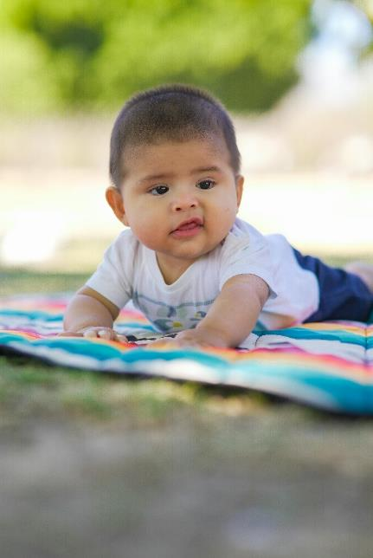
Infants in the Garden
Tummy Time
Opportunities to roll and crawl
Bubble play
Sitting on the grass, with support if needed
Opportunities for reaching and grasping
Sensory exploration of natural objects
Water play
Notes:
Suggested Speaker notes:
The recommended physical activity practices include infants experiencing outdoors play 2-3 times a day. Many infant activities done indoors can easily be brought outdoors. As much as possible, keep infants out of confining equipment when outdoors.
Photo by Luis Becerra Fotógrafo: https://www.pexels.com/photo/face-of-boy-lying-down-on-blanket-16053835/
Photo by AMBADY KOLAZHIKKARAN : https://www.pexels.com/photo/little-boy-leaning-on-a-wooden-chair-standing-in-the-back-yard-17901181/

Slide 23
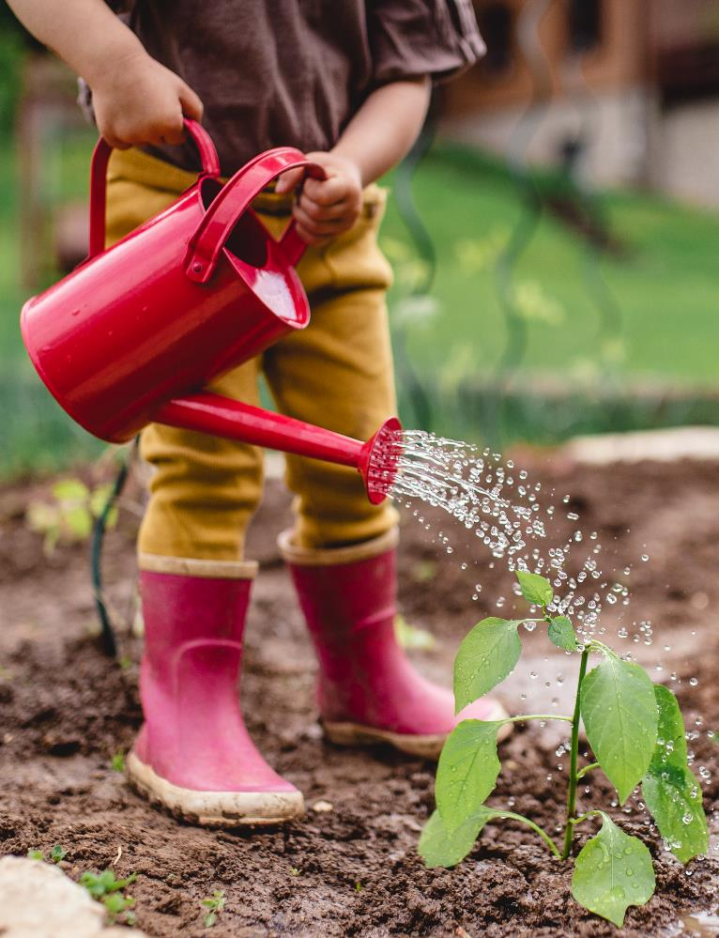
Toddlers in the Garden
Provide shovels, cups, and scoops to practice digging in earth play areas
Scoop soil, sand, or water and pour it out
Squat and practice covering pretend seeds
Control a watering can and gently water the soil around plants
Notes:
Suggested speaker notes
Toddlers enjoy assisting and pretending with garden activities. Demonstrate and then let them practice skills in earth, sand, or water play areas.
Consider the skills children are practicing when watering. There are the locomotor skills of carrying a watering can, object control skills in pouring and directing the water to a specific space and controlling the rate of flow, and the stability skills of balancing to accomplish this while standing or squatting.
Microsoft stock image

Slide 24
Preschool Garden Games and Activities
Notes:
Trainer notes;
Over the next few slides, you will find a few activities that connect physical activity to garden topics and themes. If time allows, consider facilitating one of the games with your participants. If you are training virtually, Gardener Says is a good choice. The speaker notes contain a description of how each game is played. In discussions, highlight the fundamental movement skills practiced in the game and other skills used. As time allows, encourage discussion of adaptions of each game for younger children or children with different abilities.
Suggested speaker notes:
Next, we will explore several games you can incorporate into your garden time.

Slide 25
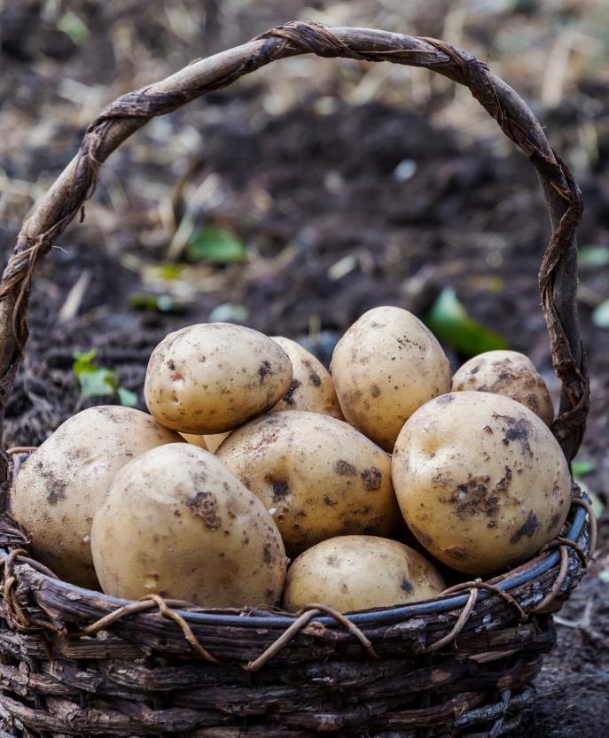
Hot Potato, Hot Potato
Fundamental Movement Skills
Receiving and passing an object
Other skills
Eye-hand coordination
Attention
Variations
Add a second potato
Roll or toss the potato instead of passing
Children sing a song as the potato passes, an adult claps randomly to stop the game
Notes:
Suggested speaker notes:
Hot potato is a fun, energetic game that allows children opportunities to practice eye-hand coordination, passing and receiving an object, crossing the midline and increasing attention spans. To play the game, three or more children sit in a circle with a soft object such as a ball or beanbag to stand for the hot potato. An adult plays music, sings or chants and children begin passing the potato around the circle quickly to not get burnt and avoid being caught when the music stops. At random intervals, stop the music. You may be familiar with the version of hot potato where the player holding the potato when the music stops is out of the game. In early childhood, we want to avoid exclusion games that limit the amount of active time. Instead of elimination, instruct the child caught holding the potato to clap a rhythm the other children must copy or jump 3 times.
The game can increase in speed with faster music; the circle can get larger with more space between children to encourage reaching or tossing.
This would be a fun game to play on a day your program is serving baked potatoes for lunch. This game can be played with a real potato-but not a hot one!

Slide 26
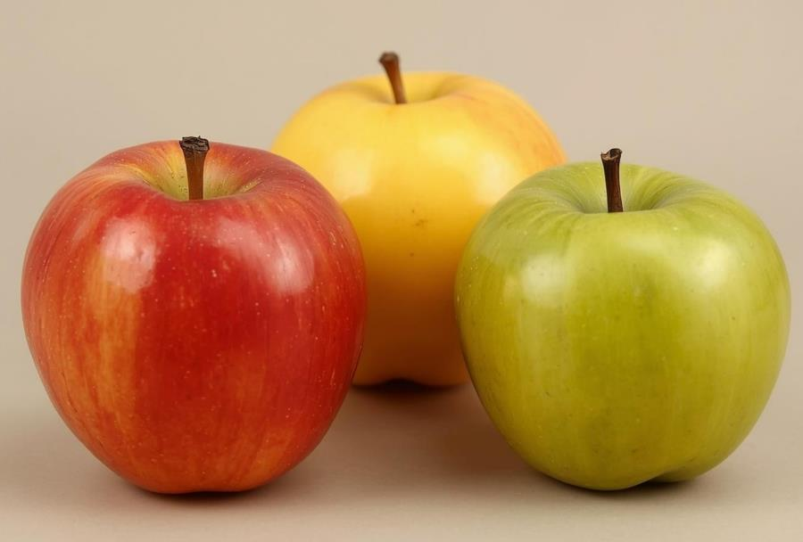
Red Apple, Yellow Apple, Green Apple
Fundamental Movement Skills
Various locomotor skills
Balance skills (when stopped)
Other Skills
Listening
Movement control and coordination
Self-regulation
https://sites.google.com/asu.edu/sageasu/home
Notes:
Suggested speaker notes:
This game is from the SAGE curriculum. SAGE stands for Sustainability via Active Garden Education. SAGE is a free, garden-based physical activity and nutrition program for early care and education centers. SAGE was developed by the University of Arizona and meets Arizona education and national standards. The SAGE program has a total of 12 units. A link to this curriculum is in the participant handout.
Red Apple, Yellow Apple, Green Apple is similar to the familiar game “red light, green light.“
The children line up opposite the teacher.
When the teacher holds up the green apple, the children begin performing an activity as they make their way toward the teacher. For example, the teacher may tell the children to hop like a grasshopper. When the green apple is showing then the children will hop like a grasshopper toward the teacher.
When the teacher holds up the red apple, the children stop doing the activity.
When the teacher holds up the yellow apple, then the children perform the activity very slowly.
Once the children reach the teacher on the opposite side of the room, then the children start the game over, maybe with a new method of moving (Flying like a butterfly, crawling like a turtle, jumping like a kangaroo).
Curriculum https://sites.google.com/asu.edu/sageasu/curriculum/curriculum?authuser=0
Lee RE, Arriola A, Lorenzo E, Soltero EG, Szeszuski J. SUSTAINABILITY VIA ACTIVE GARDEN EDUCATION (SAGE): THE PROCESS OF INCORPORATING WATERING INTO STRUCTURED PRESCHOOL CURRICULUM. Agric Food. 2024;12:138-143. doi: 10.62991/af1996562854. Epub 2024 Dec 16. PMID: 41019297; PMCID: PMC12466310.

Slide 27
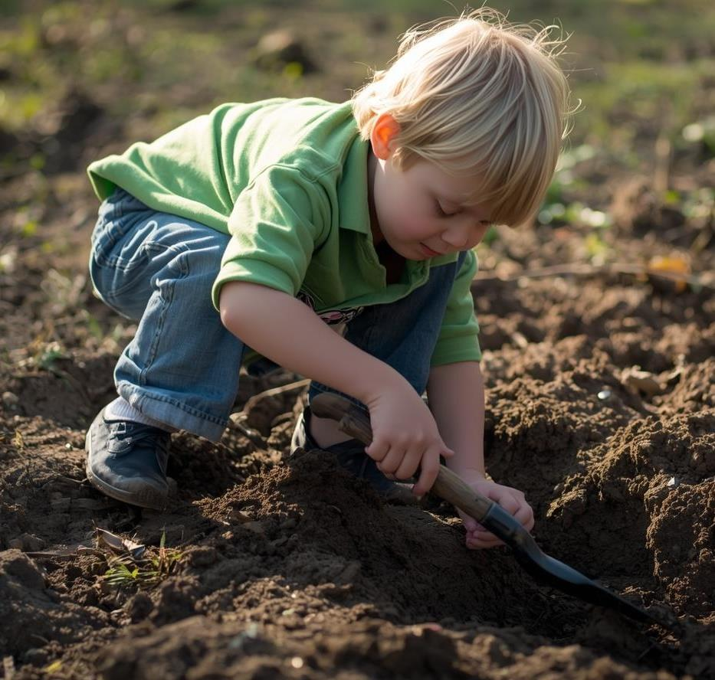
Gardener Says
Played like ‘Simon Says’ with movements used in the garden, for example:
Dig a hole for a new plant
Bury a seed
Rake up leaves
Water the seedlings
Push a wheelbarrow
Harvest carrots
Harvest apples
Carry a heavy garden hose
https://sites.google.com/asu.edu/sageasu/home
Notes:
Suggested speaker notes:
Another game in the SAGE curriculum is Gardener Says.
Gardener Says
To further emphasize gardening as physical activity and to practice the use of gardening skills, the teacher leads the children in a game of “Gardener Says” (played like Simon Says).
The adult will demonstrate movements before the game begins. Children stand up, and the “gardener” says “Gardener Says to Dig,” and the children make a digging motion pretending to have a shovel in their hands.
This game is repeated as the children practice other gardening actions such as raking, watering, harvesting down low (bend at the waist and bend their arms at the waist, moving them back and forth to pretend like they are picking fruits and vegetables), and harvesting high (children stand on their tiptoes and pretend to pick apples from the top of the tree by reaching up high with their left and right hand).
To make Gardener Says a non-elimination game, divide the group of children into two groups. When a child acts out a command the Gardener does not give, have the child move to the other group. This keeps all children moving and the game is fun for all!
Curriculum https://sites.google.com/asu.edu/sageasu/curriculum/curriculum?authuser=0
Lee RE, Arriola A, Lorenzo E, Soltero EG, Szeszuski J. SUSTAINABILITY VIA ACTIVE GARDEN EDUCATION (SAGE): THE PROCESS OF INCORPORATING WATERING INTO STRUCTURED PRESCHOOL CURRICULUM. Agric Food. 2024;12:138-143. doi: 10.62991/af1996562854. Epub 2024 Dec 16. PMID: 41019297; PMCID: PMC12466310.

Slide 28
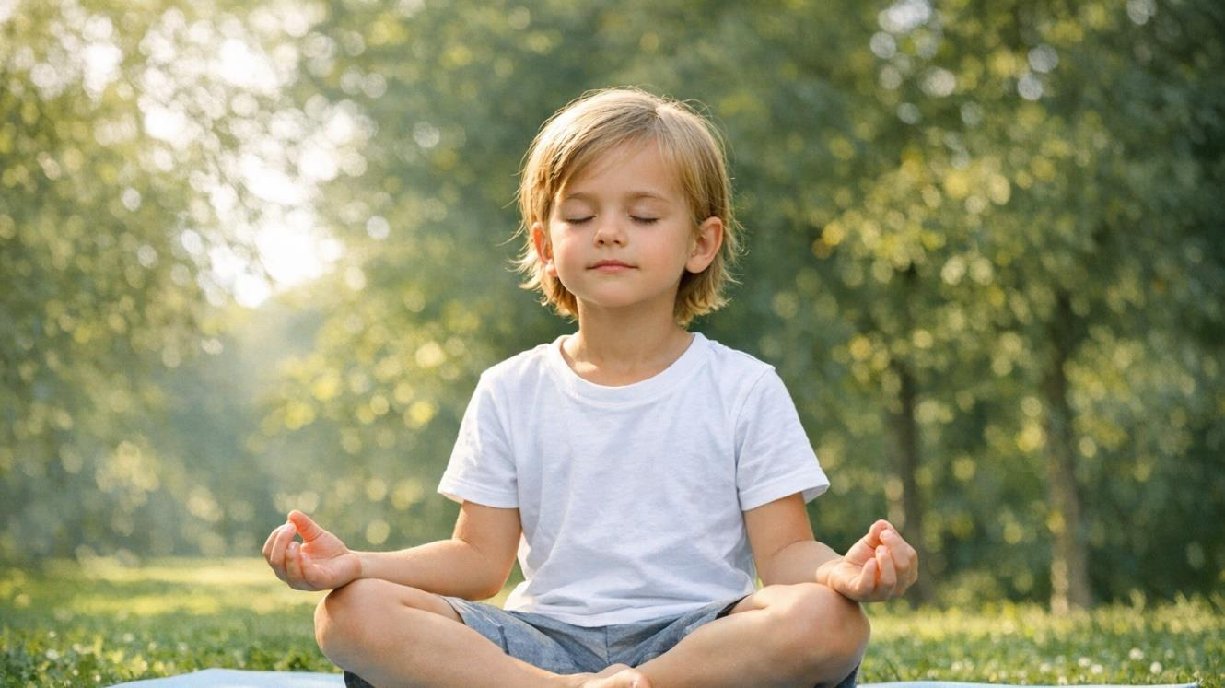
Notes:
Suggested speaker notes:
Yoga is another activity that fits outdoors and in the garden.

Slide 29
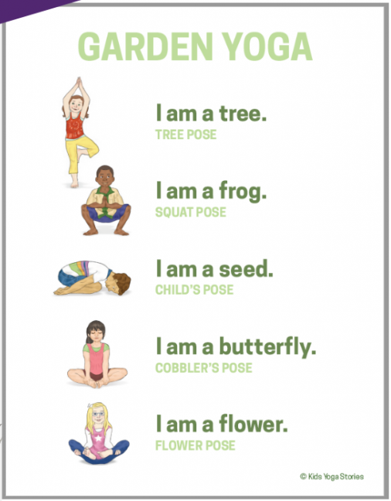

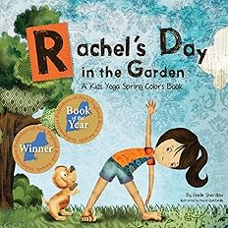
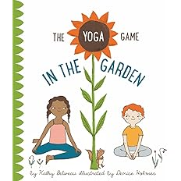
Garden Yoga
Tree Pose
Frog Pose (Yoga Squat)
Seed Pose (Child’s Pose)
Butterfly Pose
Flower Pose
Notes:
Suggested Speaker Notes:
Garden yoga for kids is a fun way to promote activity, creativity, and an appreciation for nature.
While doing simple poses, children can enjoy the benefits of yoga while learning about gardening and the environment. In a classroom or the garden, yoga can be a joyful experience for children of all ages.
When first trying yoga, children may find it challenging to stay still and focused during poses. Keep the sessions short and engaging. Having a theme like the garden incorporates playful elements and variety. Be patient and consistent, gradually helping children build their skills. Encourage children to hold poses for 2-3 breaths building to 4-5 breaths. This allows time to work on coordination and body awareness and matches young children’s short attention spans. Sample poses are listed on the slide with a few early childhood yoga resources. The resources are listed in the handout.
Free yoga resources including a yoga garden poster can be found at Free Kids Yoga + Mindfulness Resources | Kids Yoga Stories https://www.kidsyogastories.com/free-resources/
Optional activities:
Invite a willing participant to demonstrate the poses on the slide.
Watch a short (3:38 minute) video of the author reading Rachel's Day in the Garden.
Images
Rachel’s Day in the Garden: A Spring Colors Book by Giselle Shardlow from Amazon and Kids Yoga Stories
D is for Downward Dog ABD by Calm Mindful Press
The Yoga Game in the Garden by Kathy Beliveau and Denise Holmes

Slide 30
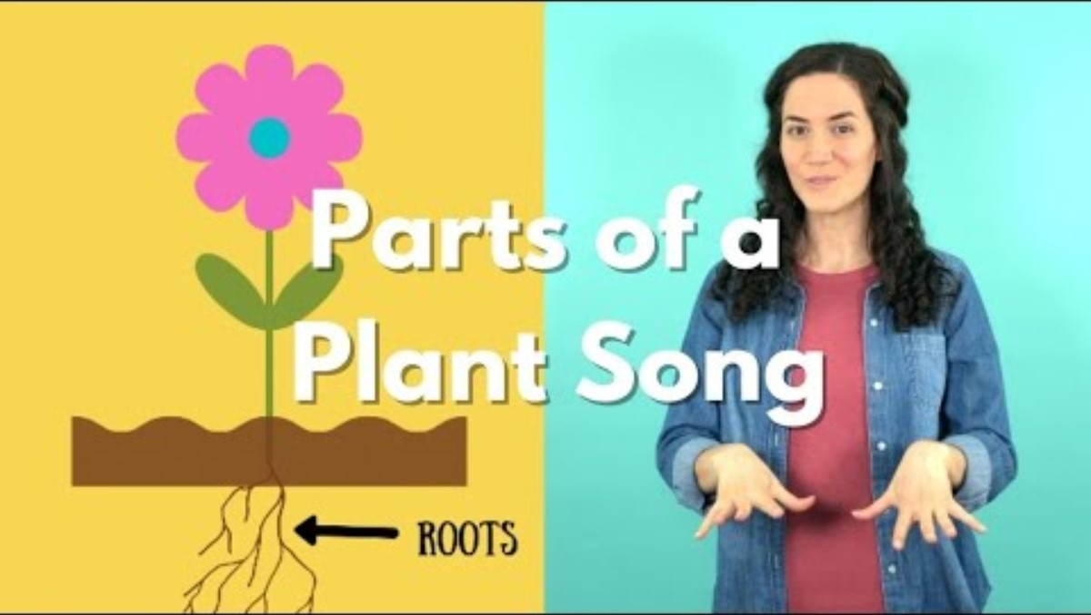
Notes:
Trainer notes:
This is a training brain break. The short video clip (2:19) is embedded in the slide deck.
The link is https://youtu.be/9bFU_wJgvBI?si=IVf-u0uthwSZuBt9
Suggested Speaker Notes:
This song shares the parts of a plant and the important roles they play in the plant life cycle. These are essential components of science education. The words to the song are in the participant handout, move along with the video.
Optional discussion questions:
How would you use the song with children?
What type of extension ideas can you imagine setting up for children?

Slide 31
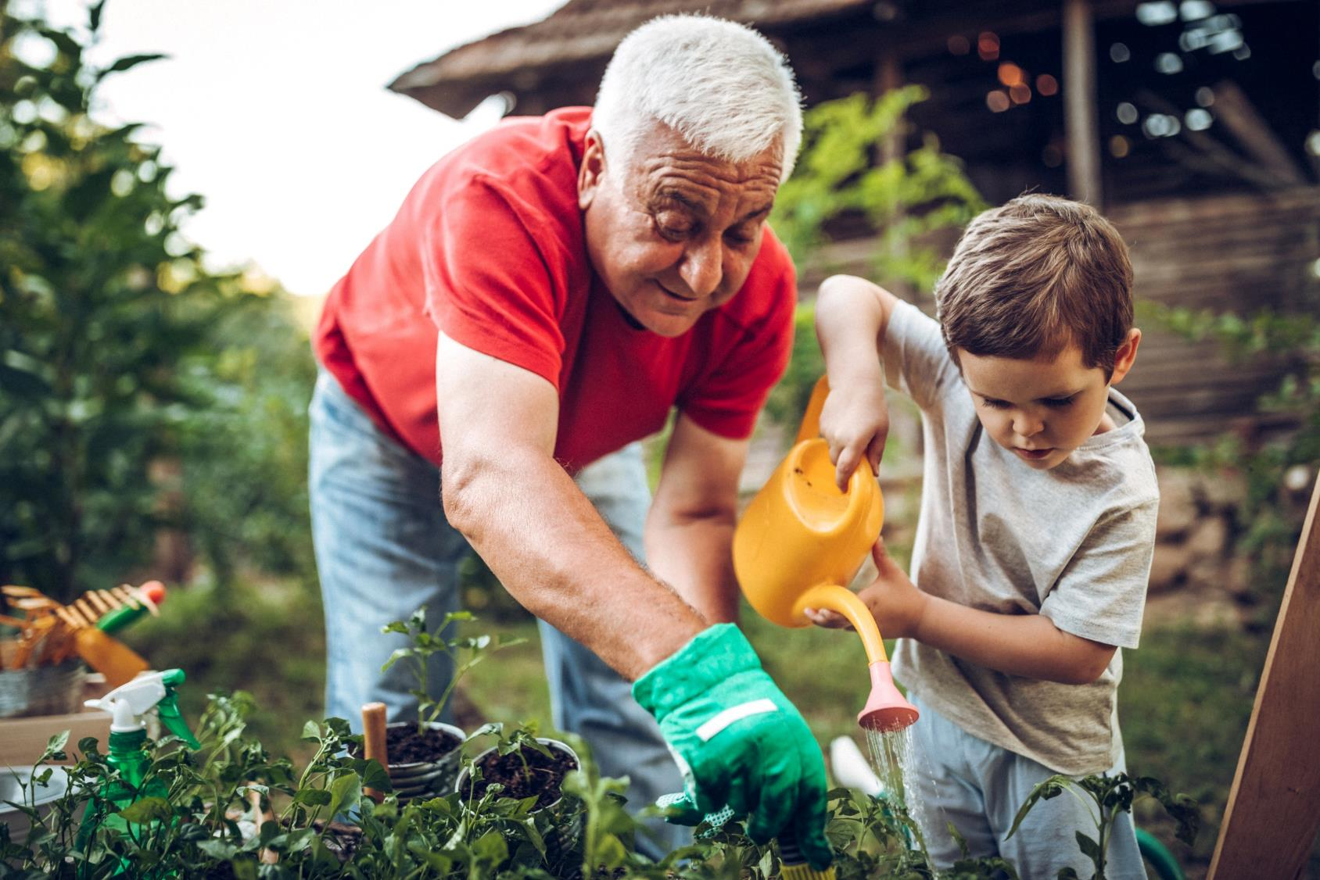
Gardening – Good physical activity for any age!
Notes:
Suggested speaker notes:
Gardening is an activity that can be done at any age. It bridges the gap between our youngest learners and our wisest community members.
Are there any gardeners here today who would like to share how they benefit from their gardens?

Slide 32
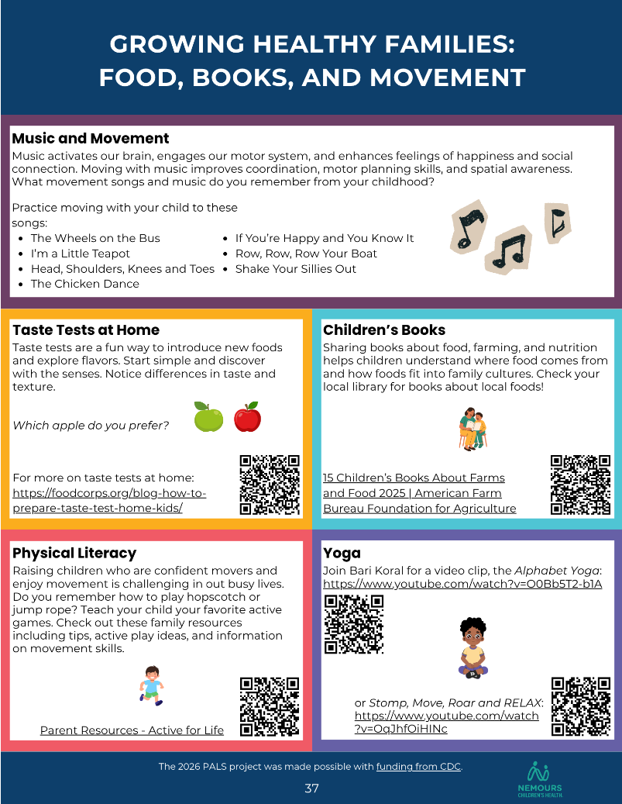
Family Engagement
Host a taste test of local produce at pickup
Share the lyrics to a food song for the trip home
Set up a story walk in the hallway or around the playground for pickup
Share a recipes card with low-cost, simple meals
Host a farm stand market for families at pick-up
Share mealtime conversation prompts
Notes:
Suggested speaker notes:
Sharing educational material and information about your programs farm to ECE activities builds awareness and knowledge among families. The slide lists a variety of simple activities. If your site has a garden, families can assist with the maintenance and work of sustaining a healthy garden. Ask families about cultural foods that are important to them and consider adding them to your garden. The handout shown on the slides can be shared with families electronically or in print.
For additional family engagement ideas developed by Community Ground Works (Wisconsin)- * Engage Families with Farm to ECE_reduced size.pdf https://www.communitygroundworks.org/sites/default/files/Engage%20Families%20with%20Farm%20to%20ECE_reduced%20size.pdf

Slide 33
Key Takeaways
All children should experience outdoor play 2-3 times daily when weather conditions are safe.
Gardens at ECE sites provide hands-on learning, build a connection with nature, and nurture an understanding of where food comes from.
Garden activities can support multiple developmental domains including motor/physical development.
Children of all ages can enjoy a variety of activities using garden themes that build vocabulary and knowledge, develop motor skills, and holistic development.
Notes:
Trainer notes:
Share the key take aways with your participants.

Slide 34
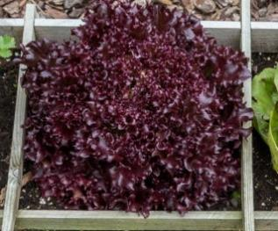
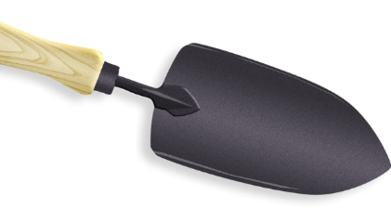
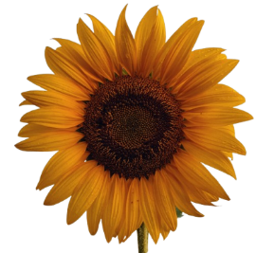
Summary Activity
What are you taking away from this session?
Identify 3 ideas or concepts discussed that “square” with your thinking.
List 2 ideas or activities you will take back and share with peers, families, or apply in your practices with children.
Discuss 1 idea still circling in your head or that you’d like more information on.
Notes:
Trainer notes:
This is a 3-2-1 Summary Activity. In this ‘pair and share’ activity, you will ask participants to gather in small groups of 2-4 and discuss the prompts on the slide. Each group should identify responses to each prompt and be prepared to share back to the large group. Direct participants to the activity space on Page three of the session handout.
Slide images include a square foot garden- a popular method of setting up a garden, a garden trowel or small shovel, and a sunflower. Sunflower gardens are fun for young children.
Allow 5 minutes for small group discussion and 5 minutes for debrief.

Slide 35
Questions?
Notes:
Trainer note:
Add your contact information to the slide.

Slide 36
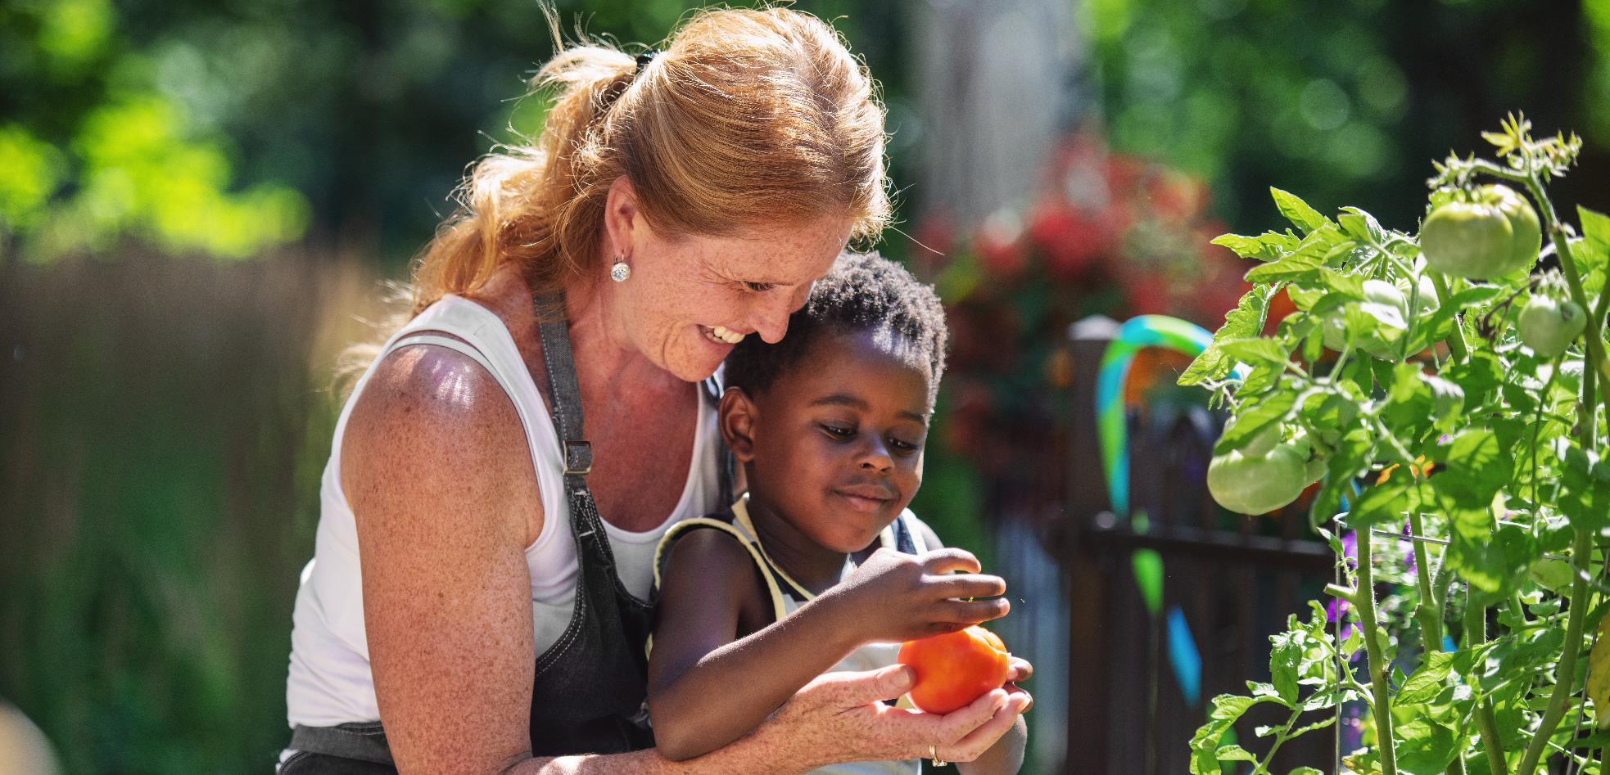
Thanks for joining today’s session!

Slide 37
References
American Public Health Association, American Academy Of Pediatrics, Child, I., & United States. Maternal And Child Health Bureau. (2019). Caring for our Children: National health and safety performance standards, Guidelines for early care and education programs. Apha Press, Imprint Of American Public Health Association ; Itasca, Il.
Ayres, K. (2007). Up, Down, and Around. Candlewick Press.
Common Ground Works. Engage Families with Farm to ECE. https://www.communitygroundworks.org/sites/default/files/Engage%20Families%20with%20Farm%20to%20ECE_reduced%20size.pdf
Firefly Family Theatre. (2021, March 11). Parts of a Plant Song. YouTube. https://youtu.be/9bFU_wJgvBI?si=IVf-u0uthwSZuBt9
National Farm to School Network, & Association of State Public Health Nutritionists. (2021). Farm to Early Education Self-Assessment. Farmtoschool.org. https://www.farmtoschool.org/resources-main/farm-to-early-education-self-assessment
NC State Natural Learning Initiative. (2023, August 23). Weeding, Planting, & Watering. YouTube. https://youtu.be/Q3ixAJpfblY?si=Uqu4OFr_7gz91ZU6

