Slide 1

Add your agency logo here
Active Play in Hot Weather:
Supporting Outdoor Play in ECE Settings
Add Trainer information here
Notes:
Suggested Speaker Notes:
Welcome to today’s training. Our content today will build on the best practice of outdoor play covered in PALS. We’ll specifically talk about supporting active outdoor play in hot weather, including understanding risks and strategies for safe outdoor play during hot weather.
Trainer notes:
This PALS Micro Training session is targeted at participants who have attended PALS sessions and understand the best practices of physical activity in early childhood settings. Concepts from PALS will be reviewed. The participants in your training may be a mix of administrators, classroom teachers, and home providers.
Trainers are encouraged to add a GROUP NORMS slide after slide 2. Use your preferred norms and invite participants to share what they would like to see added to the list. A few suggestions are listed below. Having around 5 group norms is a good goal.
Be considerate of differing opinions
Speak respectfully to each other
Share your knowledge and experience
Minimize side conversations
Take care of your needs
Celebrate accomplishments

Slide 2
Disclaimer
Nemours Children’s Healthy Kids, Healthy Future Technical Assistance Program is funded through a subaward agreement with the Association of State Public Health Nutritionists, the funding for which comes from the Division of Nutrition, Physical Activity and Obesity (DNPAO) in the National Center for Chronic Disease Prevention and Health Promotion (NCCDPHP) at the Centers for Disease Control and Prevention (CDC) of the U.S. Department of Health and Human Services (HHS) as part of a financial assistance award (cooperative agreement number 6NU38PW000047-02-02) totaling $ 2,775,000, which funds several ASPHN and Nemours Children’s Health programs. This program is 100 percent funded by DNPAO/NCCDPHP/CDC/HHS. The contents are those of the author(s) and do not necessarily represent the official views of, nor an endorsement, by CDC/HHS, or the U.S. government. For more information visit https://www.cdc.gov/nccdphp/divisions-offices/about-the-division-of-nutrition-physical-activity-and-obesity.html.
Notes:
Suggested Speaker Notes:​
Development of the Physical Activity Learning Session (PALS) materials including today’s session was funded by the Centers for Disease Control and Prevention (CDC). The views expressed in this session do not necessarily reflect the official policies of the Department of Health and Human Services or the US Government.

Slide 3
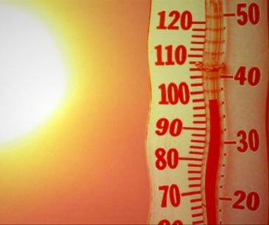
Session Objectives
Understand how heat affects young children’s bodies.
Recognize strategies to reduce the impact of heat during outdoor play.
Identify two activities to do with young children during hot weather.
Explore how to adjust ECE schedules to keep outdoor play safe in hot weather.
Notes:
Suggested Speaker Notes:
Our objectives today will explore strategies that support children and ECE providers in safely enjoying active play in hot weather.​
Image source: PowerPoint Online Photo

Slide 4

Goal
Increase daily outdoor play for children.
Notes:
Suggested Speaker Notes;
Our goal is for children to have daily, year‑round outdoor play, and for caregivers to know how to support it safely, even in hot weather.
Image source: Pexels, Photo by Beard Kid

Slide 5

Opening Activity: Hot Weather Fact or Fiction
Children should avoid outdoor play entirely during hot weather.
​
Thirst is the only sign a child needs to drink water.
The hottest part of the day is usually between 10 AM and 3 PM.
Notes:
Trainer Notes:
This slide includes animations. Participants can engage with this activity in multiple ways- if presenting virtually, they can use the chat box to write fact or fiction, use reactions (thumbs up, thumbs down), or you can assign movements to “fact” and “fiction” to encourage physical activity (i.e., fact = arm circles, fiction = raise the roofs)
Suggested Speaker Notes:
For our opening activity today, we are going to do a short game of “Fact or Fiction” to check your knowledge about hot weather play.
Children should avoid outdoor play entirely during hot weather.
FICTION- outdoor play is vital for children’s healthy development. Today we’ll talk about how to manage it safely.
Thirst is the only sign a child needs to drink water.
FICTION- Children need regular reminders and frequent water breaks. Children are not as aware of their hydration status, so it’s important to provide water even before they tell you they are thirsty.
The hottest part of the day is usually between 10 AM and 3 PM
FACT- Knowing this helps us plan for safe, outdoor play.
Image Source: Microsoft Copilot

Slide 6
Review of PALS content
Space- Young children need adequate space to practice gross motor skills including outdoor play areas.
Type- Children should experience different types of play daily including adult-led, free play, MVPA and outdoor play.
Daily Activities- Outdoor play should be woven in the daily schedule 2-3 or more times per day.
Providers Role-Schedule outdoor time, set up experiences during outdoor play, lead activities, encourage, role-model and supervise.
Policies-Policies, family and staff handbooks address outdoor play including clothing, staff roles, and weather considerations.
Time
Training
Space
Policies
Families
Type
Providers
Daily Activities
Notes:
Trainer notes:
Outdoor play was a part of the PALS learnings session content and was included in multiple recommended practices- space, types, daily activities, and provider role. Outdoor practices related to physical activity should be included in program policies as well. This slide recaps the outdoor play best practices addressed in PALS.
Suggested speaker notes:
The PALS training addressed the best practices of physical activity in eight areas seen in the image on the screen, (Time, Space, Type, Daily Activities, Providers Role, Families, Training & Resources, and Policies)
Let’s review a few of the concepts covered in PALS that are relevant to our topic of today, outdoor play during hot weather.
Space-Young children need adequate space to practice gross motor skills including outdoor play areas. Children tend to be more active outdoors as they have more space to move and use large muscles.
Type- Children should experience different types of play daily including adult-led, free play, MVPA (moderate to vigorous physical activity) and outdoor play.
Daily Activities-Outdoor play should be woven in the daily schedule 2-3 or more times per day for infants, toddlers, and preschoolers.
Providers Role-Providers (adults) are responsible for setting up environments and experiences that support children in active play and practicing fundamental movement skills. Some provider roles include scheduling outdoor time, setting up experiences during outdoor play, leading activities, encouraging, being a role-model and supervising.
Policies-Policies, family and staff handbooks address outdoor play including clothing, staff roles, and weather considerations.

Slide 7
PALS recap – Outdoor play best practices
Infants
How many times each day do children go outside at your program?
Outdoor play 2-3 times daily
Toddlers & Preschoolers
Outdoor play 2-3 times daily
60-90 minutes of outdoor play daily
2 or more structured (adult-led) activities
Notes:
Suggested speaker notes:
The recommended practices come from Caring for Our Children: National Health and Safety Measures for Young Children in Out of Home Settings, and include 2-3 periods of outdoor play daily, weather permitting, for all children. There is not an established time recommendation for infants to be outdoors. Time outdoors may be shortened due to hot conditions, but children should still go outside 2-3 times each day except in conditions of extreme or dangerous weather.
Recommended practices also include that children experience a minimum of 2 adult led activities outdoors daily. Structured activities can allow an ECE provider to better regulate the intensity of the activities for children, something that is extra important during hot weather.
Trainer Note:
After discussing the best practices, advance slide to trigger animation. Ask participants how many times each day the children typically go outside? Does outdoor time happen on hot weather days? What happens during outdoor play time? Are ECE providers leading activities, engaging with children, and modeling enjoyment of outdoor play?

Slide 8
Benefits of outdoor play and outdoor time
Caregivers & Children
Children
Boosts immunity
Exposure to fresh air
Vitamin D
Strengthens mental wellbeing
Improves vision
Lowers stress
Improves sleep
Increases amounts of
  active play
  creative play
  problem-solving play
  cooperative play
Increases awareness and appreciation of the environment
Notes:
Suggested Speaker Notes:
Adults and Children: The benefits of time spent outdoors continue to be understood. Research reveals many health benefits to outdoor time including strengthening the immune system. Short periods of exposure to sunlight promotes the production of Vitamin D in the body. Vitamin D helps regulate the amount of calcium and phosphate in the body which are essential for bone, teeth, and muscle development.
Time outdoors supports mental health and well-being. It has been shown to reduce stress, boost mood and lessen anxiety and depression.
Time spent outdoors decreases the risk of Myopia (also called short-sightedness or near-sightedness) in children and ECE providers. Outdoor time allows us to focus on distant objects like trees or play equipment such as a ball flying through the air— anything that’s more than an arm’s length away. This use of long-distance vision uses different parts of the eye muscles. Think about how much time children and adults spend on devices that limit the use of peripheral and distance vision.
Children: The time spent outdoors is strongly linked with children’s physical activity levels. Outdoor open spaces allow children greater opportunities to practice and develop gross motor skills.
Studies have shown that children who spend time outdoors as young children grow up to be more engaged in the environment and conservation.

Slide 9
Objective 1:
Understand how heat affects young children’s bodies
Notes:
Suggested Speaker Notes:
Let’s discuss the impact of heat on a young child’s body, especially during physical activity. It is important to understand the impacts, so that we can plan and prepare for safe outdoor physical activity during hot weather.

Slide 10

How does heat impact young children?
Children can become sick more quickly
  Smaller bodies = heat more quickly reaches children’s center
  Bodies take longer to increase sweat production
  Get dehydrated more easily
  Not good at knowing when they are thirsty or getting dehydrated
Notes:
Suggested Speaker Notes:
Think of cooking a potato, if it’s a big potato, heat will have a tough time getting to its core and it will take a while to cook. But smaller potatoes cook much faster because heat can reach their center more quickly. Young children are like the small potato in which heat can get faster to the core. Children also have a larger body surface area compared to their weight. On a hot day, they absorb heat faster because more of their body is exposed, relative to their size. These reasons make children’s health more at risk during hot temperatures.
Young children get dehydrated more easily, not only because a larger percentage of body weight is water, but because they are not good at knowing when they are thirsty or getting dehydrated. Children depend on adults to remind them to hydrate and to provide opportunities to hydrate.
Source: https://www.npr.org/2023/07/28/1190557974/kids-extreme-heat-outdoors-safety-water
Image Source: PowerPoint Online Photo

Slide 11
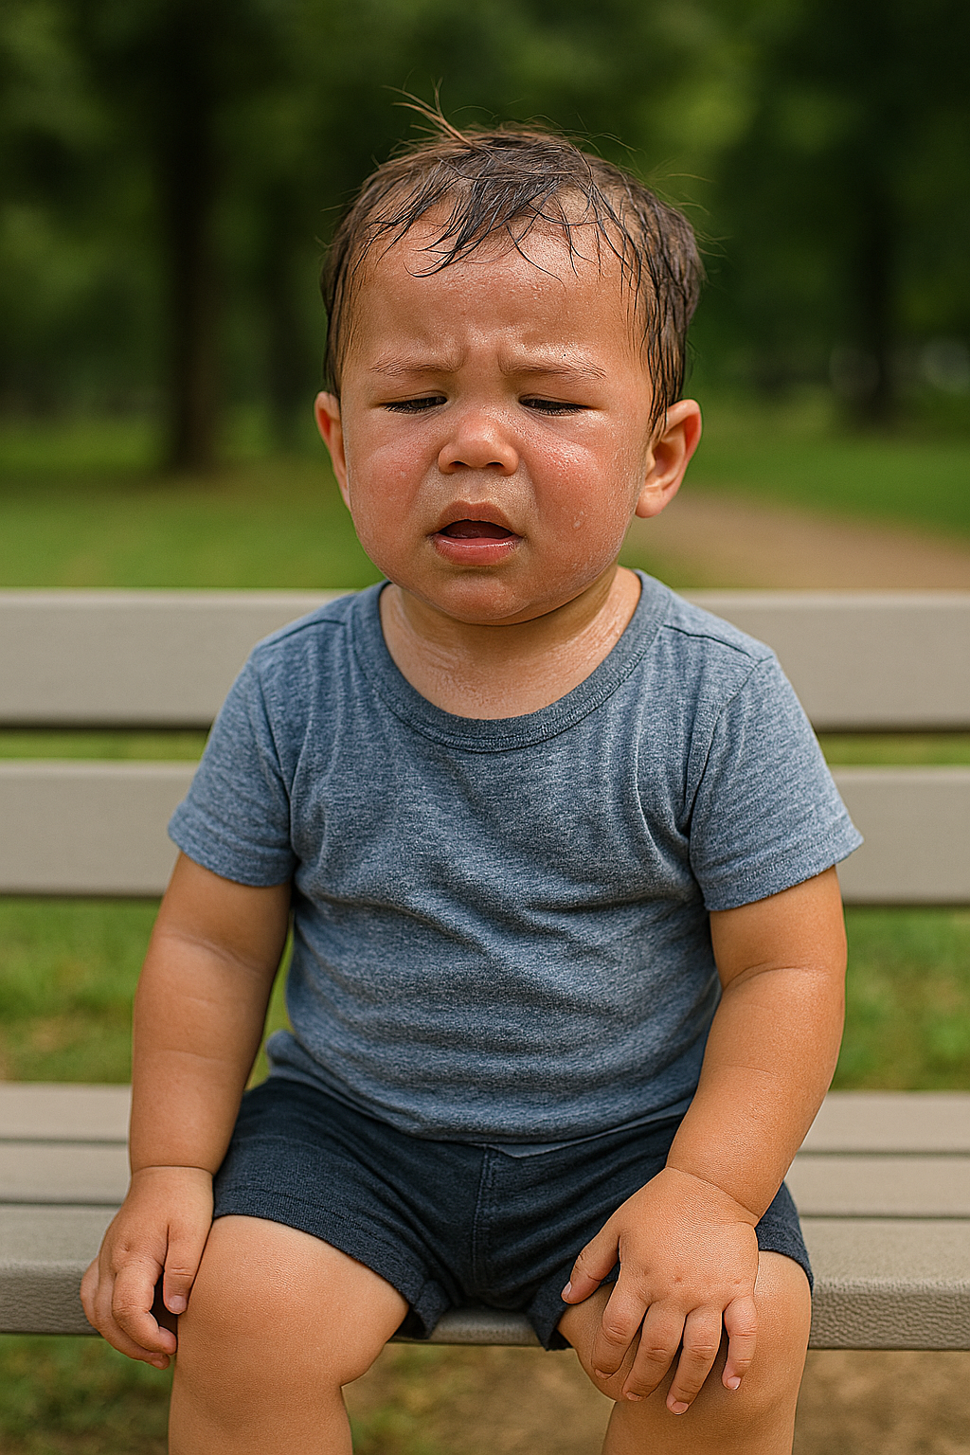
Heat-related illness
Occurs when a person is subject to extreme heat and the body temperature rises faster than it can cool down.
Signs and symptoms:
  Dizziness
  Shortness of breath
  Unusually heavy sweating
  Muscle cramps
  Change in behavior
Important: These are signs a child needs a break, shade, and/or fluids
Notes:
Suggested Speaker Notes:
Hot temperatures can cause children to become sick very quickly, so it’s important to know the signs and symptoms of heat-related illness. Staff play a critical role in monitoring children for these signs and symptoms and if they notice them, to provide a break, shade, and/or fluids. The younger children are, the more carefully children should be monitored. Heat can impact children’s behavior — crankiness or “not acting like themselves” may be due to overheating so that’s something to keep an eye on.
Sources:
https://www.healthychildren.org/English/safety-prevention/at-home/Pages/Protecting-Children-from-Extreme-Heat-Information-for-Parents.aspx
https://www.cdc.gov/heat-health/about/index.html
Image Source: Microsoft Co-Pilot

Slide 12

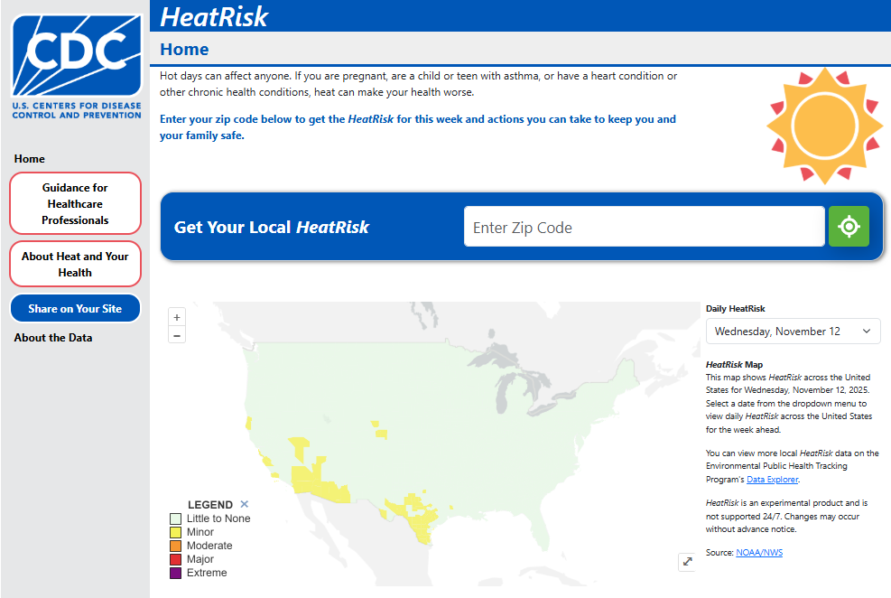
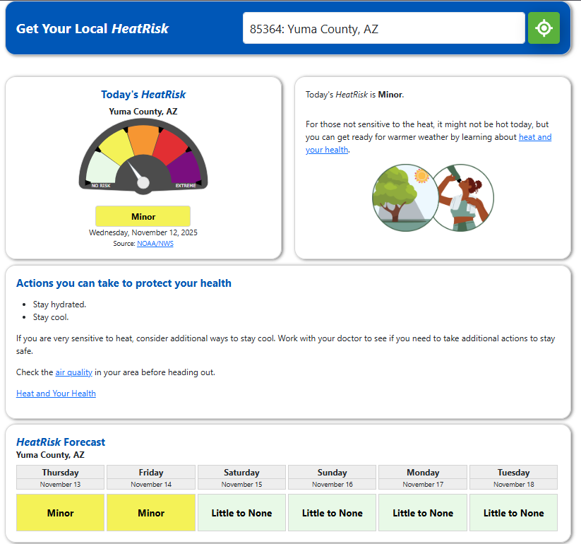
Understanding Risk
Notes:
Trainer Notes: Trainers can replace the screenshot on the right with the health risk for your community, on the day of the training. Trainers can also lead participants in an activity where they prompt participants to use the QR code to access the website and have them check the current heat risk for their zip code and explore the information on the page. - https://ephtracking.cdc.gov/Applications/HeatRisk/
Suggested Speaker Notes:
Now that we know how heat can have negative impacts on children, we need to know how to understand the risk of heat and extreme heat in our community. The CDC has a free ‘HeatRisk’ resource that helps you understand your local Heat Risk. You can enter your zip code, and it will share a color-coded heat risk. You can see from the example on the slide that for Yuma County Arizona on November 12th, the heat risk was “minor.”
This CDC Heat Risk resource also includes information about Air Quality because heat can make air quality worse. We’ll talk a bit more about air quality in a few slides.
Resource: https://ephtracking.cdc.gov/Applications/HeatRisk/

Slide 13
Child Care Licensing & Heat example
Tennessee Licensure Chapter 1240-04-01 November 2025
(3) Outdoor Play and Playground Routines.
  (a) Children of all ages, including infants, who are in care more than three (3) daylight hours, shall have a daily opportunity for outdoor play when the temperature range, after adjustment for wind chill and heat index, is between thirty-two degrees and ninety-five degrees Fahrenheit (32°F and 95°F) and it is not raining.
  (b) Agencies shall develop written policies promoting physical activity and shall strive to remove any potential barriers for children to participating in physical activity,
  (c) Outdoor play and moderate to vigorous indoor or outdoor physical activity shall be available as follows:
    1. Weather permitting, infants shall be taken outside two to three times per day.
    2. Toddlers and preschoolers shall have sixty (60) to ninety (90) minutes of outdoor play per day for full-time programs. Exception: Indoor activity can be increased if adverse weather does not permit outdoor play.
    3. Toddlers shall have sixty (60) to ninety (90) minutes of moderate to vigorous physical activity per eight (8) hour day for full-time programs.
    4. Preschoolers shall have ninety (90) to one hundred and twenty (120) minutes of moderate to vigorous physical activity per eight (8) hour day for full-time programs.
    5. Physical Activity Requirements for Part-Time Providers
Notes:
Trainer Notes: Update the information on this slide with any state specific information related to child care licensing and hot weather. The example on the slide is from Tennessee which has the strongest licensure supporting physical activity of all states. If your state does not have licensing that includes information about hot weather, you can keep the Tennessee example and discuss the different parts of the licensure, specifically calling out the heat threshold (a), written policies (b), proper dress and time adjustments for weather (d), and being alert for any signs of distress (e).

Slide 14
Child Care Licensing & Heat example
Tennessee Licensure Chapter 1240-04-01 November 2025
  (d) Children shall be properly dressed, and the length of time outside adjusted according to the weather conditions and the age of the children.
  (e) Educators shall be alert for any signs of weather-related distress, including
  dehydration, heat stroke, and frostbite.
  (f) Each child care agency shall develop simple playground rules that use positive
  language. Staff shall verbally communicate these rules to children prior to outdoor play.
  (g) Staff shall plan and implement activities that engage all children in developmentally appropriate active, physical play such as skipping, running, and jumping.
Notes:
Trainer Notes: Update the information on this slide with any state specific information related to child care licensing and hot weather.
Understand state child care licensing rules related to weather.

Slide 15
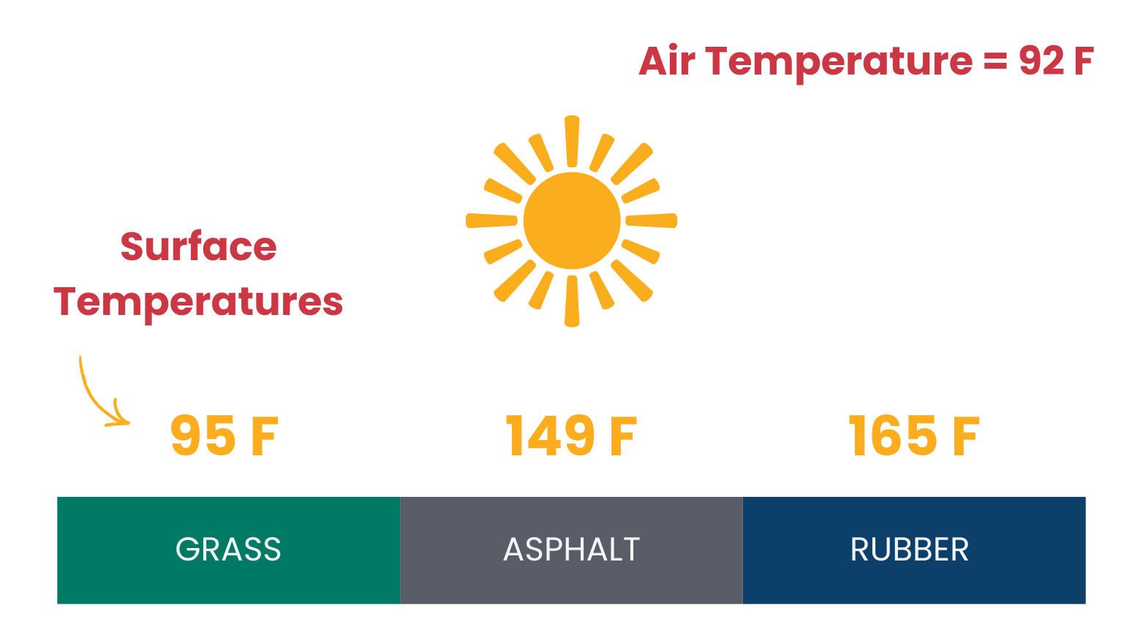
Other Environmental Risks
Paved concrete or asphalt play surfaces can be 50-90 degrees hotter than shaded surfaces on a sunny day
Ensure equipment is safe use
Adapted from ‘The Problem with Hot Schools”-
Luskin Center for Innovation at UCLA
Notes:
Trainer Notes: Note how the image shows the surface temperature for different surfaces on a 92-degree day. The grass is 95 degrees; asphalt is almost 150 degrees and poured rubber surfaces can be the hottest at 165 degrees.
Suggested Speaker Notes:
In addition to the risks of the temperature, hot weather brings additional environmental risks to the equipment and materials of play spaces. Research from the Luskin Center for Innovation at UCLA has shown how different surfaces temperatures can vary based on the surface material, with rubber surfaces getting the hottest. Play areas in the shade can reduce the temperatures even more and be an important strategy for reducing the impact of health that we’ll dive into in the next section.
Adults should also be sure to check any play equipment that has been outside in the heat to ensure it is safe for children’s use. Using portable play equipment that you can bring from inside, or from a shaded area, can ensure the equipment is safe for use.
Source- https://extension.psu.edu/programs/betterkidcare/news/keeping-your-cool-heat-awareness-and-solutions &
UCLA Luskin Center for Innovation- https://innovation.luskin.ucla.edu/publication/the-problem-with-hot-schools/

Slide 16
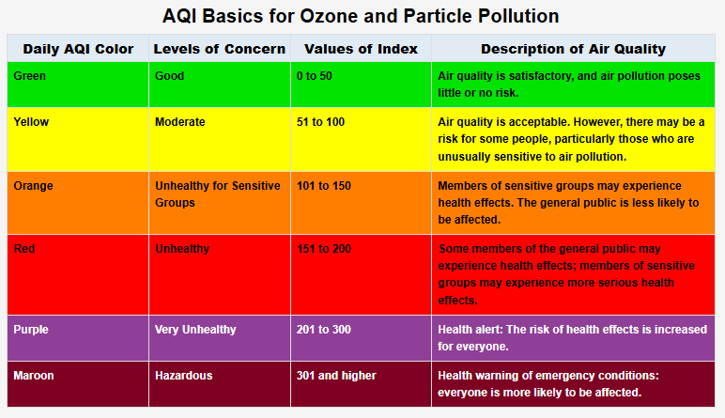
Other Environmental Risks cont.
Air Quality:
AQI or Air Quality Index is a tool for communicating about outdoor air quality.
The higher the AQI value, the greater the level of air pollution and the greater the health concern.
Air quality can be negatively impacted by heat.
Notes:
Suggested Speaker Notes:
Another environmental risk to be aware of during hot weather is air quality. Air quality can be negatively impacted by heat. It is important to understand the air quality, because young children breathe faster and breathe more air compared to their body weight than adults. So, if the air quality is at an unsafe level, children can be especially impacted. Additionally, individuals with asthma may be more sensitive to air pollution or higher AQI. AQI is an important risk factor to consider when making decisions about outdoor play in hot weather.
Local air quality information is available on weather apps and airnow.gov. Air quality is measured using an Air Quality Index or AQI and is color-coded. Air quality from 0-50 is considered good; 50-100 moderate and is acceptable for most people. 100-150 is considered unhealthy for sensitive groups such as people with heart and lung diseases. Above 150 is unhealthy and children and caregivers may experience side effects.
Sources:
https://www.healthychildren.org/English/safety-prevention/all-around/Pages/how-climate-change-heat-and-air-pollution-affect-kids-health.aspx
https://www.airnow.gov/aqi/aqi-basics/

Slide 17
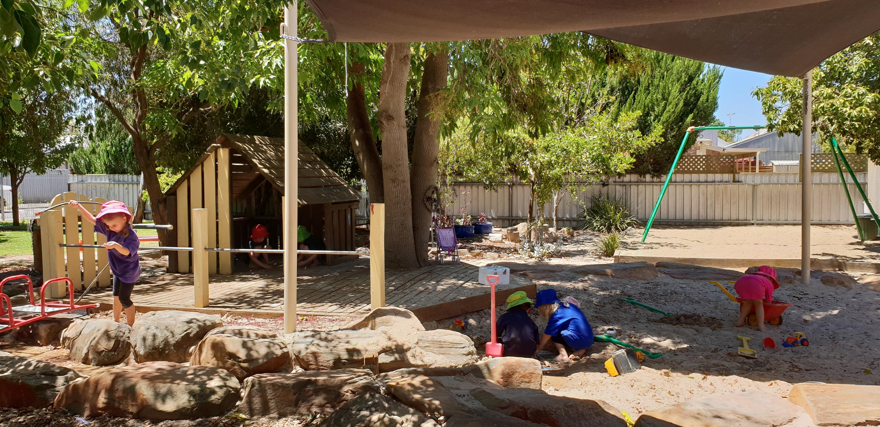
Deciding When Outdoor Play is Safe
Licensing Requirements
Heat Index or “Feels Like” Temperature
Air Quality Index (AQI)
Access to Shade
Surfaces for Play
Age of Children
This Photo by Unknown Author is licensed under CC BY
Notes:
Suggested Speaker Notes:
We know that there are many factors that influence the decision of whether or not to play outside during hot weather. In order to make an informed decision, it’s important to consider all of these factors:
What are the licensing requirements in your state? Is there a temperature threshold included like the example we saw from Tennessee?
What is the current heat index or “feels like” temperature? You can find this on most weather apps. Heat Index is a combination of the air temperature and the humidity.
What is the Air Quality Index? Remember, a higher AQI can be unhealthy, especially for sensitive groups including young children, and children with asthma.
How much shade does your play area provide? What surfaces are your play area made of? On hot days, opportunities for play outside in the shade or on grassy areas are encouraged because they are not as hot as other surfaces.
How old are the children in your program? Remember children absorb heat faster because more of their body is exposed, relative to their size. So, if you have all infants or toddlers, your decision to go outside, might be different than if your class is all preschoolers. In all cases, close monitoring of children during outdoor play is critical.
Remember, there are times when the weather is too hot or your outdoor play area is not well-suited for hot weather play. In these cases, it might not be appropriate for younger children, especially infants and toddlers to play outside.
Ask participants: what other things to do you take into consideration when you decide on hot weather outdoor play?
More information about heat index can be found here: https://www.weather.gov/ama/heatindex

Slide 18
Objective 2: Recognize strategies to reduce the impact of heat during outdoor play.
Notes:
Suggested Speaker Notes:
Now that we understand how heat negatively impacts children and how to understand the heat risk in your community, we are going to discuss strategies to reduce the impact of heat during outdoor play.

Slide 19

Key Strategies
Adapting schedules & routines
Extra sun protection
Water
Policies and Family Engagement
Notes:
Suggested Speaker Notes:
Outdoor play is essential for motor development, learning, and well-being. But heat exposure for young children can rise quickly, especially on playground surfaces and in humid climates. Safe, outdoor play during heat requires planning ahead and always monitoring children closely for signs of heat stress! In the next few slides, we’ll discuss these four key strategies for reducing the impact of heat during outdoor play, while keeping children safe, hydrated, comfortable, and active.
Image source: Getty Images- SolStock

Slide 20
Adapting Schedules & Routines
Plan outdoor play earlier or later in the day when the sun is not as strong
Avoid the hottest part of the day:
  10 AM- 3 PM
Shorter periods of play and many breaks
Less intense activities
Thinking about your schedule, how could you modify it for safe outdoor play during hot weather?
Notes:
Suggested Speaker Notes:
Our first strategy is adapting schedules and routines. In our “fact or fiction” opening activity we learned that the hottest part of the day is from 10 AM- 3 PM. So, we want to adjust our schedules to plan for outdoor play either earlier or later in the day when the sun is not as strong. We know our best practice around outdoor play is for children to have 2-3 opportunities a day. Later in the training, we’ll have the opportunity to look at a schedule and identify how it can be adapted.
Another way to adapt your routines would be to plan for shorter periods of outdoor play, along with many built-in breaks for water and shade. Additionally, you can plan for less intense or energetic activities, including structured, adult-led activities. We’ll also share some specific examples of these types of activities in the following section.
Discussion Prompt: Thinking about your schedule, how could you change it for safe outdoor play during hot weather?
Some potential answers include outdoor play time during arrival, first thing in the morning, or at the end of the day.

Slide 21
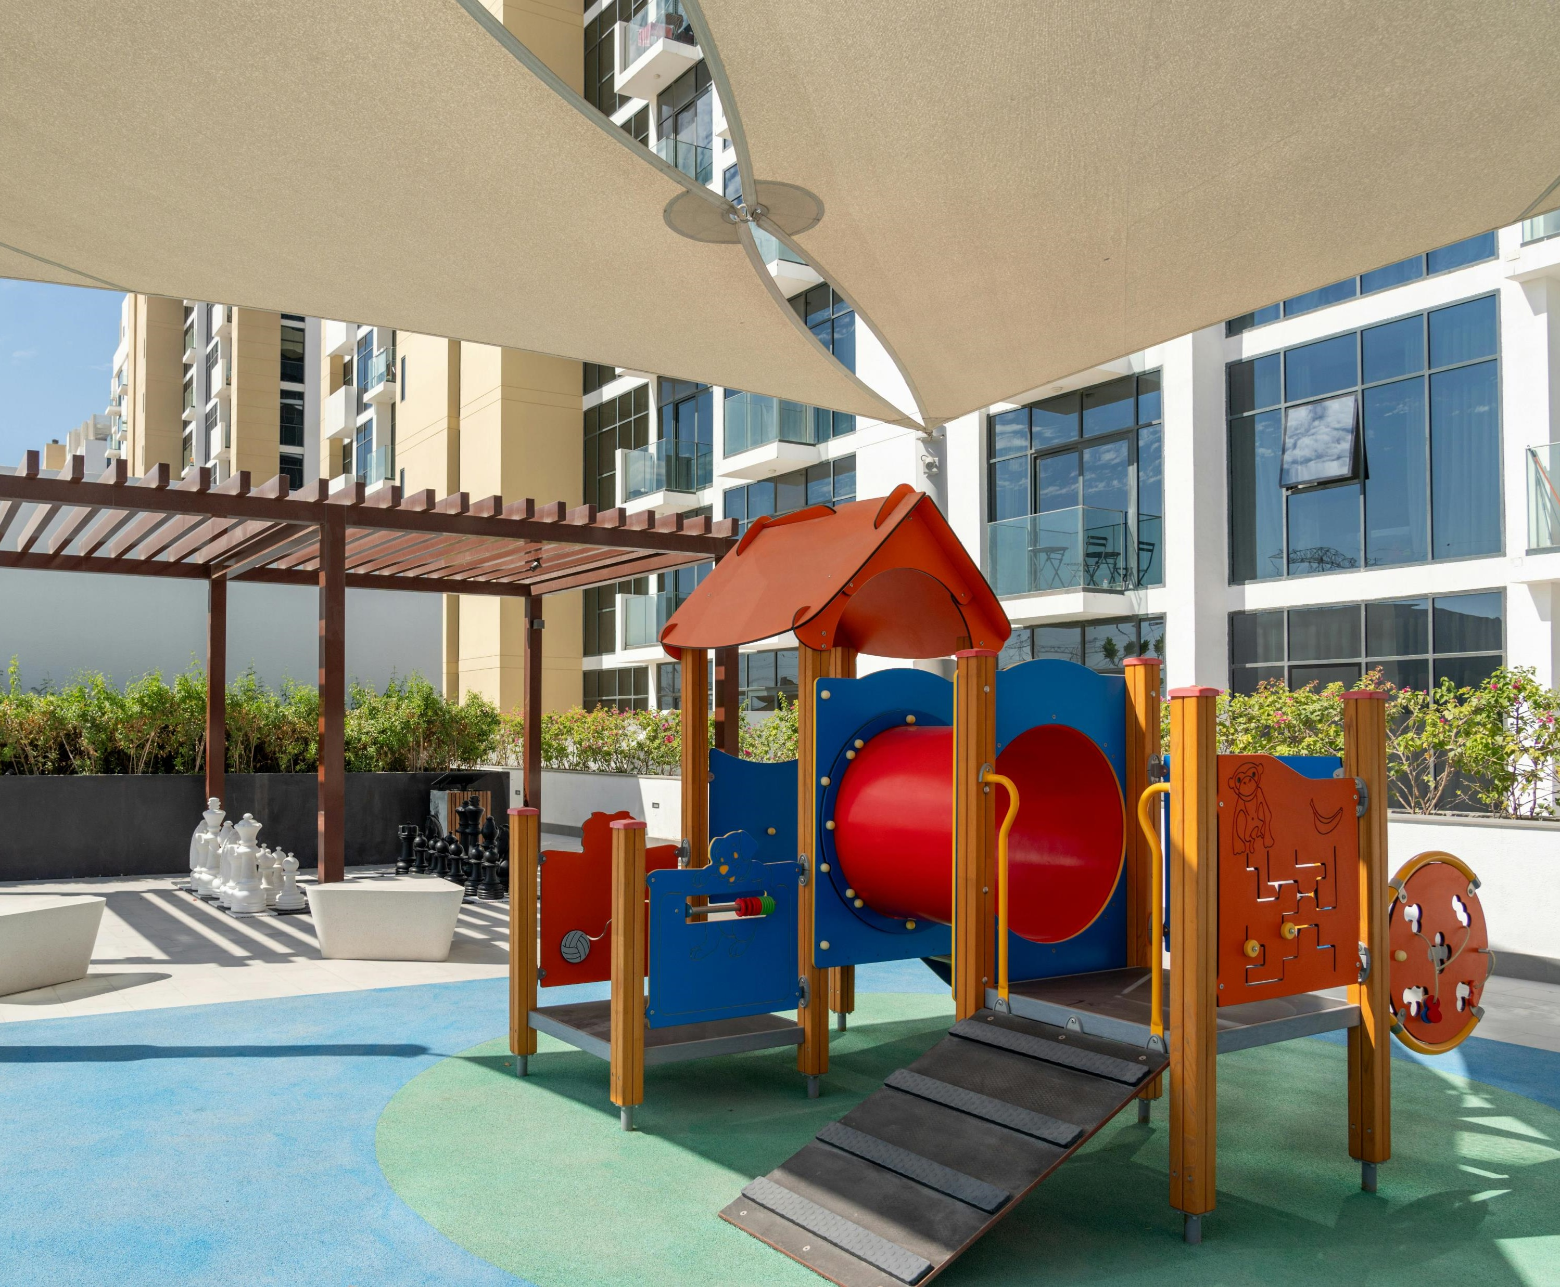
Sun Protection
Shade
Sunscreen
  For children over 6 months
  SPF 15 or higher
Sun protective clothing
  Lightweight, loose-fitting
Hats and Sunglasses
Notes:
Suggested Speaker Notes:
Our second strategy is sun protection. There are many ways we can help protect children from the sun including: shade, using sunscreen, and sun protective clothing and accessories.
Shade not only provides a place to escape the direct heat from the sun but also provides a cooler space for children’s bodies to better regulate temperatures. Shade can be provided in many ways: trees and shrubs, structures like pergolas, trellises, or canopies (as seen in the photo). Consider temporary shade options like shade sail or sheets on the fence or tent pole, parachutes (make temporary forts and drape them over the corner of a fence), pop-up shade structures.
Trainer notes: The Natural Learning Initiative has great resources on shade that are free to download and can be shared with participants- https://naturalearning.org/11-shade-solutions
Sunscreen- with parental permission, for children older than 6 months, use sunscreen with an SPF of 15 or higher on exposed skin. Apply sunscreen 30 mins prior to outside play. Sunscreen is NOT recommended for babies who are 6 months old or younger. Keep young babies out of direct sunlight by finding shade and dressing in sun-protective clothing.
Sun protective clothing is lightweight and loose fitting. Sun-protective accessories include hats and sunglasses, which can help protect children’s skin. We’ll talk more when we get to our family engagement strategy, but it’s key to communicate with parents about the best attire to send their children in when the weather is going to be hot.
Sources:
https://naturalearning.org/wp-content/uploads/2017/04/Summer-play-beat-the-heat2.pdf
Image Source- Pexels, photo by AJ Ahamad
https://www.cdc.gov/early-care/communication-resources/outdoor-play-and-safety-for-children-in-ece.html
https://www.bccancer.bc.ca/prevention/Documents/ShadeLookbook_May2024.pdf

Slide 22
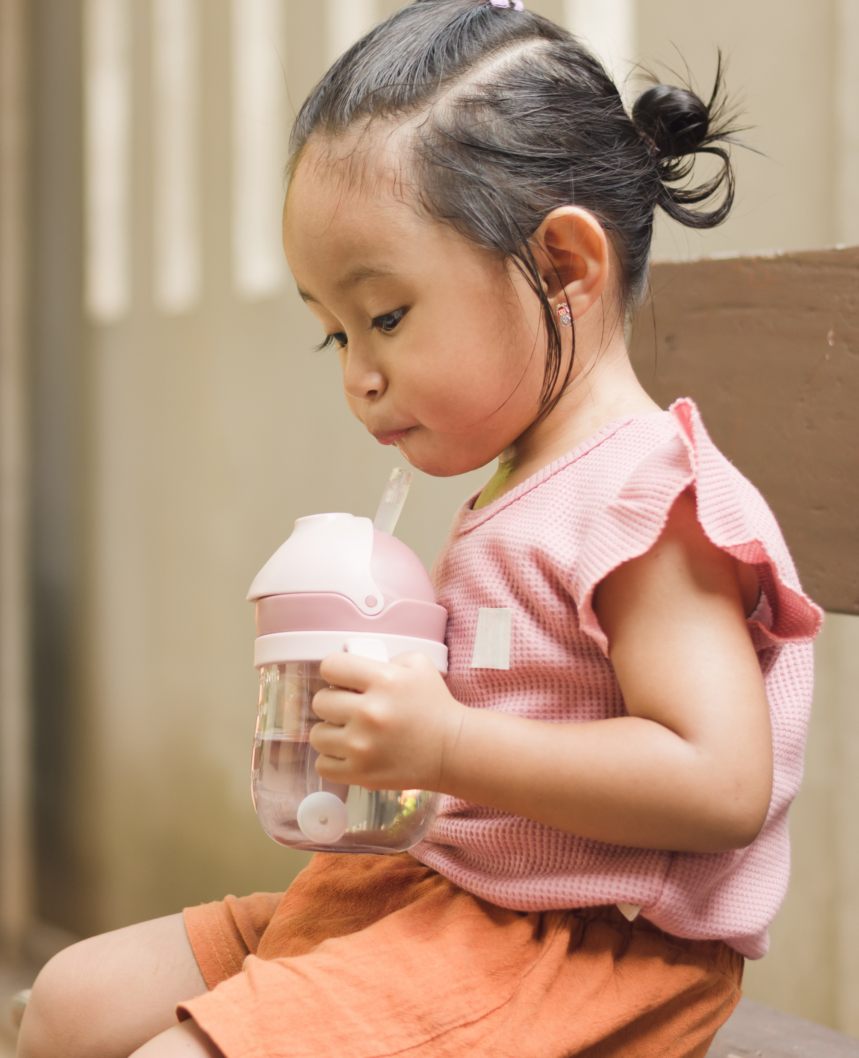
Water
Young children rely on caregivers to keep them cool and hydrated
Water breaks need to be built into outdoor play
For less than 6-month-olds, no water- extra breastmilk or formula
Notes:
Suggested Speaker Notes:
As we mentioned, children are more at risk for heat-related illness because they are less aware of their hydration status and rely on adults in their lives to provide water, and opportunities to drink. Young children may not be able to recognize their need for fluids so it’s extremely important to provide frequent opportunities for water and keep an eye out for symptoms of dehydration.
Water breaks need to be built into outdoor play, especially when it is hot. Depending on the temperature and how active children are, you should schedule water breaks at least every 15 minutes, if not more often. Add water breaks to daily visual schedules so children expect them. Plan to bring water outside with you, either a water cooler with cups or reusable water bottles. For children under 6 months old, they should only be drinking breastmilk or formula, not water to keep them hydrated.
You may ask, what about beverages other than water to keep children hydrated? Milk and sugar sweetened beverages do not rehydrate as well as water and should be avoided.
Consider also using water to create “cool down” stations with misters, fans, spray bottles, or damp towels if you have the necessary equipment. Designate a “hydration spot” in a shaded area for when you go outside.
Image Source: Getty Images- Karl Tapales

Slide 23
Policies & Family Engagement
What policies does your program have for hot weather? How do you communicate with families?
Policies on outdoor play, availability of water
Communicating with families
  Appropriate attire
  Sunscreen use
Notes:
Trainer Notes: the slide includes animation, starting with the discussion box in green.
Discussion Prompt: What policies does your program have for hot weather? How do you communicate with families?
Follow up question: how have policies/communication with families impacted your children’s readiness to play outdoors during hot weather?
Strong policies and communication with families are key to ensure that children show up at your program ready to be physically active during hot weather, including wearing the appropriate attire. Having policies on things like the temperature thresholds for going outside, or the way you plan to offer water or breaks for children outside, may help ease some families’ concerns about physical activity during hot weather. Written policies make your practices known, understood, and supported by staff and families. They can help families understand that daily physical activity is important for children’s health and well-being. Consistent routines, policies, and communication reduce risk and keep outdoor play safe and fun.

Slide 24
Hot Weather Policy Statement example
ABC early education center is committed to safe, daily outdoor experiences for all children. We strive for 90 minutes of outdoor time daily, weather permitting. We will adjust our schedule to prioritize outdoor time based on the weather conditions and air quality.
Families should dress their child in lightweight clothing that supports outdoor play, hats that shade the face and neck, and apply sunscreen before arriving at the center.
Outdoor time will be limited and children closely monitored when the heat index is 90°F or higher.
Outdoor time may be cancelled when the heat index is 100° F or higher.
The ABC director will monitor weather conditions and make decisions on outdoor time.
Staff will modify activities to encourage children to play in the shade and frequent water breaks.
What policies does your program have that support outdoor play in hot weather?
Notes:
Trainer notes:
Ask for a volunteer to read the slide aloud or give participants time to read the sample policy statement.
Facilitate a group discussion on policies.
Note: Sunscreen policies and sunscreen use must comply with child care licensure.
Suggested speaker notes:
Policies communicate programs beliefs and practices.
Discussion Prompt: What policies does your program have that support outdoor play in hot weather?
Follow up Question: How could your program’s policies be changed/adapted to support you further?
This question may be especially relevant for participants that are not program directors or do not have the power to make the policies at their program. Encourage participants to think about what statements, if included in their programs policies, would support them as they lead outdoor play during hot weather.

Slide 25

Brain Boost
Tracing fingers
Notes:
Conduct the Tracing Fingers activity to demonstrate how participants (and children) can use simple movements and breathing to calm their heart rate and relax. This is an example of an activity that can be done outdoors on a hot day when educators are noticing the children breathing heavily and in need of a reset or break or as a transition activity before moving back indoors.
Directions:
To initiate this activity, have participants stand the hold your hand in front like you are stopping traffic. Note that this is the visual signal or cue.
Wait for everyone to join before you proceed with the breathing exercise
Separate the fingers.
Prepare to trace the hand by placing the pointer finger of the opposite hand at the base of the thumb.
Inhale as you trace up the thumb, exhale as you trace down the thumb.
Repeat breathing pattern as you trace each finger ending at the base of the hand under the pinkie finger.
Note that consultants may find it useful to exaggerate shoulder movement indicating inhale and exhale.
Facilitate large group discussion using these prompts:
What other times this activity could be used?
How can this activity be used for different age groups?
Video option for this activity: https://www.youtube.com/watch?v=pPawLNYdMkQ

Slide 26
Objective 3
Identify two activities to do with young children during hot weather.
Notes:
Suggested speaker notes: Now we’ll discuss two types of activities that you can do with young children during hot weather.

Slide 27
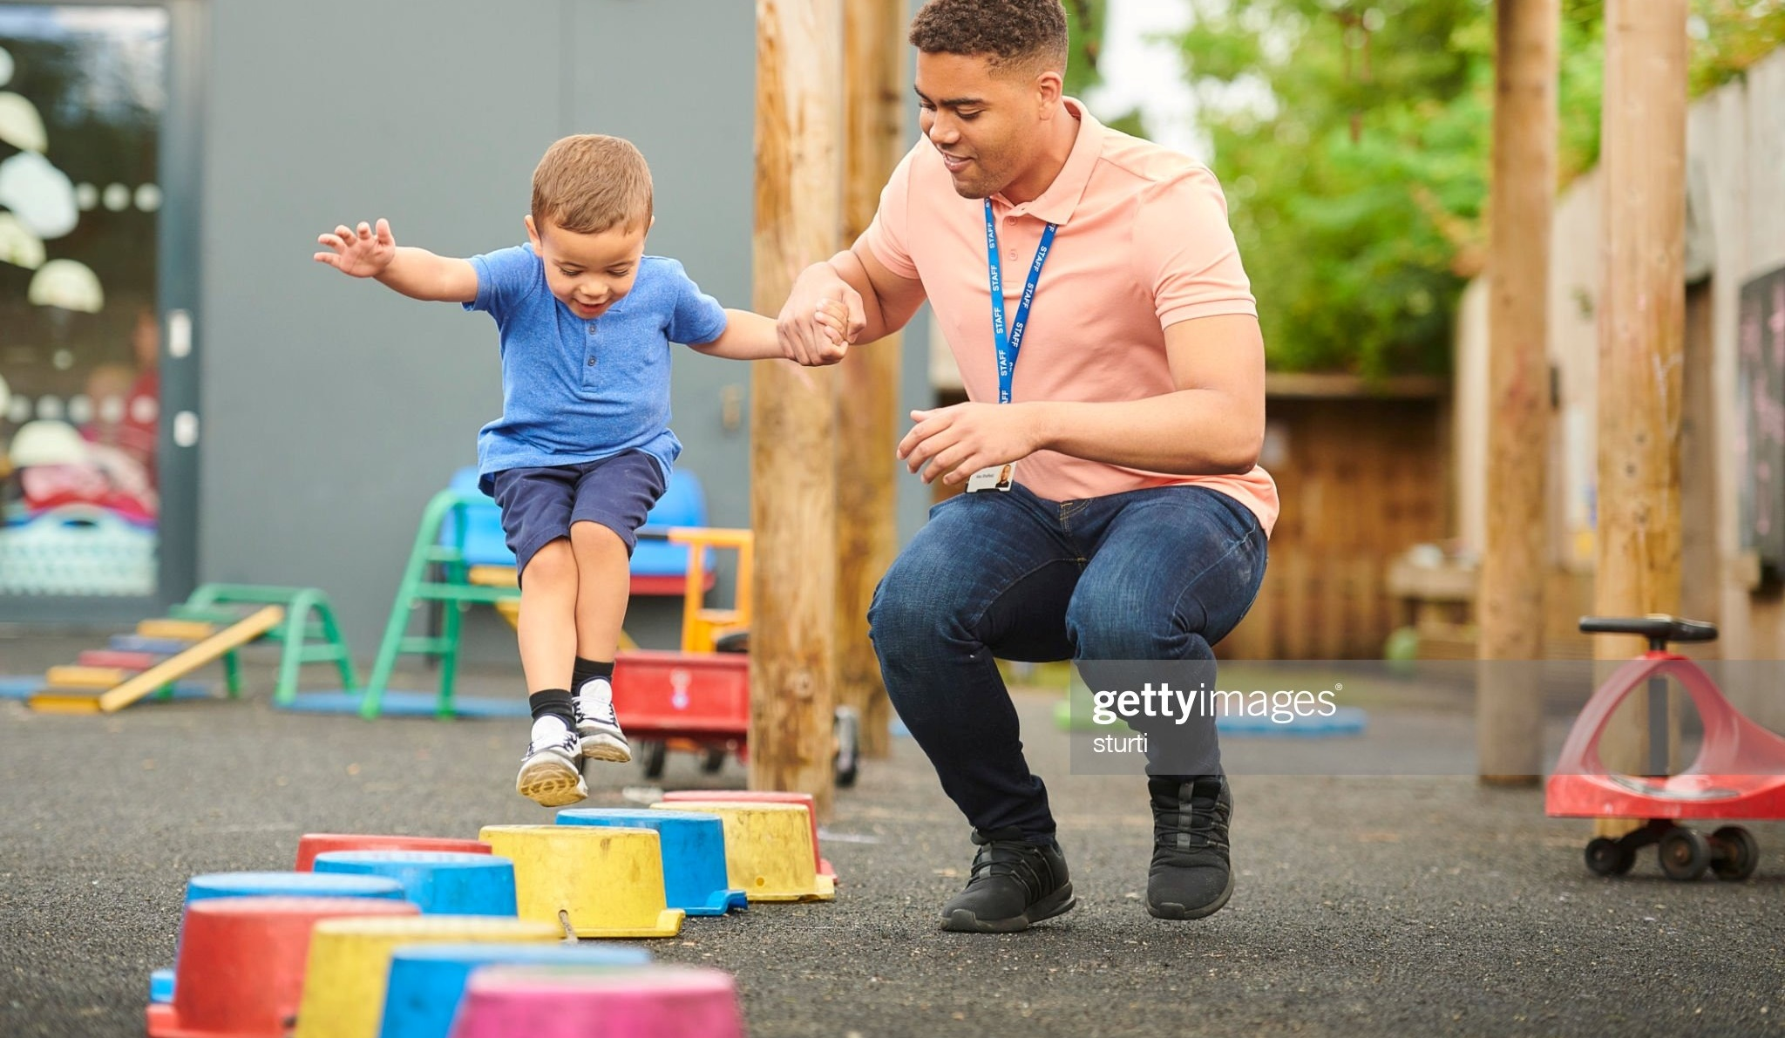
Slower & Shorter Activities
Catching Activities
Kicking Activities
Balance Challenges
Yoga
Wheeled Vehicles
Notes:
Suggested Speaker Notes:
As we discussed, adapting routines is a key strategy to reduce the risk of heat for young children. One way to do so is to plan for both slower and shorter activities when outside. Consider activities that are in the category of “light physical activity” rather than “moderate to vigorous.”
Practicing gross motor skills like catching or kicking is a great way to encourage activity while promoting fundamental movement skills.
Trainer Notes: Ask participants what are some of their favorite catching or kicking activities? Consider sharing the tip from Dr. Diane Craft of putting punch balloons in panty hoses, tying them to a clothesline and having children practice kicking or striking. This activity allows for children to practice the skills of kicking or striking without having to run and get the ball, keeping exertion low.
Balance challenges or yoga are other examples of slow and short activities. For balance activities you could use chalk to designate pathways for children to move along.
The use of wheeled vehicles like tricycles or balance bikes can support children in practicing balance and coordination, without as much physical exertion.
Moving outdoor physical activities into shaded areas can also be a strategy for reducing the impact of heat.
Many of these activities include staff as active participants in play. Remember, young children are more engaged when adults join them in physical activities, whether that is doing the activity with them, or showing enthusiasm and encouragement.
Discussion Prompt: what are your favorite activities to play on a hot day?
Image Source: Getty Images- struti

Slide 28
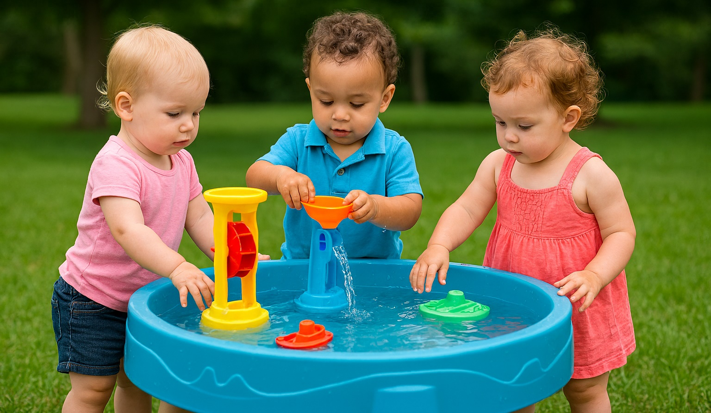
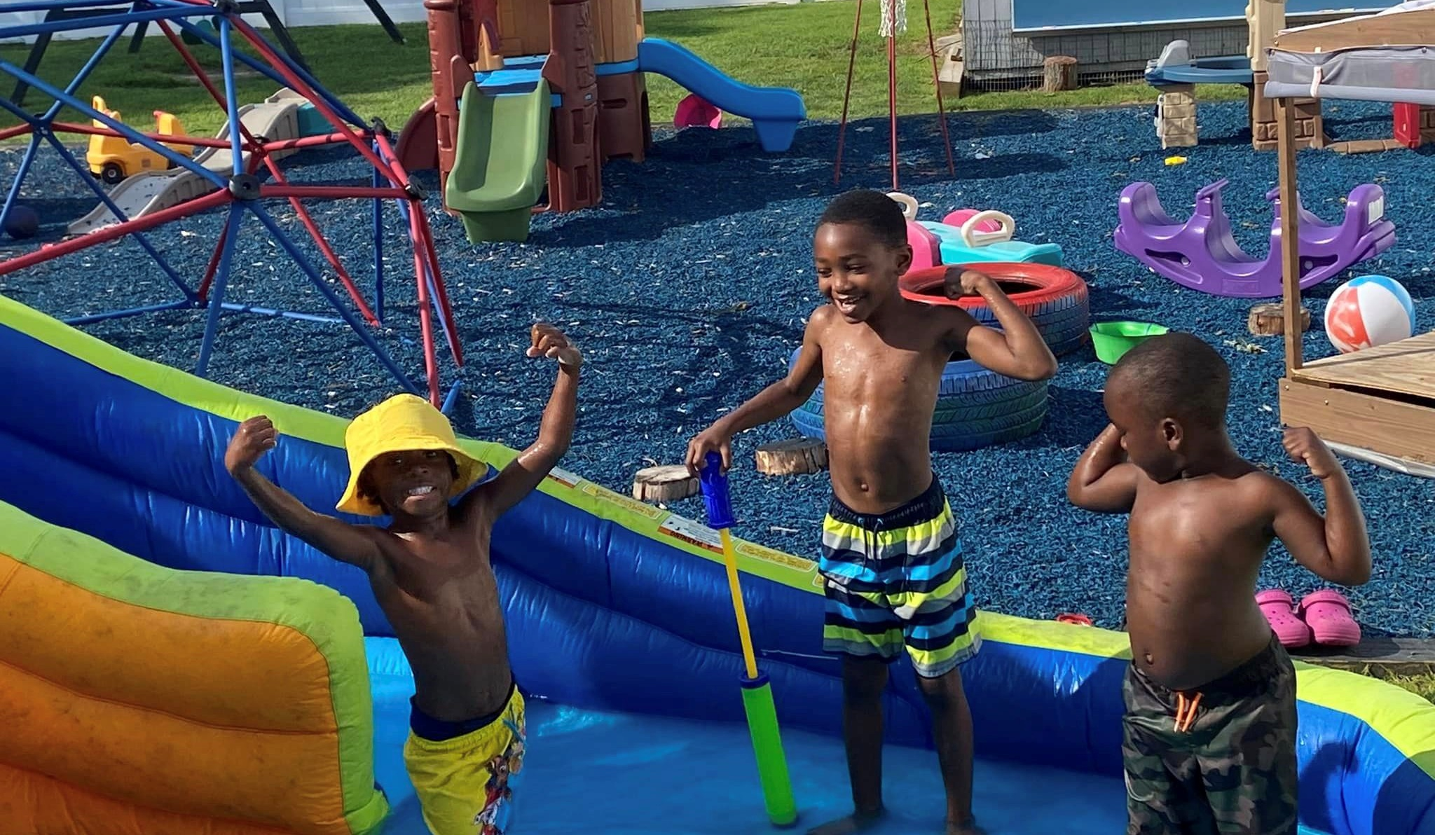
Water Play
Whole body water play
Toy wash, sponge games, ice age bin
Painting with water
Photo Credit: Rhonda’s Little Angels, DE
Notes:
Suggested Speaker Notes:
Another great option for physical activity during hot weather is water play! Engaging in play with water will help children stay cool during the heat. Portable wading pools are not recommended because they are hard to clean and can promote the spread of disease. Sprinklers, hoses, or small, individual water basins are safer than wading pools. Some examples of water play include:
Whole body water play is ideal for keeping cool on hot days, while also encouraging moderate to vigorous physical activity. Examples of whole-body water play include running and moving through sprinklers or squirt toys for older children.
Examples of water play activities that are focused on more fine motor movements and include low-cost equipment are:
Toy wash- think of a car wash, but for toys! A great activity for a water table or a bucket. Small buckets can also be used for water table fun. For toddlers, using cookie sheets as their water table can make it easier for them to access, while also not using as much water.
Sponge games- sponges are a relatively cheap piece of “equipment” that can be used for various games such as sponge tag (tagging others with a wet sponge), sponge pass (passing a wet sponge down the line without dropping it- consider adding in balance poses to make it more difficult), wet sponge hot potato (passing it around a circle while music plays and when the music stops the child with the sponge can squeeze it over their head- you can add large body movements also), or target toss.
Ice age bin- Add small plastic items (dinosaurs, safari animals) to containers (or metal bowls) and then add water. Freeze overnight. Bring the bin/bowl outdoors and you can put it directly on the grass or ground. Add additional water toys like cups and spoons and have children enjoy unearthing treasures from the ice! Consider using child safe food coloring for additional sensory engagement.
Painting with water- with paint brushes of any size is a wonderful way to engage large muscle groups. Children can paint directly on the sidewalk or fence.
Water safety is extremely important. Ensure there is constant adult active supervision. Other things to consider when planning water play include appropriate attire (change of clothes and shoes), towels and scheduling time to change.
Discussion prompt: What other water-based activities do the kids in your program enjoy?
Additional resources:
More information on water play ideas can be found here: https://naturalearning.org/40-water-play
Ideas for building your own water table: https://activeforlife.com/diy-water-table/?utm_source=AfL&utm_medium=bottom+read&utm_campaign=summer+resources+active-ities
Be Active Kids- 50 ways to Cool Off this Summer: www.beactivekids.org/assets/pdf/50_Ways_to_Cool_Off.pdf
Images- Microsoft Co-Pilot, Rhonda’s Little Angels- Delaware
Sources: https://naturalearning.org/40-water-play, https://dpi.wi.gov/sites/default/files/imce/community-nutrition/pdf/grow_healthy_kids_just_add_water_toolkit_.pdf

Slide 29
Objective 4:
Explore how to adjust ECE schedules to keep outdoor play safe in hot weather.
Notes:
Suggested speaker notes: For our final objective today, we are going to explore ways to adjust ECE schedules for safe, outdoor play during hot weather.

Slide 30
Daily Schedule Activity
8:00am - 9:00am | Drop-off + breakfast
9:00am - 9:30am | Independent play/play centers
9:30am - 10:00am | Circle time (morning routine + songs)
10:00am - 10:15am | Morning snack
10:15am - 11:30am | Outside play + physical activity
11:30am - 12:00pm | Lunch
12:00pm - 1:00pm | Sensory or art activity
1:00pm - 1:30pm | Story time (books + songs)
1:30pm - 2:30pm | Nap time
2:30pm - 3:00pm | Afternoon snack
3:00pm - 4:00pm | Group play (puzzles + games + center activities)
4:00pm - 4:30pm | Closing circle
4:30pm - 5:00pm | Choice time/Pick Up
How can this schedule be adjusted for a hot weather day?
Notes:
Lead a large group discussion on how to adjust this schedule for a hot weather day.
Possible responses include:
Including opportunities for physical activity during arrival and/or pick-up.
Hold circle time outdoors in a shady area.
Move Outdoor Play before Morning snack, so you can get outdoors before 10 AM (beginning of peak UV hours).
Group play in the afternoon can be outdoor play.
Shorten and break up outdoor play- instead of longer sessions outdoors (45 mins), break outdoor time into shorter periods (~15-20 mins), multiple times per day.
What are other adjustments you would have to make?
Water availability - especially during arrival and/or pick-up.
Communicating with families – about appropriate attire, expectations for physical activity during arrival and/or pickup
Shade- temporary pop ups to support outdoor play in shade.
Trainer Note: If you work with programs that cannot change their schedule, consider adjusting the content of this section. Consider an activity where participants have time to reflect on what to do if schedules can't be changed or consider how to integrate one of the other key strategies into their program: extra sun protection, water, or policies and family engagement.

Slide 31
Summary Activity: Lightning Round
One action step my program can take to prepare for safe, outdoor play during hot weather is…
Notes:
This summary activity is meant to be an energizing way to close out the training, have participants reflect on what they learned and identify one step they can do in their program to support active play in hot weather. Depending on the size of the group, you can pair providers or put providers in small groups to identify one action step together and then do the lightning round.
Go around quickly and have each participant complete the sentence “One action step my program can take to prepare for safe, outdoor play during hot weather is…”
Examples include:
Review our policies to ensure it includes specific information about hot weather play.
Develop a newsletter template to share information about hot weather play with families.
Develop a modified schedule to prepare for hot weather days.
Write down a list of activities you can do outdoors next time there is hot weather.
Prepare a “hot weather kit” including equipment and game ideas for the next hot day.
Install or identify shaded play areas.

Slide 32

Key Takeaways
All children should experience outdoor play 2-3 times daily when weather conditions are safe.​
Heat impacts young children differently, so safe, outdoor play during heat requires planning ahead.
Keeping outdoor play safe in hot weather involves understanding environmental factors, adapting schedules and activities, and engaging with families.
Notes:
Trainer Notes: Share key takeaways with your participants.
Photo by Beard Kid: https://www.pexels.com/photo/happy-smiling-girl-16057247/

Slide 33
Question and Comments
Notes:
Trainer Notes:
Invite your participants to raise any remaining questions or share other comments on hot weather play.

Slide 34


Thank you for joining today’s training!
Insert Trainer Contact information
Notes:
Image source: Pexels Photo by Bruno Scramgnon: https://www.pexels.com/photo/silhouette-photo-of-a-mountain-585759/

Slide 35
References & Resources
https://www.healthychildren.org/English/safety-prevention/at-home/Pages/Protecting-Children-from-Extreme-Heat-Information-for-Parents.aspx
https://www.healthychildren.org/English/healthy-living/nutrition/Pages/Choose-Water-for-Healthy-Hydration.aspx
https://naturalearning.org/wp-content/uploads/2017/04/Summer-play-beat-the-heat2.pdf
https://naturalearning.org/40-water-play
https://www.bccancer.bc.ca/prevention/Documents/ShadeLookbook_May2024.pdf
https://www.cacfp.org/assets/pdf/August-2025-Mealtime-Memo-Staying-Hydrated-In-The-Summer/
https://www.cdc.gov/early-care/communication-resources/outdoor-play-and-safety-for-children-in-ece.html
https://extension.psu.edu/programs/betterkidcare/news/keeping-your-cool-heat-awareness-and-solutions
https://innovation.luskin.ucla.edu/publication/the-problem-with-hot-schools/
https://www.c-uphd.org/documents/wellness/weatherwatch.pdf
https://www.npr.org/2023/07/28/1190557974/kids-extreme-heat-outdoors-safety-water
https://headstart.gov/publication/summer-safety-tips
https://www.healthychildren.org/English/safety-prevention/all-around/Pages/how-climate-change-heat-and-air-pollution-affect-kids-health.aspx
https://www.airnow.gov/aqi/aqi-basics/

