Slide 1

Add your agency logo here
Active Play in Cold Weather:
Supporting Outdoor Play in ECE Settings
Add Trainer information here
Notes:
Trainer notes:
Welcome your participants to the session, introduce yourself and share housekeeping information such as restroom locations and requesting cell phones to be silenced. Trainers are welcome to add a slide with group norms as desired. Sample group norms you might include:
Be considerate of differing opinions
Speak respectfully to each other
Share your knowledge and experience
Minimize side conversations
Take care of your needs
Celebrate accomplishments

Slide 2
Disclaimer
Notes:
Suggested Speaker Notes:
Development of the Physical Activity Learning Session (PALS) materials including today’s session was funded by the Centers for Disease Control and Prevention (CDC). The views express in this session do not necessarily reflect the official policies of the Department of Health and Human Services.

Slide 3
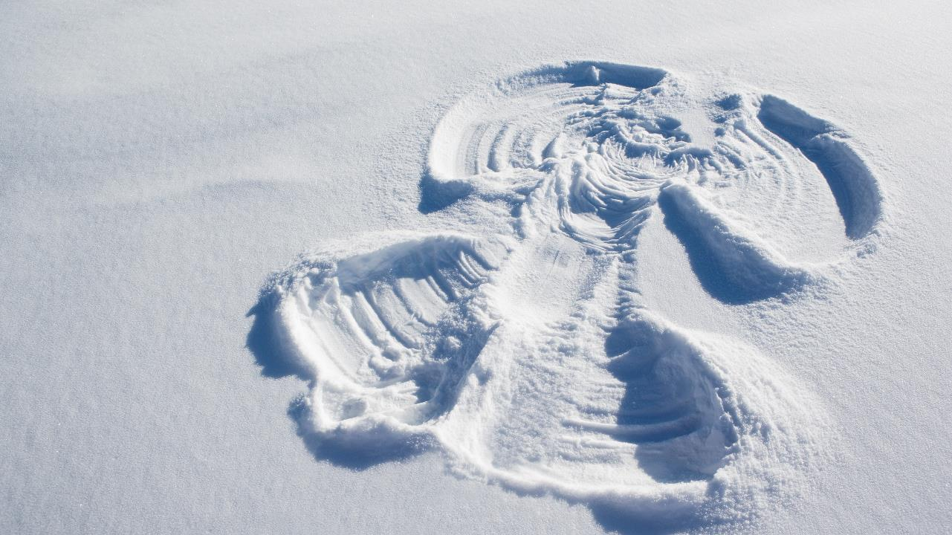
Session Objectives
Explain common misunderstandings
Recognize challenges and solutions to cold weather play
Understand National Recommendations, State Standards, and Program Policies on cold weather outdoor play
Identify two strategies that support ECE providers and children in enjoying outdoor play in cold weather
Notes:
Suggested Speaker Notes:
While some ECE provider and children enjoy being outdoors in the cold weather, others may need a shift in mindset to learn to enjoy the experience. Our objectives today will explore strategies that support children and ECE providers in safely enjoying active play in cold weather.
Image source: PowerPoint Stock Photo

Slide 4

Goal
More children experience outdoor play best practices daily
Notes:
Suggested Speaker Notes;
The goal or outcome of our session is that more children experience outdoor play best practice daily, year-round, in early care and education settings.
Image source: Microsoft Stock Photo

Slide 5

What positive things do you notice after being outdoors?
Notes:
Trainer note:
Share something positive you experience after being outdoors then ask participants to introduce themselves and share a benefit or positive things they notice after being outdoors. This might be a personal benefit or something they notice in the children they care for.
Image source: Microsoft Stock Photo

Slide 6
PALS recap – Outdoor play best practices
Infants
How many times each day do children go outside at your program?
Outdoor play 2-3 times daily
Toddlers & Preschoolers
Outdoor play 2-3 times daily
60-90 minutes of outdoor play daily
2 or more structured (adult-led) activities
Notes:
Suggested speaker notes:
The recommended practices come from Caring for Our Children: National Health and Safety Measures for Young Children in Out of Home Settings include 2-3 periods of outdoor play daily, weather permitting, for all children. There is not an established time recommendation for infants to be outdoors. Time outdoors may be shortened due to cold conditions, but children should still go outside 2-3 times each day except in conditions of extreme or dangerous weather.
Recommended practices also include that children experience a minimum of 2 adult led activities outdoors daily. Children may be more active in structured activities and movement is important for children (and ECE provider) staying warm when it is cold outside.
Trainer Note:
After discussing the best practices advance slide to trigger animation. Ask participant how many time each day to the children typically go outside? Does outdoor time happen on cold weather days? What happens during outdoor play time? Are ECE provider leading activities, engaging with children and modeling enjoyment of outdoor play?

Slide 7
Benefits of outdoor play and outdoor time
Caregivers & Children
Children
Boosts immunity
Exposure to fresh air
Vitamin D
Strengthens mental wellbeing
Improves vision
Lowers stress
Improves sleep
Increases amounts of
active play
creative play
problem-solving play
  cooperative play
Increases awareness and appreciation of the environment
Notes:
Adults and Children
The benefits of time spent outdoors continue to be understood. Research reveals many health benefits to outdoor time including strengthening the immune system. Short periods of exposure to sunlight allow promotes the production of Vitamin D in the body. Vitamin D helps regulate the amount of calcium and phosphate in the body which are essential for bone, teeth, and muscle development.
Mental Health-fights depression and anxiety.
Time spent outdoors decreases the risk of Myopia (also called short-sightedness or near-sightedness) in children and ECE provider. Outdoor time allows us to focus on distant objects like trees or play equipment such as a ball flying through the air— anything that’s more than an arm’s length away. This use of long-distance vision uses different parts of the eye muscles. Think about how much time children and adults spend on devices that limit the use of peripheral and distance vision.
Children
The time spent outdoors is a strongly linked with children’s physical activity levels. Outdoor open spaces allow children greater opportunities to practice and develop gross motor skills.
Studies have shown that children who spend time outdoors as young children grow up to be more engaged in their surroundings and conservation.
Next we will consider national guidance on outdoor play in cold weather.

Slide 8
Common challenges to cold weather play
Misunderstandings or myths about cold weather play can lead to family and ECE provider resistance
Additional clothing requirements for providers and children
Additional time required for children to dress for outdoor play
Family resistance to cold weather play
ECE provider resistance to being outdoors in cold weather
Notes:
Suggested Speaker Notes:
Days with perfect weather conditions are rare. As adults we need to adapt to less than perfect weather and help children learn to enjoy being outdoors in those conditions.
The slide captures some of the common challenges regarding outdoor play in cold weather.
What other challenges do you face in this situation?
During our time together today, we will discuss the challenges and strategies to address these challenges
Let’s start with misunderstanding of myths about cold weather play.

Slide 9
Objective 1:
Explain common misunderstandings about cold weather play
Notes:
Trainer Notes:
The next 4 sides address common myths or misunderstandings about cold weather. Trainers can read the slide content and lead a brief discussion on each misunderstanding. A second method for facilitating these slides would be to print them (see the facilitator guidance document for printing) and do a table activity to share this content. Divide your participants into four or more groups giving each group one slide. Give them 5 minutes to discuss the slide. Instruct groups to be prepared to share their discussion highlights with the full group.
If you have a large participant group, print 2 or more copies of the slides as you may want to have 2 groups discussing the same slide.
Suggested Speaking Notes:
Let's address some common misunderstanding about cold weather play. Talking about misunderstandings or myths about the weather can increase awareness and encourage a healthy attitude about being outdoors in the cold weather.

Slide 10
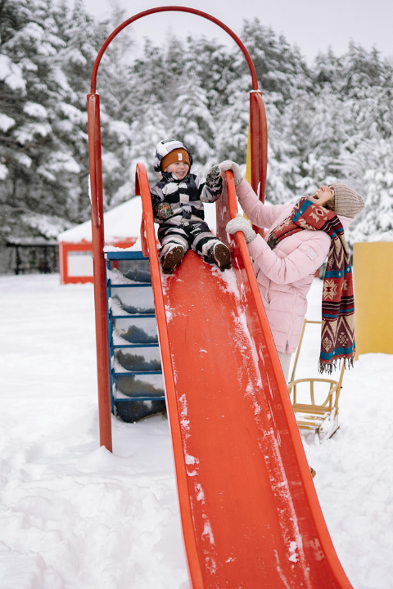
Fact or Fiction
Cold weather or being cold causes the common cold
Fact
Colds are caused by viruses, not from cold temperatures
Viruses are more common in winter months as we spend more time indoors where viruses spread easily through the air
Notes:
Trainer notes:
Depending on your facilitation method, read the slide or ask group(s) to share on their discussion.
Image Source: Yan Krukau: https://www.pexels.com/photo/a-smiling-child-in-snow-suit-sitting-on-a-red-slide-beside-a-laughing-woman-6615678/

Slide 11

Fact or Fiction
We lose most of our body heat through our head
Fact
Adults lose 10% of body heat through their head
Children lose a bit more than 10% as their head is a larger proportion of their total surface area
10% is a significant amount a of heat loss and wearing a hat is important for both adults and children in cold weather
Notes:
Trainer notes:
Depending on your facilitation method, read the slide or ask group(s) to share on their discussion.
While a loss of 10% of body may not seem like a lot, it is in fact a significant amount. Always wear a winter hat in cold weather to reduce heat from radiating off the body.
Image source: Microsoft Stock Photo

Slide 12

Fact or Fiction
We do not need to drink as much water in the winter months
Fact
Cold dry air and heated rooms make hydration just as important in the winter as the summer
Children and ECE providers should have access to water on demand year-round
Notes:
Trainer notes:
Depending on your facilitation method, read the slide or ask group(s) to share on their discussion.
Very young children cannot ask for water, so it is important for providers to offer water regularly to children over 6 months of age.
Image source: Microsoft Stock Photo

Slide 13
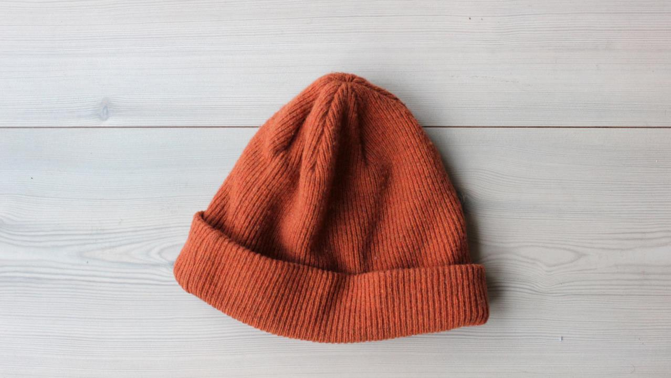
Fact or Fiction
Windy weather causes ear infections
Fact
Ear infections are usually caused by bacteria from the throat that travel up the eustachian tube
Ear infections are very painful for young children
Keep ears warm and out of the wind with hats
Notes:
Trainer notes:
Depending on your facilitation method, read the slide or ask group(s) to share on their discussion.
Image source: Microsoft Stock Photo

Slide 14
Objective 2: Recognize challenges and solutions to cold weather play
Notes:
Suggested Speaker Notes:
Being aware of challenges can help us plan solutions. As we go through each challenge, we will present some solutions, but I encourage you to share strategies you incorporate and your ideas to overcome the challenges.
Our first challenge is on cold weather clothing.

Slide 15
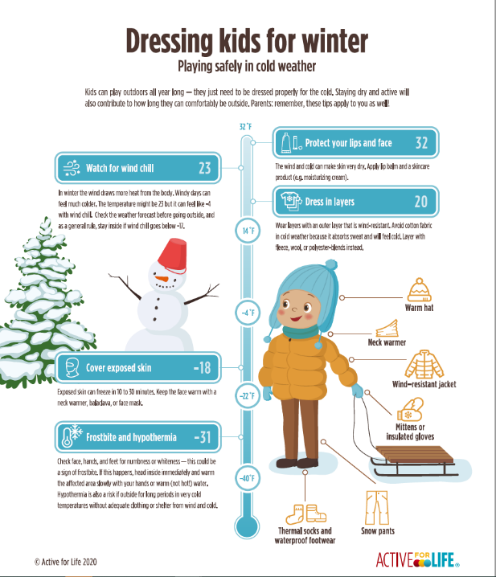
Dressing for cold weather
Notes:
Trainer Notes: Ask participants to refer to the handout shown on the slide, Dressing kids for winter: Playing safely in cold weather. This resource was developed by Active for Life® and is used with permission. Active for Life® adjusted the document from Celsius to Fahrenheit and this version is not available on their website.
Suggested Speaker Notes:
You may have heard the saying, “there is not bad weather, only poor clothing choices.” Having the right clothing and gear can make the difference between unpleasant and wonderful outdoor experiences for both ECE provider and children. Let's consider what dressing for cold weather looks like in practice.
The first lesson for dressing for cold weather is layering. Light layers provide insulation and are more effective at keeping us warm than one thick layer. The first layer or base layer is long underwear or long johns. The middle layer provides warmth. This might be a sweater, sweatshirt, or fleece. The outer layer also adds warmth but also protects from elements including water and wind.
Try to keep most of your skin covered.
Think function over fashion. For example, a hat is much more effective in retaining body heat than earmuffs.
Notice the jacket is all the way zipped, the wrist is covered by the jacket. Children may outgrow a winter coat before winter is over. If the coat sleeves leave the wrist exposed, cut tube socks make effective inexpensive wrist warmers.
Ideally outer layers are water and wind resistant to allow children to play in snow. Bib snow pants or 1 one-piece suits are ideal for snow play.
We will discuss two challenges related to cold weather clothing. First, we will discuss access and availability of clothing, then we will address the additional time required for young children to dress and undress.

Slide 16
Challenge – Lack of Cold Weather Clothing
Children arrive at our program not wearing winter coats, boots, gloves, or hats
What can we do?
Host a coat and boot drive
Shop a resale shops for gently used clothing
Look for local agency grants
Ask for donations
Notes:
Suggested Speaker Notes:
There are several reasons that children may arrive at a program without adequate cold weather clothing.
One consideration is that some families may bring their child into a program quickly from a warm car without cold weather clothing. Keep in mind that it is not safe for children to wear bulky winter coats in a car seat. In a crash, bulky materials compress leaving space under the straps for a child to be ejected from the seat. Children can quickly get overheated in a warm car if they are wearing coats, hats and mittens.
Another challenge is the expense of clothing. Coats and cold weather gear can be costly posing a challenge for many families and rapidly growing children can go through multiple coats or boots over a winter season.
What solutions do you see to this challenge?
Trainer Note:
Facilitate a brainstorming of solutions to the questions and then advance the slide for the animation to reveal sample solutions.
Suggested Speaker Notes continued:
These are some ideas to gather cold weather gear to keep at your program. Having spare cold weather gear available allows all children to experience outdoor play. Gear can be stored in each child’s cubby or storage space.
For cold weather clothing drive ask that families to send in outgrown coats, snow boots, hats, and gloves.
Success story:
A family reached out to a child care program in Louisville, Kentucky to ask how they could support the program and honor their child who had attended the program. The director and family worked together on ideas. The family purchased 100 sets of child sized rainboots and 15 pairs of adult sized rainboots for staff as well as a storage rack for the program to hold boots. This purchase allows children to play outside on cold, rainy days and when the playground is muddy.
Transition statement: Cold weather clothing is one challenge we may encounter with families. Let’s consider a few strategies we can apply to encourage families understand our programs outdoor play practices.

Slide 17
Challenge – Time needed to gear up
Young children are developing self-care skills- this means dressing for cold weather play can be time consuming
What can we do?
Build time in the schedule for getting dressed
Post visual cues with the order of dressing
Pair up older children with a younger child
Save some layers for outside
Stagger departure as staffing allows
Notes:
Trainer Notes:
As on the previous challenge slide, present the challenge to participants and allow a few minutes for brainstorming solutions. Then advance the slide and discuss the solutions presented.
Suggested Speaker Notes:
Discuss the order of putting things on. Post pictures with the order for dressing as a visual cue. Help children learn to follow along with the order.
Pair older children with a younger child to assist in putting on gear. Pair up similar aged children to help each other. Sometimes it is easier to zip a friend's coat than your own.
Save the final layer, hats, for putting on outside. Children can get overheated in the process of dressing and waiting for everyone. Teach them to put the last layer on as they walk out the door.
If staffing allows stagger classroom departure with children who are dressed first going outside with one provider, so they don’t get overheated.
Additional Resources on visual cues in ECE settings:
https://afirm.fpg.unc.edu/sites/afirm.fpg.unc.edu/files/imce/resources/Home%20Companion%20Guide%20for%20Visual%20Cues.pdf

Slide 18
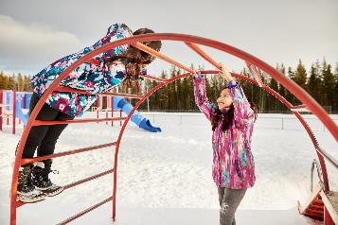
Challenge- Family Resistance
Present outdoor play as a year-round activity
  Include outdoor spaces on all tours and enrollment visits
  Discuss the daily schedule and outdoor time periods
  Provide information on the seasonal clothing family's supply
  Share information on safety measures
Arrange spaces and provide activities for families to engage in outdoor play with their child
Provide opportunities for families to observe children enjoying outdoor spaces and activities
Proactively communicate clothing needs before the seasons change
Notes:
Suggested Speaker Notes:
It is not uncommon for families to be resistant to their young children going outside in cold weather. While some reluctance may stem from the misunderstandings or myths about cold weather play, we discussed earlier, families may have concerns about their children getting wet, clothing getting dirty, safety, or other considerations. Take the time to connect with families to understand where their reluctance is coming from so you can assist. Communicating with the appreciation that each of you is thinking of the needs of their individual child and how you can support that child’s growth creates a space of shared respect and allows for an open dialogue.
Families of children with asthma may be especially concerned about their child playing outside. Weather changes and cold, dry air are common triggers for asthma symptoms. Talk with families about their child’s known triggers. Some children with asthma have success covering their mouth and nose with a loose scarf or face mask in very cold weather.
There are strategies that programs or child care homes can put in place to support families from the start and reduce resistance.
Present year-round outdoor play as the standard at your program. When prospective families visit your site, share the outdoor spaces and equipment, and discuss how outdoor play is on the schedule daily.
Talk about seasonal clothing that families are expected to supply. If your program has coats and gear for children to use, discuss how this happens at your site.
Share information on safety procedures. Talk with families about what weather and temperatures are the limits for outdoor play at your program. Share information on you programs outdoor play policy including who makes decisions on when outdoor play is cancelled due to weather.
2. Encourage families to spend time at pick up or drop off playing outdoors. Set up an obstacle course or nature walk around the playground perimeter as a short activity they can share with their child.
3. Share pictures and stories of outdoor play experiences on closed SM groups, newsletters, or parent information boards. A picture is worth a thousand words!
4. Help families be prepared for the season changes. Several weeks ahead start sending and posting reminders about gear needed. This is important year-round not just in the winter. Remind families to label items to reduce loss.
Image source: Microsoft Stock Photo
Additional Resources on asthma and cold weather:
https://kidshealth.org/en/parents/weather-asthma.htm
https://allergyasthmanetwork.org/news/cold-air-asthma-in-winter/

Slide 19
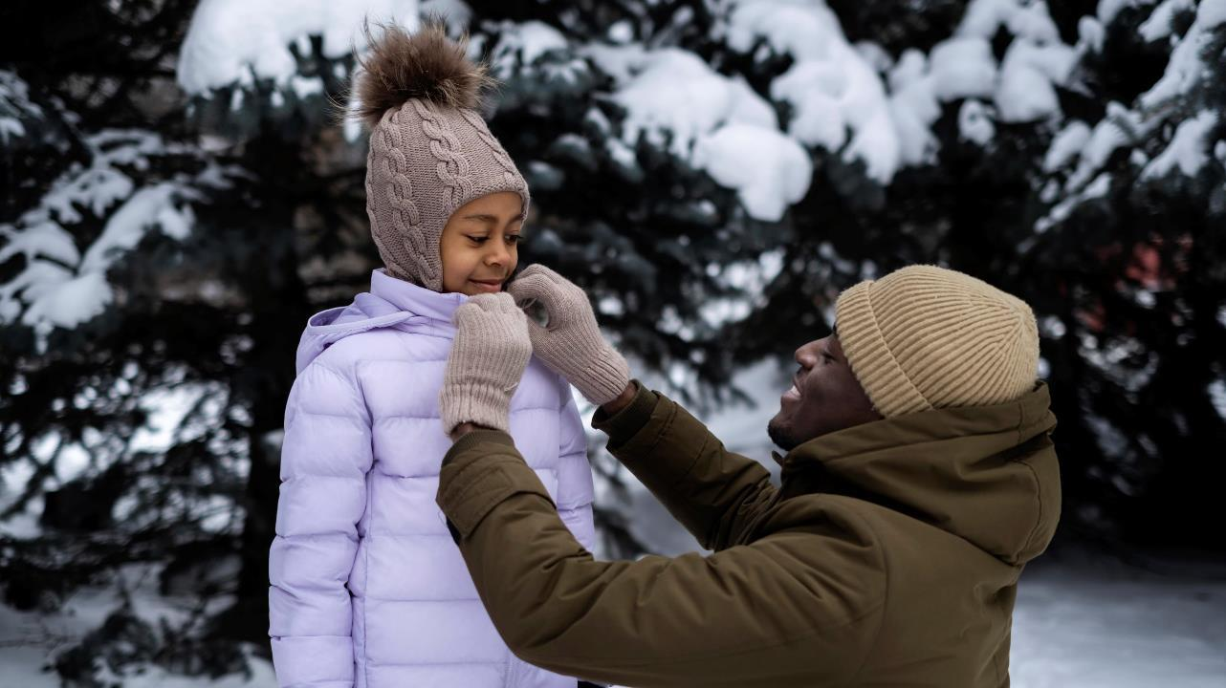
What additional strategies does your program use to support families?
Notes:
Trainer notes:
Facilitate a large group discussion how participants communicate with families to support seasonal transitions and concerns over cold weather play currently and how they might enhance their practices to better support families.
Image source: href="https://www.freepik.com/free-photo/young-father-tying-his-daughter-s-jacked-snowy-winter-day_24238504.htm#&position=48&from_view=collections&uuid=1f22d680-a8ed-433e-804d-79036510aed9">Freepik</a>

Slide 20
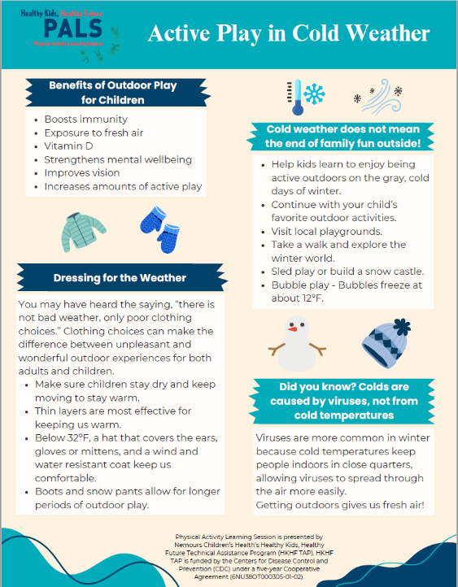
Family material-
Active Play in Cold Weather
Notes:
Trainer Notes:
Ask participants to refer to the handout shown on the slide, Cold Weather Play for Young Children.
Walk through the handout reviewing the concepts discussed in the session. Facilitate a group discussion on how they might use this handout with families.
This is the suggested end point for session 1 if the content is being delivered over two-30-minute sessions.

Slide 21
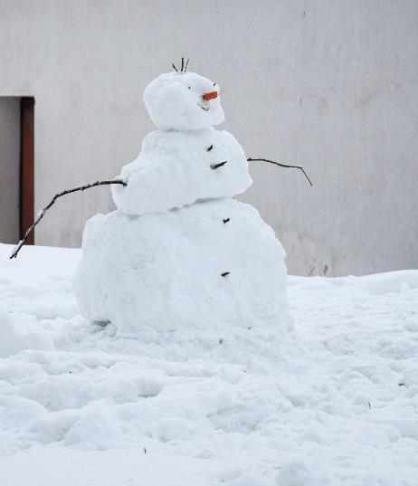
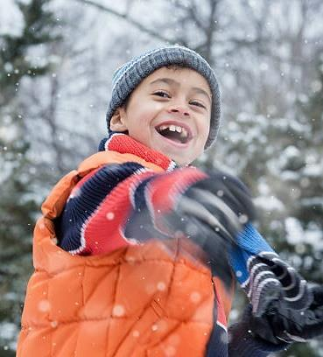
Do You Want to Build a Snowman?
Notes:
Trainer Notes:
This is a brain break stretching activity. As you read the script, pause to allow time for participants to stretch in the positions for approximately 10-20 seconds.
Suggested Speaker Notes:
I invite you to join me in a brain break activity where we move our bodies. You can stand with me or remain seated, moving as you are comfortable.
We will move our bodies in some of the ways children and ECE providers might move during an outdoor activity.
Let's start with gazing at the snow around us. Relax your shoulders and turn you head gently to the right as far you can. Hold there as you look out at the snow and feel the stretch in your neck. Now let's look at the snow behind us over our left shoulder. Bring your head back to the center and look straight up to see the snow swirling down.
Next let's loosen our shoulder by reaching up to catch falling snowflakes. Reach up high and gently lean to the right and left stretching out our side bodies.
Let’s go to the trees to find arms for our snowperson. Walk across the snow and imagine it crunching under your feet. Can you walk with your toes in? Try walking with your toes out. Lift your knees and march in the snow. We’ve made it to the tree line, let’s look for small branches or twigs we can use for arms. Oh look, a perfect one is on the ground can you bend to reach it? While you are reaching down, notice the stretch in your lower back. There are few acorn caps we can make a face from. Pick up some! Do you have everything you need to trim your snowperson?
Let's pretend to skate back to our building spot. Push out with each leg and notice the stretch in your glutes and quads.
It’s time to build! Let’s squat down and pack snow into a large ball for the snowpersons base. Nice job! Next let’s turn to the left for fresh snow and repeat the squat. Gather up snow to pack it into a smaller ball for the middle section. Hold it in your arms as you carefully stand. Feel your quads working to stand! Place the second ball on the first and pack it in. One more squat to make our snowman’s head! Once you have the perfect head, carefully stand and reach up to put it on top. Steady!
Take a few moments to add the branch arms and acorn cap face. Personalize your snowperson with final touches!
Take a giant step backwards and admire your work. Nice job!
To wrap up our activity, bend down one last time and pick up enough snow for the perfect snowball. Stand and pack your ball. When it is ready toss it at the screen!
Great job stretching!
Image source source snowman: Jana: https://www.pexels.com/photo/a-snowman-is-standing-in-front-of-a-house-15393693
Image source source child: /Image source Ariel Skelley #514410343 Collection: DigitalVision

Slide 22
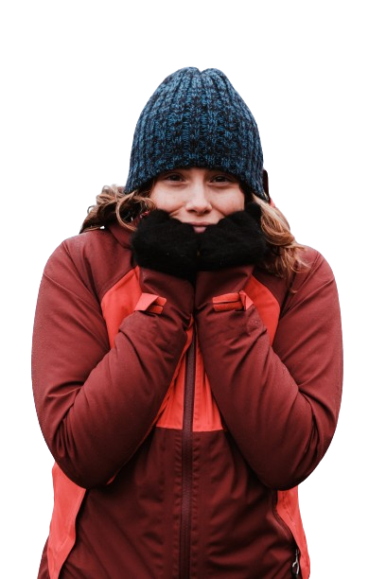
Challenge- Provider Resistance
Managing personal preferences about being outdoors in cold weather
Notes:
Suggested Speaker Notes:
The final challenge we will address today is overcoming personal resistance to being outdoors in cold weather. While you may not have this resistance, you may work with peers or administrators who don’t enjoy going outside in the cold or in any weather. Maybe understanding the benefits of outdoor play, learning from the fact or fiction discussion or other content has influenced your thoughts. Perhaps you realized in our cold weather clothing discussion the impact of a warm coat and winter boots to better tolerate your work time outdoors. Let’s discuss the provider role in cold weather play and consider how we can shift our mindset or that of co-workers.
Image source source: Microsoft Stock Photo

Slide 23
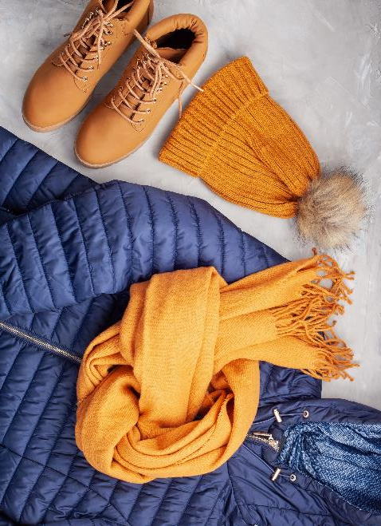
Provider role
Role model
    Clothing choices that support outdoor play
    Enjoyment of outdoor time
    Move with the children
    Demonstrate interest in nature and changes in the winter environment
Plan activities that encourage children to move
Communicate with families the benefits of outdoor play
Support children in self-care activities
Monitor and supervise all children
Check clothing and skin for wetness
Monitor children with asthma
Notes:
Suggested Speaker Notes:
Role Model
Children watch ECE providers nonstop and learn how and what to do as they observe. Role modeling for outdoor play includes your clothing choices, how much fun you are having (or pretending to have), and how you move and engage with nature.
Plan While cold weather gear is essential, children and ECE provider must be moving to stay comfortable outdoors. Active play gets our hearts pumping blood and help the body stay warm. Have several structured (adult-led) activities available. We will talk more about specific activities in a few minutes. Providers should also plan the length of time children will be outside. The length of time can vary based on the temperature, conditions, and precipitation.
Communicate Talk with families about benefits of play. Share stories of what children did during outdoor play and what they enjoyed.
Support: Practice patience as children are learning the important self-care and independence skills of dressing for cold weather play. We discussed some classroom strategies for this previously (visual cues, scheduling time, pairing children, staggering exit, hat on outside) but having patience with the process supports children as they are become proficient at these important life skills.
Monitor and supervise
Watch the temperature and wind child. If temperatures are extremely cold-limit time outdoors to 20-30 minutes.
Notice which children are not engaging in active play and may chill sooner.
Monitor gloves and clothing for wetness. Hands will get cold much faster in wet gloves. If possible, have a backup pair.
Cold weather can be a trigger for some children with asthma. Communicate with families to understand their child’s asthma triggers and control measures.
Image source source: Microsoft Stock Photo

Slide 24
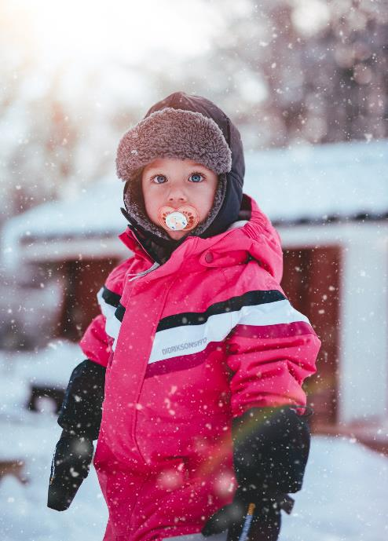
Cold weather safety for Infants & Toddlers
Outer layers should be wind and water resistant
Check each child every 10-15 minutes
  Feel a child’s face and hands
  Monitor for red skin, blue lips and shivering
Monitor for the signs a child is overheating such as a red face or a sweaty neck
Check gloves, mittens and clothing for wetness
Watch for clothing hazards
  Avoid jackets or hats with strings
  Avoid scarfs or tuck in completely
Notes:
Suggested Speaker Notes:
Rather than eliminating outdoor play, schedule shorter periods allowing children to experience the benefits of outdoor play.
Monitor the weather at the time play is scheduled.
Check each child- Monitor children for early signs of frost nip or frost bite. These include red skin, blue lips and shivering. Move children indoors when these signs appear.
Be aware and monitor for the signs of overheating.
Check gloves and clothing- Wet clothing can draw heat away from the body, so it’s important to keep kids and babies dry in any cool temps. Sometimes, children may only need dry gloves. Put an extra pair of gloves or mittens in their pockets if they plan to be outdoors for a while.
Help children learn that when being cold becomes unpleasant, it's time to go inside.
https://kidshealth.org/en/parents/winter-safety.html
Image source: Photo by Janko Ferlic: https://www.pexels.com/photo/toddler-boy-wearing-red-and-black-winter-jacket-and-gray-ushanka-hat-standing-on-snow-covered-field-744790/

Slide 25
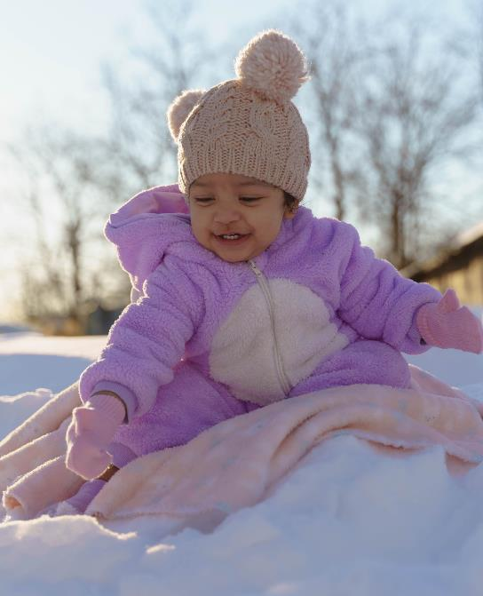
Additional safety considerations for infants
When below 32°F limit outdoor time to 15- 30 minutes
Consider infant carriers that keep baby up against the ECE provider's body
Be flexible with staffing to allow 1 provider to take out 1-2 infants at a time
Cover infants in strollers or sleds with a blanket
Notes:
Trainer Notes:
Read the bullets on the slide.
Image source: Photo by Noé Villalta Photography: https://www.pexels.com/photo/a-young-girl-sitting-on-the-snow-11023373/

Slide 26
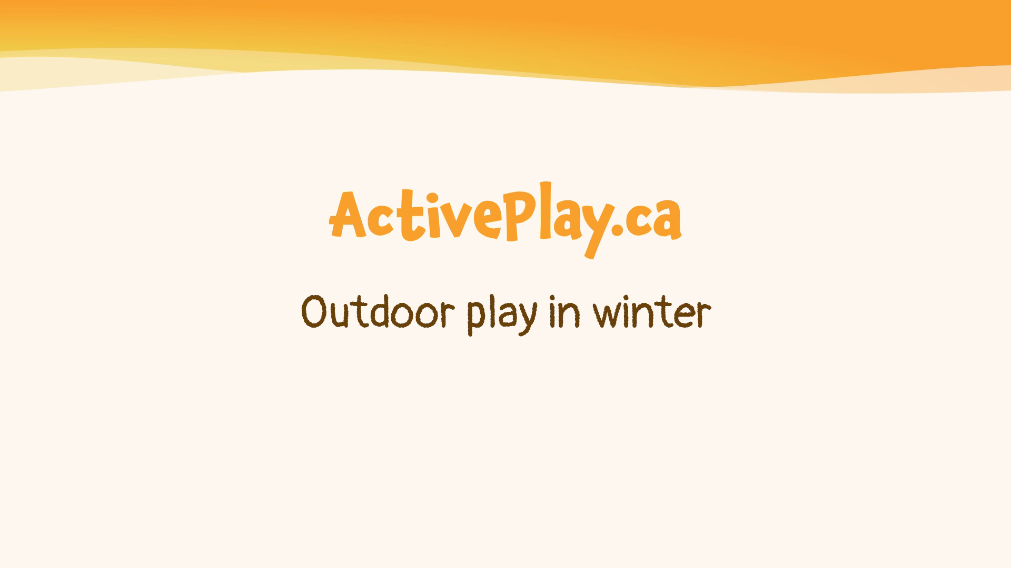
What activities are children engaged in?
Notes:
Trainer Notes:
Share this 2-minute video with your participants. As a prompt before the video ask participants to notice what the ECE provider are role modeling and the activities the children are doing.
Note the video starts 6 seconds after the music and has no captions or voices, only music. The video embedded in the presentation has captions in English.
Captions in additional languages can be accessed at https://activeplay.ca/videos/. Language options include English, Arabic, Farsi, Inuktitut, Ojibwe, Plains Cree, Simplified Chinese, Spanish, Tagalog and Urdu.
Suggested Speaker notes after video:
What did you notice in the video?
On the video clip we saw children engaging in several activities in the snow and cold weather with engaged adults. Next, we will look at some outdoor activities to consider adding to our outdoor routines.
Video synopsis:
The video shows children dressing for play independently and with adult help. Children are shown playing on a snow-covered play outdoor play space, using a playground slide, rolling down a small bank of snow, making snow angels, swinging, playing hopscotch on a grid made with colored water, and playing tug of war.

Slide 27
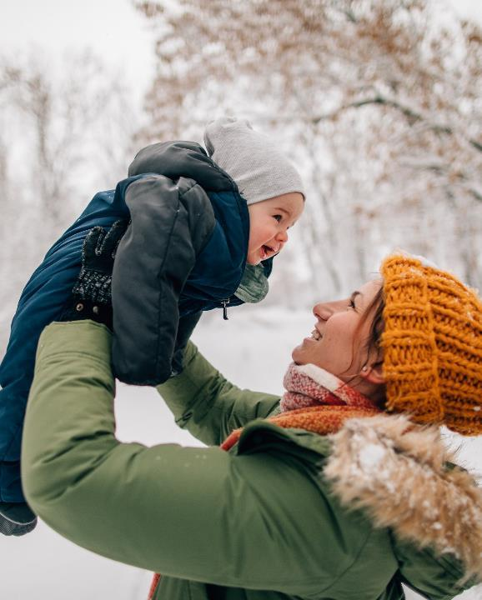
Infant experiences in cold weather
Sled pulls
Stroller walks
Nature walk
Tummy time
  Cover snow with a tarp or play mat
  Place a blanket on top for tummy time
Mobile infants
  Set up space for pulling to stand
  Provide push or pull toys
Notes:
Suggested Speaker Notes:
As with indoor play, infant experiences involve engaged ECE provider. Caregivers that are on the ground during tummy time and engage in play, assist in rolling or holding them in a standing position.
Holding the infant in the lap or carrying the infant helping them learn to enjoy time outdoors.
Caregivers can position equipment to allow infants to pull to stand on play equipment or snowbanks.
What cold weather activities do you do with infants?
Image source: Microsoft Stock Photo

Slide 28
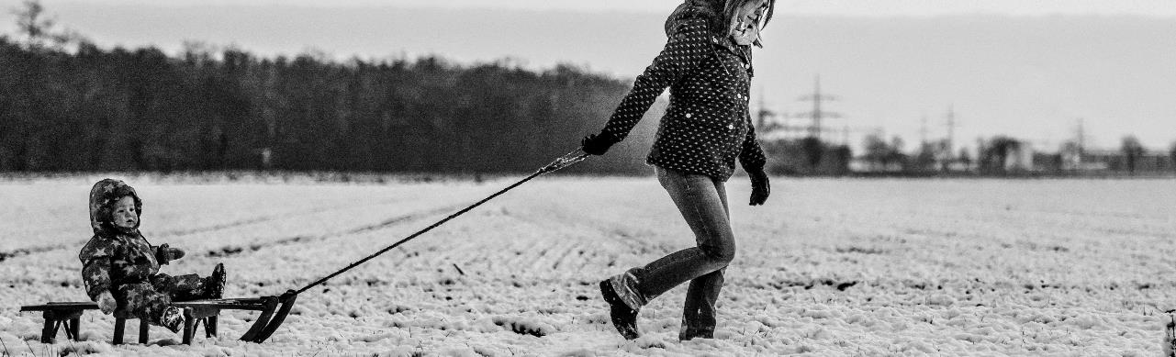
Toddler play in cold weather
Sled play
Snow painting with colored water
Shoveling
Throwing snowballs at targets
Digging for treasures in snow
Snow maze obstacle course
Bubble blowing
Notes:
Suggested Speaker Notes:
Adult led activities games are more likely to keep children moving. Start your time outside with a quick activity to warm kids up.
The slide lists several activities children can do with snow on the ground but there will be cold days without snow. On non snowy days keep toddlers engaged in the usual movement activities you do outdoors. Many of your normal movement activities are possible with snow or with a few modifications.Push pull toys for toddlers are even more challenging in a bit of snow.
Note that frozen bubbles are fun. Several websites have tips to make your own solution that tends to freeze better. See the resource document for websites.
Image source: Photo by Alexander Dummer: https://www.pexels.com/photo/woman-pulling-snow-sled-with-baby-132677/

Slide 29
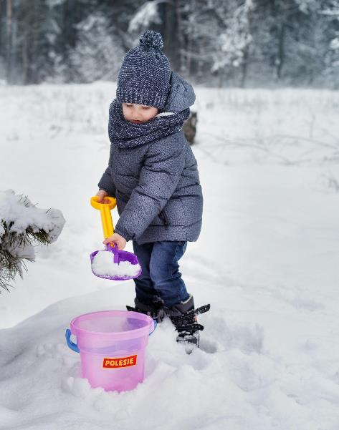
Activities for Preschoolers
Follow the Leader
Obstacle courses
Creative Play- Build animals, forts, snow people
Carry games- move snow between areas
Dance outdoors
Sledding-pushing, pulling
Target practice at hula hoops or buckets
with sock snowballs
Shovel snow
Red Light, Green light
Animal races
Groups walks
Snowflake Tag
Notes:
Suggested speaker notes:
Start outdoor time with a structured activity to help children warm up. Identify 1-2 structured activities to lead during the outdoor period that are designed to keep children’s bodies moving and active. Provide equipment that supports continued movement and play.
The list on the slide has some ideas for snowy weather and cold days without snow. You will notice many games that can be played year-round or with small adaptions for the winter.
Obstacle courses can include hopping over and balancing on snow piles, crawling over snow mounds.
Dance while nature watches! Search children's winter music on your music source. If you have Spotify, Maine WinterKids Playlist is great list.
Optional information
Directions for Snowflake tag
Running is a great way to stay warm when it’s cold outside. Running is a great way to stay warm when it’s cold outside. To play snowflake tag, choose a couple of children to be old man winter, old woman winter, or Jack Frost and 2-3 children to be the “sunshine.” When the children are tagged by Jack Frost, they become snowflakes and must stand frozen with arms and legs extended. If the frozen children are tagged by a sunshine, they melt and return to the game.Source: https://activeforlife.com/outdoor-winter-activities-for-kids-no-snow/
Image source: Photo by Polesie Toys: https://www.pexels.com/photo/a-kid-playing-in-the-snow-6138612/

Slide 30
Objective 3
Understand National Recommendations, State Regulations, and Program Policies on cold weather outdoor play
Notes:
Suggested speaker notes:
While having a health mindset and appropriate clothing supports outdoor play, we should also understand how regulations and policies support or challenge outdoor play practices.

Slide 31
National Guidance on Cold Weather Play
Weather that poses a significant health risk includes wind chill factor below -15°F (-26°C) and heat index at or above 90°F (32°C)*
Wind chill is what the air temperature feel like to the skin
Wind chill reflects the combination of the air temperature and the wind
*Caring for Our Children: National Health and Safety Performance Standards Guidelines for Early Care and Education Programs, 4th edition
Notes:
Suggested Speaker Notes
Caring for our Children, the national guidelines for children in out of home care states that children should play outdoor when conditions do not pose significant health and safety concerns. During our session today we discussed with proper clothing, planning and supervision, how outdoor play can be safely enjoyed in most weather conditions. You will notice that the slide states that wind chill below -15 degrees Fahrenheit poses a health risk meaning children outdoor play should not occur.
Some states set standards in licensure as well that we will discuss next.
Consider that the understanding of what is extreme weather varies regionally. While a provider in Maine, Minnesota or New York State might consider an overcast 20 degrees Fahrenheit a great day for outdoor play, a provider in Georgia may find this too cold for the children in care.
Temperature and wind-chill should be checked at the time of scheduled play as they change over the day. This information can be found on many weather apps or from the National Weather Service
https://www.weather.gov/unr/hourly_wx_forecast
Wind chill Source: https://www.weather.gov/ama/WindChill
Wind Chill is a term used to describe what the air temperature feels like to the skin due to the combination of cold temperatures and winds blowing on exposed skin. The colder the air temperature and the higher the wind speeds the colder it will feel on your skin if you're outside. So even if it remains the same temperature, but the wind speed increases it will feel colder to your skin because as wind blows across our bodies it takes the heat we naturally emit and blows it away from our bodies.
Trainer notes:
The Iowa department of Health developed the Child Care Weather Watch a tool used by many states to provide guidance on determining outdoor play decisions. https://hhs.iowa.gov/media/2901/download?inline=

Slide 32
State Guidance on Cold Weather Play
Child Care regulations example
New York State Child Day Care Regulations
Part 418-1: Child Day Care Centers
Effective 10/7/2021
1.7 Program Requirements
(k) Daily supervised outdoor play is required for all children in care, except during inclement or extreme weather or unless otherwise ordered by a health care provider. Parents may request and programs may permit children to remain indoors during outdoor play time so long as such children will be supervised in accordance with section 418-1.8 of this Subpart.
https://ocfs.ny.gov/programs/childcare/regulations/418-1-DCC.pdf
Notes:
Trainer Notes:
Trainers are encouraged to pull information from their state child care administrative regulations/licensure related to outdoor play and post it on the slide. Look in regulations for guidance on number of times outdoor play or amount of time outdoors is mandated. Check if your states regulations define temperature limits or the term weather permitting. While there are states that provide temperature guides, many states leave this up to provider interpretation.
Different types of care (Small/Large Child Care Home, Child Care Centers, Preschools) typically have different regulations and thus may have different standards for outdoor play.
Other aspects of cold weather play to look for in regulations are the standards on provider role during outdoor play. There may be standards on providing structured (adult-led) activities, engaging in play with children or providing equipment that supports gross motor development.
Suggested speaker notes:
Let’s take a moment to consider how today’s content aligns with our state’s child care licensing/administrative regulations.
New York State child care regulations state that outdoor play is required daily. The licensure also lists exceptions including extreme weather, health care provider order, and parent request (if supervision is available indoors). Notice that the regulations do not define inclement or extreme weather.
Trainer notes:
If the session time allows, facilitate a large group discussion asking participates to reflect and share how the listed licensure standard supports in supporting children to experience outdoor play in cold weather.

Slide 33
Program policies and decision makers
Who decides if outdoor play will occur at your program?
Is the decision determined by defined weather conditions or personal preference?
How are families notified about weather conditions and outdoor plans.
What does your program policy and parent or staff handbooks specify about outdoor play standards and decisions?
Sample Handbook or Policy Statement:
At ABC Child Care, all children will go outside 2-3 times each day when the temperature is above 28 degrees and wind chill and precipitation do not pose a danger.
Notes:
Suggested speaker notes:
A written policy that outlines the criteria for outdoor play can ensure that children are allowed to experience it daily.
While children need protection during extreme weather, they should also learn how to safely enjoy time outdoors in the winter.
Strong family handbooks contain information about the program policy as well as how parents can support the policy including providing clothing to allow outdoor play. Staff handbooks that contain information about staff clothing and define roles and responsibilities during outdoor play support recommended practices.

Slide 34
Objective 4
Identify two strategies that support
ECE professionals and children in enjoying outdoor play in cold weather
Notes:
Suggested speaker notes:
In our session today we have discussed how enjoyment of outdoor play can be improved with the appropriate clothing (coats, hats, mittens, boots) and engaged ECE provider providing equipment and activities that keep kids moving and role modeling for children. Having patience while children learn to enjoy outside play is essential. Let’s know think about solutions to the challenges we discussed that can keep both ECE provider and children from enjoying outdoor play.

Slide 35
Activity
1
Misunderstandings about cold weather
3
Time to Dress for Outdoor Play
4
Family Resistance
5
Provider Resistance
2
Access to cold weather clothing
Notes:
Trainer Notes:
This summary activity can be facilitated as a pair and share or large group activity.
Suggested Speaker Notes:
For a large group activity
For our summary activity we will recap solutions and strategies we discussed to the challenges listed on the screen.
What solutions or strategy will you use to address misunderstands or myths about cold weather play?
Continue around challenges in the circle, allowing time for reflection and discussion
For a pair and share activity, divide Participants into groups of 2-4, assign each group a challenge number 1-5, and challenge the groups to identify 2 or more solutions or strategies they will use to address the challenge. Give 4-5 minutes for discussion. Debrief the activity by asking each group to share aloud their solutions and discussions.
Possible responses include:
1) Share fact or fiction information with staff and families. Provide family handout on the benefits of play.
2) Host a coat and boot drive, Shop a resale shops for gently used clothing, Look for local agency grants, Ask for donations from local Civic groups
3) Build time in the schedule for getting dressed, Post visual cues with the order of dressing , Pair up older children with a younger child, Save some layers for outside, Stagger departure as staffing allows
4) Share family handout, Share photos of children enjoying outdoor play on closed SM groups or bulletin boards.
5) Dress for the weather, Lead active play games or activities so children and adults stay warm, Develop program policy and staff handbooks that define staff responsibilities,

Slide 36
Question and Comments
Notes:
Trainer Notes:
Invite your participants to raise any remaining questions or share other comments on cold weather play.

Slide 37


Thank you for joining today’s training!
Insert Trainer Contact information
Notes:
Image source: Microsoft Stock Photo

Slide 38
References & Resources
American Public Health Association, American Academy Of Pediatrics, Child, I., & United States. Maternal And Child Health Bureau. (2019). Caring for our children : national health and safety performance standards : guidelines for early care and education programs. Apha Press, Imprint Of American Public Health Association ; Itasca, Il.
Carlsson, E., Ludvigsson, J., Huus, K., & Faresjö, M. (2016). High physical activity in young children suggests positive effects by altering autoantigen-induced immune activity. Scandinavian journal of medicine & science in sports, 26(4), 441–450. https://doi.org/10.1111/sms.12450
Dressing for cold weather. (2021, March 4). Active for Life. https://activeforlife.com/content/uploads/2020/12/AfL-dressing-kids-for-winter.pdf
Elliott, H. (2021). Whether the weather be cold, or whether the weather be hot … children’s play preferences outdoors across a year in one private pre-school setting. International Journal of Play, 10(1), 25–42. https://doi.org/10.1080/21594937.2021.1878771
Hoonan, R. (2021, June 2). Can Exercise Improve the Immune System? Right as Rain by UW Medicine; University of Washington. https://rightasrain.uwmedicine.org/body/exercise/exercise-immune-system
How-to-Guide: Outdoor Play in Winter. (2021, January 14). National Wildlife Federation Early Childhood Health Outdoors. https://www.nwf.org/-/media/NEW-WEBSITE/Programs/ECHO/How-To-Guides/ECHO_HowTo_WinterPlay.ashx?la=en&hash=AE2D96A834274D908BD8B3BA00F5A93EB0F2BC6F
Hughes, A. C., Zak, K., Ernst, J., & Meyer, R. (n.d.). Exploring the Intersection of Beliefs toward Outdoor Play and Cold Weather among Northeast Minnesota’s Formal Education and Non-formal EE Communities. The International Journal of Early Childhood Environmental Education.
Scandiffio, S. (2020, December 16). 29 fun games kids can play in the snow. Active for Life. https://activeforlife.com/active-games-to-play-snow/

Slide 39
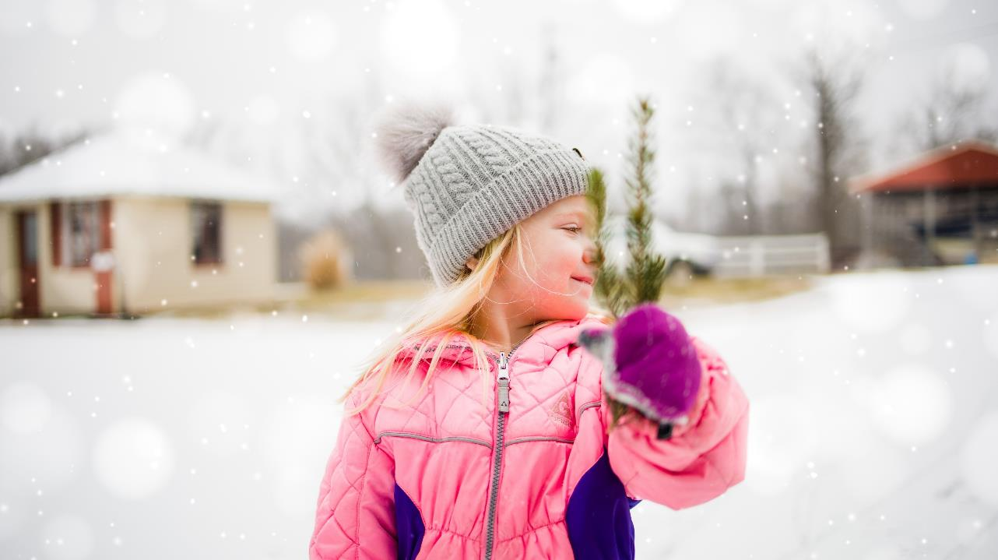
Notes:
Image source: Photo by<a href="https://unsplash.com/photos/girl-in-blue-bubble-jacket-and-gray-knit-cap-standing-on-snow-covered-ground-during-daytime-pUt-XlkQCSI?utm_content=creditCopyText&utm_medium=referral&utm_source=unsplash">Unsplash</a>

Slide 40
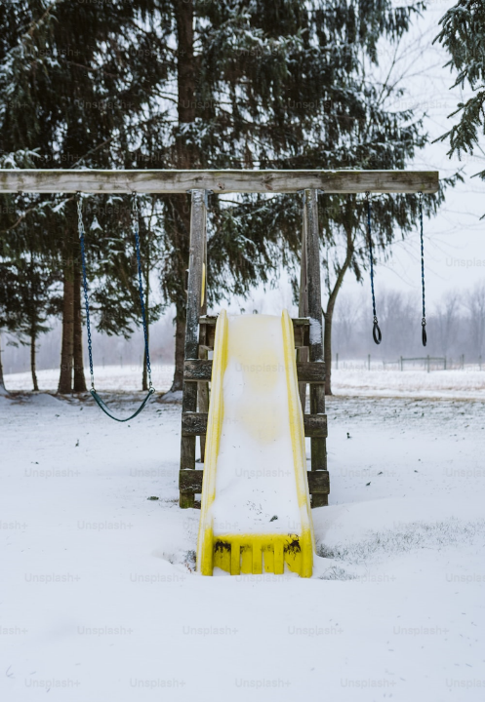
Notes:
Image source: Unsplash-Jason Hawke

