Slide 1
Active Play with Mixed Age Groups
Active Play with Mixed Age Groups
Insert Trainer Agency
Logo Here
Notes:
Suggested Speaker Notes:
Welcome to our session, Active Play for Mixed Age Groups!
Trainer Notes:
Introduce yourself and share any necessary housekeeping items with participants such as the location for bathrooms (for in-person trainings) or an overview of training platform features (for virtual trainings).

Slide 2
Disclaimer
Notes:
Suggested Speaker Notes:
Development of the Physical Activity Learning Session (PALS) materials including today’s session was funded by the Centers for Disease Control and Prevention (CDC). The views expressed in this session do not necessarily reflect the official policies of the U.S. Department of Health and Human Services.

Slide 3
Learning Objectives
Review developmentally appropriate practice and the implications for mixed age groups.
Adapt and select active play opportunities for mixed ages according to the needs of each age group.
Notes:
Suggested Speaker Notes:
It may be challenging for ECE providers to select activities that promote active play for use in a program that serves mixed age groups –like family child care homes. At different ages, children are learning and practicing different skills and we want to promote those skills and give children an opportunity to develop and practice them in active and engaging settings with their peers. In this session, we will focus on how we can maximize active play options for ECE programs with mixed age groups. We will review the concept of developmentally appropriate practice and recommendations for active play for young children. Then we will apply these recommendations to adapt and select active play opportunities according to the needs of each age group.

Slide 4

Opening Activity
Introduce yourself and share your favorite ECE age group to work with and demonstrate a physical activity you like to do with that age group.
I like to work with preschoolers
and have a dance party.
Notes:
Suggested Speaker Notes:
We will open our session with this icebreaker to introduce ourselves. Please introduce yourself and share your favorite Early Care and Education (ECE) age group to work with and then demonstrate a physical activity you like to do with that age group. You can also share an activity you like to do with all age groups.
Trainer Notes:
Depending on the number of participants, this icebreaker can be done as a whole group, in pairs, or small groups.
Image Source: Microsoft Stock Photo

Slide 5
Objective 1: Review developmentally appropriate practice and the implications for mixed age groups.
Notes:
Suggested Speaker Notes:
Let’s start by reviewing a concept many ECE providers are familiar with –developmentally appropriate practice. Reviewing this concept will help us focus on the needs of each individual child as we plan, select, and adapt activities for each age group.

Slide 6
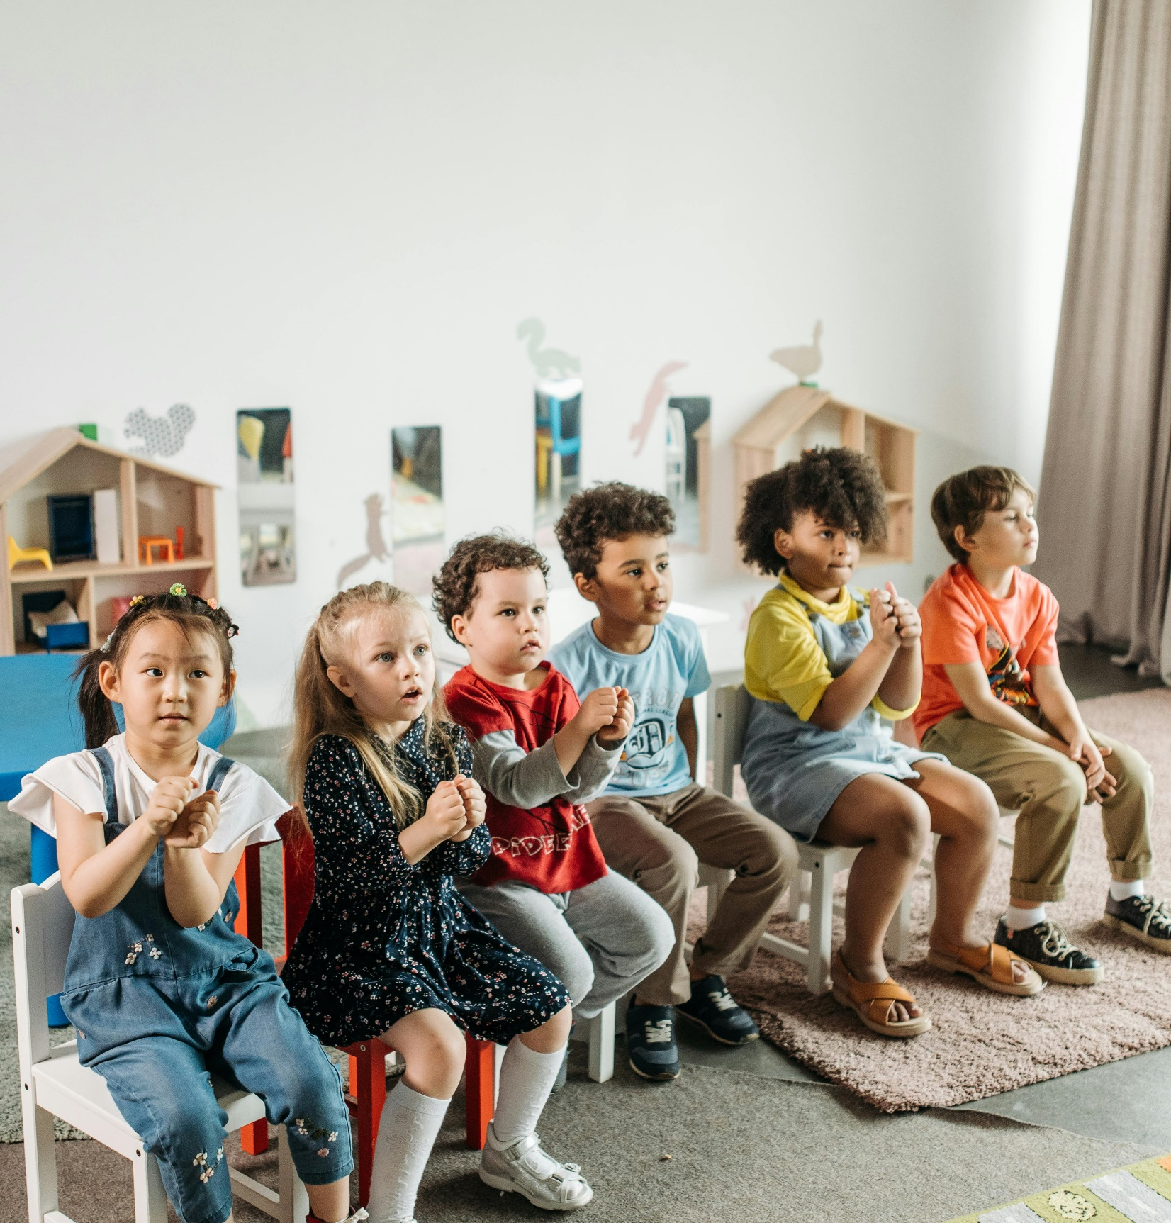
Developmentally Appropriate Practice (DAP)
Commonality is development and learning that applies to all
Individuality is reflecting each child’s unique characteristics and experiences
Context refers to the social and cultural contexts in which development and learning occur
Source: NAEYC
Notes:
Suggested Speaker Notes:
As we begin to discuss active play with mixed age groups, it’s important to highlight developmentally appropriate practice as we discuss how best to meet the needs of all children in our care regardless of age. According to the National Association for the Education of Young Children (NAEYC), “developmentally appropriate practice” refers to “methods that promote each child’s optimal development and learning through a strengths-based, play-based approach to joyful, engaged learning.” Developmentally appropriate practice supports children’s development and learning while understanding three core considerations: commonality, individuality, and context.
Commonality refers to the current research and understanding of child development and learning that applies to all children.
So, to ensure we address commonality in planning and selecting active play opportunities for children, we must ask, “What types of physical activity should all children be able to do at this age and developmental stage?” For example, resources on developmental milestones can provide examples of motor skills that all 3-year-olds have.
Individuality refers to the characteristics and experiences that unique to each child, within the context of their family and community.
To ensure we address individuality, we must ask, “What skills, materials, lessons, etc. can be incorporated to support this particular child’s physical abilities and interests?” Our observations, of individual children will tell us what materials they really enjoy or what skills we need to plan to have them practice. For example, 3-year-old Marcus loves cars, building, and construction inside the classroom. We may also need him to practice gross motor skills so we might suggest he try out the Little Tykes car, in which he can use his feet to pedal. He can also pretend the sandbox is a construction site where he can build, stack, fill and dump large containers.
Context is everything about the social and cultural contexts for each child, each educator, and the program as a whole.
To ensure context is addressed, we must ask, “What considerations should be addressed based on things like the home setting, the ECE program, the child’s community, their family’s socioeconomic status?” Establishing rapport and getting to know each family can reveal some of this information. We may note that Marcus and his family live in a two-story walk-up apartment (where he gets physical activity taking the stairs). They don’t have access to a yard to play, but there is a park close by in his neighborhood that he and his family visit every weekend. Marcus’ family has lived in Washington DC for three generations and they love the local go-go music. Marcus hears this music at home, and he sings and dances to it.
So, taking these three core considerations (commonality, individuality, context) will help us plan activities that best meet each child’s learning and developmental needs.
Typically, in ECE, practitioners think of developmentally appropriate practice as ensuring that lessons, activities, materials, etc. are appropriate according to children’s age and developmental stage. DAP also includes ensuring that lessons, activities, materials, etc. are appropriate according to additional contexts –like individual, social, cultural – as well. Ensuring we consider these other contexts for each child of every age group in our care, will ensure each child’s needs are met for physical activity and child learning and development overall.
Source: NAEYC DAP Position Statement 2020
https://www.naeyc.org/resources/position-statements/dap/core-considerations#:~:text=Developmentally%20appropriate%20practice%20requires%20early,the%20context%20in%20which%20development
Image source: Pexels

Slide 7



Summary of best practices: Time & Space
Infants
Toddlers
Preschoolers
Supervised tummy time frequently
3-5 minutes increasing as tolerated
Outdoors 2-3 times daily
60-90 minutes of MVPA
60-90 minutes of outdoor play
Outdoors 2-3 daily
90-120 minutes of MVPA
60-90 minutes of outdoor play
Outdoors 2-3 daily
Notes:
Trainer Notes:
Review best practices for time and space from the PALS curriculum.
Suggested Speaker Notes:
To implement DAP, ECE providers working with mixed age groups must intentionally plan to meet the recommended best practices for each age group in their care. As we review these best practices, note the areas of overlap for the best practices and recommendations for time and space within the different age groups. We see that each age group needs to be outdoors 2-3 times daily. We also see that toddlers and preschoolers need around 90 minutes of MVPA and both also need 60-90 minutes of outdoor play. Since the best practices overlap for the toddlers and preschoolers, we will discuss how to adapt activities that both these age groups can engage in together while an activity that works on similar skills or with similar materials will be shared for infants.

Slide 8
Objective 2: Adapt and select active play opportunities for mixed ages according to the needs of each age group.
Notes:
Suggested Speaker Notes:
Next, we will discuss how we can adapt and select activities for use with each group.

Slide 9


Planning Strategies for Active Play with Mixed Age Groups
Adapt instructions for use with different age groups.
Select materials based on ability and/or that can be used with most ages.
Engage in concurrent activities with toddlers and preschoolers.
Notes:
Suggested Speaker Notes:
These are some considerations for selecting activities for mixed age groups.
We want to ensure materials and instructions can either be used and understood by all ages or adjusted/ adapted for use with all ages.
We can also engage in concurrent activities with the children. You can conduct an activity with the infant and younger toddler children (like stretching) while preschoolers and school-agers engage in a separate activity of their own (like practicing kicking balls into a net while taking turns) within visual range to provide adequate supervision.
Before implementing the activities, some questions you might ask yourself are:
How can I support independence and leadership in older children while still ensuring they have an opportunity to be active and have fun?
What needs might arise for younger children while older children engage in longer periods of play and how would I address them?
Image Source: Getty

Slide 10
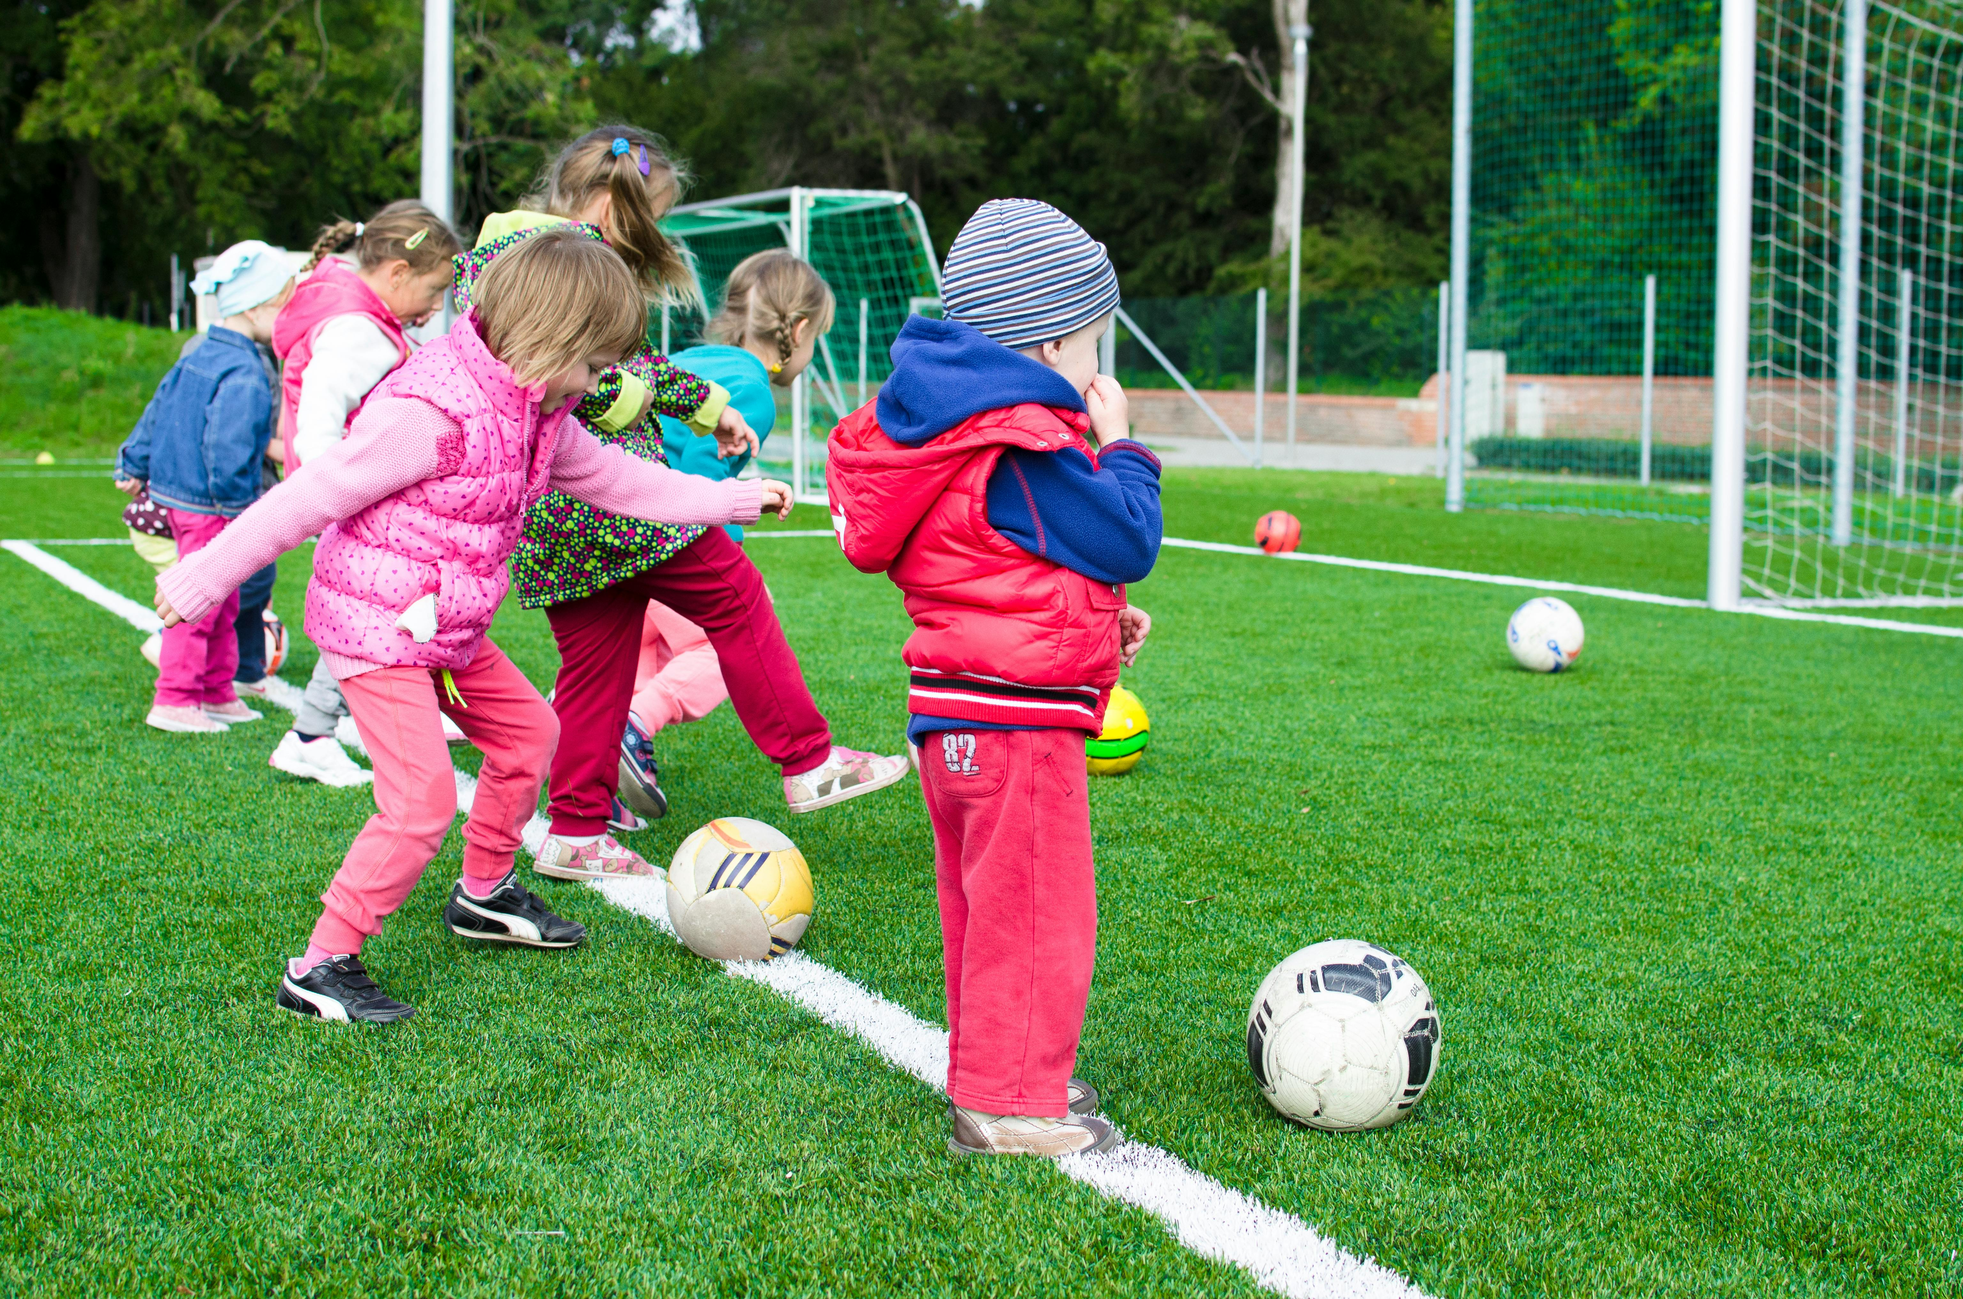

Selecting Activities for Mixed Aged Groups
Active play challenges with Balls
Skills: Sensory, fine and gross motor skills
Adapting materials: size, weight or texture of balls
Adjusting for age groups:
  Infants: holding, reaching, visual tracking
  Toddlers: passing, rolling
  Preschooler: tossing, catching, kicking
Notes:
Suggested Speaker Notes:
Now we will explore some ideas for selecting and adapting activities for mixed age-groups. Children of all age groups can participate in activities that are:
Challenges,
Open-ended, and/or
Teacher-led
Suggested Speaker Notes:
For instance, here are some examples of Challenges with Balls that you might consider when selecting activities for mixed age groups.
Keep in mind the planning strategies and considerations from the previous slide:
Ensure materials and instructions can either be used and understood by most ages or adjusted/ adapted for use with all ages.
Engage in concurrent activities with the children. You can conduct an activity with the infant and toddler children while preschoolers and school-agers engage in a separate activity of their own within visual range for supervision purposes.
Trainer Notes: Review skills that will be explored, how materials can be adapted, and how the instructions of object of the activity for can be adjusted for age groups as the children play on the slide.
Suggested Speaker Notes:
So, you might have multiple soccer balls and have the preschoolers and school-agers engage in a game of soccer or practice kicking a soccer ball. While this is happening, you might be seated on a blanket and have a smaller ball an infant can crawl to or reach for.
If time permits, these questions can be shared for discussion, or they can be shared as considerations for provider to keep in mind when selecting activities.
How can you support independence and leadership in older children while ensuring al children have an opportunity to be active and have fun?
What needs might arise for younger children while older children engage in longer periods of play?
Image Source: Pexels and Getty

Slide 11

Selecting Activities for Mixed Aged Groups
Open-ended Physical Activity with Music and Movement
Skills: gross motor skills, balance, coordination
Adapting materials: Share instruments with children depending on fine motor abilities: drums and maracas.
Adjusting for age groups
  Dance with infants, swaying back and forth. Move their arms and legs to the rhythm as they lay on a blanket.
  Ask toddlers and preschoolers to show you their moves as the music plays.
Introduce cultural songs and music.
Notes:
Suggested Speaker Notes:
Next, we will explore some examples of Open-ended physical activity with music and movement that you might consider when selecting activities for mixed age groups.
Keep in mind the planning strategies and considerations from the previous slide:
Ensure materials and instructions can either be used and understood by all ages or adjusted/ adapted for use with all ages.
Engage in concurrent activities with the children. You can conduct an activity with the infant and toddler children while preschoolers and school-agers engage in a separate activity of their own within visual range for supervision purposes.
Trainer Notes:
Review skills that will be explored, how materials can be adapted, and how the instructions of object of the activity for can be adjusted for age groups as the children play.
If time permits, these questions can be shared for discussion, or they can be shared as considerations for provider to keep in mind when selecting activities.
How can you support independence and leadership in older children while ensuring al children have an opportunity to be active and have fun?
What needs might arise for younger children while older children engage in longer periods of play?
Image Source: Pexels

Slide 12

Selecting Activities for Mixed Aged Groups
Teacher-led stretching, yoga, and mindfulness
Skills: balance, coordination, flexibility, build core muscle strength
Adapting materials: Play soothing music.
Adjusting for age groups
Have infants engage in tummy time as tolerated or help them to stretch their arms and legs.
Have toddlers and preschoolers participate in yoga and mindfulness.
Demonstrate poses and use pictures/cards depicting poses and movements.
    Boat
    Bridge
    Flamingo
    Superman
    Warrior Poses
Notes:
Suggested Speaker Notes:
Now we will explore some examples of Teacher-led stretching, yoga, and mindfulness that you might consider when selecting activities for mixed age groups.
Keep in mind the planning strategies:
Ensure materials and instructions can either be used and understood by all ages or adjusted/ adapted for use with all ages.
Engage in concurrent activities with the children. You can conduct an activity with the infant and toddler children while preschoolers and school-agers engage in a separate activity of their own within visual range for supervision purposes.
Trainer Notes:
Review skills that will be explored, how materials can be adapted, and how the instructions of object of the activity for can be adjusted for age groups as the children play.
If time permits, these questions can be shared for discussion, or they can be shared as considerations for provider to keep in mind when selecting activities.
How can you support independence and leadership in older children while ensuring al children have an opportunity to be active and have fun?
What needs might arise for younger children while older children engage in longer periods of play?
Source: Kids Yoga Stories https://www.kidsyogastories.com/kids-yoga-poses/
Image Source: Getty

Slide 13

Supporting Mixed Abilities
Strategies for active play with mixed age groups can be used to support children with special needs and mixed abilities.
Materials
Instructions
Time
Notes:
Suggested Speaker Notes:
Meeting individual needs may sometimes mean meeting the needs of a child with different abilities. Some of the strategies for active play with mixed age groups can also support children with mixed abilities.
Select materials based on ability. You can still incorporate challenges with balls as an active play strategy, but you can also incorporate different types of materials to support children with special needs and different abilities. You can include weighted balls, balls with different textures, balls of different sizes, balls with gripping supports, etc.
Adapt the instructions. Changing the object of the game or activity can make it more achievable for younger children or children with special needs to participate. Make instructions simple and easy to follow based on abilities/ needs. For example, with music and movement, if I am showing the children a new dance move or routine to practice, I may adapt that to include the children showing me a dance move they can do so it will be according to their ability.
Adjust the time (increase or decrease). Depending on their abilities, children with special needs may sometimes be able to engage in the same types of activities as typically developing children but may just need the time to be adjusted. They may benefit from shorter periods of engagement in an activity or may require longer periods of time to complete an activity. For example, during yoga, you may want to decrease the activity from 8 minutes to 4 minutes. During a relay race, they may need a longer timeframe to complete the race.
Image Source: Microsoft Stock

Slide 14

Safety and Supervision
Scan for safety
Provide guidance and directions around safety
  Be mindful of large and small bodies playing together
Using your voice as a safety measure
Older children as safety leaders
Notes:
Suggested Speaker Notes:
With mixed age groups, supervision is all the more important. It is easy to get distracted with infants while older children are mobile enough to move out range of vision. Providers should constantly scan the surroundings visually to ensure children are engaged in safe active play. Moving around to supervise is also important if you are not directly involved in an activity with the children.
Clear guidance and directions should also be provided to children so they understand the rules around how to stay safe while engaged in active play. Rules should be brief and easy to remember.
Providers can also use their voice as a boundary or to reinforce safety measures while outdoors. For example, calling out to remind children “Remember we don’t run beyond the fence. I need to be able to see you.” reinforces boundaries and rules for safety outdoors.
One benefit of mixed age groups is that the older children can model safety measures for the younger children and can even be selected as safety leaders to help keep everyone safe while engaged in active play.
Image Source: Microsoft Stock

Slide 15

Family Engagement Considerations
Provide activities families can do at home
Invite families to share
Demonstrate activities for mixed age group
Notes:
Trainer Notes:
Review the family engagement considerations on the slide.
Suggested Speaker Notes:
To engage families whose children are attending a family child care ECE program or program with mixed age groups, providers may consider some of these suggestions:
Share a list of activities families can do at home to keep children active and highlight how to adjust activities for their children of different ages.
Invite families to share how they’re implementing the activities at home (photos/video/share aloud).
During parent nights/ family engagement events, demonstrate activities for mixed group for parents to consider using with their children of different ages.
Share: “Activities for Families” Handout
Image Source: Microsoft stock

Slide 16
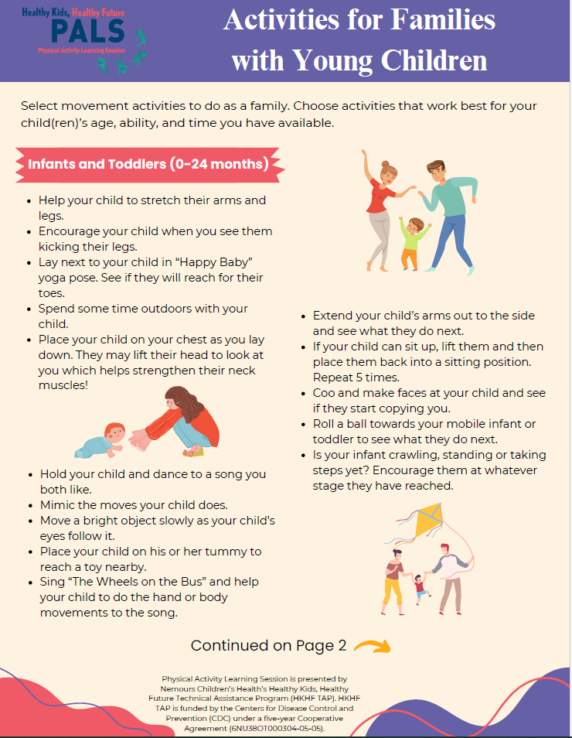
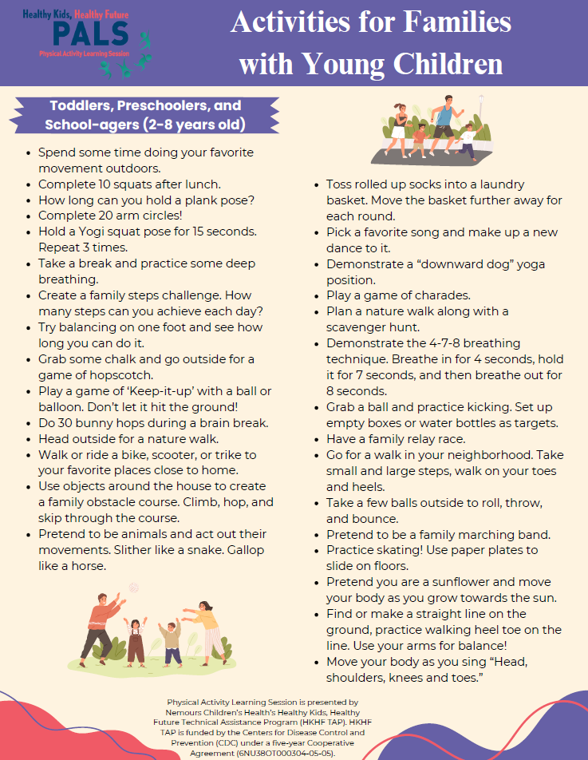
Session
Handouts
Notes:
Trainer Notes:
Review the session handout – Activities for Families. The handout shares a activities families can do with their infants, toddlers, preschoolers, and school agers (ages 0-8).

Slide 17
Questions?
Notes:
Trainer Notes:
Address participant questions.
NOTE: This concludes the content for the 30-minute micro-training. For an extended training (60 minutes), trainers can facilitate 2 of 4 optional activities in the remaining slides.

Slide 18
Supporting Mixed Abilities
Supporting a specific need/ability:
2-year-old child who has Cerebral Palsy and uses an assistive device (leg braces) to walk
5-year-old child with a visual impairment
What is needed? What should be considered?
How can strategies for active play with mixed groups be used to support children with special needs?
How would you ensure this child feels included while promoting active play with all the children? What adaptions would you offer?
Notes:
[Optional Extended Content Option 1 of 4]
Suggested Speaker Notes:
Meeting the needs of all children means ensuring there are opportunities for ALL children to be active no matter their level of skill or ability. How can we ensure the needs of every child is met while promoting active play with mixed age groups when we also have mixed abilities?
Discuss how to support a child with a specific need/ability: Child with Cerebral Palsy or Child with a visual impairment. What is needed? What should be considered?
Trainer Notes:
Share background Information on each special need/ disability:
1. Cerebral Palsy: Cerebral palsy (CP) is a disorder that affects muscle tone, movement, and coordination. It happens when the brain can’t properly send messages to muscles about how to move in smooth or well-coordinated ways. CP can also affect other body functions that involve motor skills and muscles, like breathing, bladder and bowel control, eating, and talking. Depending on the type of CP, children may experience a combination of muscle stiffness, trouble moving, uncontrolled movements which causes a problem with balance and depth perception i.e. judging the distance between two objects (Nemours Kids Health).
2. Visual Impairment: Visual impairment is vision loss that cannot be corrected by glasses, contacts, or other methods. A child may have complete vision loss (blindness) or partial vision loss. A child with a visual impairment may not be able to see objects at a distance, focus on objects, or follow them with their eyes, have sensitivity to light, etc. (Nemours Kids Health)
Samples responses to questions “What is needed? What should be considered?”
2-year-old with cerebral palsy
Needs: 1) may need additional time to walk or move or may only be about to engage in MVPA for short periods of time 2) may need extra room to move about
Considerations: 1) Examples of appropriate active play can be shared by parents or the child’s therapist/ care team. 2) Consider the child’s activity level in planning activities for their participation. 3) Refer to the child’s Individualized Family Service Plan (IFSP) for ages 0-3/ Individualized Education Plan (IEP) ages 3 and up for accommodations recommended by their care team.
5-year-old child with a visual impairment
Needs: 1) may need auditory cues (e.g. bells, chimes) to signal their proximity to furniture or equipment when moving about; 2) if child has partial visual impairment, they may need to stand closer to targets for kicking and throwing
Considerations: 1) Child may use a guide cane – consider spatial accommodations. 2) Speak with other children on ways to safely play with the child who has a visual impairment. 3) Be mindful of infants crawling/ smaller children moving about in a mixed age group setting that may not be conscious of the child’s visual impairment or their use of assistive devices.
Any of the following formats can be used to facilitate this discussion.
-Pair and share
-Small groups
-Whole group
Share 2-3 responses with whole group and debrief. (5 minutes)
Additional Discussion Questions (share as time permits or mention them to the group as planning considerations):
How can strategies for active play with mixed groups be used to support children with special needs?
How would you ensure this child feels included while promoting active play with all the children?
Assign the discussion questions above to participants. (8 minutes)
Sources:
Nemours Kids Health https://kidshealth.org/en/parents/cerebral-palsy.html
https://kidshealth.org/en/parents/vision-factsheet.html

Slide 19
Activities with Mixed Age Groups
Small Group Brainstorm
In small groups, brainstorm ways you can integrate active play or movement into one of the following activities for each of these age groups: infants, toddlers, preschoolers, and school-agers. Brainstorm as many as you can!
Activities with scarves
Sensory Activities
Music and movement
Literacy
Notes:
[Optional Extended Content Option 2 of 4]
This activity can be implemented in small groups in person or break-out groups virtually.
Assign breakout groups.
Instruct participants to brainstorm ways they can integrate active play or movement into one of the following activities for each of these age groups: infants, toddlers, preschoolers, and school-agers. (5 minutes)
Activities with scarves
Sensory Activities
Music and movement
Literacy
Have each group share out their list of activities. (3 minutes)
Debrief the activity with the whole group. Ask if there are any activities participants heard that they would want to try. (2 Minutes)
Activities can be compiled into a list to distribute to the whole group after the training, so participants have a collection of activity ideas for mixed age groups.

Slide 20

Active Play with Mixed Age Groups Challenge Carousel
In-person: Walk around the room, and with a post-it note, add potential solutions to each challenge listed.
Virtual: Add potential solutions to each challenge listed on the virtual whiteboard.
Notes:
[Optional Extended Content Option 3 of 4]
Prep:
In person: In advance, set up 5-6 sheets of chart paper around the room. Distribute post-it notes to participants.
Virtual: In advance, set up a Virtual whiteboard with 5-6 pages/sheets.
Before the virtual training or as participants enter the room in-person, ask them to submit one challenge they have implementing active play with mixed aged groups (in-person: post it notes; virtually: chatbot)
Activity:
Select some of participants challenges and add to the top of each sheet of chart paper or whiteboard page.
Give participants 10 minutes to add potential solutions to each challenge.
Debrief and share potential solutions with the whole group for 5 minutes.
Image Source: Microsoft Stock

Slide 21
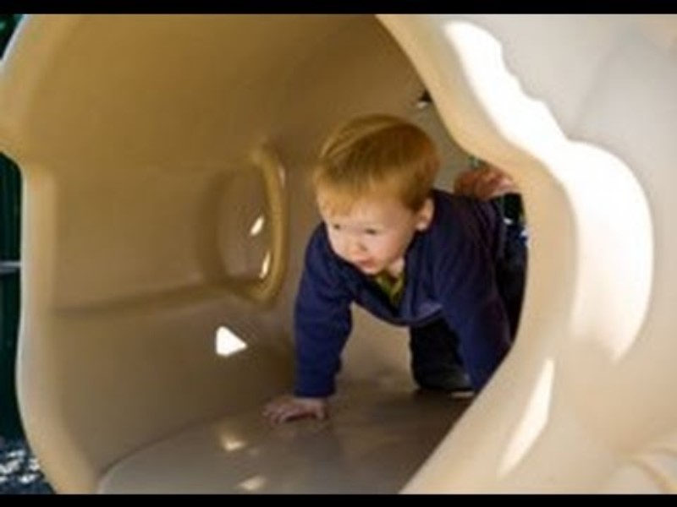

Active Play with Mixed Age Groups
Infants and Toddlers vs. Preschoolers
Notes:
[Optional Extended Content Option 4 of 4]
Have participants watch each video and then discuss comparisons and debrief afterwards.
Video Links:
https://www.easternct.edu/center-for-early-childhood-education/physical-and-outdoor-play/supporting-physical-development-in-infants-and-toddlers.html
https://www.easternct.edu/center-for-early-childhood-education/physical-and-outdoor-play/incorporating-motor-play-in-the-preschool-classroom.html
Suggested Speaker Notes:
To share some additional examples of developmentally appropriate activities, we will view two videos showing videos appropriate for infants and as well as toddlers and preschoolers.
Discussion Questions (10-12 minutes):
-What stood out to you each video? What did you notice that reminded you of developmentally appropriate practice discussed previously in the training?
-What types of active play did you notice amongst the different age groups (infants/toddlers vs. preschooler)?
-What motor development skills are being used?
-Are there other ways you would suggest the children be engaged in active play if there were mixed age groups?
Debrief the activity sharing take-aways from the video. (3-5 minutes)

