Slide 1
The Connections Between Active Play and
Social-Emotional Learning in Early Childhood
Add your agency logo here
Add trainer contact info here
Add trainer contact information here
Notes:
Speaker notes:
Welcome to today’s training session, the connections between active play and social-emotional learning.
Introduce yourself.
Research shows that children with strong social emotional skills have increased academic performance as well as improved mental wellness and health behaviors. Our content today will explore how active play can support social-emotional learning. Our session will use the terms physical activity and active play. Active play is the way that young children engage in physical activity.
Trainer notes:
Add your contact information and agency logo to the opening slide.
Welcome your participants to the session, introduce yourself and share housekeeping information such as the location of restrooms and silencing of cell phones.
Trainers are encouraged to add a slide with group norms if desired.
Sample group norms include:
Be considerate of differing opinions
Speak respectfully to each other
Share your knowledge and experience
Minimize side conversations
Take care of your needs
Celebrate accomplishments
The information below is provided to support entry of the training session in state professional development registry systems, creation of marketing materials and details needed for participant certificates.
Session Title: The connections between active play and social-emotional learning* in early childhood
Time: 60 minutes
Description: Young children start learning social-emotional skills from birth. Like skills in all developmental domains, social-emotional skills are learned best though play where children can practice skills in safe spaces supervised by nurturing adults. This session content explores four social-emotional skills and identifies how active play can encourage skill development. Participants will be challenged to identify practices and activities they can bring to their programs that encourage active play and social-emotional skill development.
Core Content Area(s): Child Growth and Development
Objectives:
1. Recognize the impact of active play on the brain
2. Recall four social-emotional (SE) skills developing in early childhood and discuss how active play supports growth of social emotional skills
3. Identify one strategy to incorporate into practice that supports social-emotional skill development
*In certain states the term social-emotional learning has become controversial, and use of the term has been discouraged. Trainers may choose to adjust the title of this workshop and slide content using terms such as ‘key life skills,’ ‘social skills’, or terms preferred in their communities.

Slide 2
Disclaimer
Notes:
Suggested Speaker Notes:
Development of the Physical Activity Learning Session (PALS) materials including today’s session was funded by the Centers for Disease Control and Prevention (CDC). The views express in this session do not necessarily reflect the official policies of the Department of Health and Human Services.

Slide 3
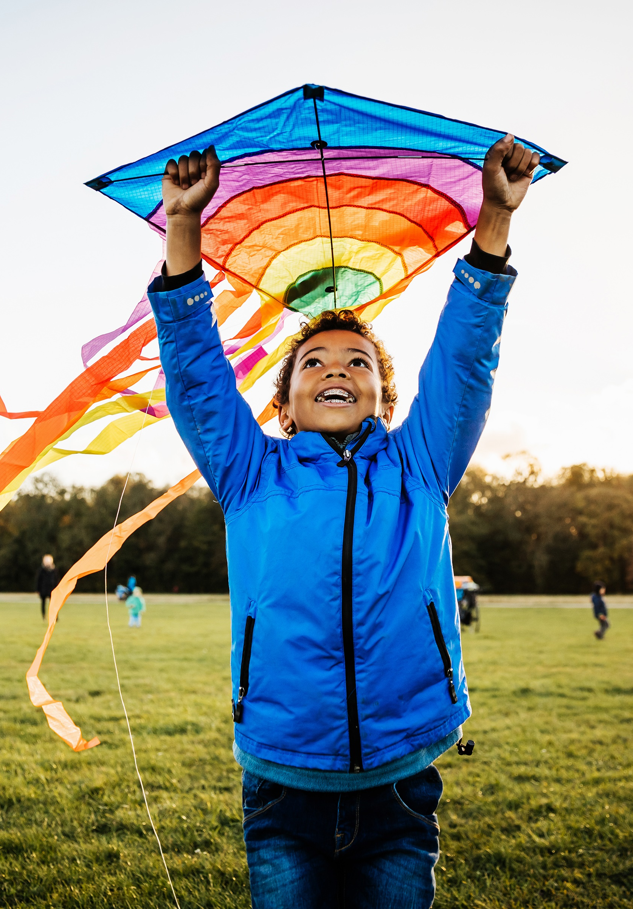
Objectives
Recognize the impact of active play on the brain
Recall four social-emotional skills developing in early childhood and discuss how active play supports growth of skills
Identify one strategy to incorporate into practice that supports social-emotional skill development
Notes:
Suggested Speaker Notes:
The session objectives are listed on the slide.
1. Recognize the impact of active play on the brain
2. Recall four social-emotional skills developing in early childhood and discuss how active play supports growth of skills
3. Identify one strategy to incorporate into your practice that supports social-emotional skill development
Our session will use the terms physical activity and active play. Active play is the way that young children engage in physical activity.

Slide 4
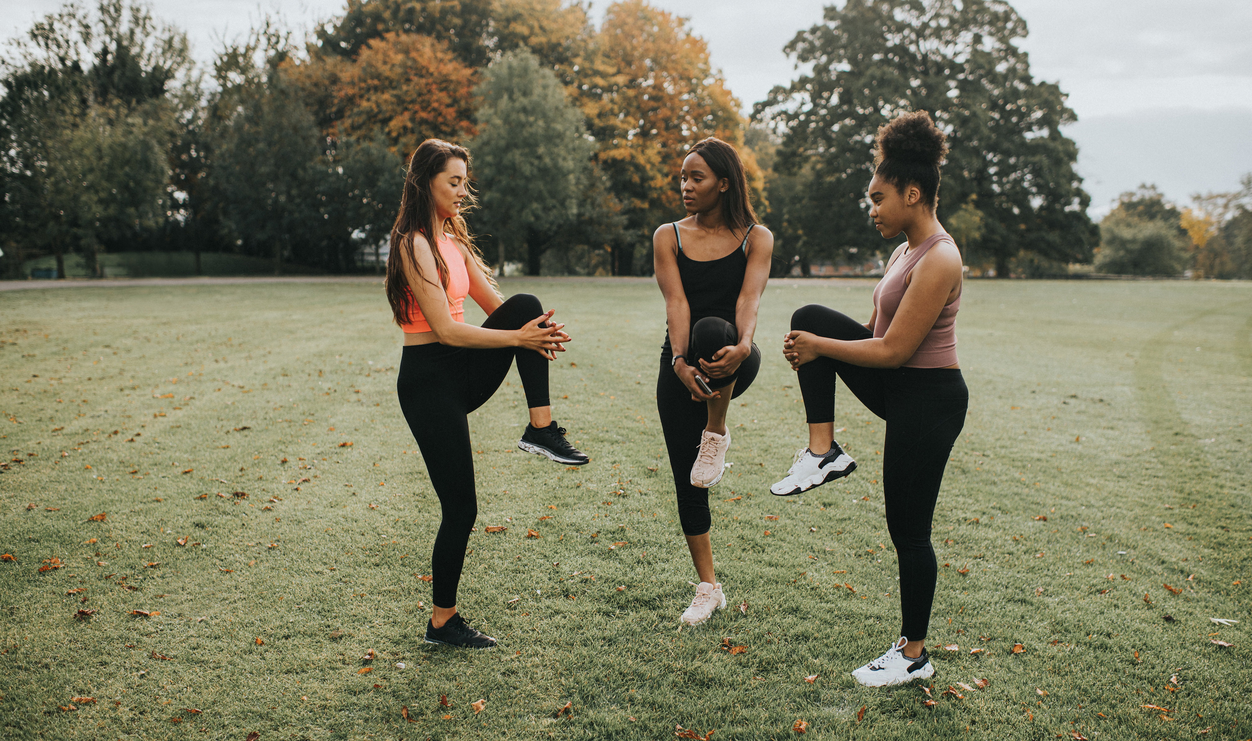
Stretching and Serotonin
Notes:
Trainer Notes:
This goal of the activity is for participants to experience how a physical activity, stretching, can influence their emotional state or impact their physical feelings such as stress and tension.
For this opening movement activity invite participants to join as they are comfortable either standing of sitting. Let them know they can opt out of the movement but encourage them to participate in the introductory breathing activity and closing reflective piece.
Suggested Speaker Notes:
Take a moment to think about where you are right now physically and emotionally. In your mind, name the physical sensations you notice in your body and the main emotion you are feeling at this moment.
Take four deep breaths in and out through the nose, counting to four as you inhale and again as you exhale
Gently tilt your ear toward your shoulder to stretch your neck, hold the stretch as you reach your hand toward the floor, repeat on the other side
Turn your head to the right as far as you can and hold for a full breath cycle. Repeat turning to the left
Lift your arms to make a T. Make several slow, large circles forward to stretch the shoulders
Now reverse the direction for a few circles.
Extend your arms in front of your body and gently rotate your hands stretching your wrist, reverse the direction
Reach your arms above your head and interlace your fingers. Extend and stretch up high then lean slightly reaching to one side stretching the side body for a few minutes. Repeat stretching to the other side.
Release your arms beside your body and take another few deep breaths.
Debrief-
What is the main emotion you are feeling after stretching? What physical sensations are you feeling?
Did you notice any changes after stretching?
Ask all participants to introduce themselves and share one word on how they feel physically or their main emotion after stretching.
Photo PowerPoint Stock Images

Slide 5
Objective 1
Recognize the impact of active play on the brain
Notes:
Suggested Speaker Notes:
There are distinct areas of the brain that govern our social and emotional skills. In early childhood, brain development is impacted by many factors including nurturing relationships, nutrition, sleep, and the experiences children have.
In our first objective we will look at how physical activity and active play impact the brain.

Slide 6
Physical Activity (PA) and the Brain
PA increases our heart rate sending more oxygen and nutrients to the brain
PA increases the levels of chemical messengers in our brain which play an important role in mood regulation, reducing stress, mental alertness and focus
PA increases levels of Brain Derived Neurotropic Factor (BDNF)
Notes:
Trainer Notes:
Suggested Speaker Notes:
Physical activity causes several immediate changes the brain.
When we are engaged in moderate to vigorous physical activity, we breath harder, and our hearts pump faster. This increases blood circulation (the movement of blood in the body). This increase in blood circulation leader to more oxygen and nutrient rich blood reaching the brain. Our brains use oxygen to metabolize nutrients for energy and growth. This helps children (and adults) grow neurons and build neural pathways.
Physical activity has been shown to increase levels of neurotransmitter such as such as serotonin, dopamine and norepinephrine. Neurotransmitters are the body’s chemical messengers that carry signals from one nerve cell to the next cell. One type of messengers is known as endorphins. These messengers carry signals that offset stress hormones such as cortisol. This type of messenger (endorphins) can help stabilize mood, make us feel good, and decrease depression and anxiety. In our opening activity you may have experienced the impact of increased serotonin levels.
Physical activity increases levels of Brain Derived Neurotropic Factor (BDNF). BDNF helps our brains grow, create new cells, and build new connections.
Let’s look a bit more at the brain and how being physically active impacts the brain.

Slide 7
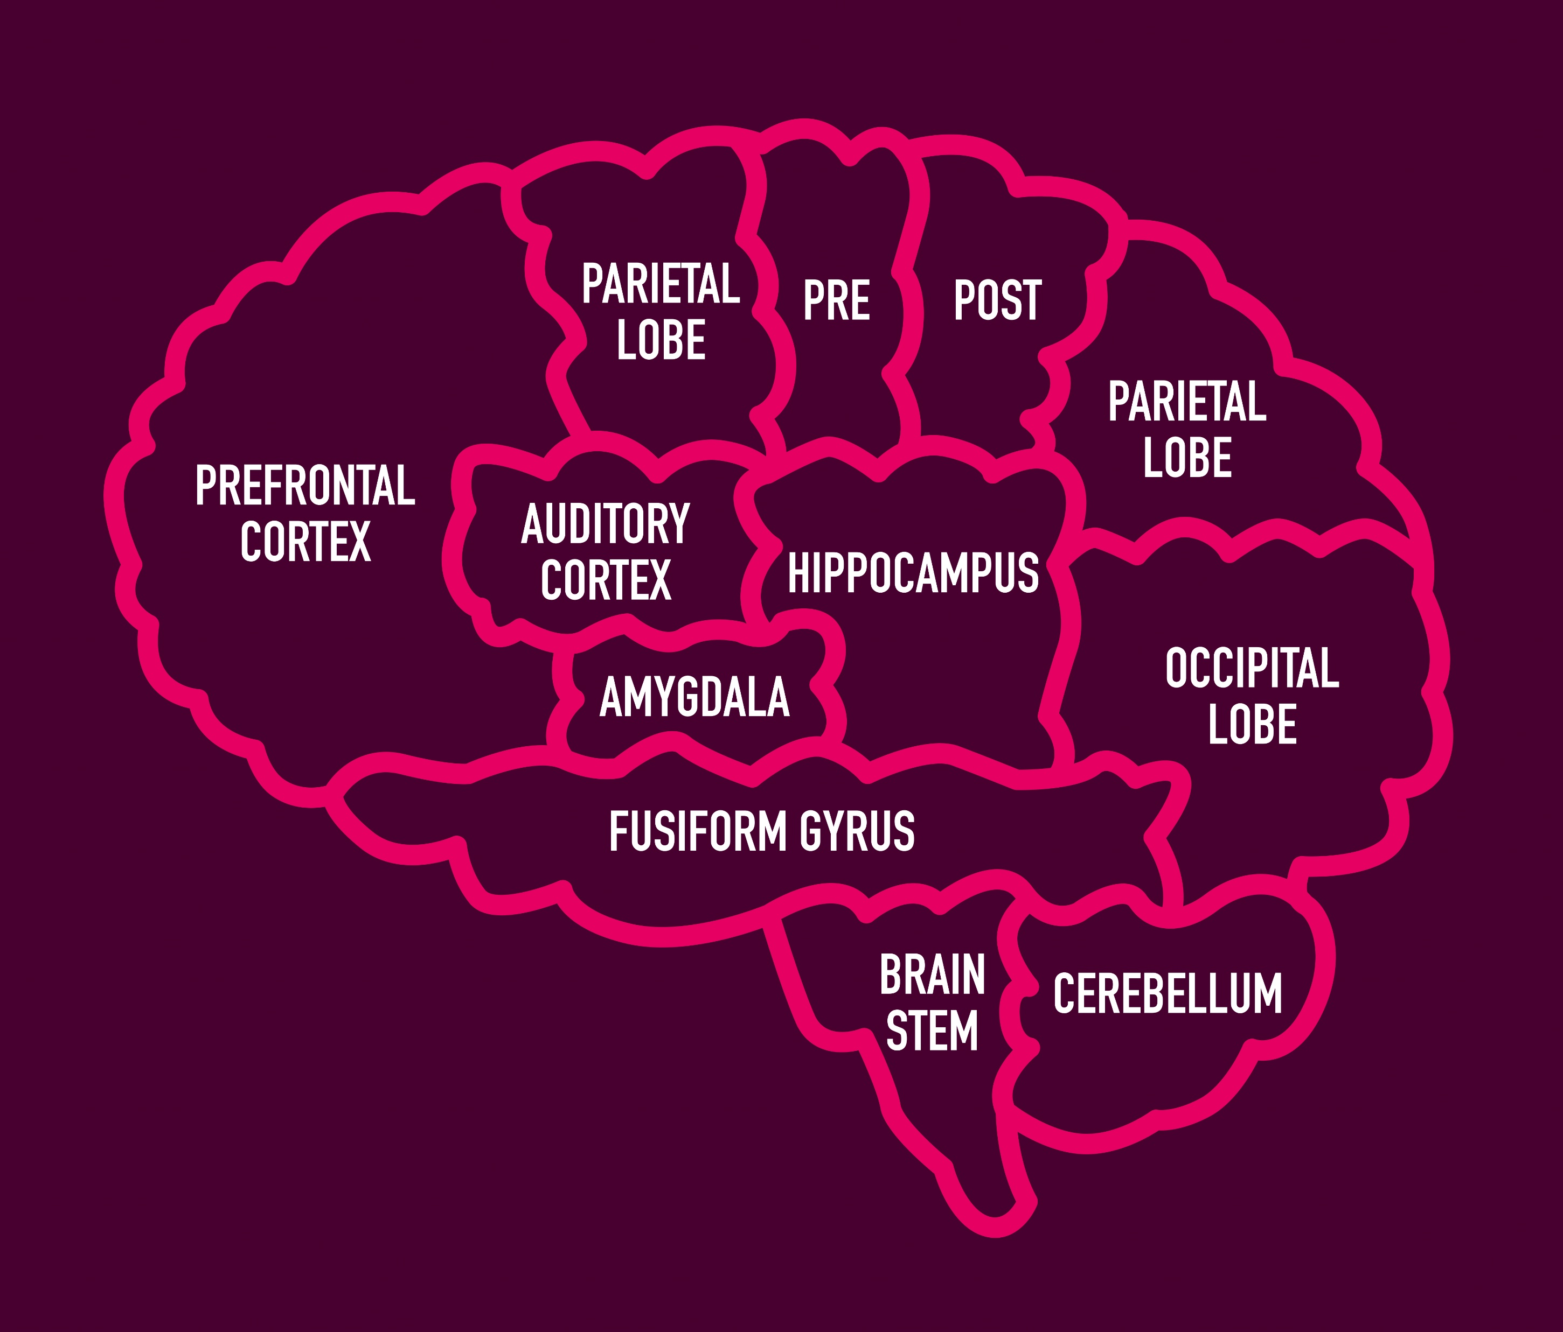
Physical Activity activates and strengthens key areas
Prefrontal Cortex –
the area that manages executive function skills
Hippocampus –
the area that regulates emotions and learning
Notes:
Suggested Speaker Notes:
Researchers have identified that regular physical activity appears to boost the size of two areas of the brain, the prefrontal cortex and the hippocampus.
Prefrontal cortex-The prefrontal cortex is the front area of the brain. This area is responsible for regulating our thoughts, actions and emotions through connections with other areas of the brain. The prefrontal cortex plays an important role in executive functions such as impulse control, decision making and planning.
Hippocampus-The hippocampus is located deep in the brain. The hippocampus plays a role in short and long-term memory and learning as well as in regulating emotions. The hippocampus is larger in children who are more fit. A larger hippocampus is linked to better memory.
The neural circuits in the brain, including in these two areas, are important in the regulation of emotions. Emotional self-regulations is the ability to respond to the demands of an experience with healthy strategies.

Slide 8
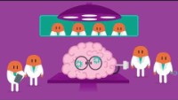
Physical Activity and the Brain
Notes:
Trainer Notes:
Video link- https://www.youtube.com/watch?v=zyCsDsBGfKw (2023, 1:52) from ParticipACTION- Canadian non-profit_
Closed captions in English are available for this video by taping on the icon CC
Trainers are encouraged to preview the video and identify their response to the prompt below.
Suggested Speaker Notes:
Prompt - As we watch this video, look for the ways physical activity impacts the brain. After the video I will ask a few volunteers to share what stood out for them.
Debrief- What did you hear in the video that interests you?
We can see that physical activity has several positive impacts on the brain throughout the lifespan. Next, we will explore how the physical activity can have a positive role in the development of Social-Emotional skills in early childhood.

Slide 9
Objective 2
Recall four social-emotional skills developing in early childhood
& discuss how active play can support skill growth
Notes:
Suggested Speaker Notes:
In this objective we review four social-emotional skills and examine how active play can support developing skills.
As early care and education providers, you play an important role in helping young children develop skills ranging from dressing and toileting to communication, early literacy, and social-emotional skills.
Play is serious business for young children as their best learning happens when they are playing. Play providers opportunities to explore and interact with others. During play children practice skills, try out different possibilities, and build relationships. Active play activates the brain and gives children the opportunities to practice gross motor skills, try balance skills, learn concepts and to use social-emotional skills.
Trainer notes:
A quote from Fred Rogers, a.k.a. Mr. Rogers, captures this concept nicely.
“Play gives children a chance to practice what they are learning.”

Slide 10
Social-Emotional Skills in Early Childhood
Emotional literacy
Friendship skills
Problem solving
Behavior regulation
National Center for Pyramid Model Innovations
Notes:
Trainer Notes:
This slide introduces the four social-emotional skills covered in the content.
Suggested Speaker Notes:
Social-emotional skills are the skills that help us understand who we are, what we are feeling and what to expect when interacting with others. These skills are used in our interactions with the world and others. Social-emotional skills are also known as social skills, soft skills, and key life skills. These are the skills that help children and adults interact with others and build connections.
The development of these skills begins at birth and continues throughout the lifespan.
Babies start learning these skills as they interact with families and caregivers, observe caregivers' responses in situations.
Toddlers and Preschoolers continue skill growth as they interpret their experiences and begin to understand what others are feeling.
During the preschool years, children develop more emotions and begin to use language to communicate their feelings.
Social-emotional skill growth in early childhood lays a foundation for future growth. Children who don’t become proficient at social-emotional skills can display challenging behavior. These challenging behavior can impact learning. Early care and education settings are rich settings to teach social-emotional skills and for children to practice skills with their peers.
The National Center for Pyramid Model Innovations (https://challengingbehavior.org/) categorizes the social- emotional skills developing in early childhood into four categories.
Emotional literacy is the ability to identify, understand and express emotions in a safe and healthy way.
Friendship skills- Children with friendship skills demonstrate several behaviors including include organizing play (let’s play with the ball-we can kick it back and forth), sharing, assisting others (helping a peer balance on a log) and complimenting others. Having friendship skills allows opportunities to practice other social skills including cooperation and resolving conflicts.
Problem solving skills include the steps to overcoming challenges such as recognizing the problem, thinking about solutions and past experiences with similar situations, and asking for help.
Behavior regulation is the use of executive function skills. In early children this involves impulse control, paying attention, and applying information learned (for example remembering directions).
Let’s consider each of these four skills individually and how active play can afford opportunities to practice each skill. We will start with Emotional Literacy Skills.

Slide 11

Emotional Literacy Skills
Recognize emotions in self
Label emotions and understand what events led to this feeling
Express emotions
Regulate emotions
Recognize emotions of others
Notes:
Suggested Speaker Notes:
Emotional literacy is the ability to identify, understand and express emotions in a safe and healthy way. Child care settings can support children by helping them develop a vocabulary to label feelings and learn to appropriately express feelings.
Emotional literacy involves the skills listed on the slide.
Recognizing emotions in self
Labeling the emotions and understanding their cause
Expressing emotions
Regulating emotions
And lastly recognizing emotions of others.
As children learn to recognize emotions of others they begin practicing empathy. Empathy can be seen in children as young as 3 years but may not be consistently displayed. We continue to refine our emotional literacy skills throughout our lives. Helping children develop a vocabulary to label feelings and learn to appropriately express feelings while in child care settings lays a strong foundation for emotional literacy.
Let’s take a moment to consider our personal emotional literacy skills. The picture on the screen is of a traffic.. What are your processes for handling emotions in this situation.
What emotions might you feel here?
Maybe you feel anxiety at being late, frustration you were not notified of construction, worry or concern over those involved in a possible collision, anger and how other drivers are navigating in the stall, maybe you feel peaceful that you have a few moments to yourself to sit and relax.
How do you recognize these feelings and label them?
Do you sense tension in your shoulders, notice an increased heart rate? Do you reflect on the events that are connected to your emotions and physical sensations?
What regulation strategies do you use?
Deep breathing (focusing on the sensations of breathing or an exercise such as box breathing)
Self-talk (I can’t control this situation, but I will get through this)
Reflection and Perspective taking (That driver appears to be having a bad day, I should give them some space)
As caregivers the ways we talk with children and help them learn to label and process emotions builds emotional literacy.

Slide 12
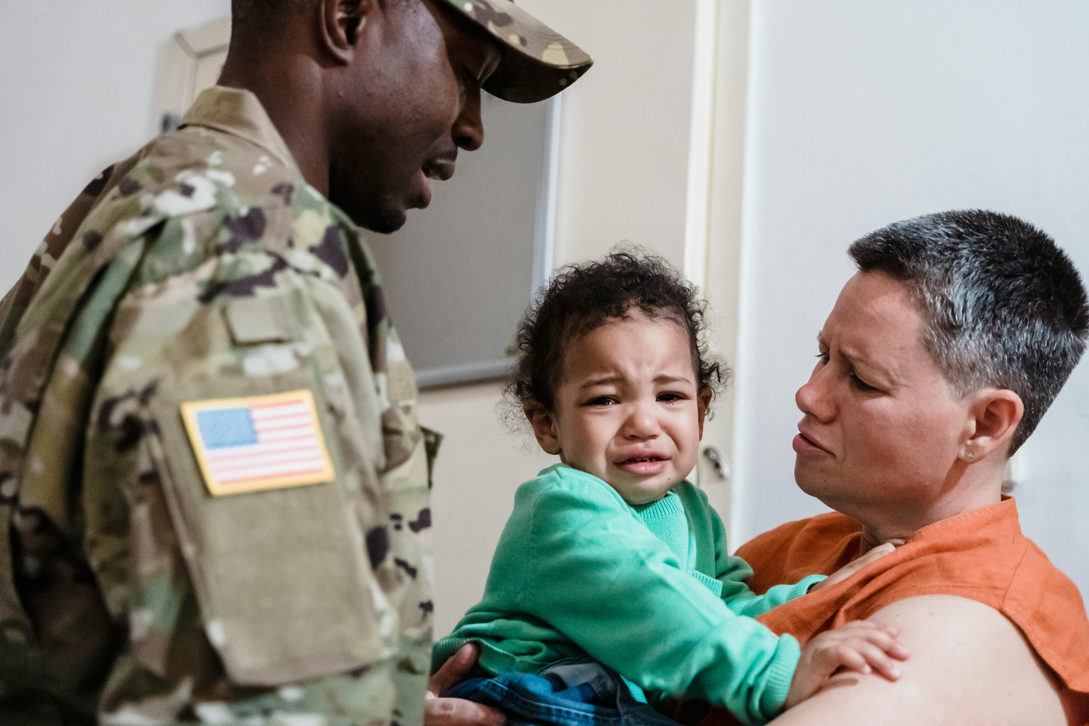
Co-regulation
Co-regulation involves
Warm responses
Calming presence and voice
Verbal acknowledgement of emotion
Modeling of behaviors
A structured safe setting (emotionally and physically)
Notes:
Suggested Speaker Notes:
One strategy to build social-emotional skills in children is through co-regulation. Co-regulation is the process through which children develop the ability to soothe and manage emotions and sensations through connection with nurturing and reliable caregivers. Co-regulation occurs with caregivers who are attuned to the child’s cues and respond consistently to cues.
Co-regulation involves
Warm responses
Calming presence and voice
Verbal acknowledgement of emotion
Modeling of behaviors
A structured safe setting (emotionally and physically)
In infants coregulation can look like the caregiver picking up a fussy child, cuddling and calming them with a soothing voice. The adult is providing calm responses to their distress and helping the child to regulate. Adults may talk with the child, oh your diaper is wet, that is uncomfortable and may be making you unhappy. Let’s put a fresh diaper on and see if that helps you feel better.
In toddlers' co-regulation can involve changing activities-from active play to calmer activities and helping the child adjust to changes in the tempo. Caregivers provide cues such as changing tone of voice, providing transition cues or warning and encouraging children to identify emotions with words to label emotions.
In preschoolers' co-regulations continues with labeling emotions and learning to express and manage their emotions. Becoming proficient at emotional literacy skills requires practice, coaching and observing adult model the ability to self-regulate.
Coaching emotional skills can sound like a sports announcer. A caregiver can state what is observed, comment on how that might make the child feel, discuss ways to express the emotion and resolve the situation. Keep in mind that young children frequently mirror the emotions of caregivers. If caregivers are calm and even-keeled children become calm.
Photo by George Pak : https://www.pexels.com/photo/man-standing-by-a-woman-holding-their-crying-son-7984325/

Slide 13

Promoting Emotional Literacy Skills
Plan fun experiences
Offer physical challenges
Set up safe play spaces with boundaries and rules
Read children’s cues and provide support
Model expression of emotions
Notes:
Suggested Speaker Notes:
Active play, such as running in tag, is associated with many positive emotions such as laughing and smiling. Active play with peers offers children opportunities to experiences emotions and practice expressing and managing those emotions.
Providers can promote emotional literacy skills through active play.
Plan fun experiences--Children will want to engage in activities that are fun.
Offer physical challenges--activities that offer a developmentally appropriate level of physical challenge-this provides opportunities for the child to test emotions such as frustration, and to practice perseverance. Succeeding at physical tasks and skills is a boost to self-esteem. Create new motor challenges through obstacle courses and introducing new active games.
Set up safe play spaces with boundaries and rules--caregivers should set up safe play spaces and settings that are supportive and promote success.
Read children’s cues and provide support. Cues can be facial expressions, tone of vices, and body language. Coaching and feedback from nurturing adults can help children develop skills. For example:
I see your arms crossed and an expression on your face. I cross my arms when I am angry.
What are you feeling?
What happened to make you feel this way?
Empathizing and helping the child understand the emotion and identify a safe and appropriate way to express the emotion.
Model expression of emotions
More information on Emotional Literacy Skills:
https://www.easternct.edu/center-for-early-childhood-education/about-us/publications-documents/moving-with-feeling.pdf
Photo by Monstera Production: https://www.pexels.com/photo/upset-black-girl-in-studio-7114749/

Slide 14
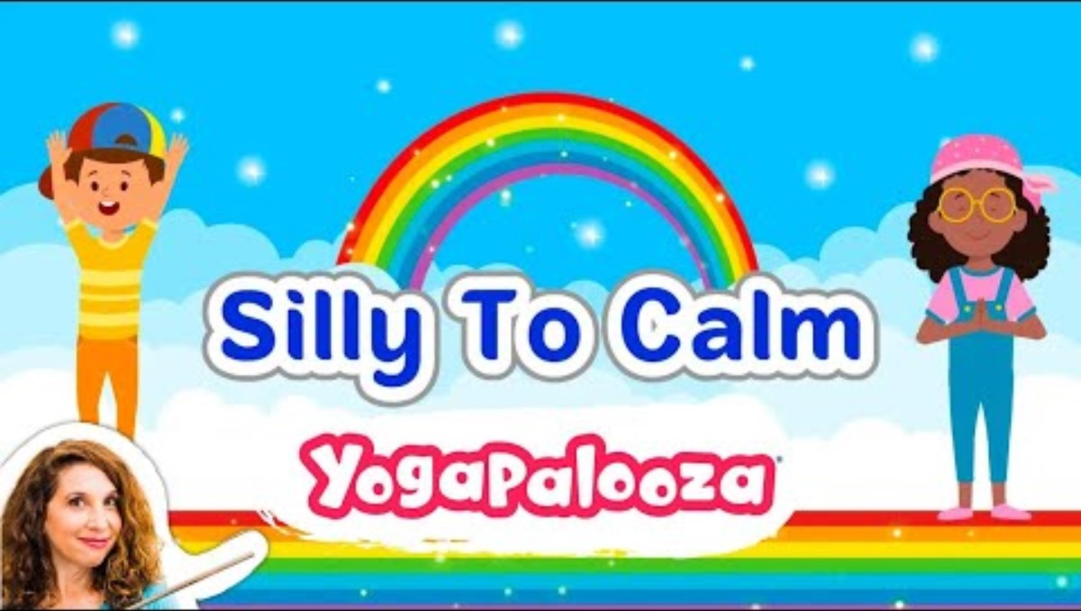
Notes:
Trainer Notes:
This is a physical activity break for your participants. https://www.youtube.com/watch?v=29DQJWGwEnY
(3:16)
Suggested Speaker Notes:
This brain break is Silly to Calm by Bari Koral. Bari is singer songwriter and yoga instructor who has released several albums for children. She has many videos available on YouTube. Please stand or remain sitting and participate as you are able.
Debrief the activity by discussing how the song might be used in the programs they work in?

Slide 15
Social-Emotional Skills in Early Childhood
Emotional literacy
Friendship skills
Problem solving
Behavior regulation
National Center for Pyramid Model Innovations
Notes:
Suggested Speaker Notes:
Friendship skills are the next social-emotional skill we will discuss.
Children with friendship skills demonstrate several behaviors including include organizing play (let’s play with the ball-we can kick it back and forth), sharing, and assisting others (helping a peer balance on a log). Having friendship skills allows opportunities to practice other social skills including cooperation and resolving conflicts.

Slide 16
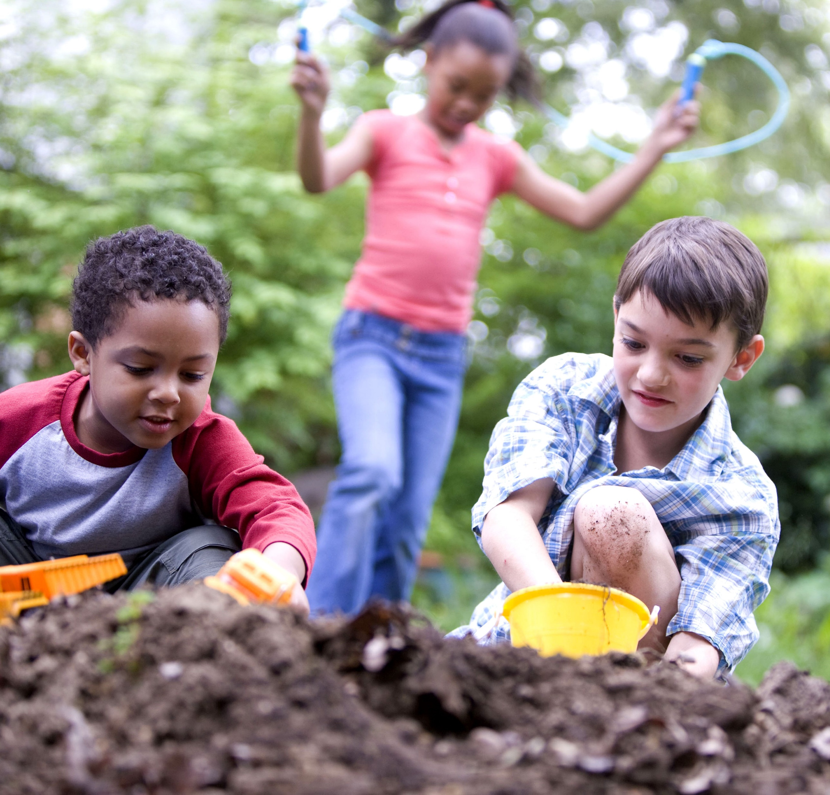
Friendship skills in early childhood
Organizing play
Sharing and taking turns
Cooperating
Negotiating
Helping others
Notes:
Suggested Speaker Notes:
Active play like all play gives children space to practice social skills. For play to continue in a fun way – each child must follow rules, control their impulses and be nice to the others engaged in the play.
The slide lists 5 friendship skills that are emerging in early childhood.
Organizing play
Sharing and taking turns
Cooperating
Negotiating
Helping others
Consider the two children playing in the foreground of this picture in the dirt. They appear to be digging and moving earth with trucks they are pushing.
What friendship skills can you imagine them practicing while playing?
Possible responses include:
Coordinating and organizing play-discussing roles, rules and sequence of play
Negotiating to reach agreement
Working toward a common goal
Practicing Communication skills
Resolving conflict
More information at You’ve Got to have Friends- Gail E. Joseph, Ph.D. & Phillip S. Strain, Ph.D. Center on Evidence Based Practices for Early Learning University of Colorado at Denver

Slide 17
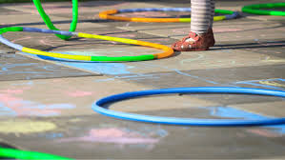
Promoting friendship skills in structured activities
Sharing space
Interacting in close spaces
Cooperating
Helping others in noncompetitive play
Notes:
Suggested Speaker Notes:
Caregivers can incorporate non-competitive games and activities that involve peer interactions. These type of adult-led or structured activities and allow children to practice friendship skills. Non-competitive games give all children the chance to practice skills and play as long as they are enjoying the activity. As providers, we want play to be fun and being eliminated from a game is not fun for a child.
One active game that promotes friendship skills is musical hula hoops, a non-elimination game where children play and move together.
Supplies needed for this game are hula hoops and music.
The game can be played indoors or outdoors.
Hula hoops are placed on the ground. If supplies support this, start with one hoop per child. If you have more children than hula hoops, this game can also be started without a hoop for each child. Children are instructed to listen to the music and move around the area. When the music stops, the children quickly move to stand inside a hula hoop. They can do this in small groups. Each time the music starts, or every so often, a hoop is removed. You can instruct them to move in different ways such as on tip toes, hopping like a bunny, or walking like a crab. As the number of hoops decrease children can stand with one foot in the hoop. Since this is not competitive, it prompts children to work together to achieve the task of getting in a hoop when the music stops.
What other ways might musical hoops promotes friendship skills?
Trainer Notes:
The PALS curriculum shared information on the Online Physical Education Network (OPEN) early childhood curriculum. https://openphysed.org/
This free curriculum resource promotes movement exploration for children 3-5.
A short video from OPEN demonstrates a trainer instructing caregivers on musical hula hoops. This may be useful for trainers to view as they prepare for the micro training.
https://www.google.com/search?sca_esv=7dcd546513c970a8&rlz=1C1GCEA_enUS1076US1076&tbm=vid&sxsrf=ADLYWII5QqPCfDcmqQ5jhzv8Z_AiTVtoEA:1715722000786&q=musical+hula+hoops&sa=X&ved=2ahUKEwi2mI_Dio6GAxUcv4kEHRZPA94Q8ccDegQIFBAH&biw=1366&bih=607&dpr=1#

Slide 18

Active Play Equipment to build Friendship Skills
Balls, baskets & other targets
Wagons or sleds
Rocking toys
Loose parts for building & creating
Hula hoops
Notes:
Suggested Speaker Notes:
Another strategy caregivers can use to promote practice of friendship skills during active play is to provide equipment designed for cooperative play.
Cooperative play is where children engage in activities together working towards a common goal. This type of play typically develops between the ages of 3 and 6.
The equipment listed supports active cooperative play. Loose parts such as sticks and small logs support creative play and allow children to be creative, encourage cooperation and communication. Portable play equipment that is easily accessible allows children to engage in play without a caregiver leading or directly play.
Caregivers may pair children to encourage cooperative play and join in play on the children’s terms role modeling friendship skills.
What equipment and items are popular for cooperative play in your program?

Slide 19
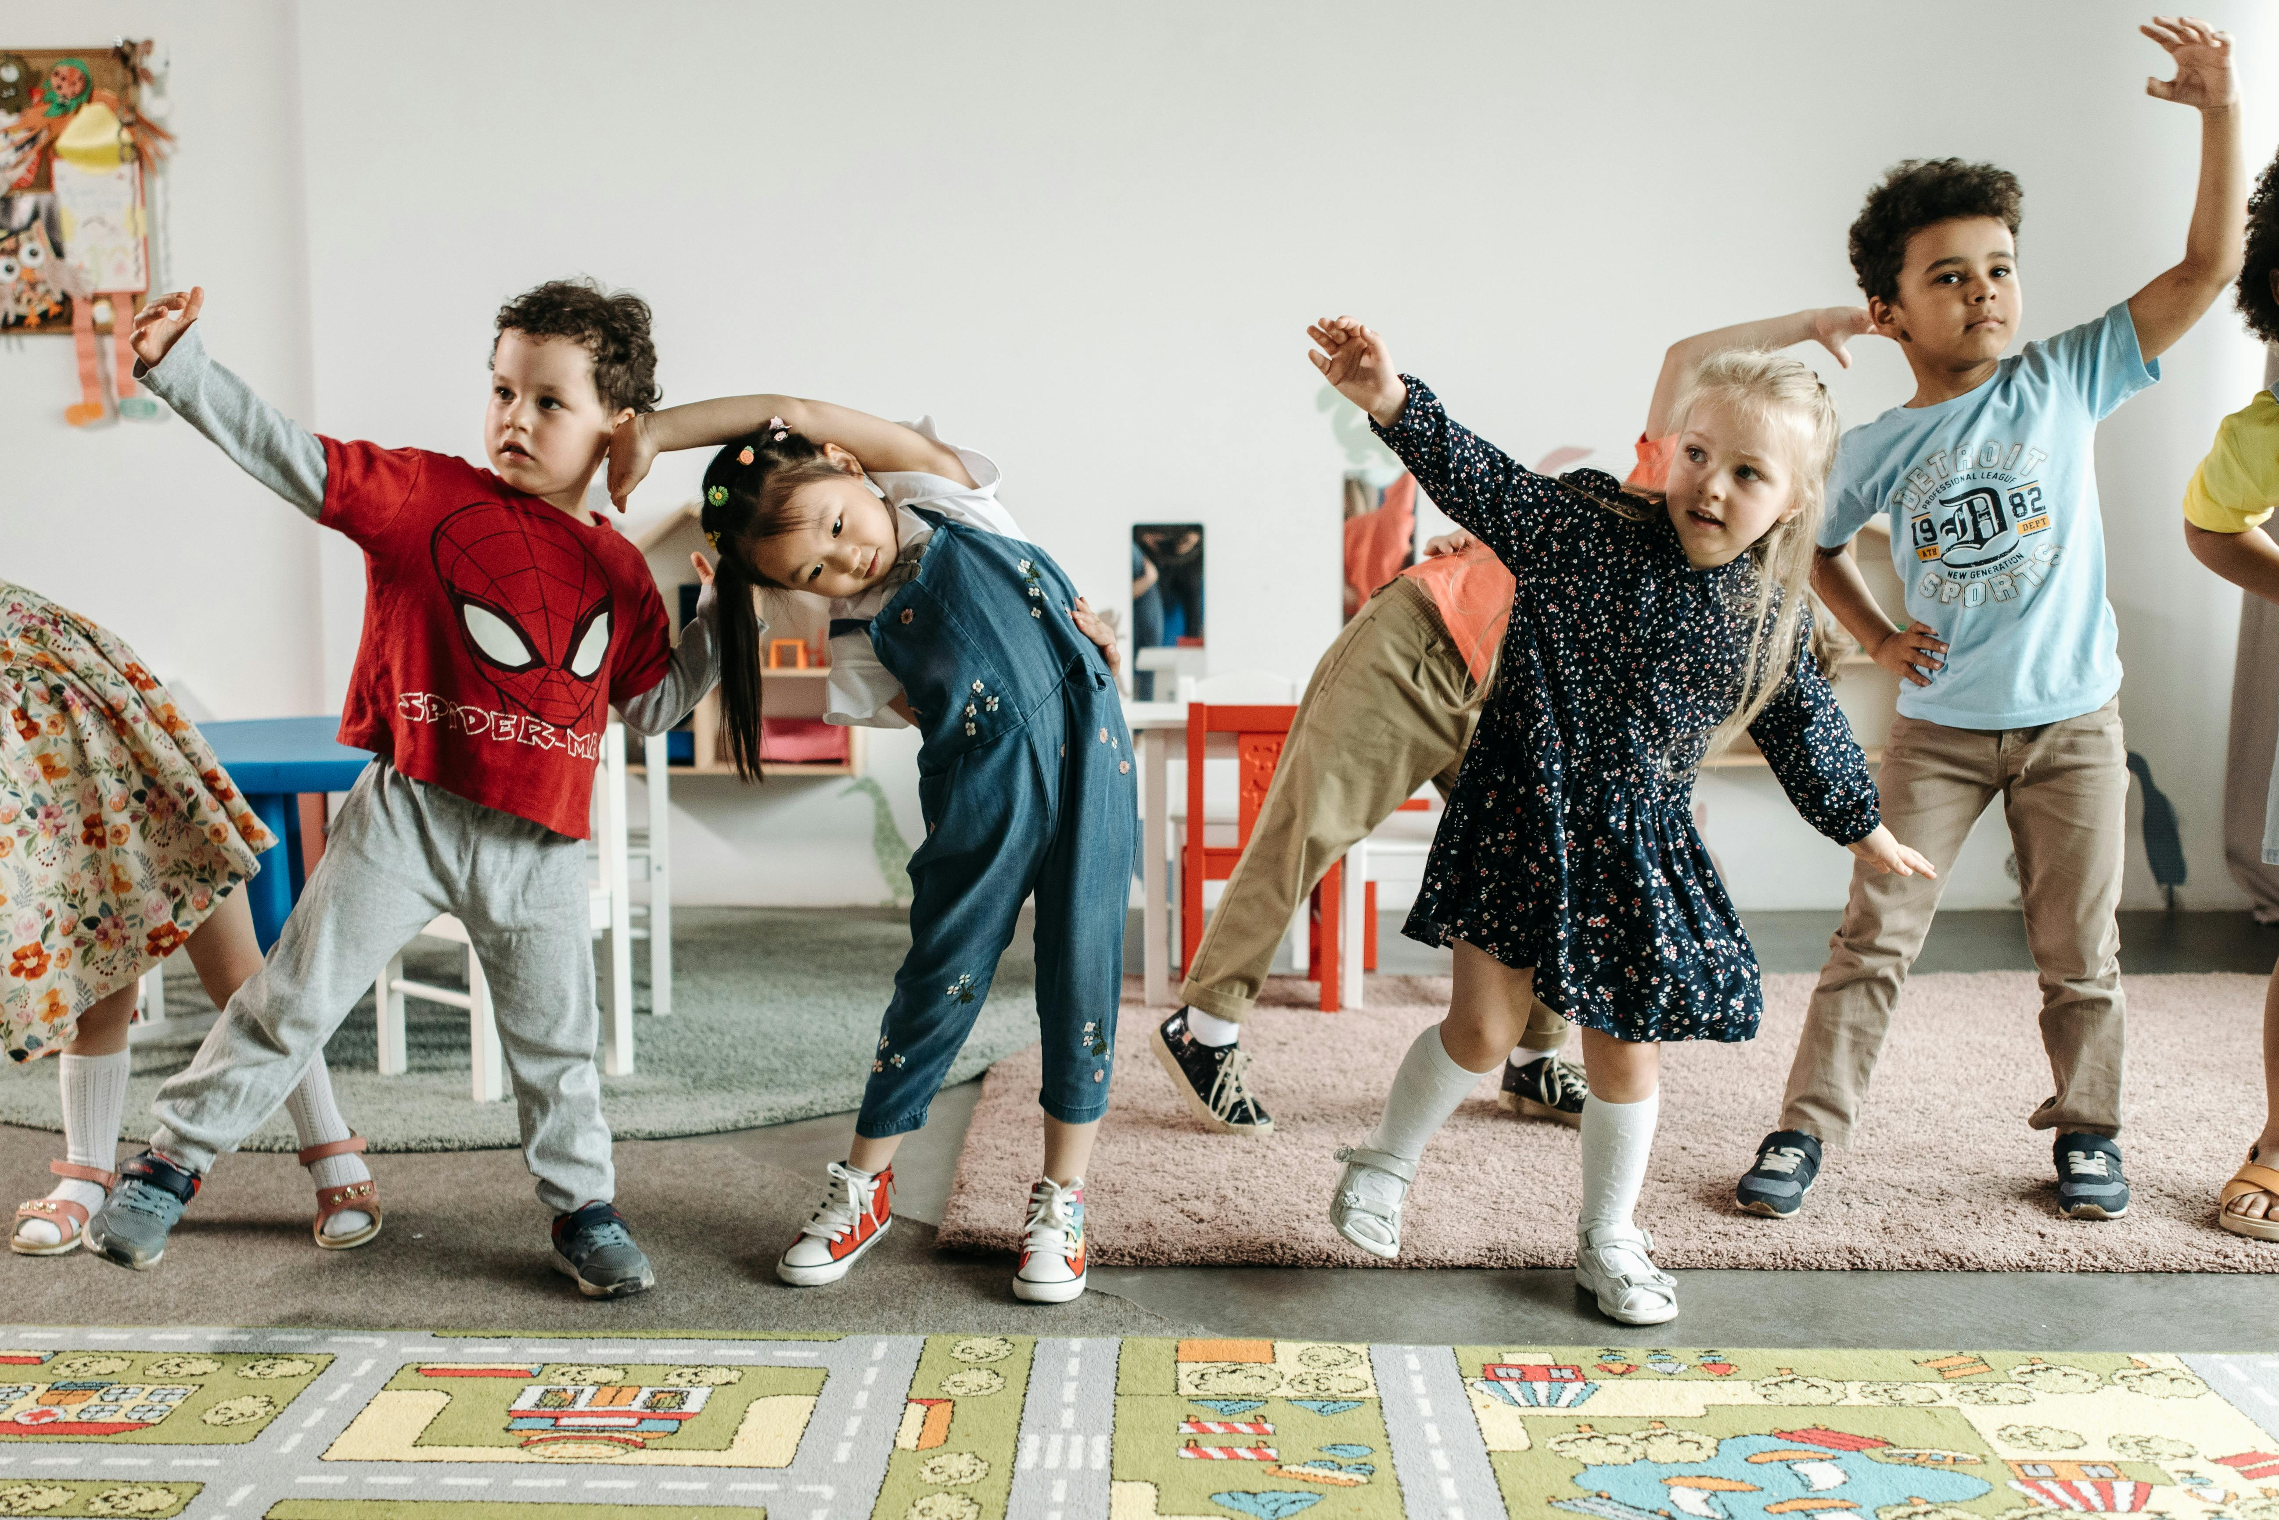
Caregiver Strategies to Support Friendship Skills
Pair children
Lead structured noncompetitive games and activities
Provide equipment that supports collaborative play
Praise the positive
Schedule free play
Notes:
Suggested Speaker Notes:
Let’s discuss some of the strategies that support Friendship skills in active play.
Pairing children encourages them to interact and work together
Noncompetitive games encourage children to work together for success
Certain equipment can inspire collaborative play
Praise or acknowledge from caregivers when children demonstrate friendship skills helps children recognize and understand the skill. “I see how you and Amy negotiated the space on the slide. That is using your friendship skills!”
Schedule free play

Slide 20
Social-Emotional Skills in Early Childhood
Emotional literacy
Friendship skills
Problem solving
Behavior regulation
National Center for Pyramid Model Innovations
Notes:
Suggested Speaker Notes:
The third social-emotional skill we will discuss in relation to active play is problem solving.

Slide 21
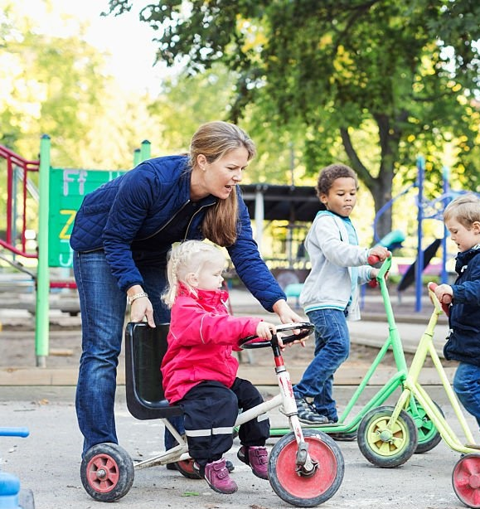
Problem Solving Skills
Identify the problem
Think of solutions
Evaluate solutions for safety, fairness, and the feelings of others
Ask for help
Notes:
Suggested Speaker Notes:
Problem solving skills include the steps to overcoming challenges such as recognizing the problem, thinking about solutions, evaluating possible solutions based on past experiences, and asking for help.
Trainer notes:
Encourage a large group discussion using the prompt “What can the caregiver in this image of a playground of wheeled toys do to assist children with problem solving in this situation?”
Notice that several children are using different types of wheeled toys in a small space.
As the trainer, Consider providing one or two examples as a starting point.
Set up clear boundaries such as by using cones
Encouraging children to rid, in a similar direction-for example clockwise inside the boundaries to reduce blocks in the traffic flow
Verbally describe problems to help children identify problem solving steps
It looks like we have a problem here-Ally and Jonah can’t move.
How can we solve this problem?
Remind children of boundaries/rules.

Slide 22
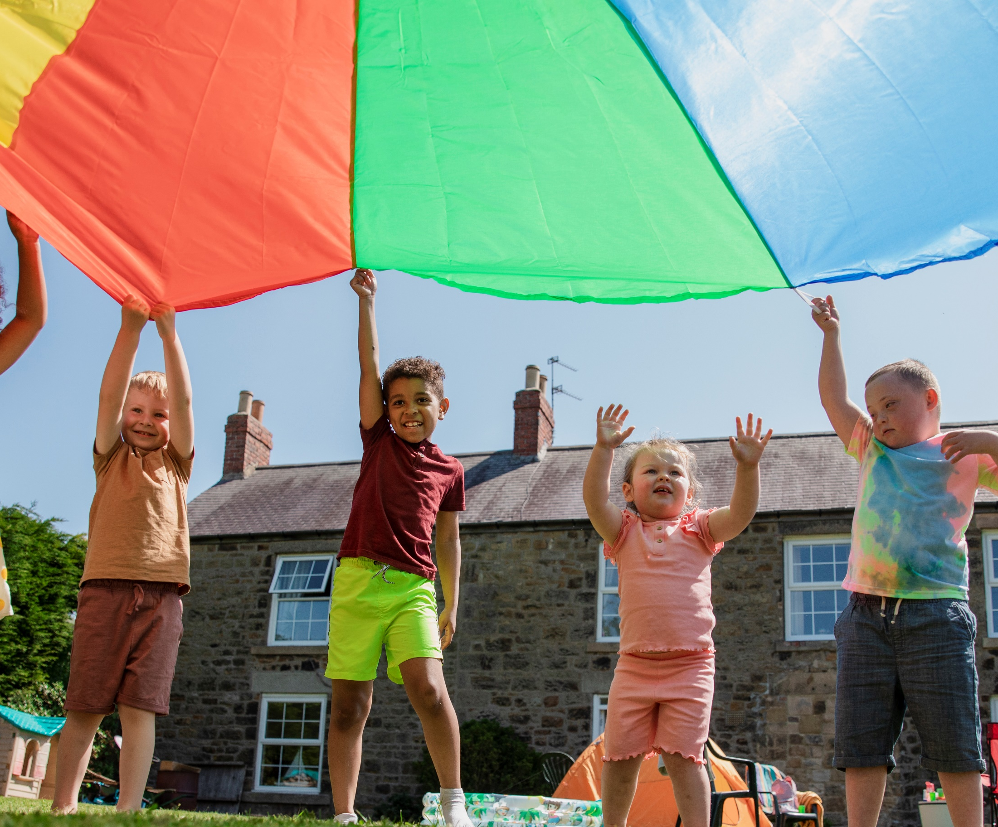
Promoting Problem Solving Skills with Parachute Play
Identify the problem
Think of solutions
Evaluate solutions for safety, fairness, and the feelings of others
Ask for help
Notes:
Suggested Speaker Notes:
Parachute play encourages children to work together to accomplish a task. Many group games with a parachute are cooperative and are non-competitive.
Parachute play is great for gaining strength and skills in the arms, shoulders and hands. Large piece of fabric such as a tablecloth or sheet can be used for parachute play. Many vendors have parachutes around $30 that have handles for little hands.
Games with parachutes are great for friendship skills and problem solving.
Trainer Notes:
Read the directions for one of the games listed below. Ask participants to brainstorm how the game promotes problem solving skills listed. If you have access to a parachute or large sheet, consider conducting one of the games as a physical activity break. Debrief the activity encouraging participants to reflect on how the game supports problem solving skills.
The Wave
Have children hold one or two handles and move their arms up and down. Like water in the ocean, the parachute will move in waves. Shake the parachute slowly for small waves and quickly for giant ones. This game can be done sitting on the floor or in chairs as well as standing.
Changing Spots
Have the children spread themselves evenly around the parachute and each take hold of a handle. As the kids lift the parachute high above them, call out a detail that some players will have in common. Whichever players share that detail must run and trade places with each other before the parachute falls.
Examples could include everyone wearing a blue shirt, everyone whose name starts with the letter C, or calling two children’s names.
Popcorn
Lay the parachute on the ground and place light objects such as balls or stuffies in the center. Have the children pick up one or two handles and on the count of three, begin shaking the parachute up and down. The toys will bounce up like popping popcorn! Can the kids work together to keep the toys from bouncing off the parachute?
Merry Go Round
Have the children hold a handle with their right hands so they’re all facing in one direction. Start by having them walk in that direction and on cue (could be your voice or a pause in music if you’re playing some), have them take the handle in their left hand and walk in the opposite direction. Can they skip in a circle with the parachute? Jog slowly?
More parachute games can be found at https://activeforlife.com/parachute-games-for-kids/

Slide 23
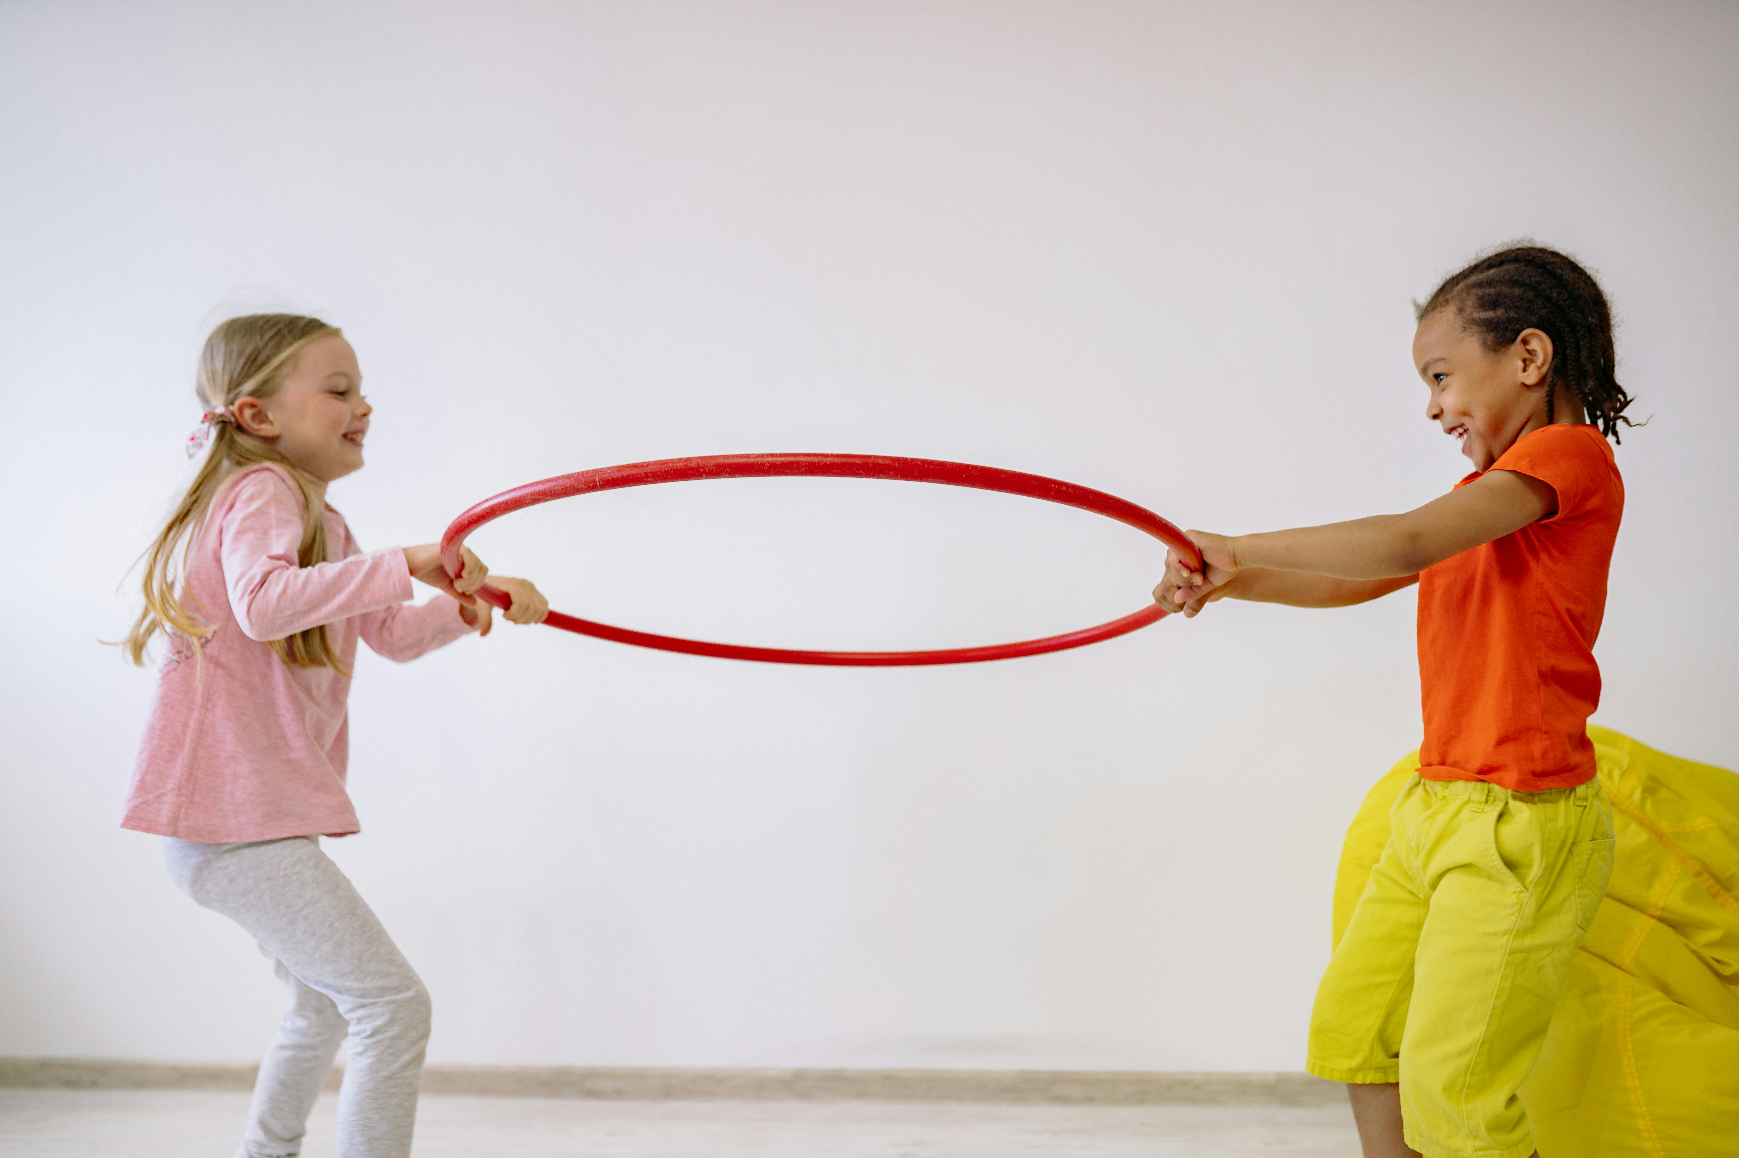
Coaching for Problem Solving
Respond versus react
Ask open-ended questions
Model out loud
Notes:
Suggested Speaker Notes:
On the slide are a few coaching skills to support problem solving among children. When educators coach children on the spot, they help children realize what they are doing, understand how their actions affect others, and choose positive alternatives. Let’s look at how these might sound in practice.
Respond versus react- Instead of immediately stepping in, an educator might pause and say “I see both of you want the same toy, let’s figure out what we can do.” This gives children time to think and builds their independence. These conversations can build vocabulary, identify and name emotions and normalize talking about emotions during play.
Ask open-ended questions to support children to develop their problem solving skills. Adults can guide thinking by asking “What could we try?” or “How can we solve this together” instead of giving direct solutions These types of questions help children generate their own solutions.
Model out loud- educators can support problem solving by teaching and modeling multiple ways to problem solve daily challenges. For example let’s imagine the scenario in the photo. An adult can say “Looks like there is only one hula hoop and both of you want to use it. Maybe we could take turns or use it together—what do you think?” These simple language shifts help children understand how to problem solve in real time.
What does coaching look like for you now? How do you use it in active play?
Think about using these skills more intentionally during active play
Photo by Yan Krukau from Pexels

Slide 24
Social-Emotional Skills in Early Childhood
Emotional literacy
Friendship skills
Problem solving
Behavior regulation
National Center for Pyramid Model Innovations
Notes:
Suggested Speaker Notes:
The final Social-Emotional skill we will discuss today is behavior regulation. Behavior regulation develops gradually beginning in infancy and involves using other social-emotional skills including emotional literacy and problem solving. Co-regulation is an important strategy to help young children develop behavior regulation.
Challenging behavior is a common training request and concern among providers. As professionals it is important to recognize that challenging behavior has many causes and one of our roles is to reflect and try to understand each child individually and consider possible causes such as change in routines, transitions, sensory overload, physical discomfort, or unmet needs. Equipping children with social-emotional skills can reduce the incidence of challenging behavior as it equips children with tools.

Slide 25
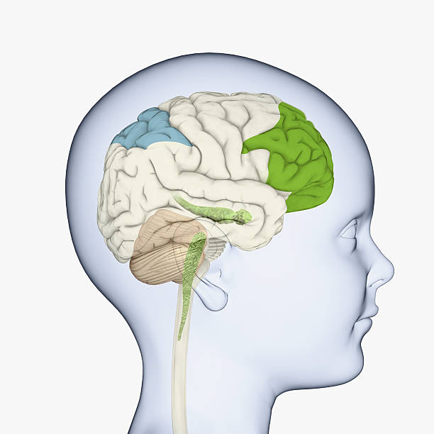
Behavior Regulation
Develops rapidly between the ages of 3 and 7 years
Experiences influence development
Active play activates the prefrontal cortex-the same area of the brain responsible for behavior regulation
Research show positive links between the amounts of MVPA experienced and behavior regulation
Notes:
Suggested Speaker Notes:
Behavior regulation involves the use of executive function skills. In early children this involves impulse control, paying attention, and applying information learned (for example remembering directions).
In simple terms, behavior regulation is the ability to manage emotions and behaviors to meet the situations and settings. Behavior regulation skills grow with experiences.
Children develop self-regulation through nurturing, responsive relationships and watching the adults around them model self-regulation.
Having opportunities to practice regulation is important.
The video we watched earlier in our session described out active, energetic play activates the part of the brain known as the prefrontal cortex; this is the same area of the brain responsible for behavior regulation.
Trainer notes:
MVPA is Moderate to Vigorous Physical Activity which refers to the intensity level of physical activity. MVPA is the combination of moderate activity, such as a brisk walk, and vigorous activity, such as running MVPA is a typical pattern in early childhood active play. We might see a child might run to a play structure and climb or ride a tricycle or strider bike fast then slow. MVPA is positively linked with behavior regulation skills.

Slide 26
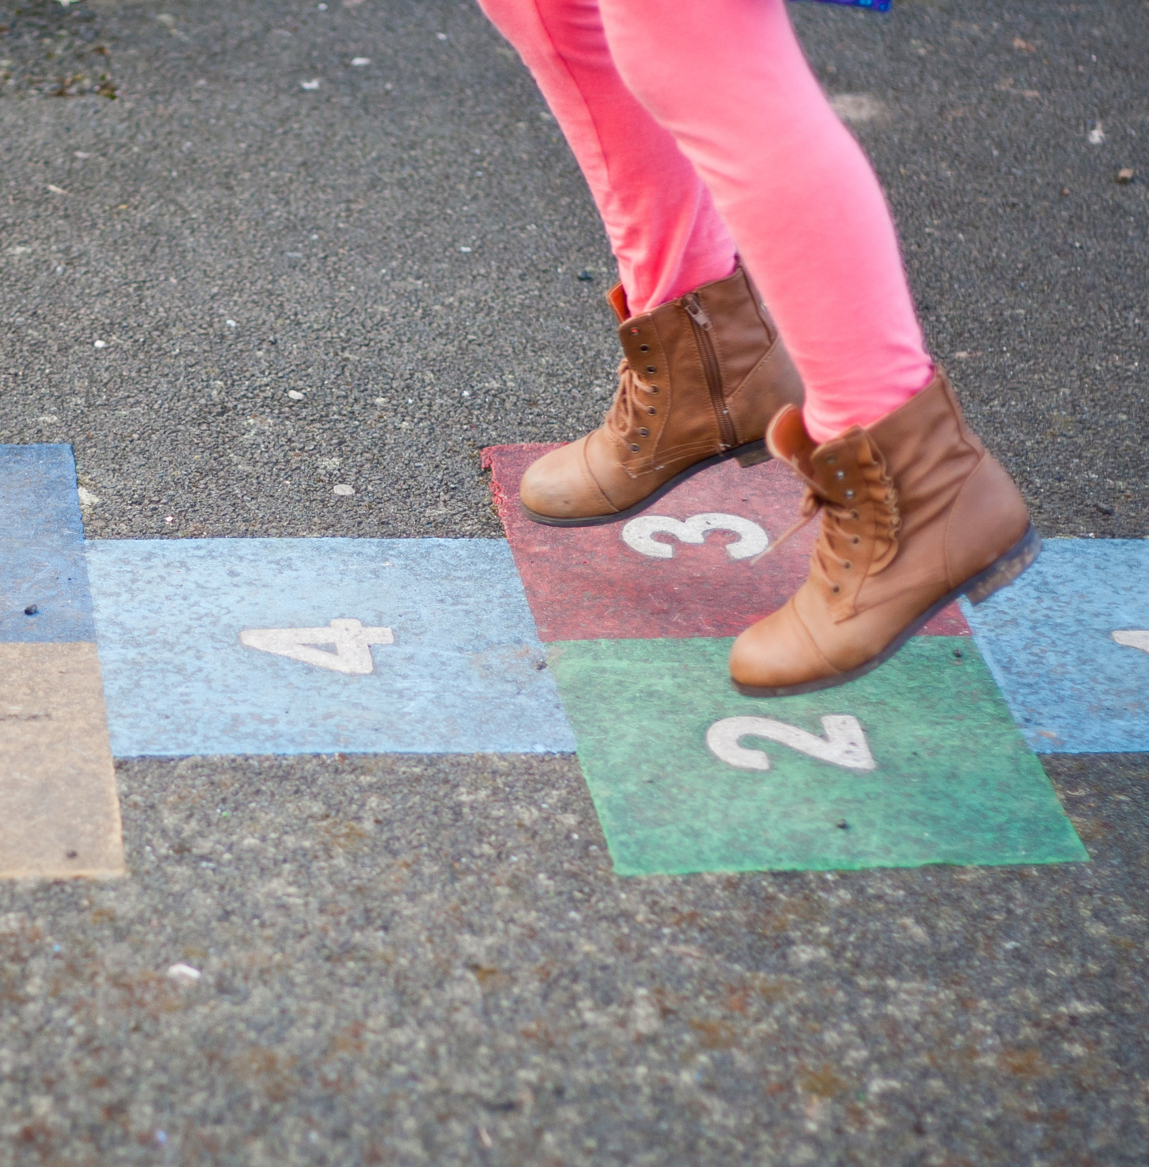
Behavior Regulation Skills
Maintaining attention
Switching focus
Remembering directions
Impulse or Self Control
Notes:
Trainer Notes:
Hopscotch grids can be made outdoors with chalk or paint as shown on the image or indoors with painters' tape or carpet squares.
Trainers will talk through the examples of how hopscotch supports the development of behavior regulation skills and on the following slide will challenge participants to independently consider examples from a different active game.
Suggested Speaker Notes:
The ability to regulate one’s behavior requires using several skills including the four listed on the slide: maintaining attention, switching focus, remembering directions and self-control.
Let’s consider the game of Hopscotch and how this game can give children opportunities to practice the four skills.
You recognize the traditional hopscotch grid on the slide with numbered squares. Let’s review simple rules of hopscotch for young children.
Read the directions for hopscotch
Each player tosses a small object such as a bean bag inside one of the squares on the hopscotch grid.
Next the player hops from square to square, hopping over the square where the bean bag rests using one foot in single squares and both feet in side-by-side squares. At the end of the grid the player turns and hops back, stopping to pick up the bean bag on the return. Rules can become more complex as children get older. Hopscotch could be simplified further by omitting the tossing and having children hop through the pattern.
The goals of hopscotch are to hop without losing balance, to jump in the squares, not on the lines, and to pick up an object while balancing. We can see the change to practice fundamental movement skills of tossing, hopping balancing and turning.
Consider how does hopscotch gives children an opportunity to practice the behavior regulation skills listed on the slide.
Maintaining attention- Child maintains awareness of the square where the bean bag lies in order to hop over it as well as the pattern for jumping one foot, both feet. What else is the child attending to?
Switching focus-Hopscotch requires the child to stop movement and change direction at the end of the grid and to pause hopping to bend over and pick up the bean bag. These activities are a change in focus. What other examples of switching focus are there in hopscotch?
Remembering directions- While playing hopscotch children follow simple rules (directions) and take turns. Caregivers can advance rules as children develop skills and are able to remember more rules.
Impulse or self-control- Children are practicing physical control of their bodies in hopscotch as they become aware of their movements and understand where their body is in space (proprioception). There may be chances for emotional control as they experience frustration at loosing balance or excitement at their success.
Optional speaking notes:
Adaptations for early childhood:
Draw a longer hopscotch pattern and eliminate turning at the end. Start a second child on the grid as the first child nears the end.
Vary the shape of the pattern- use circles instead of squares. Use a zig zag or circles instead of a straight grid.
Adaptions as children gain skills:
Play with traditional rules of completing the gird by throwing in the ‘1’ square, completing the course and throwing in the ‘2‘square repeating for each numbered square.
Draw the hopscotch in a spiral shape or with twists.
Add a twist, hop backwards, jump twice or three times
Variations of hopscotch, with different names, are in played in India, France, Argentina and Vietnam.

Slide 27
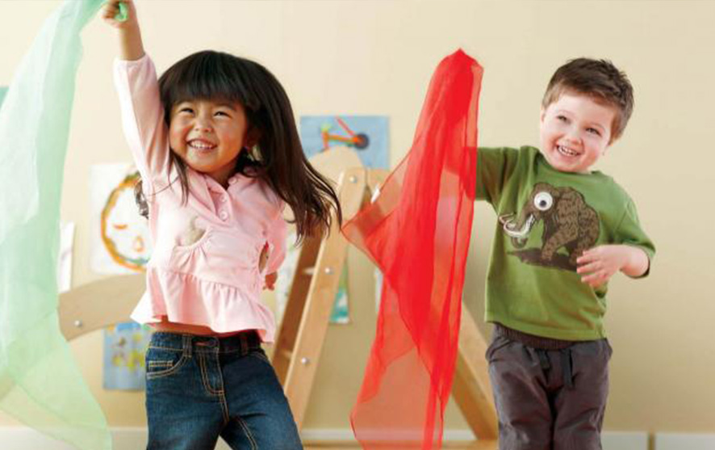
Behavior Regulation Skills
Maintaining attention
Switching focus
Remembering directions
Impulse Control
Notes:
Trainer Notes:
Read the directions for this variation of freeze dance with streamers and challenge participants to describe how this active game can allow children an opportunity to practice the skills on the slide.
Suggested facilitation techniques include a large group discussion or pair and share activity.
Facilitate a large group discussion encouraging participants to think about the skills on the slide and this active game allows children to practice the skill.
or
Ask participants to gather in groups of 2 or 3 and identify an example of how freeze dance supports two of the skills making up behavior regulation.
Suggested Speaker Notes:
In freeze dance, everyone dances as the music plays and waves their scarf or streamer in the air. Before children start moving, they should be given directions on the boundaries of the dance or play area and expectations on keeping everyone safe ‘pay attention to where you are moving and personal spaces. When the music stops, children must freeze and hold the position until the music begins again. If a player does not freeze, they draw 3 big circles in the air with their scarf when the music starts before they begin dancing. In freeze dance the caregiver can change the way children move each time the music starts.
What behavior regulation skills are children experiencing with freeze dance?
Possible responses include:
Maintaining attention:
Staying attuned to the music starting and stopping
Maintaining awareness of where their body is in space (proprioception) and the movement of others to avoid collisions
Holding the ‘freeze’ position
Switching focus
Changing from movement to stillness
Changing the type of movement (sliding, hopping, tip toes, heels, etc.
Remembering directions:
Freeze dance ‘rules’ are simple but children must also remember the safety rules.
Impulse Control:
Holding still when there is no music
Photo by Pavel Danilyuk: https://www.pexels.com/photo/children-dancing-8422100/

Slide 28


What are some active games or
movement activities
that provide opportunities to practice
behavior regulation skills?
Maintaining Attention
Switching focus
Remembering Directions
Impulse Control
“Simon Says”
Red light, Green light
Yoga & Balance Poses
Notes:
Trainer Notes:
This is a brainstorming activity asking participants to games they use with children that support the behavior regulation skills. Three games are listed on the slide. Speaker notes have one example of how each game supports one behavior regulation skill. Encourage participants to consider games they do or have done with children.
Suggested Speaker Notes:
Simon Says encourages children to maintain attention to the caller's instructions and listen for ‘Simon Says’. Children practice impulse control to listen and think before moving.
*Note that there are several ways to play no-elimination Simon Says including dividing the children into two or more groups. When a child is tricked, instead of falling out of the game they simply move to the other group. Active games should allow all children to play as long they are interested.
During games of Red Light, Green Light, children practice switching focus from movement to stillness and maintain attention on the caller’s instructions.
Yoga & Balance Poses encourage children to maintain attention on their position and breathing.

Slide 29
Objective 3
Identify one strategy to incorporate into your practice that supports Social-Emotional skill development
Notes:
Suggested Speaker Notes:
The final objective of the training challenges you to identify a something you will bring back to your program. This might be active games we have discussed that you will share with children, changes to your schedule to allow more opportunities for active free play or caregiver practices.

Slide 30
Caregiver Strategies to Nurture Skills
Practice co-regulation
Role model the use of social-emotional skills
Teach, coach, and guide as children are learning skills
Provide experiences to practice skills
Active play offers opportunities for social interactions where children practice social-emotional skills by taking turns, playing with others, and following instructions
Notes:
Suggested Speaker Notes:
The content today has presented many strategies and activities providers can use to nurture the development of social-emotional skills in young children. Families and caregivers influence social-emotional skill development in children by role modeling use of skills, providing experiences for children to practice skills, and coaching as children are learning skills. Coaching on the spot helps children understand their actions and how their actions affect others. Coaching can be as simple as walking a child through the situation or problem, helping children understand what happened, labelling emotions they may have felt as well as the emotional of peers. What skill does the child need to be successful the next time? Ask the child did you use your friendship skills? Did you use your problem-solving skills? Help them understand the skills they can use to be successful in the situation. This includes asking an adult for help.
While leading structured active play and observing free play caregivers can guide children through situations where they use skills. During these interactions acknowledge and reinforce positive behaviors, teach expectations and behaviors in different settings, and discuss replacement behaviors when challenging behaviors are presented.

Slide 31
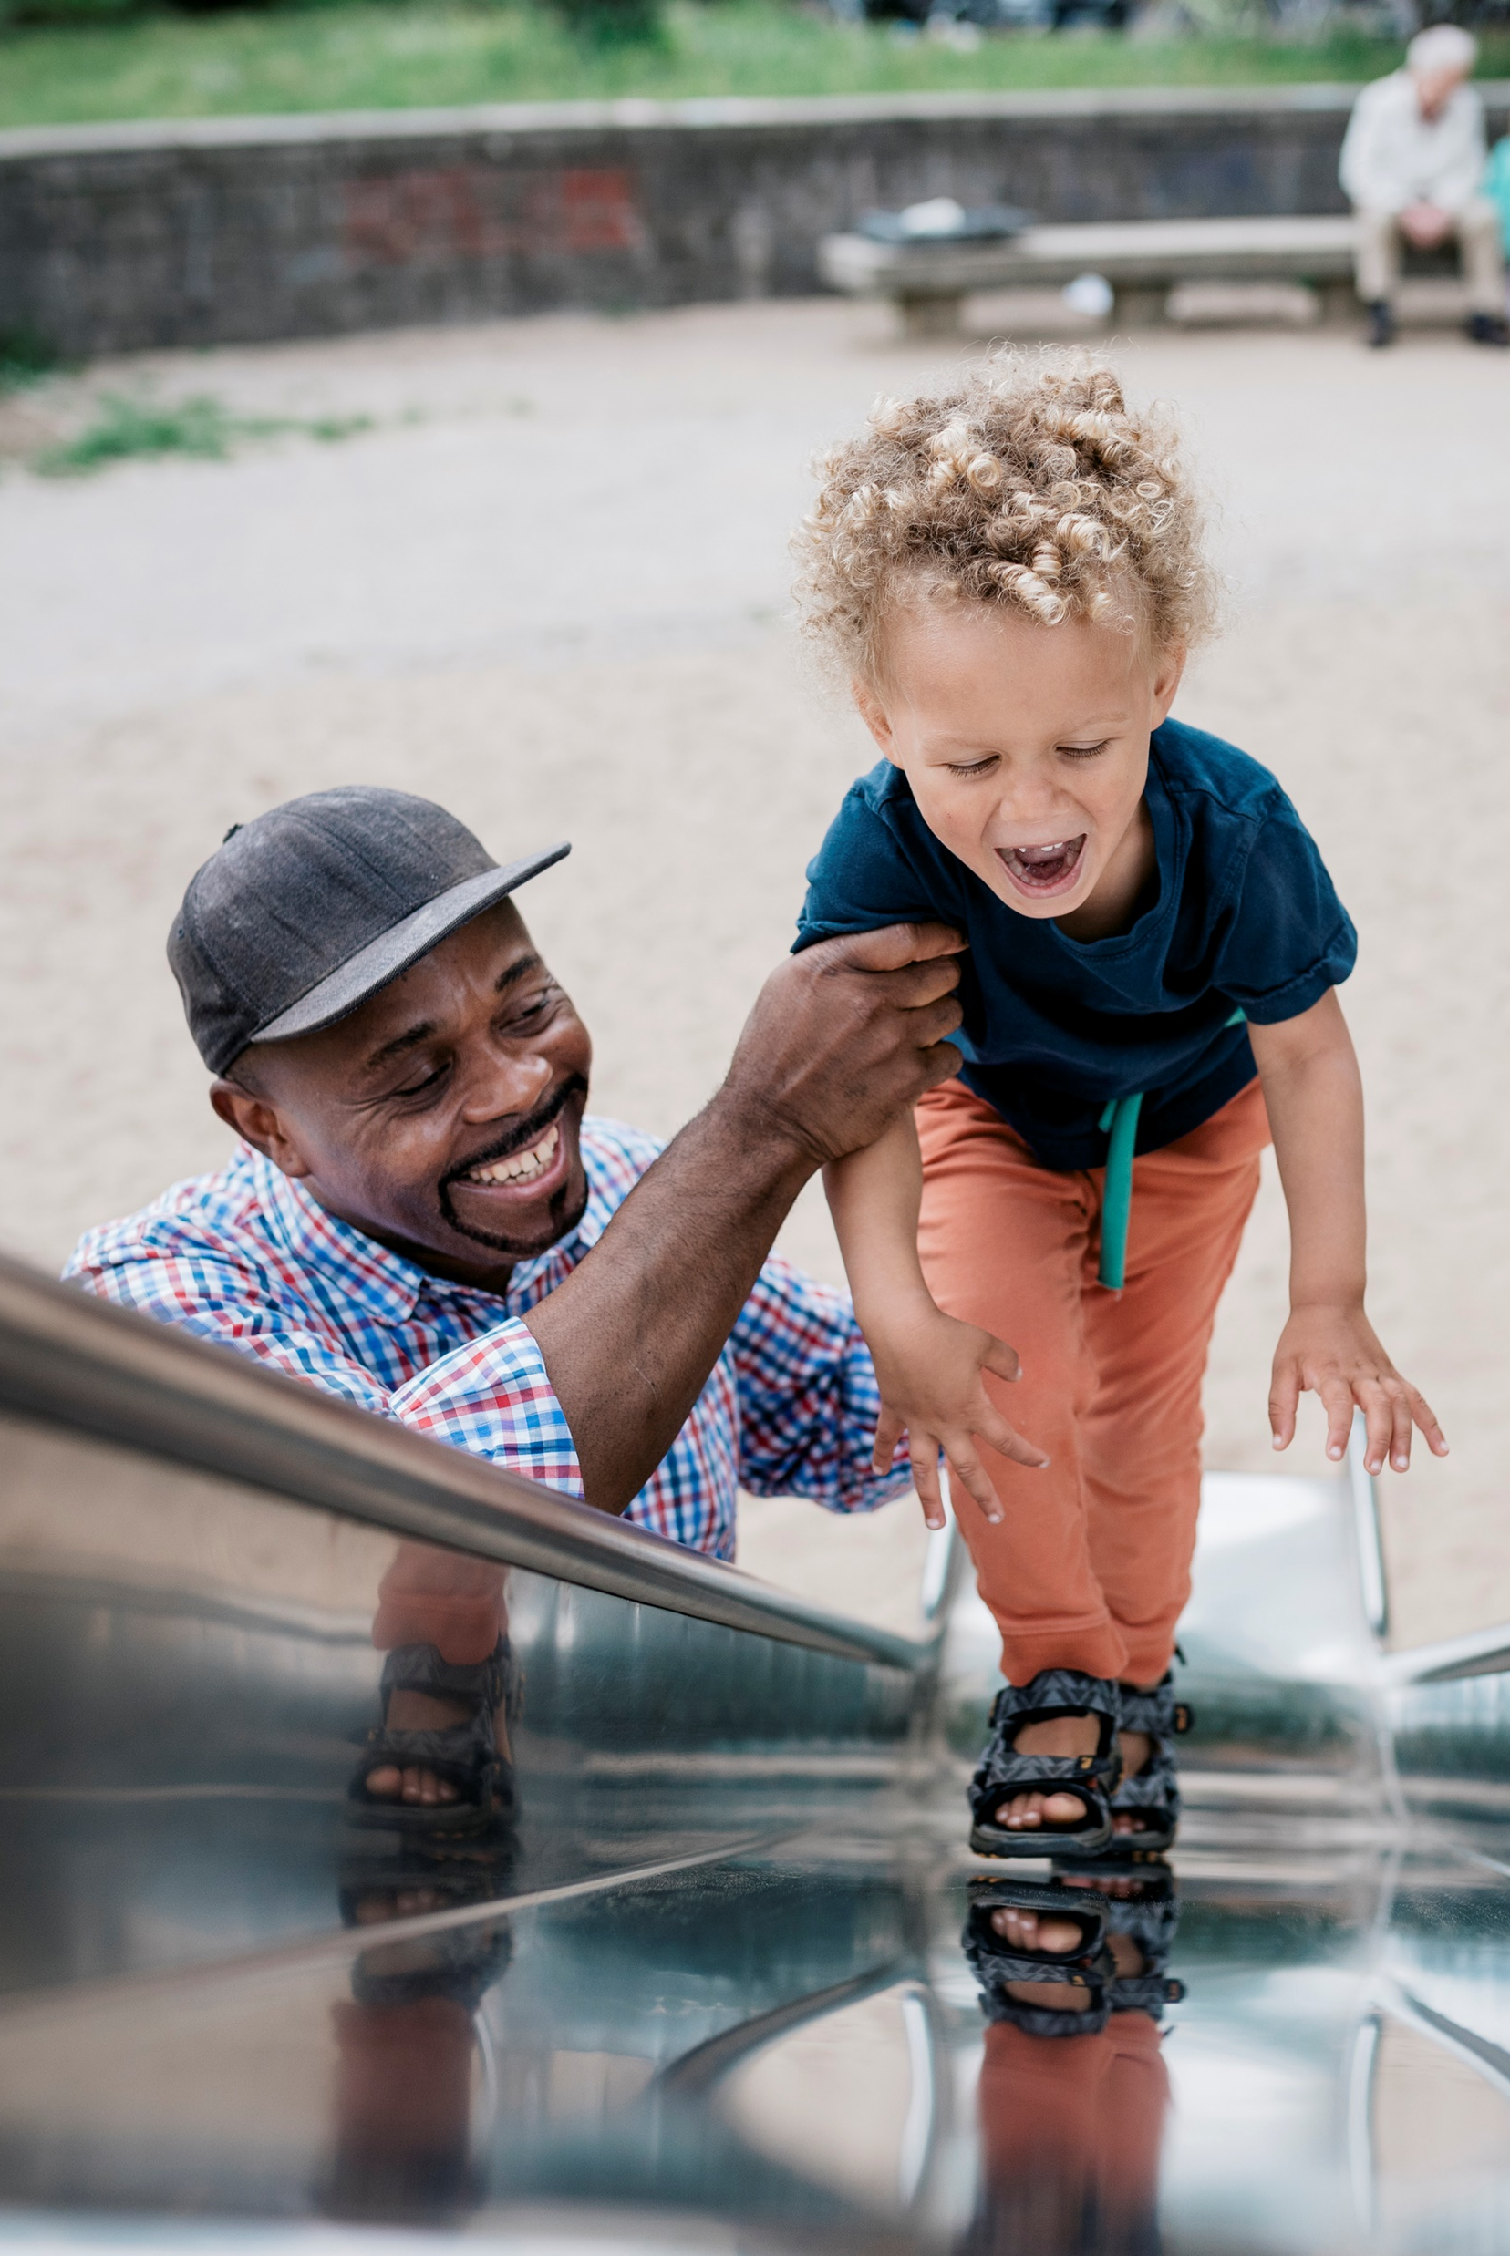
Classroom Strategies
Use stories to talk about different social situations and how each person might be feeling Ask “What would you do?” to help develop problem solving skills.
Encourage kids to try new things and learn how much they are capable of.
Play games to teach kids how to take turns, share, and negotiate.
Adapted from Early Social-Emotional Development Pathways.org
Notes:
Suggested Speaker Notes:
Early care programs are rich places for social-emotional learning. Three strategies are listed on the screen. What strategies do you use with children?

Slide 32

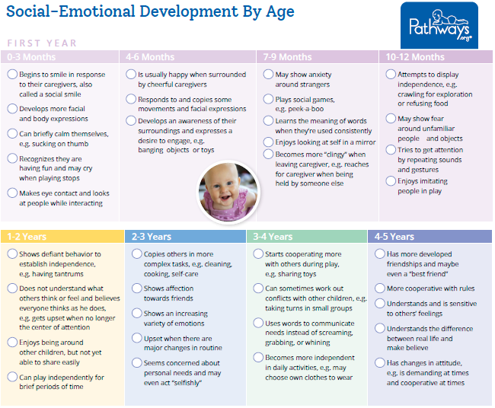
Engaging Families
Notes:
Trainer Notes:
Distribute the handout in the Trainer Materials. The brochure from Pathways is available in English, Hindi, Italian Oriya, Persian, Spanish and Turkish and can be accessed at https://pathways.org/print/social-emotional-brochure/
Trainers are encouraged to incorporate any state materials for families on early childhood social-emotional development. Early Intervention Programs, Early Childhood Mental Health Specialists and Child Care Health Consultant Networks are agencies that may have resources tailored to communities. Trainers may add state materials as additional resources for participants or replace the Pathways materials.
Suggested Speaker Notes:
Developmental milestones give caregivers and families a general understanding of when children will learn certain skills. While all children develop at their own pace, understanding the milestones can help caring adults be on the watch for new skills and aware of any skills they are missing. The brochure distributed shares a continuum of social-emotional skill development for children birth to 5 years old. Take a few moments to look at the age group you work with.
How might you share this resource with families?
Families are the child’s first teacher for social-emotional skills. Cross cultural differences exist in social skill development and expectations of children. While cultural norms and values can influence social emotional skill development there are unique differences in all families. Provider led conversations on the families' expectations and goals for their child’s development can help everyone work together to build skills.

Slide 33
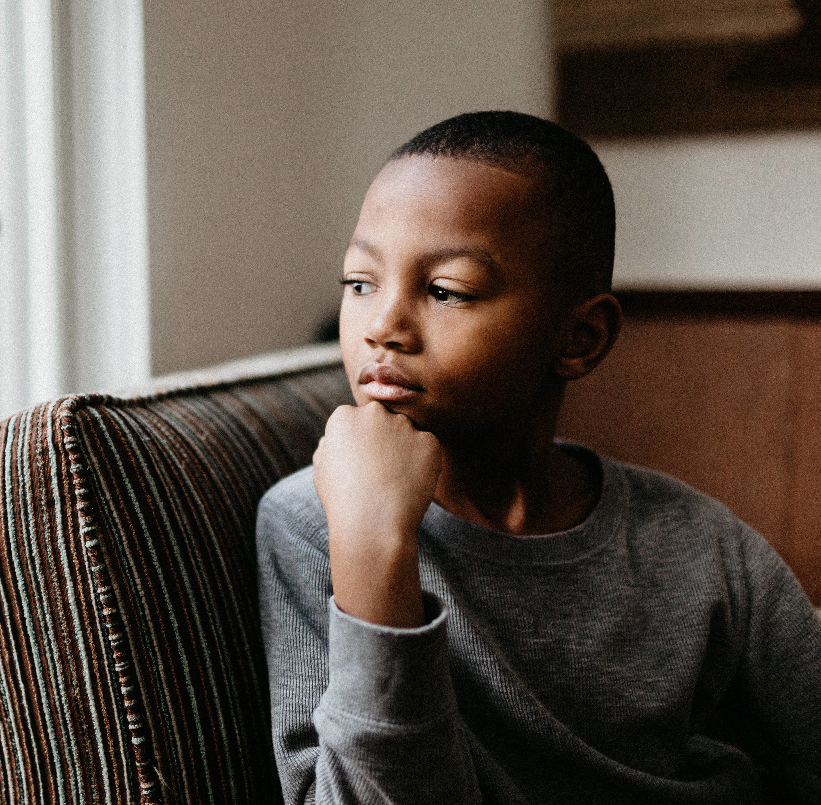
Taking away active play as a form of discipline
“Active play should never be withheld from children who misbehave (e.g., child is kept indoors to help another caregiver/teacher while the rest of the children go outside). However, children with out-of-control behavior may need 5 minutes or fewer to calm themselves or settle down before resuming cooperative play or activities. “
Caring for our Children 4th edition.
Notes:
Trainer Notes:
The picture on the slide is intentionally selected to depict a Black child as Black children, especially Black boys, are more likely to suffer this form of discipline which removes them from classroom and activities than their peers. Black preschoolers are 3.6 times as likely to receive one or more suspensions relative to White preschoolers. This is particularly concerning as Black children make up only 19% of preschool enrollment but comprise 47% of preschoolers suspended one or more times. Similarly, boys are three times as likely as girls to be suspended one or more times. When a child is removed from the classroom sent to the director’s office for behavior challenges, this is in-school/in-program suspension. Child care programs may not use the same language (expulsion or ‘suspension) as is seen in K-12 settings, but the practice of being sent to the directors' office has the same impact of removing a child from the learning setting, learning experiences and opportunities to be physically active.
Many states have additional trainings available on guiding children’s behaviors and nurturing social-emotional growth including workshops on the pyramid model, trainings from the Center for Advancing Social-Emotional Learning (CASEL), and Head Start Early Childhood Learning and Knowledge Center (ECLKC) behavior coaching.
Suggested Speaker Notes:
The statement on the screen is taken from Caring for Our Children: National Health and Safety Performance Standards Guidelines for Early Care and Education Programs
“Active play should never be withheld from children who misbehave (e.g., child is kept indoors to help another caregiver/teacher while the rest of the children go outside). However, children with out-of-control behavior may need 5 minutes or fewer to calm themselves or settle down before resuming cooperative play or activities.
Throughout today’s training we have discussed the many ways that active play can promote the social emotional skills children need, skills that equip a child with the ability to communicate and express feelings, make friends and practice behavior regulation. These social emotional skills are essential to reducing challenging behaviors. Our content today has also shared how active play releases hormones (endorphins) that counter the effects of stress hormones such as cortisol. Physical activity benefits children and adults by regulating mood, reducing stress, and improving mental alertness and focus. Taking away active play can impair relationships between children and caregivers and can impact a child’s sense of self-worth.
More information on this content can be found in the resources below:
Novak, S. (2023, January 12). Half of the 250 Kids Expelled from Preschool Each Day Are Black Boys. Scientific American. https://www.scientificamerican.com/article/half-of-the-250-kids-expelled-from-preschool-each-day-are-black-boys/
Dombro, A., Jablon, J., Johnsen, S., & Children, Y. (2016). Coaching with powerful interactions : a guide for partnering with early childhood teachers. National Association For The Education Of Young Children.

Slide 34
TAKE Back Activity
Talking Point What is something from this session you will share with others?
AHA moment What new information or ideas did you hear?
Keeper List an activity you want to keep and use with children?
Energy What energizes or excites you about social-emotional learning and active play?
Notes:
Trainer Notes:
TAKE BACK is the summary activity for the session.
This activity guides participants to consider the content that stood out and resonated for them and to identify the concepts, activities, and materials they will incorporate into their practices.
A participant handout for the activity is included in the Facilitator Guide materials. This activity can also be done with an index card or sticky note.
The activity can be facilitated as a small group activity, a pair and share, or a large group discussion. If you are facilitating the session virtually, break out rooms can be effective.
Suggested Speaker Notes:
In just a moment I will ask you to group in twos or three to identify a response for each of the prompts on the screen.
T- Talking Point- what is something from this session you will share with peers or the families of children in your care?
A- AHA Moment- What new information or ideas did you hear today?
K-List a new activity or resource you want to keep and try with children?
E- What energizes or excites you about social-emotional learning and active play?
After 3 minutes we will regroup to share responses.

Slide 35
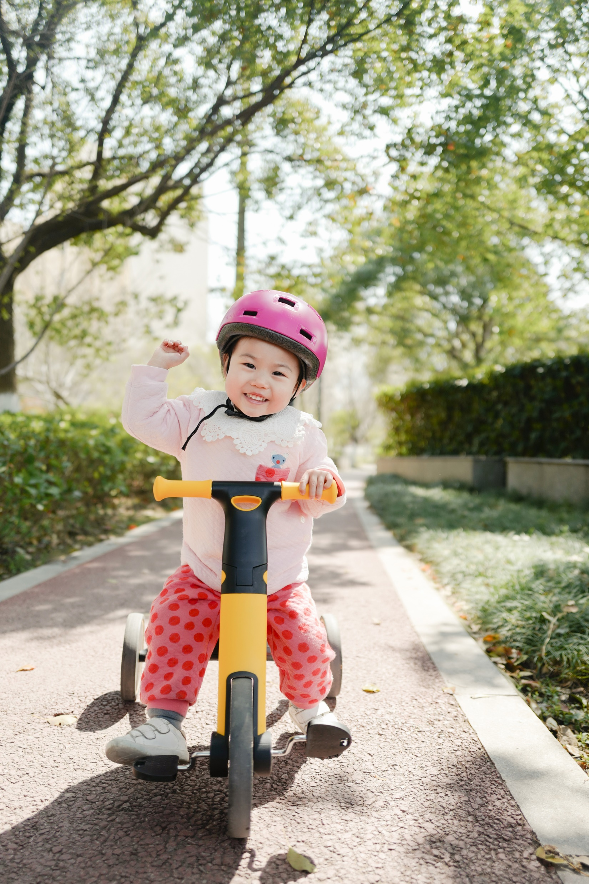
Play gives children a chance to practice what they are learning...They have to play with what they know to be true in order to find out more, and then they can use what they learn in new forms of play.
Fred Rogers
Notes:
Trainer notes:
Share this quote statement from Mr. Rogers on play.

Slide 36
Questions and Comments
Notes:
Trainer Notes:
Invite your participants to raise any remaining questions or share other comments on physical activity and social-emotional learning.
Share dates and information on any upcoming PALS sessions or micro trainings with your participants.

Slide 37
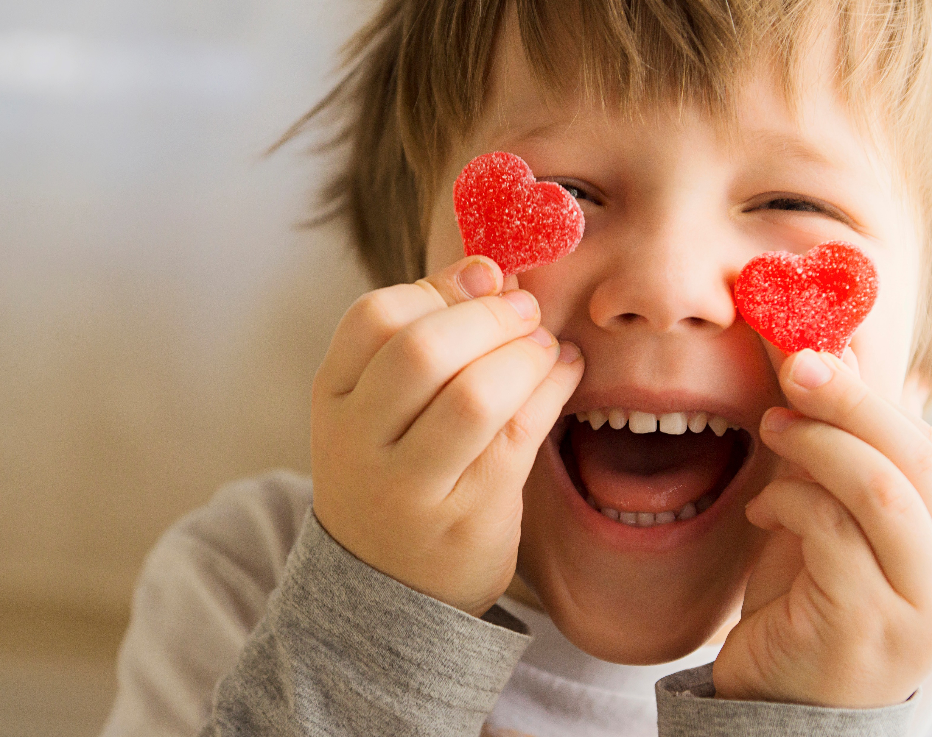

Thank you for joining today’s training!
Insert Trainer
Contact information
Notes:
Trainer Notes:
Thank your participants for their engagement during the training.
Image source: Microsoft Stock Photo

