Slide 1
Increasing Active Play at Child Care:
Outdoor Activity Settings
Add your name, agency logo, and contact information here
Notes:
Trainer notes:
This session is targeted at participants who have attended PALS sessions and have an understanding of the best practices of physical activity in early childhood settings and providers interested in outdoor play and learning. Concepts from PALS will be reviewed. The participants in your training may be a mix of administrators, classroom teachers and home providers. Some of your participants will not have the ability to influence the outdoor space or create activity settings. This session will introduce ideas and concepts they can bring back to their program to influence future quality improvements.
Suggested speaker notes:
Welcome to this bonus session of PALS. This training will build on the importance of outdoor play covered in PALS. Research reveals that children are more active when outdoors and the features or qualities of the outdoor settings influence the levels and amounts of their activity. Studies have shown that children are more physically active in outdoor settings that offer a range of activities and opportunities. During our session today we will learn about outdoor setting and reflect on settings we’d like to incorporate into the outdoor spaces at our child care sites.
Trainer Resources
The following resources will help build content knowledge to support trainers as they facilitate discussions on the concepts presented in the training session.
Smith WR, Moore R, Cosco N, et al. Increasing physical activity in childcare outdoor learning environments: The effect of setting adjacency relative to other built environment and social factors. Environ Behav. 2016;48(4):550-578. doi:10.1177/0013916514551048
Adding value to early childhood outdoor play and learning environments. Naturalearning.org. Accessed May 24, 2023. https://naturalearning.org/adding-value-to-early-childhood-outdoor-play-and-learning-environments/
Measuring physical activity affordances in preschool outdoor environments. Naturalearning.org. Accessed May 24, 2023. https://naturalearning.org/measuring-physical-activity
How-to Guide Outdoor Play with Infants and Toddlers. Accessed May 19, 2023. https://www.nwf.org/-/media/NEW-WEBSITE/Programs/ECHO/How-To-Guides/ECHO_HowTo_InfantAndToddlerPlay.ashx?la=en&hash=6F9371F2B9C0214A055B9A1B464C0C146548EA2A
Suggested participant handouts:
Nemours session handout: Increasing Active Play at Child Care: Outdoor Activity settings
Natural Learning Initiative (NLI) Infosheets
Gross Motor Logs- https://naturalearning.org/13-gross-motor-logs
Multi-Purpose Lawns- https://naturalearning.org/16-multi-purpose-lawns
Pathways- https://naturalearning.org/09-pathway-designs
Top Ten Activity Settings for Outdoor Learning- https://naturalearning.org/02-top-ten-activity-settings-for-outdoor-learning

Slide 2
Disclaimer
Nemours is currently funded by the Centers for Disease Control and Prevention (CDC) under a five-year Cooperative Agreement (5 NU38OT000304-05-00) to support statewide early care and education (ECE) organizations to integrate best practices and standards for healthy eating, physical activity, breastfeeding support, and reducing screen time in ECE systems and settings. The views expressed in written materials or publications, or by speakers and moderators do not necessarily reflect the official policies of the Department of Health and Human Services, nor does the mention of trade names, commercial practices, or organizations imply endorsement by the U.S. Government.
Notes:
Suggested speaker notes:
This training was made possible with funding from the Centers for Disease Control and Prevention (CDC). The views expressed in the content do not necessarily reflect the official policies of the Department for Health and Human Services.

Slide 3

We especially thank:
Notes:
Suggested speaker notes:
The development of this training was a component of the Early Childhood Outdoor Play and Learning Train the Trainer Course at NC State University. Development was funded by the CDC.
Trainer notes:
The following training plan is provided to support entry into professional development registry systems and to assist you as you plan and promote your session.
Training Plan
Session Title: Increasing Active Play at Child Care:
Outdoor Activity Settings
Session Description: During this workshop, participants will examine the use of activity settings as a strategy to boost physical activity and learning in outdoor spaces. The concepts of affordance and spatial range will be explored. Participants will identify 1-2 activity settings to strengthen their current outdoor spaces.
Session Objectives:
1. Understand the concepts related to outdoor play and learning (affordance, activity settings, and spatial range).
2. Identify activity settings in early care outdoor settings that encourage physical activity.
3. Recognize activity settings that support active play to incorporate into existing spaces.
Subject Areas/Competencies: Learning Environments and Experiences
Length of Training: 90 minutes
Training Methods Used: Brief lectures, video clips, knowledge check, discussions, reflection activities

Slide 4
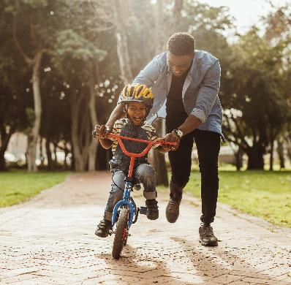
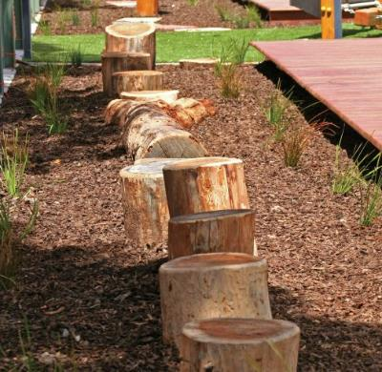
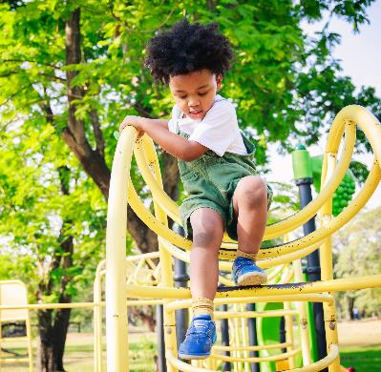
Opening Activity
What do you remember about the outdoor spaces you played in as a child?
How did you play in these spaces?
Notes:
Trainer notes:
For this opening activity, we connect participants to their prior knowledge and experiences with outdoor spaces. Divide participants into groups of 2-4. Encourage participants to introduce themselves and share responses to the prompts on the slide. Allow approximately 4 minutes for small groups to discuss and 4 minutes for a large group sharing and debrief. During the debrief, explore connections between participant’s reflections and the potential impact of outdoor spaces at child care.
Suggested speaker notes:
The outdoors influences the ways that children play and their levels of physical activity. What were your favorite outdoor play places as a young child? What do you remember about those spaces? In small groups, introduce yourself and share your memories from childhood of outdoor play spaces.
Log image from Creative Recreation Solutions

Slide 5
Review of PALS content
Space-Young children need adequate space to practice gross motor skills including outdoor play areas
Type- Children should experience different types of play daily including adult-led, free play, MVPA and outdoor play
Daily Activities-Outdoor play should be woven in the daily schedule 2-3 or more times per day.
Time
Providers Role-Schedule outdoor time, set up experiences during outdoor play, lead activities, encourage, role-model and supervise
Policies-Policies, family and staff handbooks address outdoor play including clothing, staff roles, and weather considerations.
Training
Space
Policies
Families
Type
Providers
Daily Activities
Notes:
Trainer notes:
Outdoor play was included in the PALS learnings session content to include the recommended practices for outdoor time, outdoor spaces, types and daily activities. Outdoor practices related to physical activity should be included in program policies as well. This slide recaps some outdoor play best practices addressed in PALS.
Suggested speaker notes:
The PALS training addressed the best practices of physical activity in eight areas seen in the image on the screen, (Time, Space, Type, Daily Activities, Providers Role, Families, Training & Resources, and Policies)
Let’s review a few of the concepts covered in PALS.
Space-Young children need adequate space to practice gross motor skills including outdoor play areas. Children tend to be more active outdoors as the have more space to move and use large muscles.
Type- Children should experience different types of play daily including adult-led, free play, MVPA and outdoor play.
Daily Activities-Outdoor play should be woven in the daily schedule 2-3 or more times per day for infants, toddlers and preschoolers.
Providers Role-Providers (adults) are responsible for setting up spaces and experiences that support children in active play and practicing fundamental movement skills. Some provider roles include scheduling outdoor time, setting up experiences during outdoor play, leading activities, encouraging, being a role-model and supervising
Policies-Policies, family and staff handbooks address outdoor play including clothing, staff roles, and weather considerations.

Slide 6


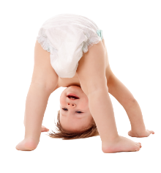
Outdoor recommended practices-Time
Infants
Toddlers
Preschoolers
Infants
Outdoors 2-3 times daily
60-90 minutes of MVPA
60-90 minutes of outdoor play
Outdoors 2-3 times daily
90-120 minutes of MVPA
60-90 minutes of outdoor play
Outdoors 2-3 times daily
Notes:
Trainer notes:
This slide recaps the best practices for time. Call out the minutes of outdoor play recommended for participants and the number of times outdoors.
MVPA is Moderate to Vigorous Physical Activity
Moderate to vigorous refers to the intensity of physical activity. It is a combination of two activity levels.
Moderate-intensity activity is a brisk walk that still allows normal talking and breathing.
Vigorous-intensity activity, like a jog or run or strenuous cycling, causes faster and deeper than normal breathing and interferes with the ability to talk (for example, it leaves you “breathless”). Children who are breathless because of physical activity exercise their heart and lungs along with the muscles in their arms and legs.

Slide 7

Objectives
With this training you will:
Learn about concepts related to outdoor play and learning
Identify activity settings in early care outdoor settings that encourage physical activity
Consider activity settings to incorporate into your existing spaces that support active play
Notes:
Trainer notes:
Share the session objectives with your participants. The objectives are also listed on the top of the participant handout.

Slide 8
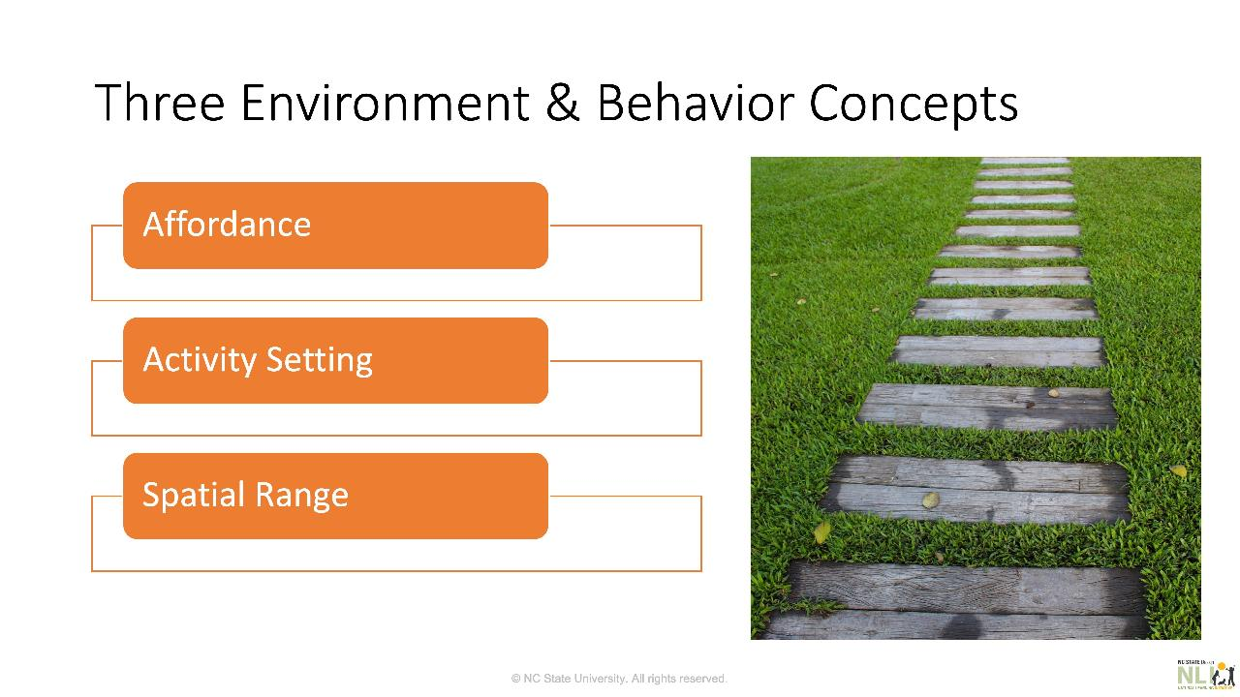
Notes:
Trainer notes:
Slide courtesy of the Natural Learning Initiative, NC State University
These three terms are on page 1 of the suggested participant handout and will be covered on the next three slides.
Suggested speaker notes:
This is the path for understanding how physical spaces influence children’s behavior.
Three Environment and Behavior concepts:
Affordance
Activity Setting (also known as “behavior settings”)
Spatial range

Slide 9
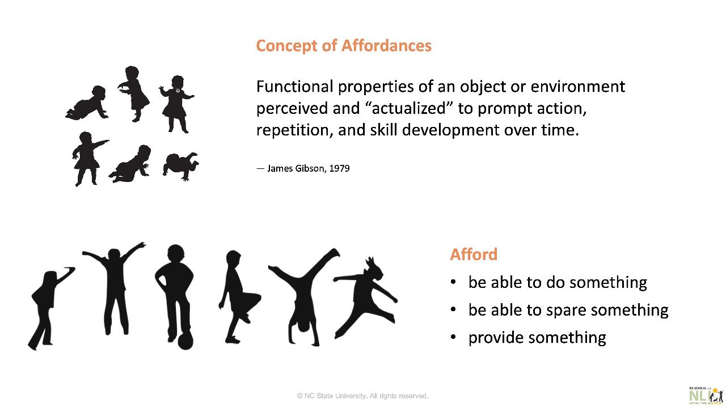
Notes:
Trainer notes:
Slide courtesy of the Natural Learning Initiative, NC State University
Suggested speaker notes:
What is to afford?
Afford
be able to do something
be able to spare something
provide something
James Gibson, 1979 described this concept as:
The functional properties of an object or environment that is perceived and “actualized” (by the individual) to prompt action, repetition, and skill development over time.
Affordances area explored by developing children in different ways. Freedom to experiment is critical for young children to understand the surrounding physical space.
Plain language:
Affordances are the ways an object or space is understood and used in relation to a child’s interests and abilities.

Slide 10
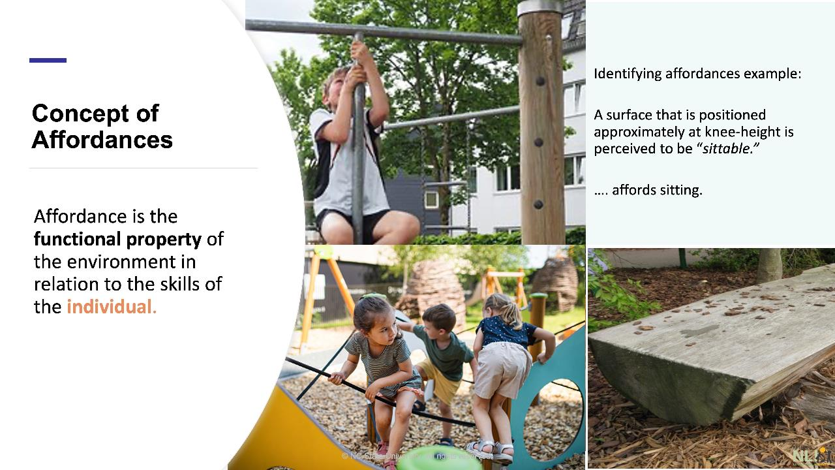
Notes:
Trainer notes:
Slide courtesy of the Natural Learning Initiative, NC State University
Suggested speaker notes:
Affordances are properties of the environment as they are related to children’s capabilities for using them.
They include not only objects but the layout of the space and its components.
Affordances are also offered by events, including social events such as bubble play!
Identifying affordances example:
A surface that is positioned approximately at knee-height is perceived to be “sittable.”
…. affords sitting!

Slide 11
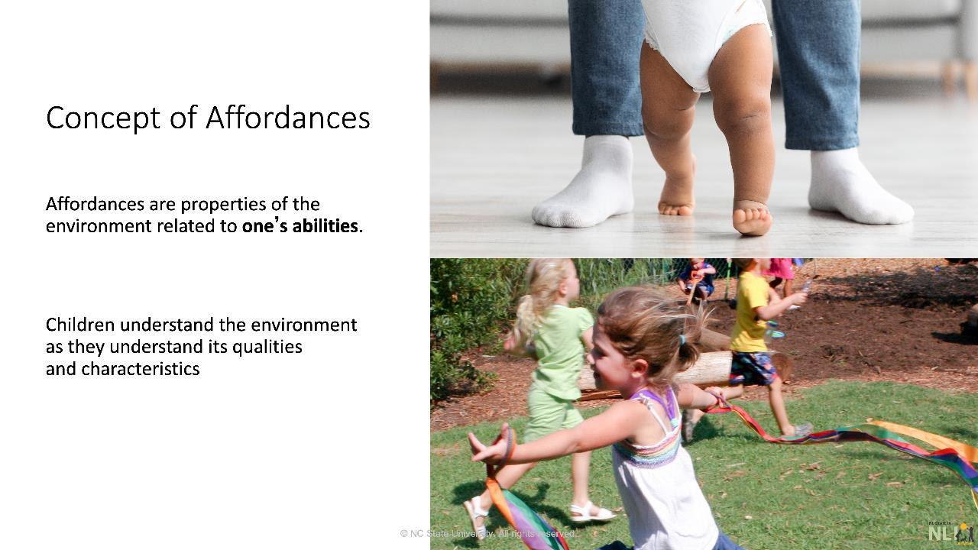
Notes:
Trainer notes:
Slide courtesy of the Natural Learning Initiative, NC State University
Suggested speaker notes:
The realization of an affordance requires the child or the individual to interact with their setting.
Realization of an affordance, means that children understand the qualities of the setting in relation to the capabilities and dimensions of their own body.
Trainer note
Consider adding a slide with a photo of a local play area and do a group activity to identify activity settings and discuss affordances.

Slide 12
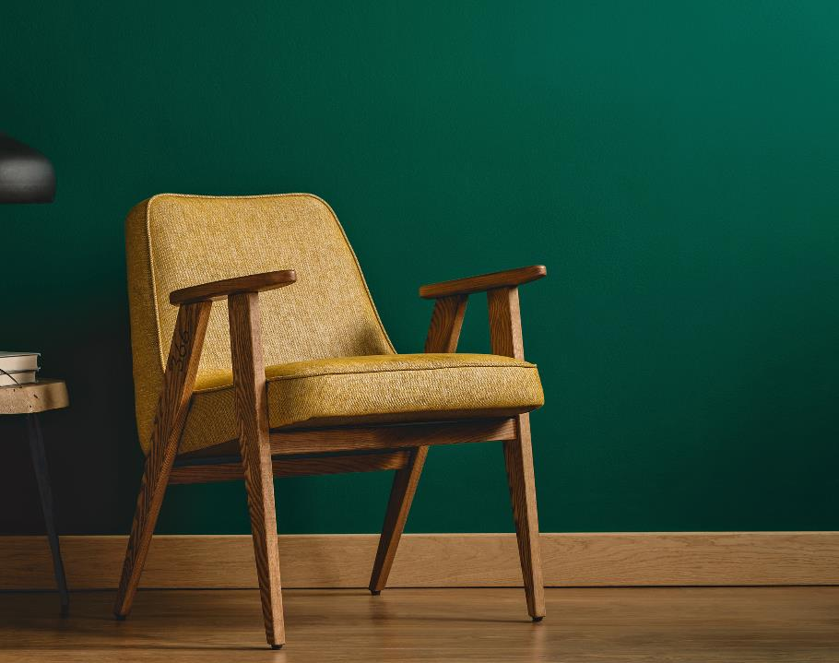
Video:
Affordance and Behavior Settings
Notes:
Trainer notes:
The suggested YouTube video is 3:07 and the video link is embedded in the picture. Before starting, adjust the YouTube settings to enable closed captions by clicking on the cc icon on the bottom of the video control panel.
https://www.youtube.com/watch?v=UYlASVcirqQ
Suggested speaker notes:
Before the video:
This video demonstrates the concepts of affordance and behavior settings. Notice how one setting can provide different affordances based on how the user understands the setting and the skills they have.
After the video debrief with the following questions:
What stood out for you in the video?
How do activity settings in your outdoor space provide different affordances for young children?

Slide 13
Knowledge Check
Fill in the blank:
Affordance is the property of the environment in relation to the skills of the __________ .
Choices:
functional
individual
Functional | Individual
Structural | Owner
Physical | Manager
Notes:
Trainer notes:
This slide contains animations. Advance the slide to fill in the first blank. Advance a second time to fill in the second blank.
Suggested speaker notes:
Let’s have a quick check to make sure we understand the term affordance. Take a moment to think about which words from the list go in each black in the definition on the screen.
Affordance is the [functional] property of the environment in relation to the skills of the [individual].

Slide 14
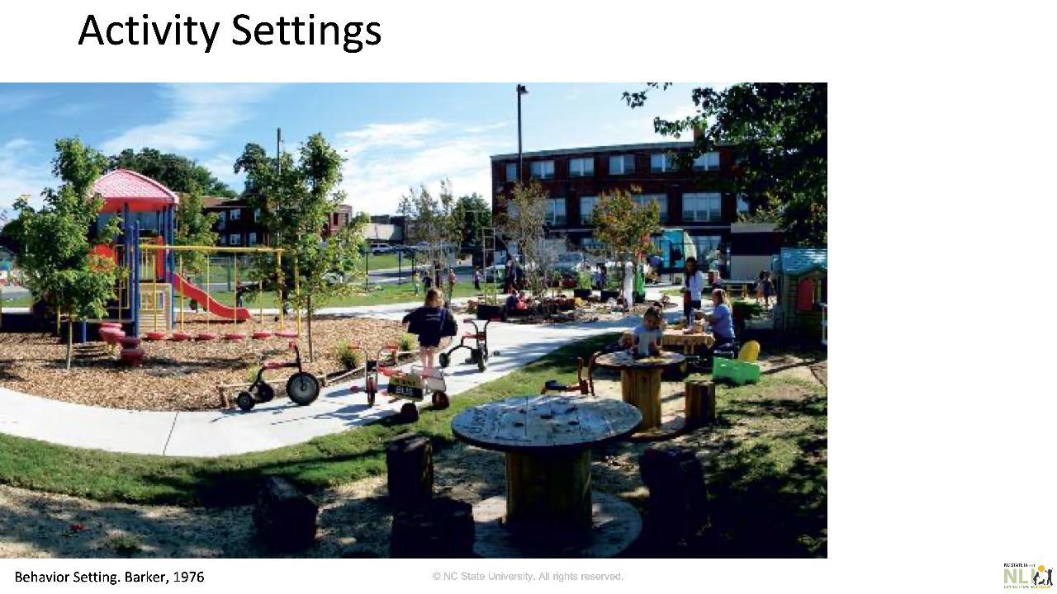
Notes:
Trainer notes:
Slide courtesy of the Natural Learning Initiative, NC State University
A variety of settings serve children with different abilities, ages, interests, and culture.
This preschool play area contains various age-appropriate behavior settings: play equipment, “earth play” (or a digging area light soil mix), a play kitchen setting, a pathway for riding toys, and more..
Suggested speaker notes:

Slide 15
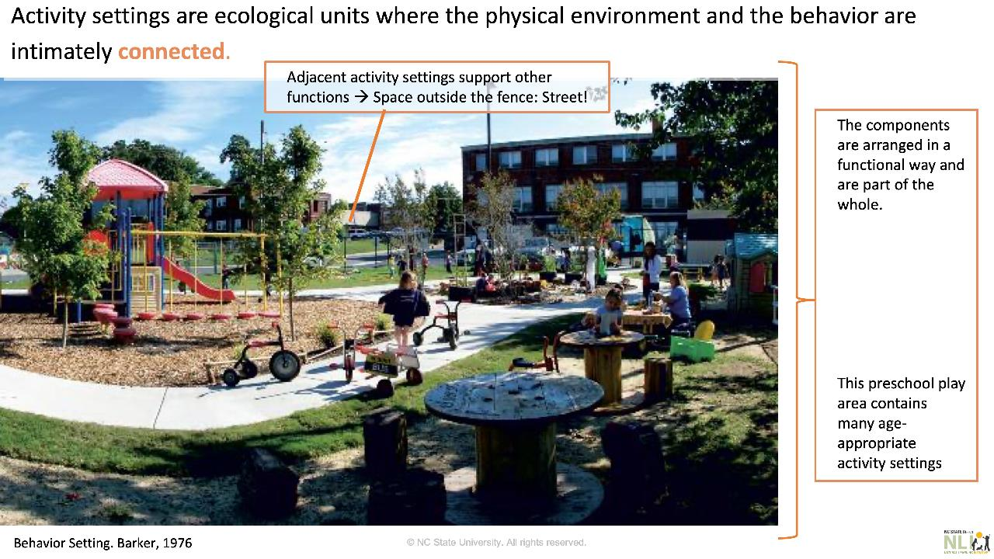
Notes:
Trainer notes:
Slide courtesy of the Natural Learning Initiative, NC State University
Suggested speaker notes:
The definition of “activity setting” states: Activity settings are ecological units where the physical environment and the behavior are intimately connected.
Behavior and space connection. Can you describe how behavior and space are connected? For example, the pathway allows children to ride wheeled toys on a smooth hard surface.
Activity settings boundaries, How it is possible to know where a setting starts and ends? Because “The components of an activity setting are arranged in a functional way and are part of the whole.” For example, the “play kitchen” area contains a table, stools, utensils to “cook” and it occupies a specific space within the play area. However, all activity settings as a whole complete the outdoor learning space offering a highly stimulating space for child development.
Why is this important? Because activity settings help organize the space (as in the indoor classroom) in a functional way. For example, clustering high activity settings in an area and passive or low energy settings in lower noise corner of the site. Adjacent activity settings that support functions other than outdoor play and learning should be clearly marked or separated (e.g., using regulatory fences) for the protection of children.

Slide 16
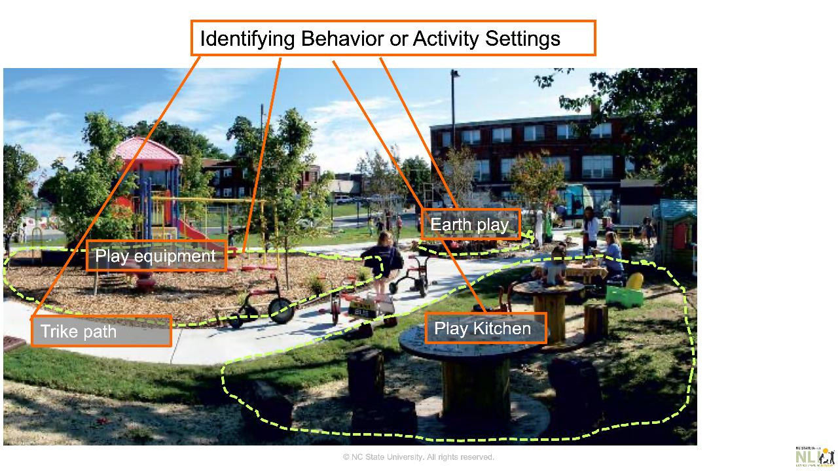
Notes:
Trainer notes:
Slide courtesy of the Natural Learning Initiative, NC State University
Suggested speaker notes:
A variety of settings serve children with different abilities, ages, interests, and culture.
This preschool play area contains various age-appropriate behavior settings: play equipment, “earth play” (or a digging area light soil mix), a play kitchen setting, a pathway for riding toys, and more..
Discussion:
What other settings can you identify? What are their purposes?
What additional activity settings would you add to enrich children’s experiences?

Slide 17
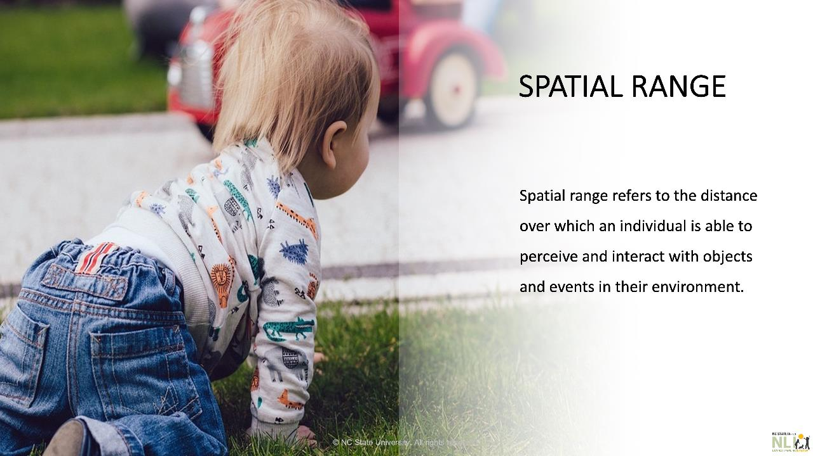
Notes:
Trainer notes:
Slide courtesy of the Natural Learning Initiative, NC State University
Suggested speaker notes:
Spatial range refers to the distance over which an individual is able to perceive and interact with objects and events in their environment.
As infants continue to develop and explore their settings, their spatial range continuously expands.
Naturally, over time, infants and toddlers expand their spatial range across more and more activity settings.
How would you encourage infants and toddlers to explore their age-appropriate outdoors?

Slide 18
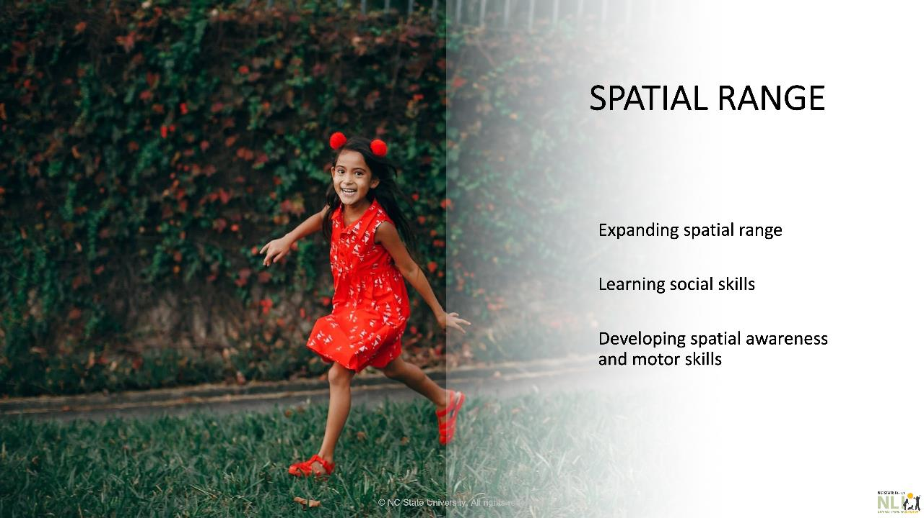
Notes:
Trainer notes:
Slide courtesy of the Natural Learning Initiative, NC State University
Suggested speaker notes:
At this stage, preschoolers are able to navigate their spaces confidently. They can move around independently.
They can climb, run, jump, and engage in physical activities with other children. Physical exploration helps preschoolers to develop spatial awareness and motor skills.
Outdoor play and exploration will also help expand their spatial range and improve their overall physical and cognitive development.

Slide 19
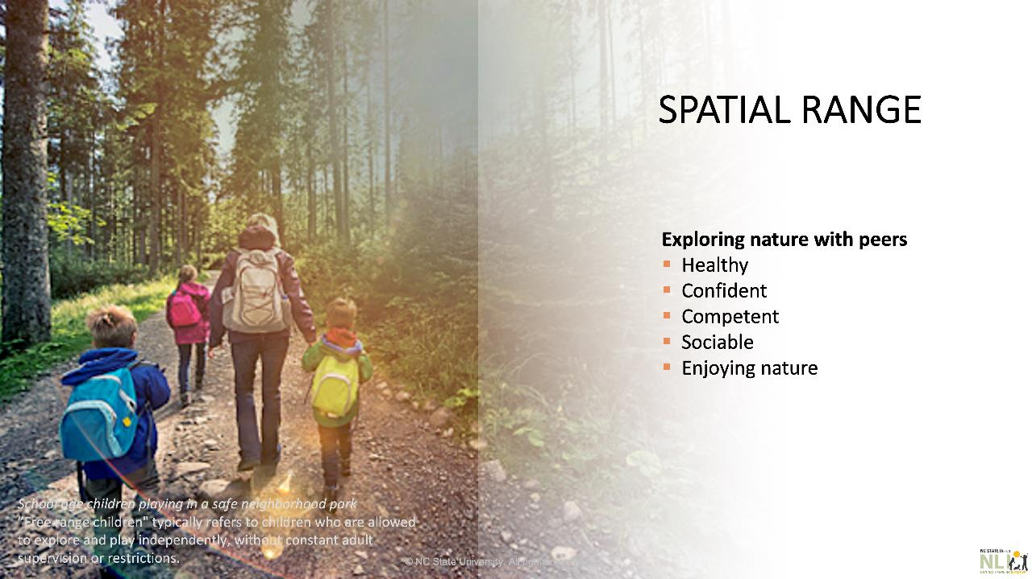
Notes:
Trainer notes:
Slide courtesy of North Carolina State National Learning Initiative (NLI)
Suggested speaker notes:
The preschool years prepare children to expand their territories using the skills acquired in varied naturalized settings previously (hopefully at childcare and kindergarten).
Kindergarten and school age children, living in safe communities, may become confident to enjoy nature with peers.
Note:”Free range children" typically refers to children who are allowed to explore and play independently without constant adult supervision or restrictions, it is important to note that families should properly evaluate the risks in their communities (especially traffic) if their children are allowed to roam freely.

Slide 20
Knowledge Check
Spatial range refers to…..
Select one:
An area bounded in space and time supporting predictable patterns of behavior stimulated by identifiable affordances.
The distance over which an individual is able to perceive and interact with objects and events in their environment.
The available objects and components in a space enticing physical activity.
The functional properties of an object or environment perceived and “actualized” to prompt action, repetition, and skill development over time.
Notes:
Trainer notes:
Read the knowledge check question and responses aloud. Give participants a few minutes to answer. Advance the slide and the correct response is highlighted.

Slide 21
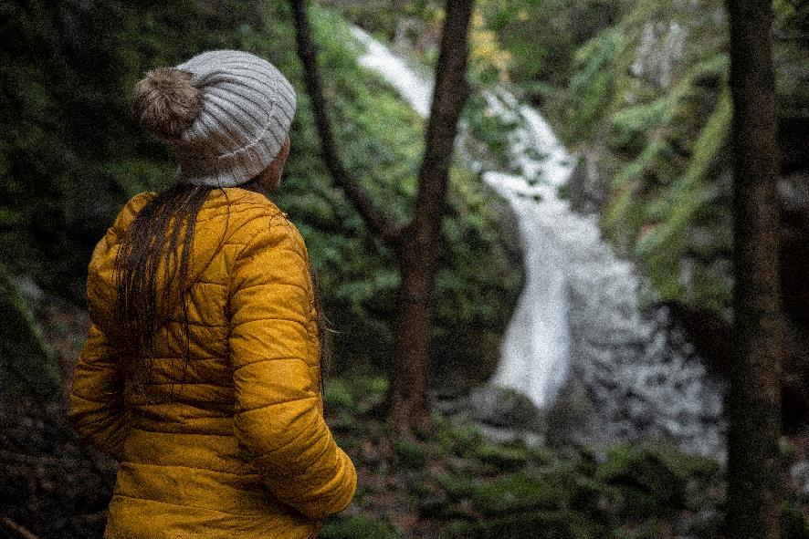
Brain boost
Notes:
Trainer notes:
Mindfulness can be understood as intentional and non-judgmental present-moment awareness and is a valuable tool to for children and adults. Being in nature offers many opportunities to practice mindful approaches. The script below will guide your participants through a mindfulness exercise. You may ask your participants to look out the window or ask them to look at the image on the screen. If you have Wi-Fi, consider playing the video of a waterfall in the forest. The link is embedded in the picture. (https://www.youtube.com/watch?v=eKFTSSKCzWA&t=46s)
or
Use a short, guided meditation video, such as the link below, that incorporates nature. 5 minute Guided Meditation with Nature Sounds (youtube.com) https://www.youtube.com/watch?v=GvrykEBPUW0Tsuch as this one
Debrief the mindfulness meditation by asking participants to share 1 word on how they feel.
Suggested speaker notes:
I invite you to join me in a short mindfulness exercise. If begin to notice thoughts coming into your mind, remember that this is normal. Our brains are designed to think but we can learn to refocus our attention. Take this as an opportunity to be kind to yourself and not judge. Just notice that you are having thoughts, then, redirect your attention back to the present moment.
Sit in a comfortable upright position with your feed planted flat on the ground. Rest your hands on your thighs or on your work surface.
Bring attention to your breath- the inhale, the exhale, and the pauses between.
Bring awareness to the things you see. Notice the colors, shapes, and textures. Silently list five things you see.
Tune in to the sounds around you. Listen carefully. Try not to judge the sounds just notice them. Silently name three sounds you hear.
Imagine what you might smell in this setting. What might the plants smell like? What two scents can you imagine are present?
Consider what your sense of touch might experience in this space. What are the sensations on your skin, on your feet as they stand in this place? What temperature is the air as you inhale? Describe the feeling or texture you have imagined?
Take a few more deep breaths and notice how your body and mind feel in this moment.

Slide 22
Outdoor Activity Settings
Acoustic/Music Play Setting
Cut Flower Garden
Deck
Dry Stream Bed
Earth Play Setting
Fruit and Vegetable Garden
Gathering Setting
Grass Maze
Greenhouse
Gross motor logs
Grove of Small Trees/Shrubs
Indoor-Outdoor Transition Setting
Loose Parts Setting
Manufactured Play Equipment
Mound
Mud Kitchens or Café
Multipurpose Lawn
Natural Construction Setting
Orchard
Outdoor Classroom
Pathway (primary)
Pathway (secondary)
Performance Setting
Playhouse
Project Setting
Sand Play Setting
STEM or STEAM Center
Water Play Setting (full-body)
Water Play Setting (hands-in)
Wildlife/Pollinator Garden
Notes:
Trainer notes:
This is the first slide of the content supporting Objective 2, identify activity settings in early care outdoor spaces that encourage physical activity.
This slide contains animation. As you discuss the types of settings, advance slide for two additional columns to appear. Note that four of the settings are described in detail below.
Suggested speaker notes:
Outdoor play and learning activity settings are physically-bounded spaces with predictable patterns of activity. A high-quality preschool play and learning area contains at least ten activity settings. The more settings and components a space contains, the greater the opportunities for children with different skills, interests, and backgrounds to play and learn together. As stated in the session opening, the outdoor settings influence how active children are when outdoors and studies have shown that children are more physically active in varied outdoor conditions. High quality early care settings offer children a variety of settings. Creating an outdoor settings that has variety of activity settings involves planning, time, and resources. These rich conditions do not happen overnight.
As we go through the settings together, put a checkmark by the settings in your handout that might support high levels of active play or physical activity. Which of these settings may predict active play that causes children to breath faster and their heart to beat faster?
An acoustic play setting provides opportunities for “making music” and enjoying beautiful sounds. Settings can be created from recycled/re-purposed items such as pots, pans, and pipes, or manufactured items including drums, cymbals, xylophones, gongs, bells, and rattles mounted on a fence or structure designed for children to engage in percussive play. al
Decks- decks provide dry, above-ground surfaces for all-season play. As gathering places for children, decks support social and imaginative play. Larger decks can accommodate educator-facilitated group activities. Designed as stages, decks support dramatic play.
Natural Construction Setting- Natural construction in the outdoor learning environment (OLE) supports open-ended, creative, and free play using varied natural materials such as sticks, tree limbs, large leaves, and bamboo.
Outdoor Classrooms- Create an outdoor classroom by adding a greenhouse, multipurpose deck, or covered porch to serve as an activity space.
Which settings did you check?
Possible responses may include many if not most of the settings on the list.

Slide 23
Reflection Activity
What type of activities does this activity setting, a fixed play structure, afford?
Climbing, Balancing, Hanging
List out 1 to 3 different outdoor activity settings children can access at your program.
What type of activities do the outdoor activity settings at your programs afford?
Notes:
Trainer notes:
This slide contains animation. Pose the question to your group “What type of activities does the fixed play structure seen in the image afford? Some possible responses will appear when the slide is advanced.
After brief discussion on activities, advance the slide again and direct participants to the Reflection Activity Box on page 2 of the session handout.
Ask them to complete the table by listing out 1 to 3 different outdoor activity settings at their program and the types of activities do the settings afford children?
Allow 3 minutes for participants to reflect and make notes. Ask for a few volunteers to share one setting and the activities it affords.

Slide 24
Three outdoor activity settings
Let’s consider a few activity settings that support moderate to vigorous physical activity (MVPA)
  Pathways
  Multi-purpose Lawns
  Gross Motor Logs
Notes:
Suggested speaker notes:
Next, we will spend some time looking at three setting that support active play.

Slide 25
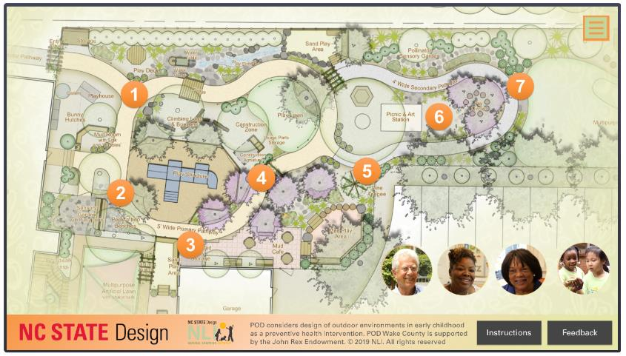
Pathways
https://naturalearning.org/vft
Notes:
Trainer notes:
If your training site has Wi-Fi, go to the website https://naturalearning.org/vft
Click on icon 1 to watch a 30 second video on pathways. *
Suggested speaker notes:
Research shows that well-designed pathways promote physical activity, play, and learning by providing children and teachers with integrated access to outdoor learning environments (OLEs).
Pathways promote circulation by connecting classrooms to activity settings outdoors. They simplify navigation for children and caregivers. Looped pathways invite movement. Gently curving pathways will stimulate excitement, exploration, chase games, and higher levels of healthy physical activity. Wide pathways allow room for children, toys, and movement without conflict. Consider that pathways are more than for circulation but are play spaces too. Pathways can be made of many materials including concrete, poured rubber surfacing, asphalt, crushed stone, shredded mulch, or stepping stones.
Optional Handout:
National Learning Initiative (NLI) Infosheet
Pathway Designs https://naturalearning.org/09-pathway-designs
*If you have remaining time in your session, consider coming back to the virtual field trip and watching clips 2-7.

Slide 26
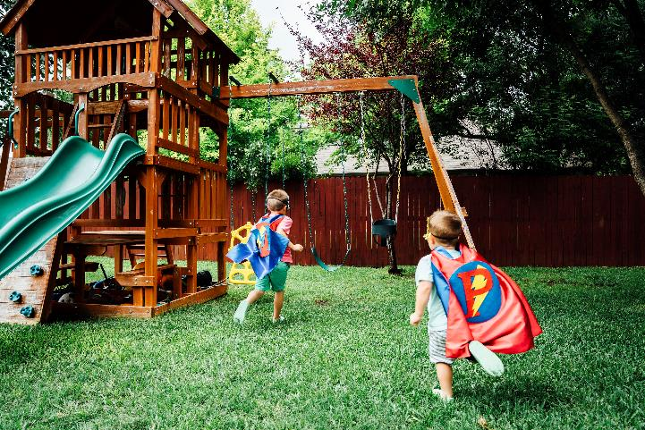
Multipurpose Lawns
Notes:
Suggested speaker notes:
Multi-purpose lawns provide a soft surface for active play such as ball games, parachute play, and group activities, as well as a place for quieter activity such as story-time. Rising and falling ground surfaces and bordering shade trees, shrubs and/or flowering perennials add play value. A recommended practice is to have the lawn bounded by a curvy, looping concrete pathway to prevent the spread of aggressive grass and create an anchor for active, physical play.
How do the children use lawns at your space, if lawns are available?
Optional Handout:
National Learning Initiative (NLI) Infosheet Multi-Purpose Lawns
https://naturalearning.org/16-multi-purpose-lawns
Image: Microsoft stock image

Slide 27

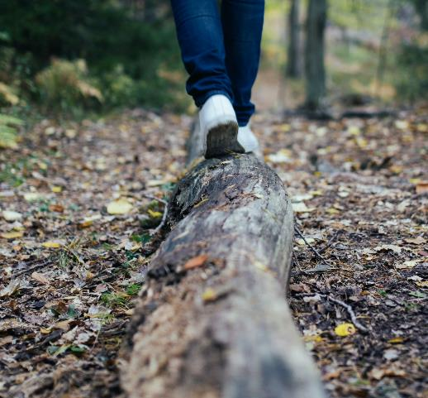
Gross Motor Logs
Notes:
Suggested speaker notes:
Gross motor logs may be as simple as a single, horizontal log installed on the ground or a low grouping of various sized logs and/or limbs installed to provide a natural alternative to fixed, manufactured play structures. Logs installed this way may afford balancing, climbing, scrambling, jumping, and leaping. Logs can usually be found locally for free from tree care companies.
Wood can have many uses in natural learning settings. Logs can be used for seating, tree cookies (disks of lumber) can be used in loose parts areas or to create pathways.
Optional Handout:
National Learning Initiative (NLI) Infosheet Gross Motor Logs
https://naturalearning.org/13-gross-motor-logs
Log image on right from Creative Recreation Solutions
Log image on left Photo by Jon Flobrant on Unsplash

Slide 28
Knowledge Check
How many activity settings does a high-quality preschool play and learning area contain?
Three (3)
Five (5) or more
At least ten (10) activity settings
Notes:
Trainer notes:
Read the knowledge check question and responses aloud. Allow time for participants to consider the response.
Advance the slide and the correct response is highlighted.

Slide 29
Summary Activity
Acoustic/Music Play Setting
Cut Flower Garden
Deck
Dry Stream Bed
Earth Play Setting
Fruit and Vegetable Garden
Gathering Setting
Grass Maze
Greenhouse
Gross motor logs
Grove of Small Trees/Shrubs
Indoor-Outdoor Transition Setting
Loose Parts Setting
Manufactured Play Equipment
Mound
Mud Kitchens or Café
Multipurpose Lawn
Natural Construction Setting
Orchard
Outdoor Classroom
Pathway (primary)
Pathway (secondary)
Performance Setting
Playhouse
Project Setting
Sand Play Setting
STEM or STEAM Center
Water Play Setting (full-body)
Water Play Setting (hands-in)
Wildlife/Pollinator Garden
Notes:
Trainer notes:
This is the first slide of the content supporting Objective 3, consider activity settings to incorporate into your existing spaces that support active play.
Facilitate a closing large group discussion on activity settings that they would like to add to their program’s outdoor spaces. Recognizing that many providers would like the full list of 30 settings, encourage participants to consider the space at their site, the resources available, and the settings that are achievable.
After reading the notes/giving instructions, allow participants about 3-5 minutes to consider which settings they’d like to add. As the time ends, ask a few volunteers to share the settings they identified and what interested them about the settings.
Suggested speaker notes:
High quality outdoor spaces don’t happen overnight. Establishing 10 or more outdoor activity setting takes time and resources. Start with small steps to strengthen your outdoor spaces. Let’s return to our handout and find the summary activity on page 2. Using the list on the first page, circle 1, 2 or 3 settings you would like to add to your spaces. Note on page 2 why you selected these settings.

Slide 30
Key take-aways
Affordance is the functional properties of the environment in relation to the skills of the individual.
Spatial range refers to the distance over which an individual is able to perceive and interact with objects and events in their environments.
Outdoor play and learning activity settings are physically-bounded spaces with predictable patterns of activity. A high-quality preschool play and learning area contains at least ten activity settings
High quality outdoor spaces take time to build and grow. Start with adding one setting and see where it takes you.
Notes:
Trainer notes:
Recap the 4 bullets on the slide that summarize concepts covered in the training.

Slide 31
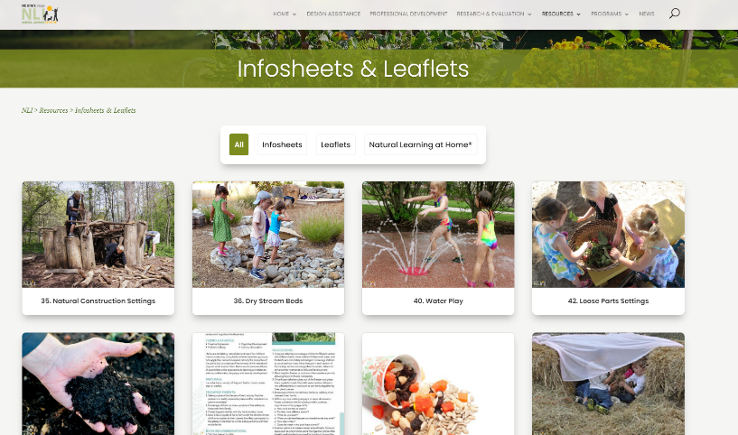
For more information on Outdoor Play & Learning
https://naturalearning.org/infosheetsleaflets/
Notes:
Suggested speaker notes:
If you would like to learn more out outdoor play and learning, the Natural Learning Initiative (NLI) at NC State has a free resource library with dozens of resources for ECE programs and families. NLI also offers a certificate course targeted for early childhood educators who are interested in planning, managing, and sustaining high-quality outdoor play and learning spaces. The course is titled Early Childhood Outdoor Learning Environments and can be access from the professional development tab on their website.

Slide 32

Questions?
Notes:
Trainer notes:
Provide a final opportunity for questions and discussion.

Slide 33
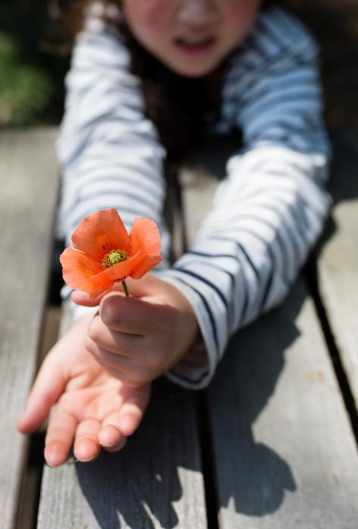
Thanks for participating in Increasing Outdoor Active Play:
Activity Settings in Child Care
Notes:
Trainer notes:
Thank your participants for attending this session. If your role permits, offer opportunities to continue discussion on outdoor activity settings in technical assistance visits or by providing additional resources.

