Slide 1
Insert Trainer Agency
Logo Here
Physical Activity in Small Spaces:
Four Games to Promote Movement in Limited Space
Add Trainer information here
Notes:
Trainer Notes:
Introduce yourself and cover any housekeeping information.
Consider adding a slide that addresses ground rules, norms, or guidelines for participants. Common ground rules include being respectful of differing opinions, keeping an open mind, not interrupting, staying on topic during discussions, participating in activities as able, and sharing knowledge and experience.
Suggested Speaking Notes:
Welcome to Physical Activity in Small Spaces: Four Games to Promote Movement in Limited Space. This training will build on content presented during the Physical Activity Learning Sessions (PALS).
Training information for PD systems, marketing or recruiting for this workshop:
Session Title: Physical Activity in Small Spaces: Four Games to Promote Movement in Limited Space
Time: 30-60 minutes
Target Audience: Professionals caring for toddlers and preschool aged children (ECE providers).
Session Description: This session will share four physically active games you can play with young children (2-6 years old) in small spaces that promote early childhood development. Additional topics include family engagement and provider role.
Core Content Area: Health, Safety and Nutrition
Session Objectives:
Describe how small spaces can promote opportunities to practice gross motor skills, engage large muscle groups and be active at various intensities.
Recognize how to set up your small space for active play.
Identify four games that can be played in small spaces.

Slide 2
Disclaimer

Slide 3
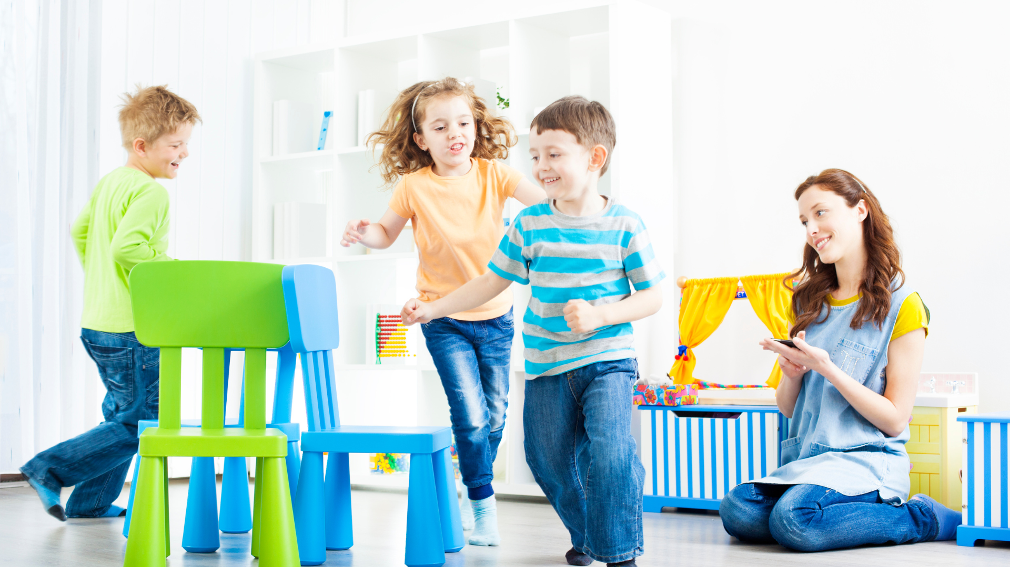
Session Objectives
Describe how small spaces can promote opportunities to practice gross motor skills, engage large muscle groups and be active at various intensities.
Recognize how to set up your small space for active play.
Identify 4 games that can be played in small spaces.
Notes:
Suggested Speaker Notes:
Small spaces can be seen as a barrier to being physically active- people often think that in small spaces there is not enough space to move, increase your heart rate or practice gross motor skills. Our objectives today will help shift that mindset by exploring four games that promote movement and early childhood development in small spaces.
Photo:
Canva Pro- Pavel Danilyuk

Slide 4
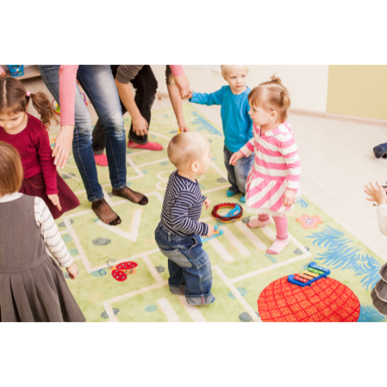

Icebreaker
Share a memory of a physical activity you did inside on a rainy day/bad weather day.
Notes:
Trainer Notes:
Remember the functions of icebreakers include: meeting your attendees, allowing participants a moment to reset, get them thinking about the topic and start using their voice. The idea behind this icebreaker is to get participants thinking about their experiences with physical activity in small spaces.
Suggested Speaker Notes:
Ask participants to share their name, the age group they work with, and to share a memory of a physical activity they did inside on a rainy day or bad weather day.
Photos:
Canva Pro- Beli_photos
Canva Pro- oksanashufrych

Slide 5
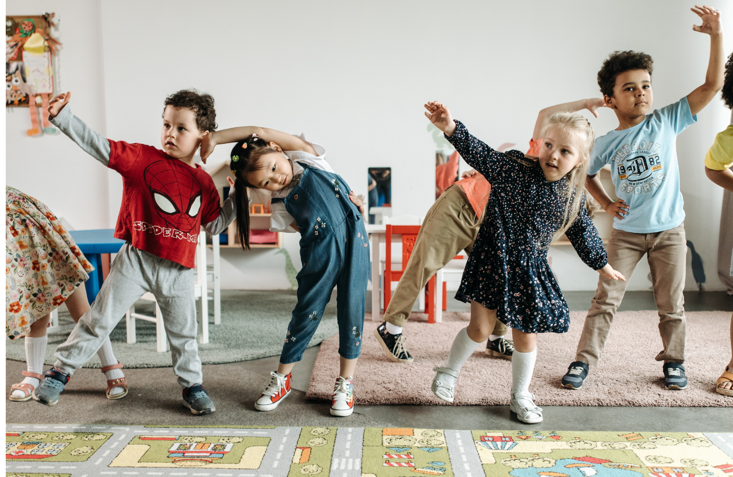
Physical Activity in Small Spaces
Notes:
Suggested Speaker Notes:
Let's dive into physical activity in small spaces.
Photo:
Pexels- Pavel Danilyuk

Slide 6
Objective 1: Describe how small spaces can promote opportunities to practice gross motor skills, engage large muscle groups and be active at various intensities.

Slide 7
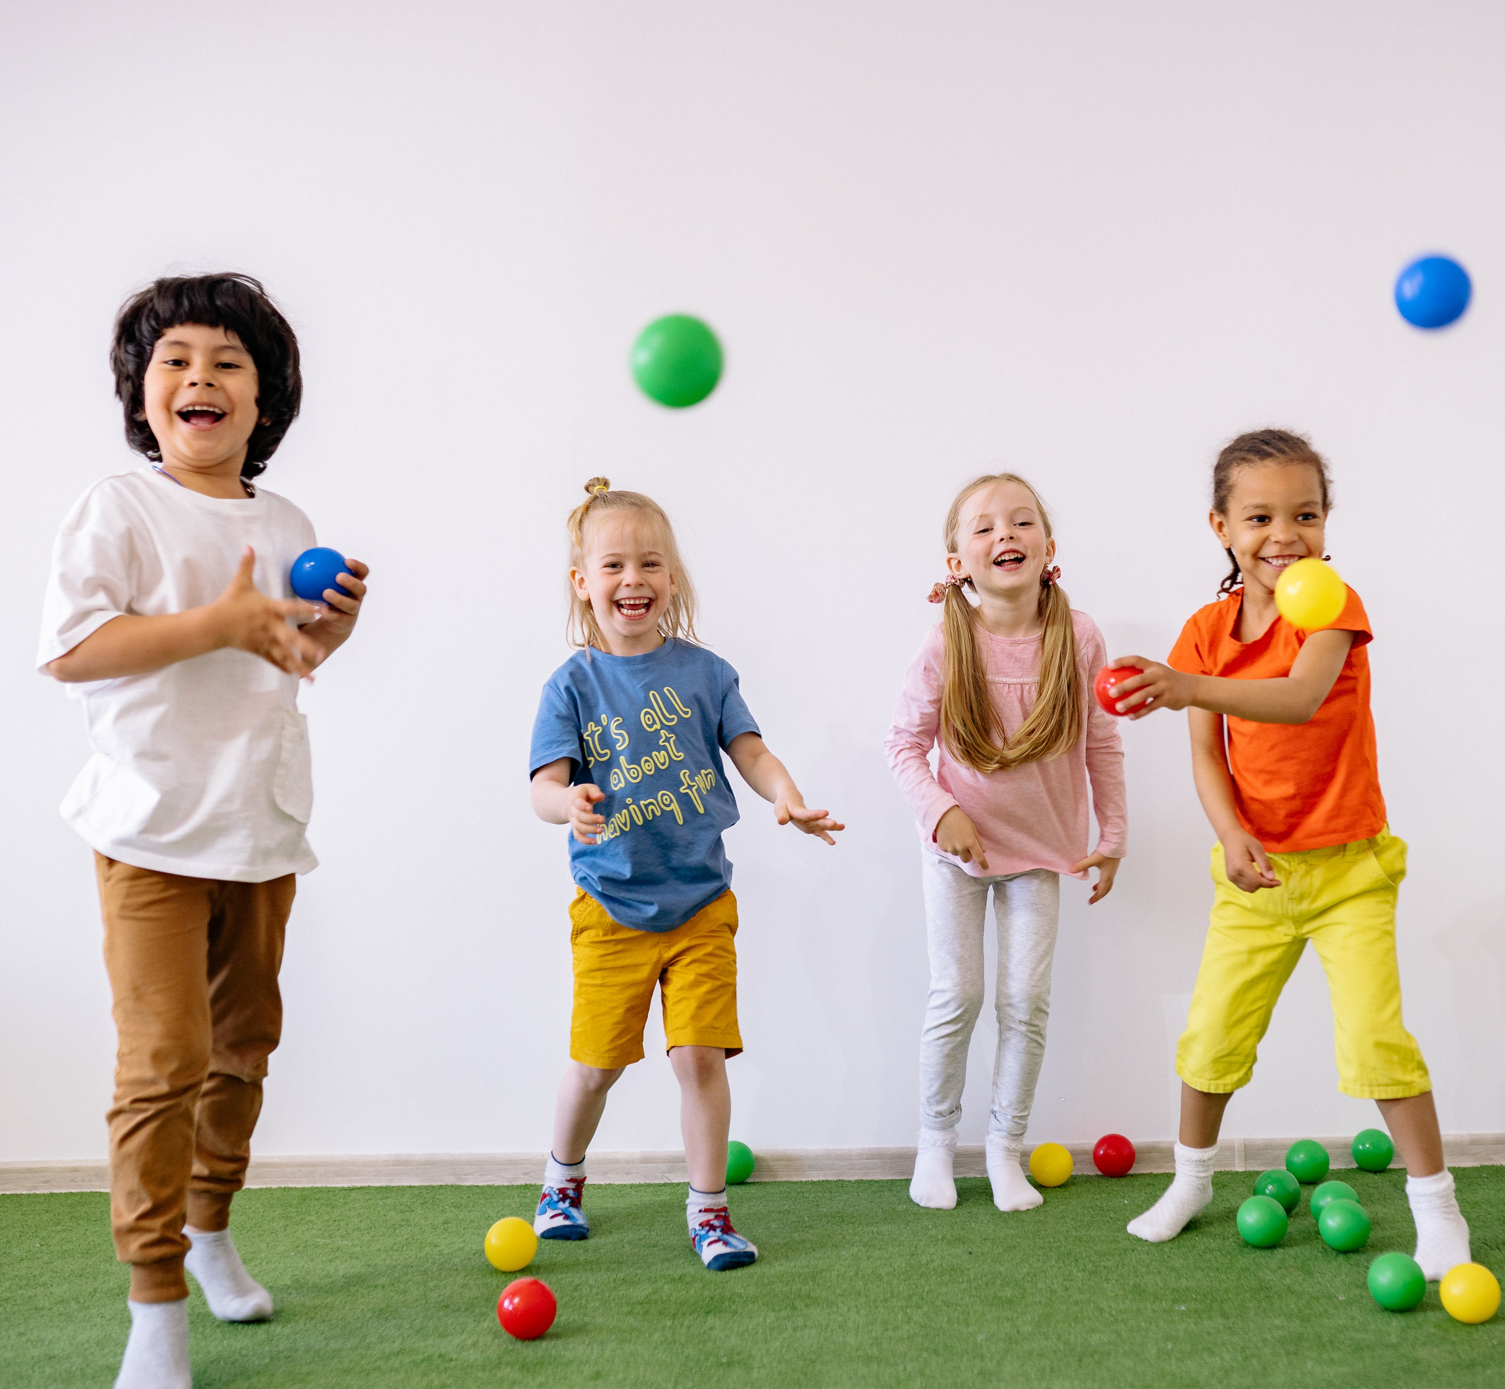
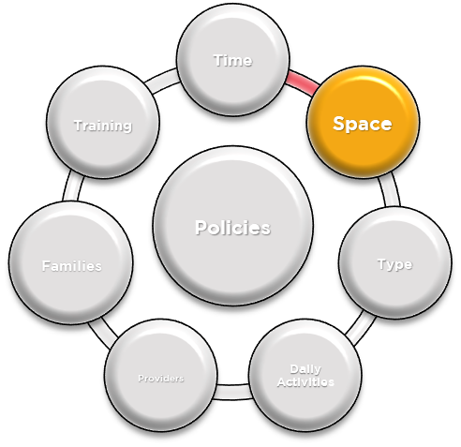
PALS Recap: Space
Children need space to practice gross motor skills
Notes:
Suggested Speaker Notes:
One of the best practices we discuss during the PALS training is space- children need space to practice gross motor skills. We know that young children's physical activity is influenced by the child care space. Quality conditions and equipment can support development of movement skills like locomotion and agility. Therefore, it's important that ECE providers identify spaces both indoors and outdoors where young children can:
be physically active,
practice gross motor skills,
engage large muscle groups, and
be active at a higher intensity (where they are breathing harder, and their heart rate is higher)
You can do all these things in small spaces, and in this training, we will share examples of how!
Photo:
Pexels- Yan Krukau

Slide 8

Example of an activity in a small space
Gross Motor Skill Development:
Walking, Running, Jumping, Balancing, Stretching
Large Muscle Engagement:
Legs, Entire Body
Various Intensities or Abilities:
Yellow = Slow, Green = Fast
Adapt movements to various intensities- i.e. blue light = bunny hops, purple light = toe touches
Red Light, Green Light
Notes:
Trainer Notes:
Start by reviewing how Red Light, Green Light is typically played and then how it can be adapted in small spaces.
Suggested Speaker Notes:
Red Light, Green Light is a classic game that can be easily adapted for small spaces- For green light, children run in place rather than across a space. Sometimes adding animals can help identify speeds- green light = run in place like a cheetah, yellow light = move slowly in place like a turtle, red light = freeze like a penguin (arms at your side). Feel free to get creative and add in other colored lights and movements (I.e., blue light = bunny hops, purple light= toe touches, pink light= raise the roofs).
Gross motor development: games like Red Light, Green Light give children chances to channel movements safely and appropriately like walking, running, or jumping. Especially when an activity like this played in a small space, children can practice adapting movements to different sized spaces.
Large Muscle Engagement: a game like Red Light, Green light will engage children’s legs, and as you add different movements, you can encourage engagement of the entire body.
Various Intensities: Red Light, Green Light is a great game to practice moving at various intensities- where ‘red light’ is no movement, ‘yellow light’ is slow movement, and ‘green light’ is faster movement. These various speeds allow for various intensities from light to moderate-vigorous. As you get creative an add additional ‘lights’/movements into the game you can encourage light intensity movements like “toe touches” or more high intensity movements like “bunny hops.” You can also offer adaptations for children with different abilities. For example, you can demonstrate arm only movements for a child that uses a wheelchair or offer slower movement adaptations- instead of jumping jacks, you can demonstrate the jumping jack movement but stepping out instead of jumping.

Slide 9
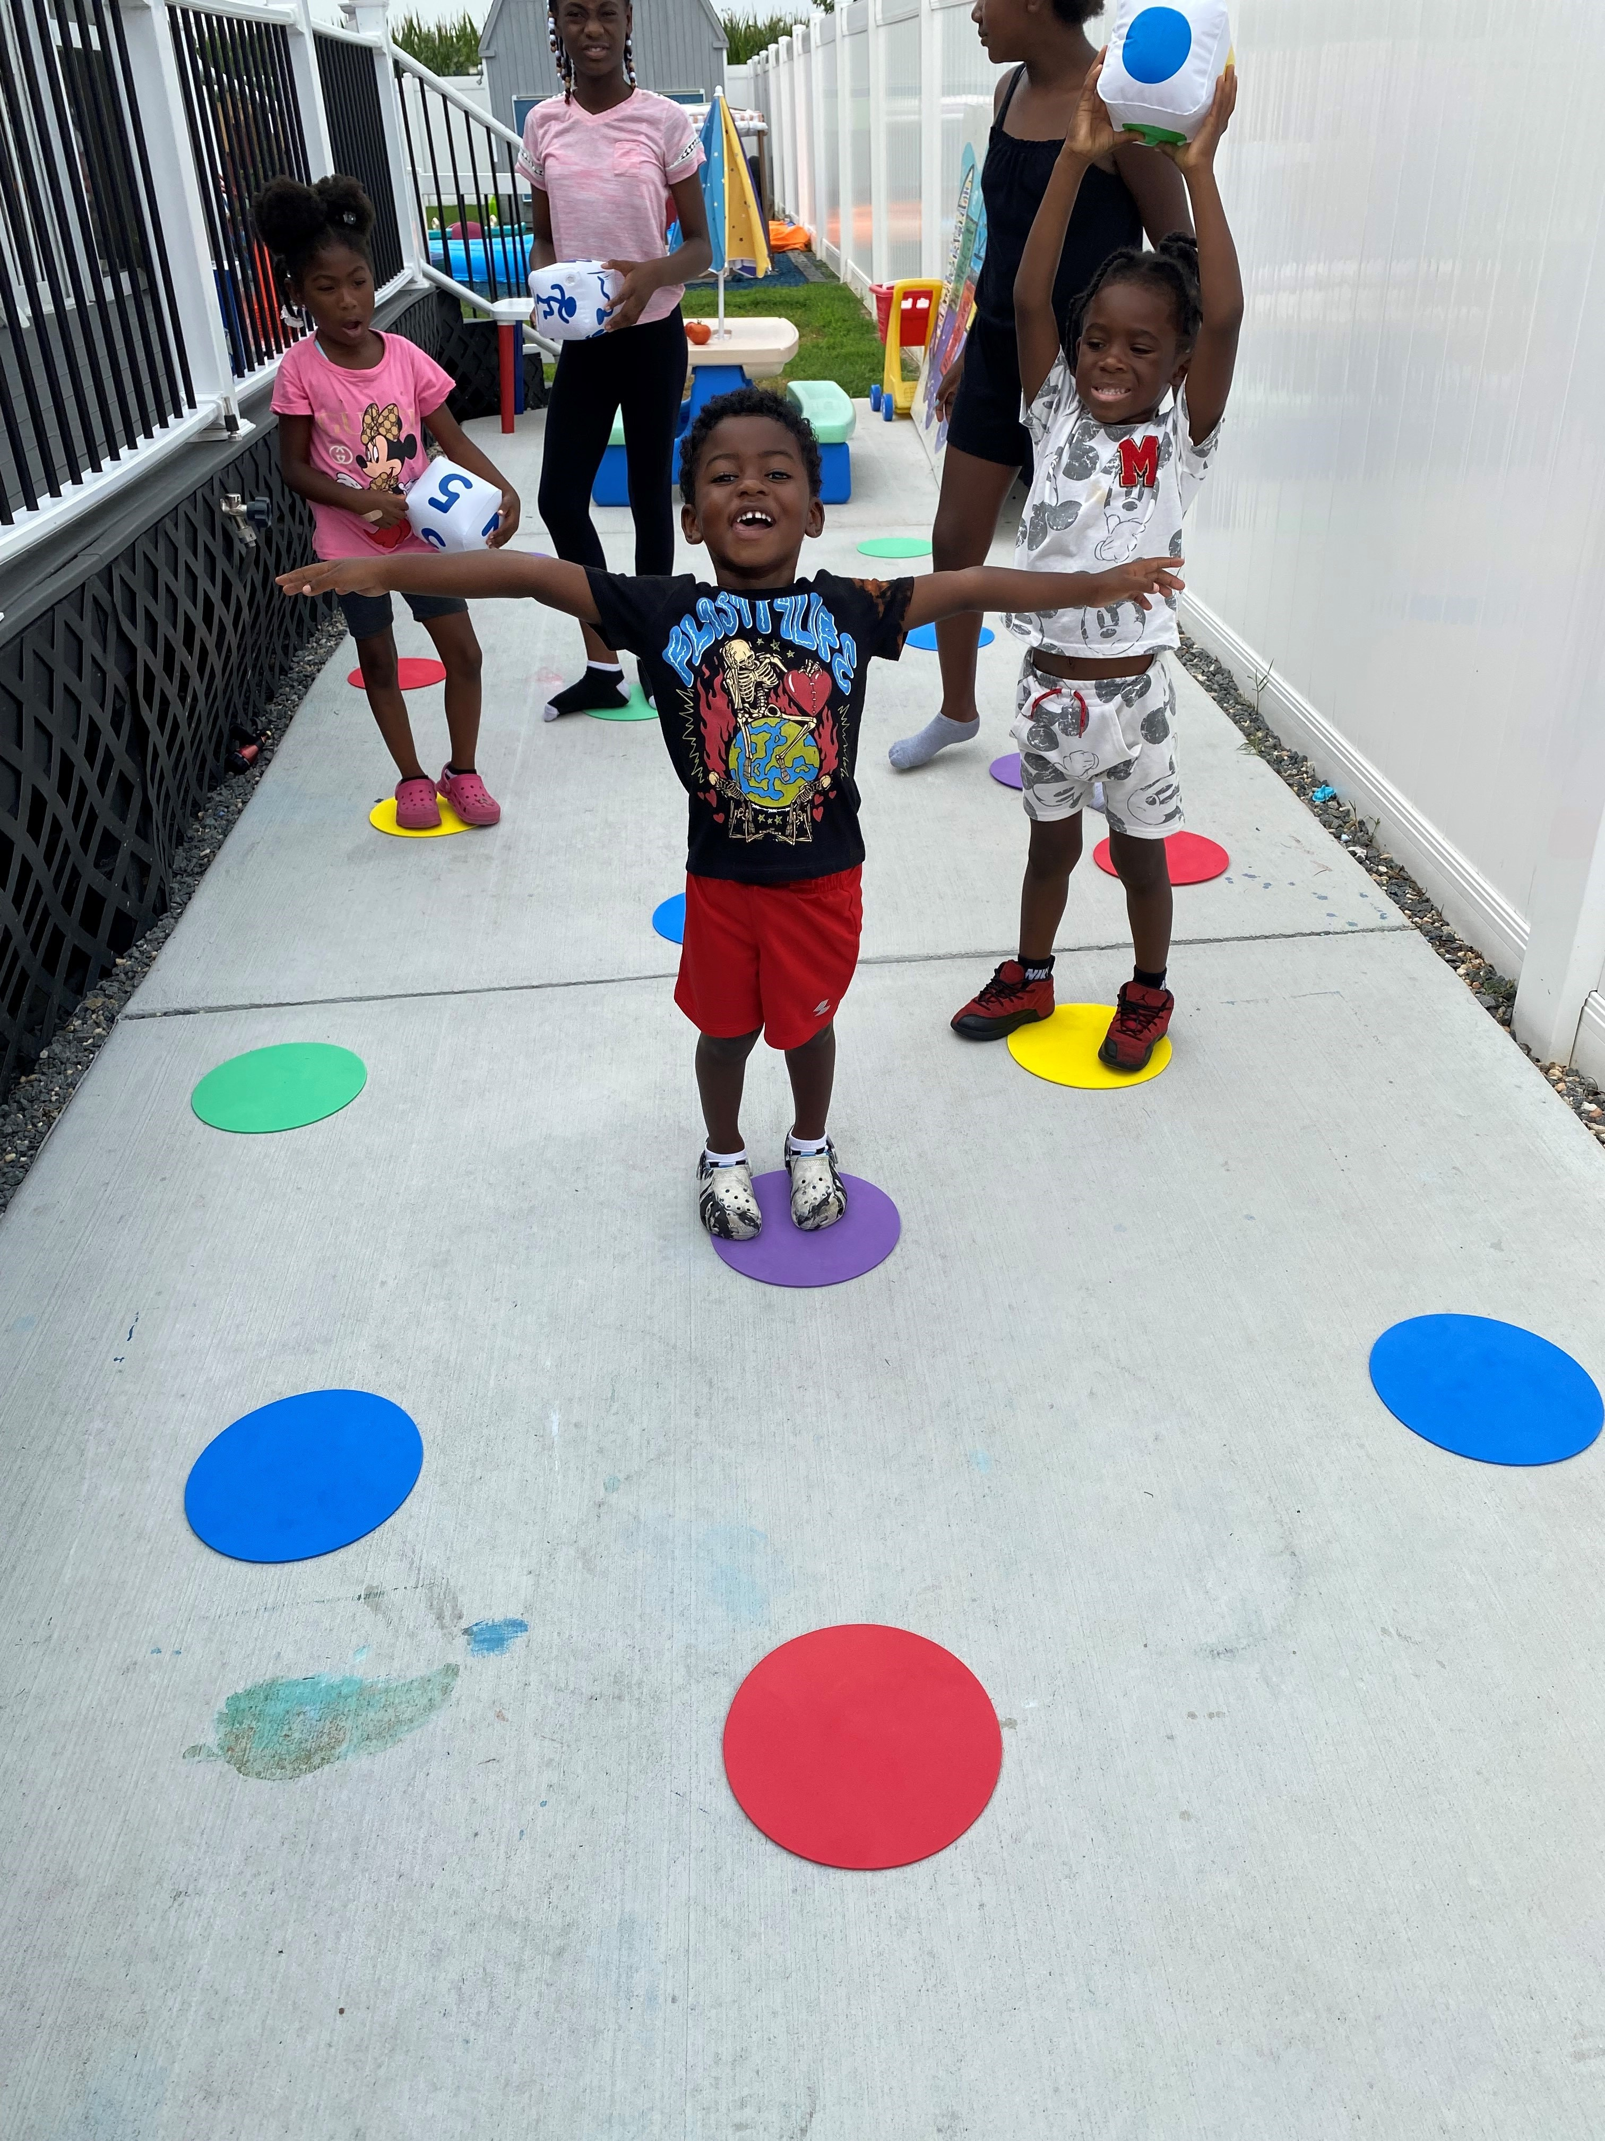
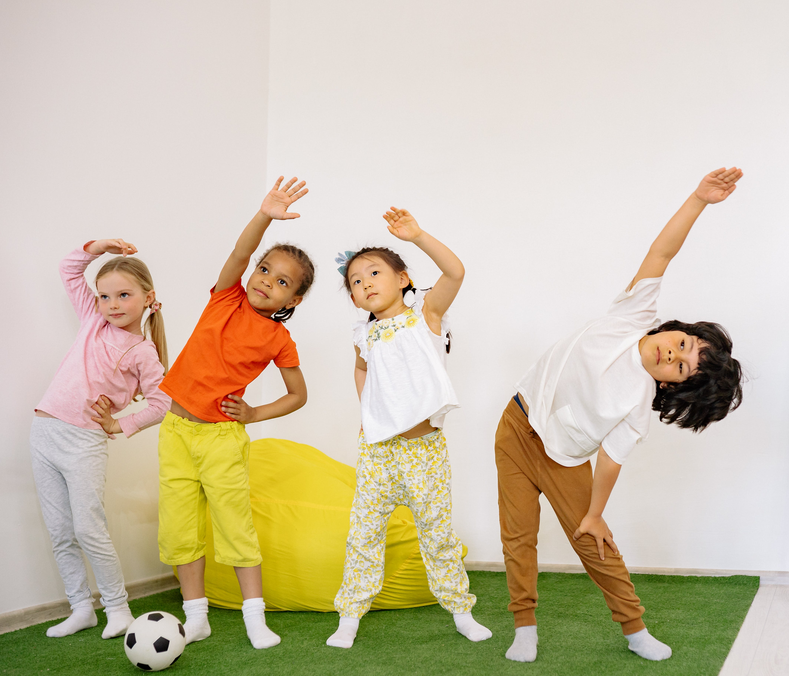
Small Spaces
Outdoors
Indoors
What small spaces do/can you use for physical activity in your program?
Notes:
Suggested Speaker Notes:
When you think of physical activity in small spaces, you might immediately think of a small classroom space, but small spaces can be both indoor and outdoor. For outdoor small spaces, you might be able to take your children outside, but you share the space with another group, or you have access to outside space, but it's a small yard (as compared to a larger field or park). The photo on the left of the slide is from a provider in Delaware. The small space where the children are engaging in physical activity is a 5-foot space between two fences in their backyard.
Indoor small spaces are probably what come to mind- a small room or section of a room. You might only have the space of a rug to use or only have the space of a hallway to be active.
In this training we are going to discuss how to set up your small space for success, review four types of games to promote physical activity in small spaces and discuss ways that the games can be adjusted to be played in small spaces indoors and outdoors.
Trainer Note:
Allow a few minutes for participants to share the small spaces in their program where physical activity can occur.
Photos:
Rhonda's Little Angels, Delaware
Pexels- Yan Krukau

Slide 10
Objective 2: Recognize how to set up your small space for active play.

Slide 11
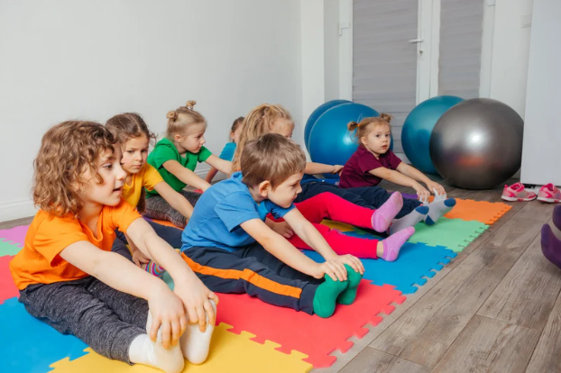
Setting up your small space for success
Poly Spots
Cones
Rugs
Space behind a chair
Personal bubble
Notes:
Suggested Speaker Notes:
When setting up your small space for success, try to use what you have to create designated areas for movement for each child. If you do not have poly spots, cones, or rug squares, you can take advantage of the space behind a chair or have children create their own "personal bubble." By creating areas for movement for each child, you are helping children understand boundaries.
Let's explore the provider's role in setting up small spaces.
Photos
Canva Pro- oksanashufrych

Slide 12

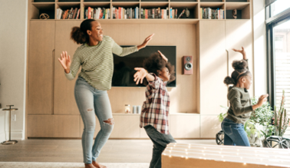
Provider Role
Safety Considerations:
Boundaries
Personal Space
Start/Stop Signals
Modeling Movements
Notes:
Speaker Notes:
ECE Providers play a key role in ensuring the safety of children during physical activity, especially in small spaces.
Boundaries: Setting up boundaries before you start the activity is especially important to ensure safety while moving in small spaces. For example, if you are sharing an outdoor space with another group try to use cones or some other marker to differentiate the spaces. If you're indoors in a house, ensure that as you're explaining the game, you share the areas that the game can be played – i.e., only in the living room, the hallway, etc.
Personal Space: The "personal bubble" is a great way to help demonstrate personal space. Children can spread their arms out to the side and ensure they are not touching any other children.
Start/Stop Signals: Another safety consideration is using start and stop signals for all physical activity. Ensure that you review start and stop signals when introducing the activity.
Modeling Movements: Before starting an activity, the provider should demonstrate the movement, task, or skill to provide a visual learning opportunity.
Trainer Note:
Start/Stop Signal Examples:
Use music- turning music "on" to start activity and "off" to stop
Use specific words like start, stop, go, freeze
Count downs- “3, 2, 1, play”
Visual signals- arm movements (raised hand), colored signs (red for stop, green for go), or sign language
Ask participants to share any start/stop signals they currently use in their program for activities.
Photos:
Canva Pro- andy_Q
Canva Pro- kate_sept2004

Slide 13
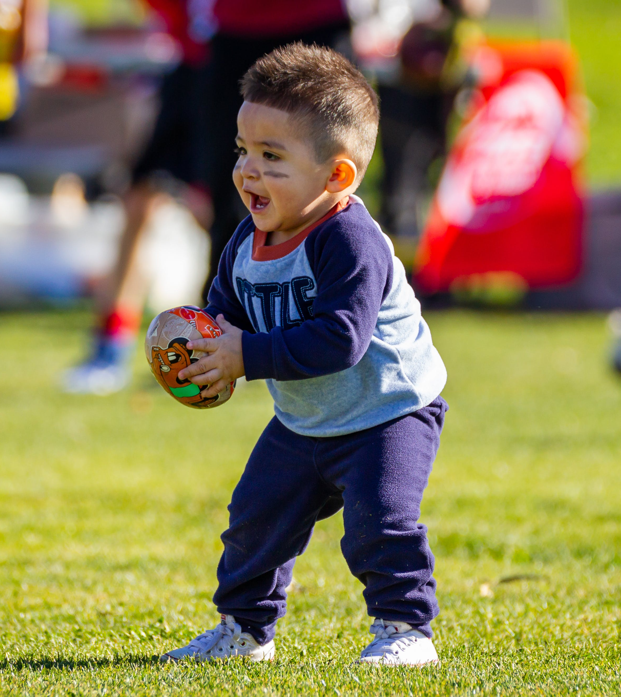
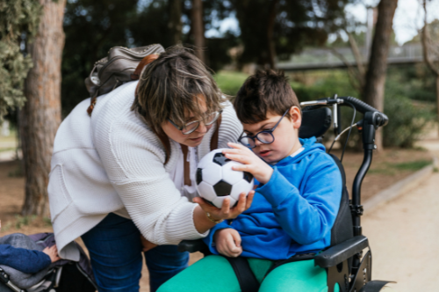
Choosing Activities
General adaptations for small spaces
Developmentally appropriate:
  Different equipment
  Different opportunities
Notes:
Suggested Speaker Notes:
When choosing activities, consider some general adaptations for small spaces: slowing down movements can make them safer to play in smaller spaces. For example, changing the movement from running to hopping or creeping. Also, many movements that are traditionally done across spaces (from one end of a space to another), can be done in place- for example instead of running from one side of a gym to another, children can march in place in their “personal bubble.”
Also consider adjusting be developmentally appropriate for the children in your care- both through equipment and opportunities.
Not all equipment is a good fit for all abilities. Consider using several types of balls including different sizes, colors, textures, and weights. Lighter balls or larger balls can be easier to catch.
Provide developmentally appropriate options for children to participate. For example, allow children to clap hands or tap feet instead of jumping. Make sure all tasks have been demonstrated previously by visual cards, demonstrations, or verbal instructions.
Photos:
Canva Pro Image-jordimorastock
Sides Imagery- pexels.com

Slide 14
Objective 3: Identify 4 games that can be played in small spaces.

Slide 15
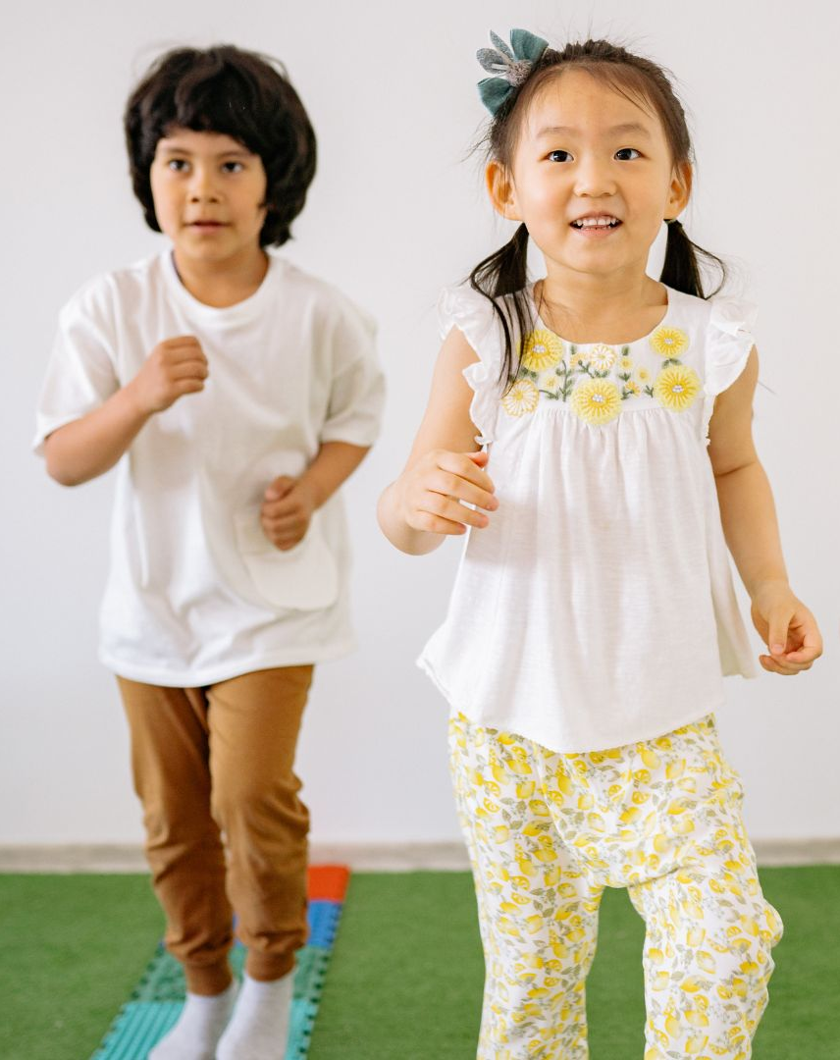
Games for Small Spaces:
Without Equipment
Notes:
Suggested Speaker Notes:
During this part of the training, we will discuss games without equipment that can be played in small spaces. We'll discuss movement and music activities as well as line game adaptations. As we discuss, please share examples you currently use or favorite activities in your program.
Photo:
Pexels- Yan Krukau

Slide 16

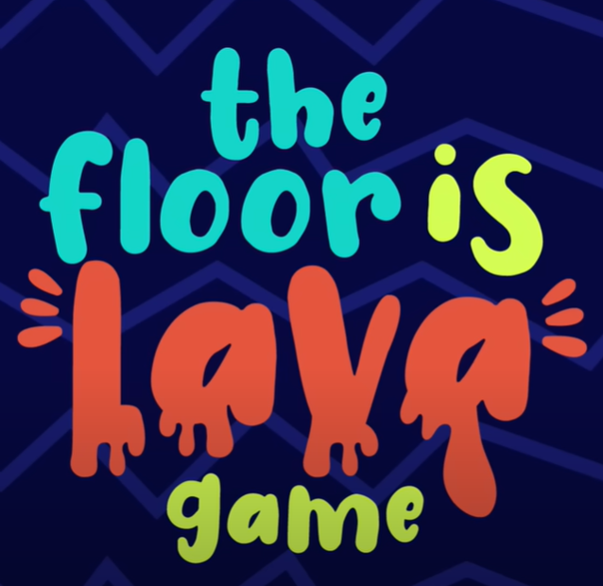
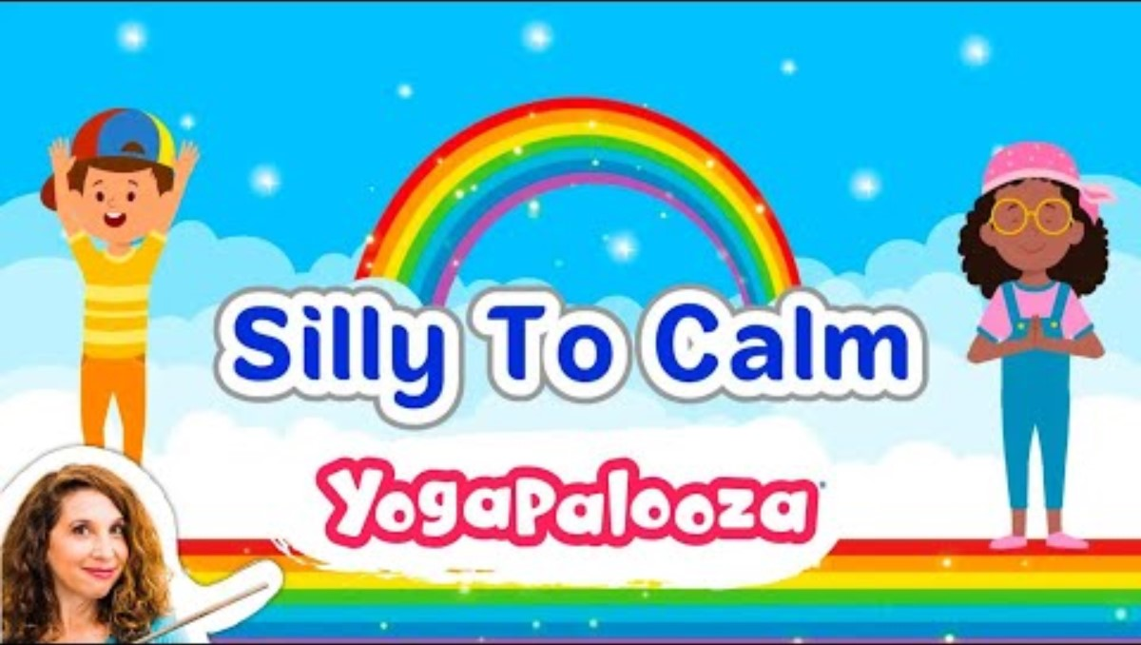
1. Movement and Music
Notes:
Suggested Speaker Notes:
Using music is a wonderful way to encourage movement in early childhood. Music and movement activities provide benefits for physical development and help children in nearly all aspects of physical literacy. When choosing movement and music activities, you can connect the music/songs to what you are learning about, or you can play any upbeat song. All these activities can be played in small spaces either indoors or outdoors (as long as you have access to a speaker).
Silly to Calm is a movement song from Bari Koral. Move, dance, sing, relax. Enjoy a dancing and kids yoga break. Go from silly to calm in 3 minutes.
Trainer Notes:
Depending on time available, you can play this video for a movement break for participants, you can play ~30 seconds to demonstrate the video, or you can share the link.
Mirror dance - children can mirror the ECE provider or each other while dancing to a favorite song. You can incorporate equipment (I.e., scarves). You can also add a “freeze” component and when the music stops, dancers must freeze in whatever position they are in (can help support balance skill development). If you are using partners for this activity, “freeze” is a good time to switch who is mirroring who.
Floor is lava: The gist of the game is that the floor is lava and if you touch it, you’re lava! The only way to move across the lava is by walking along furniture, cushions, blankets, etc. This is a great game for developing problem-solving skills and creativity while practicing movement skills like balance and coordination. Avoid rules that exclude children as “out” during any part of the game. If children fall into the “lava” offer a movement for them to do to rejoin the game, like their favorite dance move.
Trainer Notes:
Ask participants to share if they have any songs or movement and music activities they use with the children in their care.
Silly to Calm- https://www.youtube.com/watch?v=29DQJWGwEnY
Floor is Lava- https://www.youtube.com/watch?v=wbNAiN8FTfc
Additional Information on benefits of music and movement: https://activeforlife.com/music-and-movement-activities/?utm_source=Newsletter+English&utm_campaign=826f4c4b4d-EMAIL_CAMPAIGN_2025_07_15&utm_medium=email&utm_term=0_-826f4c4b4d-353246845

Slide 17
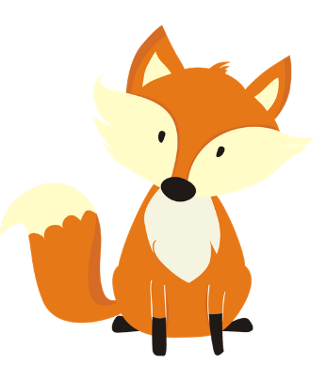

2. Line Game Adaptations
Mr. Fox
Up, Down, Stop, Go
Notes:
Suggested Speaker Notes:
Many games that you play in a larger space where children move from one end to the other of the space, can be adapted for smaller spaces. All these games can be played with children only moving in place - I.e., jogging in place rather than jogging across space, and can be played in small spaces indoors or outdoors. Adapting line games for small spaces are a great time to use poly spots, cones, designated spaces on a rug or “personal bubbles.”
It's important when playing these games, especially with younger children, to have an adult model the movements. ECE providers can also offer adaptations for children of different abilities (e.g., for running in place, a child who uses a wheelchair could pump their arms).
Mr. Fox- like Red Light/Green Light, instead of moving across the space while playing Mr. Fox, children can do a physical activity for the “time.” For example- What time is it? It’s 5 o’clock- 5 bunny hops or 5 raise the roofs. When it’s “dinner time” children can run in place as fast as they can like they are running away from the Fox.
Up Down Stop Go- a version of Simon Says that you can play in a small space is “Up Down Stop Go.” There are many variations of this game. To play this game, start by agreeing on what each command means. There are plenty of options to choose from (see below for some ideas). Take turns calling out the commands (up, down, stop, and go), switching up the order. You can start with just up and down and build in stop and go as the children become more comfortable. You can add an additional layer to the game if a mistake is made, the player (or whole group) must do an extra movement like three frog jumps. You can also use your arms to help signal the movement (up- raise your arms/point to the sky & down – arms down and point toward the ground).
Up: Jump up, stand up straight, stretch up and reach to the sky, do a jumping jack, hop up, jump on one leg.
Down: Sit down, squat down, lay down.
Stop: Freeze! stand still like a tree, balance on one leg.
Go: Jog in place, do jumping jacks, hop, spin, act like your favorite animal
https://www.playworks.org/game-library/up-down-stop-go/

Slide 18
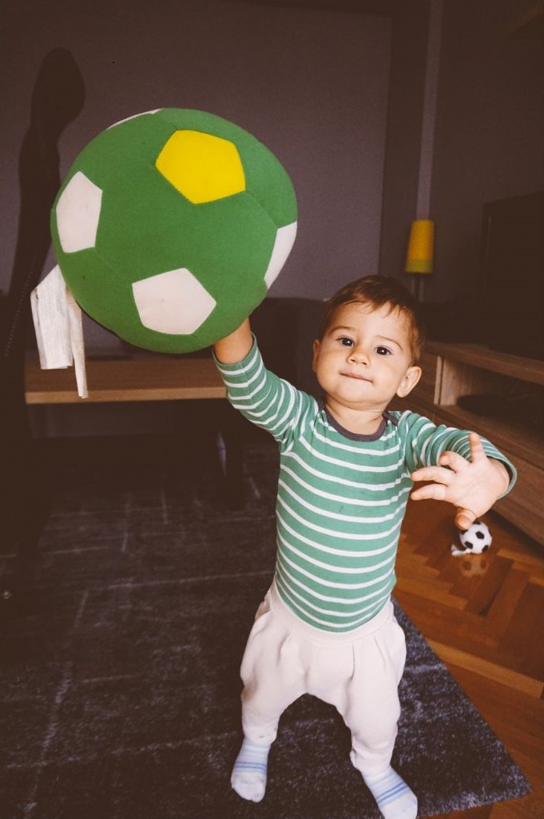
Games for Small Spaces:
With Equipment
Notes:
Suggested Speaker Notes:
During this part of the training, we will discuss games WITH equipment that can be played in small spaces. We'll discuss sock/bean bag games as well as games that can be played with tape. As we discuss, please share examples you currently use or any favorites.
Photo:
Canva Pro- freemixer

Slide 19
Equipment
Be creative with equipment!
Use items you have (balled up socks, loofas).
What creative equipment do you use in your program?
Notes:
Speaker Notes:
When considering equipment to use for physical activities, be creative! You do not have to have expensive equipment to engage children in fun games that get them moving, engaging large muscle groups, and practicing gross motor skills.
Whenever possible, use items that you already have- make a "ball" by balling up several socks. You can also consider purchasing relatively inexpensive equipment like loofas or sponges from dollar stores or cutting pool noodles into smaller pieces.
Suggested Discussion Prompt:
What creative equipment do you use in your program?
Trainer Notes:
Allow a few minutes for participants to share creative equipment they use for physical activity in their program.

Slide 20
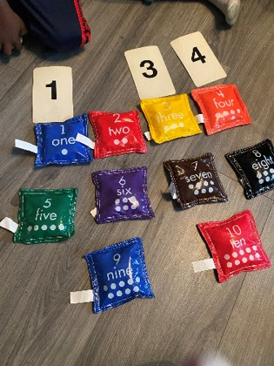
1. Sock/Bean Bag Games
Sock Toss
Snowball Throw
Bowling
Notes:
Suggested Speaker Notes:
Our first category of equipment-based games are games that can be played with socks/bean bags. Sock and bean bag games are great to promote physical activity and gross motor development among young children because they are beginning to develop their throwing, tossing, and catching skills.
Sock toss- sock toss can take various formats- you can have children toss to each other and practice throwing and catching skills, you can also have children toss the socks/bean bags into particular spaces (buckets, baskets, hoops, etc.) or at a sheet held up by a provider. You can vary the distances/challenge for different abilities. You can incorporate shapes (tossing into different shaped objects or even tape formed into shapes on the ground)
Snowball Throw- roll socks into balls and toss them at one another to practice throwing. Instead of throwing them at one another, you can have children throw the “snowballs” at a sheet/wall/mat.
Bowling- set up “pins” (they can be empty plastic/reusable bottles, cardboard paper towel tube, etc.) and have children roll the sock balls and try to knock the pins down. Students of different ages/abilities can start closer or further away from the pins.
Socks or bean bags can also be used in any variation of carry games. In carry games children carry an object from one end of a space to another. Variations can be played where children find a match (i.e. find the matching sock or even put it in a bucket of matching color). Carry games can support locomotor and cognitive skill development.
Photo:
Rhonda’s Little Angels, Delaware
Image Credit:
Rhonda’s Little Angels, Delaware
References:
Sock Games- https://activeforlife.com/6-active-games-kids-can-play-with-a-pair-of-socks/
Bean Bag Games- https://activeforlife.com/12-bean-bag-games/

Slide 21
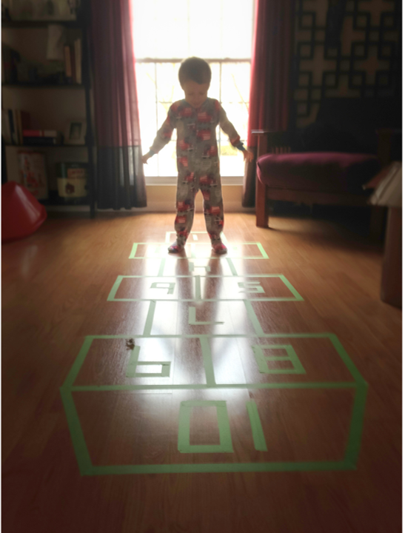
2. Tape Games
Balance Beam
Hopscotch
Pathway Challenges
Tic-Tac-Toe
Notes:
Suggested Speaker Notes:
Tape Games: Tape games are activities created by putting tape (specifically painter's tape) on the floor in different shapes and patterns. A few easy activities you can do with tape: balance beam (you can make this extra challenging by having the child hold an object in their hand as they walk), hopscotch, pathway challenges (hops over areas, crabwalks, bear walks), or tic-tac-toe. A tic-tac-toe board can be created on the ground using tape and several variations can be played:
For one variation you can use different colored bean bags between the two teams. You can make the game more active by having children do a movement (i.e., frog jump) after putting down a bean bag, and a movement activity all together when the game is over (or having the winner choose the activity for everyone)
For another variation, depending on how many children you have in your program, the children can be the game “pieces” choosing spots on the board. They can hold colorful scarfs or beanbags to differentiate teams (and you can include balancing poses while on the board or practice balancing the bean bag).
Tic-Tac-Toss: Mark out a Tic-Tac-Toe board on the floor with your tape. Give two players a set of bean bags each. Instead of marking their X’s and O’s with a pen, they will need to toss their bean bags into the squares to get three in a row!
Another variation for a balance beam or pathway challenge- cut a pool noodle in half and use painters tape to tape it to the ground. This is a fantastic way for children to practice their balance.
Tape games are great for encouraging the development of fine and gross motor skills, problem-solving skills, and creativity.
For similar activities in outdoor small spaces, consider using chalk instead of tape.
Photo:
Canva Pro- TMRoberts
References:
Tape Games- https://activeforlife.com/small-space-games-and-activities/
Tic-Tac-Toss: https://wunder-mom.com/fun-gross-motor-activity-tic-tac-toss/

Slide 22

Small Spaces Strategy
Pair and Share
Identify an activity/create a plan for your program for the next rainy or bad weather day.
Notes:
Suggested Speaker Notes: Let’s think back to our icebreaker where we reflected on memories of indoor physical activity during a rainy or bad weather day. Now that we’ve discussed considerations for setting up your small space for success and shared ideas on activities that can be done in small spaces, let’s identify an activity/create a plan for your program for the next rainy or bad weather day.
With a partner, brainstorm what you will do with the children in your program during the next rainy or bad weather day.
Photo:
Microsoft stock photo

Slide 23
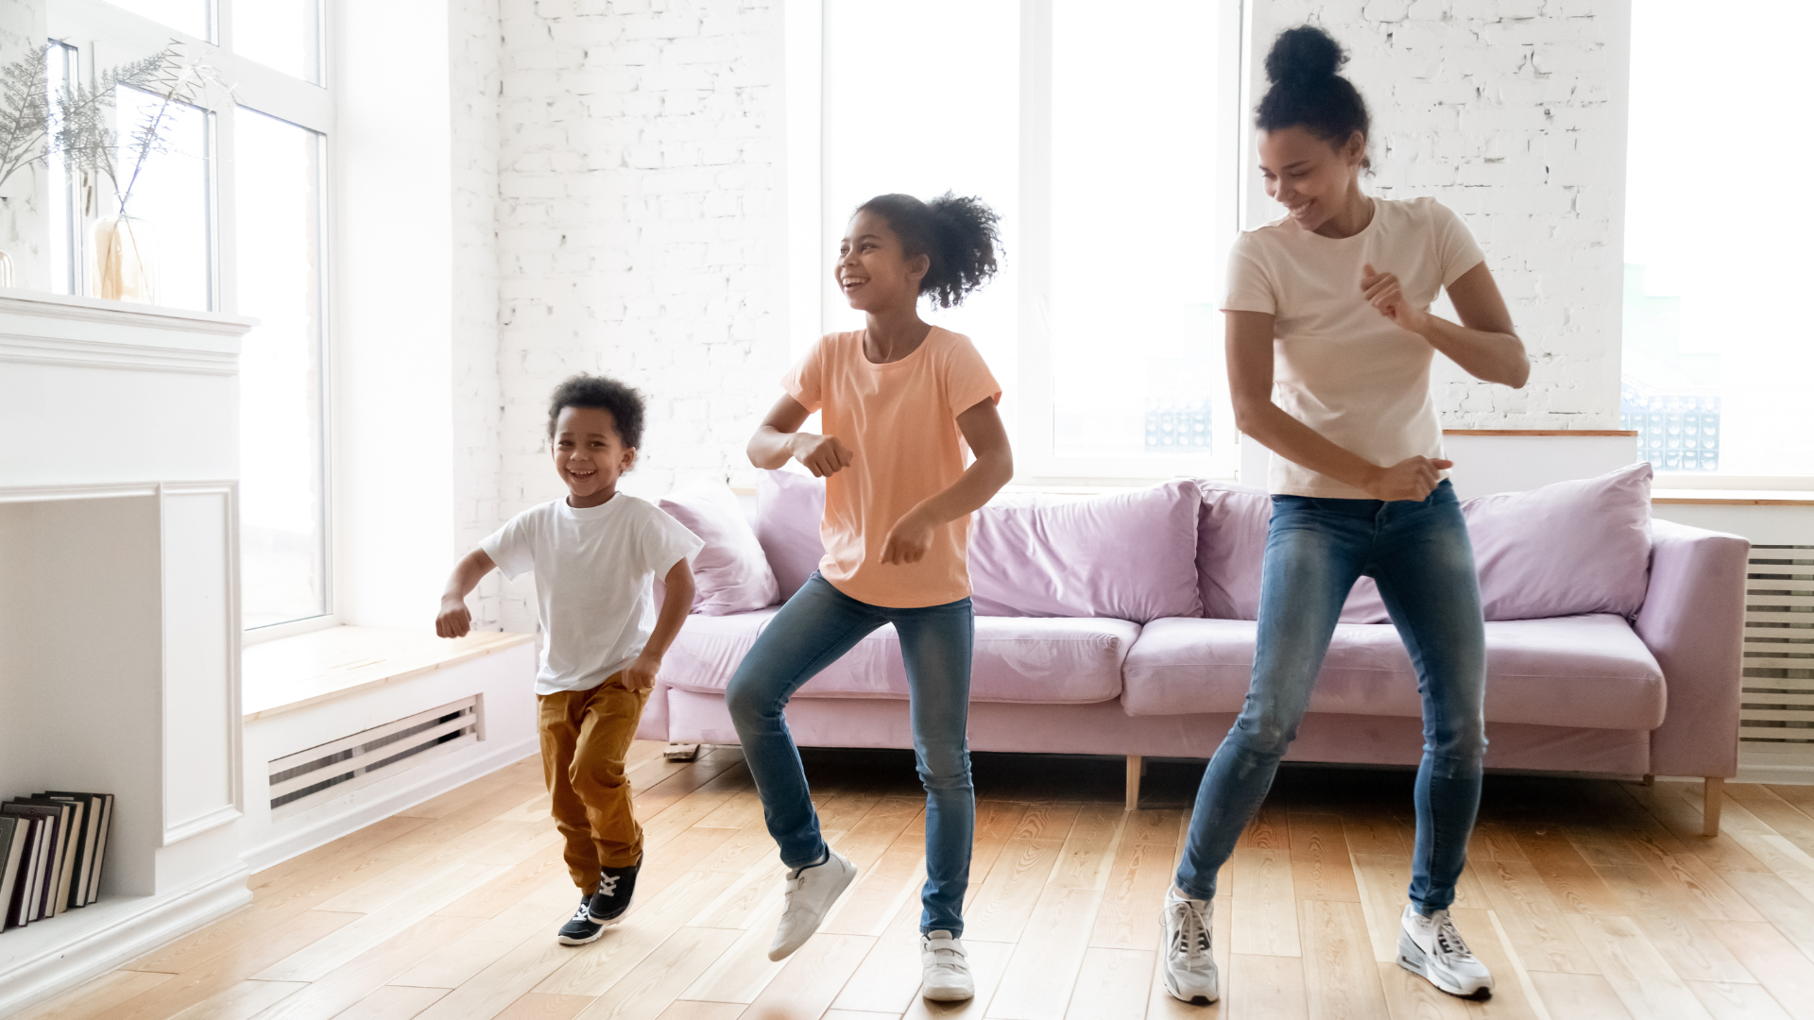
Family Engagement
Send game instructions home
Invite families into the classroom to see activities done in small spaces
Opportunities for families to share games/activities they do at home
Notes:
Suggested Speaker Notes:
Families influence and have a strong impact on their children's physical activity behaviors. So, building relationships and engaging with families allows you to share information and activities as well as learn from families. One way to engage families is by sending game/activity instructions home which allows families the opportunities to play the same games and activities at home. Also, consider inviting family members into the classroom so they can see firsthand activities that can be done in small spaces. Create opportunities for families to share games/activities they do at home. Families are creative every day in their own spaces/homes with games and activities (especially during the pandemic when many of us were stuck inside).
Trainer Notes:
Ask participants to share how they engage families in physical activity in their program and allow time for them to share.
Photo:
Canva Pro- fizkes

Slide 24
Questions and Discussion
Notes:
Trainer Notes:
Invite your participants to raise any remaining questions or share other comments on physical activity in small spaces.
This is the suggested endpoint for the first section of content.

Slide 25
Extension Ideas
“Challenge”- Breakout rooms to take a game traditionally played in large space and how to adapt for smaller spaces (I.e., Red Rover)– 10 minutes
Additional Games – 10 minutes
  Without equipment: Mind-Body Exercises- Animals, Books – 5 minutes
  With equipment: Hoop Games- OPEN PhysEd- 5 minutes
Toddler Ideas- 10 minutes
Notes:
Trainer Notes:
This slide shows three different options to extend the training. If you offer all extension content, it adds 30 minutes to the training to make the full content 60 minutes. You can choose any combination of extension activities that works for your group.

Slide 26
Challenge: Adapting Games for Small Spaces
“Ships and Sailors is a game meant for a large outdoor space and we don't have that type of space!"
Brainstorm how to adapt this game for smaller spaces
Notes:
Trainer Notes:
Assure participants there is no single solution or right answer. You may need multiple strategies to overcome the challenge. Feel free to adjust the game to be one that your participants are familiar with- the game that is being adapted should be one that is traditionally played outdoor in a large space, like Sharky Sharky/Octopus (https://www.scouts.org.uk/activities/play-sharky-sharky/).
Suggested options for facilitating this activity include:
For face-to-face trainings:
Facilitate a large group discussion or conduct as a pair and share activity.
During virtual trainings:
Use a whiteboard app such as Jamboard for participants to post solutions.
Ask participants to respond in the chat.
Divide participants into groups of 3-4, use breakout rooms to discuss the challenge statement.
Ships and Sailors is traditionally played with children lined up in the center of a large space. One person is the Captain of the ship and the children must listen and follow the captain’s orders. When the Captain yells “ships” children run to the right side of the room or field. When the Captain yells “sailors” the children run to the left side of the room. Continue to incorporate other exercises and actions like “hit the deck”- squatting down, “pirate”- hop up and down. Don’t forget to demonstrate all activities before you play!
Solution 1: To set up the game, children are evenly spread throughout the small space either on a poly spot, cone or in their own 'personal bubble.’ Explain to children that the ECE provider/another adult is the Captain of a ship and they must listen and follow all the Captain’s orders. When the captain yells “Ships” children face the right side of the room and run in place. When the Captain yells “Sailors” children face the left side of the room and run in place. The provider should use their arms to indicate which direction to face. You can incorporate other fun activity and movements like “pirate”- hop up and down or “shark attack”- freeze and do shark squats (squats with your hands above your head making a fin).
Solution 2: To set up the game, line children up in the middle of the small space indicated by painter’s tape. Instead of running to one side of the room like in the traditional game, because there is less space, have children practice slower locomotor skills like sliding, tiptoeing.

Slide 27
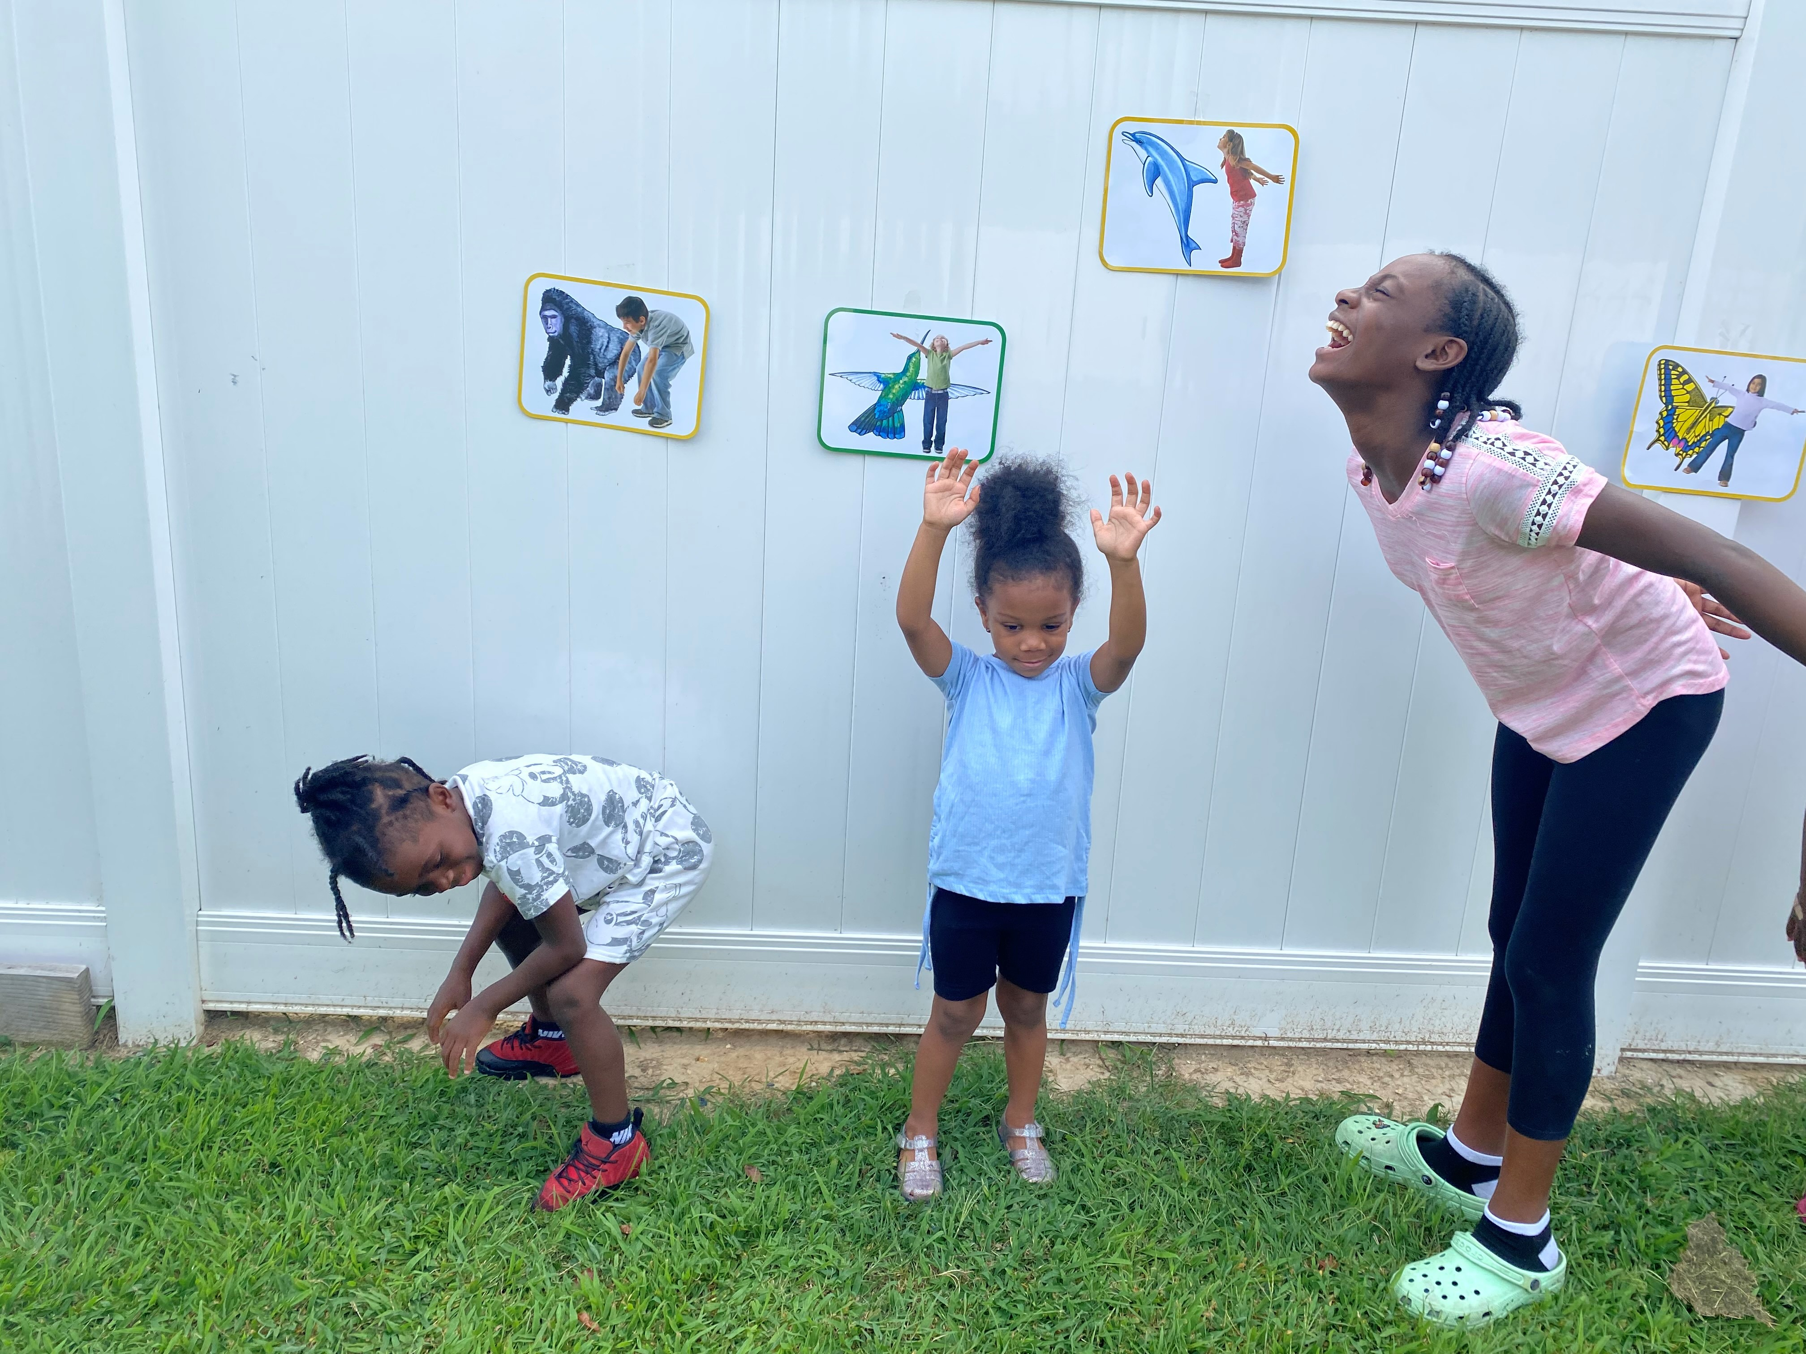
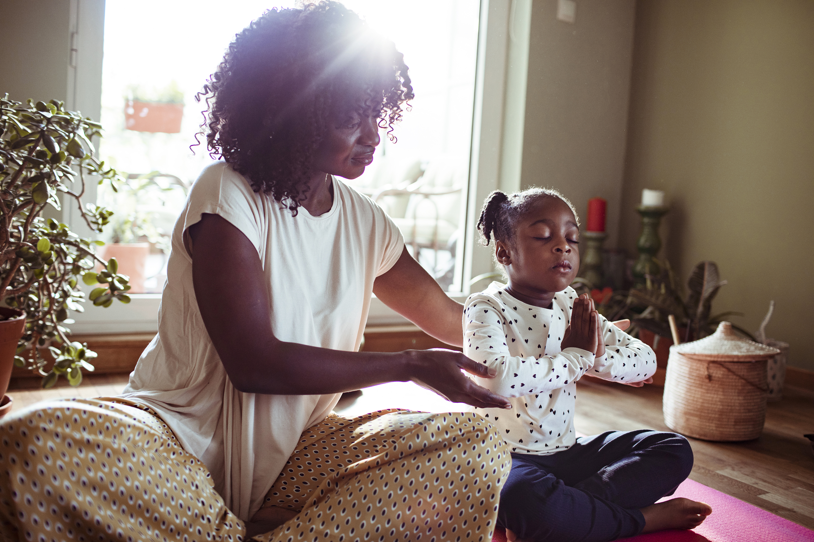
Mind-Body Exercises
Games for Small Spaces: Without Equipment
Notes:
Suggested Trainer Notes:
Mind-body exercises are a great activity that can be done in small spaces, either inside or outside. Many poses can be done standing, which requires even less space. There are a plethora of mind-body resources including books, videos (https://www.youtube.com/channel/UCbuENEBzQ69QKmfX2iumnFA) and more.
Photos:
Rhonda's Little Angels, Delaware
Microsoft PPT photos

Slide 28
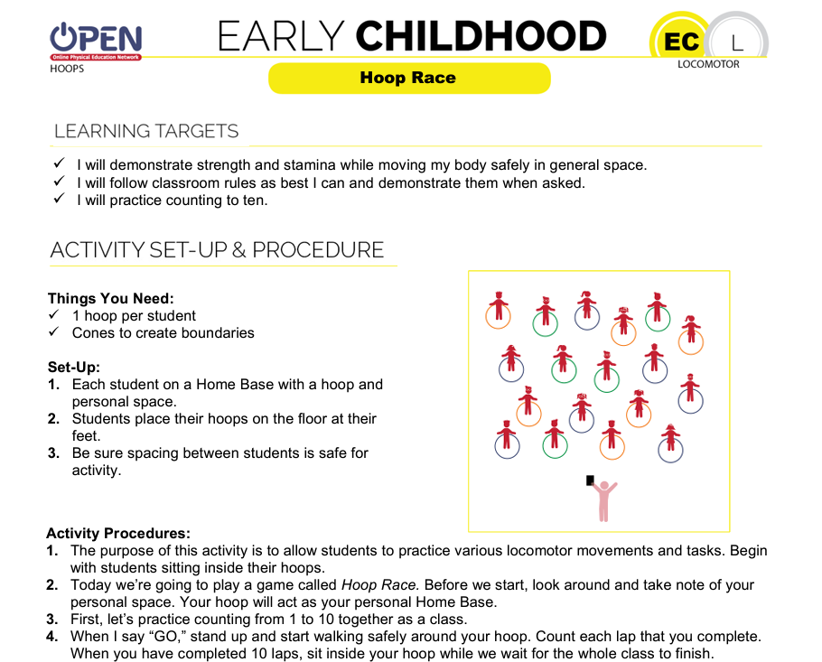
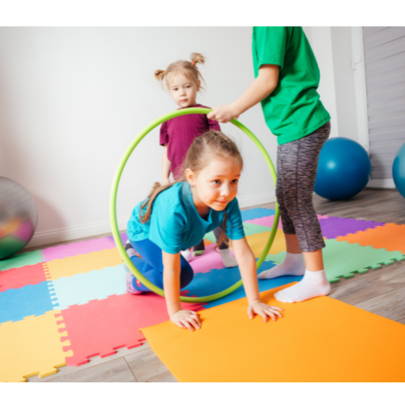
Games for Small Spaces: With Equipment
Hoop Games
Notes:
Suggested Trainer Notes:
Hula hoops are a versatile piece of equipment that can promote physical activity, especially in small spaces. Hula hoops can be used indoors or outdoors.
Open PhysED is a great resource for hoop games, with over 10 different activities involving hoops, specifically for early childhood.
OpenPhysEd: https://openphysed.org/movement/ec
Photo:
Canva Pro- oksanashufrych

Slide 29

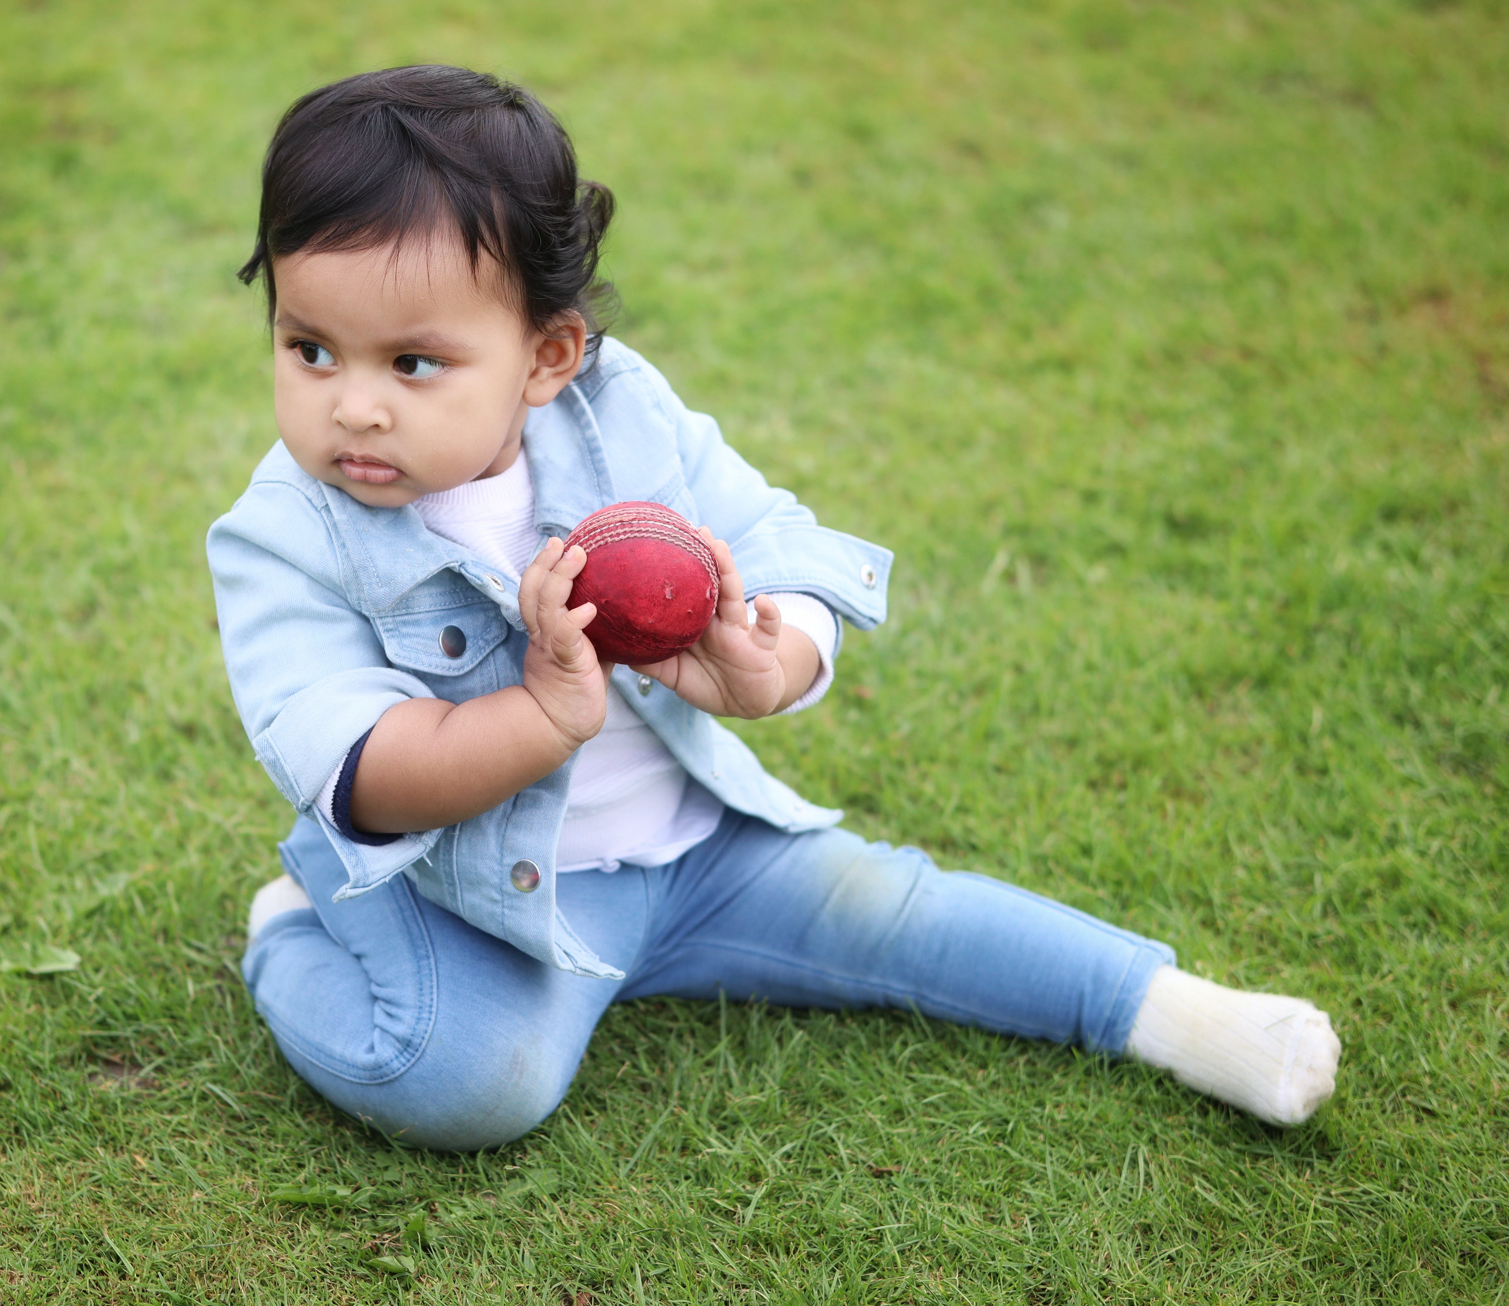
Toddler Ideas
Toddler Ball Rolling
Toddler Balance Walk
Notes:
Suggested Speaker Notes:
These toddler games are adaptations of the activities shared in the “equipment” section of the training.
Trainer Notes:
Consider asking participants how they would adapt these two activities for toddlers before sharing the activity descriptions below. Also consider asking how they like to engage toddlers in their program in physical activity in small spaces.
Toddler ball rolling²: Sit on the floor with your toddler sitting between your legs. Both you and your toddler face another ECE provider or older child sitting on the floor. With your legs spread apart, gently roll the ball back and forth between your toddler and the other ECE provider or older child. Encourage your toddler to “catch” the ball by receiving it with both hands. You can also use the socks or a dryer ball for this simple rolling game- roll the object back and forth with the child to promote coordination. When they’ve mastered doing this with two hands, challenge them to try with one.
Toddler Balance Walk¹: When walking inside, you can use tape to create a balance beam or half of a pool noodle. When walking, find simple structures such as park benches, low garden walls, raised curbs, and dry logs. Encourage your toddler to climb onto these low structures and walk along them. Always hold your toddler’s hands. As they build confidence walking, encourage them to turn and change directions while walking and balancing.
Photo:
Pexels- Subin Cherian
Canva Pro- bmcent1
Sources:
1. Toddler Balance Walk. (n.d.). Active for Life. Retrieved December 28, 2023, from https://activeforlife.com/activity/toddler-balance-walk_53/
2. Toddler Ball Rolling. (n.d.). Active for Life. Retrieved December 28, 2023, from https://activeforlife.com/activity/toddler-ball-rolling_54/

Slide 30
References
Bergeron, J. (2023, January 19). Small-space games and activities for kids. Active for Life. https://activeforlife.com/small-space-games-and-activities/
Grove, J. (2020, March 25). 6 active games kids can play with a pair of socks. Active for Life. https://activeforlife.com/6-active-games-kids-can-play-with-a-pair-of-socks/
Hart, A. (2018, October 17). Early Childhood (Ages 3-5). OPEN Physical Education Curriculum. https://openphysed.org/movement/ec
Scandiffio, S. (2023, October 6). 12 bean bag games your kids will love. Active for Life. https://activeforlife.com/12-bean-bag-games/
Toddler Balance Walk. (n.d.). Active for Life. Retrieved December 28, 2023, from https://activeforlife.com/activity/toddler-balance-walk_53/
Toddler Ball Rolling. (n.d.). Active for Life. Retrieved December 28, 2023, from https://activeforlife.com/activity/toddler-ball-rolling_54/
Wunderlich, R. (2015, January 22). Fun Gross Motor Activity: TIC - TAC - TOSS. Retrieved February 20, 2024, from Wunder-Mom website: https://wunder-mom.com/fun-gross-motor-activity-tic-tac-toss/

